Slide 1
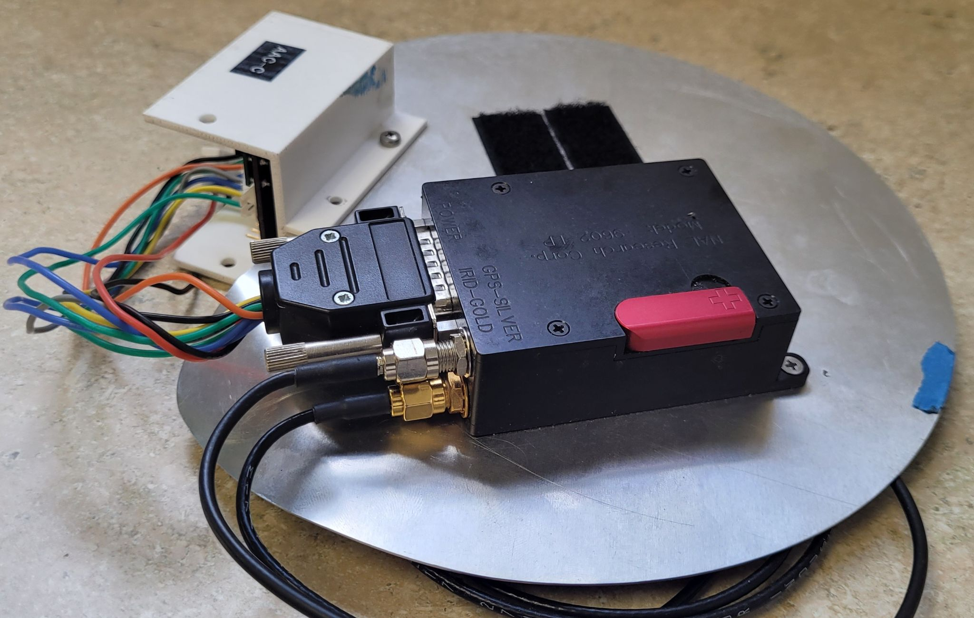
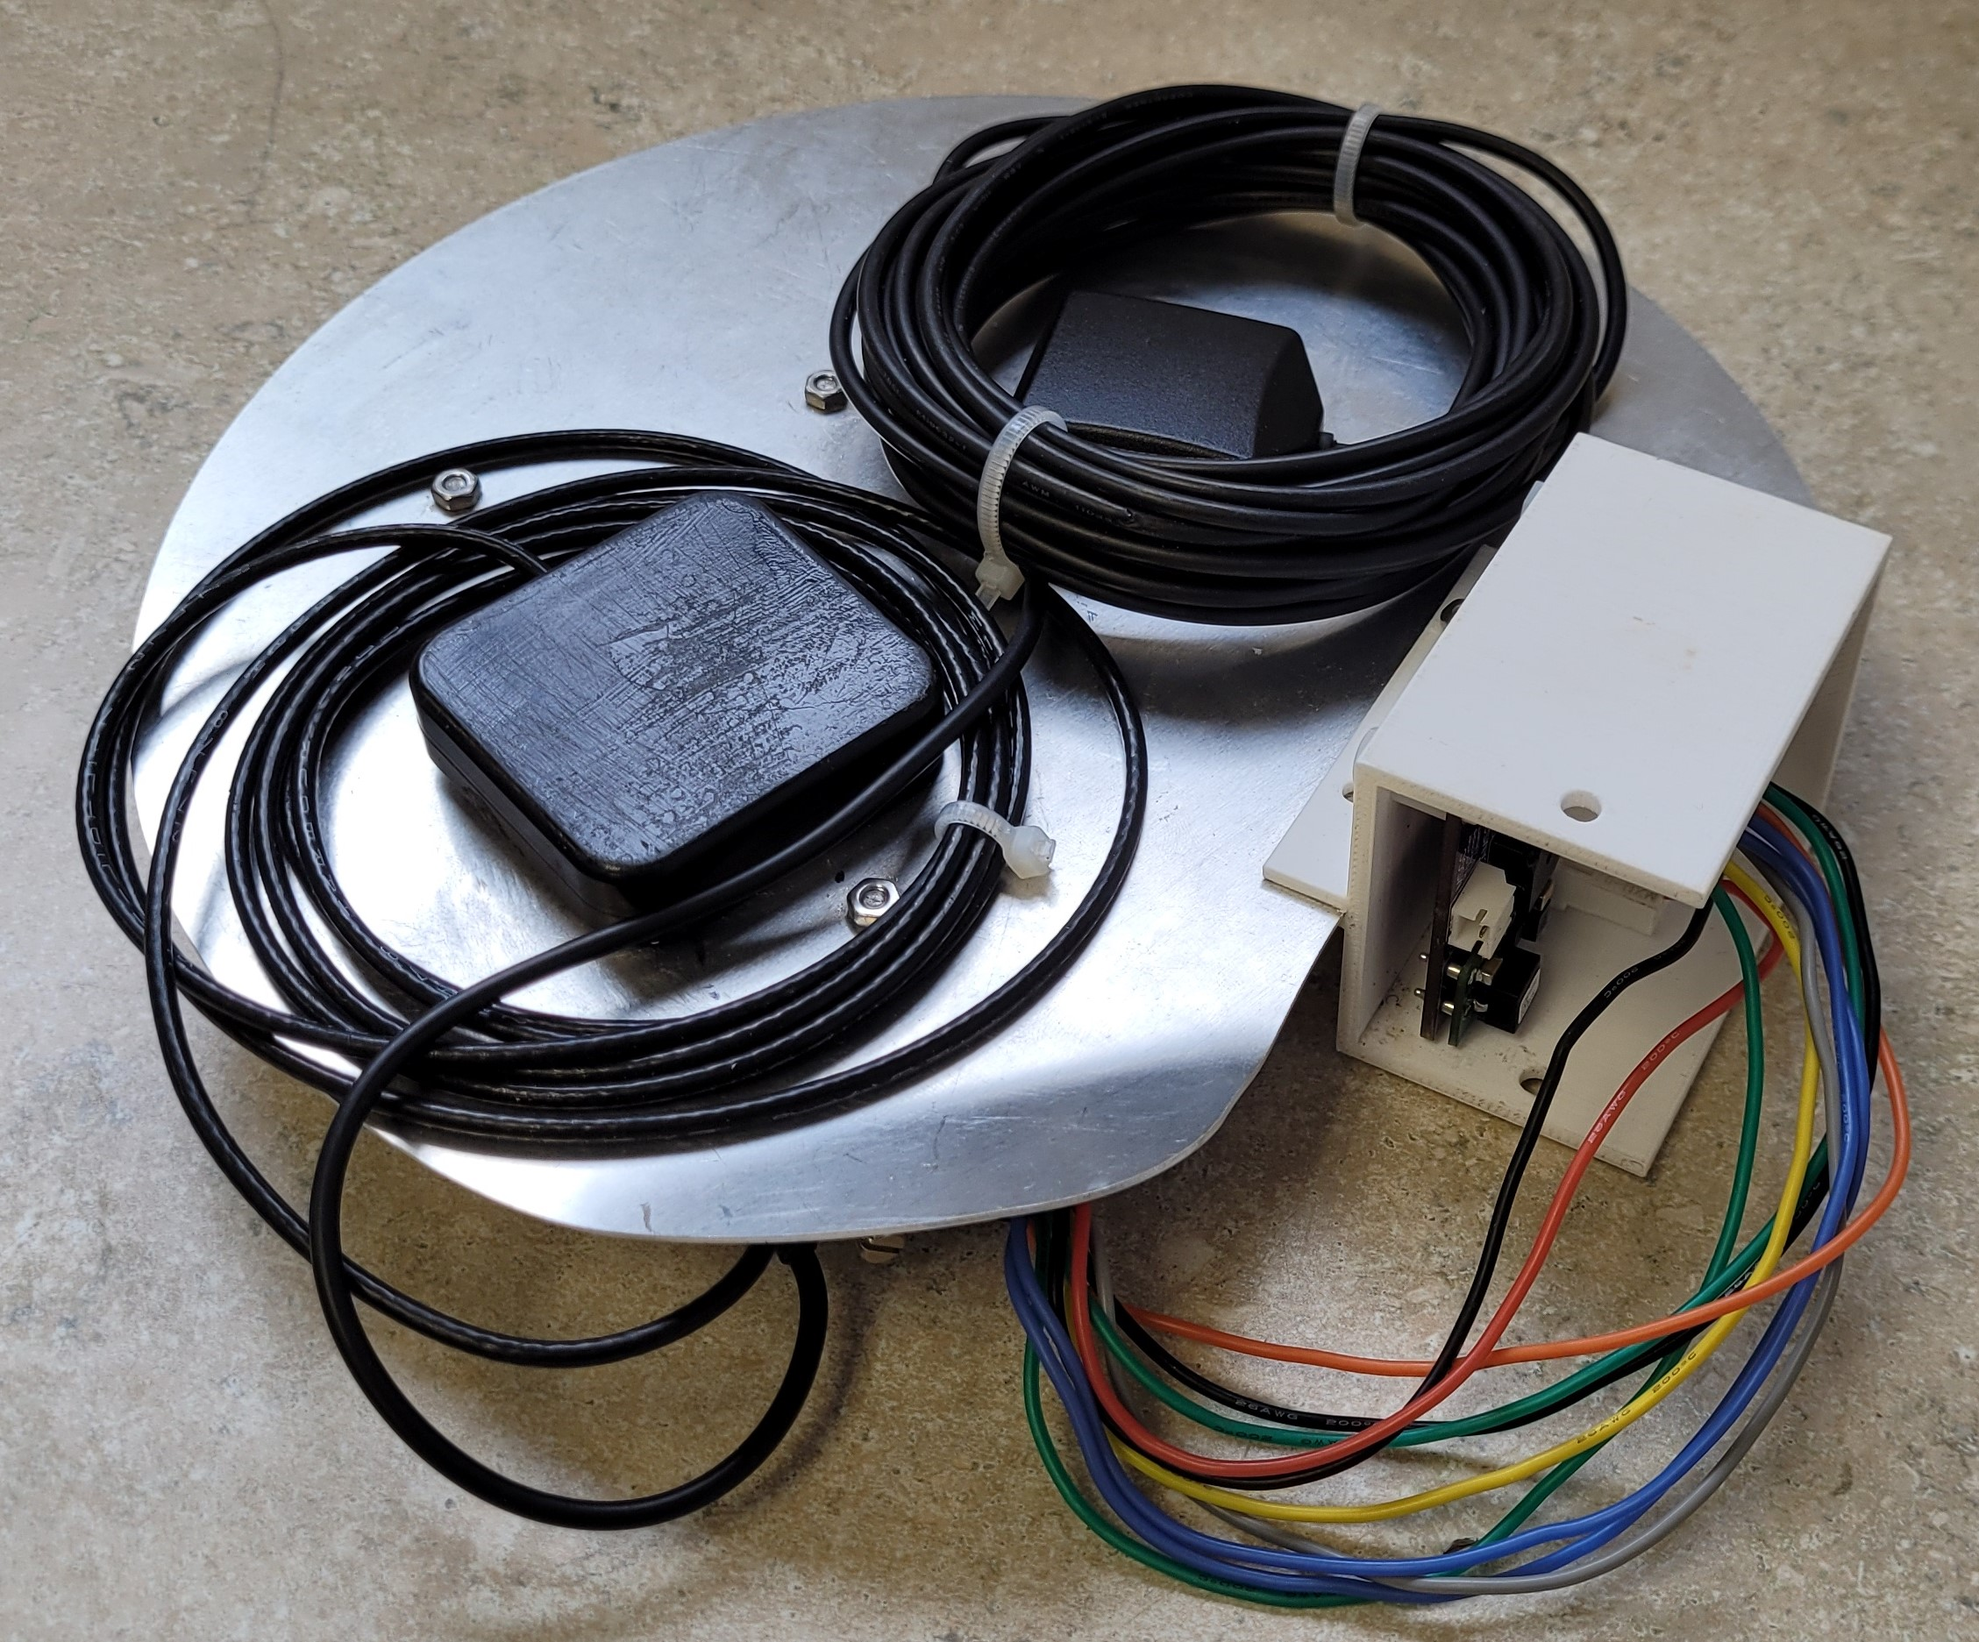
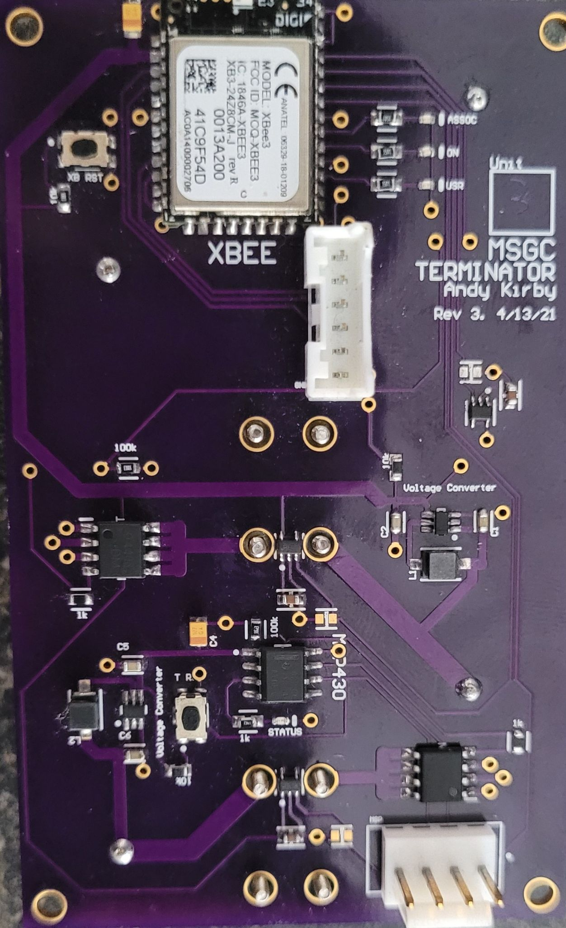
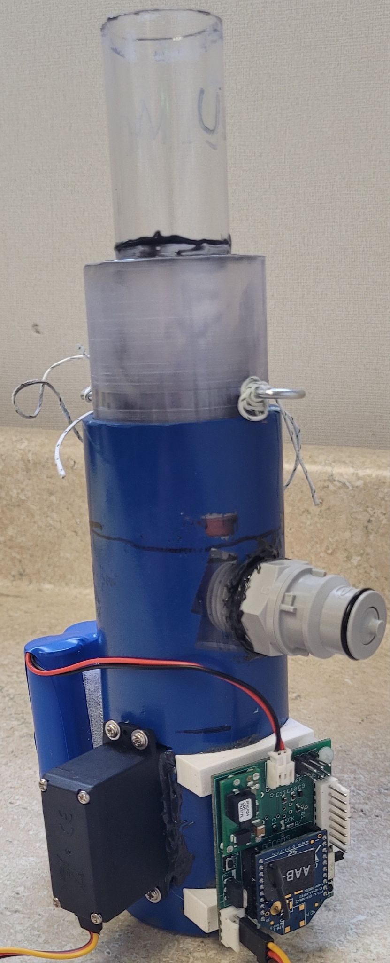
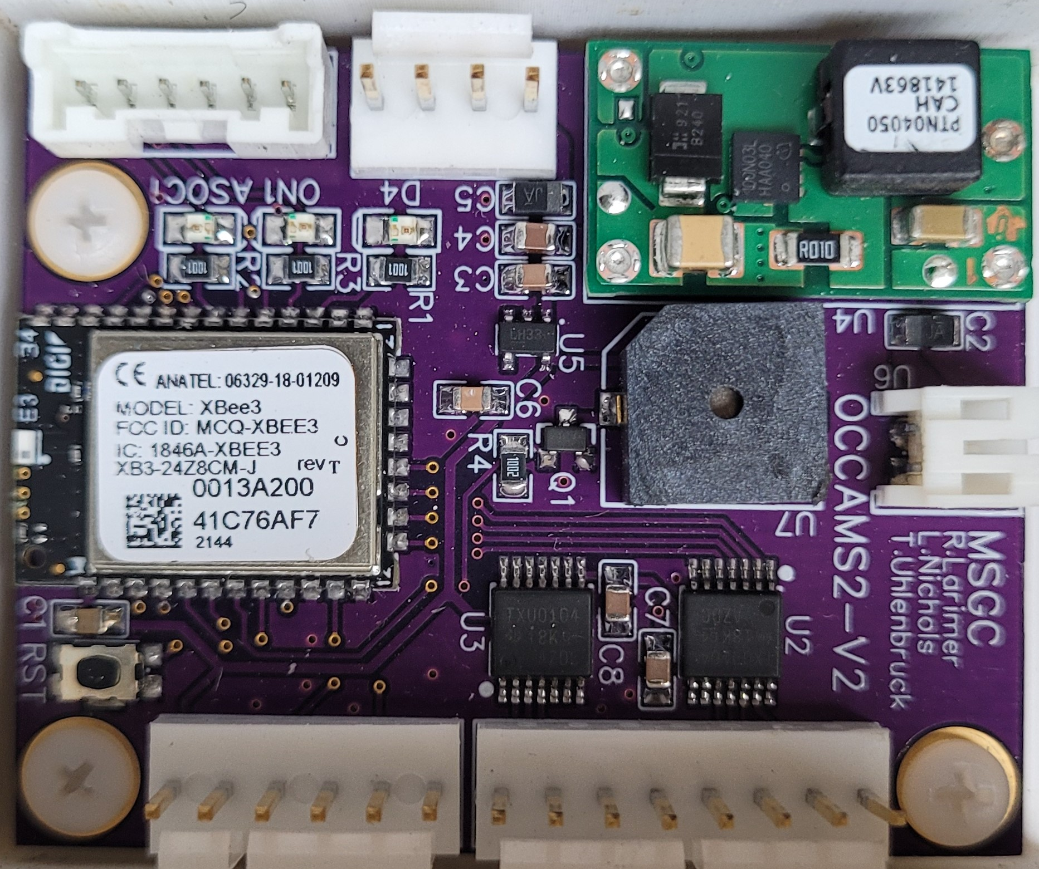
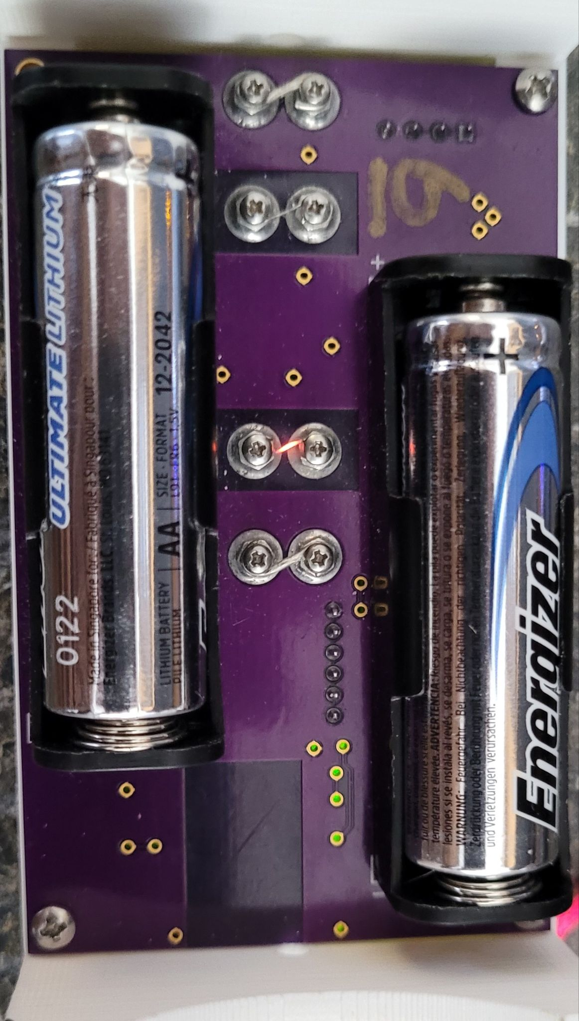
Iridium Control System
Kristoffer Allick, Maximus Marceau, and Randal Larimer Montana State University
Abstract
Iridium and OCCAMS
Flight Terminators
The Iridium system is a modem that connects our custom PCB, called an OCCAMS board, to the Iridium satellite network so we can communicate to our payloads via our ground station. This system connects to our other payloads on our string using the XBee radio frequency modules. These modules are also used as microcontrollers for other systems on our flights.
From our ground station we send an email through the Iridium network that contains a file with the 3 bit binary code for whichever operation we want to happen. This gets sent to our own Iridium modem which we then interpret through our OCCAMS board. OCCAMS then sends out that code through the Xbee3 RF module. Iridium also has precision GPS which we use in combination with our ground station to track our payloads during flight.
We communicate to our flight terminators that have a flight line run through two loops of nichrome wire. When sent the code for termination through the XBee3, the nichrome wire is flooded with current and cuts the flight line. This severs the connection between the balloon and our payload string.
Figure 1 & 2. Iridium modem and OCCAMS PCB
XBee3 RF Module
Valve/Vent
The Xbee3 radio frequency modules are short range surface mounted modules that have a large amount of customization while still being fairly simplistic and have the ability to operate on Micropython programming. These are used to send a 3 bit binary code as our commands for different payloads. They are also used as a microcontroller for the board for other operations, such as operating our valve/venting system or our Flight Terminators.
The Iridium system connects to our valve system for venting helium from latex balloons. We currently operate it using a previous iteration of the OCCAMS PCB. Currently we are working on a new iteration to bring it up to date with the rest of our payloads.
Figure 5. Flight Terminator
Figure 3. OCCAMS board
Figure 4. Valve to vent helium from balloon.
Figure 6. Flight Terminator firing

