Slide 1
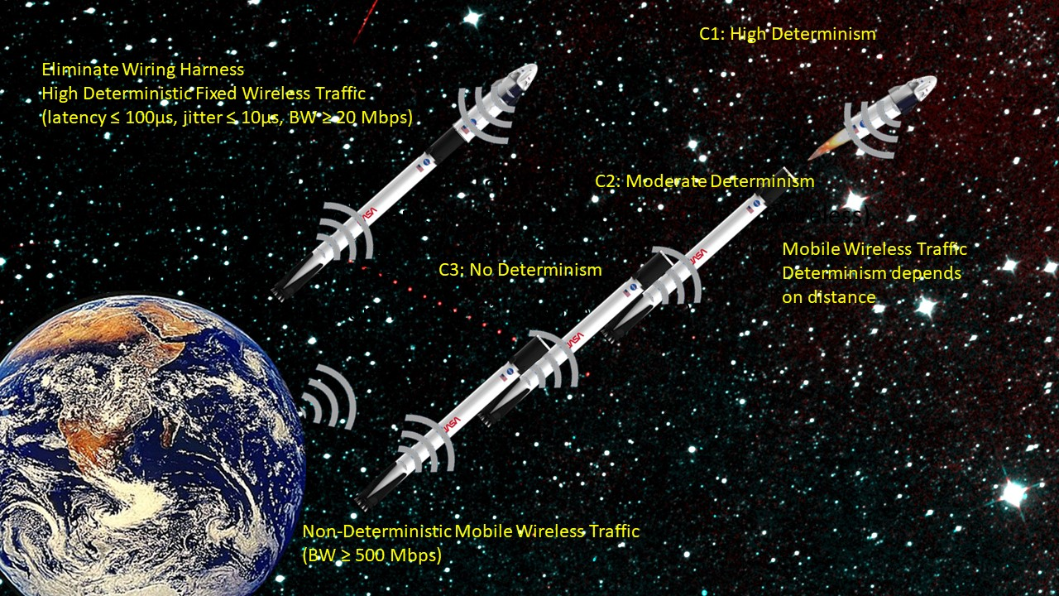
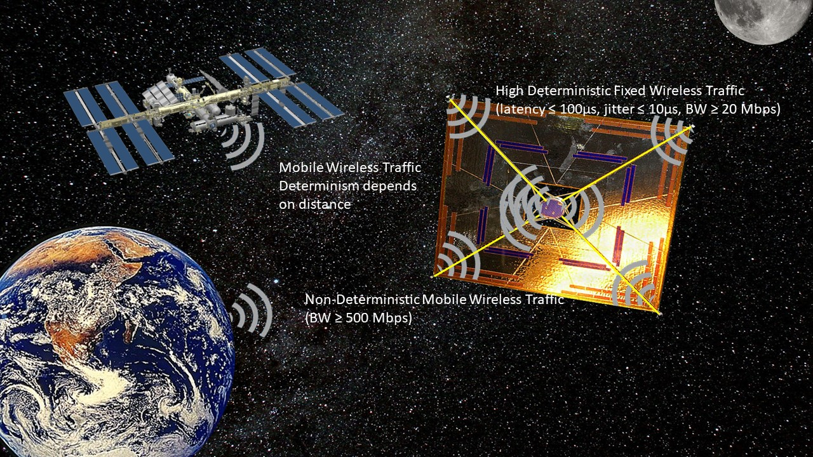
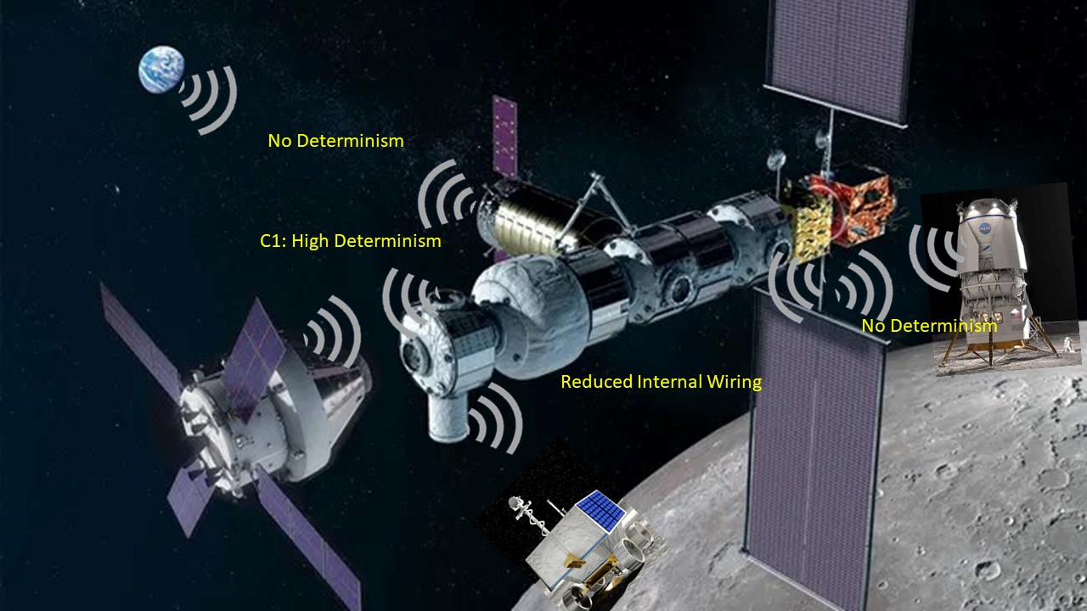
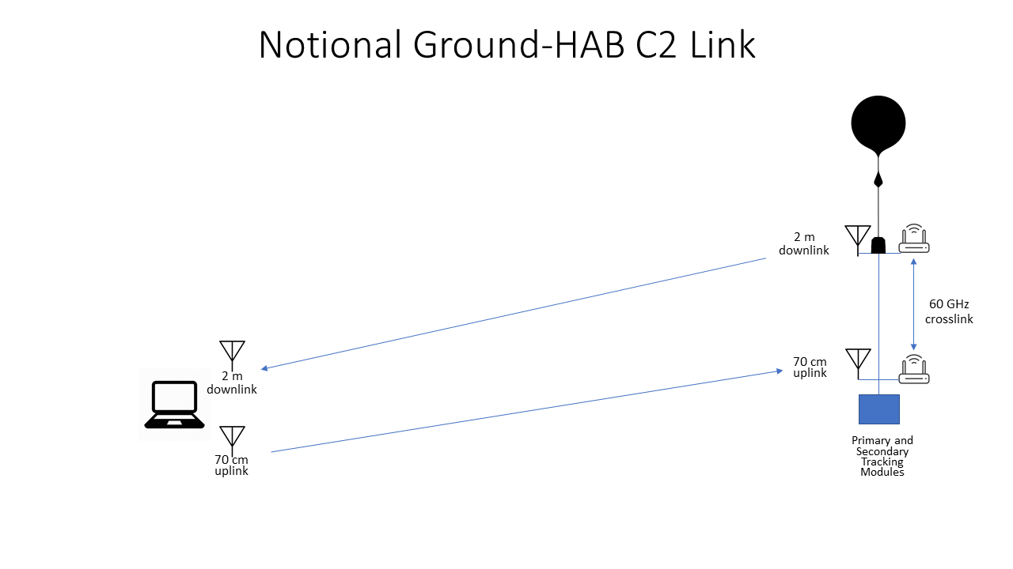
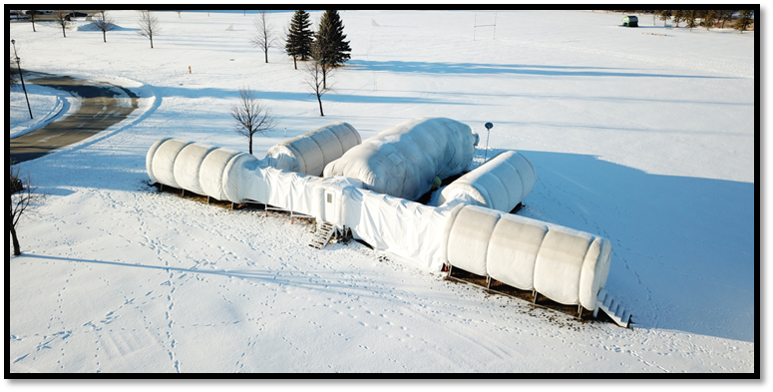
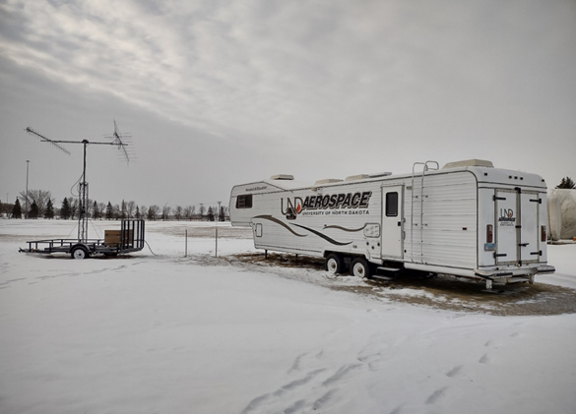
Testing SPRINT in the Near-Space Environment Dr. Ron Fevig , Dr. Ryan Adams, Dr. Sreejith Vidhyadharan, Dalia Ammar Khodja, Maleeha Altaf 2024 Academic High Altitude Conference
ABSTRACT
Description of SPRINT
A NASA Early Stage Innovations program focused on space-based wireless network development is underway at the University of North Dakota (UND). The resultant Space-based Prioritized Real-time Inter-satellite Network Technology (SPRINT) promises to reduce cabling mass on spacecraft and support inter-satellite and ground segment networking, along with other benefits. Three classes of traffic are accommodated by SPRINT:
C1 - Real-time traffic with latency ≤ 100 µs, jitter ≤ 10 µs, and
data rate ≥ 20 Mbps,
C2 - High-rate traffic with latency ≤ 4ms, jitter ≤ 200µs, and data
rate ≥ 100 Mbps, and
C3 - High data rate (≥ 500 Mbps) traffic with no bounds on
latency or jitter.
SPRINT will be tested in analog space environments. One set of tests over the next two years involves network tests in UND’s Inflatable Lunar-Mars Analog Habitat and associated space suit and rover assets. The focus of this poster is the set high-altitude balloon (HAB) missions that will assess this network in the near-space environment. This year’s HAB mission involves a single balloon with two or more network routers to test C1 traffic in the stratosphere, along with C2 traffic between the HAB payload and the ground. Next year’s HAB mission involves two balloons and will test all three traffic classes between the set of routers on each balloon payload and the ground. These analog tests will raise the TRL of SPRINT so that intra- and inter-satellite network communications coupled with ground segment communications can be tested in the future.
The space environment raises a collection of communication challenges and needs that have been quite difficult to satisfy. Many data sources contain information that is critical and needs to be delivered in a very timely manner, while other sources are less time-critical. When operating in a wireless communication scenario, the presence of both highly time-critical and non-time-critical data on the same communication channel poses significant problems.
It is assumed that each application can be placed into one of three categories of latency, jitter and data rates.
2024 Test of SPRINT in the Near-Space Environment
Two routers in close proximity to one another in the HAB payload will exchange C1 traffic, while the greater distance between the balloon and the ground segment will only allow for C2 traffic to be exchanged.

