Slide 1
NASA Nebraska High Altitude Ballooning and the Fab Lab
AHAC – June 24, 2015
Kendra Sibbernsen – Metropolitan Community College
Michael Sibbernsen – University of Nebraska - Lincoln

Slide 2
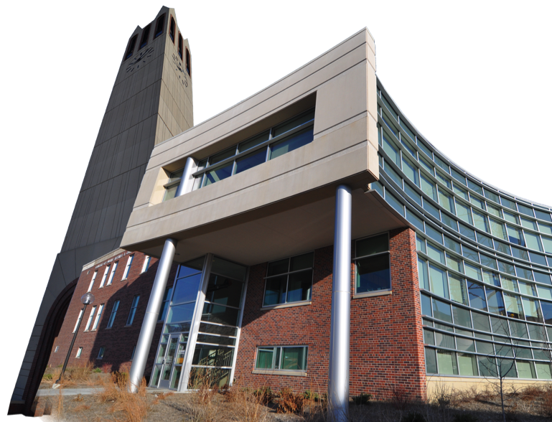
University of Nebraska at Omaha
6001 Dodge Street, CB 041
Omaha, NE 68182
P: 402-554-3772
http://nasa.unomaha.edu
Notes:
Internship and Fellowships
Minigrants

Slide 3
NASA Nebraska HAB Program
Started in 2011 using StratoStar systems
45 successful flights and recoveries
10 Metropolitan Community College (MCC)
11 Strategic Air and Space Museum (SASM)
5 UNL Husker Launch (2 Practice / 3 Day of)
6 Omaha Public Schools (OPS)
4 Girl’s Inc.
3 Nebraska BLAST! (Teacher-Training)
3 Maiden Launch Assists – OPS / Hastings/ UNO HALON
3 Misc. / Training

Slide 4
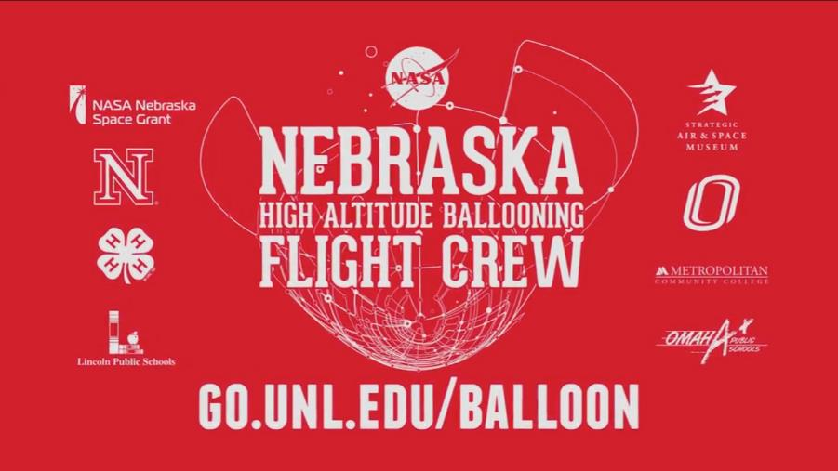
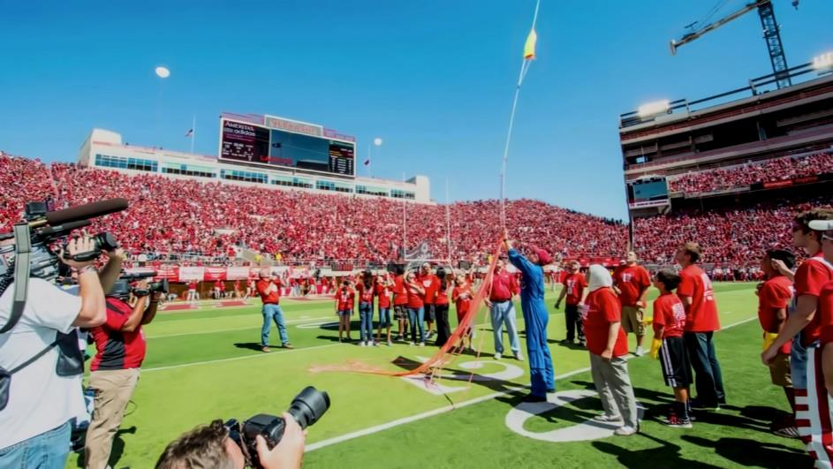
Notes:
85K people. Sept 12 2012

Slide 5
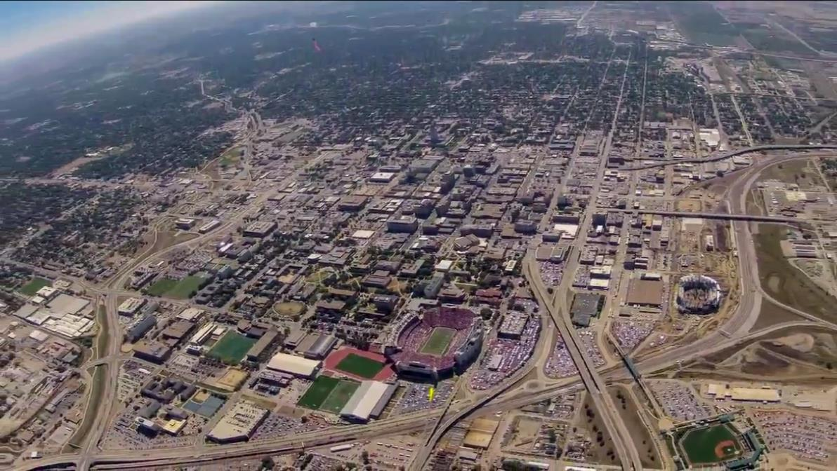
Notes:
85K people. Sept 12 2012

Slide 6
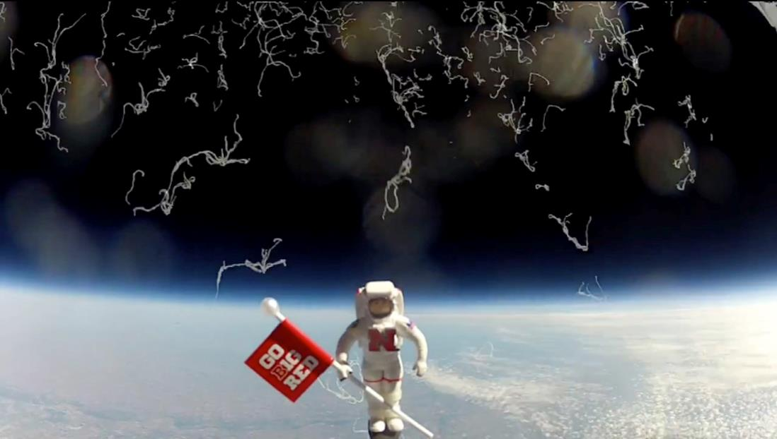
Notes:
85K people. Sept 12 2012

Slide 7
NASA-NHAB at MCC
Student Learning
Focus on Inquiry
Build scientific & engineering payloads
Working in teams
Coordinating logistics
Managing budgets and schedules
Creative problem solving
Public speaking
Notes:
Why?

Slide 8
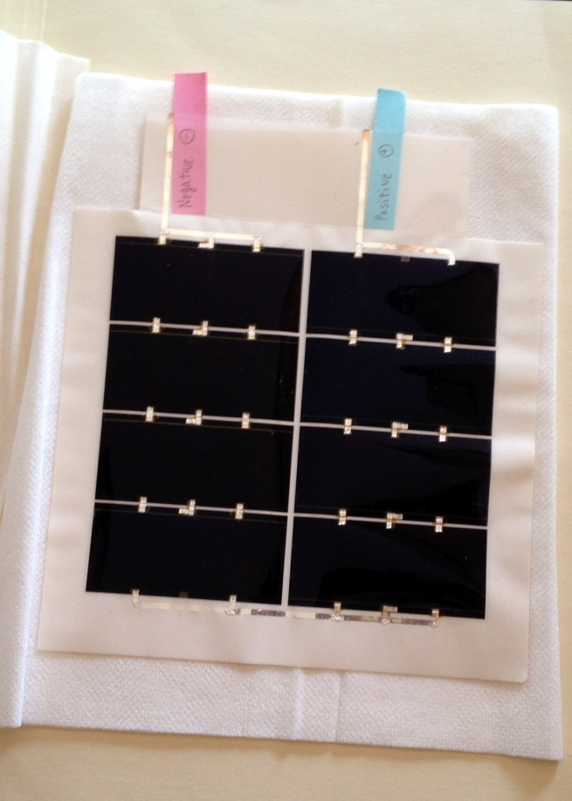
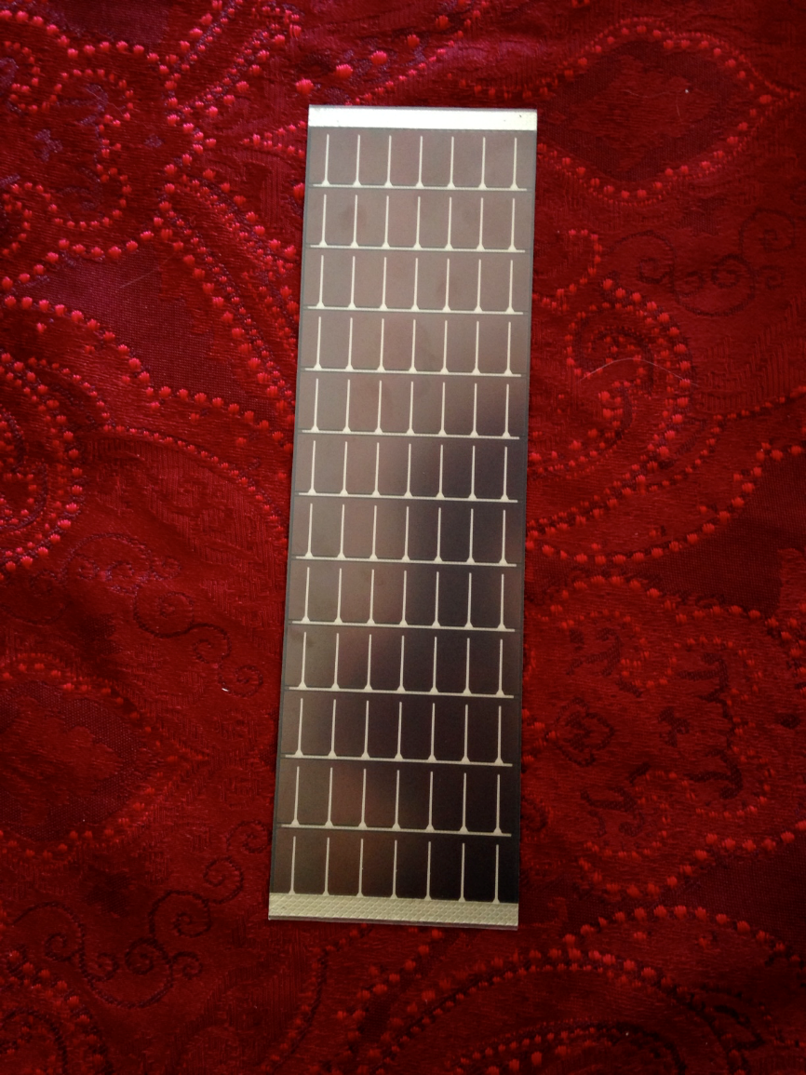
Notes:
Microlink Thin-Film Solar panel

Slide 9
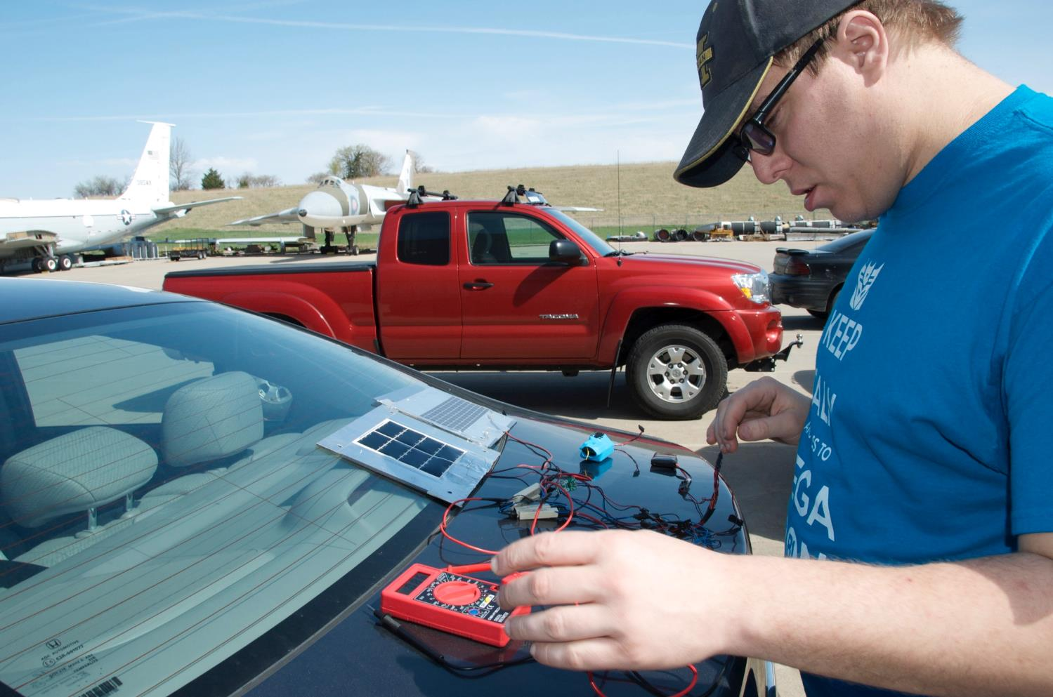

Slide 10
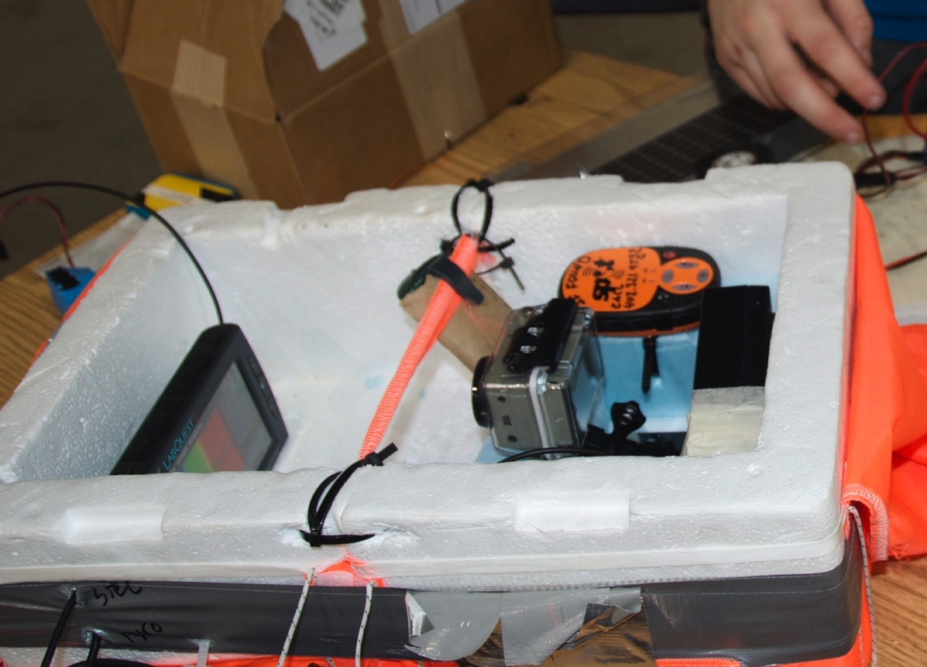

Slide 11
Fab Lab at MCC
MIT’s Center for Bits & Atoms
3D Printers
3D Scanner
CO2 Laser Cutter
CNC Machine
Drill Press
Vinyl Printer

Slide 12
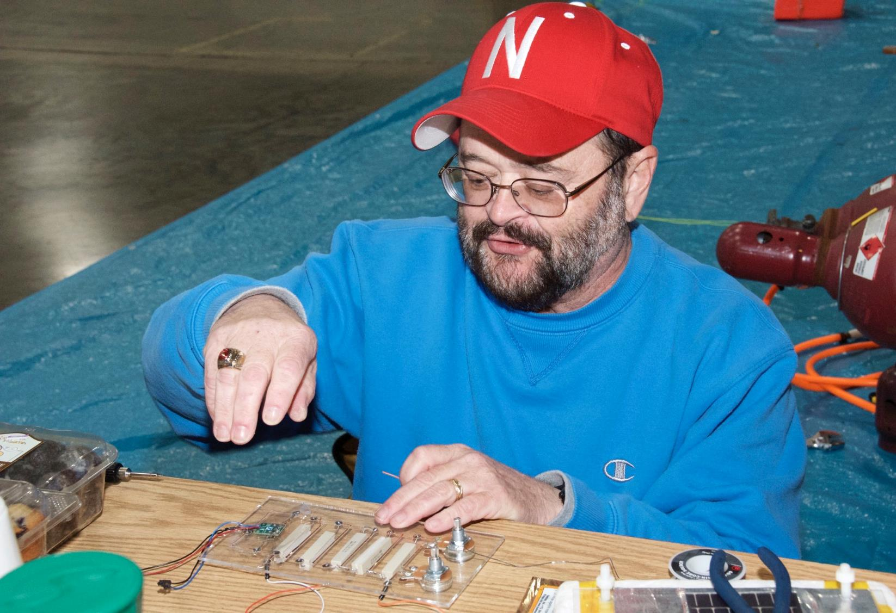

Slide 13
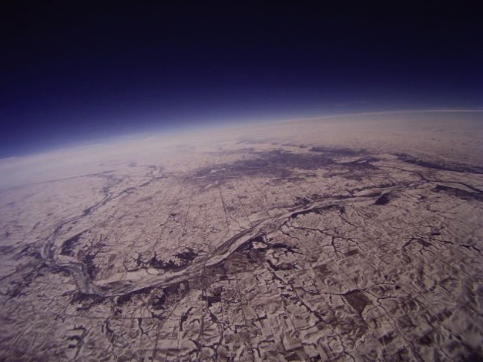

Slide 14
MCC Fab Lab / KuL3D Collaboration
Pod separated during 11/8/14 flight
Go Pro camera was lost (found 5/15)
Looking for collaborative project with KuL3D
KuL3D - New 3D printing/engineering company
Problem: Stabilize video on flights / 360 degree
Precursor to video 2017 Solar Eclipse

Slide 16
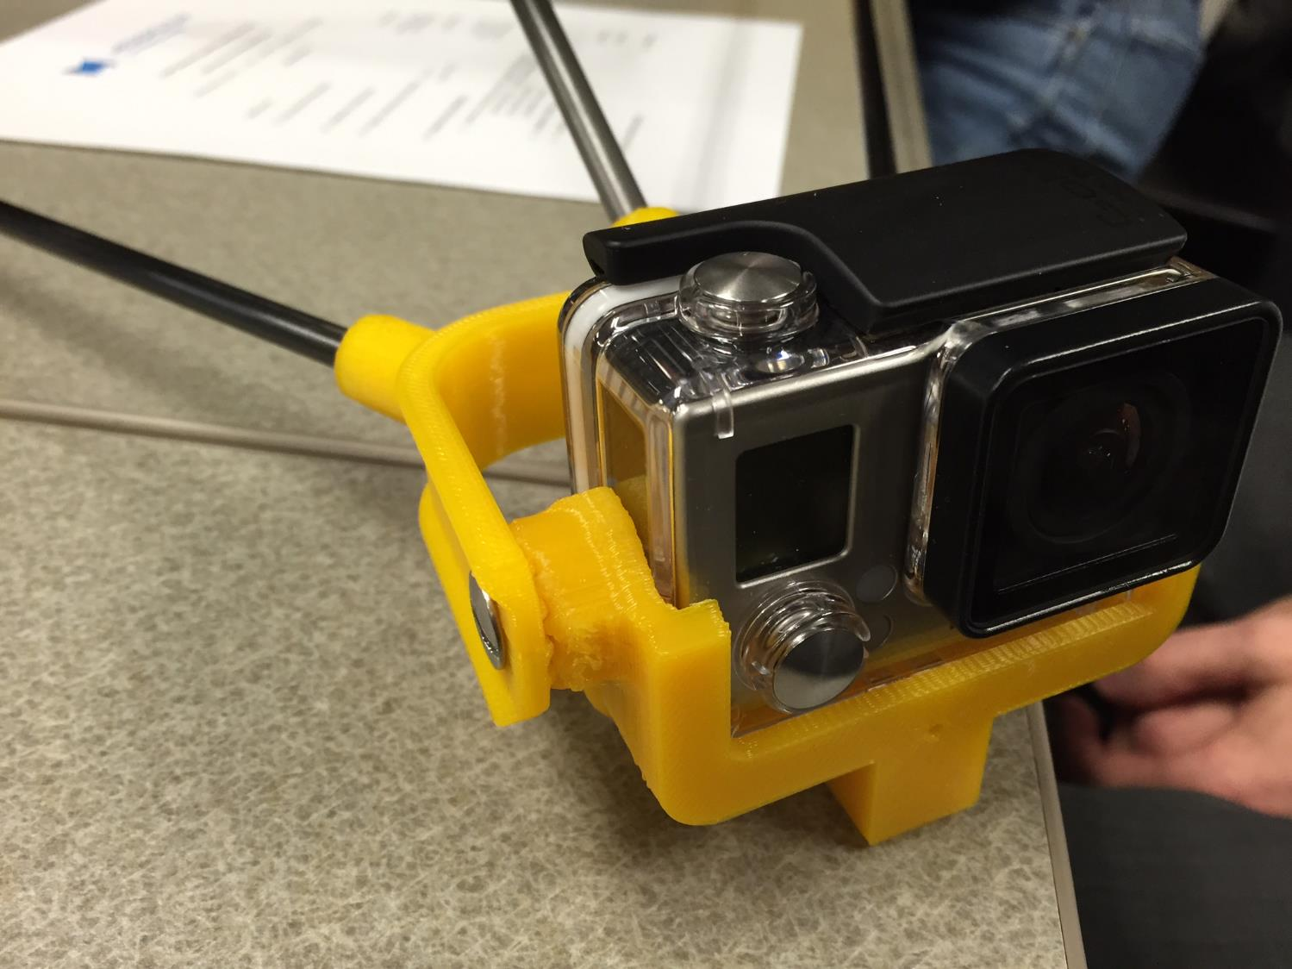

Slide 17
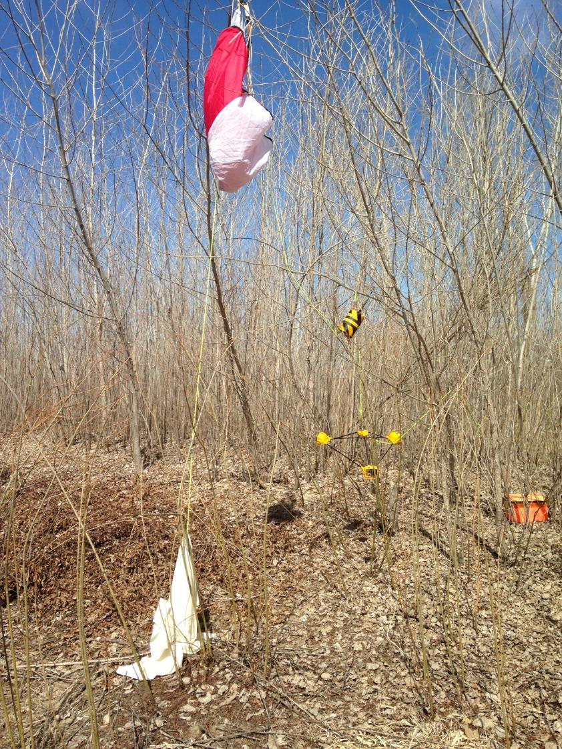

Slide 18
360 degree video

Slide 19
New Horizons Exploring the Potential of Using Small Unmanned Aircraft Systems (aka “Drones”) as Payload Recovery Scouts During High-Altitude Balloon Missions

Slide 20
Launch Video
• HAB Program Promotion
• Content for Grant Proposals
• Media for HAB Presentations
• Content for Student STE[A]M Projects

Slide 21
Payload Recovery
• Scout Out Ideal Insertion Points and Routes
• Identify Potential Recovery Obstacles
• “Sky Mark” the Payload Position
• Observe the Condition of the Payloads Prior to Recovery

Slide 22
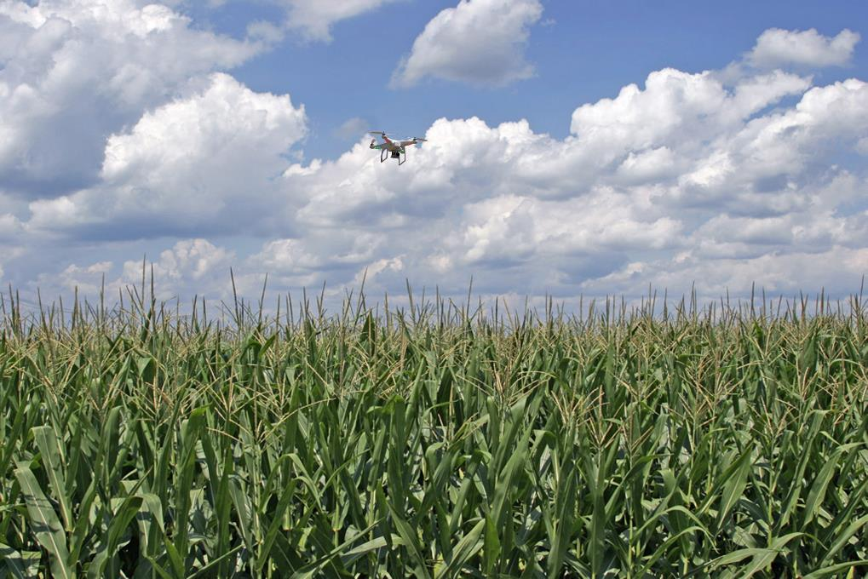
• Scout Out Ideal Insertion Points and Routes
• Identify Potential Recovery Obstacles
• “Sky Mark” the Payload Position
• Observe the Condition of the Payloads Prior to Recovery

Slide 23
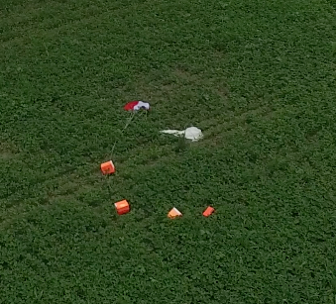
• Scout Out Ideal Insertion Points and Routes
• Identify Potential Recovery Obstacles
• “Sky Mark” the Payload Position
• Observe the Condition of the Payloads Prior to Recovery
• Find Lost Payloads
• Locate and Aid in the Rescue of Lost Recovery Personnel

Slide 24
New Horizons Exploring the Potential of Using Small Unmanned Aircraft Systems (aka “Drones”) as Payload Recovery Scouts During High-Altitude Balloon Missions
Types of UAS Operations
Defined by the FAA
• Public [Governmental]
• Civil [Non-Governmental]
• Model Aircraft [Hobby or Recreation]
Notes:
Civil Operation Special Airworthiness Certificate

Slide 25
New Horizons Exploring the Potential of Using Small Unmanned Aircraft Systems (aka “Drones”) as Payload Recovery Scouts During High-Altitude Balloon Missions
Types of UAS Operations
Defined by the FAA
• Public [Governmental]
• Civil [Non-Governmental]
• Model Aircraft [Hobby or Recreation]
- Fly below 400 feet and remain clear of surrounding obstacles
- Keep the aircraft within visual line of sight at all times
- Remain well clear of and do not interfere with manned aircraft operations
- Don't fly within 5 miles of an airport Don't fly near people or stadiums
- Don't fly an aircraft that weighs more than 55 lbs
- Do not fly for payment or commercial purposes
Notes:
Civil Operation Special Airworthiness Certificate

Slide 26
Contact Information
Kendra Sibbernsen
ksibb@cox.net
Michael Sibbernsen
msibbern@cox.net
Please Visit
NHAB Blog: www.nearspacescience.com

Slide 27
Contact Information
Kendra Sibbernsen
ksibb@cox.net
Michael Sibbernsen
msibbern@cox.net
Please Visit
NHAB Blog: www.nearspacescience.com
Any Questions?

Slide 28
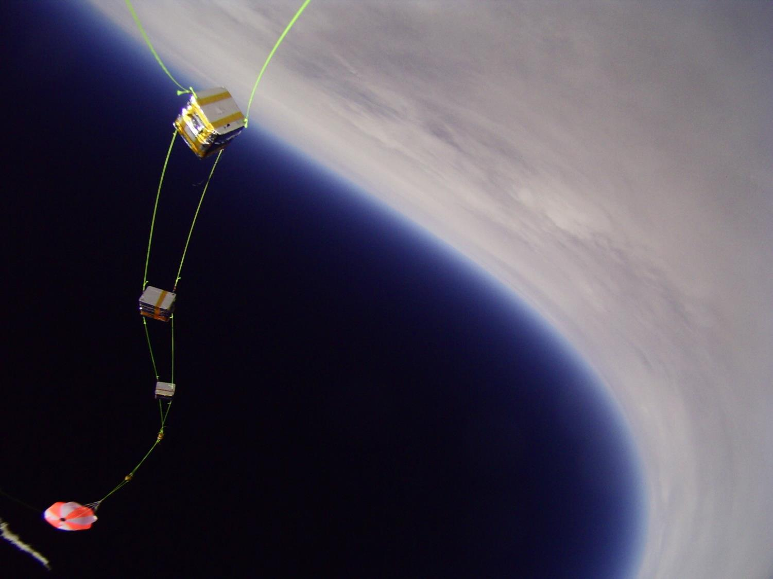
NASA Nebraska High Altitude Ballooning
Thank You
Kendra Sibbernsen – Metropolitan Community College
Michael Sibbernsen – University of Nebraska - Lincoln

Slide 29
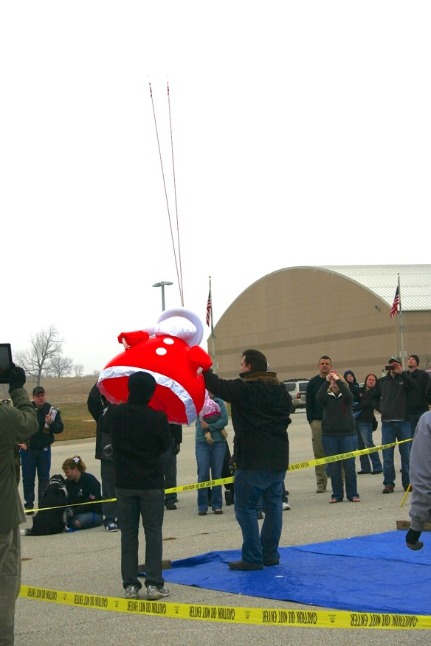
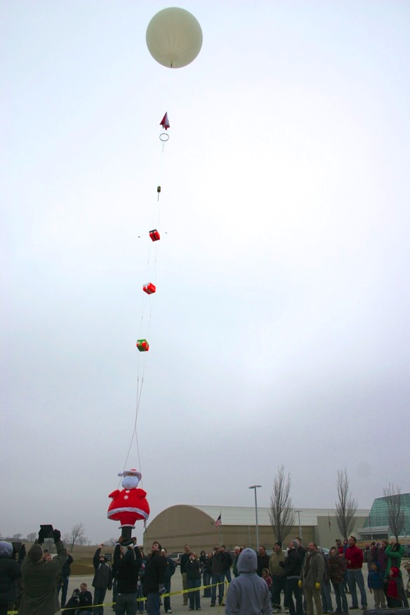
Notes:
85K people. Sept 12 2012

Slide 30
Notes:
85K people. Sept 12 2012

Slide 31
NASA Nebraska High Altitude Ballooning
Thank You
Kendra Sibbernsen – Metropolitan Community College
Michael Sibbernsen – University of Nebraska - Lincoln

Slide 32
