Slide 1
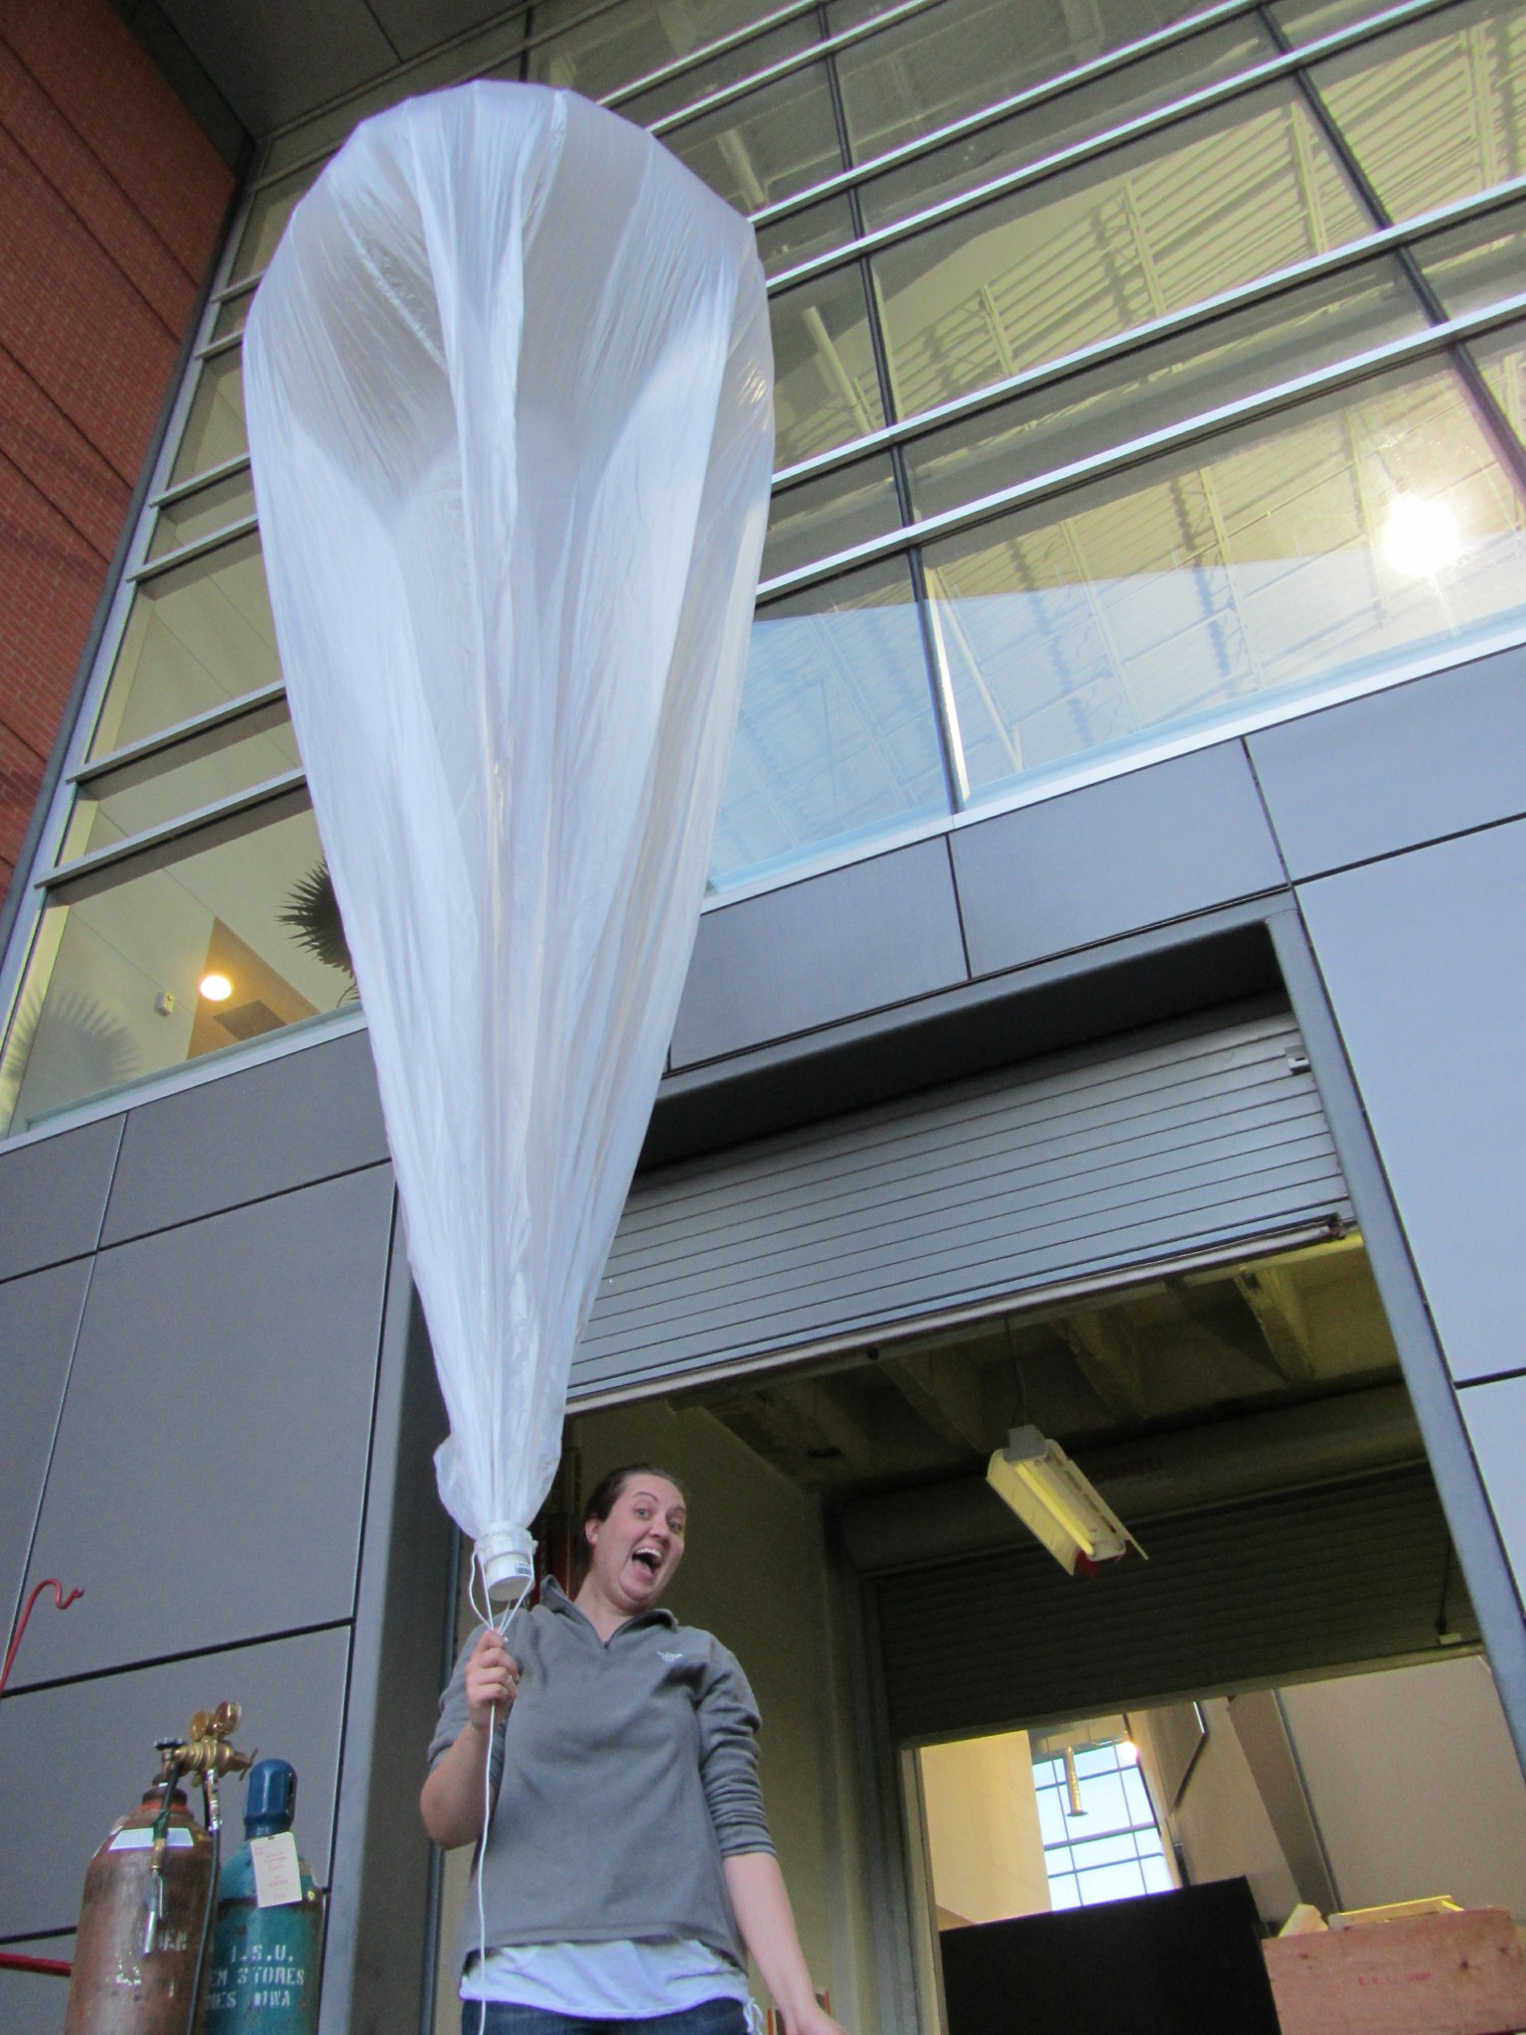
Aurora: Zero Pressure Balloon Project
Project Manager: Christine Jensen
Project Advisor: Matthew Nelson

Slide 2
Zero Pressure Balloon Project
According to EOSS
Very thin (7.5 micron) plastic that is filled with helium and vented to the atmosphere through the bottom.
Why Aurora?
Why build a zero pressure balloon?
Notes:
Aurora in Latin means dawn. It was the hope of this group that the balloon would remain aloft and be floating well through dawn
Reasons for building a ZP balloon
Long duration testing
Stable platform
Consistent Altitudes
These attributes otherwise can only be achieved with a Satellite.

Slide 3
Payload Considerations
The payload must be finalized before proceeding.
The payload weight will be the variable that influences the rest of the calculations
Want to be as lightweight as possible

Slide 4
Payload Considerations
LXE-124-B
AA Lithium Battery pack
Open Tracker+
Friendcom radio (144.390 MHz)
Timer base cutdown (24 hours)
GPS puck

Slide 5
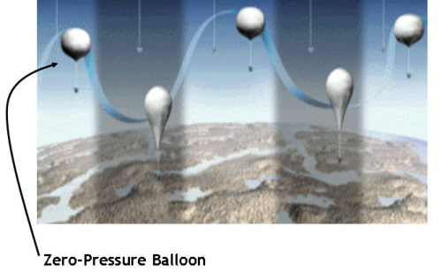
Atmospheric Considerations
Atmospheric conditions are a much greater factor the longer the flight is airborne.
Balloon calculated to see 2 night cycles and 1 day cycle.
Temperature range seen by balloon will range from 25 deg C to -65 deg C.
Ideal Gas Equation
PV=nRT
Notes:
From Ideal Gas Equation, as temperature of gas increases so does pressure. The helium will then be expelled through the vent in the bottom. This allows for the pressure within the balloon to equalize to the atmospheric pressure outside the balloon. Allowing to float at a certain altitude.
As the balloon is exposed to a night cycle, the helium will cool and not be able to hold the altitude that it could during the day. This will cause the balloon to drop.

Slide 6
Tracking
For LXE-124-A and B
Used the national APRS system for tracking
In progress
HF transceiver
Position and telemetry
Send Commands
Used in conjunction with APRS system

Slide 7
Recovery
Radius of Feasible recovery
Electronics used were older versions
Battery pack was AA batteries
Label was placed on box in case it was recovered by land owners.

Slide 8
Material for Making ZP Balloon
Must be lightweight but strong enough to hold pressure and weight of payload
Polyethylene Sheeting was found to be the material used by NASA and other institutions that use ZP balloons
Average thickness was 0.0008 inches thick
The material finally decided on by the group was Painter’s Plastic 0.31 mil thick.

Slide 9
Calculating Shape and Volume
Equations used
Density of Gas at Altitude
Volume of a Sphere
Radius of a Sphere, given certain volume
Area of Sphere, given certain radius
Volume of film
Mass of film
Notes:
Calculated values
Air density at 60,000 feet = 0.1177kg/m3
Helium density at 60,000 ft = 0.0163kg/m3
Volume of sphere = 6.901 m3 → 8.371 m3
Radius of sphere = 1.181 m → 1.260 m
Area of sphere = 17.53 m2 → 19.94 m2
Volume of film = 1.380 e-4 m3 → 0.0002 m3
Mass of film = 0.1311 kg → 0.1491 kg
Equations were integrated to find the final values taking into account the changing mass of the film as the volume increased. Once the volume converged the final values were found.

Slide 10
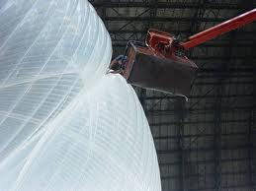
Gore Pattern
Professional ZP balloons consist of over 200 gores that create the balloon shape.
A pattern was found for a hot air balloon that consisted of 8 gores 16 feet long.
This shape gave more than enough room for the lift calculated.
Wallops Flight Facility

Slide 11
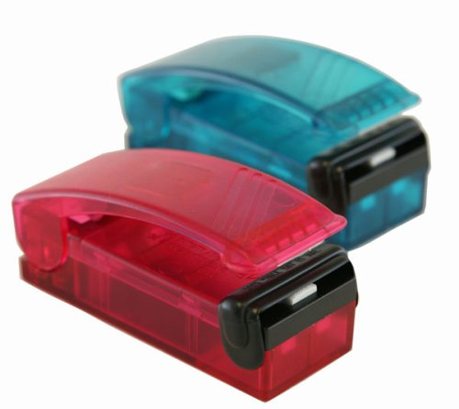
First Attempt at Balloon Construction
Winter 2010
First built under the assumption that it would become a test platform for CySat, Iowa State’s Cubesat team.
16 gore balloon 60 feet long
Sealed with Itouchless sealers
Was not finished…

Slide 12
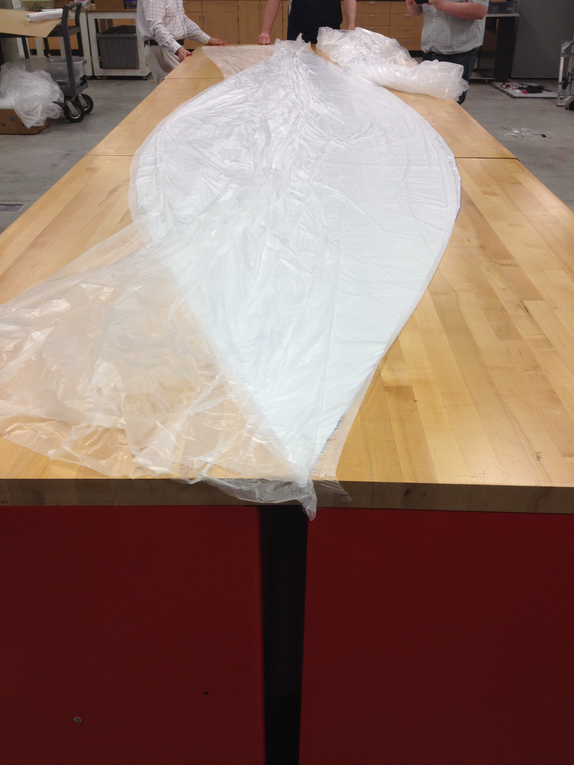
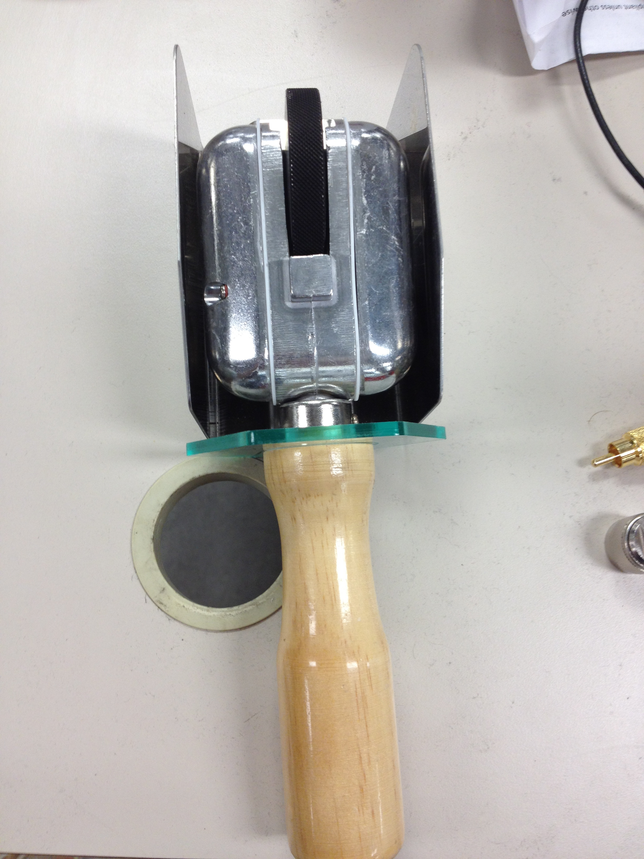
Second Attempt at Balloon Construction
Started April 2012
New heat sealer purchased
16 feet long instead of 60 ft
allowed for creating balloon
on tables.

Slide 13
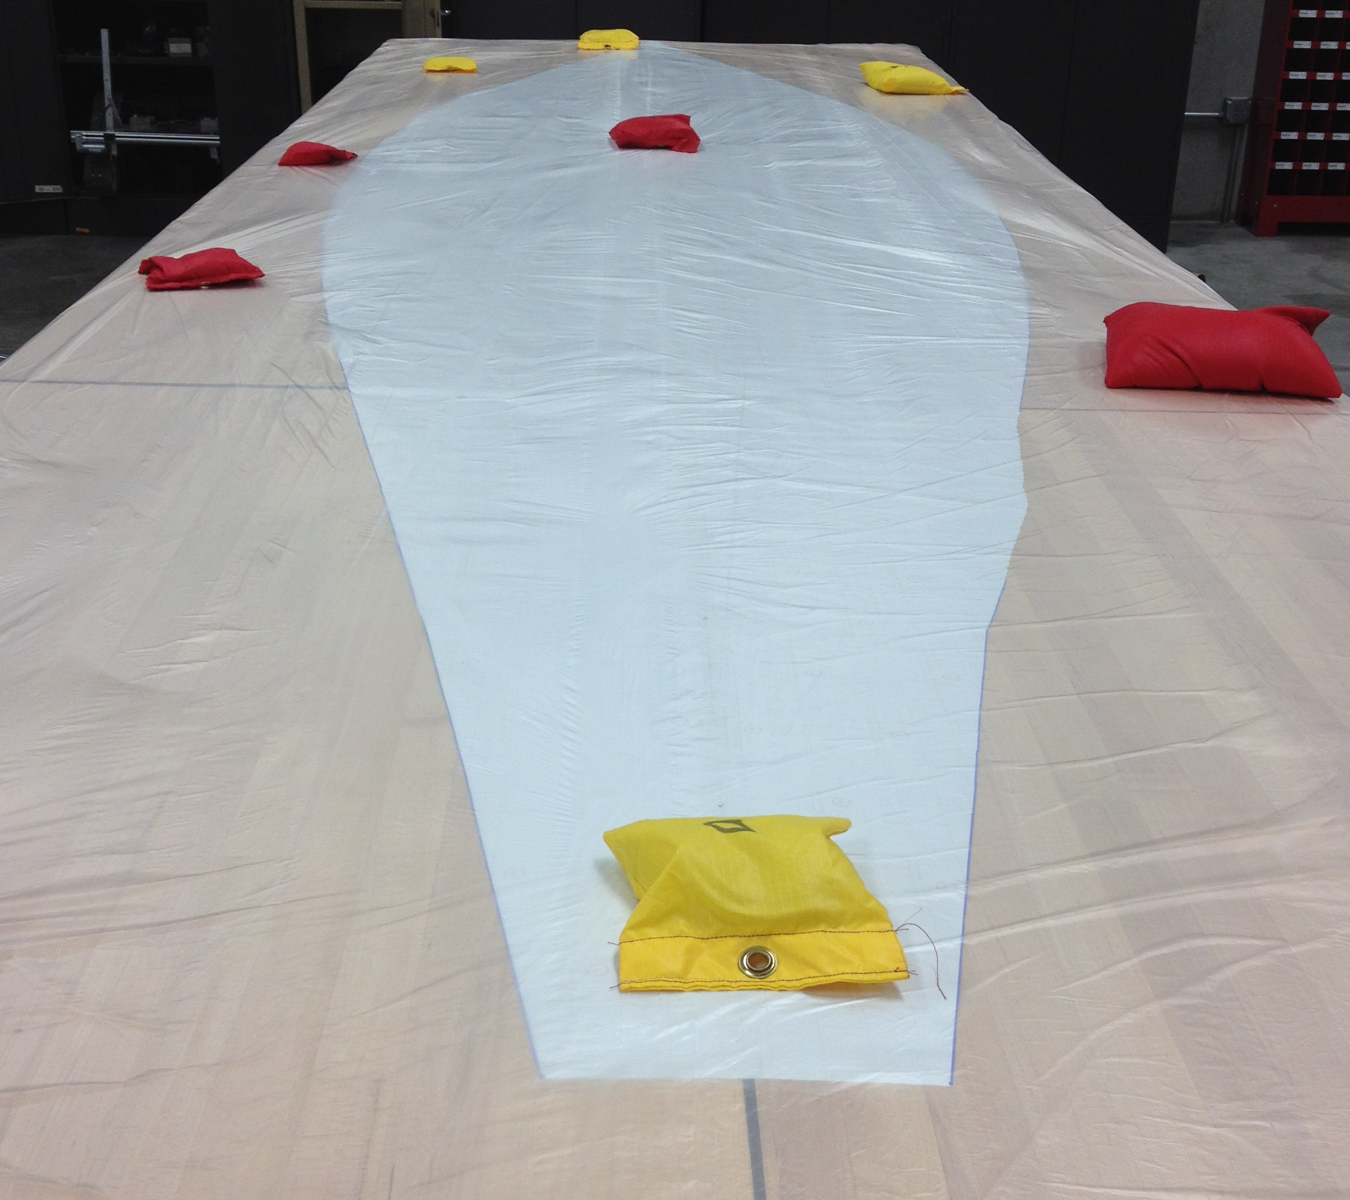
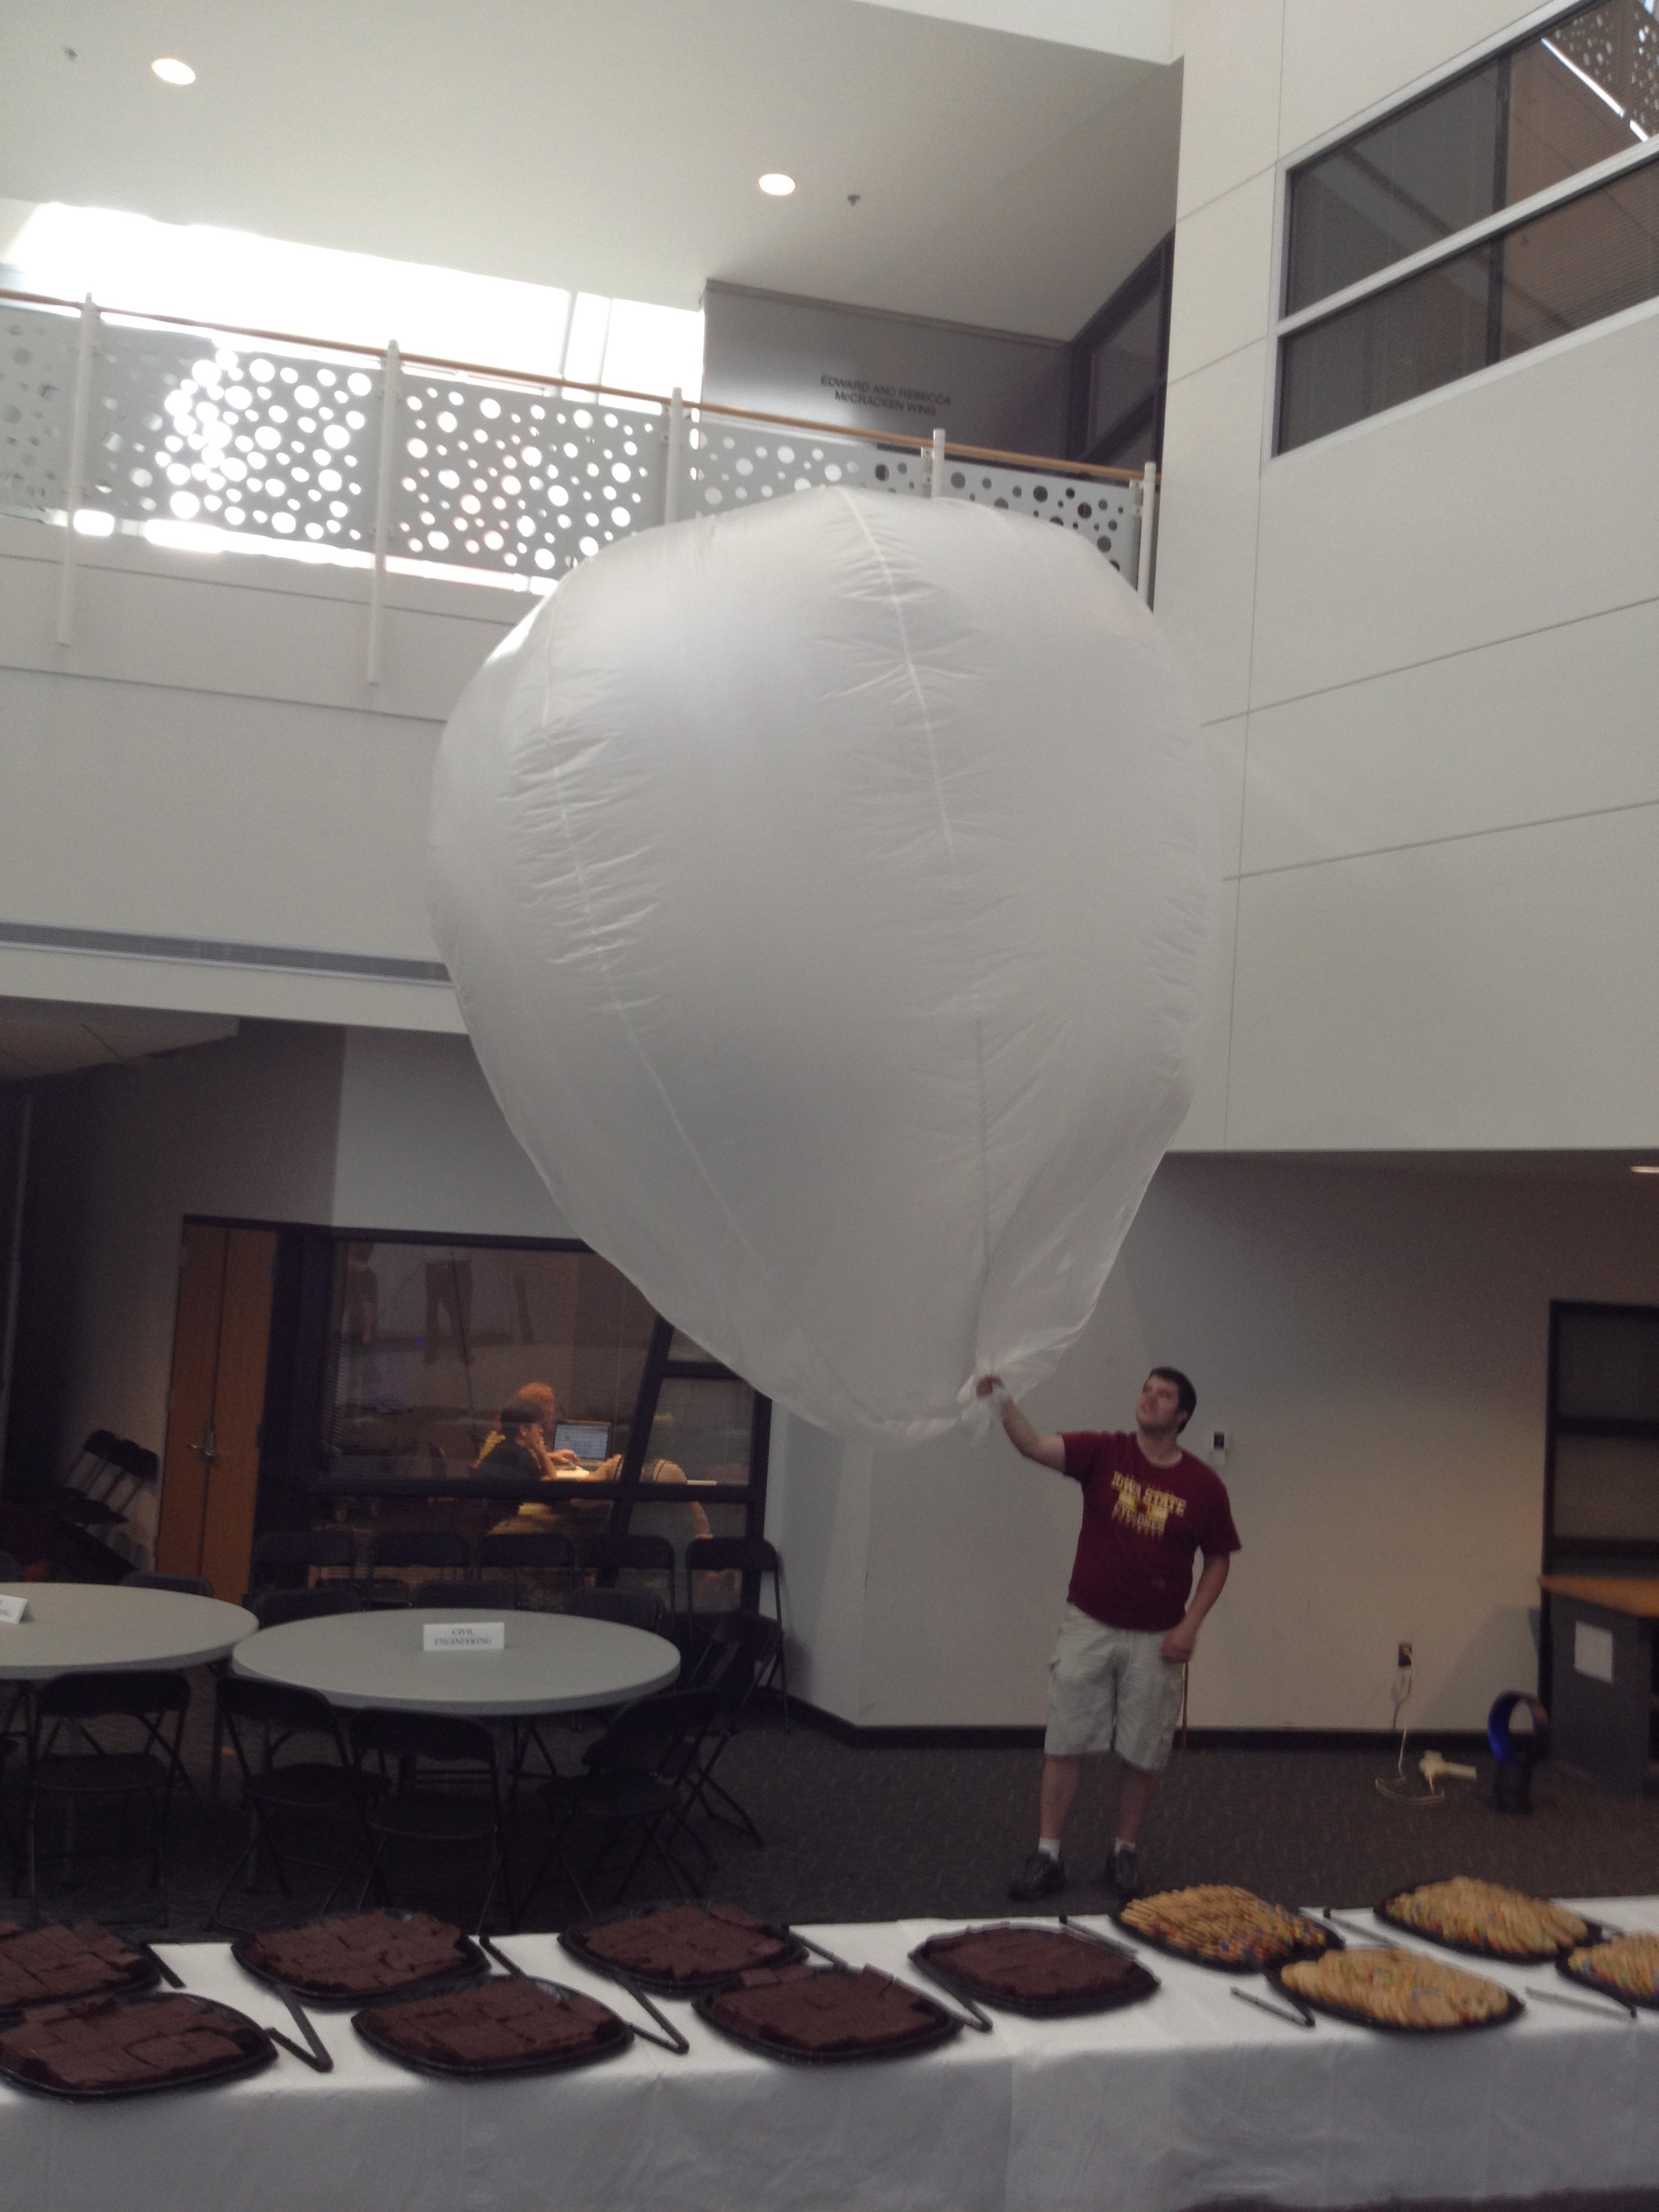
Building the balloon continued
2 layers of plastic were sealed together at one time. This allowed to create 4 pairs of gores sealed together.
The layers of plastic were laid over a template so that the gores would be relatively similar.
Once completely sealed the balloon was inflated to check for holes.

Slide 14
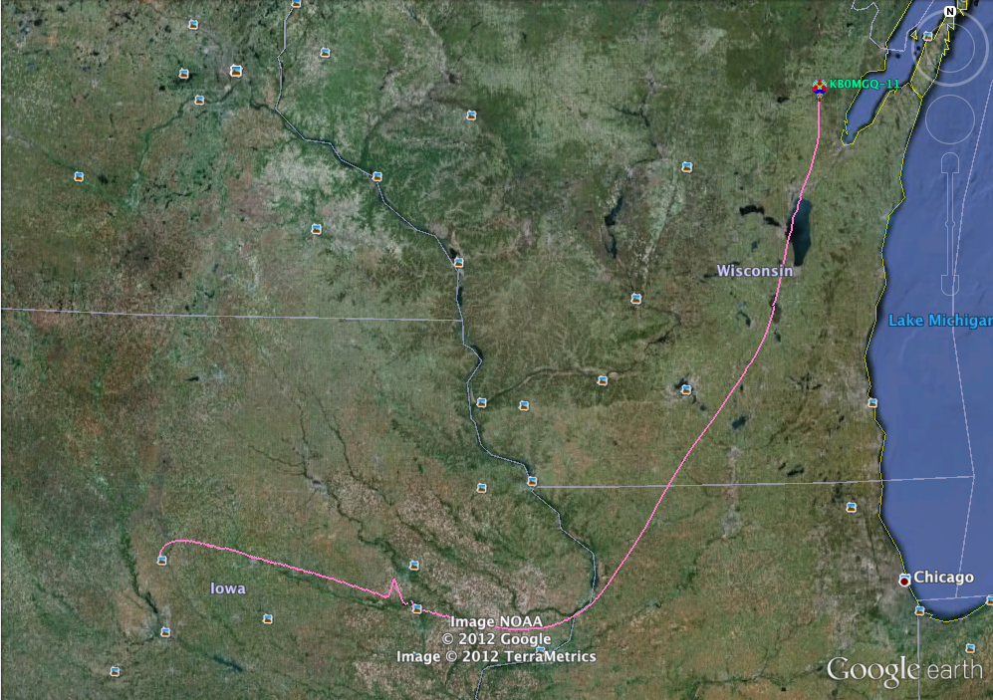
First Test – LXE-124-A
Tested venting concept on 3000 g latex balloon
In the air 12 hours
Landed near Green Bay, WI

Slide 15
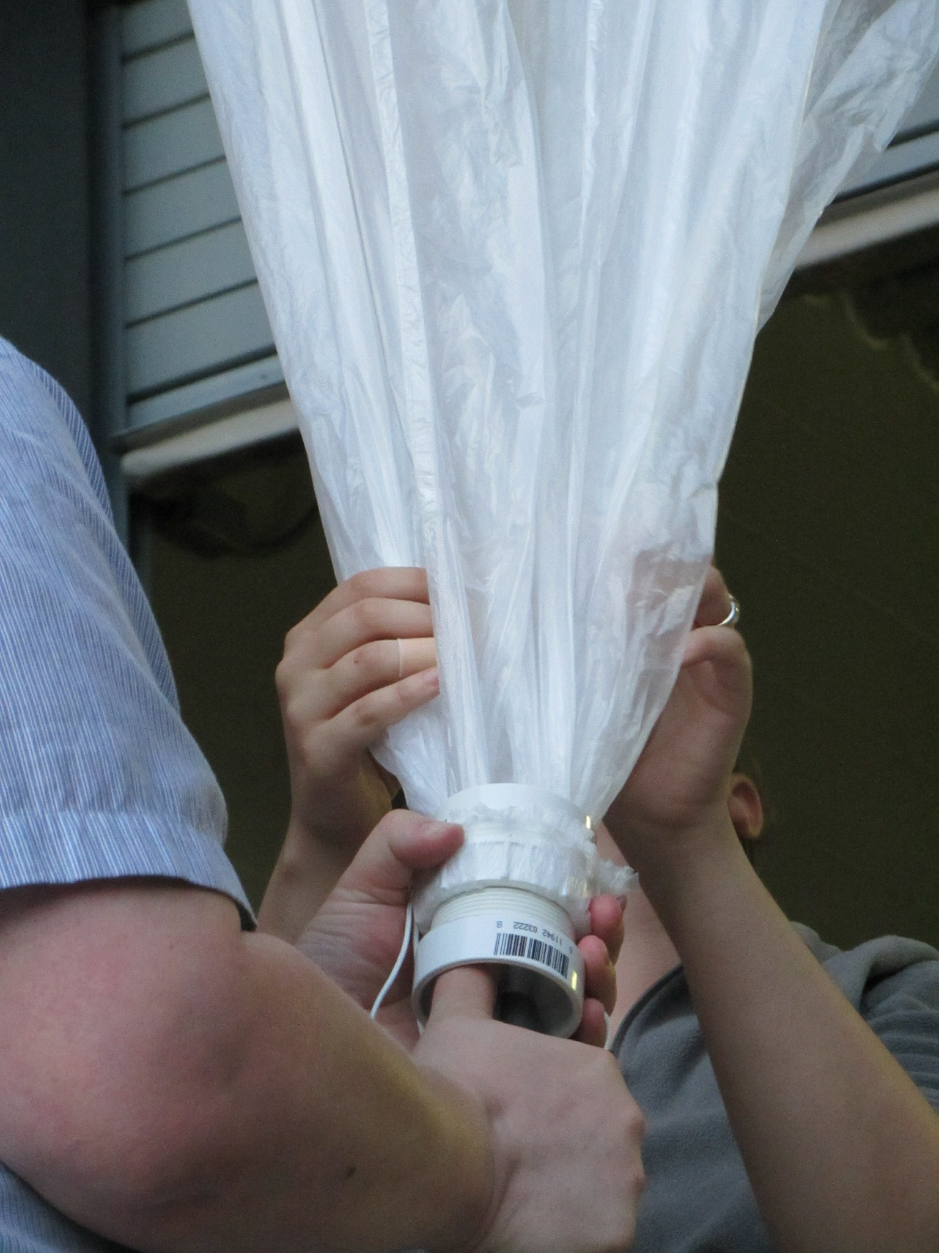
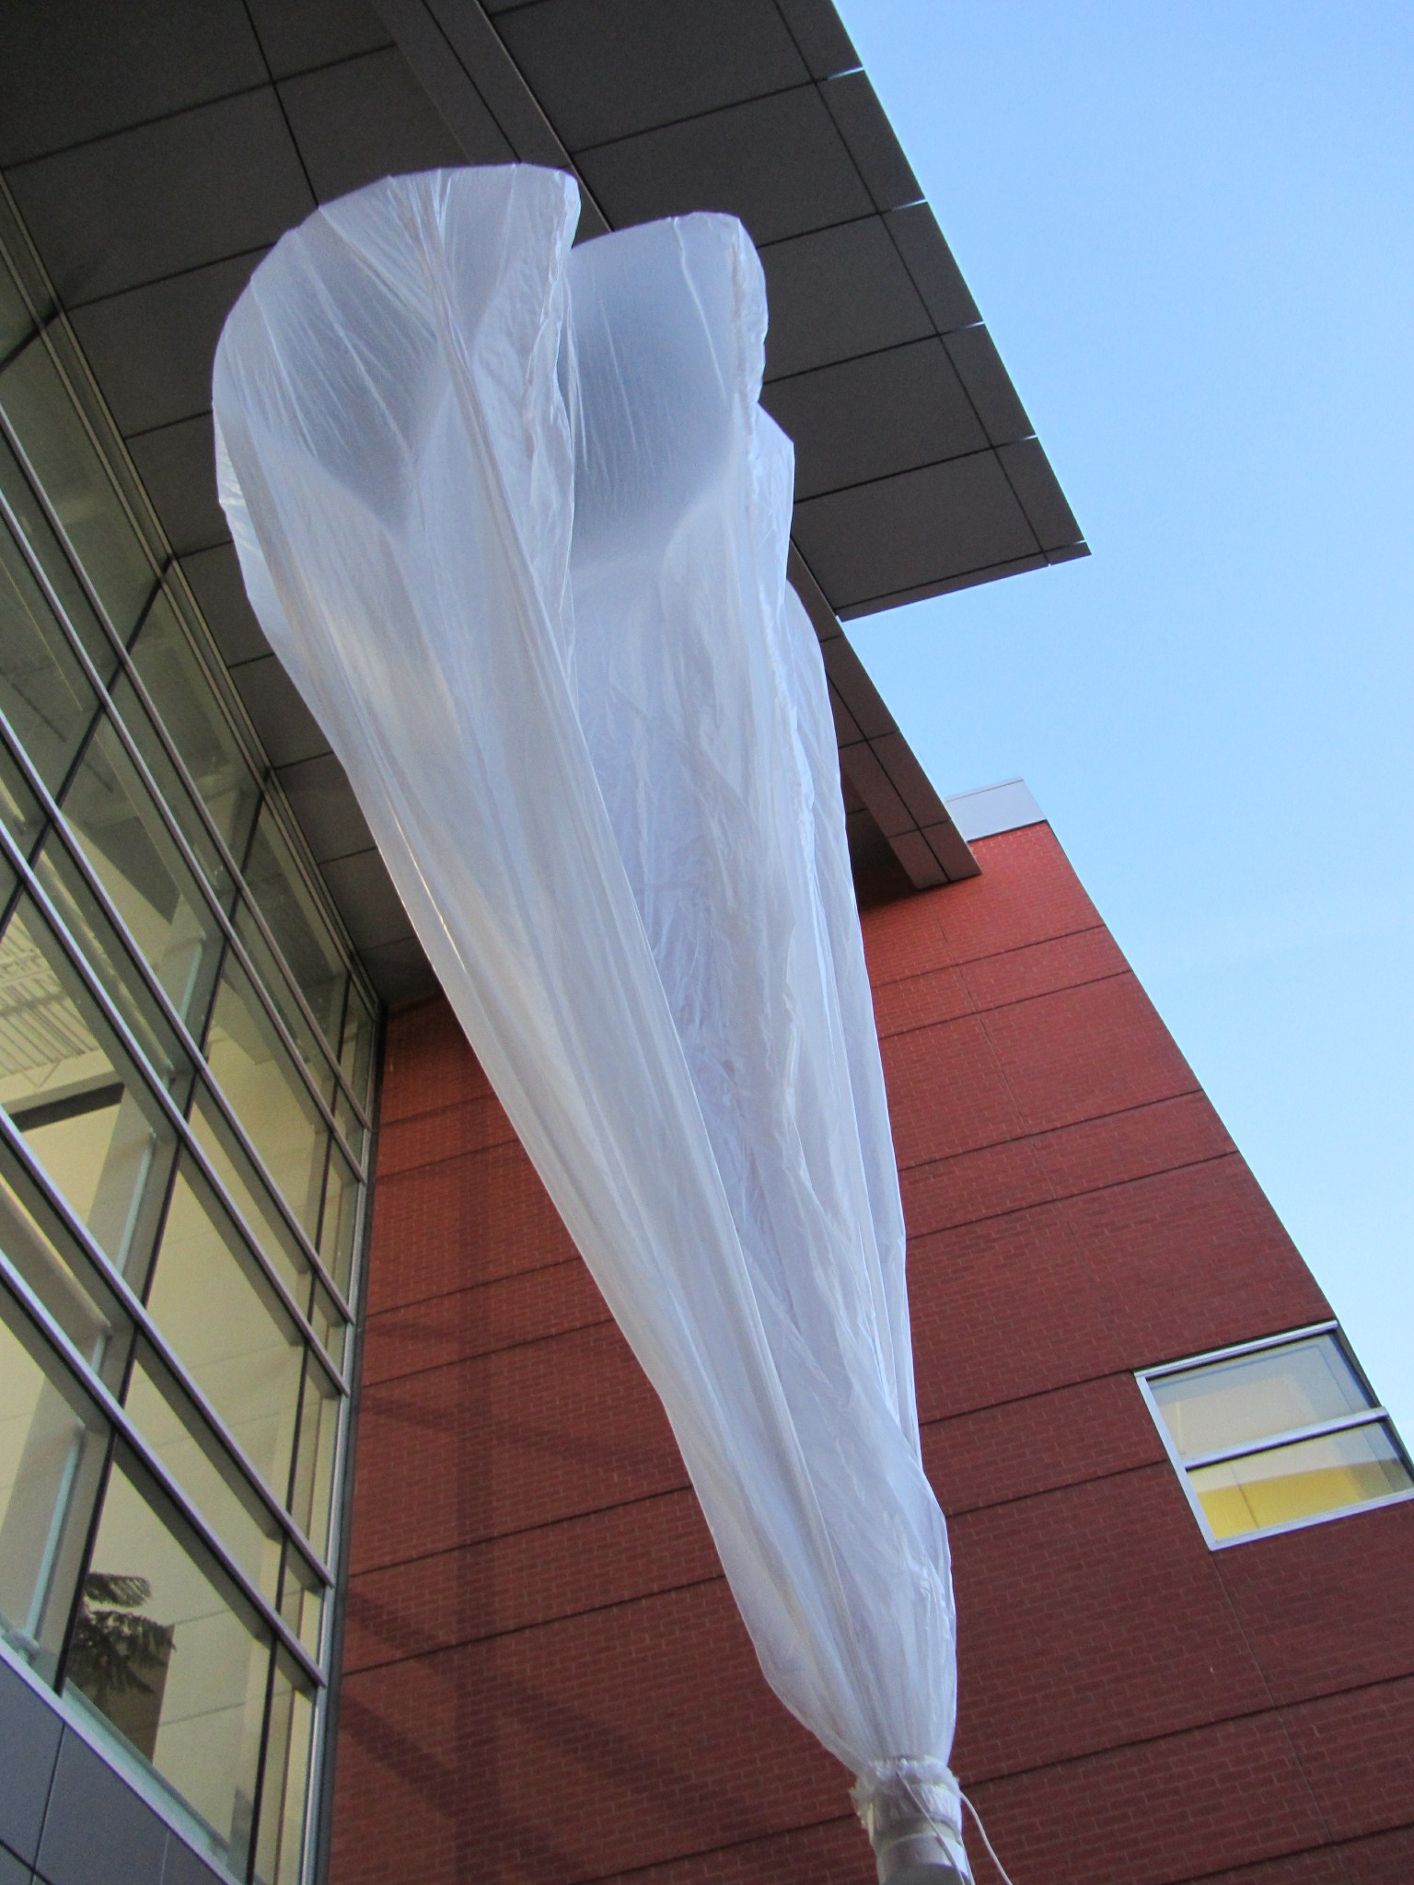
Second Test LXE-124-B

Slide 16
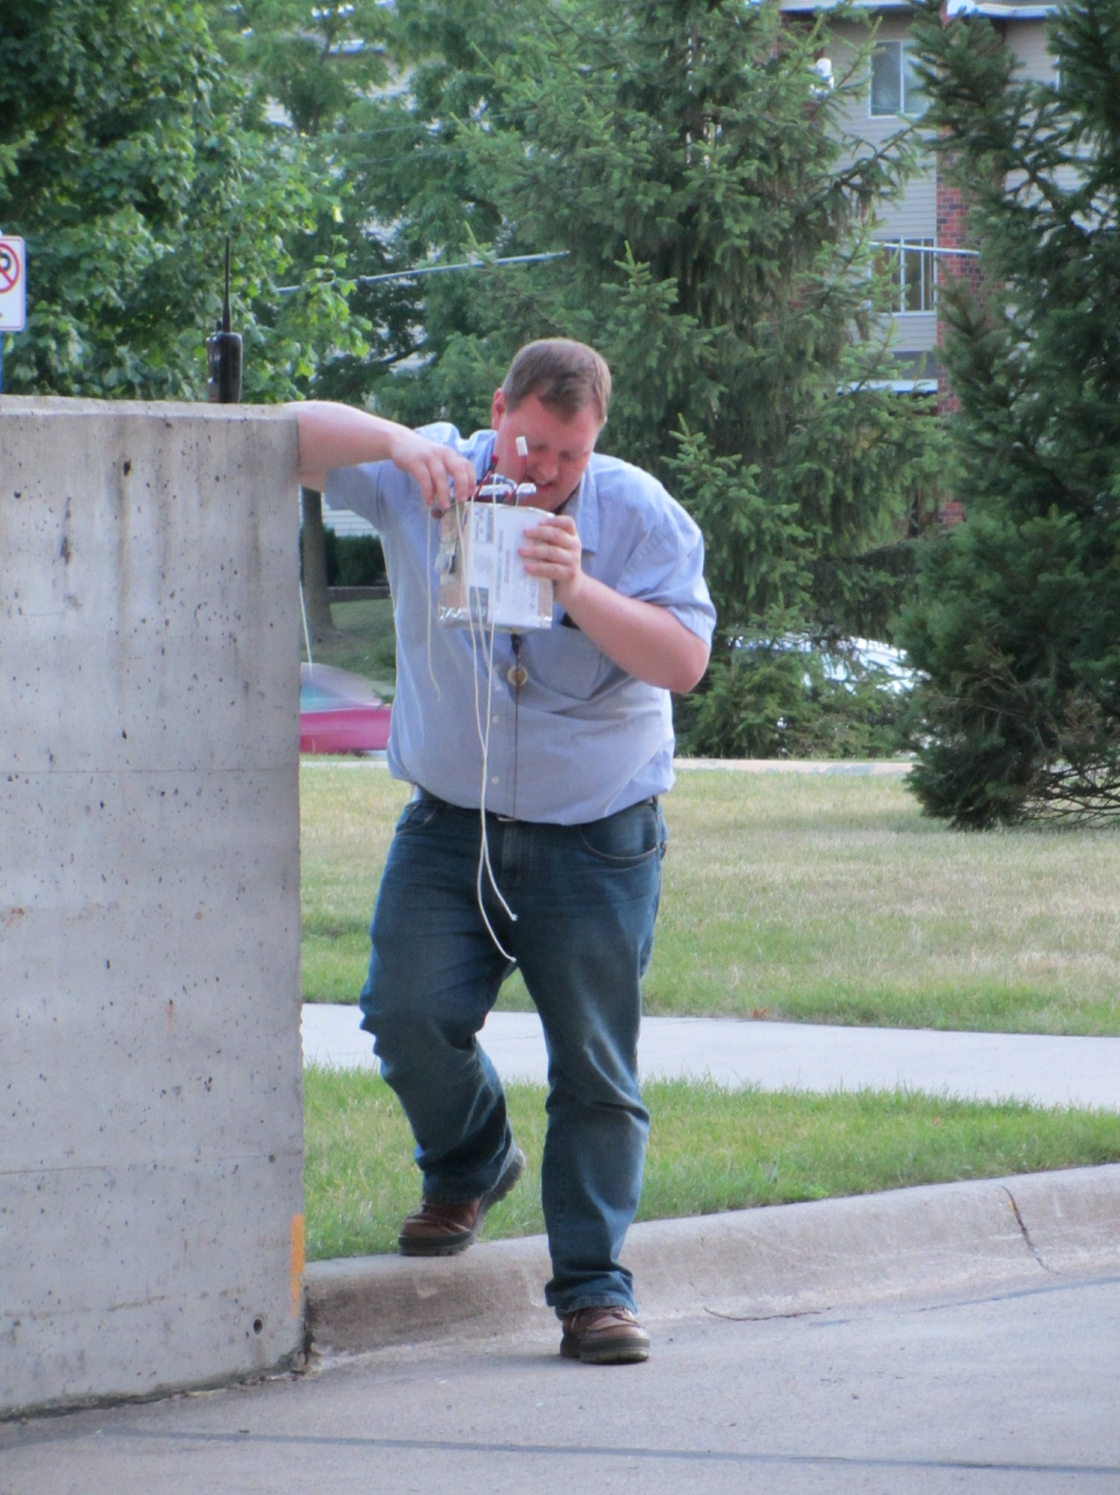
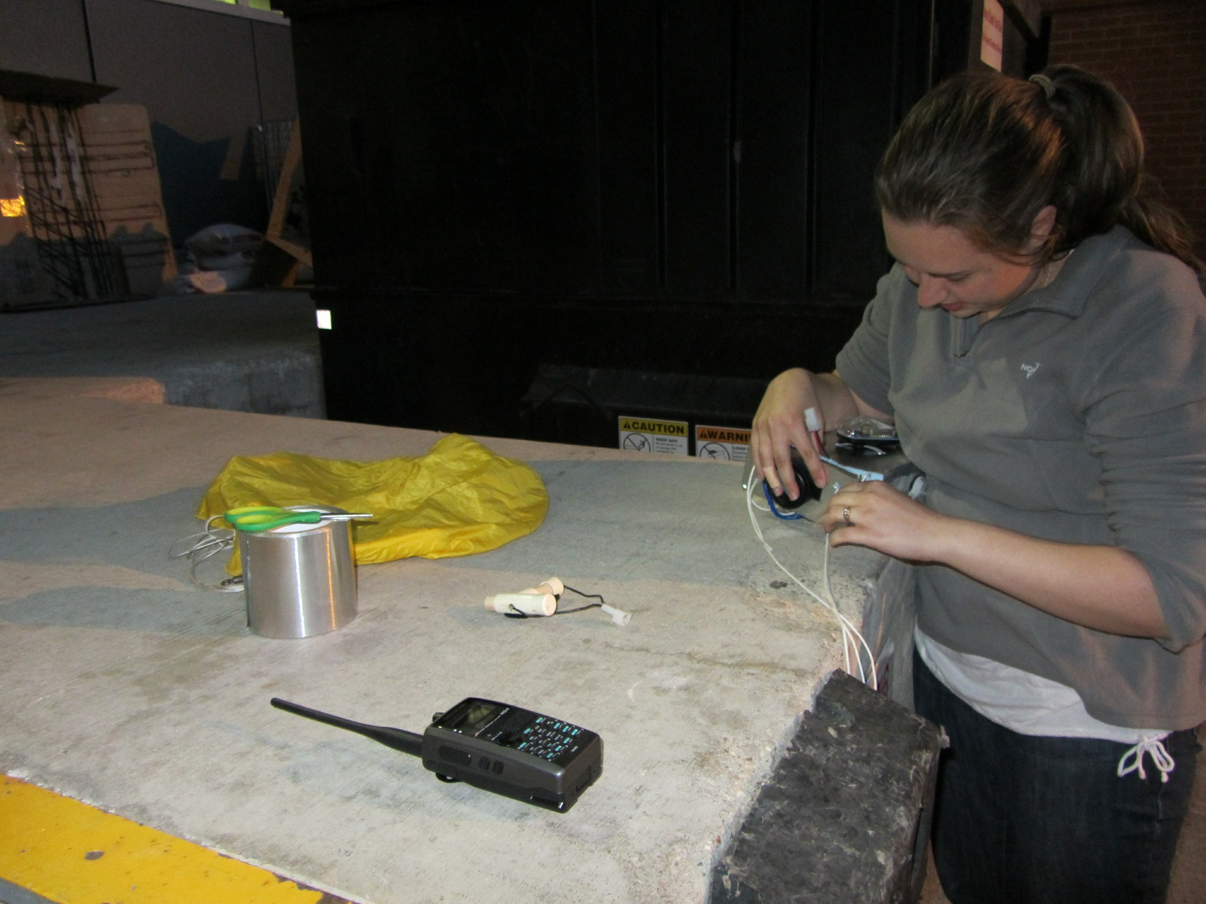
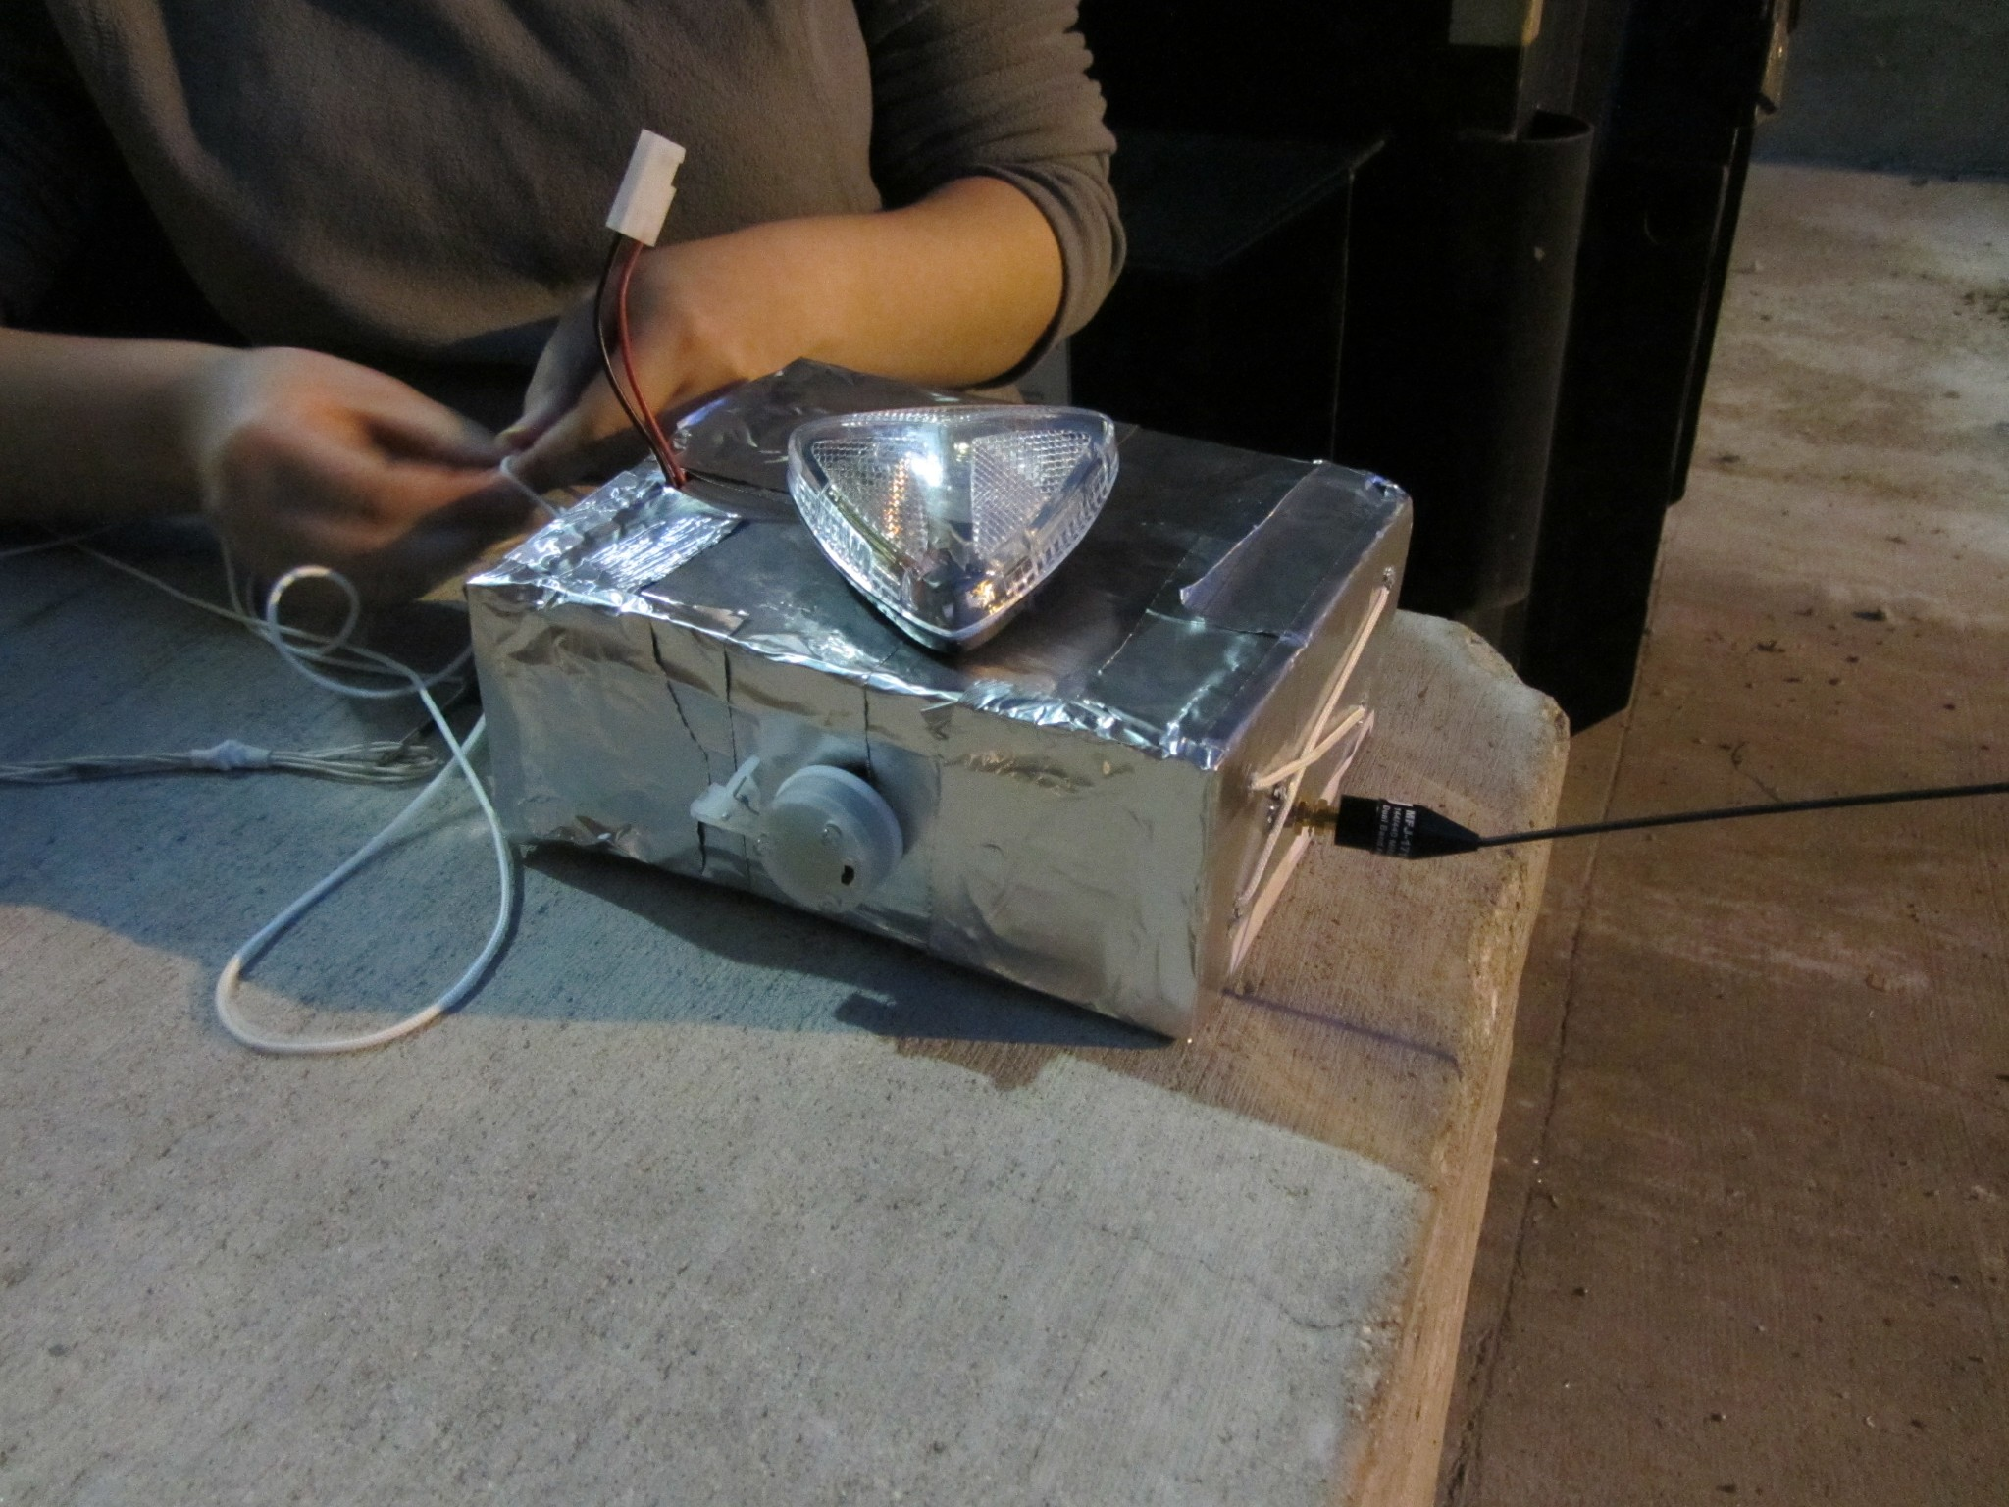

Slide 17
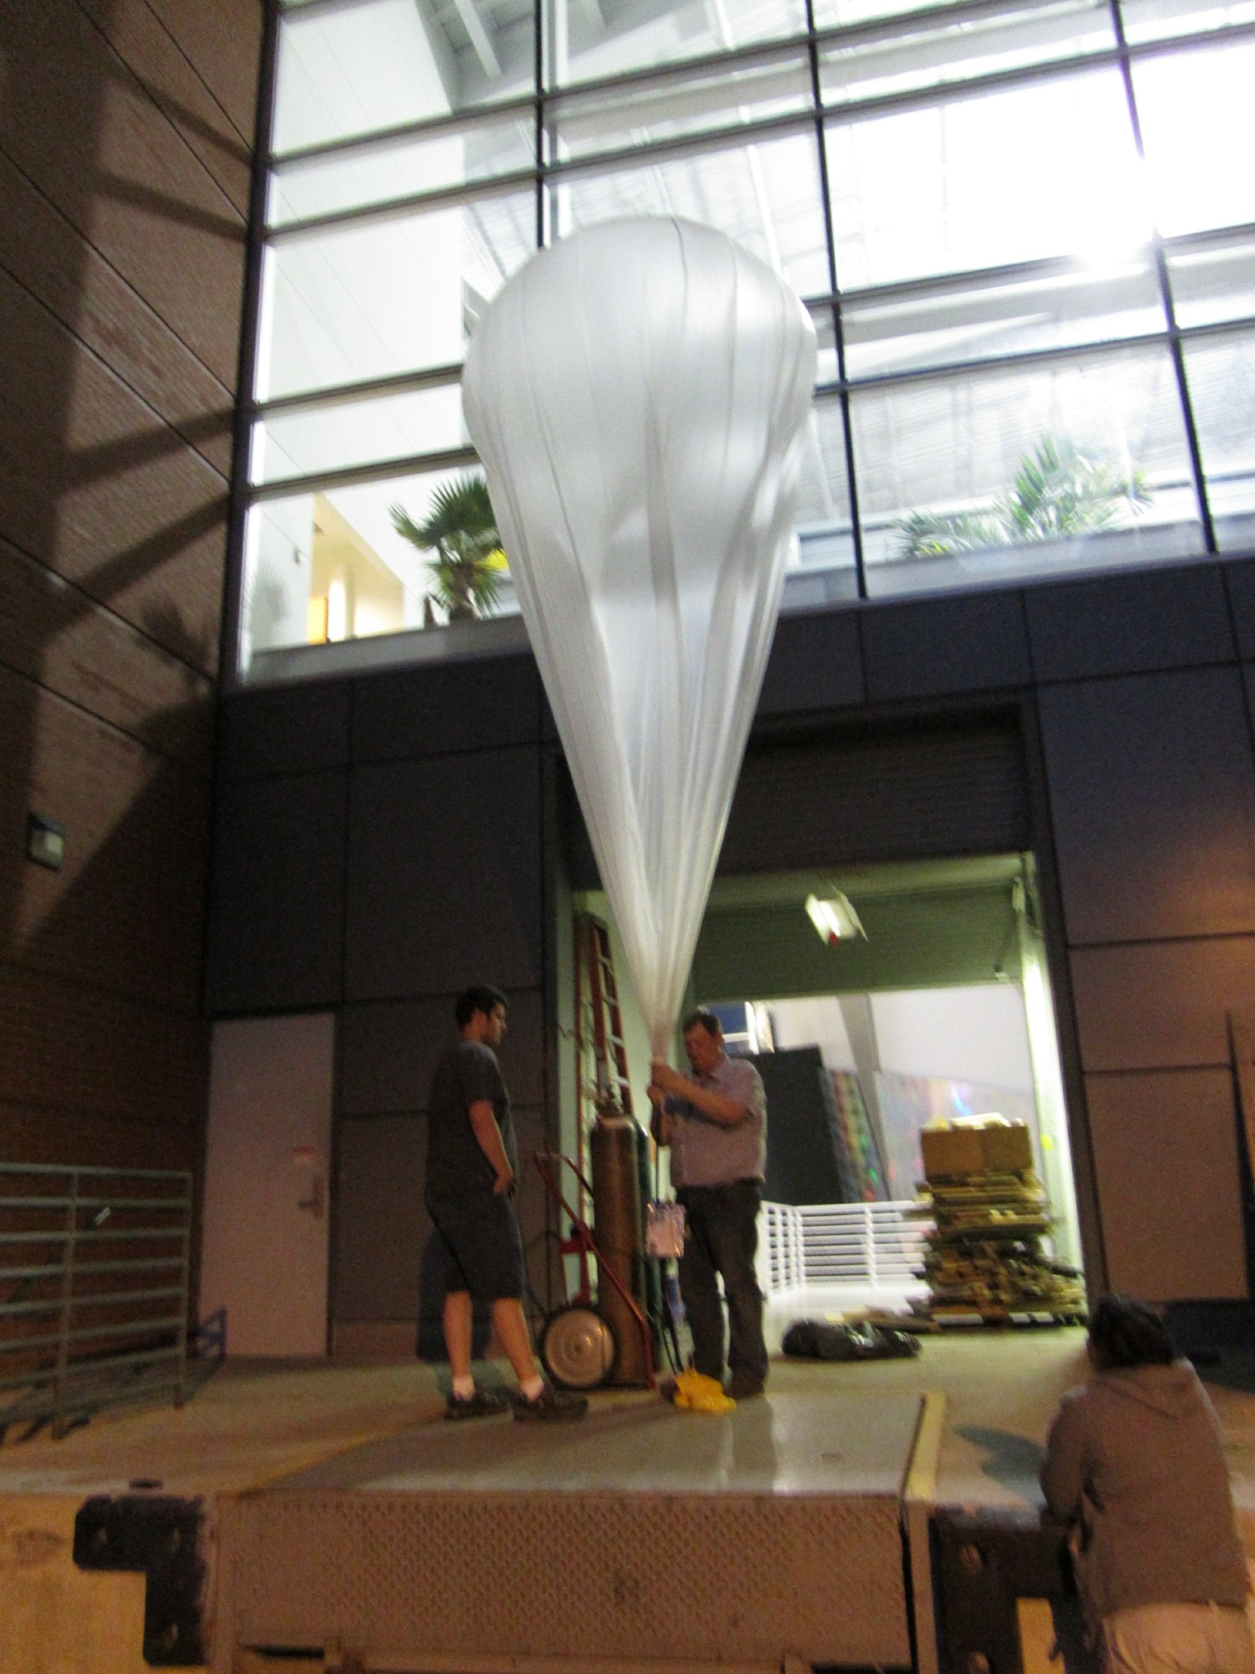
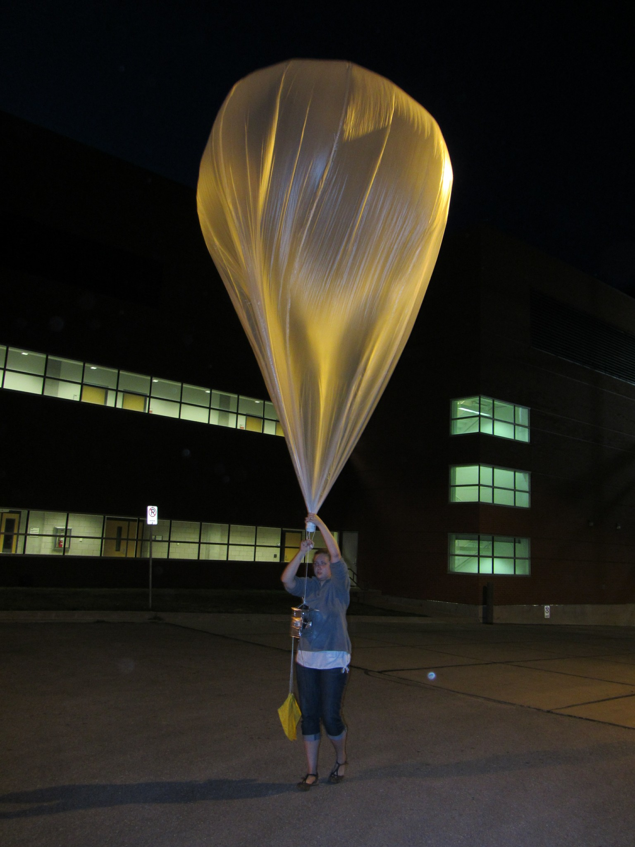
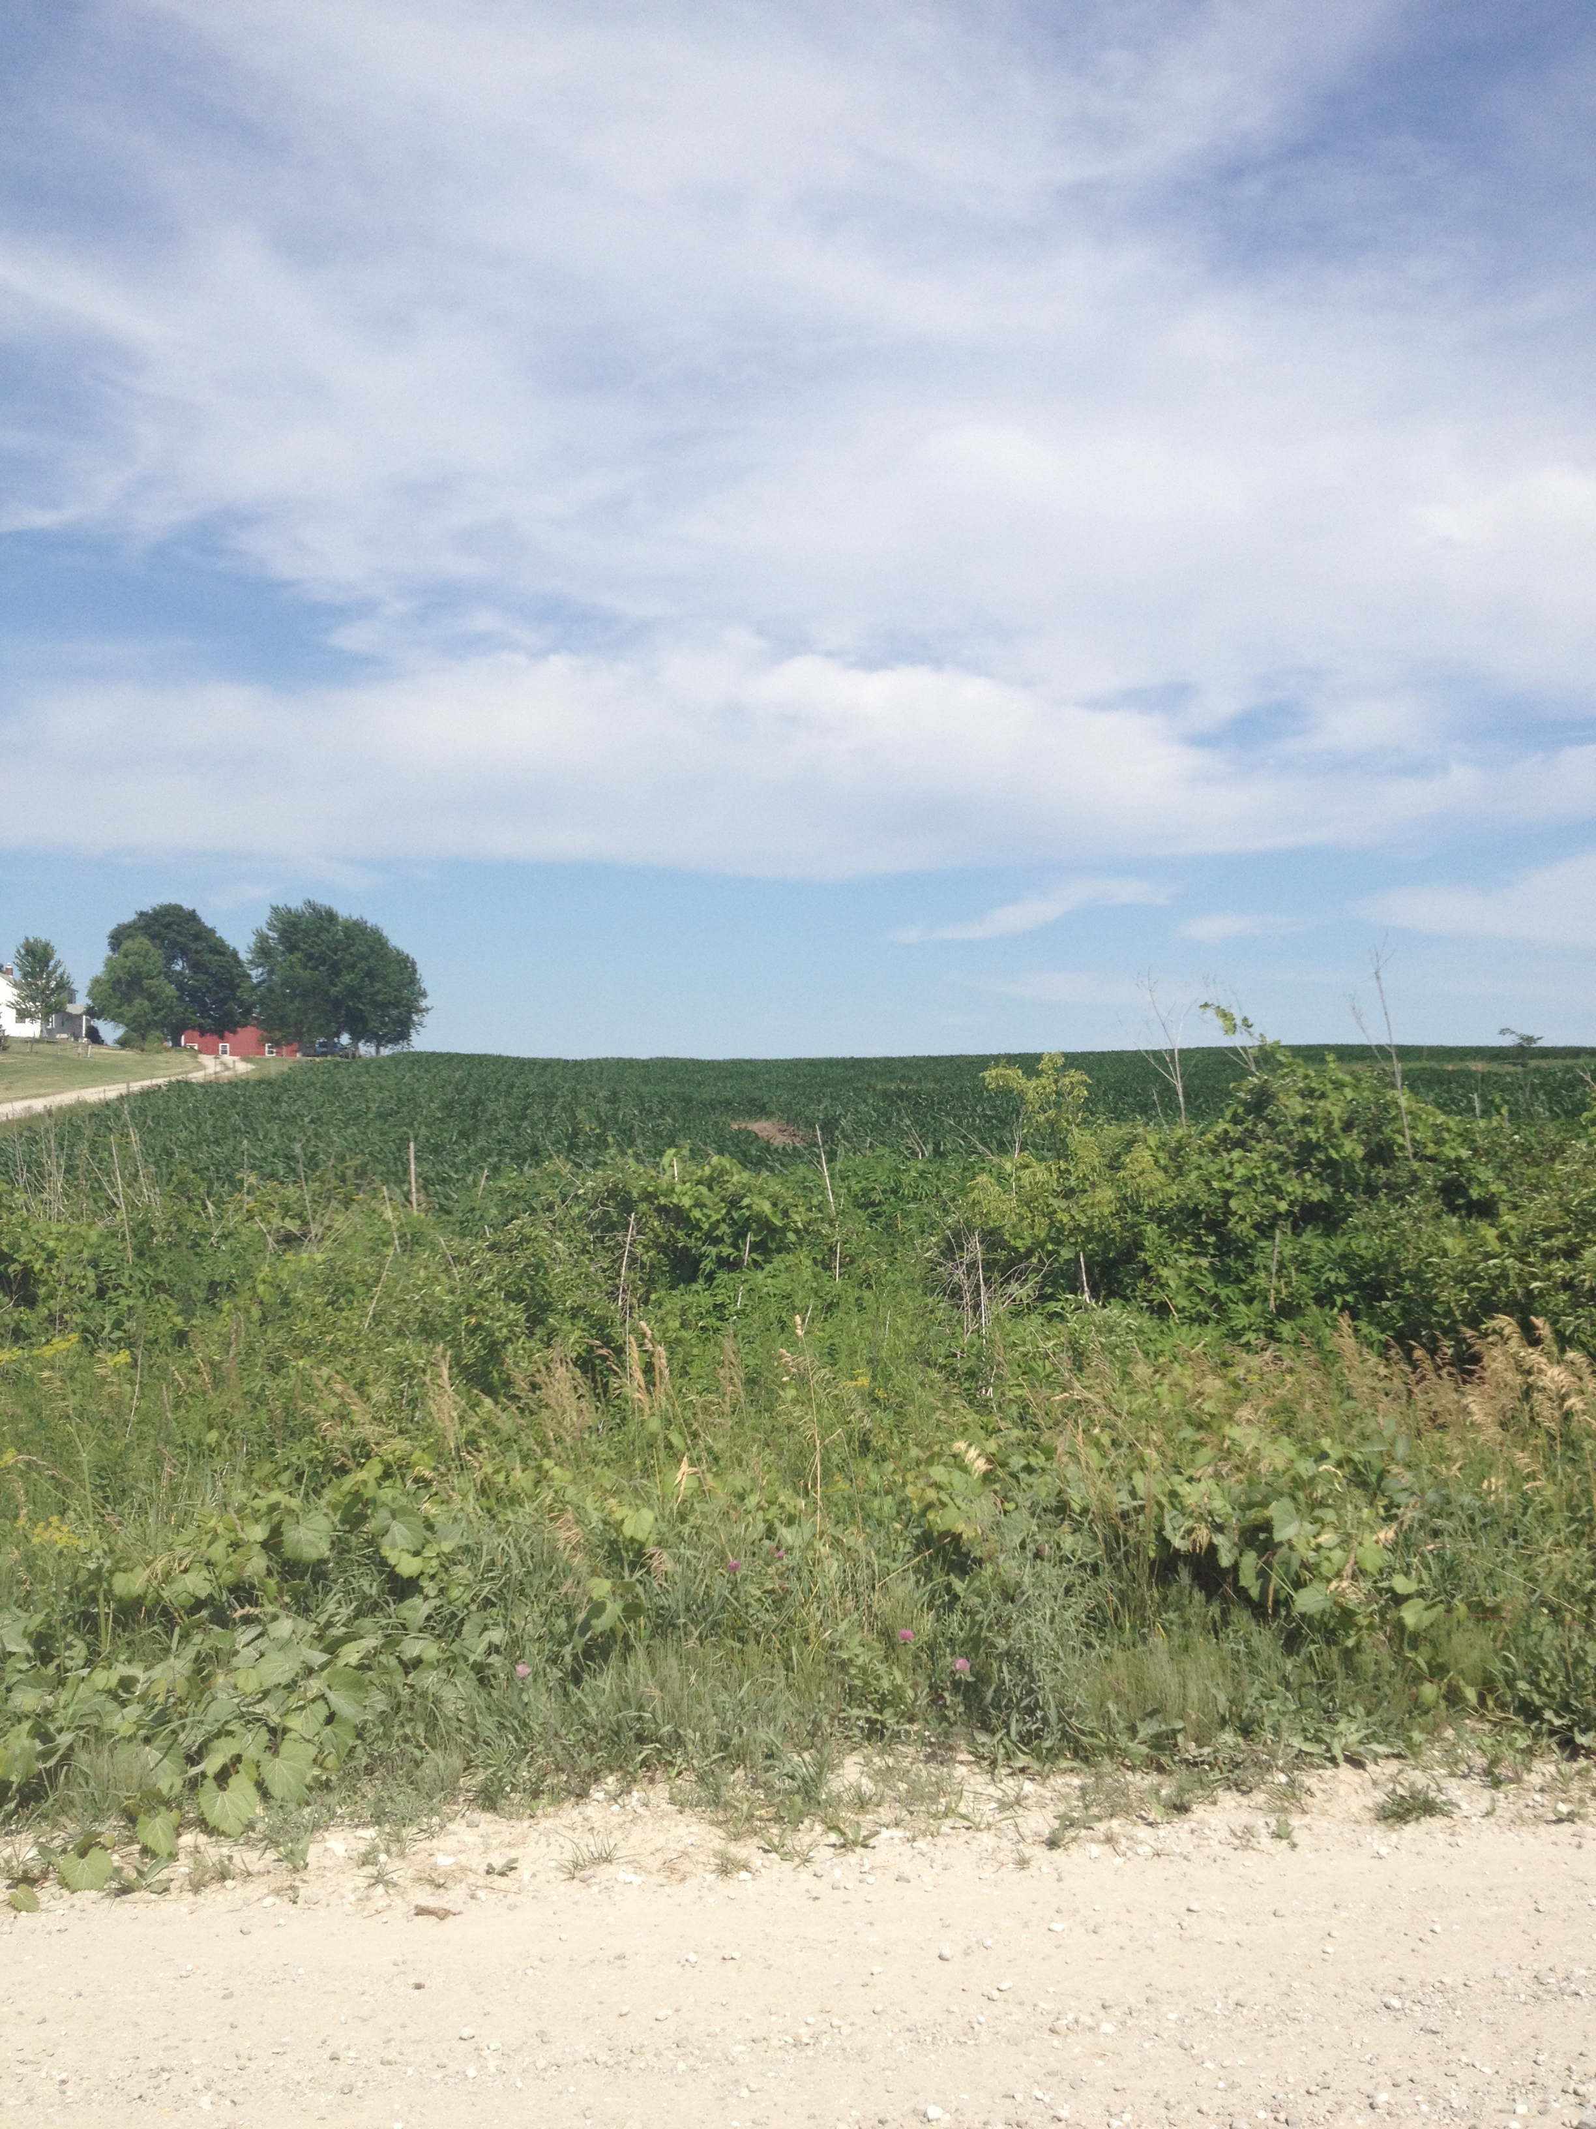
http://www.youtube.com/watch?v=nnMFe9b-VhU

Slide 18
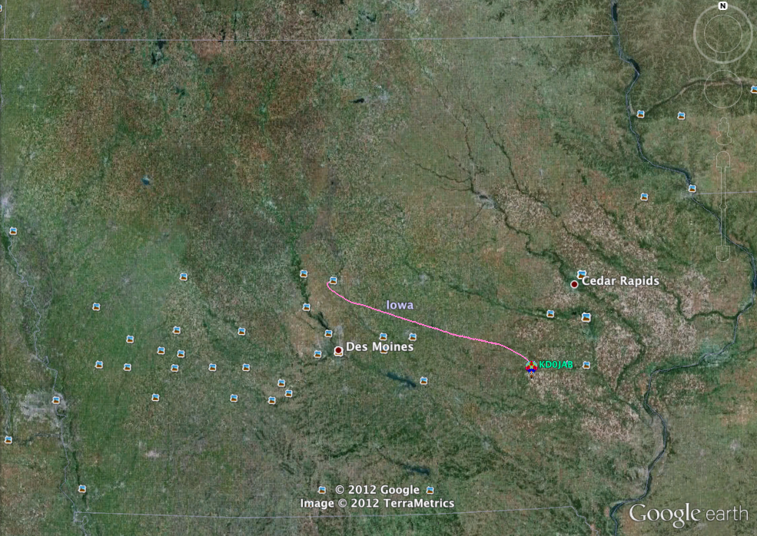
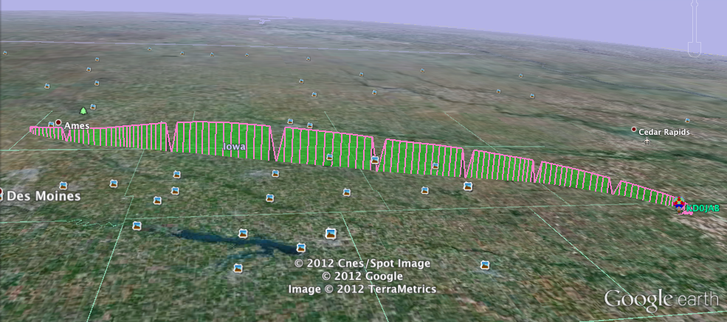
Flight Path

Slide 19
Conclusion
Zero Pressure Balloon platform shows promise as a stable Long Duration Flight platform
Much has been learned through testing and much is still to be learned.

