Slide 1
Formation of a national organization for near space activities
Matthew E. Nelson
Co-Chair

Slide 2
NNSA
Why do we need this organization?
Near Space Activities are on the rise
HAB activities in particular
We have no voice on capital hill
Although there are no reported accidents, we want to keep it that way

Slide 3
NNSA
About the name
Current we are:
National Near Space Alliance
We may change this

Slide 4
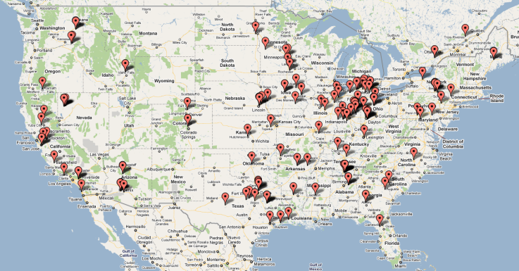
NNSA
HAB Launches in 2011

Slide 5
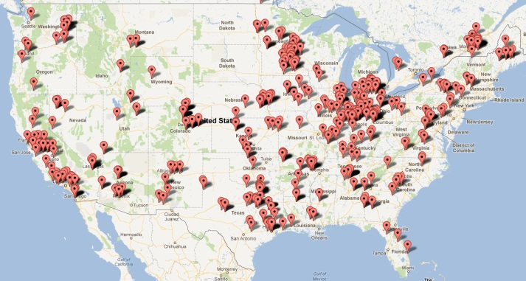
NNSA
HAB Launches in 2012

Slide 6
NNSA
@ AHAC 2011
Discussion on the formation of a new organization
Several goals were identified
Establish best practices and standards
Promote safe operation of any near space activity
Inform and Educate
Promote collaboration between members

Slide 7
NNSA
Interaction with the FAA
Unified voice
Interaction with other agencies
Space Grant
AIAA
Peer Review papers/articles

Slide 8
NNSA
Establish best practices and standards
Draw upon members experiences
Establish guidelines
Show by example

Slide 9
NNSA
Inform and Educate
STEM Activities
Promote Education
K-12
High Education
Central repository of information

Slide 10
NNSA
Promote collaboration between members
Sharing of information
Promote mentors to aid newer groups
Sharing of collected data

Slide 11
NNSA
Interaction with the FAA
Unified voice on capital hill
Input on rule changes
Strengthen HAB groups relationship

Slide 12
NNSA
Peer Review papers/articles
Plan to work with new HAB journal

Slide 13
NNSA
Where things are at
Temporary website has been setup
http://nnsa.aerodynelabs.com
Hosting provided by AeroDyne Labs
We have had dialogs with Space Grant

Slide 14
NNSA
Looking to the future
Continue building connections with other groups
Make the organization “legit”
Actively recruit members

Slide 15
NNSA
Questions!

