Slide 1

Developing an Action-Oriented Diversity, Equity, and Inclusion Roadmap
Harrison W. Inefuku and Curtis Brundy
Iowa State University Library
#ISCORE2023
Notes:
Insert session title and presenters names on this slide

Slide 2
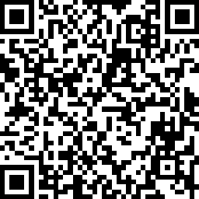
Check
In:
#ISCORE2023
Notes:
Do not edit or remove. This slide is for participants to scan and check into the conference if they haven’t done so already.

Slide 3

NCORE-ISCORE Mission
The NCORE-ISCORE Project supports Iowa State University’s diversity efforts. The project provides positive interactions and dialogue regarding race, ethnicity, and multicultural relations through local and national initiatives including participation in two conferences: NCORE (National Conference on Race & Ethnicity) and ISCORE (Iowa State Conference on Race & Ethnicity).
#ISCORE2023
Notes:
Do not edit or remove

Slide 4
Land Acknowledgement
We would like to begin this event with a land acknowledgment. Iowa State University is located on the ancestral lands and territory of the Baxoje (bah-kho-dzhe), or Ioway Nation. The United States obtained the land from the Meskwaki and Sauk nations in the Treaty of 1842. We wish to recognize our obligations to this land and to the people who took care of it, as well as to the 17,000 Native people who live in Iowa today.
#ISCORE2023
Notes:
Do not edit or remove

Slide 5

University Library
Collections and Technical Services Division
Diversity, Equity, and Inclusion Roadmap

Slide 6
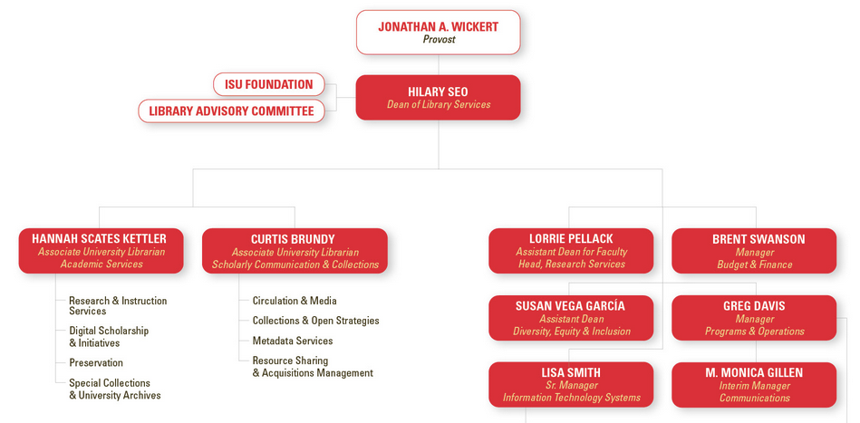
Collections and Technical Services Division

Slide 7

Why a DEI Roadmap?
What we say
What we do

Slide 8

Context
Iowa State University Strategic Plan, 2022–2031
Iowa State University Two-Year Framework, August 2019–August 2021
Iowa State University Library Statement on Diversity, Equity, and Inclusion (2018)

Slide 9

Context
Required reporting of DEI efforts in annual evaluations (2019)
Anti-racism and diversity statements released by libraries and library organizations in 2020

Slide 10

Roadmap Development
Finalize roadmap
Project Leads
Kickoff meeting
Unit Heads
Develop goals
Units
Share goals, gather feedback
Unit Heads
Refine goals
Unit Heads, Project Leads
Review roadmap draft
Unit Heads

Slide 11

Discussion Questions
What are the primary functions of your department or unit?
How does diversity, equity, and inclusion relate to your department or unit?
What diversity, equity, and inclusion initiatives are already underway?
What does a diverse, equitable, and inclusive Collections and Technical Services division look like?

Slide 12

Roadmap
Goals organized into four categories
  Collections
  Services
  Outreach
  Organization
Each goal lists responsible units and timeframe for completion

Slide 13
Example Goals
Category | Goal | Responsible Unit(s) | Timeframe
Collections | Increase acquisition of resources on topics related to diversity, equity, and inclusion, and works by and about marginalized communities | Collections and Open Strategies, Access and Acquisitions | Ongoing
Services | Provide training for Main Desk staff on assistive technologies in Parks Library. | Access Services | 1 year
Outreach | Grow relationships with diversity, equity, and inclusion-related organizations […] through intentional outreach and expanded marketing of collections and services to underrepresented and marginalized communities. | All Units | Ongoing
Organization | Support and fund function-specific professional development and training relating to diversity, equity, and inclusion | AUL for Scholarly Communication and Collections | Ongoing

Slide 14

Next Steps
Division presentation
Public release
Implementation, assessment
Periodic updates to public version

Slide 15

Acknowledgements
Unit/Department Heads
  Abbey Elder
  Matthew Goddard
  Dawn Mick
  Megan O'Donnell
  Robin Sinn
  Harriet Wintermute
Collections and Technical Services Division Staff

Slide 16

Thank you!
Questions?
Harrison W. Inefuku
hinefuku@iastate.edu
Curtis Brundy
cbrundy@iastate.edu

