Slide 1

The Effects of U.S. Tourism and Militarization in Puerto Rico
Presenters:
Confident Fandeh – NCORE ISCORE Scholar
Gracie Mutungi – NCORE ISCORE Scholar
Grace Helton – NCORE ISCORE Scholar
Rodrigo Romero – NCORE ISCORE Scholar
#ISCORE2023
Notes:
Insert session title and presenters names on this slide

Slide 2
Land Acknowledgement
We would like to begin this presentation with a land acknowledgment. Iowa State University is located on the ancestral lands and territory of the Baxoje (bah-kho-dzhe), or Ioway Nation. The United States obtained the land from the Meskwaki and Sauk nations in the Treaty of 1842. We wish to recognize our obligations to this land and to the people who took care of it, as well as to the 17,000 Native people who live in Iowa today.
#ISCORE2023
Notes:
Do not edit or remove

Slide 3
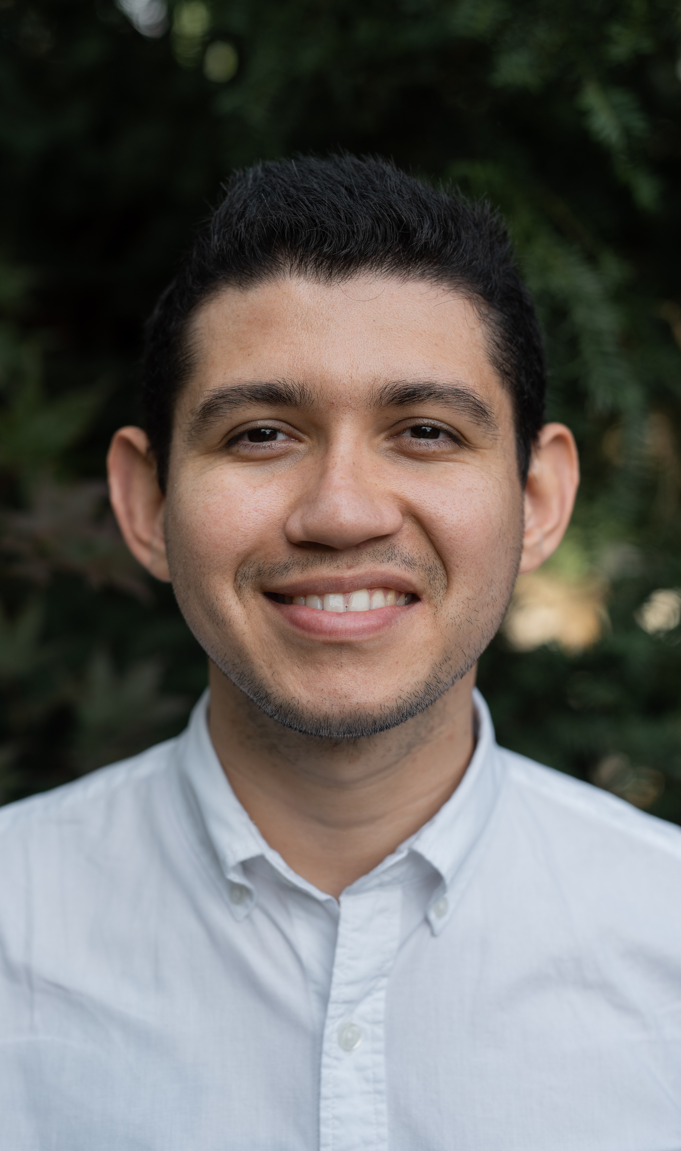



Rodrigo Romero
Senior
Electrical Engineering
Grace Helton
Junior
Global Resource Systems
Confident Fandeh
Sophomore
Architecture
Gracie Mutungi
Senior
Kinesiology and Health
#ISCORE2023
Notes:
Do not edit or remove

Slide 4




#ISCORE2023

Slide 5

Agenda
Background of Puerto Rico
Impacts due to Militarization
  Cultural
  Environmental
  Health
Impacts due to Tourism
  Environmental
  Economical
  Social
Conclusion
#ISCORE2023
Notes:
This template can be used for a majority of your content. Duplicate as necessary.

Slide 6
Research Statement
Focus on the historical involvement of United States military operations in Puerto Rico and the impacts that this matter has brought to the island as well as the impacts of tourism towards the island. The research includes the cultural, financial, environmental and social changes due to the military's strong-hold on the island due to its advantageous geo-political location. We will also dive into the long-term effects of tourism.
#ISCORE2023
Notes:
This template can be used for a majority of your content. Duplicate as necessary.

Slide 7
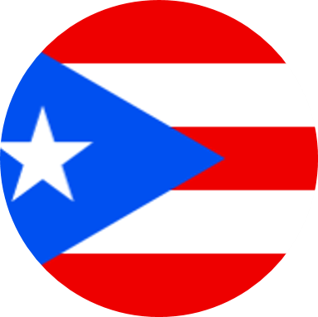
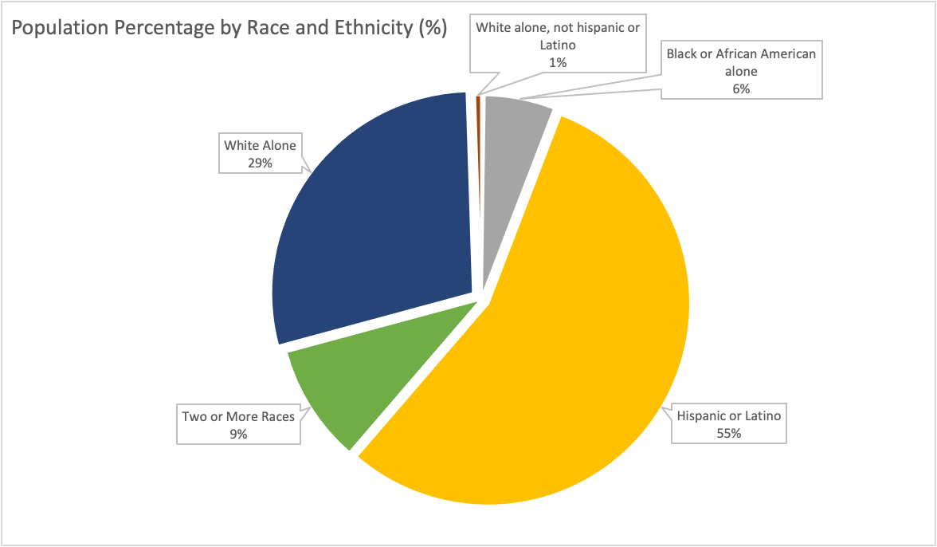
Demographics
Population: 3.2 million
#ISCORE2023
Notes:
This template can be used for a majority of your content. Duplicate as necessary.

Slide 8
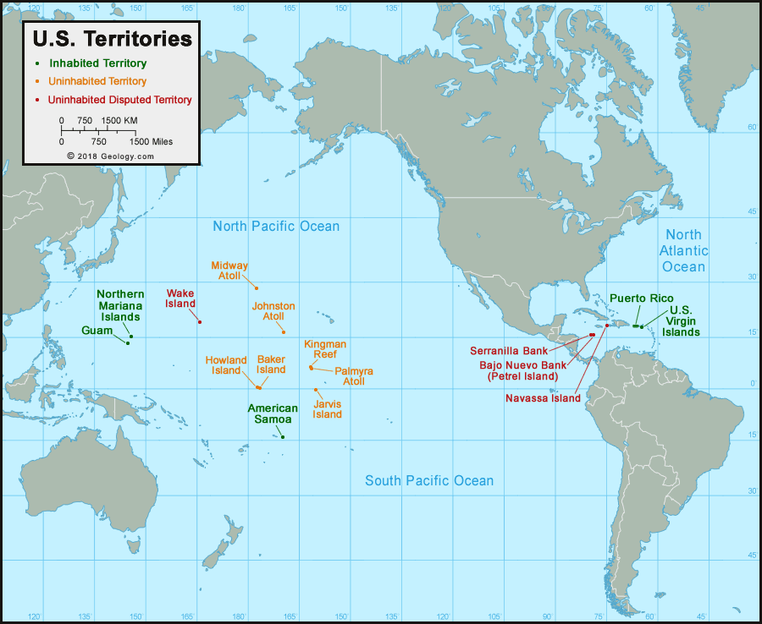
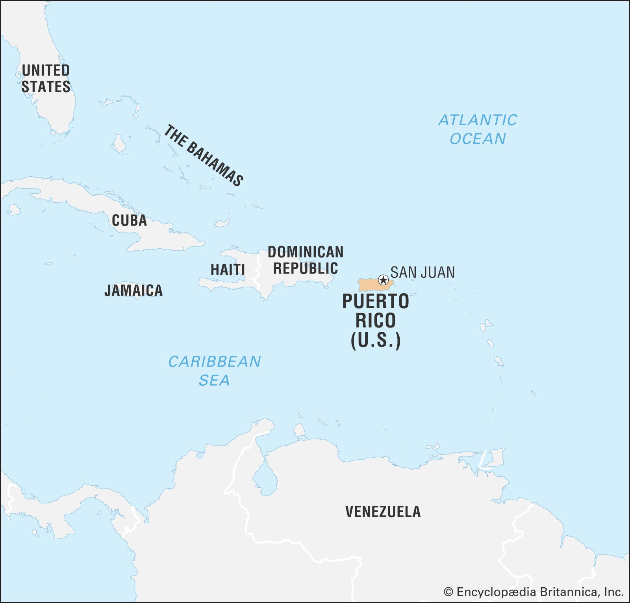
United States Territories
#ISCORE2023
Notes:
This template can be used for a majority of your content. Duplicate as necessary.

Slide 9
State vs. U.S. Territory Rights
50 States
  U.S. Citizen
  Pay all federal taxes
  Subject to all federal laws
  Full U.S. citizen with all constitutional rights
  Full voting representation in House of Representatives, Senate, and Electoral College
Territories
  U.S. Citizen
  Pay some federal taxes
  Similar government structure, but no meaningful voting representation
    Have a non-voting representative in the House of Representatives
    None in Senate, nor Electoral College
    Cannot vote in Presidential Election
#ISCORE2023
Notes:
This template can be used for a majority of your content. Duplicate as necessary.

Slide 10
Cultural Influence
Jones Act Sec. 5
First Amendment (1917)
Second Amendment (1918)
Third Amendment (1927)
Fourth Amendment (1934)
Fifth Amendment (1940)
#ISCORE2023
Notes:
This template can be used for a majority of your content. Duplicate as necessary.

Slide 11
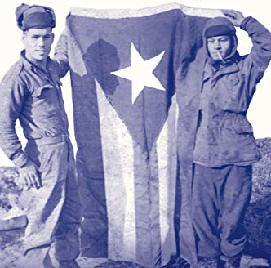
Cultural Influence
"To all Puerto Rican soldiers and veterans, whose contribution to Puerto Rican history and the American experience has been largely ignored"
Harry Franqui-Rivera
Puerto Rican soldiers serving with the 65th Infantry in Korea holding Puerto Rican flag, Fall 1952
#ISCORE2023
Notes:
This template can be used for a majority of your content. Duplicate as necessary.

Slide 12
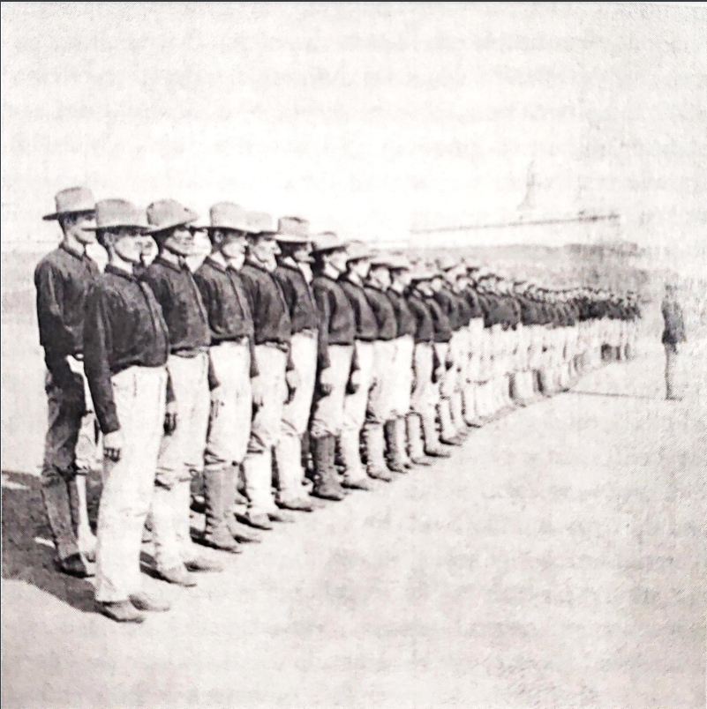
Cultural Influence
Military Involvement
DIRECT
Puerto Rican's inclusion in the armed forces in 1917 due to Selective Service Act
World War veterans residing in Puerto Rico in 1947 totaled 70,426 men and 210 women.
"Porto Ricans" in the American Colonial Army in El Morro Castle's parade field.
#ISCORE2023
Notes:
This template can be used for a majority of your content. Duplicate as necessary.

Slide 13
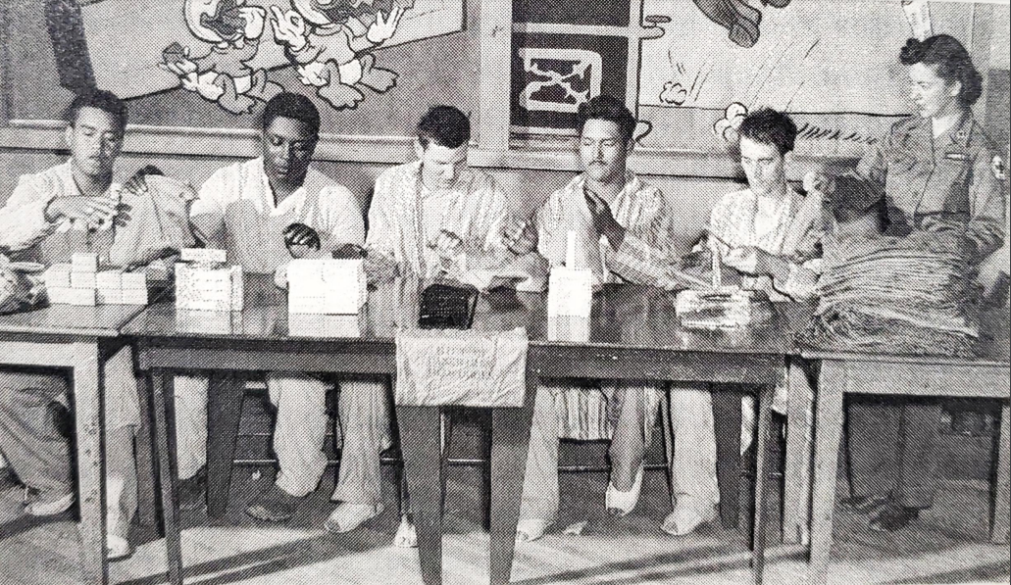
Cultural Influence
Military Involvement
DIRECT
Readjustment programs facilitated the effort to change the nature of the island's socio-economic structure.
Learning lathe work in off-duty hours are GI's of Antilles Department 1944-45. Center of Military History/Army Signal Corps
#ISCORE2023
Notes:
This was the beginning to embark the island into the industrialization, thanks to local people who knew how-to develop some tasks the communication was facilitated to include more people in the arriving industries.

Slide 14
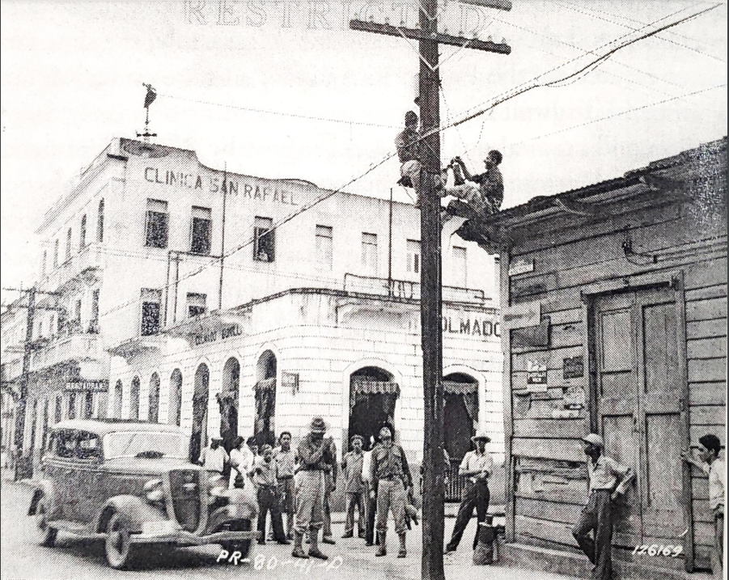
Cultural Influence
Military Involvement
INDIRECT
Non-military interactions between U.S. Army and civilians during difficulties or catastrophes.
Nov 1941: Soldiers of the 65th Infantry repair phone lines in Caguas, P.R. Center of Military History/Army Signal Corps
#ISCORE2023
Notes:
This template can be used for a majority of your content. Duplicate as necessary.

Slide 15
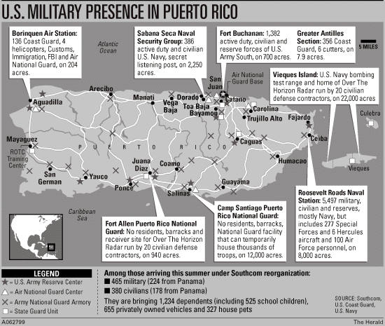
U.S. Military Bases in Puerto Rico
#ISCORE2023
Notes:
This template can be used for a majority of your content. Duplicate as necessary.

Slide 16

Vieques Before the Military
  Population: 14,000​
  Off the eastern coast of P.R.
  Small island, only 52 square miles
  Thriving sugar plantations
    Known as the 'sugar island'
    Many farms were smaller and owned by families who had farmed them for generations
  Thriving culture with many local businesses
  Main industries were fishing and tourism
    Island contained rare Caribbean plants and animals, miles of unspoiled beaches
Coat of Arms for Isla de Vieques
#ISCORE2023
Notes:
This template can be used for a majority of your content. Duplicate as necessary.

Slide 17
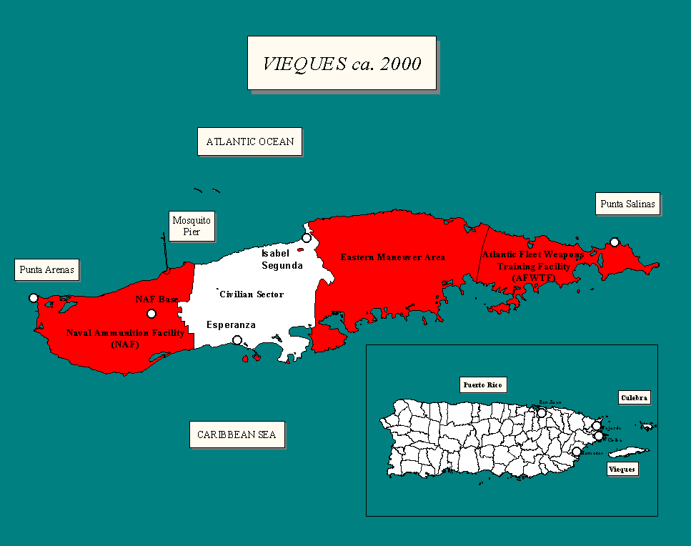
Map of U.S. Navy property, facilities and detonation fields
#ISCORE2023
Notes:
This template can be used for a majority of your content. Duplicate as necessary.

Slide 18
Timeline of Military Involvement
1940's
U.S. Military bought 60% of the land on Vieques to use as a test bombing site
1947
U.S. Navy sets up training bases, firing ranges, and ammunition storage for WWII
1999
Governor Rossello began talks with U.S. government to seek solution
2001
Governer Calderon and President Bush signed a treaty to guarantee the military's exit of the island by 2003
May 1, 2003
President Bush orders shutdown of all naval facilities
Followed by locals rejoicing and $750,000 of facilities that were turned over to the local government from the Navy
1993
A Navy jet drops 500-pound bombs off target, destroying local's homes and businesses
1994
The Vieques Land Transfer Act is created to transfer 8,000 acres of U.S. Military land for public use
April 19, 1999
500-pound bomb was dropped on a Vieques lookout, killing a Vieques local, David Sanes
2003-Present
U.S. Fish and Wildlife Service oversees former Naval bases
#ISCORE2023
Notes:
This template can be used for a majority of your content. Duplicate as necessary.

Slide 19
Forced Exit of Culture and People
  Drastic change of life from before military involvement
  3,000 Viequenses either left or were resettled by the Navy to the island of St. Croix
    Often were just given a one-day notice then their house was bulldozed
  Villages Santa Maria and Montesanto were deemed as resettlement areas
  Small landowners were paid small prices for their land
    Tenant farmers did not have recognized rights to the land, so were not paid
    Although they had lived and cultivated them for generations
  Navy used Viequenses as cheap labor to construct Naval bases
    Construction only lasted a year, so many were left without a job or land
  Seven years after the military's invasion of the island, population dropped to 9,000
#ISCORE2023
Notes:
This template can be used for a majority of your content. Duplicate as necessary.

Slide 20
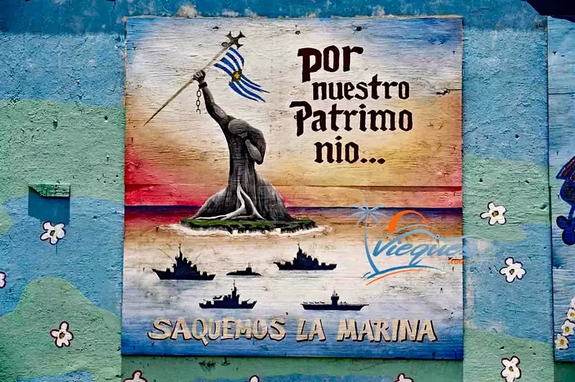
Sign on Vieques "For our heritage, let's take out the Navy"
#ISCORE2023
Notes:
This template can be used for a majority of your content. Duplicate as necessary.

Slide 21
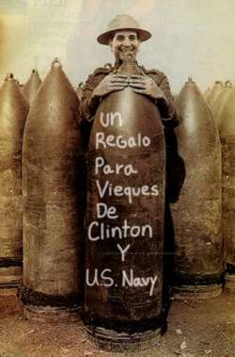
Response from the People
The 1999 Vieques Island Protests
  In response to the bomb that killed Sanes
  Most credit this year as the flame that ended up forcing the shutdown of the base
  Reengaged local activism
    Including Committee to Rescue and Develop Vieques and Crusade for the Rescue of Vieques
  Mobilized civilian protests
  Created national and international insight for what the Naval bases were doing to the island
      Lasted 4 years of non-violent protests
A Puerto Rican soldier posing in front of a bomb with writing "A present from Vieques for Clinton and the U.S. Navy"
#ISCORE2023
Notes:
This template can be used for a majority of your content. Duplicate as necessary.

Slide 22
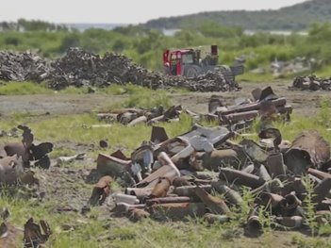
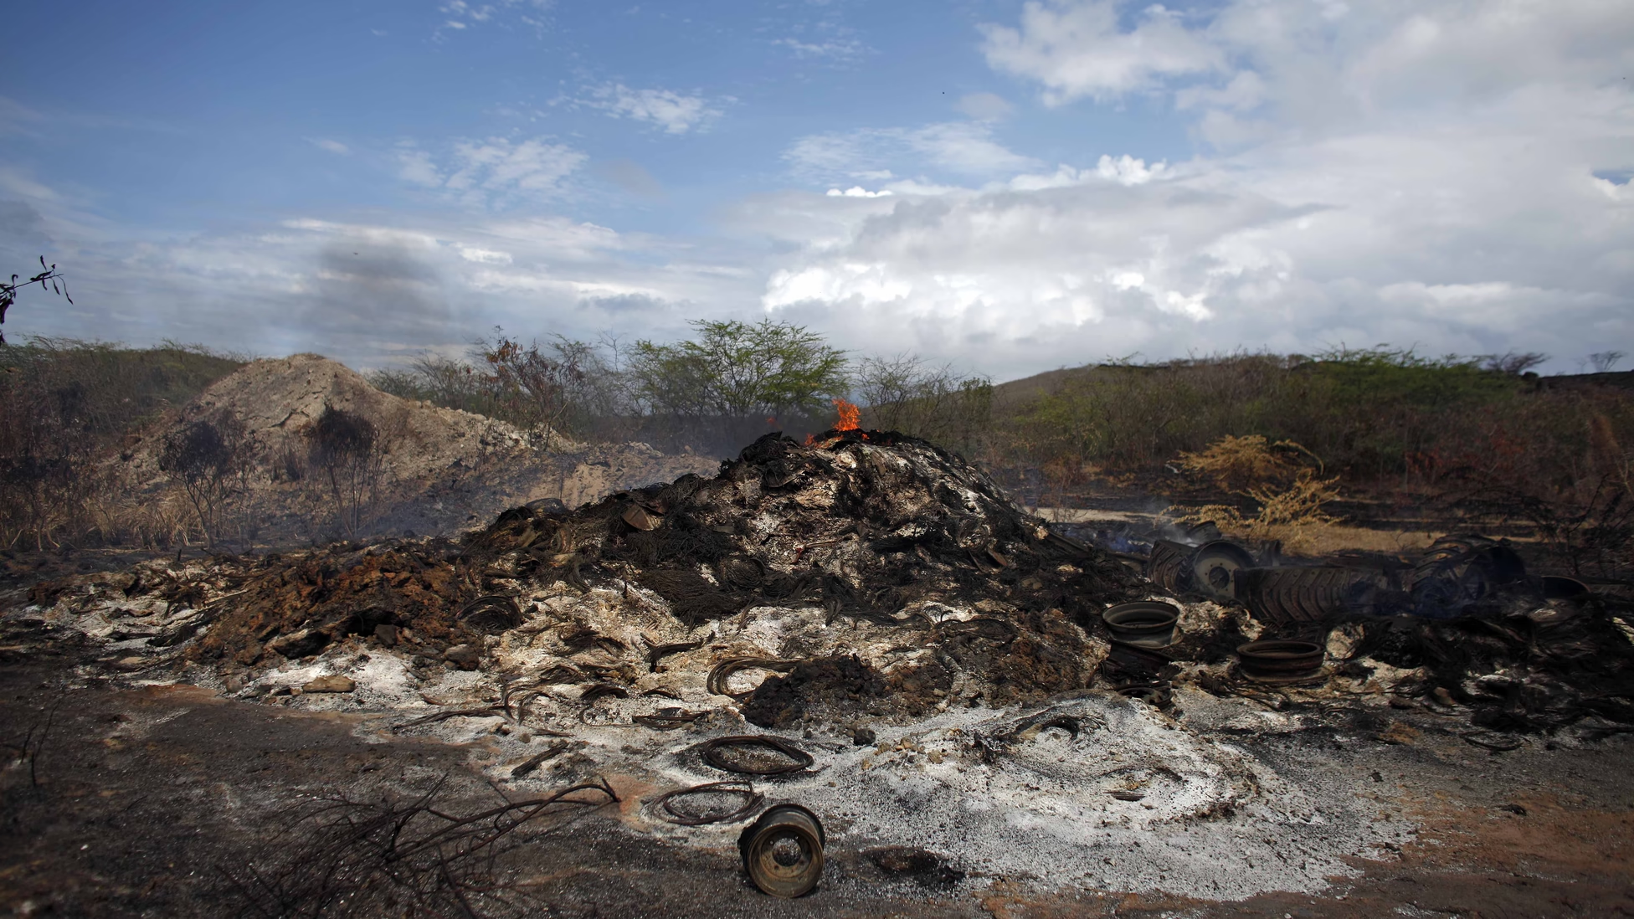
Aftermath of Military Bombing Sites
Bombing destroyed natural landscape, leaving a barren, scrub-filled wasteland with invisible toxins​
Waste that is left to this day, is openly detonated or burnt
  Often will release more contaminates such as depleted uranium, Agent Orange, napalm and heavy metals
Left over military equipment on Vieques
Burn pit
#ISCORE2023
Notes:
This template can be used for a majority of your content. Duplicate as necessary.

Slide 23
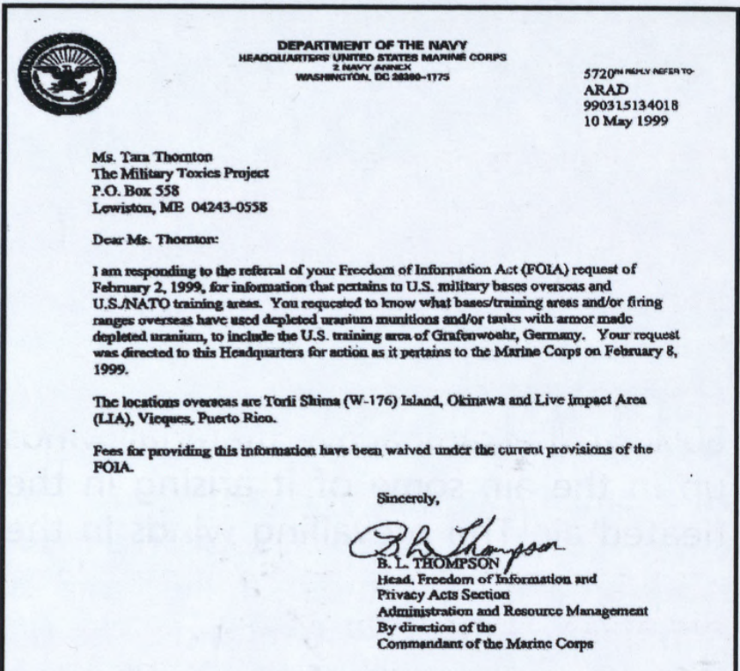
Copy of a letter stating that U.S. government knew of contaminations in 1999
#ISCORE2023
Notes:
This template can be used for a majority of your content. Duplicate as necessary.

Slide 24
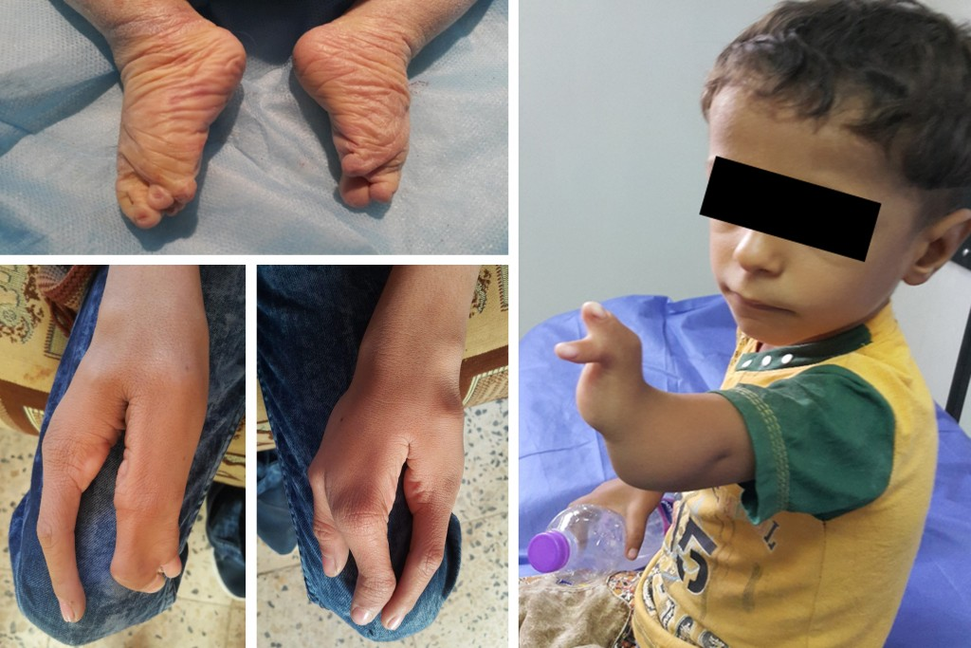
Aftermath of Health Effects
Over a third of the population is suffering from medical diseases
Depleted uranium munitions
Cancer in Vieques is 30% higher than in the main island
Cirrhosis of the liver and kidney failure 381% higher
Diabetes rates 41% higher
Lead, arsenic and mercury found in hair samples from 80% of the island's population
Water/fish contamination
Child with depleted uranium mutations
#ISCORE2023
Notes:
This template can be used for a majority of your content. Duplicate as necessary.

Slide 25
Conclusion of Military
7,000 of 9,500 Viequenses sued the U.S. government in 2005 over health problems
  Courts refused to hear the case, claiming the Navy had sovereign immunity
    This claim gives the federal government immunity from being sued
Cleanup efforts plan to continue through 2032 at an additional cost of $420 million for a total of $800 million - U.S. Government Accountability Office
A Puerto Rican soldier posing in front of a bomb with writing "A present from Vieques for Clinton and the U.S. Navy"
#ISCORE2023
Notes:
This template can be used for a majority of your content. Duplicate as necessary.

Slide 26
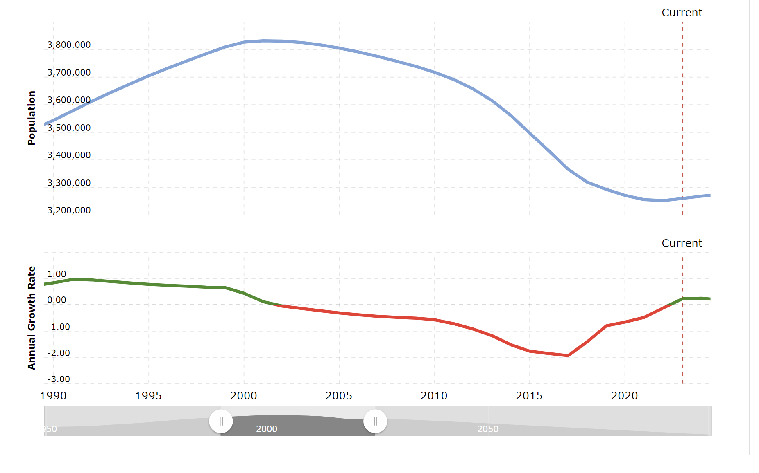
Puerto Rico Population Over the Years
1990's: Population at steady rate
2002: Population decline due to
out-migration and low birth rates
2008: Great Recession
2017: Hurricane Maria
2019 – Today: Mass increase in population due to tourism
#ISCORE2023
Notes:
This template can be used for a majority of your content. Duplicate as necessary.

Slide 27
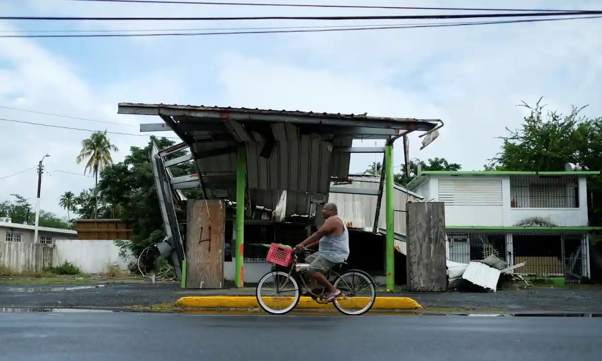
Effects of Hurricane Maria
2017: Category Four hurricane
2,900 fatalities
$90 billion in damages
Roads, hospitals, power grids, neighborhoods, schools, water systems, and other critical systems were damaged
Over 725,000 reported damages to homes
  Representing 60% of occupied housing units on the island.
Gas station damaged by Hurricane Maria
Puerto Rico has worked to make its island better over the years. However, the impact of Hurricane Maria made the nation's recovery from that more difficult.
#ISCORE2023
Notes:
This template can be used for a majority of your content. Duplicate as necessary.

Slide 28
New Construction Developments
40% of the island is under construction, due to mass tourism and the impact of Hurricane Maria.​
Tourists/investors add to the island population each year, resulting in the island population increasing.
New construction includes homes, villas, hotels, businesses, schools, etc.
#ISCORE2023
Notes:
This template can be used for a majority of your content. Duplicate as necessary.

Slide 29
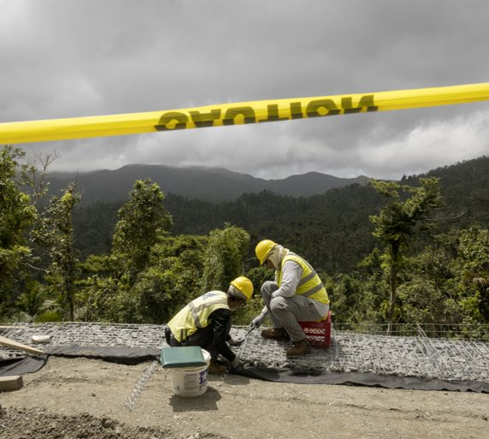
Construction Cont.
According to the government, they are merely trying to accommodate the tourism and population growth
The natural aspect of the island has suffered due to these constructions
#ISCORE2023
Notes:
For years, the government and relevant agencies have granted construction permits ignoring [their] impact on the population and nature,” says Pedro M Cardona Roig, a licensed architect, urbanist and planner known as El Urbanista

Slide 30
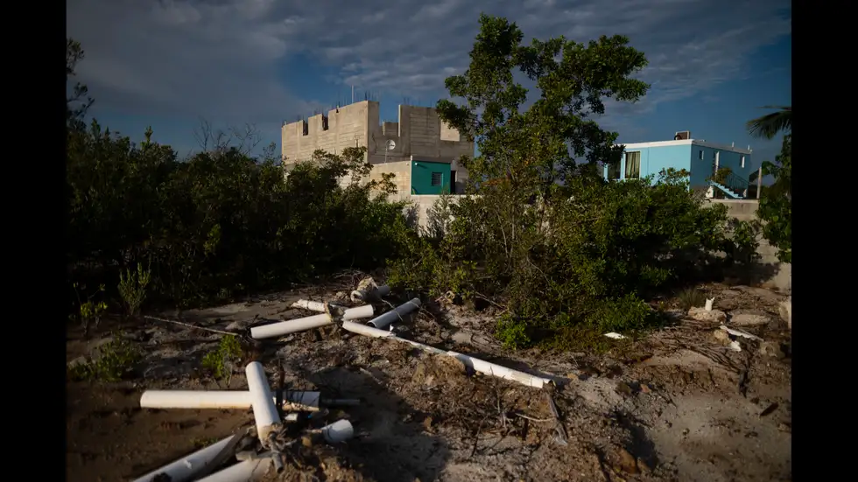
Coastline Construction
New construction leads to deforestation
Coastal lines are now becoming new construction sites resulting in
  Deforestation of trees on the coastal lines
  Destruction of Wetlands​
  Coastal Hazards ​
  Landslides ​
Coastline construction resulting in deforestation of trees on coastal lines
#ISCORE2023

Slide 31
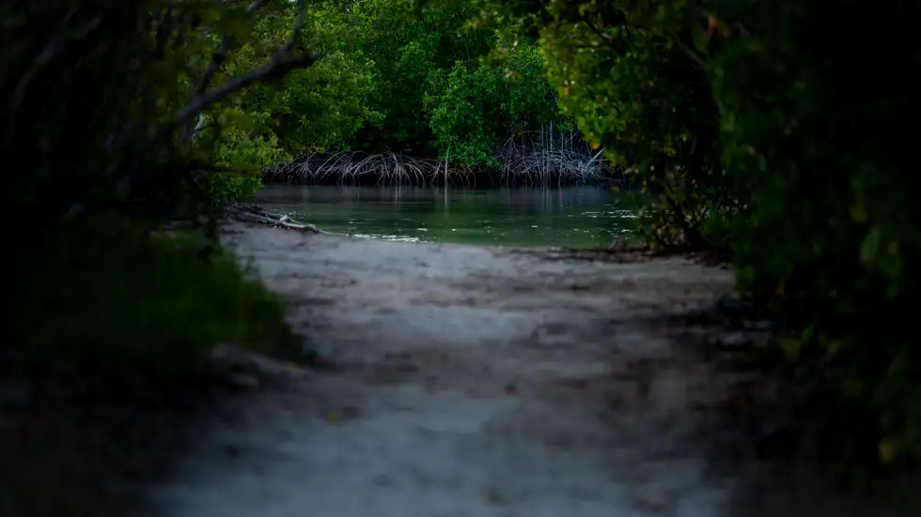
Ecological Impacts
Natural features like the beach, dunes, barriers, trees, etc., are starting to have an ecological impact on the island.
Continuous erosion and flooding are taking place.
Due to Puerto Rico's coastline's deforestation, mangrove trees have also suffered.​
Mangrove Forest
#ISCORE2023
Notes:
Mangrove forests also provides habitat and refuge to a wide array of wildlife such as birds, fish, invertebrates, mammals and plants.
Good for the ecosystem.
Puerto Rico's Justice Department has launched a criminal investigation into destruction in the ecological reserve that protects one of the island's most extensive mangrove forests.
Everything in the ecosystem is connected.

Slide 32
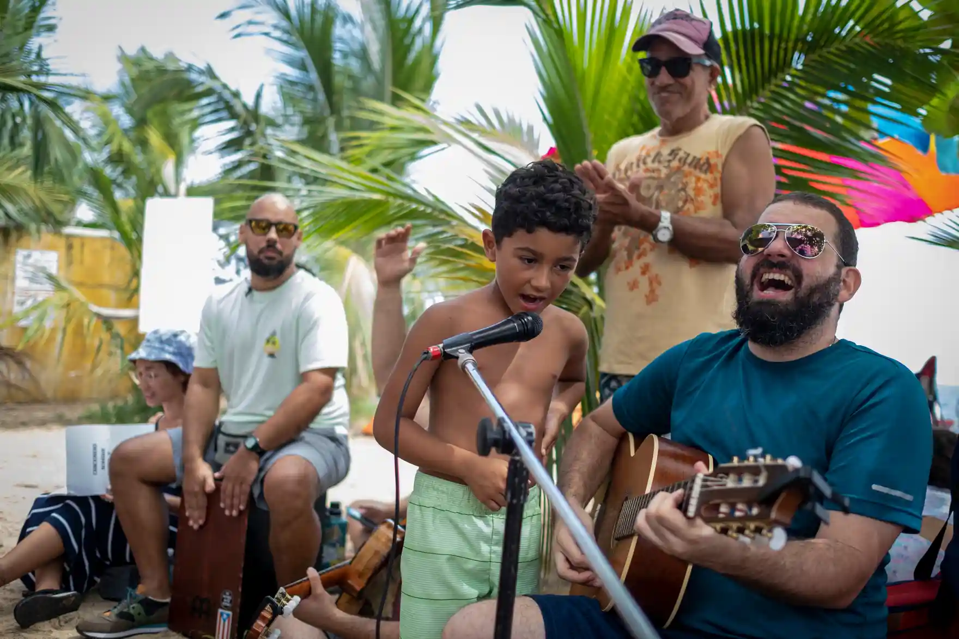
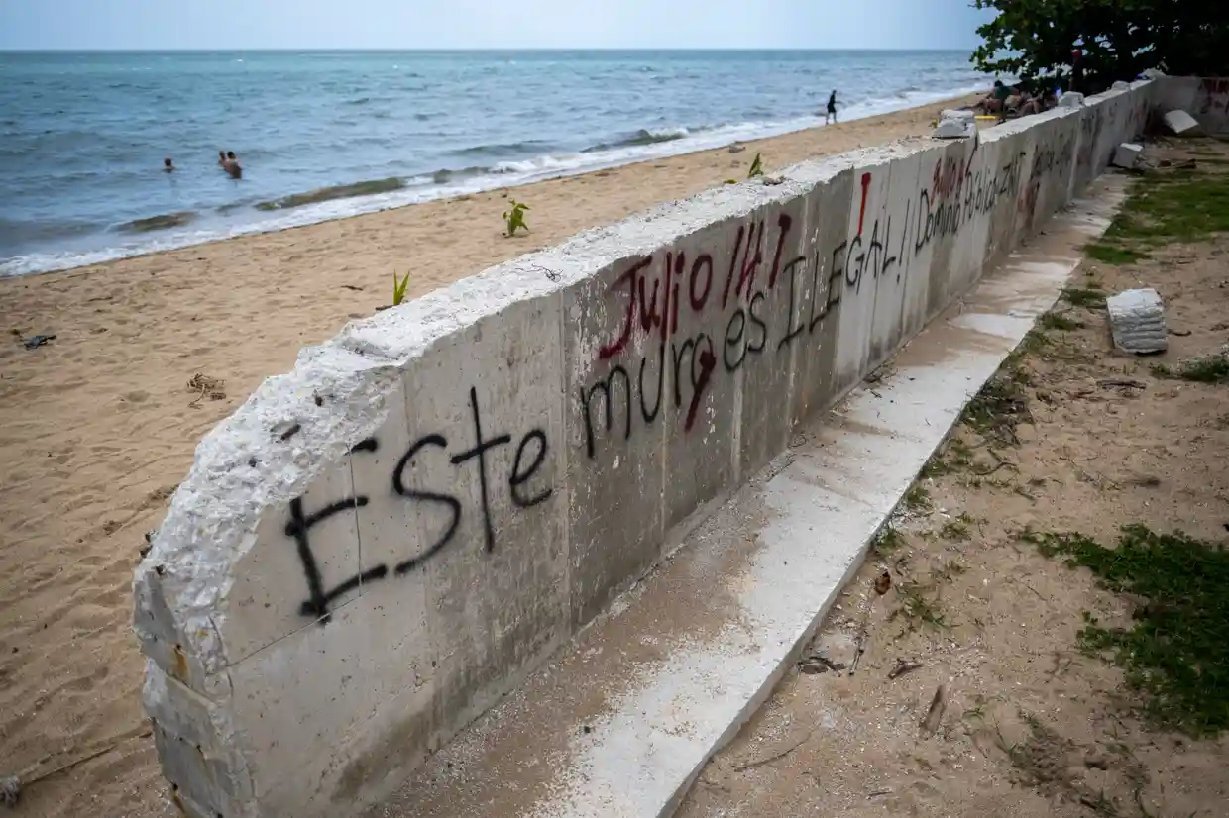
How has this affected the people of Puerto Rico?
By law, every beach in Puerto Rico must have public access.
“Party protests” in areas threatened by overdevelopment, anchored by the slogan “Las playas son del pueblo,” or “The beaches belong to the people.”
Public beaches cannot be turned into private beaches. Locals feel as if they're being pushed out of their own homes.
"Locals and climate activists battle against coastal development and privatization of public beaches as luxury condos proliferate."
Activists are still expressing their concern over the construction’s effect on the area.
People gather to sing and play music during a party protest at Los Almendros beach
Graffiti in Spanish that reads, "This wall is illegal", written on a partially destroyed wall along Los Almendros beach
#ISCORE2023
Notes:
This template can be used for a majority of your content. Duplicate as necessary.

Slide 33
Government Response to the Protest
The law is on the citizen side of Puerto Rico.
"A lower court in Puerto Rico ruled in favor of demolishing some structures this year, but the owners have repeatedly appealed the court’s decision."
Permits are still being granted by the government to start new construction on the coastal line.
The government believes they are doing what's best for the island, so they have continued to prioritize development.
"Some environmentalists say the island’s government is endangering the lives of people by greenlighting construction projects in geologically vulnerable areas."
#ISCORE2023
Notes:
This template can be used for a majority of your content. Duplicate as necessary.

Slide 34
Timeline of Government in Puerto Rico
Puerto Rico established as a US territory
Puerto Ricans gain U.S. citizenship
Triple Tax Exemption enacted on island
Operation Bootstrap begins
Transition from focus on agriculture to manufacturing
Economic boom from new companies
Tax break for companies that operated in Puerto Rico
Global recession
US Government creates PROMESA
Puerto Rico declares bankruptcy after Hurricane Maria
Act 22 enacted
1900-1925
1917
1917
Declares that lenders to Puerto Rico are exempt from taxes
Section 936 enacted
1950
1976
2007-2009
2012
Tax break for individuals creating business in Puerto Rico
2017
2016
#ISCORE2023
Notes:
This template can be used for a majority of your content. Duplicate as necessary.

Slide 35
Economic Impact
Operation Bootstrap
1950: initiation of Operation Bootstrap
Governor Muñoz Marín switched Puerto Rico's industry
  Agriculture --> Import and Export
Tax breaks for companies using Puerto Rico for manufacturing & export
$621 million produced for island
#ISCORE2023
Notes:
Decline of sugar industry
Marín's political platform was based on switching industries to eliminate sugar industry in PR
Why? Because sugar industry was limited, employed few workers, and didn't provide much revenue
450,000 PR's left island due to change in industry

Slide 36
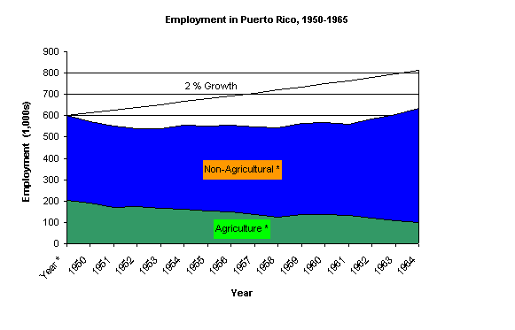
Graph of employment numbers in Puerto Rico following industry shift
#ISCORE2023
Notes:
Decline of sugar industry
Marín's political platform was based on switching industries to eliminate sugar industry in PR
Because sugar industry was limited, employed few workers, and didn't provide much revenue

Slide 37
Economic Impact
Section 936
1976: initiation of Section 936
Tax break allowed for US companies that operated in Puerto Rico
No taxes on revenue made in Puerto Rico
1996: 10-year repeal started by President Bill Clinton
Deep recession due to reliance of manufacturing and production of goods on US companies
#ISCORE2023
Notes:
caused major influx of US companies, especially wealthy ones, establishing their roots on the island.

Slide 38
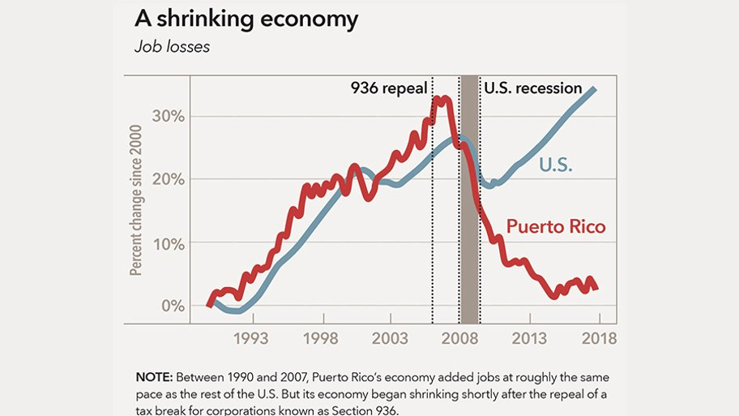
#ISCORE2023
Notes:
This template can be used for a majority of your content. Duplicate as necessary.

Slide 39

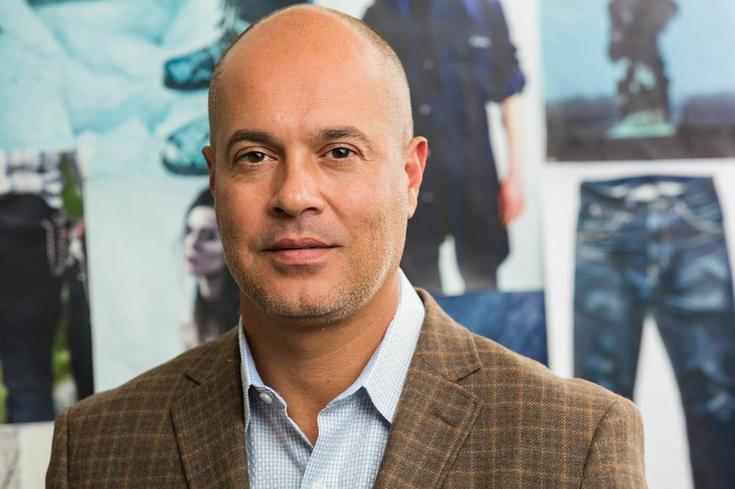
Economic Impact
Act 22 "Individual Investors Act"
2012: initiation of Act 22
Individuals who relocate to Puerto Rico are 100% exempt from taxes
  Only pay federal income taxes on money made outside of the island
Intent was to drive business and wealth to the island
Backlash for driving Puerto Ricans out
Logan Paul, influencer, net worth: $45 million
Giovanni Feroce, retired Rhode Island senator
#ISCORE2023
Notes:
Only have to pay federal income taxes on money made outside of the island

Slide 40
Economic Impact
PROMESA
2016: initiation of PROMESA
  Puerto Rico Oversight, Management, and Economic Stability Act
Allowed the US to create plan for economic repair
PROMESA board
Restructure debt payment plan
Reduce Puerto Rico’s debt from $33 billion to $7.4 billion
Reduce annual payments from $4 billion to $1 billion
#ISCORE2023
Notes:
PROMESA board: seven US government members that controlled PR's finances

Slide 41
The Connection
Tourism/Investors
Overpopulation (with other contributing factors)
New Construction Developments
Ecological/Environmental Impacts
#ISCORE2023
Notes:
This template can be used for a majority of your content. Duplicate as necessary.

Slide 42
Why should we care?
Discuss relation to ISU
Why do we care as ISU students and faculty?
What solutions do you suggest as tourists to PR or other countries?
#ISCORE2023
Notes:
This template can be used for a majority of your content. Duplicate as necessary.

Slide 43
Conclusion
The United States has always had an impact on Puerto Rico, both negatively and positively, in many areas, from the military to the economy. We, as a group, wanted to keep an open mind about the ways that all areas touched on in this presentation affect Puerto Rico. It's important to remember that just because Puerto Rico is an American territory, that doesn't mean it's okay to take advantage of the island's resources and opportunities especially without thinking about the people of that island.
#ISCORE2023
Notes:
This template can be used for a majority of your content. Duplicate as necessary.

Slide 44
#ISCORE2023
Notes:
This template can be used for backgrounds of photos during your presentation.

Slide 45
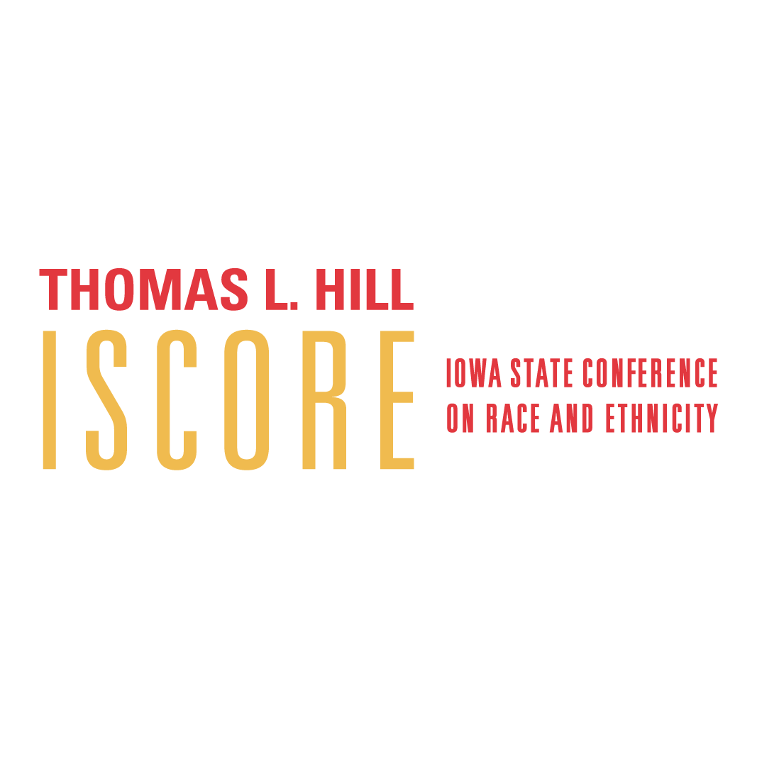

#ISCORE2023
Notes:
Insert session title and presenters names on this slide

