Slide 1

The Decision to go to Graduate School:
McNair Scholars’ Research and Preparation for Continuing Education Beyond the Bachelor’s
Dr. Ashley Garrin (she/her), Director​
Erin Todey (she/her), Assistant Director​
Regine Peters (she/her), Program Specialist​
2022-2023 First Year McNair Scholars
#ISCORE2023

Slide 2
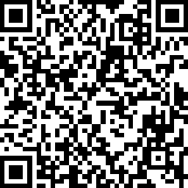
Check
In:
#ISCORE2023
Notes:
Do not edit or remove. This slide is for participants to scan and check into the conference if they haven’t done so already.

Slide 3

NCORE-ISCORE Mission
The NCORE-ISCORE Project supports Iowa State University’s diversity efforts. The project provides positive interactions and dialogue regarding race, ethnicity, and multicultural relations through local and national initiatives including participation in two conferences: NCORE (National Conference on Race & Ethnicity) and ISCORE (Iowa State Conference on Race & Ethnicity).
#ISCORE2023
Notes:
Do not edit or remove

Slide 4
Land Acknowledgement
We would like to begin this event with a land acknowledgment. Iowa State University is located on the ancestral lands and territory of the Baxoje (bah-kho-dzhe), or Ioway Nation. The United States obtained the land from the Meskwaki and Sauk nations in the Treaty of 1842. We wish to recognize our obligations to this land and to the people who took care of it, as well as to the 17,000 Native people who live in Iowa today.
#ISCORE2023
Notes:
Do not edit or remove

Slide 5
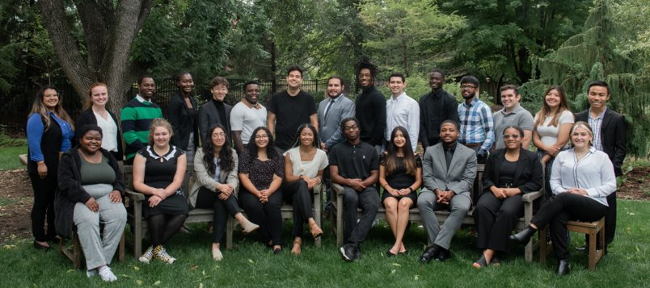
McNair Scholars Program
Notes:
The Ronald E. McNair Postbaccalaureate Achievement Program is a federally-funded TRIO program which prepares qualified undergraduates for graduate school entry, with the primary goal of increasing the attainment of a Ph.D.
McNair supports graduate school-bound Scholars by focusing on three areas: academic research, graduate school preparation, and personal and professional development. Today's presentation will highlight the research our scholars completed in Fall 2022, each of which explores the central theme of the decision to pursue a graduate degree. ​

Slide 6

What about you?
​
What motivated/is motivating you to pursue a graduate degree? ​
What barriers (if any) have you experienced in considering whether or not to pursue a graduate degree? ​
#ISCORE2023
Notes:
Who's in the room? Undergraduate students? Graduate students? Staff? Faculty? Who has a graduate degree? Is anyone in the process of applying for a graduate degree?

Slide 7
The Impact of Socio-Cultural Factors on the Decision to Attend Graduate School
Sokhna Khadija Mbacke
Jimena Mendoza
Kaleb Nichols
Blake Van Der Kamp
#ISCORE2023

Slide 8
Introduction
The pursuit of an advanced degree is often influenced by social or cultural factors (Tate et al., 2015).
To investigate the most influential socio-cultural factors (traditions, family influences, and finances) that impact individuals' decision to go to graduate school.
Do socio-cultural factors impact the decision to go to graduate school?
#ISCORE2023
Notes:
As McNair’s scholars, we are on the path of pursuing grad school and are exposed to information about research and academia in general, so it is natural to think about other people’s decisions to go to graduate school. We care because it is always helpful to have more individuals contribute to research development and fill potential research gaps.
Publication from the U.S Census bureau
Influential factors related to an individual’s graduate school attendance decision include marital status, parental education/ family status, availability of financial resources, pre college aspirations, and national culture (Abdulmohsen & Abdulmohsen, 2020). However, the strength and intersection of these motivators have differed while academic research publications have grown and become increasingly complex (Payne, 2006).
Success rate referring to financial readiness and access to education?

Slide 9
Methods
Graduate students and faculty mentors from Iowa State University (n=10)
Participants were interviewed
Responses and quotes from interview were analyzed
#ISCORE2023
Notes:
The interview questions featured six demographics regarding first-generation collegiate status, socioeconomic status, number of parents within the household, residential classification, racial and ethnic identification, and gender identity.
The other nine open-ended questions requested information about one’s educational path, financial situation, cultural background, racial identity, gender, and family structure.
Participants were also asked explicitly about their decision to attend graduate school and experiences that led to their sense of preparation or lack thereof.

Slide 10
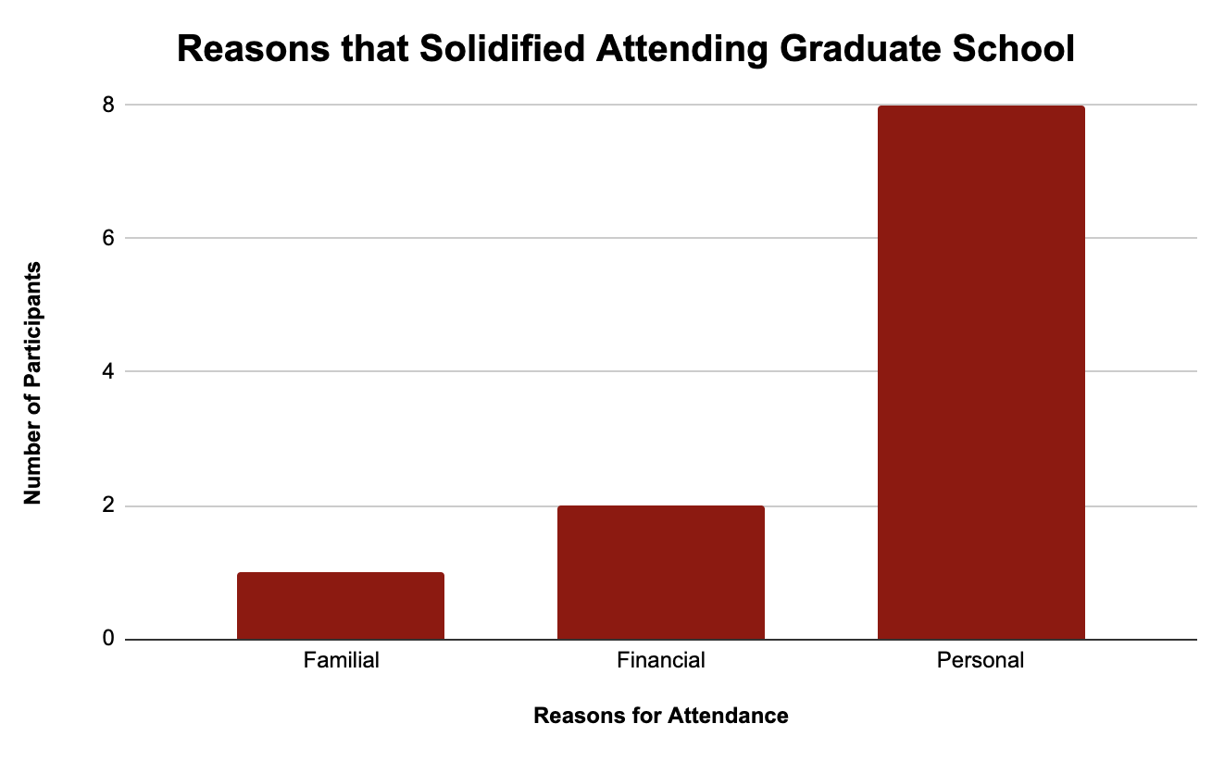
Results and Discussion
What solidified your decision to pursuit graduate school?
Interviews showed deep connections between these results.
#ISCORE2023
Notes:
This graph shows the results the different answers to this specific question. The majority of our participants expressed personal factors ranging from cultural factors, family influence, personal beliefs, or a combination of those factors. Due to the personal factors overlapping with others, our responses added up to a total of 11 as one participant expressed that both financial and personal factors influenced their decision to pursue graduate school.

Slide 11
Participant Quotes
Followed family traditions
“It was very helpful coming from a culture that highly values education.”
“Everybody on my dad’s side went to college, but no one on my mom’s side did. I will be the first person to get a PhD. in my entire family. This is what keeps me going.”
Followed beliefs
"As a Black woman it is critical to have and take care of others."
"Remember the 'Why'. The literature only knows so much"
#ISCORE2023

Slide 12
Conclusion
Personal reasons, family support, and financial are factors contributing to an individual’s desire to pursue higher education.
Future research should look more into the effects of personal experiences of undergraduate students that may influence their aspirations to attend graduate school.
#ISCORE2023
Notes:
From this collected data, it was supported that regardless of racial identity, personal reasons, family support and financial factors contributed to an individual decision to pursue graduate school. However, the majority of participants expressed personal reason that often overlaps between family and social factors. These findings leaded us to another research question: “How does the overall perception of educational experiences influence undergraduate students' decisions to attend graduate school?”

Slide 13
Investigating the Contrast Between STEM and Non-STEM Undergraduate Discipline's Influence on the Decision to Attend Graduate School
Axl Escarcega
Flora Kafunda
Daisy Hernandez
Nathan Niyen
#ISCORE2023
Notes:
Insert session title and presenters names on this slide

Slide 14
Introduction
STEM degrees vs. non-STEM degrees
  Undergraduate disciplines (Carter, Mandell, & Maton, 2009; Haeger & Fresquez, 2016)
#ISCORE2023

Slide 15
Purpose
Investigate factors influencing the decision to attend graduate school, focusing on the contrasts between STEM and non-STEM majors.
Are there any differences in the factors that influence the decision to attend graduate school between STEM and non-STEM undergraduate disciplines?
#ISCORE2023
Notes:
Previous literature reviewed in this study suggests that students with undergraduate degrees in STEM fields are more likely to pursue graduate studies than those with non-STEM degrees. STEM students may be motivated by the requirement for advanced degrees in their chosen field, as well as an interest in academic research or teaching. Non-STEM students may be deterred by the lack of clear career benefits or interest in academic research, as well as the cost and time commitment of graduate school. However, previous research has not explored potential differences in graduate school attendance between STEM and non-STEM fields within specific industries or job sectors, nor has it considered individual experiences and perspectives in the decision-making process.

Slide 16
Methods
Participants:
Randomly chose 8 participants from a pool of 16, 4 faculty, 4 graduate mentors
Methodology:
Structured interview
Analysis:
Identified motivations such as research, internships, mentorship, and finances
Themes:
direct vs indirect impact
#ISCORE2023

Slide 17
Results
Question: How well prepared did you feel for graduate school and what influenced your feelings of preparedness?
#ISCORE2023
Notes:
A non-STEM participant claimed that they did not have prior knowledge for the graduate program they wanted to pursue.

Slide 18
Discussion
There are more opportunities within STEM disciplines.
Our research demonstrates that there was a lack of resources within non-STEM majors in relation to graduate school which may strongly influence the pursuit towards higher education.
#ISCORE2023

Slide 19
Conclusion
Overall finding: Lack of resources
Future direction
  Looking into the why
  Ways to combat this
#ISCORE2023

Slide 20
Influence of Major on the Pursuit of Graduate Studies
Dela Houssou
Joshua Ylonen
Dulce Resendiz
#ISCORE2023

Slide 21
Introduction
Social and academic factors strongly influence graduate school aspirations (Shellhouse, Spratley, & Suarez, 2020).
Similarities between one’s undergraduate and graduate school pursuit (Mullen, Goyette, & Soares, 2003).
#ISCORE2023

Slide 22
Research Question
  The purpose of this study was to better understand how specific majors influence students to pursue graduate school.
  How do specific majors influence undergraduates’ pursuit of graduate school?
#ISCORE2023

Slide 23
Methods
Participants
Six graduate mentors and six faculty mentors through The Mcnair Program
Methods
In-person/online interviews
Analysis
Analyzed commonalities across interviews regarding major and faculty along with emerging themes
Nine interview questions
#ISCORE2023
Notes:
9 interview questions:
Influence from professors
Impact of race/ethnicity and culture
Path to graduate school
Influence of finances

Slide 24
Results
Life Sciences: 3
Engineering: 2
Social Sciences: 2
Mathematics: 1
83.3% of faculty mentors and 75% of graduate mentors said the major had an impact on their decision to pursue graduate studies.
#ISCORE2023
Notes:
These are the disciplines that our participants (grad and faculty mentors) come from.

Slide 25
Results
Undergraduate research
Relationships with faculty
Encouragement from faculty
The research also found other factors
  Student involvement
  Family support
  Better pay
  Availability of funding
#ISCORE2023
Notes:
This template can be used for a majority of your content. Duplicate as necessary.

Slide 26
Discussion
Major had an impact on the choice to pursue graduate degrees.
The results were consistent with previous research (Estrada et al., 2011; Monarrez, 2022).
#ISCORE2023
Notes:
This template can be used for a majority of your content. Duplicate as necessary.

Slide 27
Future Research
Investigate other factors that influence the pursuit of graduate studies:
  Financial resources
  Family support
  Potential increase in future pay
#ISCORE2023
Notes:
This template can be used for a majority of your content. Duplicate as necessary.

Slide 28
Understanding the Effects of Family Influence on the Pursuit of and Ultimate Success in Grad School
Rodrigo Romero
Tayah Lande
Pape Ndao
Tayana Roark
#ISCORE2023
Notes:
Insert session title and presenters names on this slide

Slide 29
Introduction
Higher education can offer
  greater occupational and financial stability
  increased socioeconomic mobility
  mental and physical wellness
  attainment of life goals
Marginalized communities generally suffer from
  discrimination
  low income
  lower education rates
The purpose of our study was to explore the specific influences that family background has on the decision to pursue grad school.
#ISCORE2023
Notes:
, all factors that act as barriers to the pursuit of higher education and subsequent employment and financial stability.

Slide 30
Methods
Participants
N = 17
Data Collection
Protocol
Graduate/Faculty Mentors
Interviews
Analysis
Results from Interview Questions
#ISCORE2023
Notes:
Participants
Participants were very diverse
First generation, underrepresented, and international participants
Demographics: Economic status, social environment, family situation, ethnicity, and gender
Data Collection
In-Person Interviews, questions sent out before hand, recorded on any type of recording device

Slide 31
Methods
#ISCORE2023
Notes:
Participants
Participants were very diverse
First generation, underrepresented, and international participants
Demographics: Economic status, family situation, ethnicity, and gender
Data Collection
In-Person Interviews, questions sent out before hand, recorded on any type of recording device

Slide 32
Methods
Participants
N = 17
Data Collection
Protocol
Graduate/Faculty Mentors
Interviews
Analysis
Results from Interview Questions
    Interview questions used for analysis:
      What helped solidify your decision to go to graduate school?
      How would you describe the importance of your cultural background, and what impact has it had on your decision to attend graduate school?
      Could you describe the role your family played in your applying/attending graduate school?
#ISCORE2023
Notes:
Participants
Participants were very diverse
First generation, underrepresented, and international participants
Demographics: Economic status, social environment, family situation, ethnicity, and gender
Data Collection
In-Person Interviews, questions sent out before hand, recorded on any type of recording device

Slide 33
Results
First-generation students
Pursue grad school b/c of personal goals
Difficulty finding mentorship & understanding application process
Receive familial support
Non-first generation students
Pursue grad school b/c of parental influence
See their cultural background as helping with applying and attending
Receive financial and motivational support from family
#ISCORE2023
Notes:
Less text and add some visuals, on the other hand this is a nice slide bc we had transitions, what kind of parental influence expand or add quotes

Slide 34
Discussion
Our results show many consistencies with previous research (Haney, 2015; Kricorian et al., 2020)
First-generation students worked towards personal goals
Non-first-generation students were influenced by family influences
Limited by the interviewees we had access to
Potential to be used as a motivation to create more resources for low-income, first-generation students and their families
#ISCORE2023

Slide 35
Thank you!​
​
We welcome your questions.​
#ISCORE2023

Slide 36
References
Estrada, M., Woodcock, A., Hernandez, P. R., & Schultz, P. (2011). Toward a model of social influence that explains minority student integration into the scientific community. Journal of Educational Psychology, 103(1), 206.
Haney, T. J. (2015). Factory to faculty: Socioeconomic difference and the educational experiences of university professors. Canadian Review of Sociology/Revue Canadienne De Sociologie, 52(2), 160–186.
Katherine Kricorian, Michelle Seu, Daniel Lopez, Elsie Ureta and Ozlem Equils (2020). Factors influencing participation of underrepresented students in STEM fields: matched mentors and mindsets. Kricorian et al. International Journal of STEM Education.
Monarrez, A., Frederick, A., Morales, D. X., Echegoyen, L. E., &amp; Wagler, A. (2022). Hispanic/Latinx STEM majors applying to graduate school: The role of family, peers, and undergraduate research programs in facilitating community cultural wealth. Journal of Latinos and Education, 1–15.
Tate, K. A., Fouad, N. A., Marks, L. R., Young, G., Guzman, E., & Williams, E. G. (2015). Underrepresented First-Generation, Low-Income College Students’ Pursuit of a Graduate Education: Investigating the Influence of Self-Efficacy, Coping Efficacy, and Family Influence. Journal of Career Assessment, 23(3), 427–441. https://doi.org/10.1177/1069072714547498
#ISCORE2023

