Slide 1

The Hazardous Climate of Environmental Racism
Brittney Cuevas
Aza Davis-Picou
Kaleb Nichols
#ISCORE2023
Notes:
Insert session title and presenters names on this slide

Slide 2
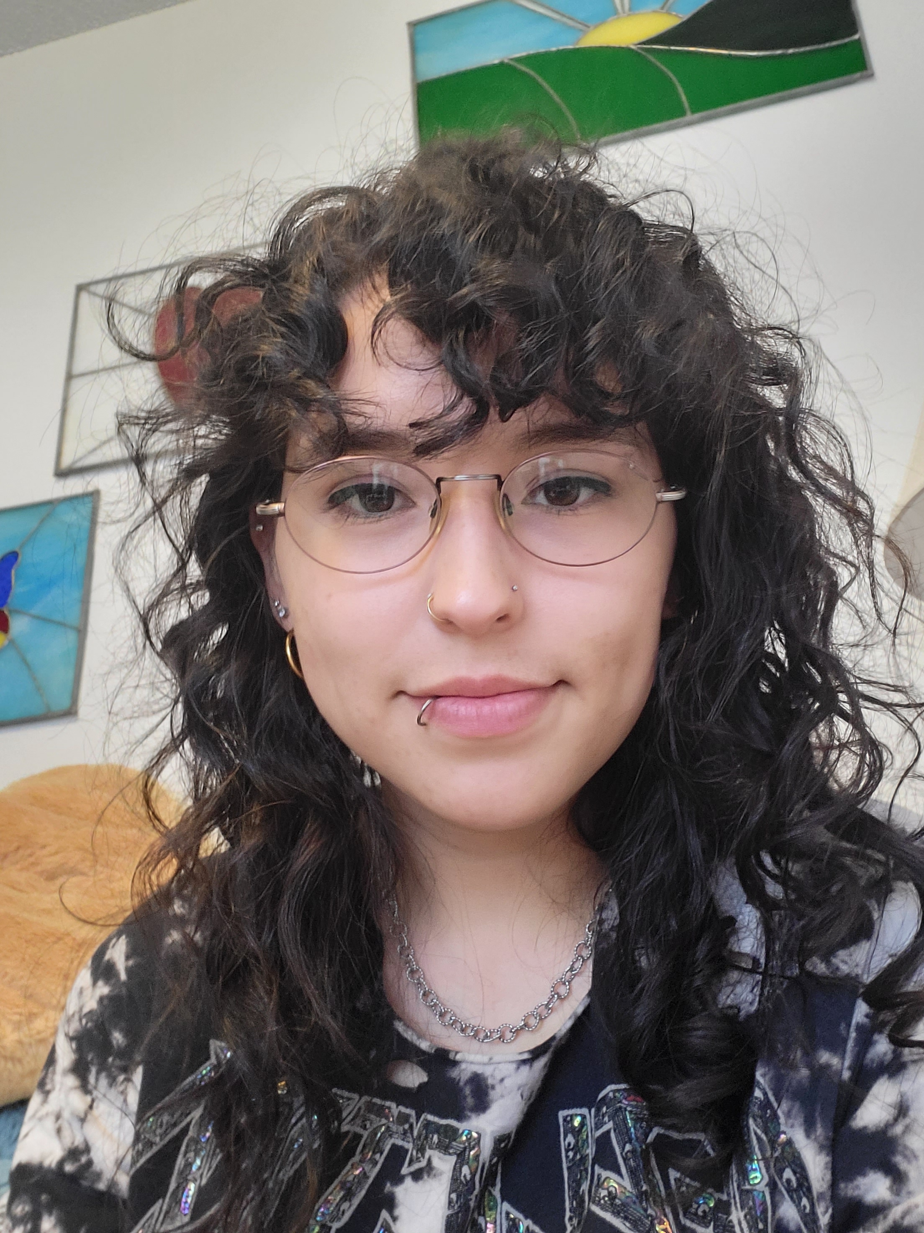
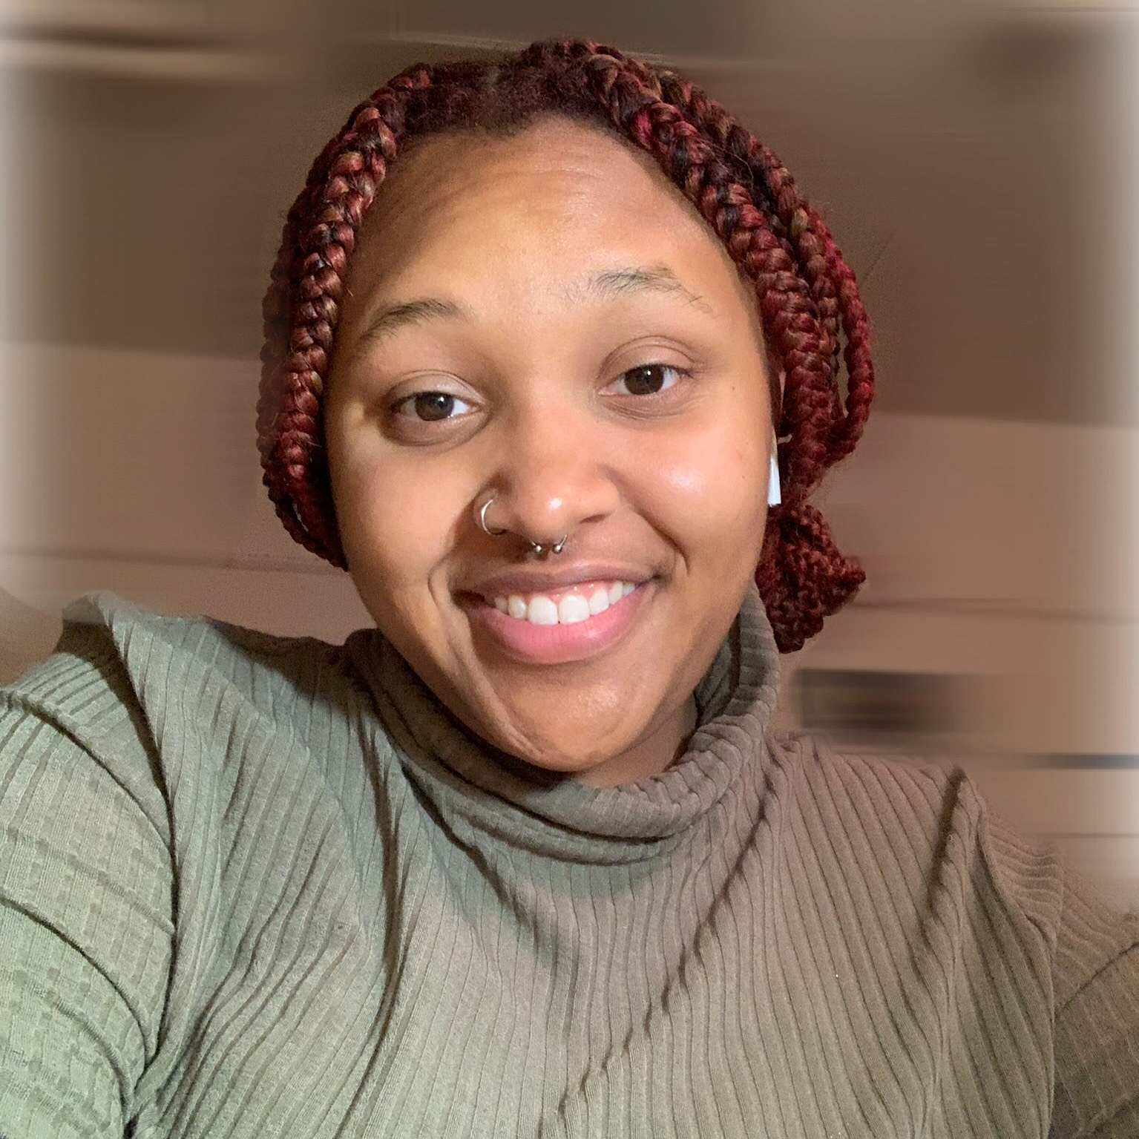
Brittney Cuevas
Major: Economics
Minor: Sociology
4th year Student/Concurrent MSE Student
Economics Club President
Kaleb Nichols
Major: Liberal Studies
Minor: Double minor
2nd Year Student
Aza Davis-Picou
Major: Human Development & Family Studies
Senior
NCORE/ISCORE Scholars
#ISCORE2023

Slide 3
Land Acknowledgement
We would like to begin this event with a land acknowledgment. Iowa State University is located on the ancestral lands and territory of the Baxoje (bah-kho-dzhe), or Ioway Nation. The United States obtained the land from the Meskwaki and Sauk nations in the Treaty of 1842. We wish to recognize our obligations to this land and to the people who took care of it, as well as to the 17,000 Native people who live in Iowa today.
#ISCORE2023
Notes:
Brittney

Slide 4

NCORE-ISCORE Mission
The NCORE-ISCORE Project supports Iowa State University’s diversity efforts. The project provides positive interactions and dialogue regarding race, ethnicity, and multicultural relations through local and national initiatives including participation in two conferences: NCORE (National Conference on Race & Ethnicity) and ISCORE (Iowa State Conference on Race & Ethnicity).
#ISCORE2023
Notes:
Kaleb

Slide 5
Research Statement: We seek to highlight water conditions amongst Black Communities and Indigenous communities in the United States. Water conditions include water quality, management, infrastructure, and accessibility.
#ISCORE2023
Notes:
This template can be used for a majority of your content. Duplicate as necessary.

Slide 6

Agenda
Key Terms
Historical Data and Background on Black Communities
Insight on Water Issues in Black Communities & Responses to Water Pollution
Indigenous Communities and The Environment
Impacts on Community Capitals
Water Issues and their Impacts
Discussion
What to do?
#ISCORE2023

Slide 7
Activity: Key Terms
Important terms to remember when thinking of Environmental Racism.
Water Quality:
Water Impairment:
Environmental Racism:
Environmental Justice:
Cumulative Impact:
Water Quality: Water quality refers to the physical, chemical, biological and taste-related properties of water.
Water Impairment: When water is contaminated by pollutants
Environmental Racism: Racial discrimination in environmental policy-making and enforcement of regulations and laws, the deliberate targeting of communities of color for toxic waste facilities, the official sanctioning of the presence of life-threatening poisons and pollutants for communities of color.
Environmental Justice: The fair treatment/involvement of all people regardless of race, color, or income, with respect to the development, implementation, and enforcement of environmental laws and regulations.
Cumulative Impact: Combination of different pollution exposures and effects, public health stressors, and socioeconomic vulnerabilities that are affecting a community.
#ISCORE2023

Slide 8
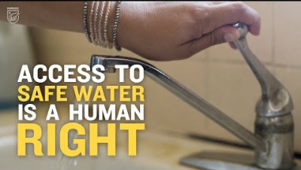
#ISCORE2023
Notes:
TURN ON CLOSED CAPTIONS!!!!!
READ: This is a video by the NRDC, The Natural Resource Defense Council

Slide 9
Historical Data and Background On Black Communities
Historical Black Americans have been disproportionately impacted by severe environmental issues, pertaining to water pollution, air pollution, and chemical waste
“The economic power, social policies, and political influences differ by place, race, and income as a result of historical disinvestment, discriminatory practices and policies over time, structural racism, higher pollution burdens, and inadequate access to healthcare resources.” – Princeton.edu
Data: “Drinking water systems that constantly violated the law for years were 40 percent more likely to occur in places with higher percentages of residents who were people of color, according to EPA data from 2016-2019 analyzed in the report.” –NRDC.org
Why does Water Pollution Happen in Black Communtites?
#ISCORE2023

Slide 10
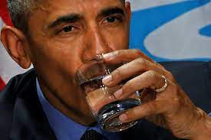
Further Insight on Water Issues in Black Communities
Environmental Racism can be seen within the Black community through many modern-day examples
Jackson, Mississippi. (Water Pollution)
The water crisis in Jackson has left the city without clean, usable water
24.5% of residents live below the national poverty line
83% of Jackson’s population is Black
Political leadership within the city has not taken charge to the situation
Flint, Michigan. (Water Pollution)
Original problem occurred in 2013.
City still has not recovered, no trust in EPA or Flint city government.
Since July 2016, the city of Flint's water system has tested below action levels of the federal Lead and Copper Rule (LCR)- (Michigan.gov)
Water Pollution has been a reoccurring environmental issue that hurts the Black community
Numerous attempts at protesting unsafe water and implementing new policies
Further problems: Health concerns, prioritizing importance of education, money, and lifestyle, broken trust
#ISCORE2023

Slide 11
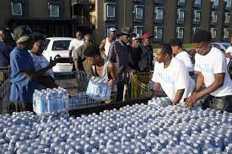
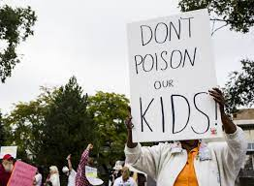
Responses to Water Pollution
Protests
Community efforts often outweigh assistance from governmental agencies
or organizations
Important to understand and value the strength of Black Communities.
#ISCORE2023

Slide 12
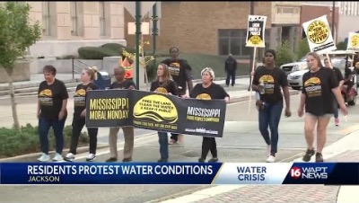
#ISCORE2023
Notes:
ADD CAPTIONS BEFORE PLAYING

Slide 13
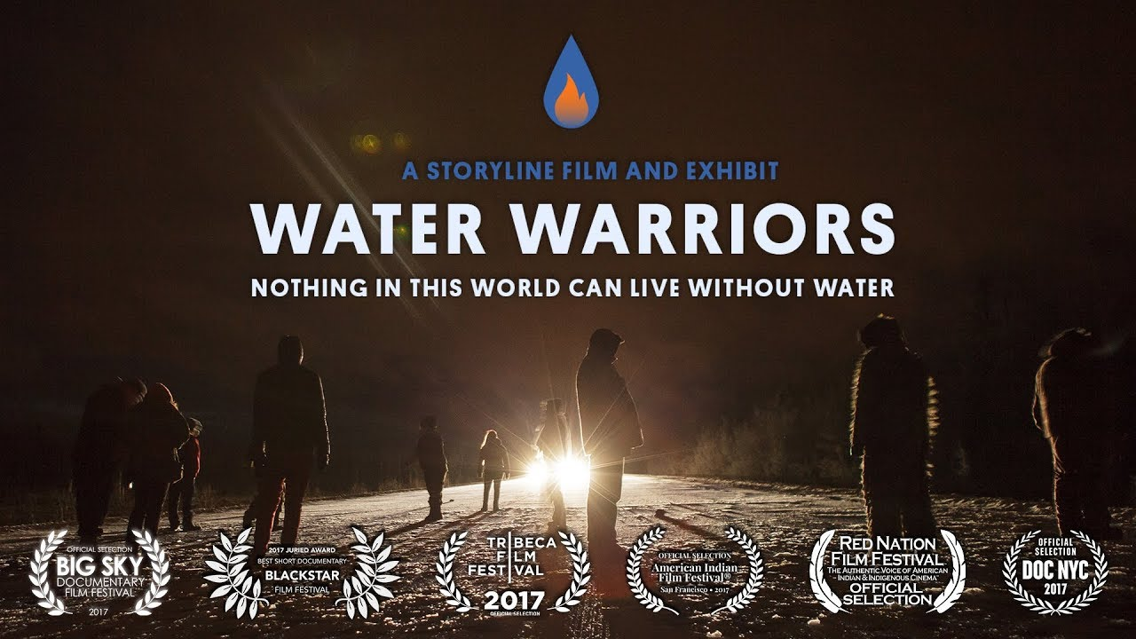
Indigenous Communities and the Environment
United Nations: "Indigenous Peoples are inheritors and practitioners of unique cultures and ways of relating to people and the environment. They have retained social, cultural, economic and political characteristics that are distinct from those of the dominant societies in which they live."
We’re fighting for soil, land, food, trees, water, birds. We’re fighting for life.” - Gregorio Mirabal ( Coordinator of Indigenous Organizations at the Amazon Basin)
Communities vs Corporations
  Indigenous Communities vs Big Oil & Gas
  Indigenous Communities vs Local & Federal Gov.
#ISCORE2023
Notes:
Explain "indigenous communities"
As a tangential comm of color, indigenous communities face a lot of those same water issues as black communities (those that are "assimilated" and those that reside in domestic dependent nations

Slide 14
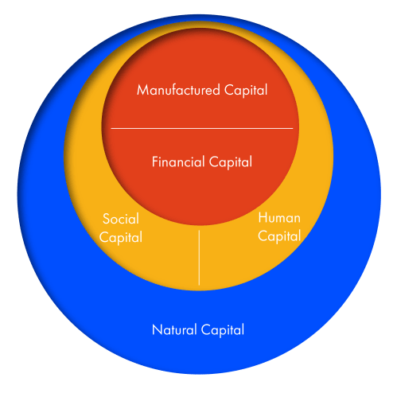
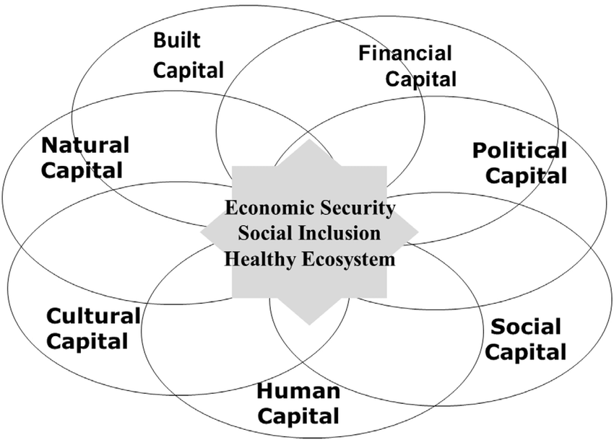
Impacts on Community Capitals
Source: Community Capitals Framework & Sustainable Communities,
Cornelia Butler Flora
Source: Capitalism As If The World Matters,
Jonathon Porritt
#ISCORE2023

Slide 15
Water Issues and their Impacts
Environmental Injustices → Economic Disadvantages → Intergenerational Effects
Health Concerns: safe drinking water and basic sanitation
REFLECT
Do you drink the tap water in your home? Do your children?
How often do you shower? How long does it take you to do so?
Could you allocate $200-$500 per month for water expenses? How would such an expenditure effect your current lifestyle? Daily routine?
#ISCORE2023

Slide 16

Let’s Talk: Discussion
What are some injustices that you know of regarding either Indigenous or Black
communities? What impact do you think those have had over time or will have in the
future?
Do you believe that there is a way to remedy the environmental injustices faced
by both groups? Why or why not?
Do you believe value can be added to the
environmental justice movement by centering Indigenous and Black peoples’ voices and experience/ knowledge? Why or why not? Do you think that’ll ever happen?
Taking into account the things you have learned here today and your own personal knowledge, do you think the government would have the same response for predominately White communities facing water quality issues? Why or why not?
#ISCORE2023
Notes:
5 minutes for groups to discuss assigned questions,
Follow up with giving our own thoughts
Issues important

Slide 17

What to Do?
Invest in environmental justice efforts
    Research
    Local Organizations
      Ex. The Iowa League of United Latin American Citizens (LULAC) climate and environmental justice committee of Iowa, Iowa environmental council, and Great Plains Action Society
    Policy makers
#ISCORE2023
Notes:
LULAC believes that addressing environmental issues and holding stakeholders accountable will improve the quality of life for Latinos living the US.
IEC's mission is a just, healthy environment and sustainable future for all Iowans.
“Great Plains Action Society addresses the trauma Indigenous Peoples and our Earth have faced and works to prevent further colonial-capitalist violence through education, direct action, cultural revival, mutual aid, and political change.” build bipoc solidarity

Slide 18
References
Adisa-Farrar, T. (2021, March 30). How 600 years of environmental violence is still harming black communities. Earthjustice. Retrieved October 26, 2022, from https://earthjustice.org/blog/2021-march/overlooked-connections-between-black-injustice and-environmentalism
Benz, T. A. (2017). Toxic cities: Neoliberalism and environmental racism in Flint and Detroit Michigan. Critical Sociology, 45(1), 49–62. https://doi.org/10.1177/0896920517708339
Bienkowski, B. (2012, June 12). Pollution, poverty and people of color: A Michigan tribe battles a global corporation. Retrieved October 22, 2022, from https://www.scientificamerican.com/article/pollution-michigan-tribe-battle-global-corp/
Duhigg, C. (2009, September 12). Clean water laws are neglected, at a cost in suffering. The New York Times. Retrieved October 18, 2022, from https://www.nytimes.com/2009/09/13/us/13water.html
Fitterman, S. T. (2022, July 29). Dakota Access Pipeline - Environmental & Energy Law Program. Harvard Law School. Retrieved October 26, 2022, from https://eelp.law.harvard.edu/2017/10/dakota-access-pipeline/
#ISCORE2023

Slide 19
References cont…
Hersher, R. (2017, February 22). Key moments in the Dakota Access Pipeline Fight. NPR. Retrieved October 26, 2022, from https://www.npr.org/sections/thetwo way/2017/02/22/514988040/key-moments-in-the-dakota-access-pipeline-fight
Keiser, D. A., & Shapiro, J. S. (2019). US Water Pollution Regulation over the Past Half Century: Burning waters to Crystal Springs? Journal of Economic Perspectives, 33(4), 51–75. https://doi.org/10.1257/jep.33.4.51
Lewis, D. (2022, September 26). Climate and environmental injustice: Thousands without water in Jackson, Mississippi. Retrieved October 19, 2022, from https://www.americanrivers.org/2022/09/climate-and-environmental-injustice-thousands-without-water-in-jackson-mississippi/?gclid=CjwKCAjwwL6aBhBlEiwADycBIEtQFwf1uDFJDSCC3uTqYAGkY5dUBaBYnFG2CDZoADuOasDcyQjgBxoCaIsQAvD_BwE
McCoy. (2022). Critical infrastructure, environmental racism, and protest: A case study in Cancer Alley, Louisiana. Columbia Human Rights Law Review, 53(2), 582–623.
#ISCORE2023
Notes:
This template can be used for a majority of your content. Duplicate as necessary.

Slide 20
References cont…
Perry, Arrington, S., Freisthler, M. S., Ibe, I. N., McCray, N. L., Neumann, L. M., Tajanlangit, P., & Trejo Rosas, B. M. (2021). Pervasive structural racism in environmental epidemiology. Environmental Health, 20(1), 119–13. https://doi.org/10.1186/s12940-021-00801-3
Tchounwou, P. B., & Warren, M. (2001). Physicochemical and Bacteriological Assessment of water quality at the Ross Barnett Reservoir in Central Mississippi, U.S.A. Reviews on Environmental Health, 16(3). https://doi.org/10.1515/reveh.2001.16.3.203
Tebor, C. (2021, June 26). On Native American reservations, the push for more clean water and Sanitation. Los Angeles Times. Retrieved October 20, 2022, from https://www.latimes.com/world-nation/story/2021-06-26/native-americans-clean-water
Wright. (2021). As Above, So Below: Anti‐Black Violence as Environmental Racism. Antipode, 53(3), 791–809. https://doi.org/10.1111/anti.12425
#ISCORE2023
Notes:
This template can be used for a majority of your content. Duplicate as necessary.

Slide 21

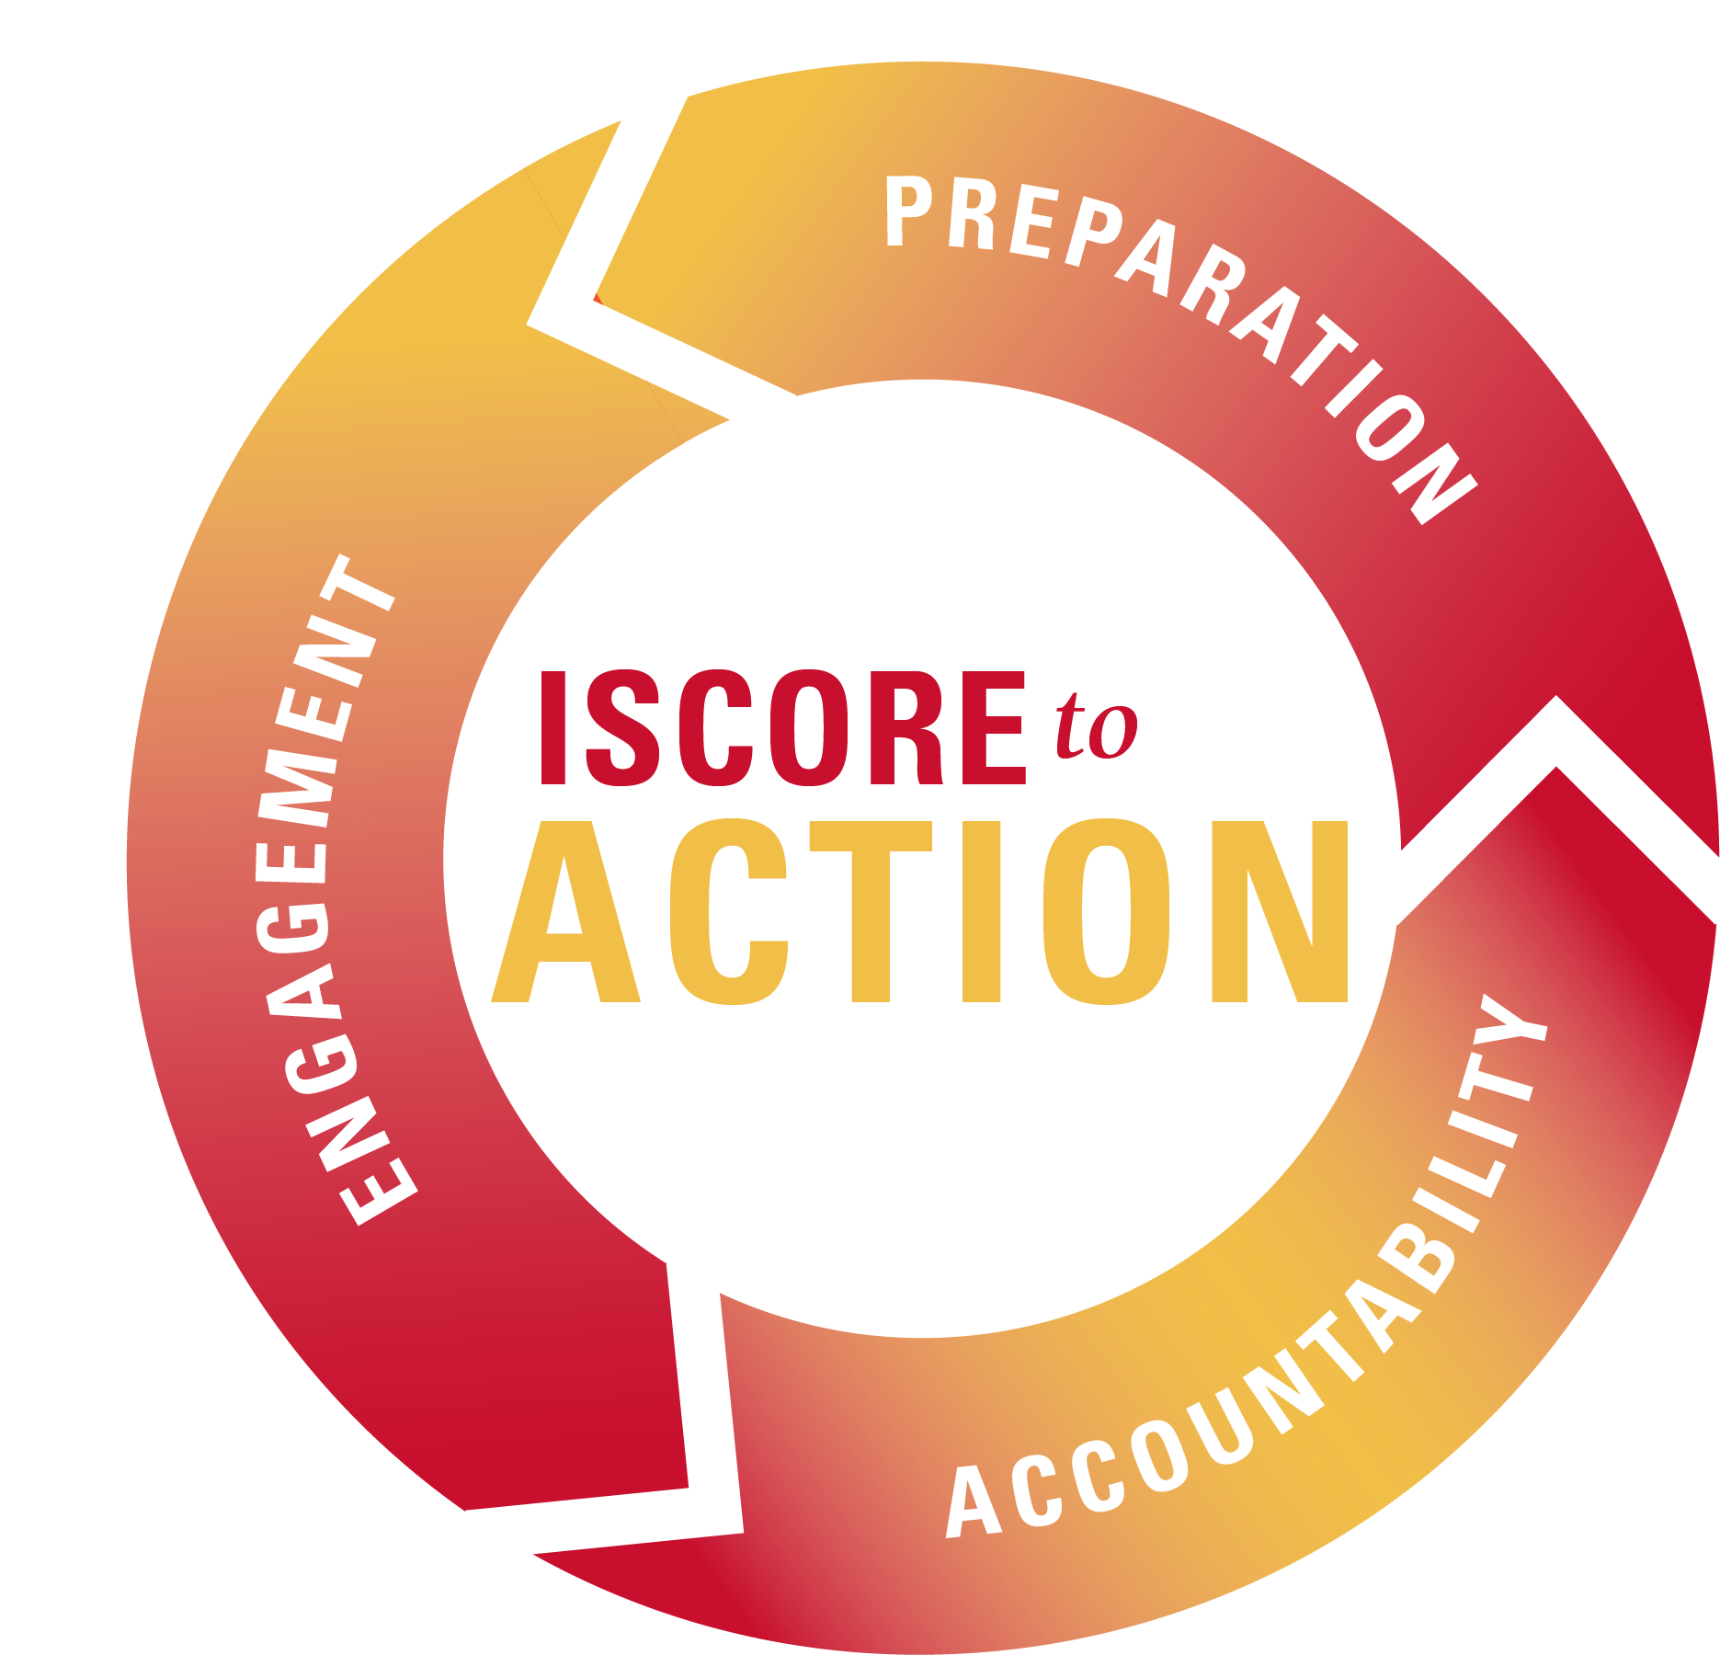
Thank you!
Brittney Cuevas: bcuevas@iastate.edu
Kaleb Nichols: kjn1212@iastate.edu
#ISCORE2023
Notes:
These graphics and footer can be used as needed throughout your presentation.

Slide 22
#ISCORE2023
Notes:
This template can be used for backgrounds of photos during your presentation.

