Slide 1

Why Representation Matters in the Classroom
#ISCORE2023
Notes:
Insert session title and presenters names on this slide

Slide 2
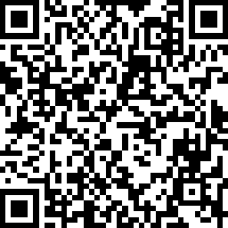
Check
In:
#ISCORE2023
Notes:
Do not edit or remove. This slide is for participants to scan and check into the conference if they haven’t done so already.

Slide 3

NCORE-ISCORE Mission
The NCORE-ISCORE Project supports Iowa State University’s diversity efforts. The project provides positive interactions and dialogue regarding race, ethnicity, and multicultural relations through local and national initiatives including participation in two conferences: NCORE (National Conference on Race & Ethnicity) and ISCORE (Iowa State Conference on Race & Ethnicity).
#ISCORE2023
Notes:
Do not edit or remove

Slide 4
Land Acknowledgement
We would like to begin this event with a land acknowledgment. Iowa State University is located on the ancestral lands and territory of the Baxoje (bah-kho-dzhe), or Ioway Nation. The United States obtained the land from the Meskwaki and Sauk nations in the Treaty of 1842. We wish to recognize our obligations to this land and to the people who took care of it, as well as to the 17,000 Native people who live in Iowa today.
#ISCORE2023
Notes:
Do not edit or remove

Slide 5


#ISCORE2023
Notes:
These graphics and footer can be used as needed throughout your presentation.

Slide 6

Get Comfortable
With Being Uncomfortable
#ISCORE2023
Notes:
This template can be used for a majority of your content. Duplicate as necessary.

Slide 7
“Representation is vital
otherwise, the butterfly
surrounded by a group of moths
unable to see itself
will keep trying to become
a moth.”
Representation
Rupi Kaur
#ISCORE2023
Notes:
These graphics and footer can be used as needed throughout your presentation.

Slide 8
It starts at home
#ISCORE2023
Notes:
This template can be used for a majority of your content. Duplicate as necessary.

Slide 9
Think of a time…
You found it hard to relate to your peers and instructors.
You DID NOT feel safe to be your most authentic self.
You were made fun of because you wore something “different.”
You walked into a classroom, and majority of your class DID NOT look like you.
#ISCORE2023
Notes:
This template can be used for a majority of your content. Duplicate as necessary.

Slide 10
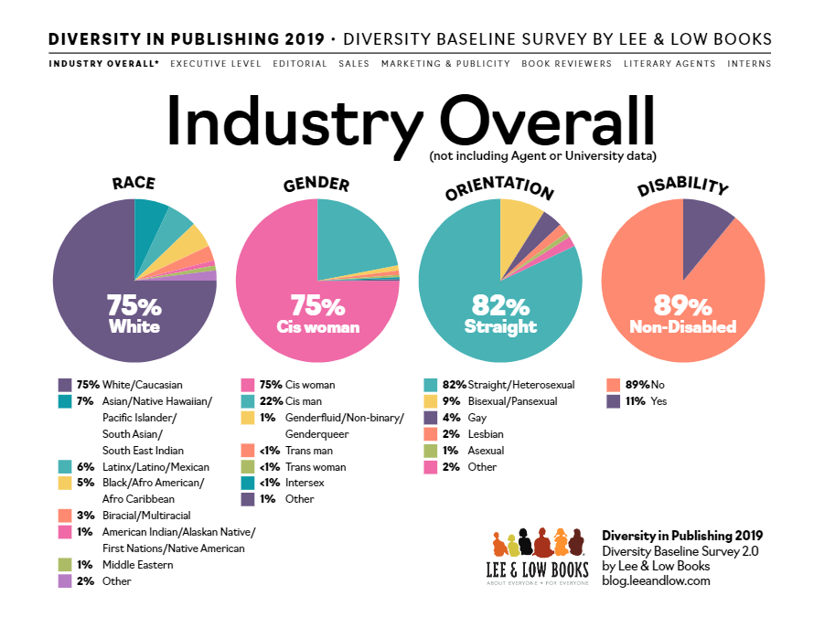
#ISCORE2023
Notes:
These graphics and footer can be used as needed throughout your presentation.

Slide 11
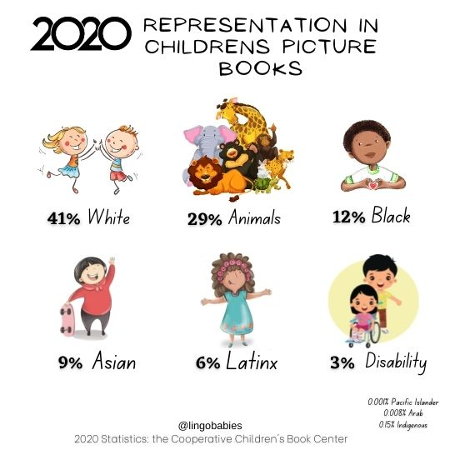
#ISCORE2023
Notes:
These graphics and footer can be used as needed throughout your presentation.

Slide 12
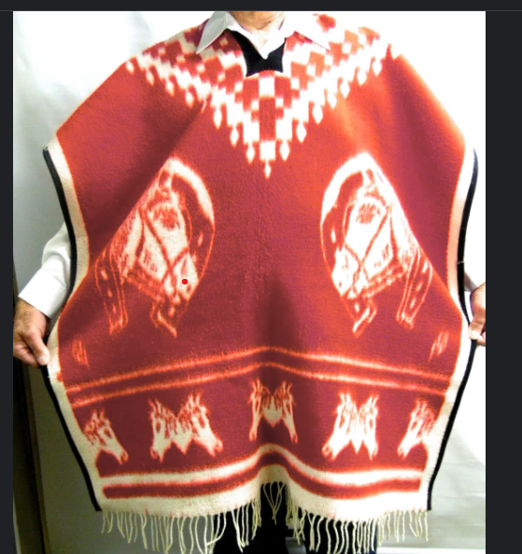
A missed opportunity
#ISCORE2023
Notes:
This template can be used for a majority of your content. Duplicate as necessary.

Slide 13
Student Voices
#ISCORE2023
Notes:
These graphics and footer can be used as needed throughout your presentation.

Slide 14
What can you do?
#ISCORE2023
Notes:
These graphics and footer can be used as needed throughout your presentation.

