Slide 1

Celebrating the Life of Frederick D. Patterson
Brad Kuennen
Vet Med and Animal Science Librarian
#ISCORE2023

Slide 2

Check
In:
#ISCORE2023
Notes:
Do not edit or remove. This slide is for participants to scan and check into the conference if they haven’t done so already.

Slide 3

NCORE-ISCORE Mission
The NCORE-ISCORE Project supports Iowa State University’s diversity efforts. The project provides positive interactions and dialogue regarding race, ethnicity, and multicultural relations through local and national initiatives including participation in two conferences: NCORE (National Conference on Race & Ethnicity) and ISCORE (Iowa State Conference on Race & Ethnicity).
#ISCORE2023
Notes:
Do not edit or remove

Slide 4
Land Acknowledgement
We would like to begin this event with a land acknowledgment. Iowa State University is located on the ancestral lands and territory of the Baxoje (bah-kho-dzhe), or Ioway Nation. The United States obtained the land from the Meskwaki and Sauk nations in the Treaty of 1842. We wish to recognize our obligations to this land and to the people who took care of it, as well as to the 17,000 Native people who live in Iowa today.
#ISCORE2023
Notes:
Do not edit or remove

Slide 5

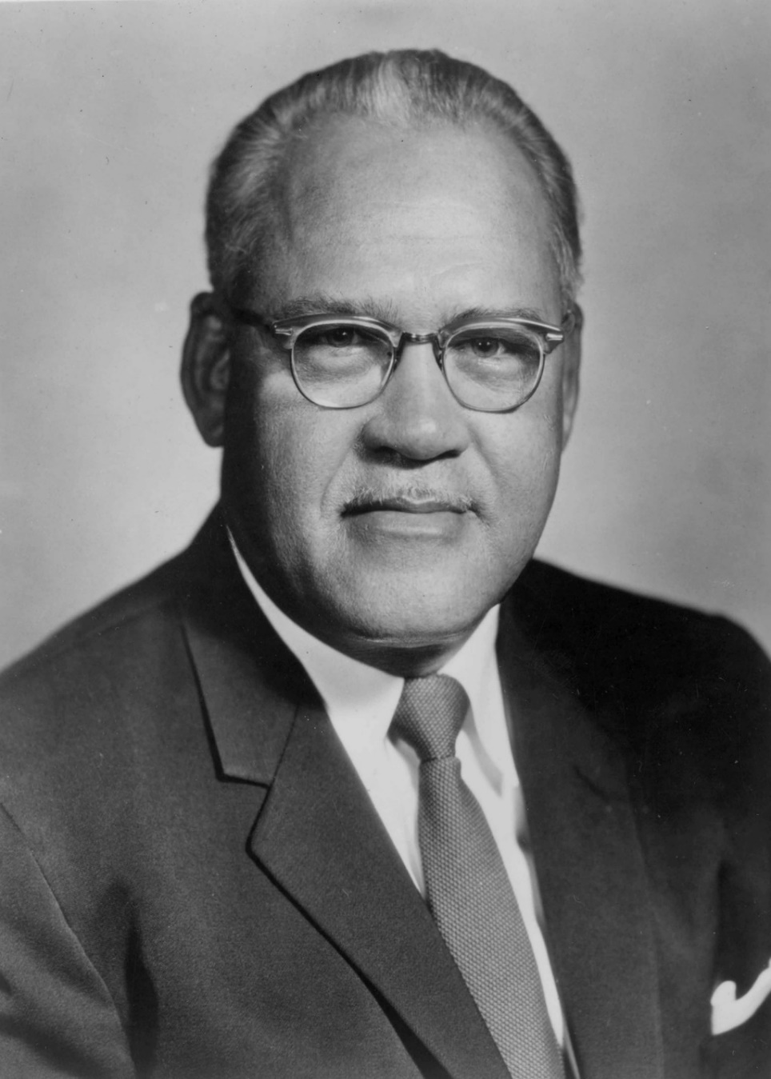
Frederick D. Patterson
Born in Washington, D.C. October 10, 1901
Educated at Iowa State College (DVM 1923, M.S. 1927) and Cornell University (Ph.D. 1932)
Professor/Administrator (1928-1935) and President (1935-1953) of Tuskegee University
Founder of United Negro College Fund, Inc.
Executive Director of Phelps-Stokes Fund
Presidential Medal of Freedom recipient 1987
Died April 26, 1988
Courtesy of Alabama State Archives
#ISCORE2023
Notes:
Explain the origins of the presentation
Give a brief account of where the information came from
Celebrate his accomplishments, dedication to service to his communities, his unwavering belief that education was the best path out of poverty
Learn why the College is taking the time to celebrate him this year

Slide 6
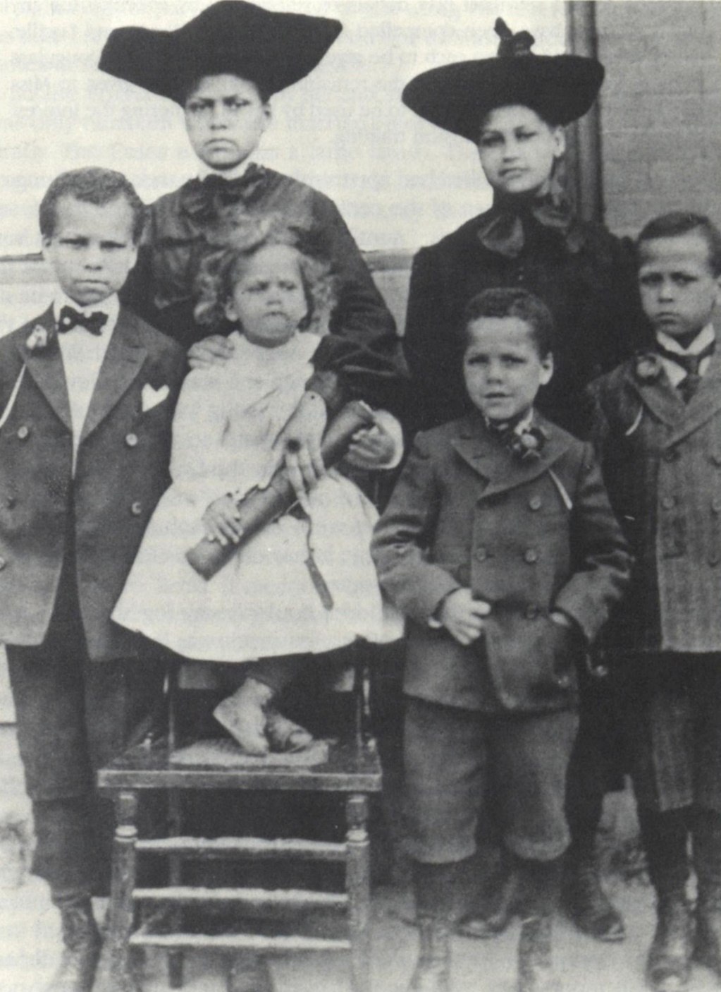
Washington D.C.
Family moved to Washington D.C. from Texas shortly before he was born
Father studied law
FDP was the youngest of six siblings
Both parents died of tuberculosis before FDP was 2 years old
Frederick Patterson and his five siblings, circa 1904. Chronicles of Faith, page 3.
#ISCORE2023
Notes:
Parents William Ross and Mamie Brooks Patterson moved to D.C.
FDP was born, youngest of six children
Named after Frederick Douglass
Upon father’s death, children were split up as dictated in his will
Patterson to Julia Dorsey

Slide 7
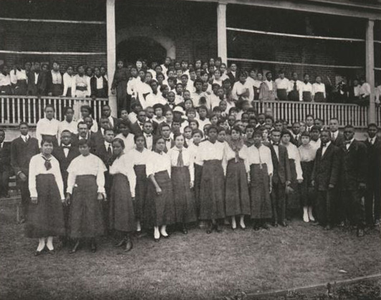
Off to Texas
Moved with eldest sister, Bessie, to Texas ca. 1908
Bessie took jobs teaching music, FDP lived with extended family
Bessie started teaching at Prairie View and FDP joined her there
FDP finally took an interest in schooling and science
Prairie View sophomore class, circa 1917. (Prairie View State Normal & Industrial College. (1917). The Prairie 1917. Page 85. Retrieved from https://digitalcommons.pvamu.edu/yearbooks/38)
#ISCORE2023
Notes:
Eldest sister Wilhelmina, who went by Bessie, was studying at Washington Conservatory of Music
Upon her graduation she moved to Texas and took FDP with her
Bessie went into music education and FDP lived with relatives San Antonio, Austin, Gainesville
Bessie took a job at Prairie View A&M
FDP joined Bessie and she made sure he attended school
He was not particularly good at school, not motivated and frequently in trouble
FDP first gained an appreciation for school here after meeting the school veterinarians
Parents were graduates of Prairie View A&M

Slide 8
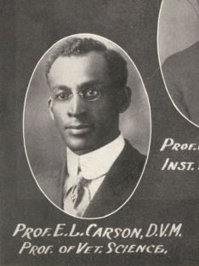
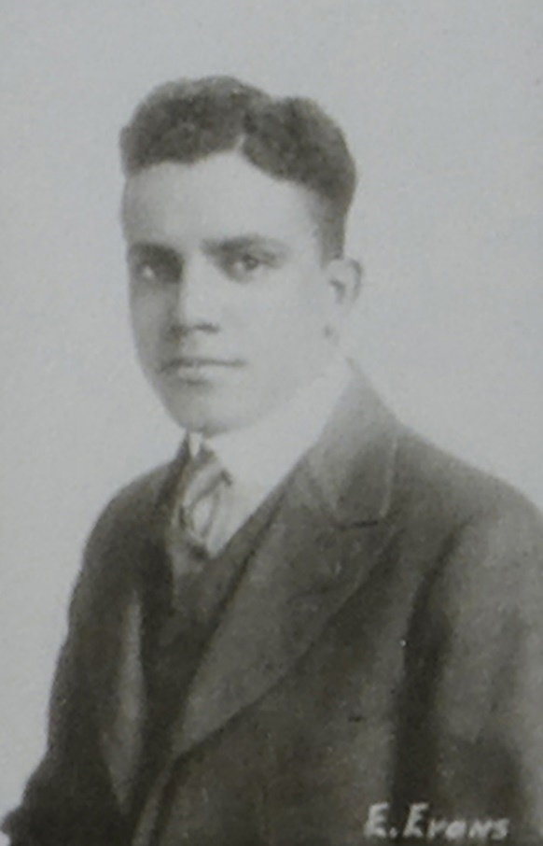
Prairie View A&M
Edward B. Evans, DVM (1918 ISU)
E. L. Carlson, DVM
E. B. Evans, 1918. Courtesy of Iowa State University College of Veterinary Medicine
E. L. Carlson, circa 1917. (Prairie View State Normal & Industrial College. (1917). The Prairie 1917. Page 25.
#ISCORE2023
Notes:
His favorite was Evans who became FDP’s mentor
Evans along with Samuel Richardson were the first black graduates of ISU CVM
FDP relates that he believed Evans should have had top honors in his class but that went to H. H. Dukes
Evans was from the Kansas City area and likely lived near a practicing Black vet

Slide 9
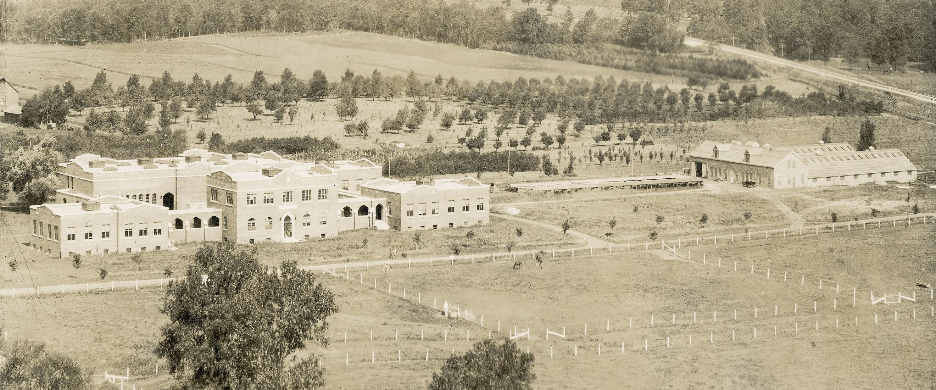
Patterson in Ames
Veterinary Buildings, 1914. Digital Collections, Iowa State University Library
#ISCORE2023
Notes:
FDP arrived in Des Moines and took a job at Hotel Fort Des Moines in 1919
Even though he had only been in Iowa for a few months he stated he was from Des Moines at registration
The registration fee was $17.50 (about $282 today)
Lagomarcino Hall picture from 1914 shortly after built
Hog serum plant to the north.

Slide 10
Patterson in Ames
“In the veterinary program, I did not feel odd being part of the group of students working in the veterinary clinic although I was the only black person there. The absence of animosity encouraged me to see veterinary medicine as a field in which I could practice without being hampered by the racial stereotypes and obstacles that would confront me as a medical doctor, for example. I found the teachers of Iowa State helpful whenever I approached them. Educationally, it was a fine experience.” – Frederick D. Patterson
#ISCORE2023
Notes:
By his own account FDP had a good experience at Iowa State
He kept in regular contact with his faculty mentors at Iowa State
Qualifies that “Educationally, it was a fine experience.”

Slide 11
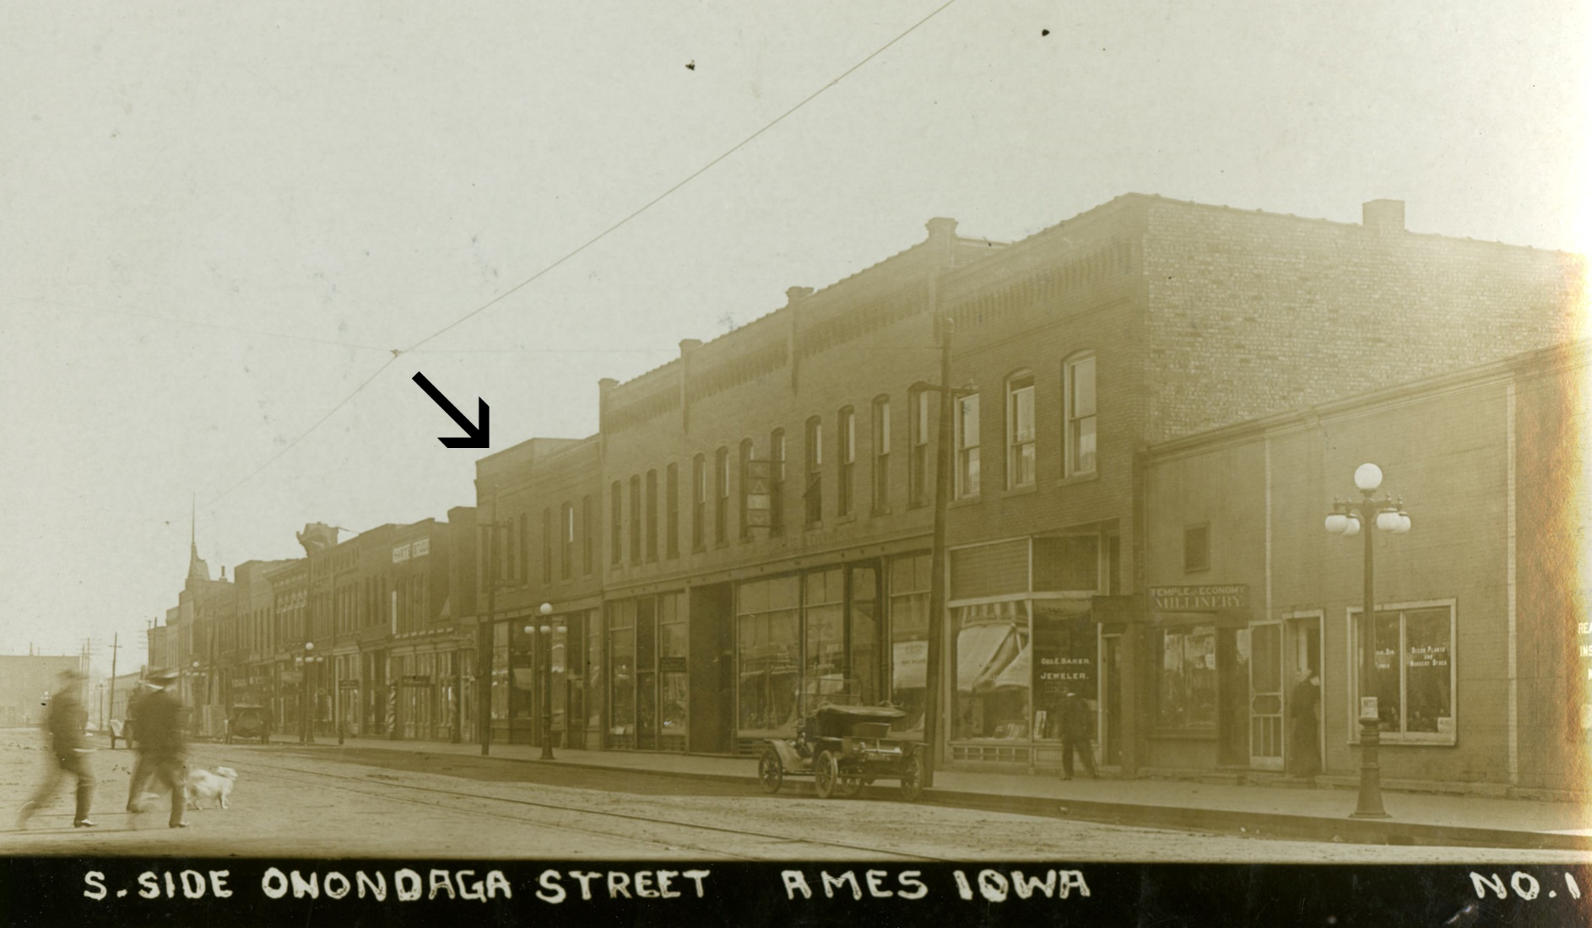
Patterson in Ames
Downtown Ames, 1909. Courtesy of Ames History Museum
#ISCORE2023
Notes:
No male residence halls on campus
Male students lived in boarding houses and fraternities where owners were free to discriminate
Several properties in downtown Ames that became frequent homes to students of color
FDP found a location downtown at 226 1/2 Main street along with 6-7 other Black roommates
There is a plaque outside the entrance to Moorman Clothiers
Received money from his sister but most of the money he needed he earned from various jobs
Waited tables at the local hotel,
Took and job as a cook even though he couldn’t cook
Worked at the Ames Pantorium, a dry cleaners
Eventually started a rug and clothes cleaning company with James Otis
Worked two jobs during summers to pay for school

Slide 12
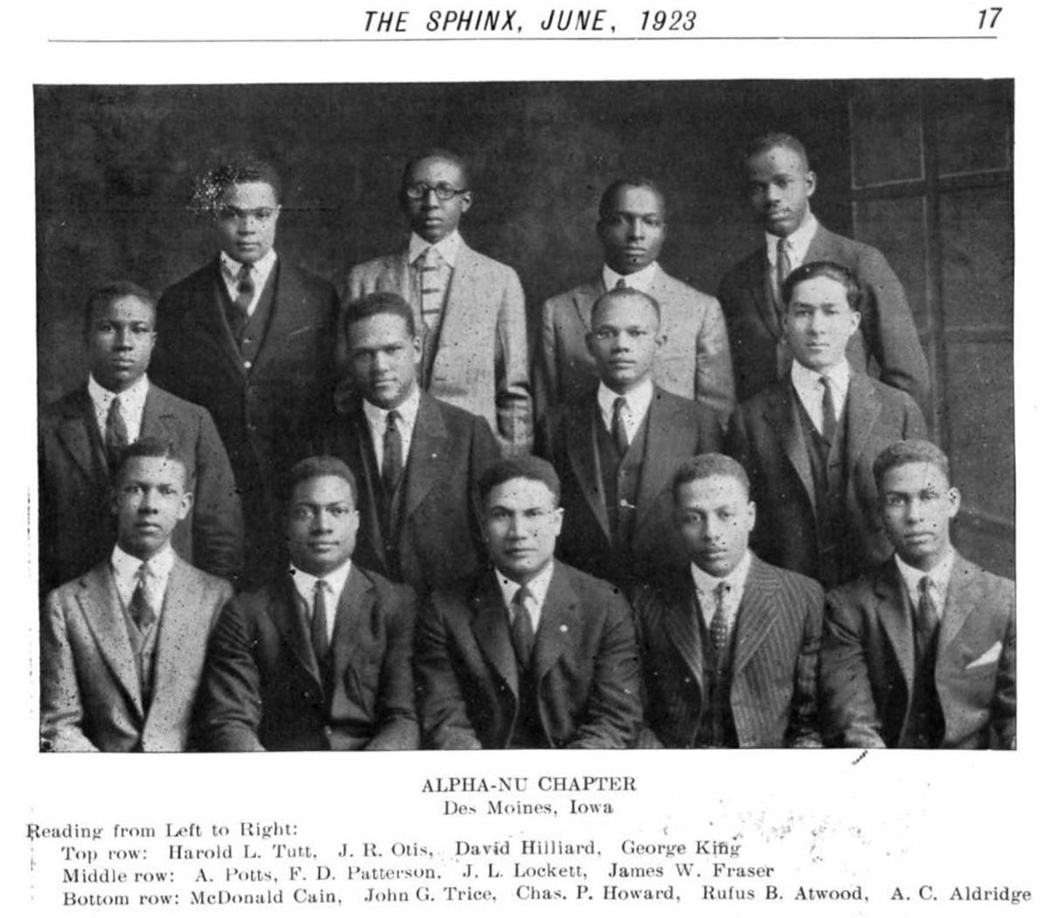
Patterson in Ames
Member of Alpha Phi Alpha
Other ISU Members:
  Rufus Atwood
  James Otis
  John Trice
https://issuu.com/apa1906network/docs/192300903
#ISCORE2023
Notes:
Member of Alphi Phi Alpha, historically Black fraternity
FDP
Rufus Atwood, Professor at Prairie View and later President of Kentucky State
James Otis, roommate, president of Alcorn State
Jack Trice

Slide 13
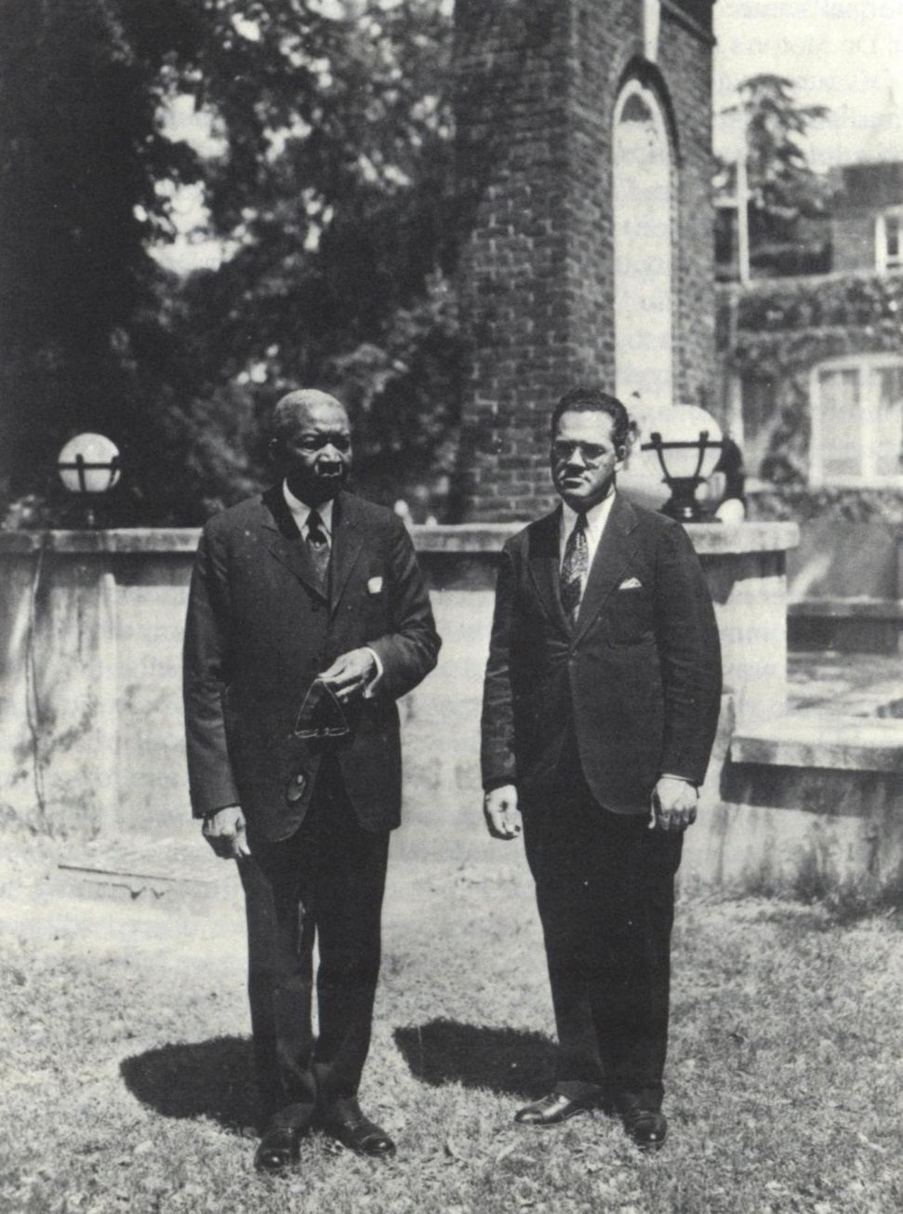
Patterson at Tuskegee
Arrived in Fall 1928 to teach veterinary science and bacteriology
Received his PhD (1932) from Cornell University in bacteriology
Named head of the Department of Agriculture (1933) and President (1935)
Patterson and Robert Moton, 1935. Chronicles of Faith, page 39.
#ISCORE2023
Notes:
Tuskegee was Founded by Booker T. Washington
Home of GWC
After a few years received a second grant from the General Education Board to pursue his PhD
Went to Cornell and returned with his PhD in 1933
Patterson was named Director of Agriculture School
When president Moton retired in the 1935, the Board of Trustees named Patterson president in part because he was the only faculty with a PhD
He also expressed a mission and direction for the university that reflected the Land Grant ideals
Didn’t hurt that he was dating and soon married the president’s daughter
He was 33 years old

Slide 14
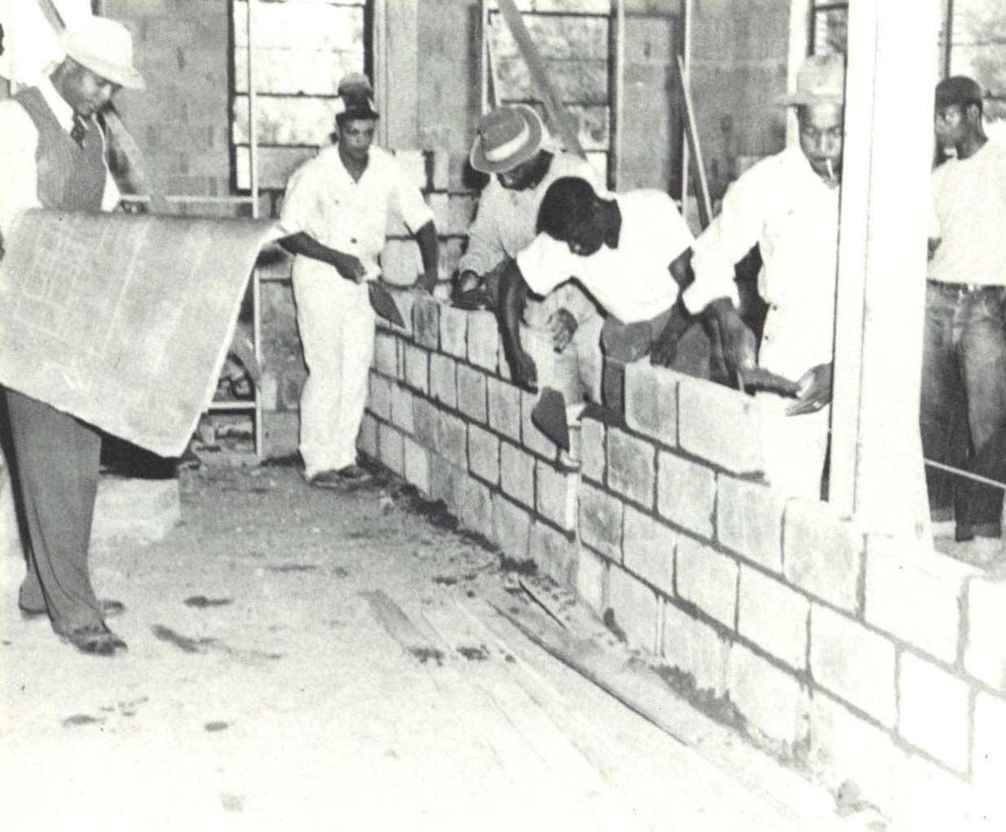
Patterson at Tuskegee
First task as President – trim the budget
Experimented with concrete block construction
Developed Schools of Veterinary Medicine, Engineering, Commercial Dietetics, and Commercial Aviation
Faculty and students building the Vet Med Building at Tuskegee, 1944. Chronicles of Faith, page 85.
#ISCORE2023
Notes:
Patterson took over during the depths of the Depression
Side note, Buchanan arrived from Iowa State to host an alumni reception. 22 of approximately 75 Black ISU grads attended
Asked to trim over 100K from the budget
Didn’t stop FDP from developing programs at Tuskegee and increasing opportunities for Black students in the south

Slide 15
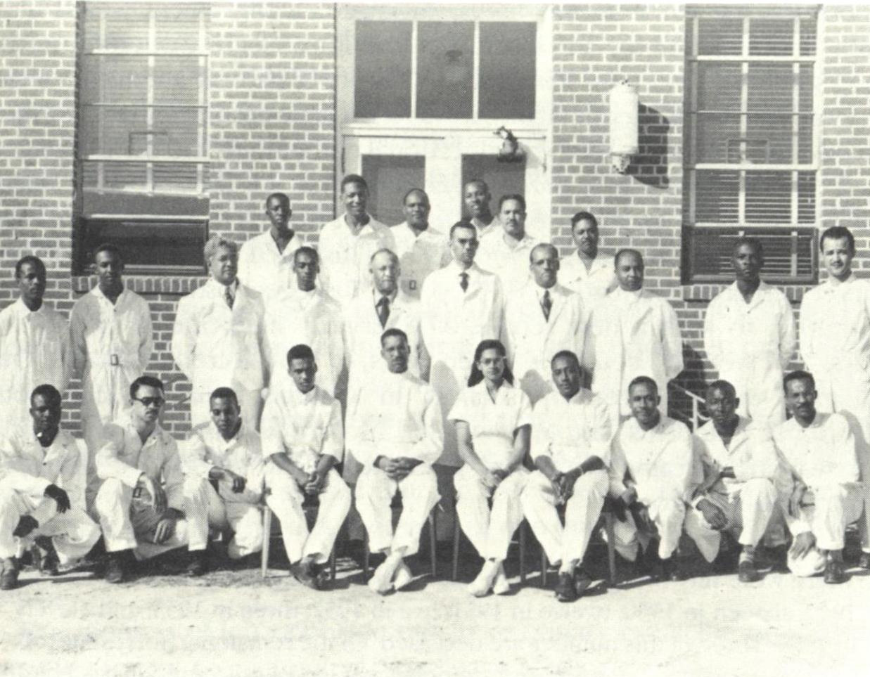
Patterson at Tuskegee
College of Vet Med
Planning began shortly after Patterson became president
Development began in 1942 with first students in 1945
There were 52 graduates from the first six classes
First Vet Med graduates and faculty of Tuskegee, 1950. Chronicle of Faith, page 95.
#ISCORE2023
Notes:
Probably the single greatest impact on improving diversity in the veterinary profession in the 20th century
Started developing a veterinary school in 1942 and was open in 1945, the first and only at HBCU
Tuskegee prided itself on having all Black faculty which was difficult to do for some programs
Contacted his mentor E. B. Evans to help start the program
Evans was the first director of the vet school at Tuskegee – left after a year
Patterson took over as Acting Dean of the school and after Evans left.
“Neither in salary or in responsibility will he have a job which is significantly different and certainly not more important than the other posts in the School of Veterinary Medicine. As a matter of fact, from what I know about administrative routine and its denial of the opportunity for intensive creative work, I would say that if he accepts the post and keeps it, that he has doomed himself to mediocrity and unproductivity in the individual sense. He shall need to derive his satisfaction from the overall growth of the School of Veterinary Medicine. He shall have the dubious pleasure of having his pants kicked for everything that goes wrong and the passing on of the credit for the good that is accomplished to the respective members of the faculty.”
By 1955 Iowa State graduated 8-10 Black vets out of a total of 1804 total graduates (as reported in v.17 iss.3 of ISU Veterinarian)
Tuskegee, which was accredited by 1954 had 52 graduates

Slide 16
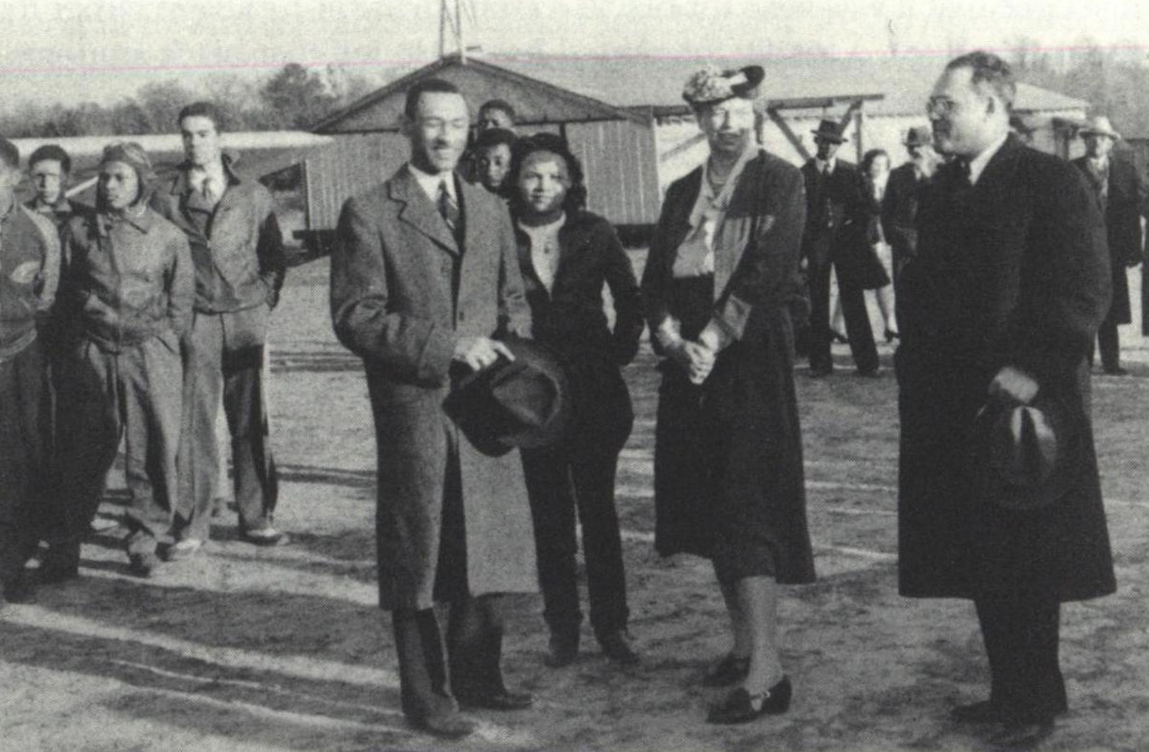
Patterson at Tuskegee
Home of the Famed Tuskegee Airmen
Developed with assistance from the U.S. government
“Once the local community recovered from seeing a black person piloting a plane, the pilot was well received.”
– Frederick D. Patterson
Eleanor Roosevelt with Patterson, G. L. Washington, and student pilots, 1940s. Chronicles of Faith, page 80.
#ISCORE2023
Notes:
Started a Commercial Aviation Program in 1939
Tuskegee provided students and pilots, federal government provided everything else
FDP was surprised he had no problems finding pilots
FDP even took up flying himself
During WWII, Tuskegee was able to be home to the Black military aviation training program
The Tuskegee Airmen had a stellar record during the war

Slide 17
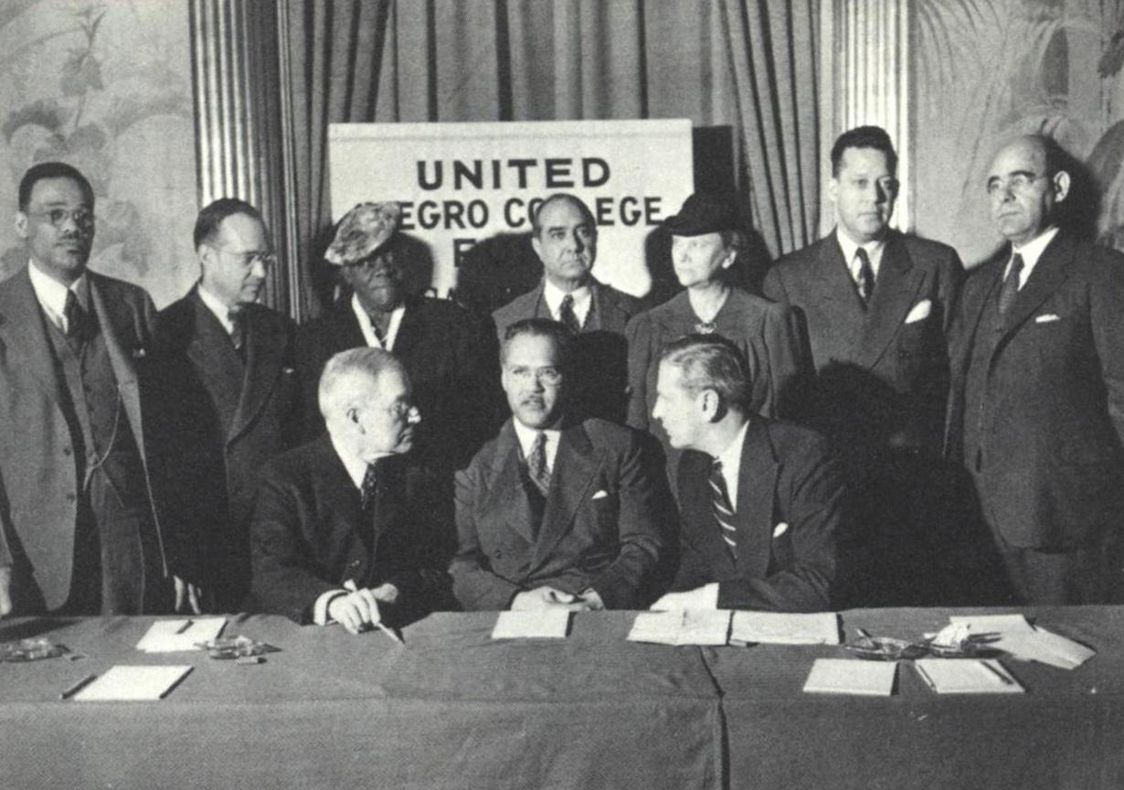
United Negro College Fund (UNCF)
By the 1940s, private sources of funding for HBCUs was scarce
Patterson felt a unified national fundraising effort would be successful
In 1944, UNCF raised $765,000, more than three times what the original 27 HBCUs raised separately the year before
Organizing meeting of the United Negro College Fund, Waldorf-Astoria Hotel, New York City, May 13, 1944. Chronicles of Faith, page 128.
#ISCORE2023
Notes:
Tuskegee and other HBCU’s were hurting during the 1930s and 40s
Funding was hard to come by at that point
1943, FDP put out a call to presidents of other HBCUs
His idea was to combine their efforts to raise money and reach beyond just alumni and a few wealthy donors
Based on his familiarity with National Red Cross and March of Dimes
FDP was named first president of UNCF
With support from Rockefeller Foundation ($25K) and Rosenwald Fund ($25K) and the member schools coming up with $50K
Rockefeller II first publicly endorsed charity
FDR and Eleanor
First year of donations exceeded expectations

Slide 18
“A mind is a terrible thing to waste.”
Since it’s founding in 1944:
Raised more than $5 billion in donations
Assisted more than 500,000 students
Awards more than 10,000 scholarships annually worth $100 million
Organizing meeting of the United Negro College Fund, Waldorf-Astoria Hotel, New York City, May 13, 1944. Chronicles of Faith, page 128.
#ISCORE2023
Notes:
Motto became one of the most well-known campaigns in history
Lou Rawls telethons
Nearly 80 years later the fund has raised $5B
Very informative history of UNCF in the library

Slide 19
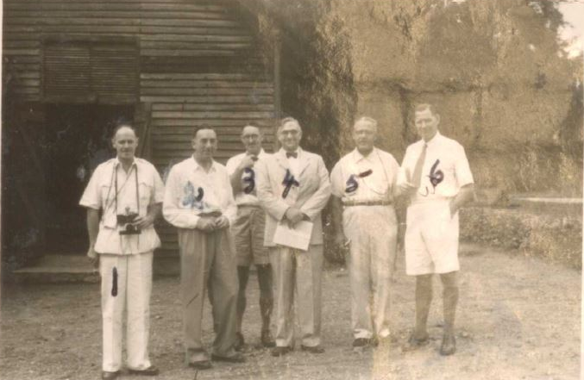
Phelps-Stokes Fund
Started work with the Phelps-Stokes Fund in 1945 while at Tuskegee
Visited Liberia several times a year to evaluate education programs
Named Educational Director of PSF in 1953 and later President
Photo of Patterson along with other members of the World Bank survey team in Nigeria from page 161 of Patterson's mission diary. The diary is included in Patterson's records at the Library of Congress (Box 6, Frederick D. Patterson papers, Manuscript Division)
#ISCORE2023
Notes:
PSF Started 1911
Primarily concerned with education of blacks, minorities and poor whites. Also working with western Africa.
Worked for the fund for 17 years, stepping down in 1969.
Continued with the Moton Institute in which Patterson had developed as a conference center at Holly Knoll, the former home of Robert Mussa Moton, his father-in-law. It became a place where leaders in the African American community could gather and strategize especially during the Civil Rights movement of the 50s and 60s. Located 140 miles south of DC, it was a convenient resting spot for travelers.
UNCF sold the property in 2006 and it is now the Gloucester Institute

Slide 20
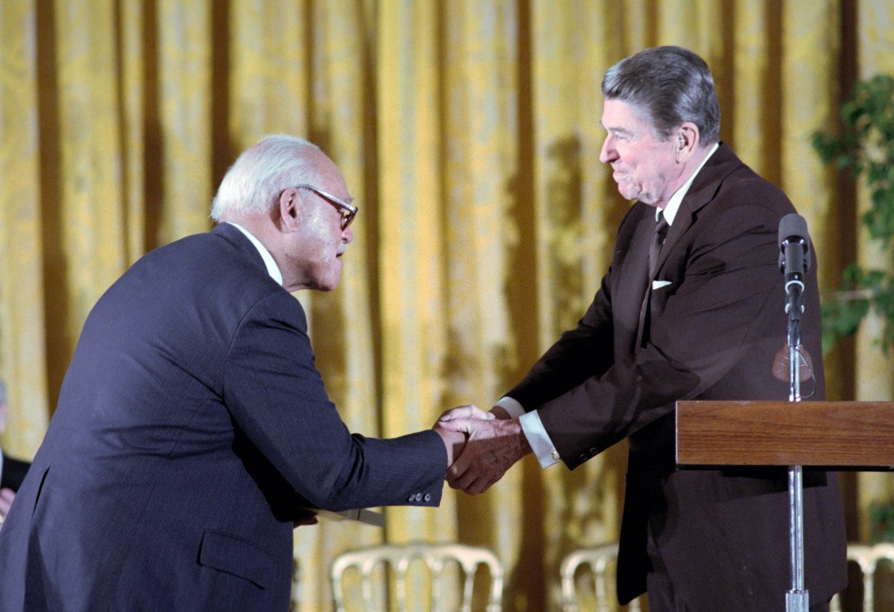
Honoring Frederick D. Patterson
Ronald Reagan presented Patterson with the Presidential Medal of Freedom in 1987
UNCF established the Frederick D. Patterson Research Institute in 1996 to focus on the education status of African-Americans of all ages.
Patterson is congratulated by Ronald Reagan after receiving the Presidential Medal of Freedom. Courtesy of the Reagan Presidential Library
#ISCORE2023
Notes:
The Medal of Freedom was established in 1963, only 650 recipients and only two other known ISU graduates

Slide 21
Honoring Frederick D. Patterson
Honorary Degrees
Xavier University, 1941
Virginia State College, 1941
Wilberforce University 1953
Morehouse College, 1956
Tuskegee Institute, 1961
New York University, 1966
Edward Waters College, 1967
Atlanta University, 1969
Franklin and Marshall College, 1970
Virginia Union University, 1975
Bishop College, 1977
St. Augustine's College, 1982
Brooklyn College of the City University of New York, 1984
Stillman College, 1985
Payne College, undated
Distinctions
Association for the Study of Negro Life and History Carter, undated
The Southern Education Foundation, Inc. Distinguished Service Citation, undated
The United Negro College Fund (UNCF) and Texas Association of Developing Colleges Annual Leadership Award, 1950
Christian Education department, African Methodist Episcopal Zion Church, Inc. Citation for Distinguished Service, 1953
Bethune-Cookman College, the Mary McLeod Bethune Medallion, 1953
John A. Andrew Clinical Society at Tuskegee Institute, Citation for Distinguished Service in the Cause of Humanity, 1953
Tuskegee Institute, Certificate of Appreciation for 25 Years of Service, 1957
Phi Beta Sigma Fraternity, Inc. Beta Lamda Sigma Chapter, Bigger and Better Business Award, 1960
National Alumni Council of the UNCF, Inc. Award, 1963
#ISCORE2023

Slide 22
Honoring Frederick D. Patterson
Distinctions (cont.)
National Business League, Booker T. Washington Award, 1965
Booker T. Washington Business Association, Certificate of Acknowledgement, 1970
Moton Conference Center Award, 1970
Tuskegee National Alumni Association, R.R. Moton Award, 1972
American College Public Relations Association, 1972 Award for Distinguished Service to Higher Education, 1972
UNCF F.D. Patterson 71st Birthday Award, 1975
National Business League, Booker T. Washington Symbol of Service Award, 1976
Phelps-Stokes Fund, Continuous Creative and Courageous Leadership in the Cause of Higher Education for Blacks, 1977
Yale Alumni Associates of Afro-America, Distinguished Service Award, 1979
Alpha Phi Alpha Education Foundation Inc., Distinguished Educator Award, 1979
Tuskegee Institute Alumni Association Philadelphia Charter Award, 1980
The Iowa State University Alumni Association, Distinguished Achievement Citation, 1980
Gary Branch NAACP Life Membership Fight for Freedom Dinner 1980, Roy Wilkins Award, 1980
State of Alabama Certificate of Appreciation, 1982
#ISCORE2023

Slide 23
Honoring Frederick D. Patterson
Distinctions (cont.)
St. Luke's United Methodist Church Achievement Award, 1983
Tuskegee Airmen, Inc., Distinguished Service Award, 1984
Booker T. Washington Foundation, Booker T. Washington Distinguished Service Award, 1984
The Ohio State University Office of Minority Affairs, Distinguished Humanitarian and Service Award, 1985
Alpha Phi Alpha Fraternity, Inc, Eta Zeta Lamda Chapter Civic Award, 1985
United States, Private Sector Initiative Commendation, 1987
Alpha Phi Alpha Fraternity, Inc of New York State, Founders Day Award, 1987
Presidential Medal of Freedom, 1987
Brag Business Achievement Award, 1987
Phelps-Stokes Fund, Aggrey Medal Public Service, 1941-1971
Southern Educational Foundation, Inc., Board Member, 1943-1988
United Negro College Fund, Founder, President, and Member, 1960s-1988
Robert R. Moton Memorial Institute, Founder, 1970s-1988
The College Endowment Funding Plan, Founder, undated
American National Red Cross, Board of Governors Member, undated
Boys Scouts of America, National Council Member, undated
#ISCORE2023

Slide 24
Honoring Frederick D. Patterson
Distinctions (cont.)
Citizens Committee for the Hoover Report on Reorganization of Federal Government, Board Member, undated
Institute of International Education, Advisory committee Member, undated
National Association for the Advancement of Colored People, Life Member, undated
National Business League, President and Board Member, undated
National Urban League, National Committee Member, undated
Phelps-Stokes Fund, Board of Trustees Member, undated
President's Commission on Higher Education for Negroes, undated
Southern Regional Education, Board of Control Member
This listing of awards is from the finding aid for the Frederick Douglass Patterson papers, Anacostia Community Museum Archives, Smithsonian Institution. https://anacostia.si.edu/collection/archives/sova-acma-06-010
#ISCORE2023

Slide 25
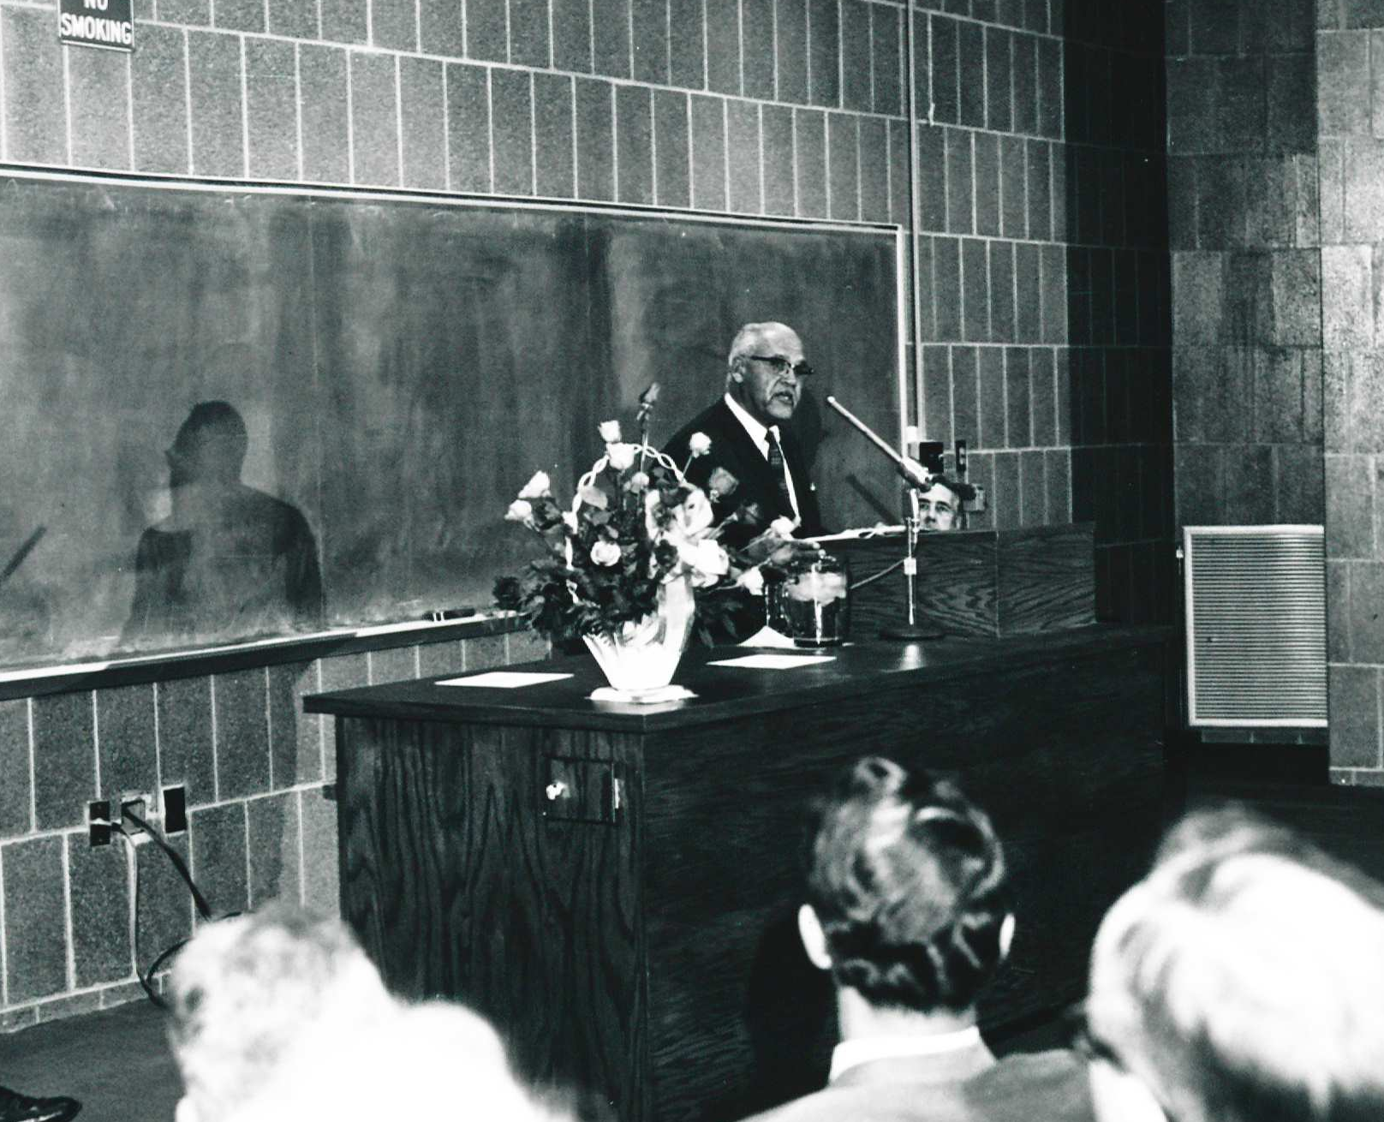
Honoring Frederick D. Patterson
Iowa State awarded Patterson the following honors:
Alumni Association Alumni Merit Award (1948)
Alumni Association Distinguished Achievement Citation (1980)
Invited to campus to speak at the dedication of Carver Hall (1970)
Above: Patterson at dedication of Carver Hall, September 27, 1970.
University Photograph Collection, Box 106, SCUA, ISU Library.
#ISCORE2023

Slide 26
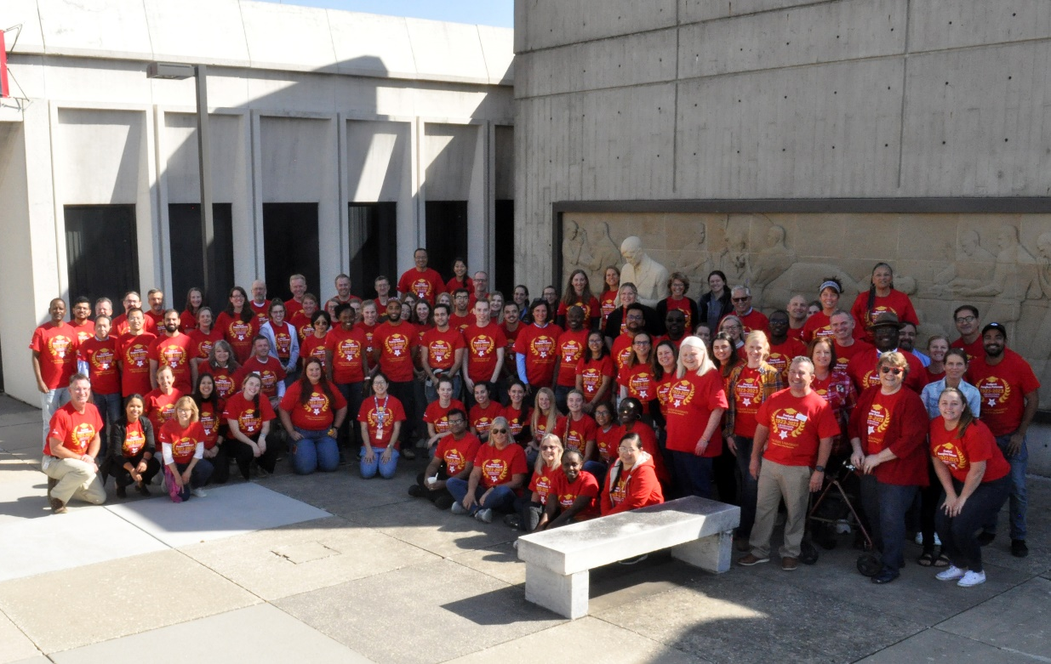
Celebration of Frederick D. Patterson at the College of Veterinary Medicine
Frederick Douglass Patterson Diversity and Inclusion Award (2018)
Frederick Douglass Patterson Diversity and Inclusion Scholarship (2018)
Frederick Douglass Patterson Celebration Committee formed in 2022
#ISCORE2023
Notes:
A scholarship for students and an award for faculty / staff established in 2018
A committee was established in spring 2022 to prepare for the upcoming yearlong series of events celebrating the centennial anniversary of his graduation in 1923.

Slide 27
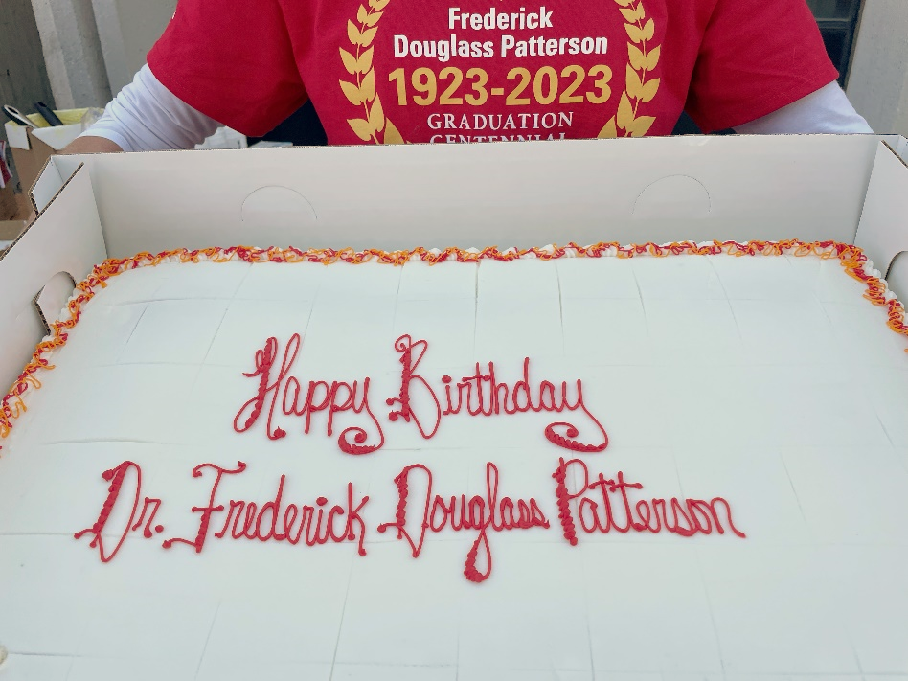
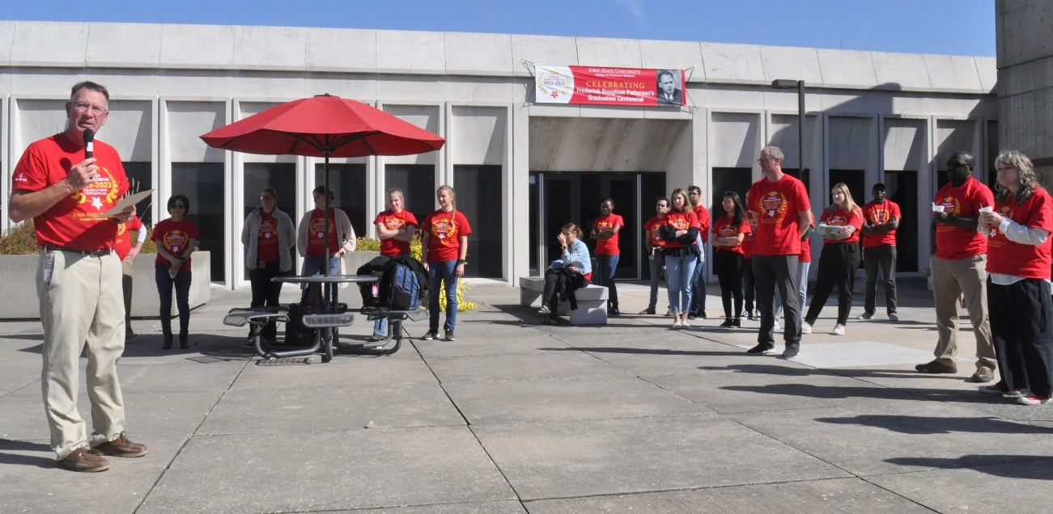
Celebration of Frederick D. Patterson at the College of Veterinary Medicine
Patterson presentation on first day
Birthday celebration on October 10
#ISCORE2023
Notes:
First day of class presentation on Patterson
Corporate sponsor COVETRUS to help cover costs for free t-shirts

Slide 28
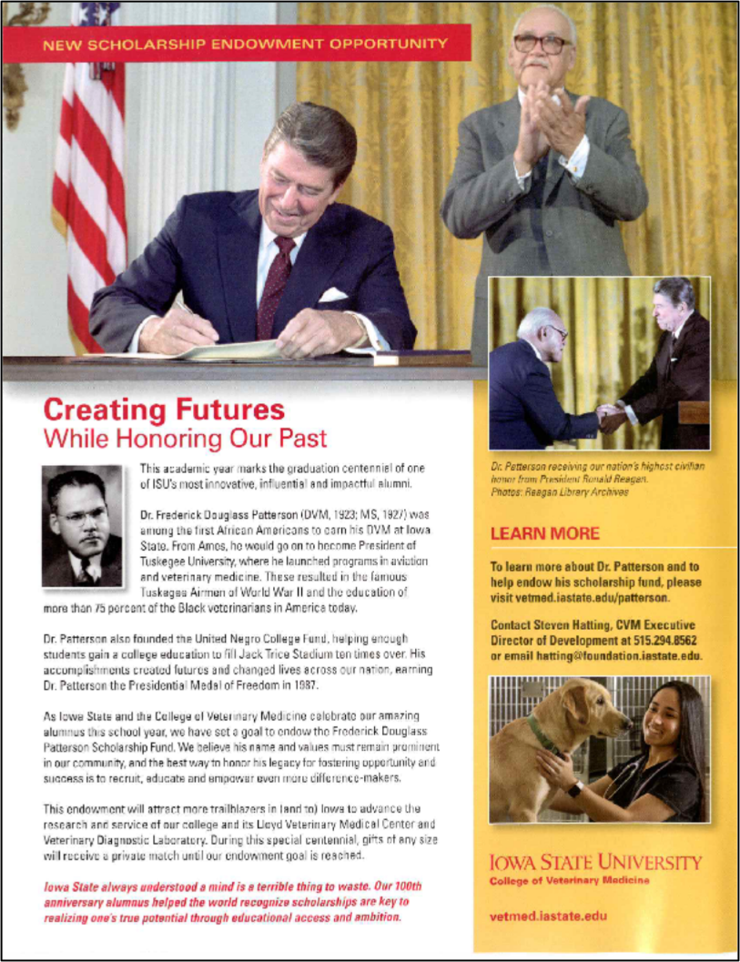
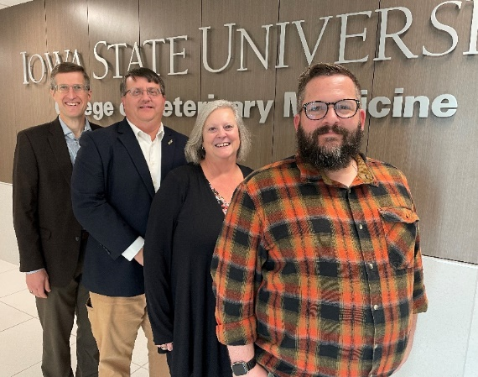
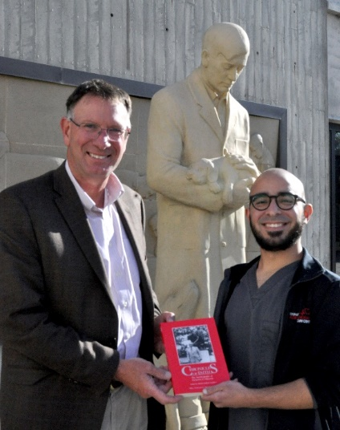
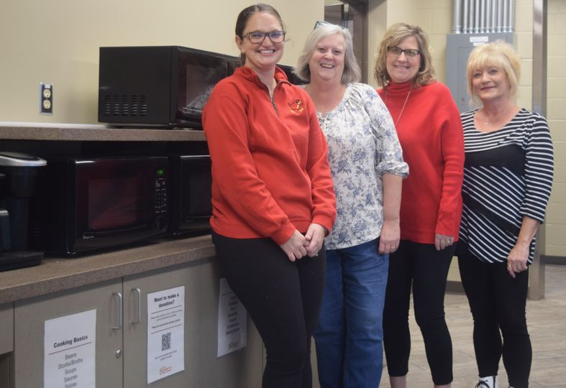
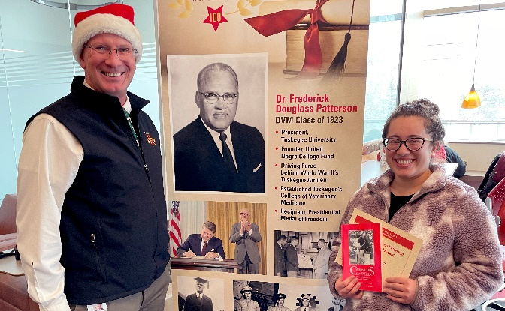
Celebration of Frederick D. Patterson at the College of Veterinary Medicine
Dr. Frederick Douglass Patterson Opportunity Fund campaign
Dr. Frederick Douglass Patterson Spirit Award
#ISCORE2023
Notes:
Fundraising campaign to raise $1,000,000 for an endowed fund to support DEI initiatives at the college
Sponsor COVETRUS also supported the Frederick Douglass Patterson Spirit Award that was given out monthly to members of the CVM community who helped to create a more inclusive community. Nominations sought from the CVM community.

Slide 29
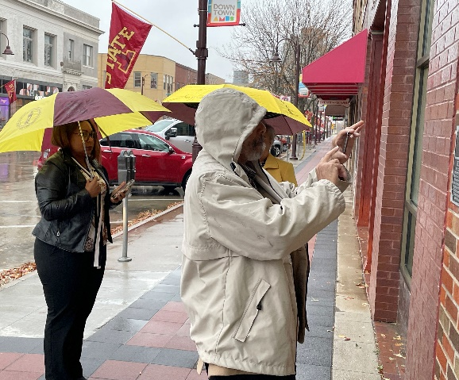
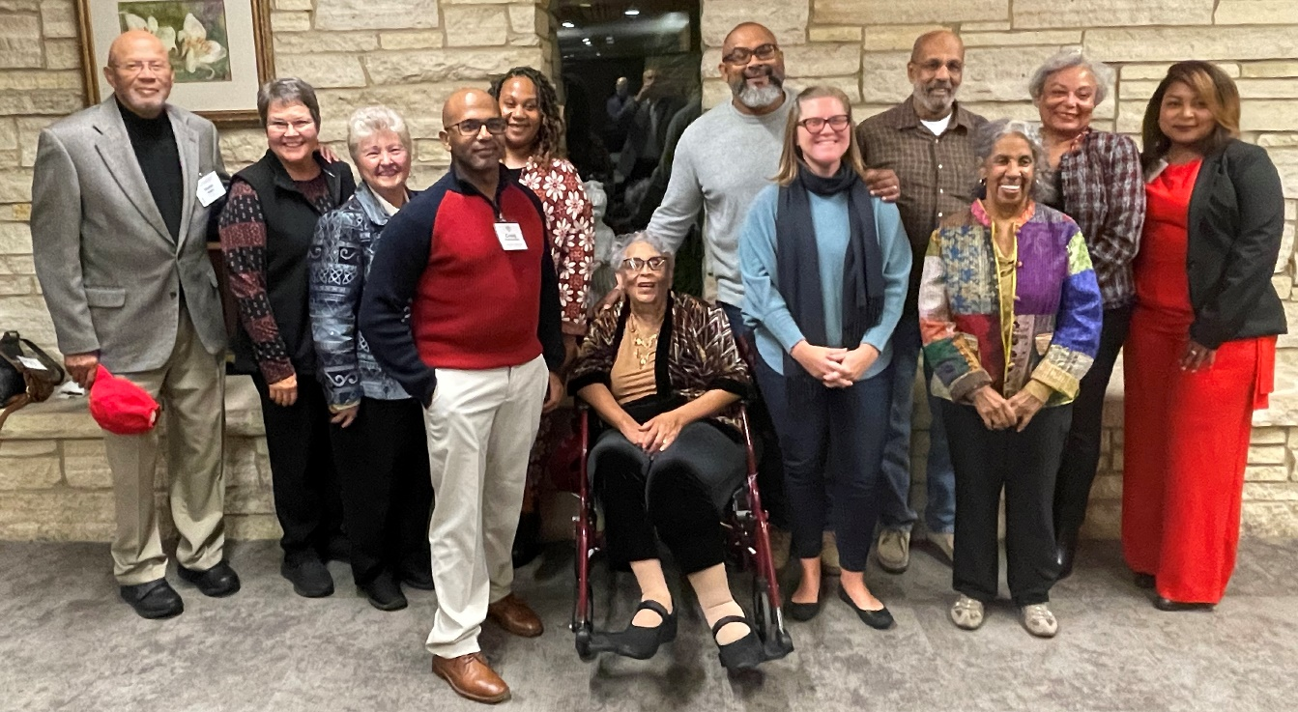
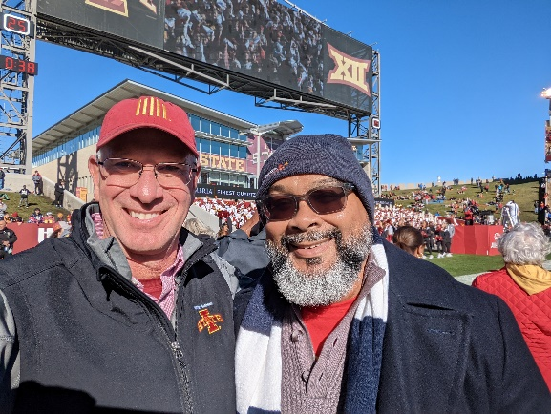
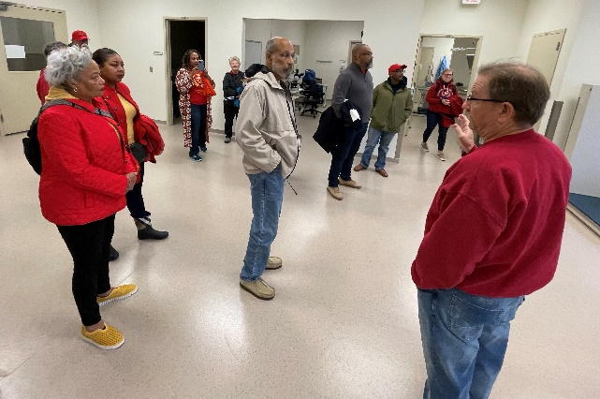
Celebration of Frederick D. Patterson at the College of Veterinary Medicine
Posthumously awarded the Stange Award
Patterson family visit for homecoming
#ISCORE2023
Notes:
Patterson was posthumously given the Stange Award, the college’s highest alumni honor.
The award was accepted by 12 members of the Patterson family who traveled to Ames from all over the country for the ceremony during Homecoming weekend

Slide 30
Celebration of Frederick D. Patterson at the College of Veterinary Medicine
Lecturers sponsored this year by CVM
First Day of Spring semester DEI Talk by Dr. Sharon Perry Fantini, ISU VP for Diversity, Equity, and Inclusion
IVMA Lecture by Dr. Latonia Craig, Chief DEI Officer, AVMA
ISU Lecture by Dr. Jontyle Theresa Robinson of the Legacy Museum at Tuskegee in April
CVM Spring Commencement speaker Dr. Ruby Perry, Tuskegee CVM Dean
#ISCORE2023

Slide 31

Celebration of Frederick D. Patterson at the College of Veterinary Medicine
And the year isn’t over!
Visit the Frederick Douglass Patterson Celebration website for more details:
http://go.iastate.edu/FDP100
#ISCORE2023

Slide 32
Legacy of Frederick D. Patterson
“Leadership is more than confrontation. It can have a number of different dimensions. And if people seeking leadership will select areas in which they want to excel, they can draw on their special skills to improve the circumstances in which all members of society live out their lives.”
--Frederick D. Patterson, Chronicles of Faith, p. 184.
#ISCORE2023
Notes:
Worked for change throughout his lifetime within the system to push for progress
Believed that education would ultimately lead to equality

Slide 33
Sources
Chronicles of Faith: The Autobiography of Frederick D. Patterson (call number LC2851 T817 P28 1991)
A Finding Aid to the Frederick Douglass Patterson papers, 1882-1988, in the Anacostia Community Museum Archives https://sova.si.edu/record/ACMA.06-010
“Frederick Douglass Patterson: A Giant of Higher Ed,” Iowa State University College of Veterinary Medicine, 2018. https://vetmed.iastate.edu/story/frederick-douglass-patterson
“A Cyclone Who Changed the World: Frederick Douglass Patterson,” Cardinal Tales, Iowa State University Library Special Collections and University Archives, 2015. https://isuspecialcollections.wordpress.com/2015/02/12/a-cyclone-who-changed-the-world-frederick-d-patterson/
“Frederick Douglass Patterson, 1901-1988,” UNCF, Inc. https://uncf.org/pages/frederick-douglass-patterson-2
“Mapping the Black ISC Student Housing Experience,” Tracing Race at Iowa State University, Iowa State University Library Digital Scholarship and Initiatives. https://digital.lib.iastate.edu/tracing-race-isu
“Women’s History Month Spotlight: Wilhelmina Bessie Patterson, 1888-1962,” Anacostia Community Documentation Initiative, Anacostia Community Museum. http://cdi.anacostia.si.edu/tag/archives/page/2/
#ISCORE2023

Slide 34
Sources
Wilson, Bertha F. “I See Myself: Presenting Dr. Frederick Douglass Patterson,” Explore History, The World Bank. https://www.worldbank.org/en/archive/history/exhibits/Presenting-Frederick-Douglass-Patterson
Envisioning Black Colleges: a History of the United Negro College Fund, 2007. https://muse-jhu-edu.eu1.proxy.openathens.net/book/3300
Chiu, Belinda H. Y. The One-hundred-year History of the Phelps-Stokes Fund as a Family Philanthropy. Lewiston: Mellen, 2012. https://iowa-primo.hosted.exlibrisgroup.com/permalink/f/11r0uch/TN_cdi_proquest_ebookcentral_EBC946889
#ISCORE2023

Slide 35
Sources
Additional resources for research on Frederick D. Patterson
Frederick Douglass Patterson papers, Anacostia Community Museum Archives, Smithsonian Institution. https://sova.si.edu/record/ACMA.06-010
Frederick D. Patterson papers, 1861-1988, Library of Congress. https://hdl.loc.gov/loc.mss/eadmss.ms011039
Frederick D. Patterson Collection, RS 21/7/19, Iowa State University Library Special Collections and University Archives. https://n2t.net/ark:/87292/w9mz29
Oral History Interview with Frederick Douglass Patterson, United Negro College Fund Project, Columbia Center for Oral History, Columbia University Libraries. https://clio.columbia.edu/catalog/13500813
Logan, Rayford Whittingham. What the Negro Wants. 1944. (call number E185.61 L82w)
Adams, Eugene W. The Legacy: A History of the Tuskegee University School of Veterinary Medicine. 1995. (call number SF756.36 A22 T87x 1995)
Research on Black veterinarians
Waddell, William H. The Black Man in Veterinary Medicine. 1969 (call number SF612 W3)
#ISCORE2023

Slide 36

Questions?
Brad Kuennen, Vet Med and Animal Science Librarian
  kuennen@iastate.edu
  515-294-2225
#ISCORE2023

