Slide 1

HOW RACIAL DISPARITIES PLAY A ROLE IN STUDENTS COLLEGE EXPERIENCE
NCORE-ISCORE Scholars
Kennedy Spurlin - Senior in Biology
Brandon Harold - Sophomore in Finance
Teagan Lipsey - Junior in Dietetics
#ISCORE2023
Notes:
Insert session title and presenters names on this slide

Slide 2

NCORE-ISCORE Mission
The NCORE-ISCORE Project supports Iowa State University’s diversity efforts. The project provides positive interactions and dialogue regarding race, ethnicity, and multicultural relations through local and national initiatives including participation in two conferences: NCORE (National Conference on Race & Ethnicity) and ISCORE (Iowa State Conference on Race & Ethnicity).
#ISCORE2023

Slide 3
Land Acknowledgement
We would like to begin this event with a land acknowledgment. Iowa State University is located on the ancestral lands and territory of the Baxoje (bah-kho-dzhe), or Ioway Nation. The United States obtained the land from the Meskwaki and Sauk nations in the Treaty of 1842. We wish to recognize our obligations to this land and to the people who took care of it, as well as to the 17,000 Native people who live in Iowa today.
#ISCORE2023

Slide 4

Kahoot
https://create.kahoot.it/share/how-racial-disparities-play-a-role-into-students-college-experience/9319fde9-1592-45b4-b166-33ca3dbee9f0
Notes:
Link kahoot, read right answers as we go through kahoot

Slide 5
We will discuss the experiences of minority students on different campuses across the nation looking at their experiences and resources, as well as statistics relating to insecurities and the effects of these statistics on their well being.

Slide 6
Agenda
Microaggressions on campus and the effects they have on students at Iowa State University
Importance of multicultural resources on campus and the resources Iowa State, The University of Texas and Howard University offer
Food and housing insecurity on campuses across the nation and the role that these insecurities play in student’s success
Notes:
“We will be talking about”

Slide 7
Terms To Know
Microaggressions - Everyday insults, putdowns, invalidations, or offensive behaviors that people experience in daily interactions with generally well-intentioned individuals who may be unaware that they have engaged in demeaning ways.
Food security - The state of having reliable access to a sufficient quantity of affordable, nutritious food.
PWI - Predominantly White Institution (≥ 50% of the population is white)
HBCU - Historically Black College or University
Multicultural Centers - The primary mission of the Multicultural Center is to develop a sense of community between students, staff, and faculty of color.

Slide 8
“Racial microaggressions across multiple campus settings are a common feature in research on Black students’ campus experiences at PWIs”
—Navigating an anti-Black campus climate

Slide 9
Studies have shown significant association between racial microaggressions and…
Anxiety
Low Self-esteem
Psychological stress
Binge drinking
Psychological trauma
Depressive symptoms
Notes:
Should we do on slide citations?

Slide 10
Effect of microaggressions in the classroom
The assumption of criminality and inferior intelligence
Black students’ feeling isolated, avoided, alienated, and being deliberately ignored by white faculty, students, staff, and administrators
Behaviors contributing to students’ overall experiences and feelings

Slide 11
After interviewing three students of color enrolled at Iowa State University we found…
  The students felt as though racism wasn’t a problem they dealt with often but do face microaggressions occasionally

Slide 12
Why are multicultural resources on campus important?

Slide 13
In a national study of Black undergraduates attending PWIs they found that Black male academic achievers often experience both racism and success simultaneously
This success was credited too:
  Involvement in student organizations
  Involvement in leadership positions
  Promotion of their success to white people
  Confronting racist stereotypes head-on
  Establishing supportive same-race peer relationships

Slide 14
University Comparative Analysis
In addition to Iowa State, we compared the University of Texas, a Public PWI, and Howard University, a private HBCU
  We selected Howard based on size and available data and information
  We tried to research larger HBCU’s, however North Carolina A&T University and Florida A&M University did not have adequate information needed for the comparison

Slide 15
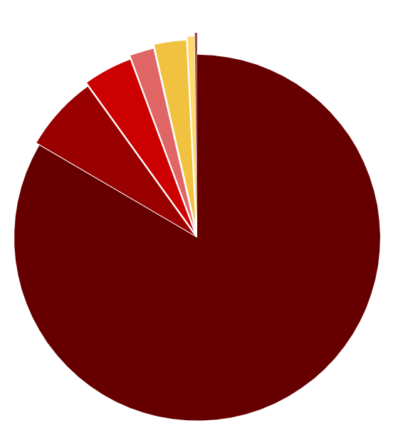
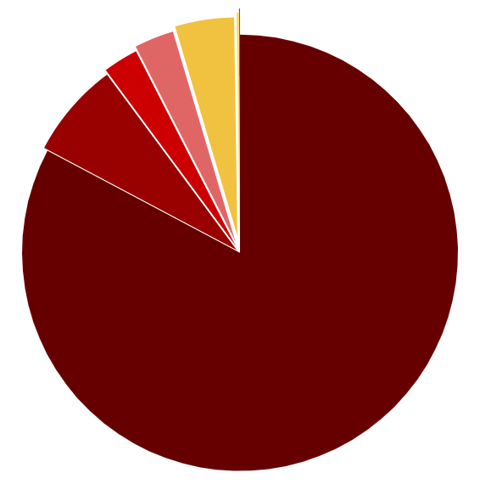

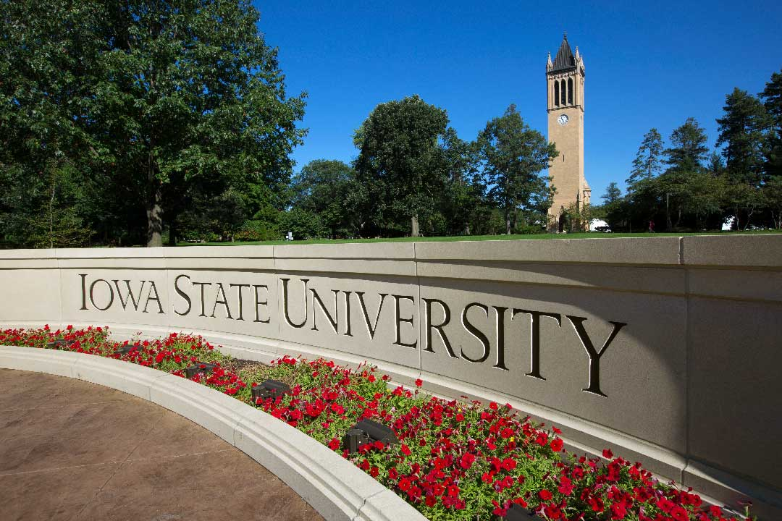

Background Information
Demographics​
The State of Iowa
Iowa State University​
Iowa State
Location: Ames, IA
Undergraduate Enrollment: 25,241
In-state Tuition: $10,133
Out-of-state Tuition: $26,617
Public & PWI
Notes:
Purpose: Show how well the university reflects state demographics vs. University demographics
State:
White: 84.1%
Hispanic or Latinx: 6.7%
Black: 4.3%
Two or more races: 2.1%
Asian: 2.8%
American Indian & Alaskan Native: 0.6%
Native Hawaiian & Pacific Islander: 0.2%
University:
White: 82.73%
Hispanic or Latinx: 7.1%
Black: 2.6%
Two or more races: 2.93%
Asian: 4.37%
American Indian or Alaskan Native: 0.17%
Native Hawaiian or Pacific Islander: 0.07%

Slide 16
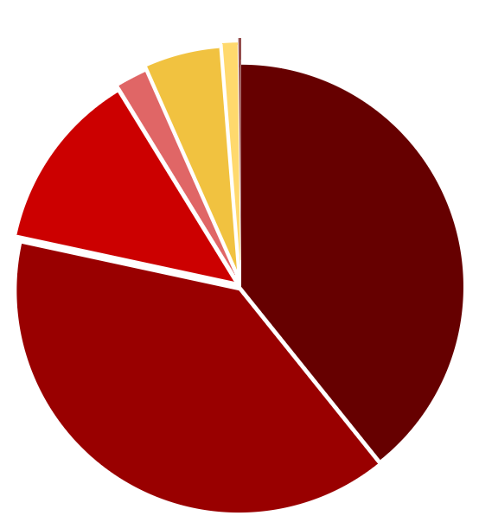
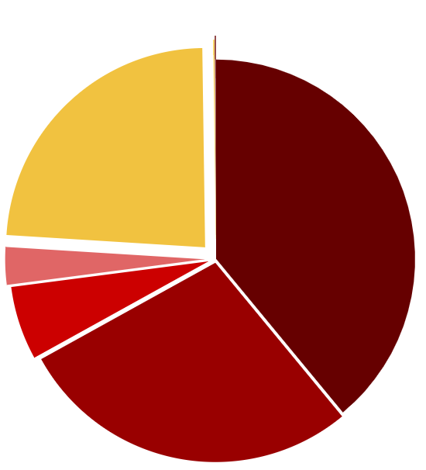

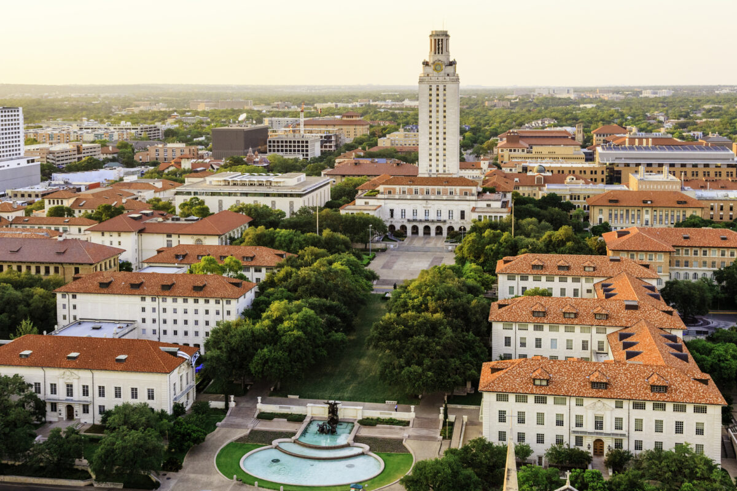
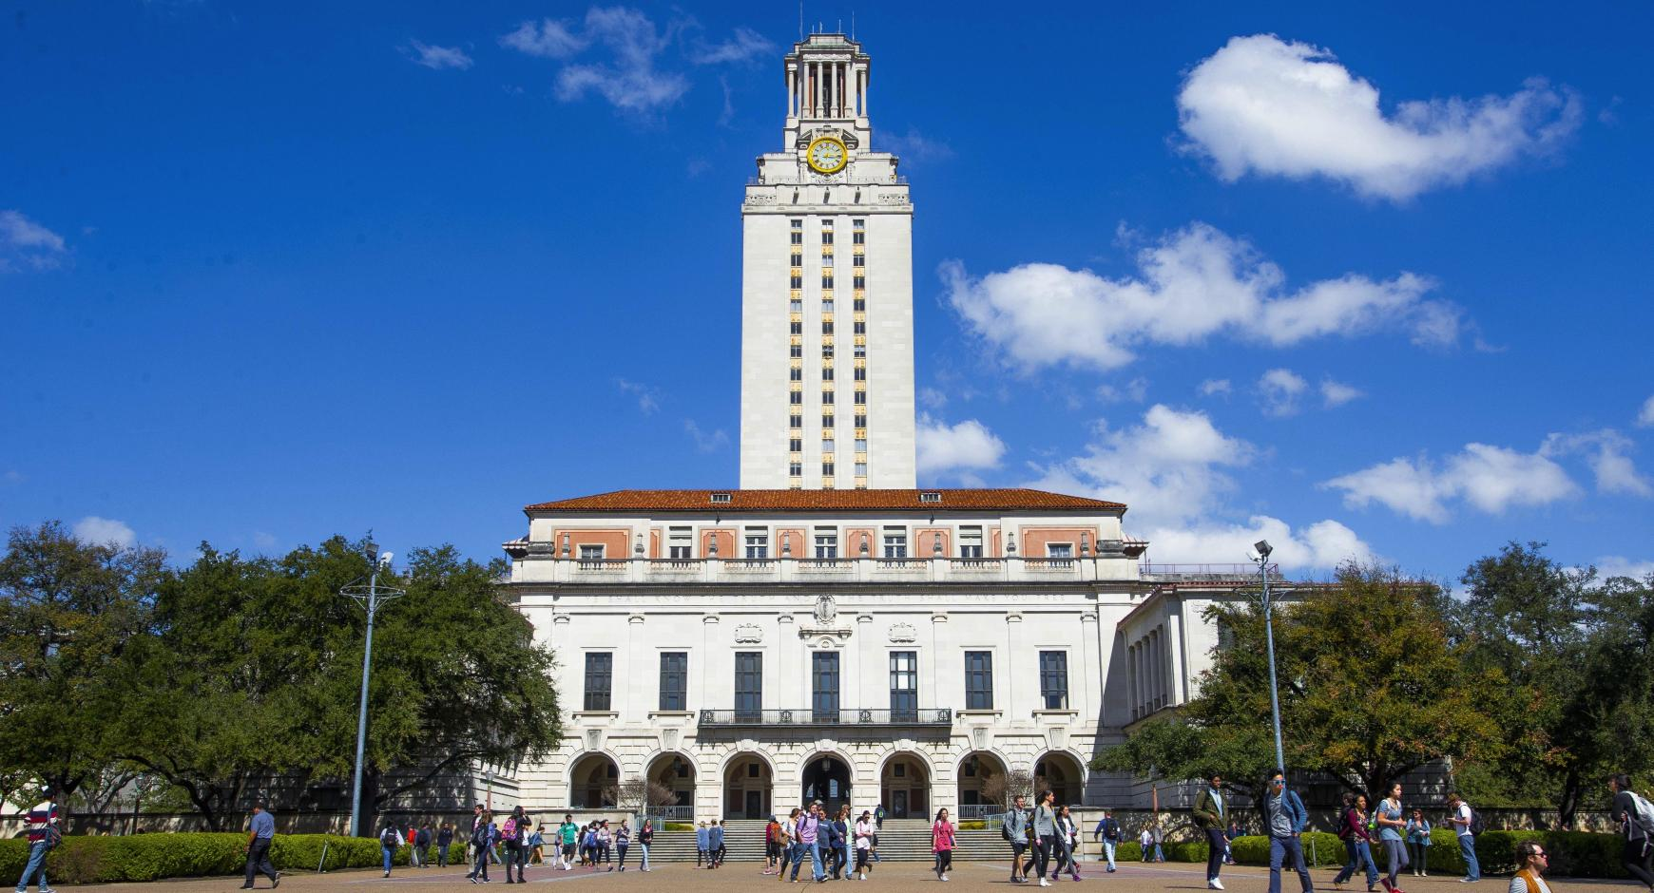
Background Information
Demographics
The State of Texas
University of Texas
University of Texas (UT)
Location: Austin, TX
Undergraduate Enrollment: 41,309
In-state Tuition: $10,858-$13,576
Out-of-state Tuition: $38,650-$46,498
Public & PWI
Notes:
State:
White: 40.3%
Hispanic or Latinx: 40.2%
Black: 13.2%
Two or more races: 2.2%
Asian: 5.5%
American Indian & Alaskan Native: 1.1%
Native Hawaiian & Pacific Islander: 0.2%
University:
White: 34.6%
Hispanic or Latinx: 24.8%
Black: 5.3%
Two or more races: 2.7%
Asian: 21.1%
American Indian or Alaskan Native: 0.1%
Native Hawaiian or Pacific Islander: 0.1%

Slide 17
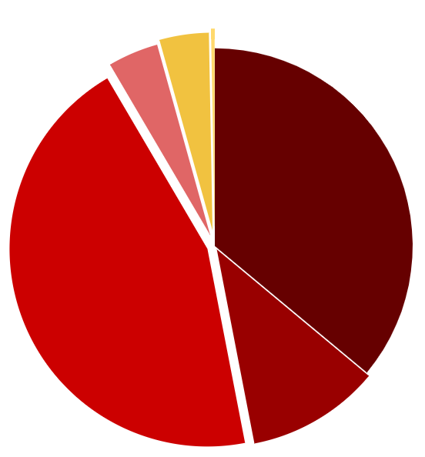
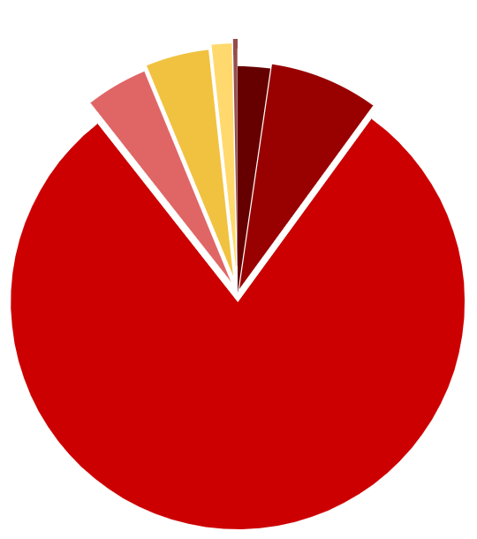

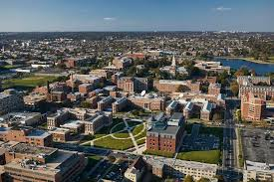
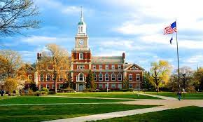
Background Information
Demographics​
Washington, DC
Howard University​
Howard University
Location: Washington, DC
Undergraduate Enrollment: 7,857
Tuition: $28,450
Private & HBCU
Notes:
Demographics don’t reflect due to being an HBCU
State:
White: 36.7%
Hispanic or Latinx: 11.1%
Black: 45.4%
Two or more races: 4.2%
Asian: 4.1%
American Indian & Alaskan Native: 0.3%
Native Hawaiian & Pacific Islander: 0%
University:
White: 1.97%
Hispanic or Latinx: 6.61%
Black: 67.9%
Two or more races: 3.75%
Asian: 3.84%
American Indian or Alaskan Native: 1.22%
Native Hawaiian or Pacific Islander: 0.26%

Slide 18
What difference would you expect among these Universities?
Notes:
DISCUSSION

Slide 19
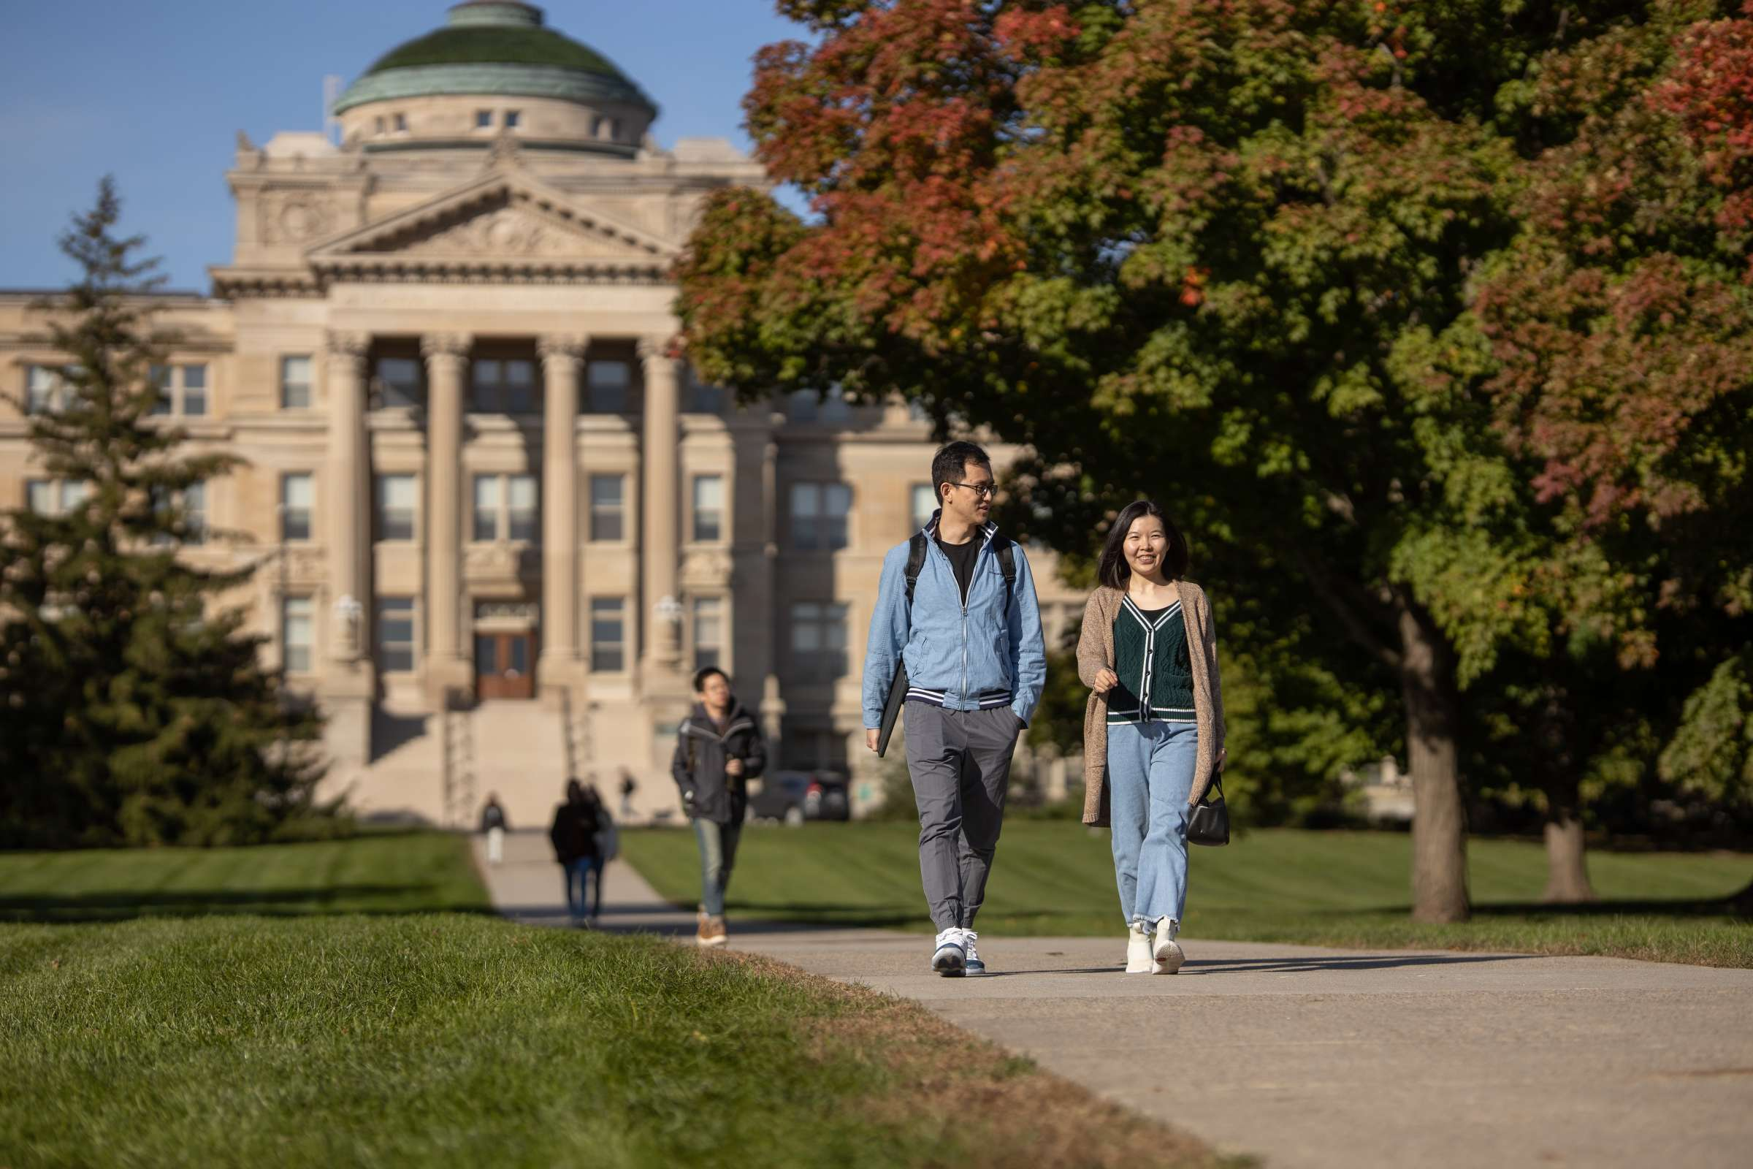
Iowa State Multicultural Student Affairs
Mission statement
"The Office of Multicultural Student Affairs (MSA) supports and empowers Iowa State University's students who self-identify as African American, Asian, Pacific Islander, Desi American, Latinx, Native American/Alaskan Native or Multiracial, and advocates for their holistic development across the University.”
Values
Agency and Advocacy
Community-minded dialogue
Culturally responsible coalition building
Social Justice and Intersectional Inclusion
Student Development and Reflection
Transformative experiential learning
Notes:
Accessibility - all resources found on one website
Structure – MSA is under student affairs so there is more support

Slide 20
Scholarship Programs
Multicultural Vision Program (MVP)
One hundred full-tuition scholarships to incoming first-year students that identify as a minority or participated in a federally funded Educational Talent Search or Upward Bound program along with students that show academic potential that go beyond class ranking and test scores
Renewable for 3 more years if a 2.00 GPA is maintained and full-time student
George Washington Carver Program (GWC)
One hundred full-tuition scholarships to incoming first-year US multicultural students
Renewable for 3 more years
Academic Program for Excellence (APEX)
8-week, immersive summer program to help transition from high school to ISU
What’s Included:
live on-campus at ISU residence hall, up to 8 credits(2-3 classes), make connections with peer mentor, faculty, and other APEX scholars

Slide 21
Other Resources
Multicultural Student Organizations
83 culture and identity-based clubs
Cargill Thrive Program
Designed to promote professional and personal development for multicultural ASTEM students.
$2,500, $3,000, and $4,000
MSA Graduation & Recognition Ceremony
Specific graduation ceremony to celebrate multicultural student’s achievements and success.
DACA/Undocumented Student Resources
List several resources that students can use and people that can be contacted for questions regarding enrollment and financial aid status.
Multicultural Student Scholarships
Crazy Horse Scholarship ($2,000), Donald Kane Smith Scholarship ($2,000), Herta David Minority Student Scholarship ($2,000), Lawrence Shindel Scholarship($2,000), Barnes & Mitchell Scholarship (Various), Student Affairs Multicultural Student Scholarship (Varies)
Notes:
A benefit of MSA being under student affairs is that there is more support for students because all the divisions under student affairs participate in coordinated care
Example: MSA will pay for one free tutor for students they are connected with

Slide 22
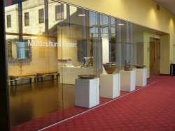
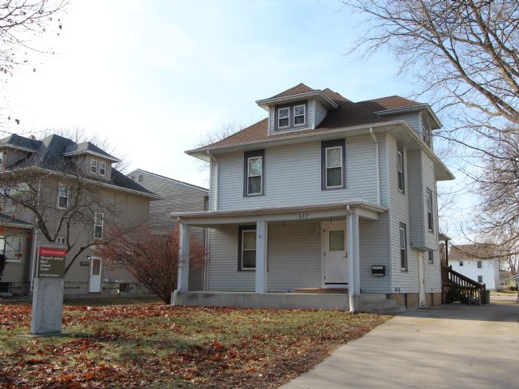
Cultural Centers
George A. Jackson Black Cultural Center (BCC)
“Serves as a foundation for African American cultural identity, education and understanding between diverse communities as ISU.”
517 Welch Ave
Can be reserved through MSA Office
Multicultural Center (MCC)
“Serves as a gathering place on the ISU campus and is home to three affinity spaces for Native American/Indigenous students, Latinx students, and Asian American, Pacific Islander, and Desi American students.”
2nd floor of the MU
Notes:
Importance of these centers because it gives minority students a space they can claim as their own.
Info on George A. Jackson
Former assistant dean of the Graduate College (1994-2009) who had a strong commitment to and passion for the recruitment and graduation of underrepresented students.

Slide 23


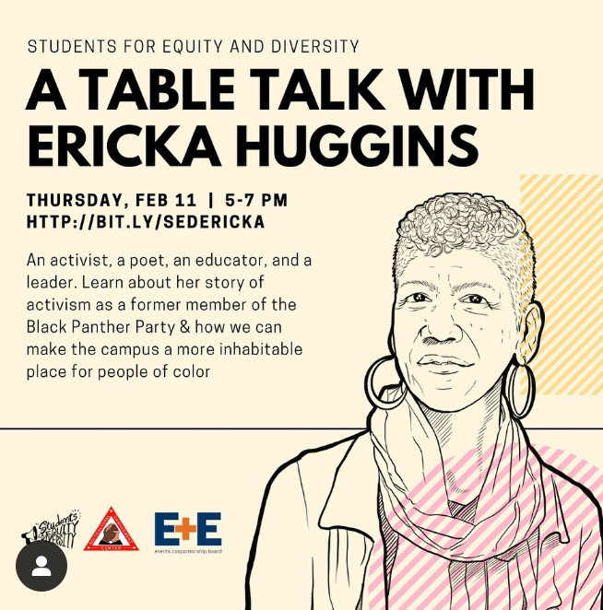
University of Texas Multicultural Engagement Center
The Multicultural Engagement Center (MEC) mission statement:
“Transform lives by providing diverse educational opportunities and support services for students.
The MEC has the following student agencies to support its mission:
Afrikan American Affairs (AAA)
Asian Desi Pacific Islander American Collective (ADPAC)
Latinx Community Affairs (LCA)
Native American and Indigenous Collective (NAIC)
Queer & Trans People of Color Agency (QTPOCA)
Students for Equity and Diversity (SED)
Other resources and opportunities offered by MEC:
Programs & Services
Education
Graduations
Notes:
All agencies have their own council that is student ran and most communication is through Instagram
They put on their own events specific to what students want to have

Slide 24
Other Resources/Opportunities at UT
Programs & Services
Academic advising for students
Programmatic advising for student organizations
Conference room and common space use reservation
Lounge areas and computer availability
Lending Library
Outreach
Education
MEC Course
  Leadership as Activism
Workshop Series
  This is Who I Am: Identity Exploration
  Power and Privilege: Moving from Awareness to Action
  Microaggressions: Understanding Impacts of Our Words and Actions
  Recognizing Implicit Bias
Graduations
Black Graduation Ceremony and Reception
Graduasian
Latinx Graduation
Notes:
All resources located at one spot, becomes the gathering place for all minority students
Encompasses the college experience for minority students

Slide 25

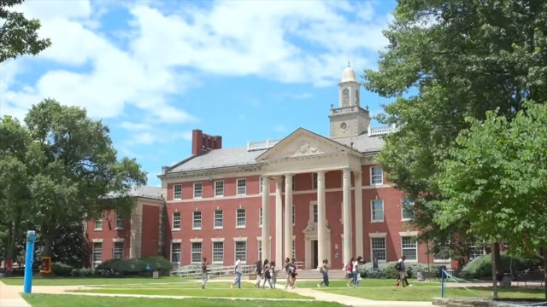
Howard University Student Affairs
Diversity & Inclusion Resources
Healing at Howard
Gender-Inclusive Housing
Accommodations
Activities on Campus
Student Government
Sororities and Fraternities
Clubs and Organizations
Reserve Space in Blackburn
Wellness Resources
Student Health Center
Counseling on Campus
Student Food Pantry
Notes:
Hard to find resource specific to "multicultural" because of being a HBCU

Slide 26
Food Insecurity Definitions
Food Insecure: lacking reliable access to a sufficient quantity of affordable, nutritious food
Food insecure households include:
Low food security – “reports of reduced quality, variety, or desirability of diet. Little or no indication of reduced food intake” (USDA, 2019).
Very low food security – “reports of multiple indications of disrupted eating patterns and reduced food intake” (USDA, 2019).

Slide 27
Food and Housing Insecurity on Campus Statistics
According to the 2021 ACHA-National College Health Assessment, 36% of college students nationwide reported being food insecure.
According to the Hope Survey from Fall 2020, 75 percent of Indigenous, 70 percent Black, and 70 percent of American Indian or Alaska Native students experienced food insecurity or housing insecurity, while just 54 percent of White students faced these insecurities on campus.
In a study done by Dr. Payne-Sturges and colleagues, they found that even after adjusting for age, gender, and family income, students categorized as African American or other underrepresented races/ethnicities were significantly more likely to be food insecure or at risk than white students.

Slide 28
Effects of Food and Housing Insecurity on Campus
Both of these studies found that food and housing insecurity affect performance in the classroom, compared to food-secure counterparts.
Food/Housing insecurity contributes to:
Lower attendance
Lower completion rates
Lower GPA
Worse Nutrition (Food insecurity)
Mental Health Issues
In the study conducted by Dr. Payne-Sturges and colleagues, they found that those who were food insecure had a GPA around .2 lower, than those who were not food insecure.

Slide 29
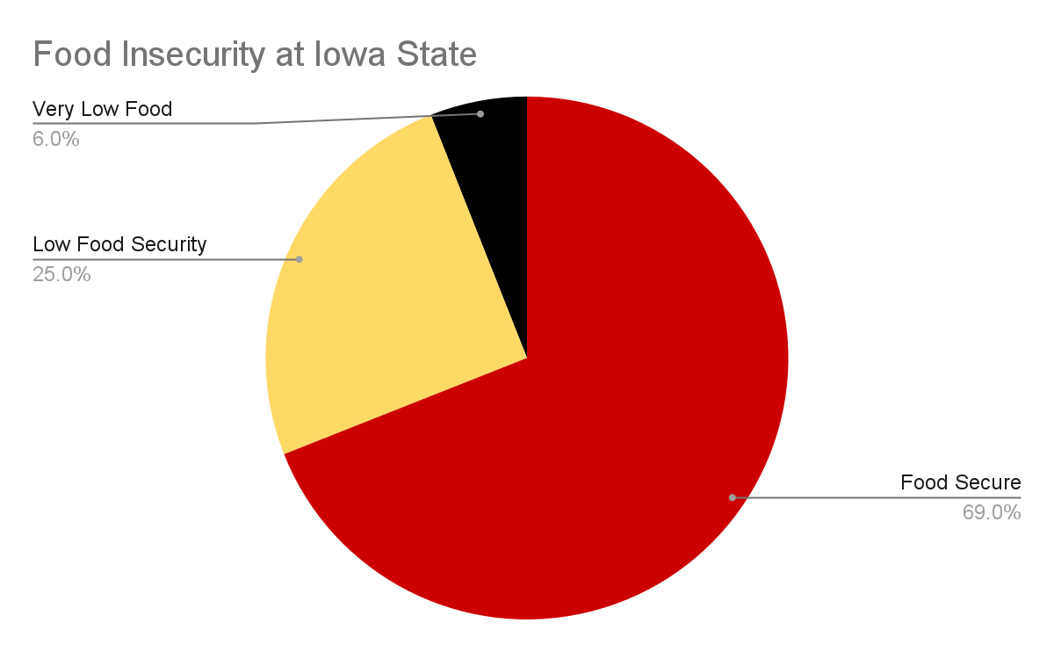
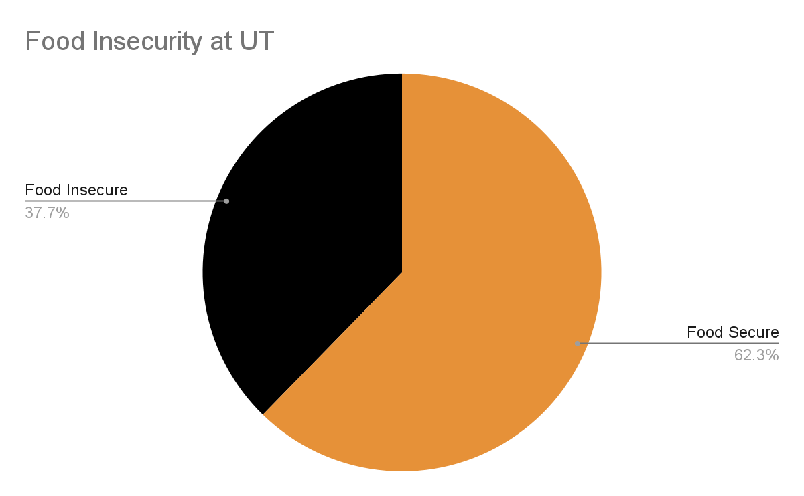
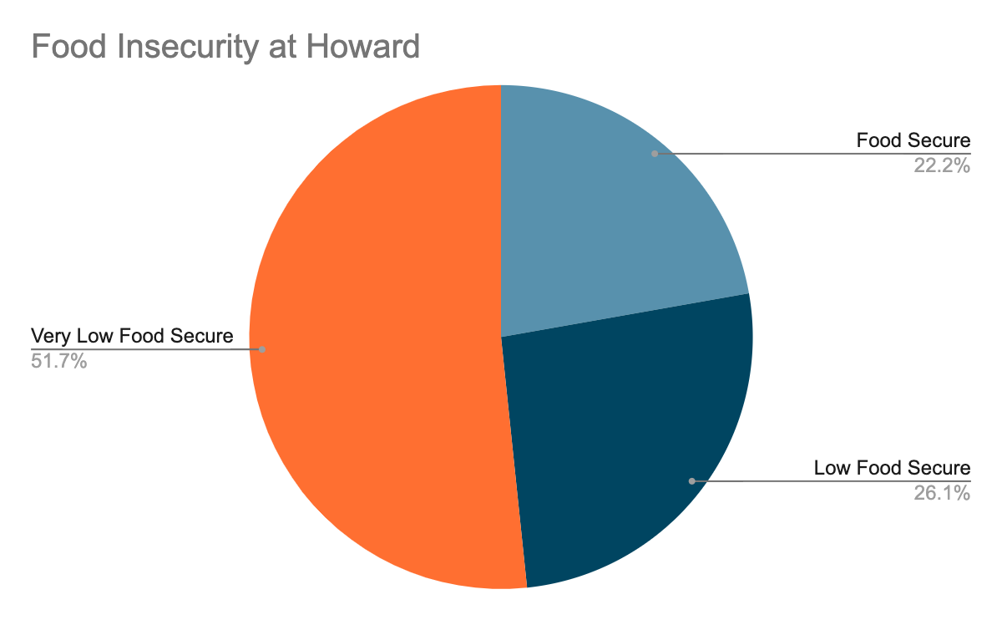
Food Insecurity Compared
Iowa State
Texas
Howard

Slide 30
Food Insecurity in Numbers
In 2019, 77.8% of Students at Howard University faced food insecurity in a study down by Howard University
  40.1% more students faced food insecurity at Howard compared to Texas
  46.8% more students faced food insecurity at Howard compared to Iowa State
Black UT students were 2.65 times more likely to be food-insecure than white respondents
68% of food-insecure students living in nearby off-campus neighborhoods and only 7% of food-insecure students living in a dorm.

Slide 31
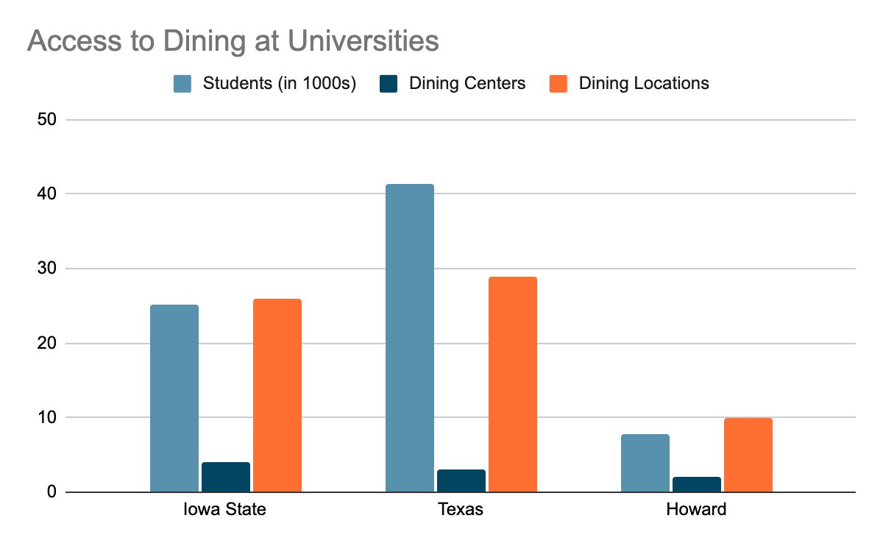
Food Insecurity Compared

Slide 32
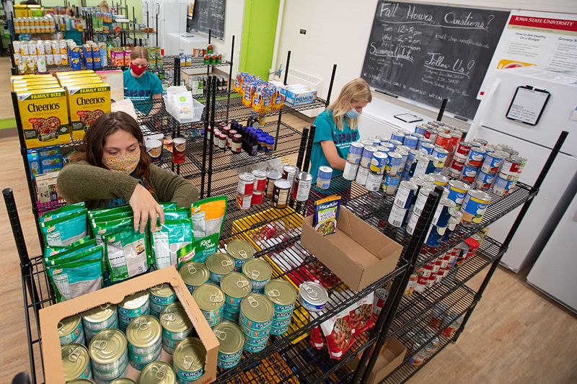

Addressing Food Insecurity at Iowa State
Mission: Engage with anti-hunger advocates and serve the student population by increasing hunger awareness and food security.
Created by a group of students looking to give back to their community
Run by volunteers
Food is obtained through donations.
Students may come in and pick up food without showing any ID, which makes this service completely confidential.
The Shop

Slide 33
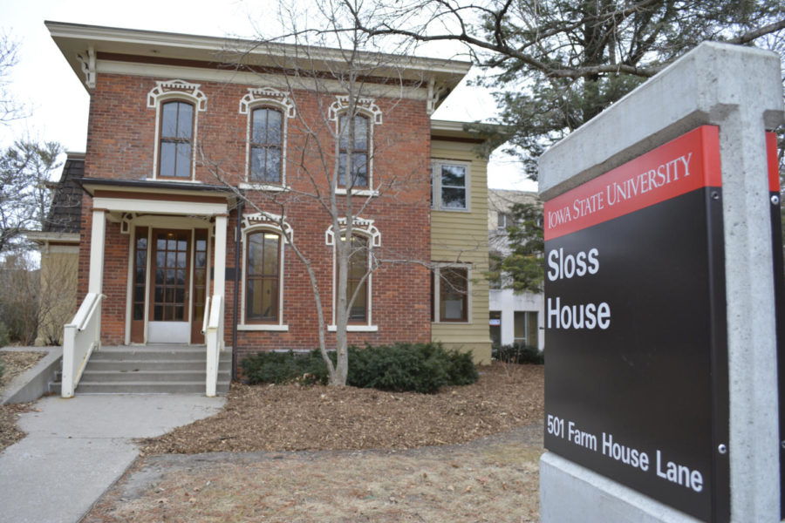
Sloss Center for Women and Gender Equity in Collaboration with The Shop:
Resource Room:
  Non-Perishable Food Items
  New or Gently Used Clothing Items
  Personal Care Items
Free Attire Pop Up Shops:
College of Life Sciences
College of Business
Liberal Arts and Sciences

Slide 34

More Programs at Iowa State University
Additional Programs at Iowa State Fighting Food Insecurity:
Give A Swipe: Allows Students to donate their meal swipes or dining dollars to other students
Iowa State Food Insecurity Challenge: Students in the College of Agriculture and Life Sciences teamed up with students from various other departments at Iowa State University to compete in Iowa State’s Food Insecurity Challenge

Slide 35
Addressing Food Insecurity
Texas
Howard
Offers Students an on-campus food pantry called the ”UT Outpost”
  Supports students with healthy food and gently used professional clothing
Offers Students an on-campus food pantry called “The Store”
    It supplies students with short-term food insecurity needs and provides basic hygiene items

Slide 36
Student & Faculty Analysis on Campus
Notes:
Student demographics: 3 black students. 2 Male, 1 Female. Ages 18-21.
Faculty demographics: Different ethnicities and background. Both male and female. Time at Iowa State varies.

Slide 37
Methods
We reached out to minority students that we knew from different resources and involvements such as classes, scholarships and church
We got connected to staff and faculty through the NCORE-ISCORE program
We sent an email to each person with 5 questions about minority student campus life and resources
We then compiled our findings and summarized the main points we got from them

Slide 38
Student Interview Analysis
Other information we found from the interviews included:
Each of the students were aware of the resources available to them, but their involvement fluctuated
Each student felt like these resources help them succeed socially and academically with things like accountability, comfort and growth to networking and professionalism
“I feel these (resources) will help me succeed socially in aspects of networking and professionalism”
Students were pleased for the most part with few suggestions like more events or renovation and growth of centers
Notes:
Demographics??

Slide 39
Faculty Interview Analysis
After interviewing faculty and staff that work with minority students at Iowa State it is clear they care about their students and their success
“I hope they get a sense of belonging and encouragement from our office. I feel we show the students our desire to help and to get them to where they want and need to be.
Resources often used by students include tutoring, study space and lounge areas
Resources staff felt students take the least advantage of include reaching out to staff and faculty about any circumstance and different events they put on
They wish to see more collaboration between students of all background so they can share their experiences and cultures as well integrating more diversity learning for both students and staff.
“I feel the upper administration still have a lot to learn about multicultural students and life on campus. I think sometimes the personal touch is missing and gets lost in bureaucracy.”
Notes:
Demographics??

Slide 40
Conclusion
After conducting interviews with students and faculty on campus and comparing Iowa State to other universities, Iowa State would benefit from:
Increased collaboration and promotion of all different types of resources on campus
  Paired scholarship events
  The SHOP with different clubs
  More Programs like Meal Swipe Donations and working for food insecurity solutions
  Shared information in gen ed classes
Overall increase in resource advertisement to reach target students
Notes:
In comparison to other universities, we are doing quite well in providing resources to students. However, lack of knowledge of available resources may be an area the university needs to improve on. Ex. I'm(Kennedy) a senior and am just now learning about more of these resources for the 1st time because of the research done for this presentation

Slide 41
Works Cited
“About UT Outpost.” Office of the Dean of Students - Student Emergency Services - UT Outpost, https://deanofstudents.utexas.edu/emergency/utoutpost.php#:~:text=According%20to%20the%20fall%202021,combat%20food%20insecurity%20on%20campus.
Academic.oup.com, https://academic.oup.com/cdn/article/3/Supplement_1/nzz051.P04-086-19/5516892.
Correia, Bierma, S. R., Houston, S. D., Nelson, M. T., Pannu, K. S., Tirman, C. M., Cannon, R. L., Clance, L. R., Canterbury, D. N., Google, A. N., Morrison, B. H., & Henning, J. A. (2022). Education Racial and Gender Disparities in COVID-19 Worry, Stress, and Food Insecurities across Undergraduate Biology Students at a Southeastern University. Journal of Microbiology & Biology Education, 23(1). https://doi.org/10.1128/jmbe.00224-21
“Enrollment Statistics.” Enrollment Statistics | The Office of the Registrar | Iowa State University, https://www.registrar.iastate.edu/resources/enrollment-statistics#:~:text=This%20fall%2C%2016%2C696%20Iowans%20are,16%2C417%20(54.8%25)%20were%20men.
“Everything about Meal Plans at Howard University: The Ultimate Guide|dining at Howard|peace Arobieke.” YouTube, YouTube, 14 July 2021, https://www.youtube.com/watch?v=keRp_ny5Xkk&t=874s.
“Facts & Figures.” Facts & Figures | The University of Texas at Austin, https://www.utexas.edu/about/facts-and-figures.

Slide 42
Works Cited
“Howard University Home.” Excellence in Truth and Service, https://howard.edu/.
“Howard University Student Population and Demographics.” Univstats, https://www.univstats.com/colleges/howard-university/student-population/.
“Howard University.” Data USA, https://datausa.io/profile/university/howard-university.
“Hunger Resources/Food Insecurity.” Student Wellness, https://www.studentwellness.iastate.edu/food-insecurity/.
“Hunger Resources/Food Insecurity.” Student Wellness, https://www.studentwellness.iastate.edu/food-insecurity/.
McCoy, Maureen, et al. “Food Insecurity on College Campuses: The Invisible Epidemic.” Health Affairs Forefront, 31 Jan. 2022,https://www.healthaffairs.org/do/10.1377/forefront.20220127.264905/#:~:text=The%20report%20also%20highlighted%20significant,54%20percent%20of%20White%20students.
Menchaca, Megan. “Survey: Nearly 1 in 3 University of Texas Students Lack Access to Affordable, Healthy Food.” Statesman, Austin American-Statesman, 11 May 2022, https://www.statesman.com/story/news/2022/05/09/nearly-third-surveyed-ut-university-of-texas-students-food-insecure-report-finds-austin/9561412002/.

Slide 43
Works Cited
Multicultural Engagement Center, The University of Texas at Austin, 1 Dec. 2022, https://diversity.utexas.edu/multiculturalengagement/
Multicultural Student Affairs: Iowa State University. Multicultural Student Affairs | Iowa State University. (n.d.). Retrieved October 13, 2022, from https://www.multicultural.dso.iastate.edu/
Payne-Sturges, D. C., Tjaden, A., Caldeira, K. M., Vincent, K. B., & Arria, A. M. (2017). Student Hunger on Campus: Food Insecurity Among College Students and Implications for Academic Institutions. American Journal of Health Promotion. https://doi.org/10.1177/0890117117719620
“Students Team up to Tackle Food Insecurity.” College of Agriculture and Life Sciences, 6 Dec. 2022, https://www.cals.iastate.edu/features/2022/students-team-tackle-food-insecurity.
U.S. Census Bureau Quickfacts: Iowa. https://www.census.gov/quickfacts/fact/table/IA/PST045221
.
“Undergraduate Students: Fall & Spring.” Office of Student Financial Aid, https://www.financialaid.iastate.edu/cost/cost-of-attendance/undergraduate-students/.
Valandra, Fields, L. S., Sebree, W., & Sober, W. (2022). Navigating an anti-Black campus climate: #black@pwi. Race Ethnicity and Education, 1–18. https://doi.org/10.1080/13613324.2022.2088720

Slide 44



Notes:
Adry Gonzalez-Elliot

