Slide 1

The Lasting Effects of the "Americanization" of Indigenous Students of North America
March 3rd @ 3:10-4:00 pm
Room 3580, Memorial Union
Iowa State University
#ISCORE2023
Notes:
Insert session title and presenters names on this slide

Slide 2
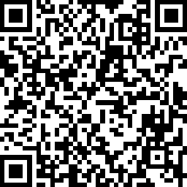
Check
In:
#ISCORE2023
Notes:
Do not edit or remove. This slide is for participants to scan and check into the conference if they haven’t done so already.

Slide 3

NCORE-ISCORE Mission
The NCORE-ISCORE Project supports Iowa State University’s diversity efforts. The project provides positive interactions and dialogue regarding race, ethnicity, and multicultural relations through local and national initiatives including participation in two conferences: NCORE (National Conference on Race & Ethnicity) and ISCORE (Iowa State Conference on Race & Ethnicity).
#ISCORE2023
Notes:
Do not edit or remove

Slide 4
Land Acknowledgement
We would like to begin this event with a land acknowledgment. Iowa State University is located on the ancestral lands and territory of the Baxoje (bah-kho-dzhe), or Ioway Nation. The United States obtained the land from the Meskwaki and Sauk nations in the Treaty of 1842. We wish to recognize our obligations to this land and to the people who took care of it, as well as to the 17,000 Native people who live in Iowa today.
#ISCORE2023
Notes:
Do not edit or remove

Slide 5

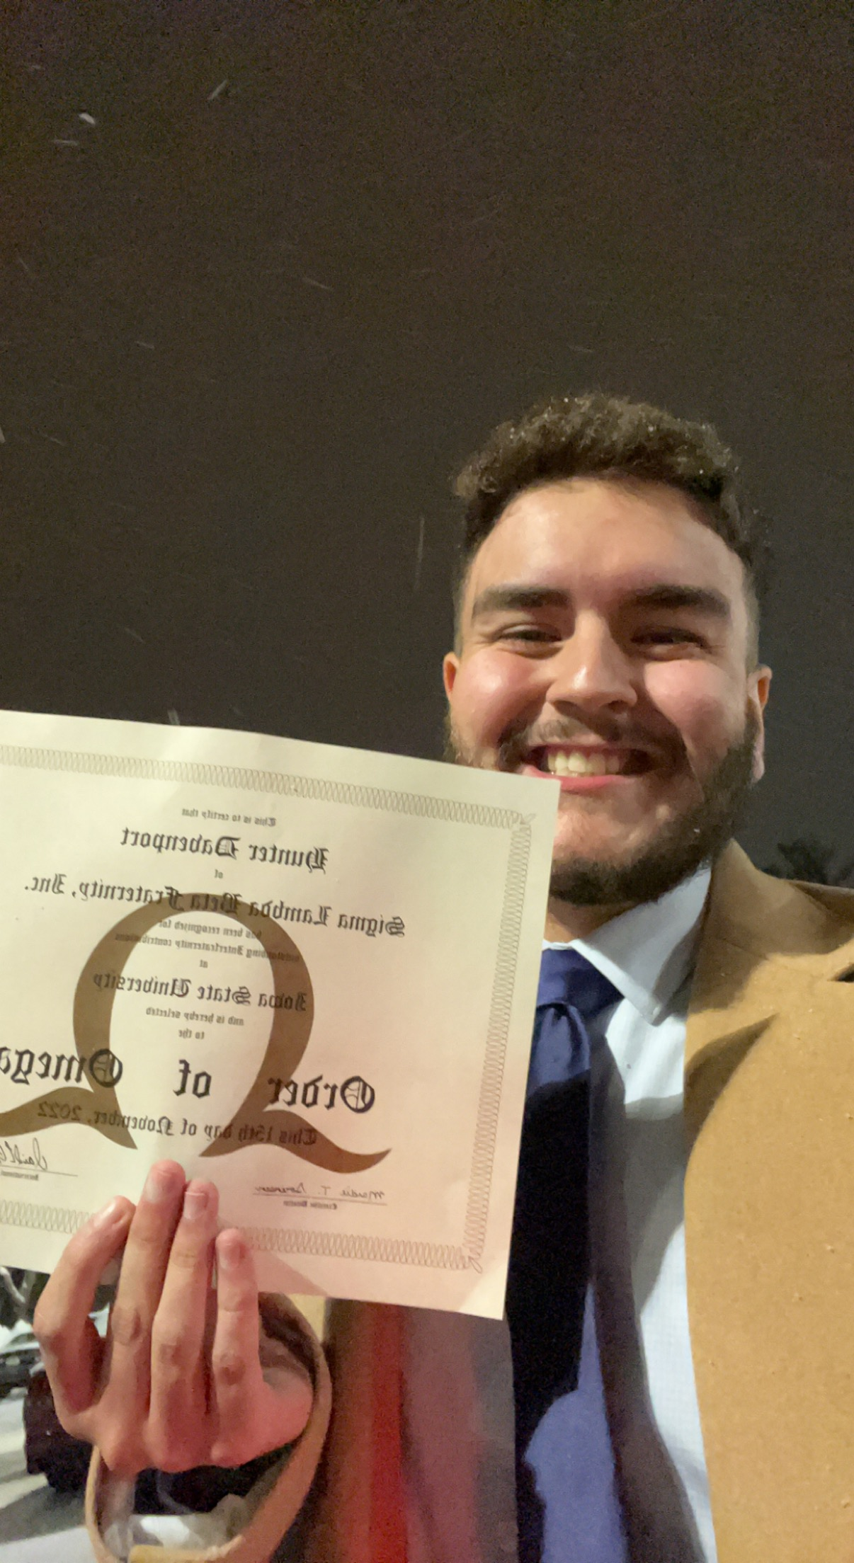
Name of Featured Speaker
Hunter Davenport
Iowa State Student
  4th year
  Biology and Kinesiology & Health major
Descendant of the Meskwaki Settlement in Tama, Iowa
President of Sigma Lambda Beta International Fraternity, Inc.
Science Bound Scholar
Honors Student
Enjoyer of Science (and basketball)
#ISCORE2023
Notes:
Use this slide to introduce presenters and add photos, if desired

Slide 6
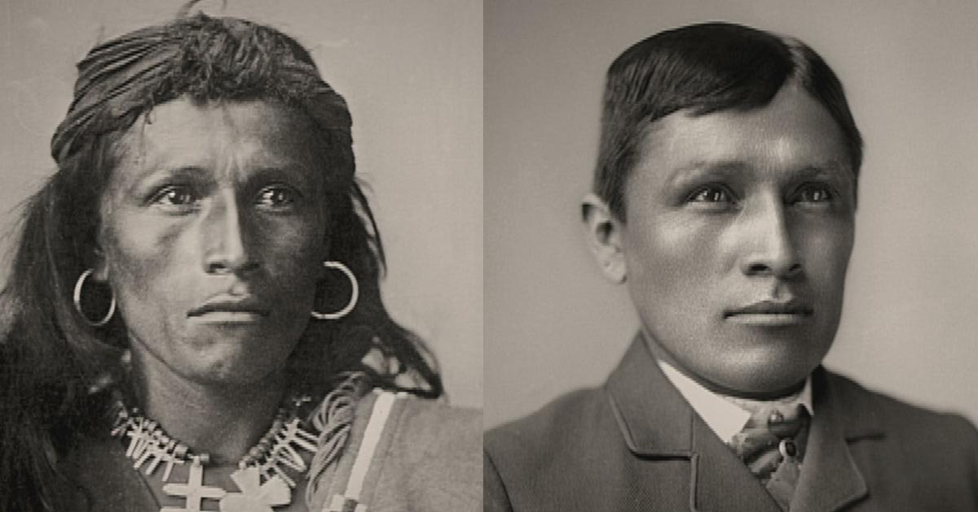
The Past: The history of Americanization
#ISCORE2023
Notes:
LINK: https://www.pbs.org/video/american-experience-us-governments-education-native-american-children/

Slide 7

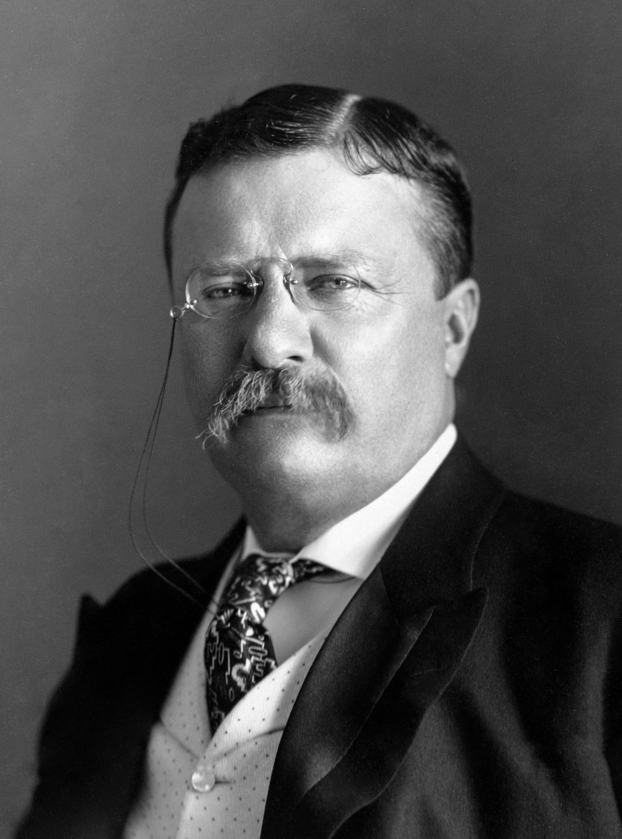
The beginning of Americanization:
“I don’t go so far as to think that the only good Indians are the dead Indians, but I believe nine out of every 10 are… And I shouldn’t like to inquire too closely into the case of the tenth.”
President Roosevelt
#ISCORE2023
Notes:
Opinions were mixed in the east during the 1870’s and 1880’s, around the time period of the plain wars. Roosevelt said (quote here) during a January 1886 speech in New York. And this sentiment was supported and based by other leaders such as General Philip Sheridan who popularized the saying, “the only good Indian is the dead Indian”.
Image Link https://en.wikipedia.org/wiki/Theodore_Roosevelt

Slide 8
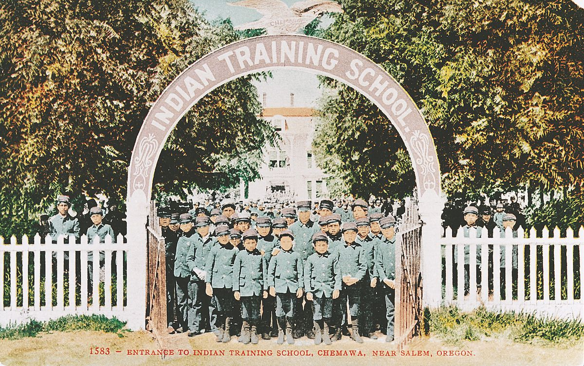
The beginning of Americanization:
The opposing viewpoint of American Reformers
Criticized the violence to the Native people
American Reformers pushed for helping (assimilating) natives through…
  Americanization via Boarding Schools
Students posing at the entrance to Chemawa Indian School in 1905. (Courtesy of Pacific University Archives)
#ISCORE2023
Notes:
On the other side of the isle, American reformers criticized the violence to the native people and came up with their own solution to helping the native people. Assimiliation via a process called americanization. And the mode of transmission would soon be completed via boarding schools
Picture Link: Students posing at the entrance to Chemawa Indian School in 1905. (Courtesy of Pacific University Archives)

Slide 9
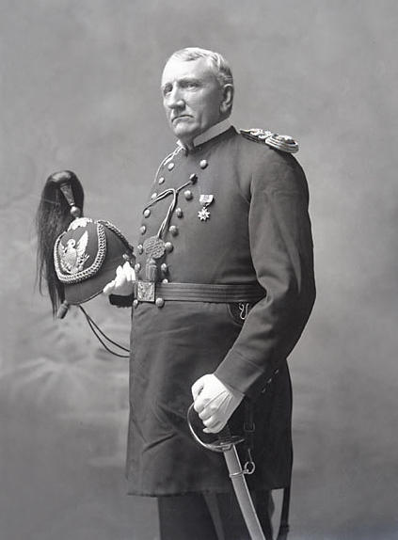
The Creation of Boarding Schools:
Richard H. Pratt
  The driving force behind Indian boarding schools
  Created the basis of both the curriculum and structure for the first boarding school founded in 1879
    The Carlisle Indian School
“Kill The Indian, Save The Man”
  Euro-American Capitalism
Richard H. Pratt
#ISCORE2023
Notes:
Richard H. Pratt was the driving force behind Indian boarding schools, Pratt had a history of assimilation through his tenure supervising a prison camp for captive Native Americans from 1875 to 1878
In a speech titled, kill the Indian, save the man, Pratt said that the indians' inferiority was cultural, not racial, and that even Native Americans could become educated and. “civilized” if only given the same opportunities provided to white Americans, African. Americans, and immigrants. separation from the tribe was necessary to achieve true assimilation. In his view, the only way to educate and civilize an Indian child was to take him away from the primitive influence of his family.
Image Link: https://en.wikipedia.org/wiki/Richard_Henry_Pratt

Slide 10
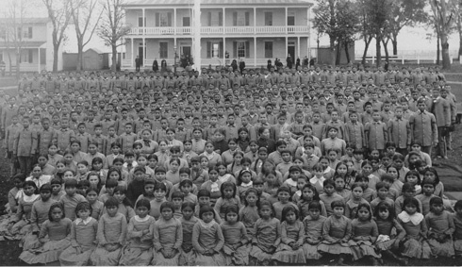
The Creation of Boarding Schools:
Carlisle Indian School Students [Photograph]
#ISCORE2023
Notes:
Today many are beginning to refer the boarding schools as assimilation camps
Image link: https://chnm.gmu.edu/cyh/primary-sources/291.html

Slide 11
What is Americanization?
Cultural Assimilation
Cultural Genocide
Forceful assertion of American values
Religious Reform
Christianity
#ISCORE2023
Notes:
Cultural assimilation to overthrow Native culture and force their culture onto them. All the while, killing the native culture through forceful assertion of American values. In doing so, pushing religious reform of ideas of Christianity to assimilate and destroy the culture
With the increase in immigration of Europeans to the United States, they wanted to have a standard, base set of values, beliefs, and culture for the majority of citizens

Slide 12
The Spread of Boarding Schools:
408 Federal Indian Boarding schools
Across 37 states or territories
Total number of children taken is unknown but…
By 1900, there were approximately 20,000 children in boarding schools
By 1925 that number had tripled
By 1926, nearly 83% of Indian school-age children were attending boarding schools.
#ISCORE2023
Notes:
Beginning with Carlisle Indian school, boarding schools spread like wildfire across the United States. Ran by both the federal government and churches in the US and canada

Slide 13
The Effects of Boarding Schools:
Kidnapping
“Child Snatching”
Long distance from reservations
Hope for adaptation
Conditions of Boarding Schools
Overcrowding
Poor Ventillation
No indoor toilets/lack of sanitary supplies
“Trough-like basins for washing”
General unsanitary conditions
“SON, BE BRAVE AND GET KILLED” – OTA KTE’S FATHER
#ISCORE2023
Notes:
as if he were going to war. He was a young Lakota boy from the first class of the Carlisle Indian school. The boy recalled the phrase as he was led onto a boat with other Lakota children guided by strange white women and men. This was Carlisle’s first class: 86 Lakota, 66 from Rosebud Agency and 20 from Pine Ridge Agency, the children of recalcitrant people who refused to cede any more land to the United States. The expression — “be fearless” — had been so thoroughly engrained in Ota Kte’s being that, he claimed, “I knew nothing else.” During the long, difficult journey eastward, which continued by rail and ended at Carlisle, the boy clung to his father’s words.

Slide 14
The Effects of Boarding Schools:
Removal of traditions
Traditional clothing/haircut
Tribal Dances/Ceremonies
Raised by strangers led to loss of culture from elders
Disease and lack of proper healthcare
Increased susceptibility to diseases like TB and measles
3x as likely to have cancer
2x as likely to have TB
80% more likely to have diabetes
#ISCORE2023
Notes:
This template can be used for a majority of your content. Duplicate as necessary.

Slide 15
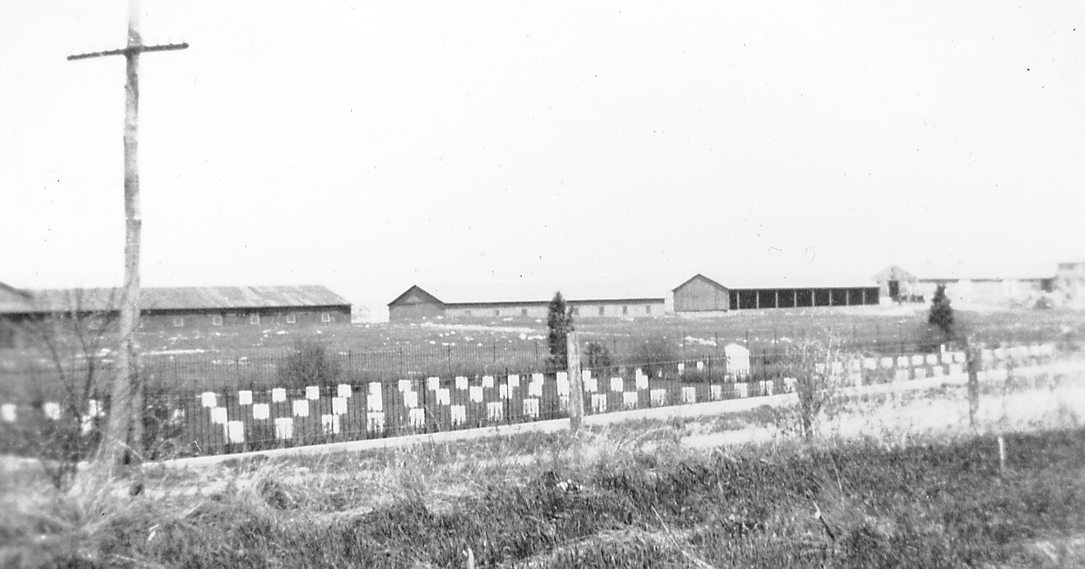
Boarding School Cemetery:
“Your son died quietly, without suffering, like a man. We have dressed him in his good clothes and tomorrow we will bury him the way the white people do.”
-Richard H. Pratt, founder of Carlisle Indian School
Carlisle Boarding School Cemetery [Photograph]
#ISCORE2023
Notes:
Almost every school had their own cemetery. And even then, the children were not allowed to be put to rest In the manner of their culture, they were forced to be assimilated, even in death
Link to quote and picture: https://boardingschool.heard.org/health/#:~:text=Overcrowding%2C%20poor%20diet%20and%20unsanitary,problem%20at%20the%20boarding%20schools.

Slide 16
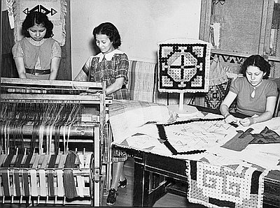
The Effects of Boarding Schools:
Child Labor:
For Boys Included:
For Girls included:
Working on railroad systems
Raising livestock and poultry
Making shoes and/or hats
Cooking and sewing garments
Removal of Culture:
Mixing tribes together in an effort to nationalize them
The outing program
1883 Religious Crimes Code
Banned practice of Indigenous ceremonies
Banned traditional healing methodologies
Medicine men seen as devices to keep the “Indians” under his influence
Girls weaving on looms at the Chemawa Indian School, 1937.
Oreg. Hist. Soc. Research Library, bb003867
#ISCORE2023
Notes:
Now, lets delve into some of the effects of boarding schools. Beginning with child labor. Children were forced to support the school with these responsibilities economically through sewing garments or making shoes
Image link: https://www.oregonencyclopedia.org/articles/indian_boarding_school/#.Y-bmxezMK3I

Slide 17
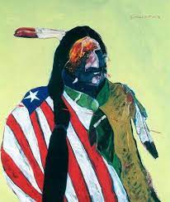
The Effects of Boarding Schools:
Physical Abuse
Low-grade rations withheld often causing starvation
Whipping/slapping
Solitary Confinement
Performance of military drills in units
Flogging
Emotional Abuse
Homesickness
Suicide
Sexual Abuse
An American Portrait by Fritz Scholder
#ISCORE2023
Notes:
Flogging is defined as a punishment where they were hit with a whip or a stick
LINK: http://publichealth.lacounty.gov/dvcouncil/minutes/2020/09/DV_AmericanIndians.pdf

Slide 18
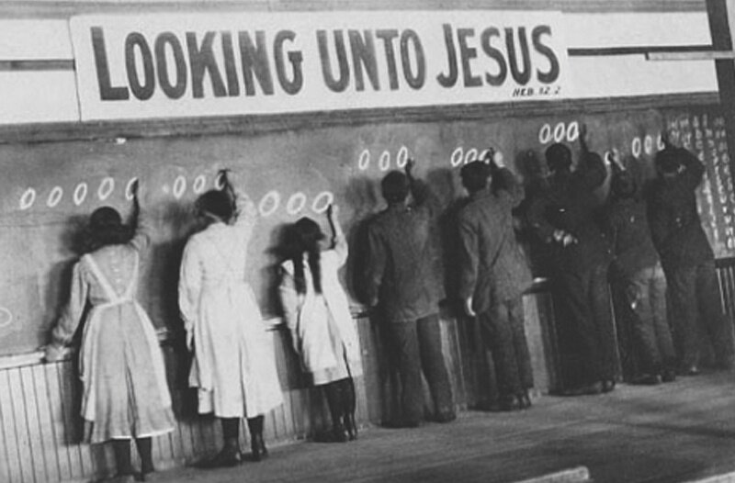
The Effects of Boarding Schools:
Conversion to Christianity
  Boarding school system turned over to churches
    In particular, the Catholic Church
  Churches, abbeys, convents and monasteries were built on or near reservations
  Children were given “Christian” Names
#ISCORE2023
Notes:
religious orders were founded and flourished.
The historical role of Christianity in Federal Indian boarding schools is thus one in which the “separation of church and state” simply didn’t apply
The indigenous ceremonies and methodologies were quickly replaced and diluted with forced religion
Image Link https://www.samanthamwilliams.com/blog/religion-and-boarding-schools

Slide 19
How The Students Stood Against The Boarding Schools
Running Away
Setting fire to buildings
Being subversive in school assignments
Plains sign talk
A form of sign used to speak between tribes that was unintelligible to the teachers
Speaking a common language
Lakota or Sioux
Students came from Rosebud and Pine Ridge reservations
#ISCORE2023
Notes:
This template can be used for a majority of your content. Duplicate as necessary.

Slide 20
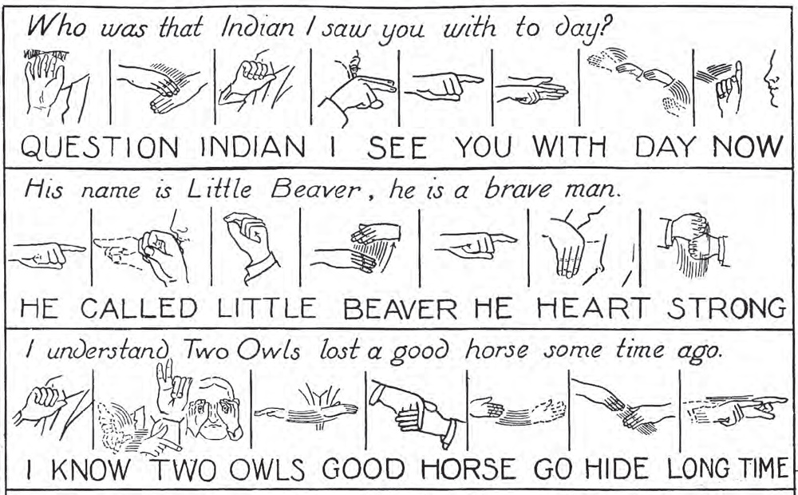
Plains Sign Talk:
William Tompkins, Indian Sign Language (1931).
#ISCORE2023
Notes:
Image Link: https://lewis-clark.org/sciences/ethnography/plains-sign-language/

Slide 21
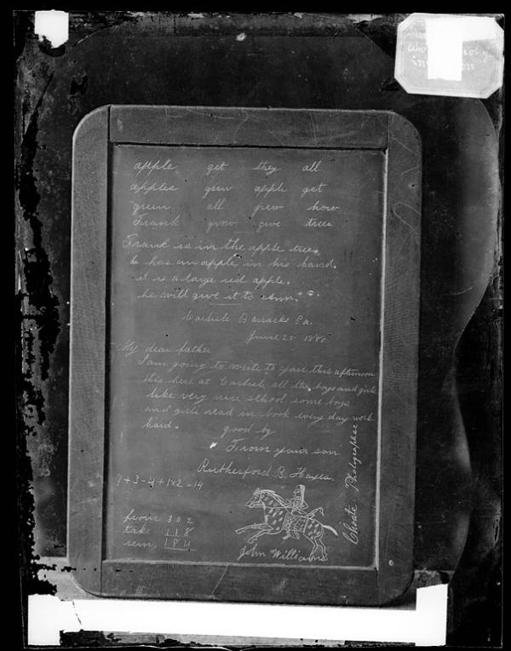
How The Students Stood Against The Boarding Schools
Pictographic Writing
To tell stories
Hope and strength
Building the Pan-Indian Resistance
Resistances of the Society of American Indians (founded in 1911) to the American Indian Movement (AIM) of 70’s can trace their roots to intertribal communities of solidarity that were built in the boarding schools.
Format: Glass Plate Negative
Photographer: John N. Choate, Carlisle, PA
#ISCORE2023
Notes:
Intertribal communities built on solidarity helped to act as the point of growth for many different resistance groups and movements decades down the line
Image link: https://carlisleindian.dickinson.edu/images/slate-showing-student-work-names-r-b-hayes-and-john-williams-version-1-1880

Slide 22
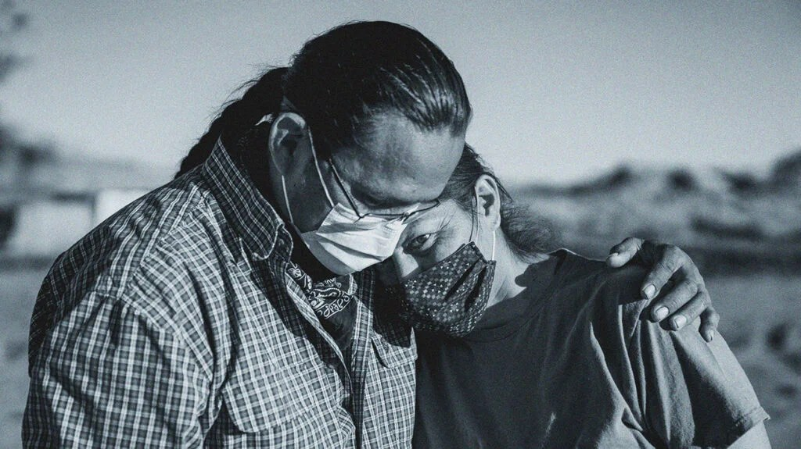
The Present: Americanization Today
#ISCORE2023
Notes:
Now that we know about the history of boarding schools and some of the immediate effects of them we can now talk about the present day. And see how the connective tissue between the past to today impacts indigenous people
Link: https://www.medicalnewstoday.com/articles/the-impact-of-historical-trauma-on-american-indian-health-equity
NOTE: may add info about covid if there istime needed to be filled

Slide 23
What Is Intergenerational Trauma?
The intergenerational and unconscious grief from the historical trauma experienced by Indigenous peoples is passed from generation to generation due to forced relocation, land dispossession, and loss of spiritual practices, language and culture.
#ISCORE2023
Notes:
Lets now look a little deeper into the historical trauma
Link: https://www.psychiatry.org/psychiatrists/cultural-competency/education/stress-and-trauma/indigenous-people#:~:text=Intergenerational%20Trauma%3A%20The%20intergenerational%20and,spiritual%20practices%2C%20language%20and%20culture.

Slide 24
What is Historical Trauma?
Historical trauma
  intergenerational trauma experienced by a specific cultural group that has a history of being systematically oppressed
The primary feature of historical trauma is…
  The trauma is transferred to subsequent generations through biological, psychological, environmental, and social means, resulting in a cross-generational cycle of trauma (Sotero, 2006)
#ISCORE2023
Notes:
Historical trauma is cyclic in nature, like this presentation. And symptoms of this can include anything from depression to substance dependence to dysfunctional parenting
Link: https://www.acf.hhs.gov/trauma-toolkit/trauma-concept#:~:text=Historical%20trauma%20is%20intergenerational%20trauma,on%20psychological%20and%20physical%20health.

Slide 25
The Three Phases of Historical Trauma (Sotero, 2006):
Phase 1
Mass trauma forced upon a population by a dominant culture which results in…
Cultural, familial, societal, and economical devastation for the population
Phase 2
Occurs when the original generation of the population responds to the trauma
In the form of biological, societal, and psychological symptoms
Phase 3
The initial responses to the trauma is conveyed to successive generations through…
Environmental and psychological factors, and prejudice and discrimination
#ISCORE2023
Notes:
Historical trauma can be broken down into 3 main phases.
Based on the theory, Native Americans were subjected to traumas that are defined in specific historical losses of population, land, family and culture. These traumas resulted in historical loss symptoms related to social-environmental and psychological functioning that continue today (Whitbeck, Adams, Hoyt, & Chen, 2004).
Link: https://amber-ic.org/wp-content/uploads/2017/01/ICMN-All-About-Generations-Trauma.pdf

Slide 26
Historical Loss Tied to Boarding Schools:
Removed from their homes at the age of 4-5
Little to no contact with native relatives for at least 8 years
Forced haircuts and clothing to match European children
Physical and Sexual abuse causing problematic coping strategies such as…
Learned helplessness
Manipulative Tendencies
Compulsive Gambling
Alcohol and drug use
Suicide
Denial
Scapegoating of other children
Considered the precursor to so many existing problems for native people
#ISCORE2023
Notes:
Native children were removed at the ages of 4-5, forced to cut their hear and remove their traditional clothing to dress as European children. They were not allowed contact with their native american relatives for a minimum of 8 years. Sacred items and spiritual practices were removed. Physucal and sexual abuse was commonplace and caused problematic coping strategies such as learned helplessness, manipulative tendencies, compulsive gambling, alcohol and drug use, suicide, denial, and scapegoating of other children)
Loss of ethnic identity occurred as a result of being so disconnected from the culture in these ways.

Slide 27
Societal-environmental concerns:
Domestic Violence & Physical/Sexual Assault are 3.5x higher than the national average in Native American Communities (Sue & Sue, 2012).
Native children are disproportionally represented in the child welfare system
-Often attributed to NA parents’ shortcomings and failures rather than the structural factors negatively influencing the parenting environment (Crofoot & Harris, 2012).
Native youth are 3x more likely to be confined than white youth (255 per 100K vs 83 per 100K)
Native jail population is up 85% since 2000
The number of people in Indian country jails increased by 61% between 2000 and 2018.
#ISCORE2023
Notes:
Number of physical and sexual assaults may actually be low as a high number of assaults are left unreported
Meanwhile, the total population of Native people living on tribal lands has actually decreased slightly over the same time period, leaving us to conclude that we are criminalizing Native people at ever-increasing rates.

Slide 28
Societal-environmental concerns:
Wealth: (Total value of assets – debts). So little data available. Source data from Mariko Chang’s 2000 seminar stated, “where it sites an estimate of a median $5,700 for Native American wealth compared to a median $65,000 of wealth for the American population as a whole.”
Income: Median Income of American Indian and Alaskan Native households - $43,825 (compared to White, non-Hispanic household median income of $68,785). In 2015, the average income on reservations was 68% below the US average, about $17,000
Poverty Level: Native Americans have the highest poverty level (US Census, 2018) at 25.4% (compared to African American poverty rate of 20.8% and the white poverty rate at 8.1% during the same period.)
Unemployment: American Indians and African Americans are the most economically disadvantaged racial groups as the employment rates for both groups is 8.1% compared to an unemployment rate of 3.3% for the white population (Bureau of Labor, 2019).
#ISCORE2023
Notes:
Wealth, income, poverty level, and unemployment are all pieces of hard data that can be used to better understand how indigenous people are surviving in society today.
they were ill-prepared to join the mainstream economy and job market by pursuing college or a career, which led to adverse economic impact on Native American communities, the report found.

Slide 29
Psychological Concerns:
Substance Abuse (Addictive Behavior)
  Data from the 2018 National Survey on Drug Use and Health
10% of Native Americans have a substance use disorder. (NSDUH, 2018).
4% of Native Americans have an illicit drug use disorder.
7.1% of Native Americans have an alcohol use disorder.
Nearly 25% of Native Americans report binge drinking in the past month.
#ISCORE2023

Slide 30
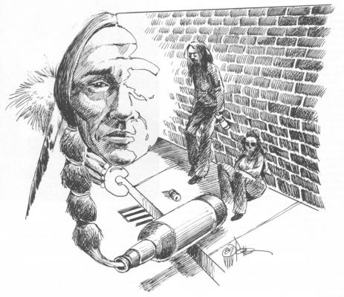
Psychological Concerns:
  Abuse and Addictive behaviors commonplace among boarding school survivors as a result of coping mechanisms (Wilk et al., 2017).
  A study has shown that of the First Nations children who consume drugs, there was a higher likelihood of the child being put into child welfare systems if their grandparents and parents attended boarding schools (Barker et al., 2019).
#ISCORE2023
Notes:
Substance abuse has been linked to being used as a coping mechanism.

Slide 31
Psychological Concerns:
  Suicide Rates:
    From 2015-2020, there was a nearly 20% increase in suicide rates among non-Hispanic Native Americans compared to a <1% increase in the overall U.S. population (Stone et al., 2022).
    Several studies have linked suicidal thoughts and attempts have been associated with personal and familial attendance of residential schools (Elias et al., 2012)
    Children who had at least one parent in residential school had increased suicide thoughts compared to those without a parent that attended ( First Nations Regional Health Survey).
#ISCORE2023
Notes:
Suicide is a very complex problem with multiple contributing circumstances
Residential school may perpetuate the cycle of victimization
Elias and colleagues [41] found that residential school attendees who suffered abuse were more likely to have a history of suicide attempts or thoughts. Furthermore, non-attendees who had a history of abuse were more likely to report having familial residential school attendance, suggesting that residential schooling might be imp
Just like we talked about with substance abuse
Elias et al., 2012: https://www.sciencedirect.com/science/article/abs/pii/S0277953612001426?via%3Dihub

Slide 32
Psychological Concerns:
  Mental Health:
    70% of Indigenous men and 63% of Indigenous women will meet the diagnostic criteria for at least one mental health condition over the course of their lifetime. Compared to 62% of non-Hispanic white men and 53% of non-Hispanic white women (Brave Heart et al., 2016)
    Non-Indigenous origins on evaluating mental health
      The standard criteria for defining mental health conditions is taken from the American Psychiatric Association’s Diagnostic and Statistical Manual of Mental Disorders (DSM), is derived from Eurocentric viewpoints (Urban Indian Health Institute, 2012).
#ISCORE2023
Notes:
Mental health may be conceptualized differently among AIAN communities than as understood in the DSM.
Cultural differences are just one reason why the evaluation of mental health among AIAN peoples is complex.
Healthcare delivery, including mental health, varies between reservation and non-reservation lands and is typically inadequate and underfunded.
Link: https://www.ncbi.nlm.nih.gov/pmc/articles/PMC4947559/

Slide 33
Psychological Concerns:
  Mental Health:
    PTSD: Rates of PTSD and trauma exposure are consistently higher in Native communities relative to other groups (Ka’apu & Burnette, 2019).
      Heightened exposure to trauma fuels the PTSD disparities, and such differences fade when controlling for trauma exposure (Basset et al., 2014; Ka’apu & Burnette, 2019).
      Some regions have rates of PTSD 2.5-3.0x higher than non-Indigenous populations (Ka’apu & Burnette, 2019).
    Substance abuse disorders often coexists with mental health disorders (Soto et al., 2022).
#ISCORE2023
Notes:
Post traumatic stress disorder is a very major problem in indigenous communities and has been for some time.
Link: https://www.ncbi.nlm.nih.gov/pmc/articles/PMC4947559/
.
Soto et al., 2022: https://www.ncbi.nlm.nih.gov/pmc/articles/PMC8910676/

Slide 34
Physiological Concerns:
  Life Expectancy and physical trauma:
    Indigenous people have a life expectancy that is 5.5 years shorter than the total U.S. populations life expectancy (IHS).
    Overrepresentation among various categories than the rest of the U.S. population (Heart Disease, diabetes, unintentional injury, respiratory disease, and more) (IHS).
    Only 28% of Indigenous people under the age of 65 have health insurance (CDC, 2010).
    Lack of funding in the IHS
      $2,741 is spent per IHS recipient in comparison to $7,239 for the general population; of that, less than 10% of these funds were utilized for mental health and substance abuse treatment in 2010 (IHS 2013 report).
#ISCORE2023
Notes:
this disparity in medical and behavioral health services is due to “inadequate education, disproportionate poverty, discrimination in the delivery of health services, and cultural differences” (IHS, 2013b). Further, Barnes and colleagues (2010)
Life expectancy is shorter, indigenous people are overrepresented in serious health categories but we still have little insurance and funding from HIS (Indian health service)
There is just not enough resources being allocated to indigenous communities and the common trend of an endless cycle continues

Slide 35
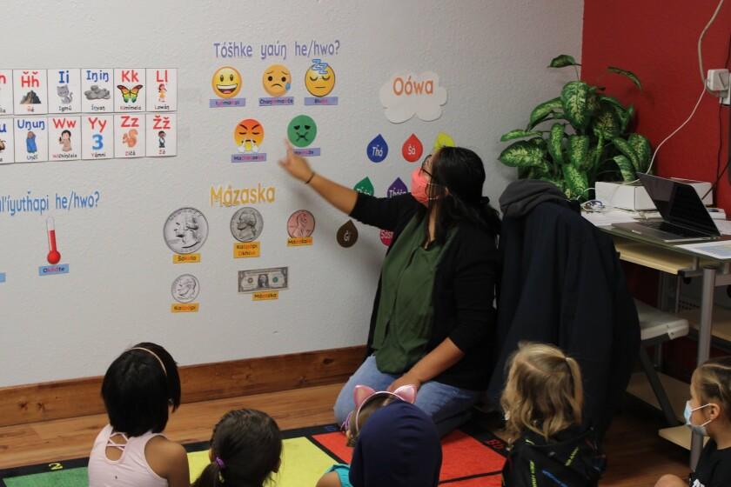
Education Today:
  There are 640,000 Indigenous students across all fifty states. With approximately 100,000 in Oklahoma alone.
  The impoverished economies of the reservations has led to underfunding in schools. Meaning…
  Educational opportunities are insufficient
  Schools, programs, and teachers do not receive sufficient funding
  Many students reach kindergarten lacking fine motor skills and additionally see a language deficit
Wakanyeja Tokeyahci Elementary School teacher Shanice Nez teaches Lakota language to students; language immersion schools are seen as a way to better reach Native students and to keep the language alive. Photo Courtesy of Wakanyeja school
#ISCORE2023
Notes:
Now lets focus more on education today. Students are less equipped for success, have fewer oppurtunities, and are lagging behind in even simple motor skills in kindergarten
LINK: https://www.mitchellrepublic.com/education/as-native-students-continue-to-struggle-in-s-d-schools-a-lakota-immersion-model-emerges

Slide 36
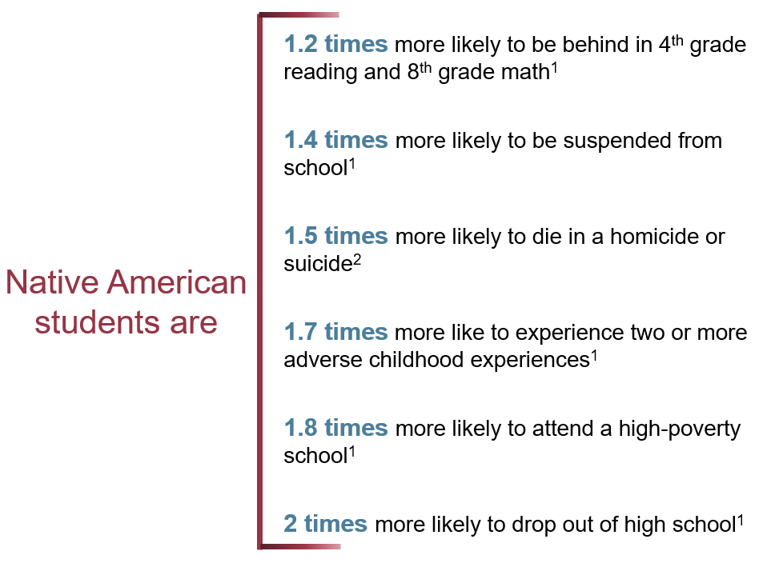
Education Today:
#ISCORE2023
Notes:
Here are just some statistics that represent the problems in education. You may notice that problems occur at all levels of education.
LINK: https://www.edpost.com/stories/america-has-always-used-schools-as-a-weapon-against-native-americans

Slide 37
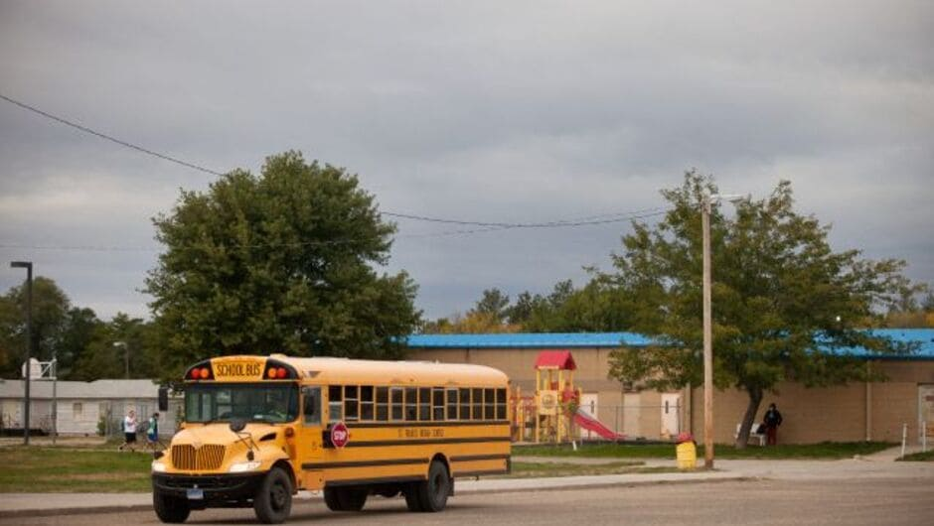
Why Is limited Change Being Seen?
  The invisible problem
    Low political reward, immense fallout potential
    Struggle to attract and retain faculty
    Lack of reform
#ISCORE2023
Notes:
It would be wrong to say that no change is occurring. But this change is limited because it is largely a invisible problem.
Link: https://www.teachforamerica.org/one-day/magazine/why-are-native-students-being-left-behind

Slide 38
Education Today:
  Between 29% and 36% off all Native American students drop out of high school (Bureau of Indian Affairs)
    The same report said the number is higher in communities where parents complain of a lack of understanding of their culture
  Native American students are disproportionally disciplined than most other racial groups (U.S. Department of Education Office for Civil Rights, 2014)
  Indigenous students have a drop out rate of twice the national average
#ISCORE2023
Notes:
Students have a very high drop out rate, and a lack of understanding of culture is a large determinant. These students are not allowed to learn about their culture and they are being disproportionally disciplined than most other racial groups and make up such a small amount of the population but a much larger amount of suspensions and expulsions.

Slide 39
Education Today:
“Many tribal leaders and education experts say these dismal statistics reflect, at worst, overt discrimination—and, at best, the alienation that Native students feel in a school system that has few Native teachers overall as well as limited lessons on Native American history and culture,” - Rebecca Clarren
#ISCORE2023
Notes:
This template can be used for a majority of your content. Duplicate as necessary.

Slide 40
Students With Disabilities:
Indigenous students with childhood and developmental disorders are often misunderstood. Disorders include:
-Autism and ADHD as examples
The diagnoses may be formal or presumed by the educator in part due to the entrenched ableist beliefs that are deeply rooted in racist stereotypes about Indigenous students being ”unintelligent”
“The same institutional racism that sees disabilities in Natives underdiagnosed or misdiagnosed, drives Special Education being disproportionately used as a form of discipline against students of color, whether they are actually disabled or not, for “behavioral issues.” (Shifrer et al., 2011)
#ISCORE2023
Notes:
Often times, students with disabilities are left to be forgotten. This is especially true for indigenous students
There may be racist stereotypes or entrenched ableist beliefs at play.

Slide 41
Education Today:
The beginning of each school year is highlighted by
-Christopher Columbus Day: The federal holiday of the Indigenous-killing mercenary
-Thanksgiving: The misguided celebration marking the arrival of religious European
-Fall sports being celebrated by demeaning and stereotype-enforcing mascots like “Redskins” and more
“These rituals dominate the first months of school, putting Native children in their place, holding up the traditions of white children, and championing the ideals of white supremacy and imperialism” - Roxanne Dunbar-Ortiz
#ISCORE2023
Notes:
how many of you went to a school with a mascot that enforced indigenous stereotypes or knew of a local or higher level school mascot that matched this description?
600,000 Native American students in our nation's K-12 public schools. Internalizing harmful images most acutely damages Native children, but absorbing racist and dehumanizing ideas about fellow classmates also diminishes the understanding and compassion of non-Native children, warping their conception of a history that often erases Native Americans altogether.
Indigenous students have been miseducated for a long time and students can feel disenfranchised. And there is Under represented federal policy, native students have been miseducated for generations, with little acknowledgement of Indigenous culture or history.

Slide 42
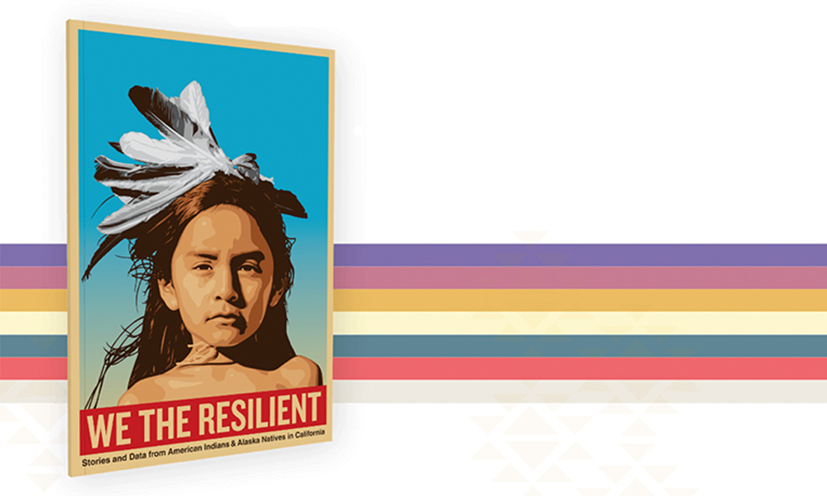
Hope For Today:
Hope and Resilience: Indigenous people draw strength from
  Traditional ways of living, places, relationships, and collective successes
  Resilience is built up through culture, spirituality, shared values, and a strong sense of identity, accountability, and responsibility.
  Familial Resistance:
    …the ability to bounce or spring back after being stretched or constrained or recovering strength and spirit (Greene, 2002).
#ISCORE2023
Notes:
But while I have spent a long time talking about the negative aspects, there is still optimism for today. Through hope and resilience
Link: https://nativephilanthropy.org/2021/06/02/we-the-resilient-report-presents-stories-data-of-californias-american-indian-alaska-native-peoples/

Slide 43
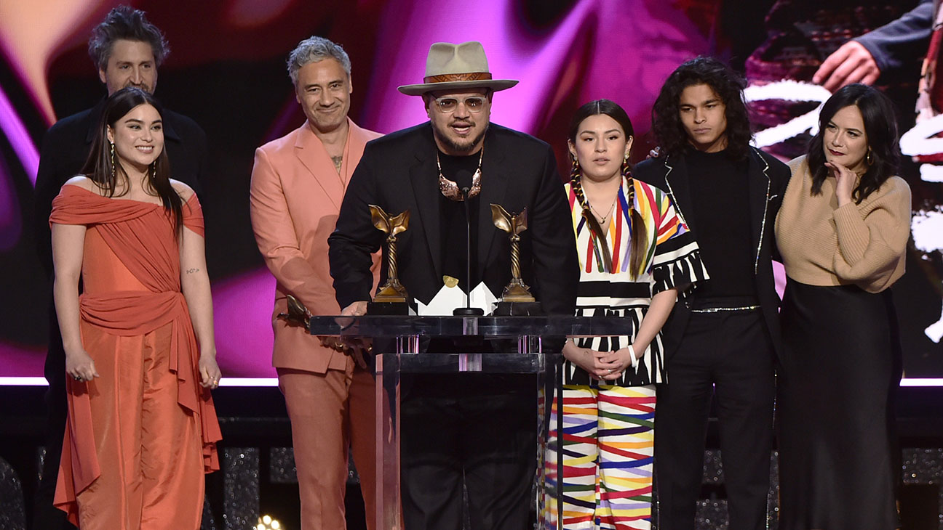
Celebrating Today:
The Red Nation Celebration Institute
  A a cultural arts nonprofit organization focused on empowering and promoting Native American storytellers across all artistic media platforms.
Reservation Dogs
  Award winning show for natives by natives
Deb Haaland
  Elected to serve as the 54th United States Secretary of the Interior
Brenda Ackerman
  My relative and former ISU professor
The 'Reservation Dogs' team at the Spirit Awards ALBERTO E. RODRIGUEZ/GETTY IMAGES
#ISCORE2023
Notes:
Link: https://www.hollywoodreporter.com/tv/tv-news/reservation-dogs-wins-spirit-award-ensemble-cast-1235105372/

Slide 44
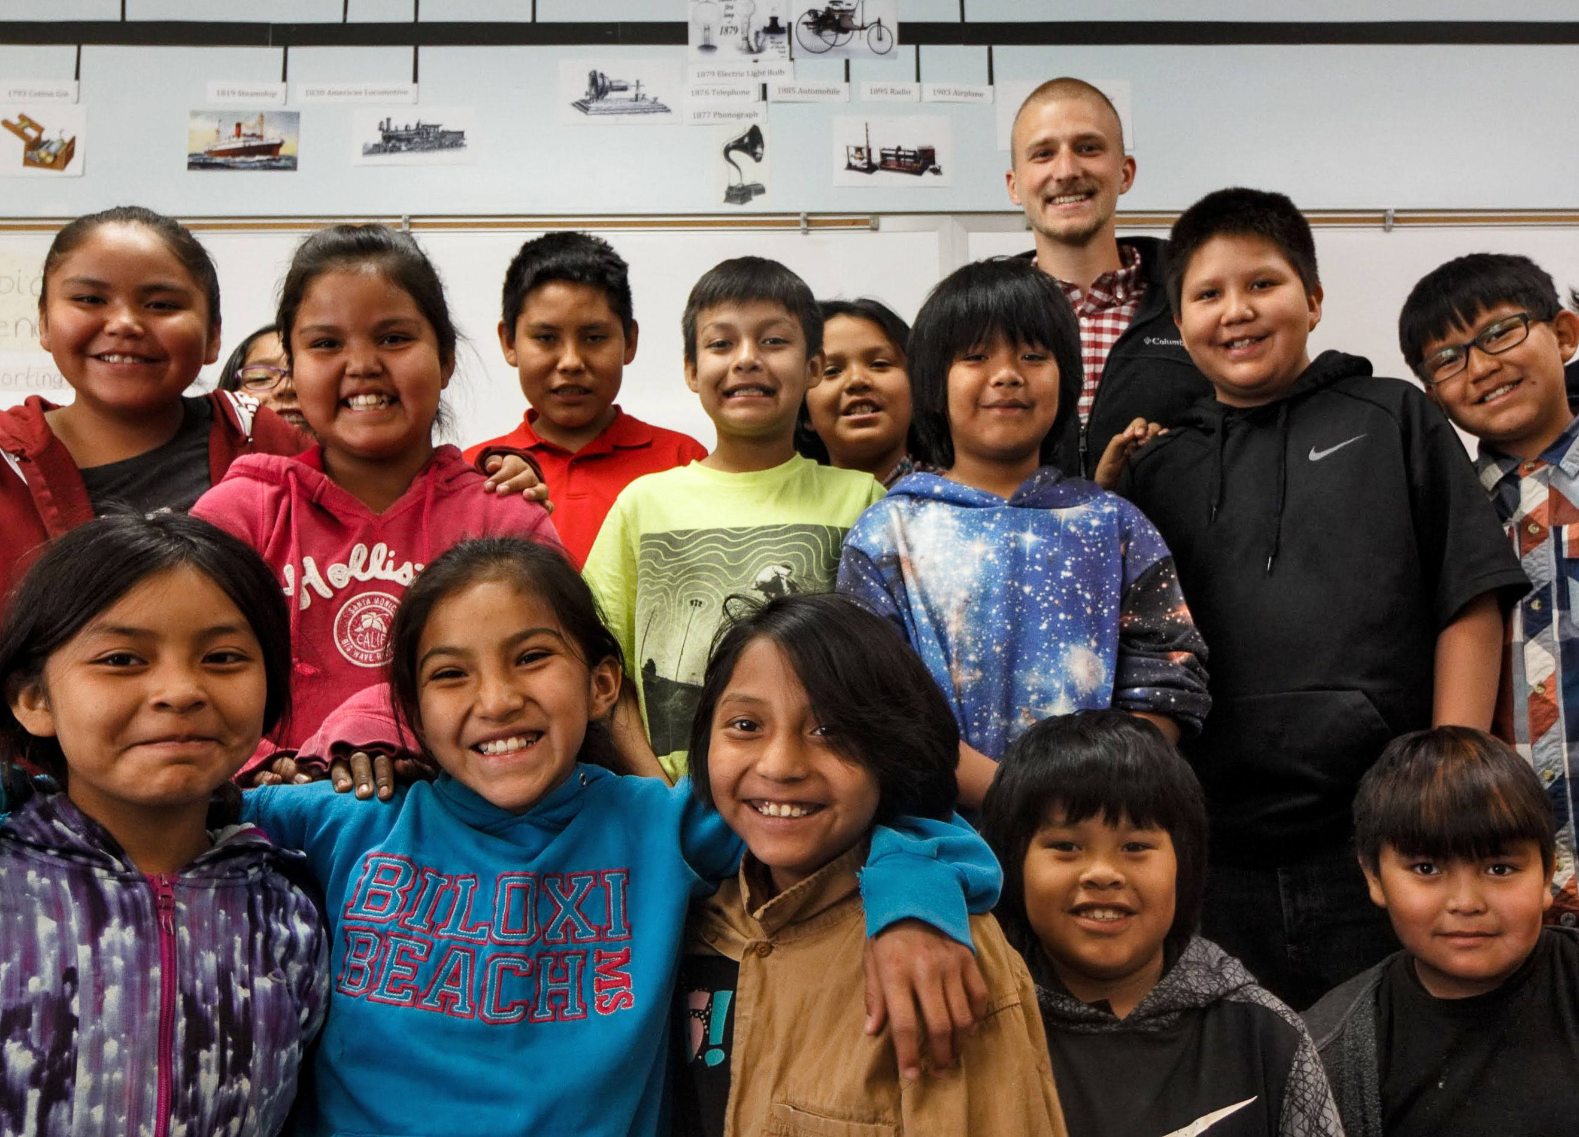
The Future: Resilience and Excellence
#ISCORE2023
Notes:
Now, I want to try and give a sneakpeak into what the future can hold in a perfect world. These are some ideas that are supported by research and professionals in a wide range of departments and groups
Link: https://education.indiana.edu/news/2018/jul-dec/2018-10-30-navajo-nation.html

Slide 45
Tribal Home Visits: To help the children help the parents
Cultural Traditions as a protective force
  Family Spirit is the only evidence-based home visiting model created for Native Americans specifically.
  Provides a wide range of services including but not limited to:
    Health child development
    Health prenatal care
    Financial Management
    Indigenous language lessons
    Connection to traditional cultural events
#ISCORE2023
Notes:
Tie to resilience and have families have real connections to the elders and have resources to change the tide

Slide 46
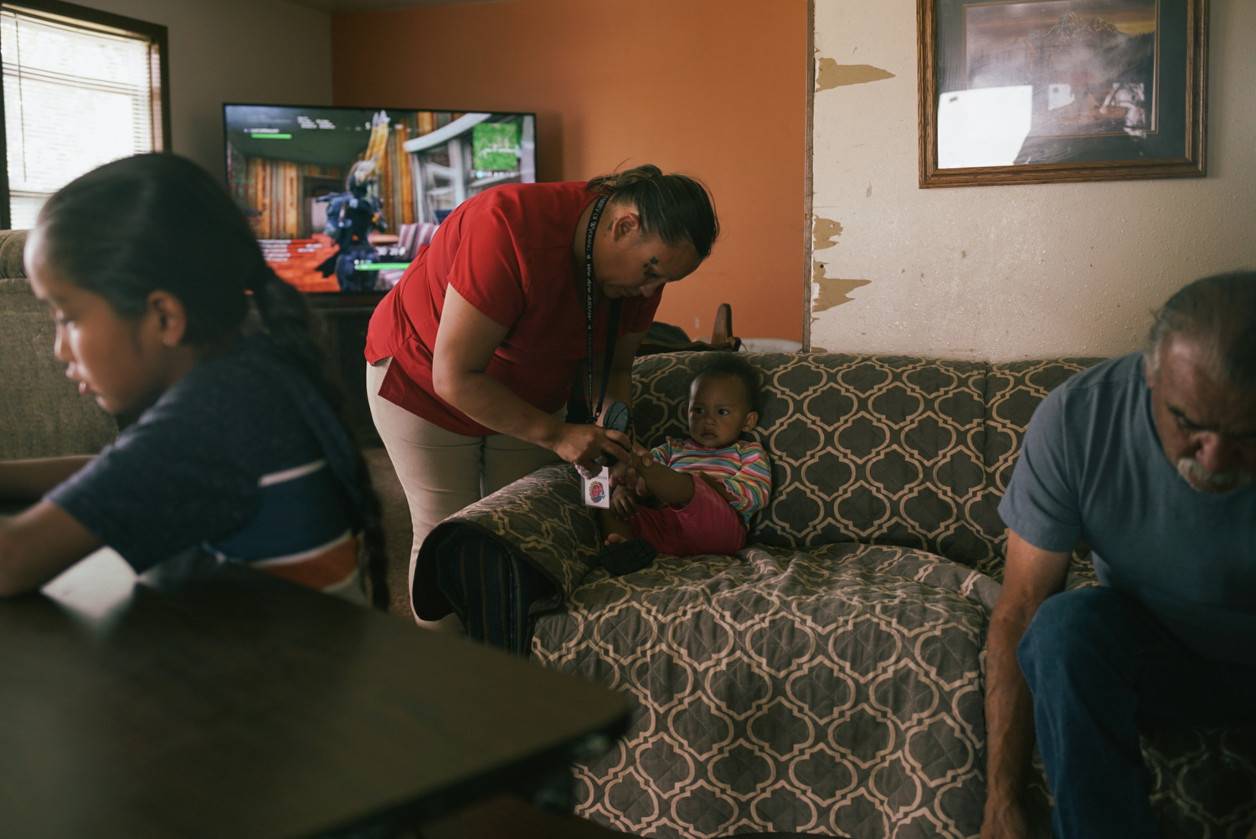
Tribal Home Visits:
Evidence has shown that mothers who are involved in such programs are more likely to… (National Home Visiting Resource Center)
-Access prenatal care
-Breastfeed longer
-Have higher incomes
-More apt to be enrolled in work or school
-Early language and cognitive development improves for the children
-Academic goals increase from grades 1 to 3
#ISCORE2023
Notes:
There is much more work to be done. Nearly 70 percent of women in the program are unemployed, according to program data. A third are experiencing postpartum depression, and many have struggled with addiction. Domestic violence is another painful reality for many women in the program.
Link: https://www.urban.org/features/tribal-home-visiting-cultural-traditions-offer-protective-force

Slide 47
Give More Respect to the Parents!
“The fact that positive youth outcomes are possible within such marginalized, impoverished, and oppressed communities is a testament to NA parents’ ability to mediate these deleterious circumstances through their resilient approaches to parenting.” – McKinley et al., 2019
#ISCORE2023
Notes:
Indigenous parents have had to find ways to adapt, overcome, resist, and circumvent structural forces working against them
In the position as a parent, they have demonstrated immense resilience
Link: https://www.parentcenterhub.org/welcome-to-the-naptac-library/

Slide 48
Suicide Prevention:
Suicide is very complex and impacts cultures and communities differently and remains a public health crisis for Indigenous youth all throughout the United States and Canada.
Professionals and researchers have provided a number of potential changes to mitigate this crisis and reduce health inequities among Indigenous peoples (Stone et al., 2022)
Delivering culturally relevant care
Telehealth for mental health concerns and well-being
The training and hiring of Indigenous providers and professionals
The promotion of community engagement and cultural traditions
Increasing coping and problem-solving skills
Increase training on reservations for properly recognizing and responding to suicide risk
Postvention programs
  To reduce risk and promote healing after a death from suicide
Promotion of the 988 Suicide and Crisis Lifeline
#ISCORE2023
Notes:
This template can be used for a majority of your content. Duplicate as necessary.

Slide 49
The Future Plans for Education:
“I see that, among my peers, I am much less likely to fall prey to alcoholism and much less likely to be suicidal as a result of being brought up in the laps of my elders, listening to stories and being engaged on a cultural level. What I've seen is that when youth are not culturally engaged, you see higher rates of incarceration, higher rates of suicide, higher rates of alcoholism, higher rates of drug abuse—all these evils that come in and take the place of culture.” - Sam Schimmel, an Alaska Native teenager, explains the importance and urgency of culture-based education
#ISCORE2023
Notes:
Now lets take some time to talk about the future of education
Link: https://www.edpost.com/stories/america-has-always-used-schools-as-a-weapon-against-native-americans

Slide 50
The Future Plans For Education: Culture-Based Education
Culture-based education: Centers learning around culture as a key to success for Indigenous students
-Make the transition from school to home and vice versa, seamless
-Linked to higher levels of trust with adults and increased socio-emotional well-being (Kana‘iaupuni, et al., 2010)
-Obtain a deeper sense of belonging and inclusion in school settings
-Enhanced motivation , resilience, and ethnic pride
-Improve college aspirations (Castagno et al., 2008).
#ISCORE2023
Notes:
“The history of American Indian education can be summarized in three simple words: battle for power” - K. Tsianina Lomawaima, 2000
Culture based education allows for the students to relish in the culture before them and obtain a deeper sense of belonging. Additionally, it makes the transition from home to school much easier and it can even improve college aspirations
Point 2: https://www.ksbe.edu/assets/research/collection/10_0117_kanaiaupuni.pdf
College: https://www.jstor.org/stable/40071151

Slide 51
The Future Plans For Education: Culture-Based Education
The Every Student Succeeds Act
Requires state education agencies to meaningfully consult with tribes
Authorizes funding for Native language immersion programs
Allocates additional funding for dropout prevention and mental health services
Diverge from deficit-based framework to understand the strengths and assets of Indigenous students and their cultures
Understand this country’s moral debt to Indigenous people
Indigenous cultural vitality and sustainability
#ISCORE2023
Notes:
How is culture based education actually done and completed?
Consult with tribes (mostly about planning for Title I or the largest federal aid program for public schools in the United States
Culture-based education also creates space to reframe learning objectives and outcomes in the geographical, historical and local context of indigenous groups. Most importantly, it provides a path to Native cultural vitality and sustainability, a path that helps Native students understand their positioning between the cultural knowledge, language and beliefs of the past and the application of that culture today and in the future.
Link: https://hechingerreport.org/opinion-culture-based-education-a-path-to-healing-for-native-youth/

Slide 52
Public School Education:
Indigenous students are often the minority in public schools
And many of the problems Indigenous students face can be exacerbated by non-Indigenous cultures
Data shows that Indigenous students are at or near the greatest risk of receiving poor education in public schools (Henson, 2008)
In addition to the high drop out rate, Indigenous students also have the highest rate of absenteeism of any group (Adcock, 2014)
Indigenous students are disproportionately placed in special education compared to other populations (Adcock, 2014)
#ISCORE2023
Notes:
And while looking at school on reservations is very important, we cannot forget about public schools. Indigenous students are often the minority and are faced with non-indigenous cultures. Additionally, indigenous students are at the greatest risk for receiving poor education and thus have the highest rate of absenteeism.

Slide 53
Public School Education: What can be done?
Decrease stereotypes: Indigenous people are often portrayed with stereotypical images and outdated children’s books.
A study by the University of Southern Mississippi found that non-indigenous students believe these inaccurate concepts about Indigenous students
Increase Indigenous education in public schools: The director of the UCLA American Indian Studies Center, Shannon Speed, said Native American history is not adequately covered in public education or education at all levels.
Doing so can increase college enrollment: College enrollment for Indigenous students aged 18-24 is 24% compared to 41% in the rest of the US population
#ISCORE2023
Notes:
But what can be done to improve the experience of public schools for indigenous people?

Slide 54
Increase Funding and Access To School Resources:
In Indigenous communities there is a lack of recruitment of high quality teachers and the underfunding of teacher salaries
Leads to little representation of Indigenous faculty in higher education for example
Indigenous students have less access to Advanced Placement or college preparation courses in high school
Indigenous students are also more likely to need grant aid assistance to attend college (Postsecondary National Policy Institute)
Increasing funding for K-12 will allow for a higher quality of teaching
Additional scholarship opportunities for Indigenous students will allow for an improvement in educational oppurtunities
#ISCORE2023
Notes:
Indigenous students should increase funding because currently
-retainment of teachers is low, and there is little representation especially at the higher education lebel
-AP coursework or college prep classes are scarce and there is little grant aid assistance to attend college
Digital equity for Indigenous people and students could provide:
The revitalization and preservation of culture and language
Can strengthen tribal sovereignty and tribal identity
Provide a platform to move Indigenous students from consumers to producers of media

Slide 55
The connection of Education and Role Models:
The lack of role models in K-12
Teachers as role models
Community programs designed for connecting Indigenous youth to leaders of the community
Success for higher education
The lack of role models in Higher Education: Lack of Indigenous professors, researchers, and administrators
Eliminate the stereotype of Indigenous students and higher learning
Demonstrates the significance of post-K-12 education
Stronger American Indian studies programs on university campuses
Connect the culture to the rest of the world
Build self-confidence and Indigenous connections to youth
#ISCORE2023
Notes:
Actions yell, words whisper, we need more role models for indigenous students both in K-12 and in higher ed

Slide 56
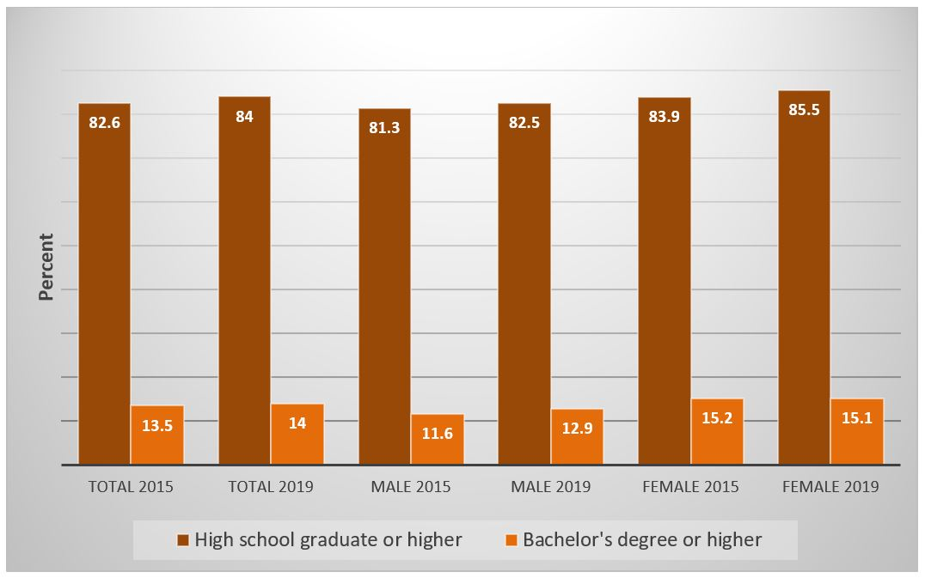
Higher Education:
Only 7 of 100 AI/AN kindergarten students will earn a bachelor’s degree (U.S. Dept. of Education, Senate Committee on Indian Affairs. (2014).
#ISCORE2023
Notes:
Indigenous faculty constitute less than one percent of higher education faculty in degree-granting institutions, according to fall 2009 data (NCES, 2011).
Link: https://ncrcrd.ag.purdue.edu/2021/12/08/educational-attainment-of-american-indians-and-alaska-natives-has-risen-in-midwest/

Slide 57
Career Paths: STEM
Indigenous people represent only 0.4% of all engineering bachelor degree recepients, 0.3% of engineering workforce, and 0.1% of all engineering faculty (Chang, 2015)
Despite the fact that employment of engineers is projected to grow 4.0 percent from 2014 to 2024 (U.S. Bureau of Labor Statistics)
More than half of Native American Students currently lack access to the math and science high school classes they’d need to fill jobs in a STEM field (U.S. Department of Education)
The American Indian Science & Engineering Society (AISES) was founded in 1977, and today has some 4,000 members in 15 professional and more than 180 college chapters
Offers scholarships, internships, professional development, career planning, and more
#ISCORE2023
Notes:
As a stem student, representation in stem is very low. But, there are steps and programs like AISES that is working to improve representation in science fields
Chang, Joy. (2015). “Bridging the Racial Gap in STEM Education.” National Action Council on Minorities in Engineering, Inc. (NACME). | Landivar, Liana Christin. “Disparities in STEM Employment by Sex, Race, and Hispanic Origin.” (2013). American Community Survey Reports, US. Census Bureau. | U.S. Dept. of Education. “Science, Technology, Engineering and Math: Education for Global Leadership.
Link: https://www.energy.gov/sites/prod/files/2018/02/f48/begay-stem-education.pdf
Link https://blog.eie.org/native-american-and-indigenous-representation-in-stem-where-are-we-now

Slide 58
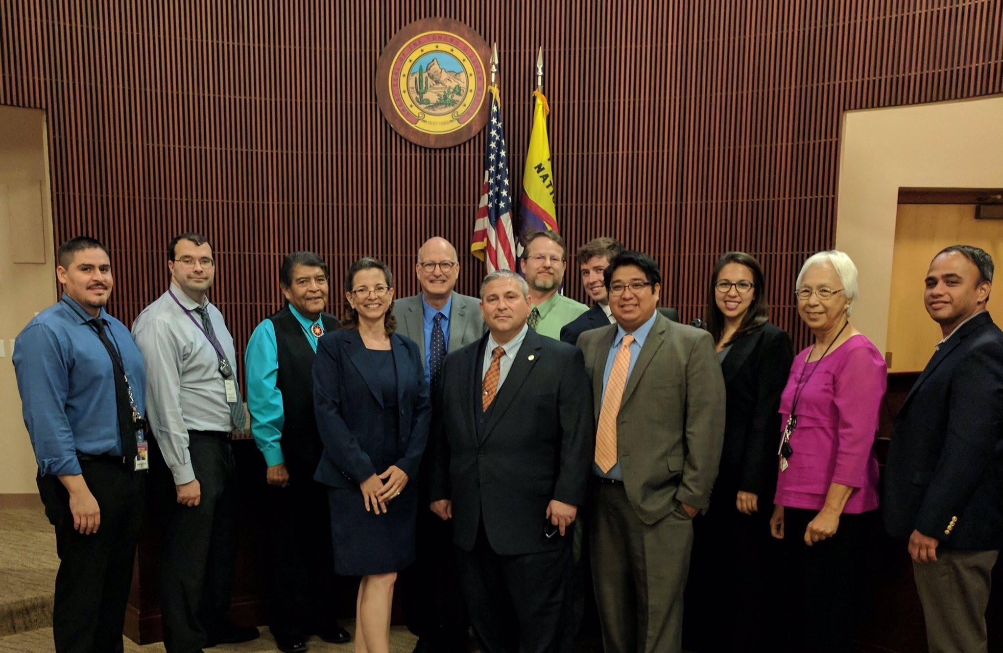
Career Paths: Non-STEM
Reasonings:
Ability to give back to the community immediately
Directly benefit the Indigenous community (i.e. Businesses/law/health)
Push back on colonial practices and policies (i.e. systematic challenges)
Tribal Justice Clinic
#ISCORE2023
Notes:
But not all students want to go into stem, and that is okay! There are many reasons as to why students don’t go into a STEM career
Link: https://law.arizona.edu/clinics/tribal-justice-clinic

Slide 59
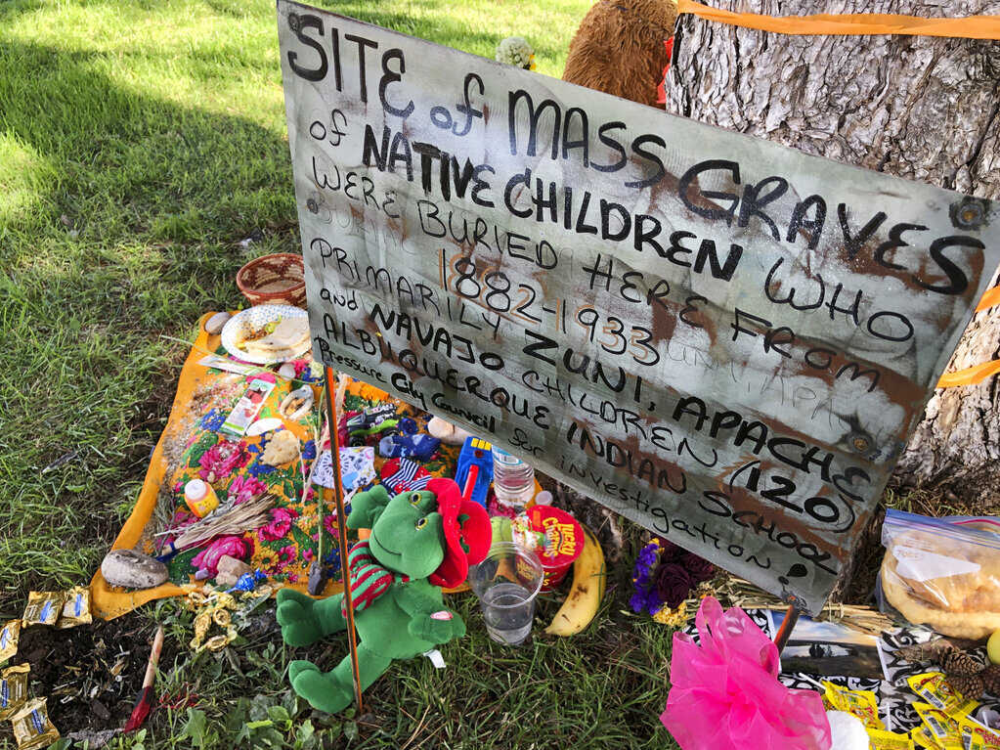
Justice:
Acknowledge the historical wrongdoings from government officials
Reparations and further studies
Identify the unmarked grave sites of linked to boarding schools
  The investigation has turned up 500 deaths at 19 schools
  Officials believe the number may be in the thousands to tens of thousands
A makeshift memorial for the dozens of Indigenous children who died more than a century ago while attending a boarding school that was once located nearby is displayed under a tree at a public park in Albuquerque, N.M., in 2021.
#ISCORE2023
Notes:
Most importantly, we need justice for these wrongdoings. Furhter acknowledgement of the wrongdoings, reparations, and investigations must be completed
Link: https://www.npr.org/2022/05/11/1098276649/u-s-report-details-burial-sites-linked-to-boarding-schools-for-native-americans

Slide 60
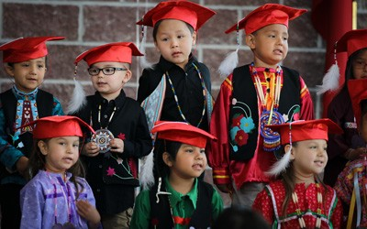
What Can You Do?
Listen
Recognize the importance of healing these historical wounds and restoring trust.
Respect the sovereignty of Native nations.
Educate yourself
Ask Questions
Be the change you want to see
#ISCORE2023
Notes:
Link: https://iowaculture.gov/history/education/educator-resources/primary-source-sets/meskwaki-culture
Actions yell words whisper

Slide 61
ketêpihi (ge te be) thanks; I’m grateful to you (literally, ‘you please me’)
#ISCORE2023

Slide 62
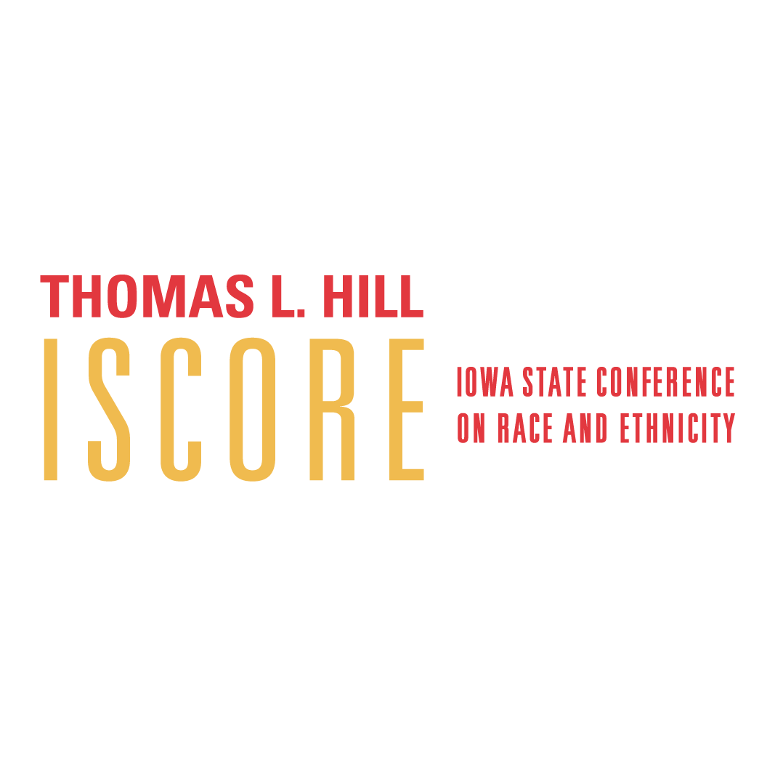
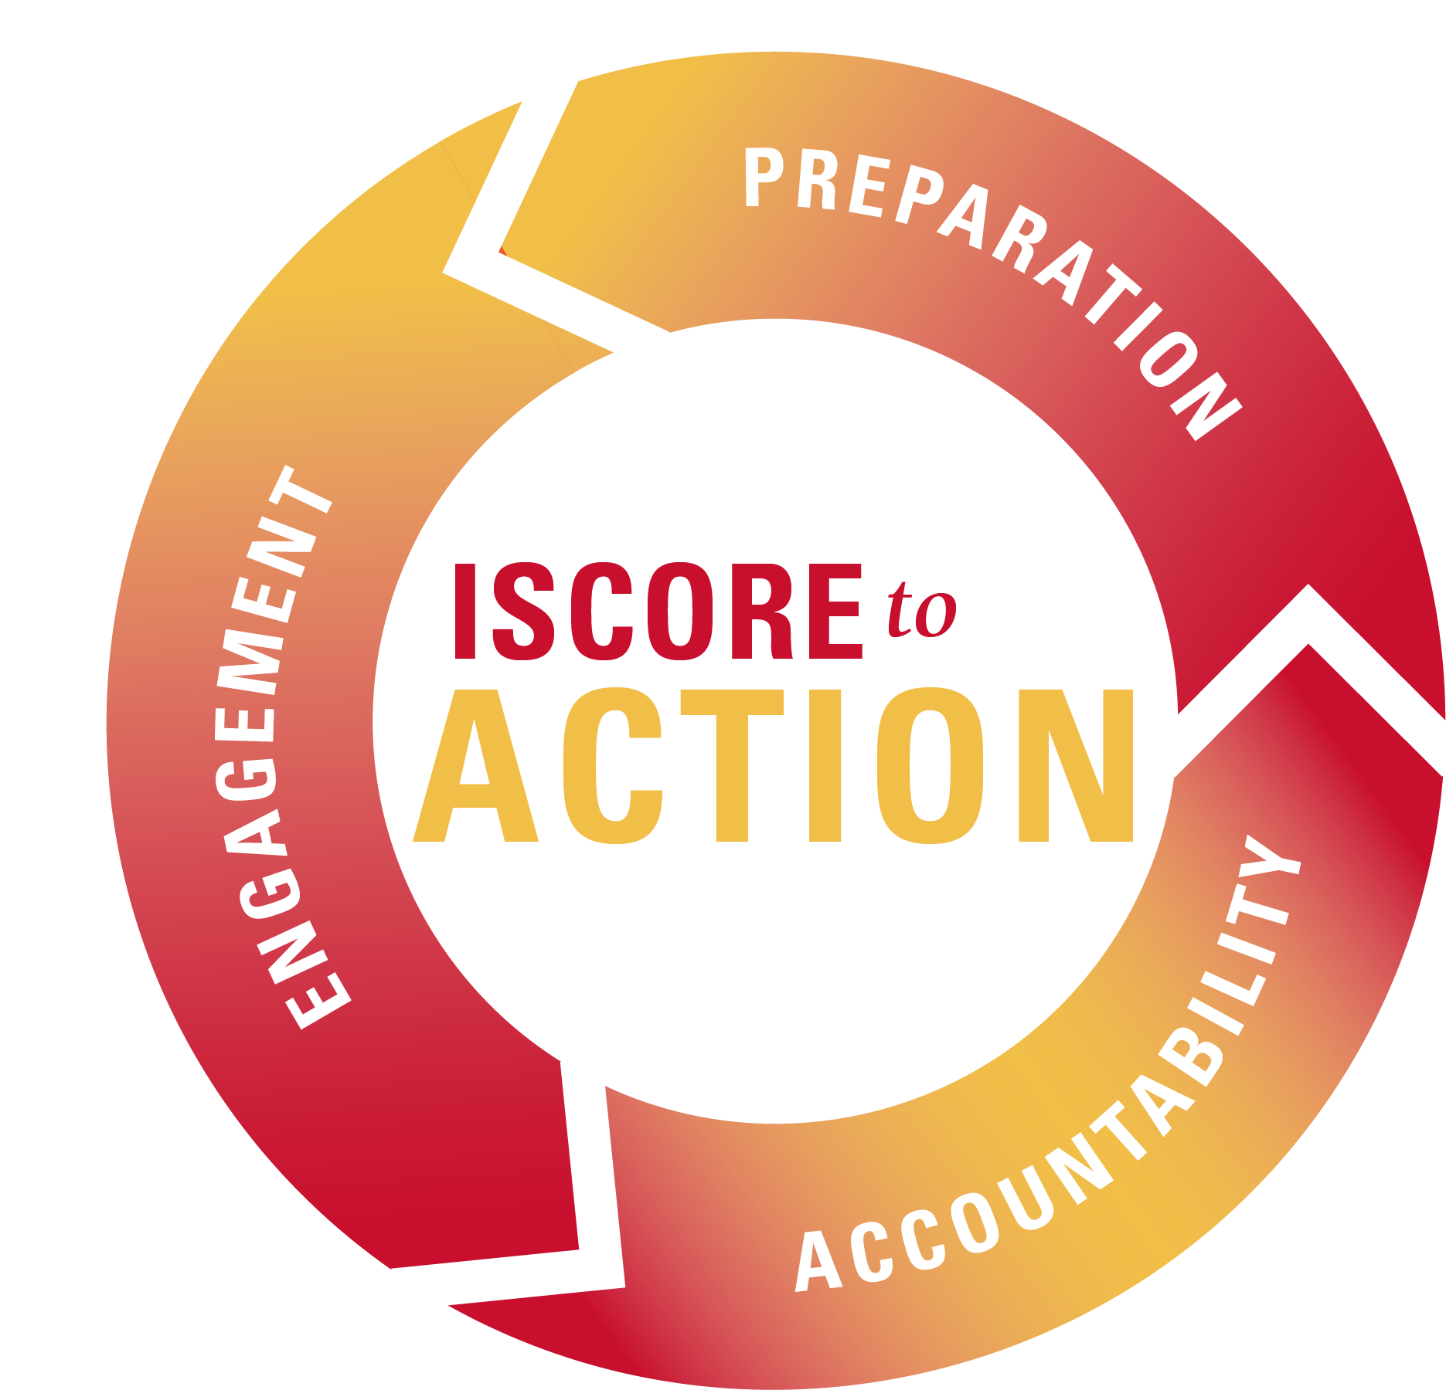
#ISCORE2023
Notes:
These graphics and footer can be used as needed throughout your presentation.

