Slide 1
Exploring Diverse Aspects of Mentorship at Iowa State University
2023 McNair Cohort

Slide 2
McNair Scholars Program
The McNair Scholars Program prepares qualified undergraduates for graduate school entry with the primary goal of increasing the attainment of a Ph.D.
Research
Graduate School Prep
Personal & Professional Development
Notes:
Federally-funded TRiO program in the Graduate College

Slide 3
McNair Scholars Program
Year 1 (Junior year)
- Faculty-mentored research
- In-class research
Summer
Year 2 (Senior year)
- Graduate school application materials
- Graduate school application materials
- McNair Symposium
- National conference presentation
- REU/internship
- McNair Symposium
- Faculty-mentored research
Notes:
Federally-funded TRiO program in the Graduate College

Slide 4
Mentorship Research
Group 1: Graduate students in multiple mentorships
Groups 3 & 4: Faculty experiences with mentoring
Group 2: The role of discipline in mentoring
Notes:
Extensive research has demonstrated the multifaceted benefits of mentorship, yet research has also demonstrated that students from underrepresented backgrounds have less access to mentoring. Given the importance of mentorship in the graduate career, we wanted our scholars to study a topic which would be of relevance as they think about transitioning to graduate school.
Based on their review of the literature, each group chose a specific focus, and as you can see here, the focus is mentoring experiences of both graduate students and faculty
Each group will speak more about their methodological approach and their analysis, but broadly we used a qualitative methodology using interviews with our faculty and graduate student mentors using an interview protocol we collaboratively designed. Interviews were conducted in-person of via Zoom/WebEx and then automatically transcribed using these platforms or otter.ai.

Slide 5
Exploring the Graduate Students’ Experience with Multiple Mentors
Alba Bon, Laurna Evans Lindsay, Cindy Lara, Edson Lopez, and Charles Taylor

Slide 6
Relevant Background
Multiple mentors have a positive impact on the mentee
The multifaceted roles of mentors: influencing personal, academic, and career domains
Multiple mentors reduce attrition rates and accommodate diverse needs

Slide 7
Gap in the Literature
How multiple mentors influence decisions in graduate students
The roles of multiple mentorships in the student’s academic journey

Slide 8
Study Purpose
Purpose:
Understand potential benefits
Community and resource expansion
Research Question:
What are the potential benefits for graduate students when involved in multiple mentorships?

Slide 9
Participants
Graduate Student Mentors:
11 women & 6 men
Ethnicities | Number
White | 7
Asian | 5
Hispanic/Latinx | 2
Black | 2
Bi/Multi-Racial | 1

Slide 10
Procedure
Previous Literature
Cohort Contribution
Graduate Student Mentors
Structured Interviews
Webex Transcripts
Question Sets

Slide 11
Analysis
Organized and Coded Data
Themes and Patterns
Similarities and Variations
Amount and Areas of Mentorship
Positive Influences
Importance

Slide 12
Results
Graduate Student | Faculty | Friendships | Family | Other
1 | ✓ | ✓ |  | ✓
2 |  | ✓ |  | ✓
3 | ✓ | ✓
4 | ✓ | ✓ | ✓
5 | ✓ |  | ✓
6 | ✓ | ✓ | ✓
7 | ✓ |  |  | ✓
8 |  |  |  | ✓
9 |  | ✓ | ✓ | ✓
10 |  | ✓ | ✓
11 | ✓ |  | ✓
12 | ✓ |  |  | ✓
13 | ✓ |  | ✓
14 |  |  |  | ✓

Slide 13
Results
Graduate Student | Faculty | Friendships | Family | Other
11 | ✓ |  | ✓
12 | ✓ |  |  | ✓
13 | ✓ |  | ✓
14 |  |  |  | ✓

Slide 14
Results
"Personally, I would say my mentor would be my parents... they are the only people with whom I discuss, and I come up with the final decision that whether I should go for this or not." (Graduate Student 11)
"[Also,] my professor was very supportive regarding my work...and he really helped me with interviews." (Graduate Student 11)

Slide 15
Results
Graduate Student | Faculty | Friendships | Family | Other
6 | ✓ | ✓ | ✓
7 | ✓ |  |  | ✓
8 |  |  |  | ✓

Slide 16
Results
“Just having different perspectives and hearing people speak about their experiences is something that was beneficial to me. Also, having multiple mentors means that they can attach in different areas of your life.” (Graduate Student 6)
“There are things I can be more comfortable talking to a graduate student mentor, but I would feel uncomfortable talking to my professor… and there are things I can be more comfortable talking to my family, for example, my dad.” (Graduate Student 6)

Slide 17
Results
Graduate Student | Faculty | Friendships | Family | Other
9 |  | ✓ | ✓ | ✓
10 |  | ✓ | ✓
11 | ✓ |  | ✓
12 | ✓ |  |  | ✓

Slide 18
Results
“You might get professors and different mentors who might be from a different background, so you might get someone [with] a different perspective or cultural background.” (Graduate Student 9)
“I think that having multiple mentors is necessary in that, it can build a stronger foundation than just having one person kind of serve as a mentor.” (Graduate Student 9)

Slide 19
Future Research
Further investigation into the nuanced dynamics of mentorship roles and strategies to resolve conflicts among multiple mentors
Developing inclusive mentoring programs targeting underrepresented and minority students to alleviate disparities

Slide 20
Limitations
Interview question sets were shared across cohort
Limiting detailed information and responses regarding our research question

Slide 21
Conclusion
Our results suggest that multiple mentorships were viewed as favorable
Mentors were found to include different roles
Graduate students often attribute guidance to multiple individuals, mainly family, faculty, and friends

Slide 22
Disciplinary Influence on Mentorship Experiences
Derek Correa, Catalina Villalpando, Eduardo Milach Teixeira

Slide 23
Introduction
How discipline effects mentorship experiences is widely unexplored in the field of mentorship experiences
Paolucci et al. (2021)
Explored relationship between graduate student well-being and peer mentorship across four different disciplines
Compared disciplines through demographics but not in mentorship differences
Salter & Gannon (2015)
Examines where and how coaching and mentoring disciplines overlap or differ in approach
Ma et al. (2020)
Used a massive survey of 37,517 mentors in STEM fields to find the correlation between a mentor’s expertise and their mentee's success in the future

Slide 24
Research Study
Objective:
To understand and analyze mentor-mentee relationships among graduate students and faculty mentors at Iowa State University across various major disciplines and areas of expertise
Research Question:
How do mentor-mentee relationships differ across various STEM and social-science disciplines?

Slide 25
Methods
Social-Science Disciplines | # of Representatives
Psychology | 7
Human Developmental and Family Studies | 1
Community and Regional Planning | 1
STEM Disciplines | # of Representatives
Computer Science | 5
Natural Resource Ecology and Management | 3
Genetics and Genomics | 2
Physics | 2
Environmental Engineering | 1
Environmental Science | 1
Microbiology | 1
Chemistry | 1
Materials Science and Engineering | 1
Participants
A total of 26 graduate students and faculty at Iowa State University
Design
Recorded interviews conducted in person or online
Analysis
Interview transcripts were sorted and coded using Excel
Emergent themes that were influenced, or not influenced by discipline were identified
Ethnicities | Graduate Students | Faculty Mentors
White | 6 | 6
Black | 1 | 0
LatinX | 3 | 1
Asian | 5 | 4

Slide 26
Evidence for Influenced
All psychology faculty mentors (four out of four) mentioned they valued interpersonal relationships compared to one out of seven STEM faculty mentors
Psychology faculty mentors use psychological theory
“[Giving] the student autonomy, or choice and responsibility, that's a psychology theory […] So my approach is completely informed by psychological theory”(Faculty Mentor, Psychology)
Environmental Engineering mentors expressed about shared values
"We [environmental engineers] have the same core values oftentimes […] and so starting from that common foundation, oftentimes gives us a- a shared value set and a shared emotion" (Faculty Mentor, Environmental Engineering)

Slide 27
Evidence for Non-Influenced
Across almost all disciplines, 9 out of 11 faculty mentors expressed value with mentoring moments when mentees achieved success
“It really brought home to me how meaningful it was to the student […] seeing how important it was to her really highlighted that for me”(Faculty Mentor, Psychology)
"I get to live vicariously through them a little bit. Have a share in their success" (Faculty Mentor, Environmental Engineering)

Slide 28
Evidence for Non-Influenced
Perspectives on having multiple mentors by graduate students
Benefits: eleven out of thirteen shared the same sentiment
"Having multiple mentors provides a range of perspectives. Each mentor offers unique insights into what's best for me, whether it's regarding my academic, professional, or personal life" (Graduate Student Mentor, Ecology)
Drawbacks: more varied, but shared a common idea
“A potential disadvantage would be if you're getting so many sources of input that it ends up being ineffective […] you don't want to lose your voice in the process” (Graduate Student Mentor, Psychology)

Slide 29
Discussion
Mentors often focus on their mentees' experiences rather than their own moments of success
Regardless of discipline, having multiple mentors has similar benefits and downsides
There are differences, especially when looking at the value of interpersonal relationships and shared values in different disciplines

Slide 30
Conclusion
To answer the question: How do mentor-mentee relationships differ across various STEM and social-science disciplines?
Most aspects of mentorship experiences were not influenced by discipline
Some differences were found in mentorship across disciplines. Should be explored further.
Meaningful because it allows the mentorship field to apply solutions with less distinction of discipline

Slide 31
Limitations
There was a lack of representation for discipline within the sample
There was a lack of demographic representation because the sample size was predominantly white.
Each interview was conducted by different people.
Notes:
Disciplines of what is considered STEM was constrained to ISU's definition of disciplines.
(Something to say outloud: primarily because of delayed uploads and also variations in questioning among the interviewers)

Slide 32
Future Direction
Explore Psychology mentor's use of psychological theory to see if it may be of benefit to mentorship.
Examine how Environmental Engineering expressed that shared core values can lead to easier relationship forming and mentorship experiences.
Need to include more disciplines within the sample space.

Slide 33
Understanding Faculty Perspectives on Mentorship at Iowa State University
Lauren McDonald, Mohammad Abdalgader, Liya Mooradian, Antara Shah, Diego Arevalo

Slide 34
Introduction
Research indicates that mentorship is continuously and successfully used to prepare students for higher education and their careers
There is little known about the science of mentorship and the information about how mentors describe mentorship
(Murray et al., 2022; Borders et al., 2012; Baltrinic et al., 2018).
Notes:
Research indicates that mentorship is continuously and successfully used to prepare students for higher education and their careers, yet there is little known about the science of it and even less information about how mentors describe mentorship and their corresponding strategies for success within this relationship.

Slide 35
Introduction
Research Question
What are the perspectives of Iowa State University faculty mentors on mentorship?
Purpose of Study
To Investigate how faculty mentors at ISU describe mentorship by conducting interviews on various descriptions regarding mentorship.

Slide 36
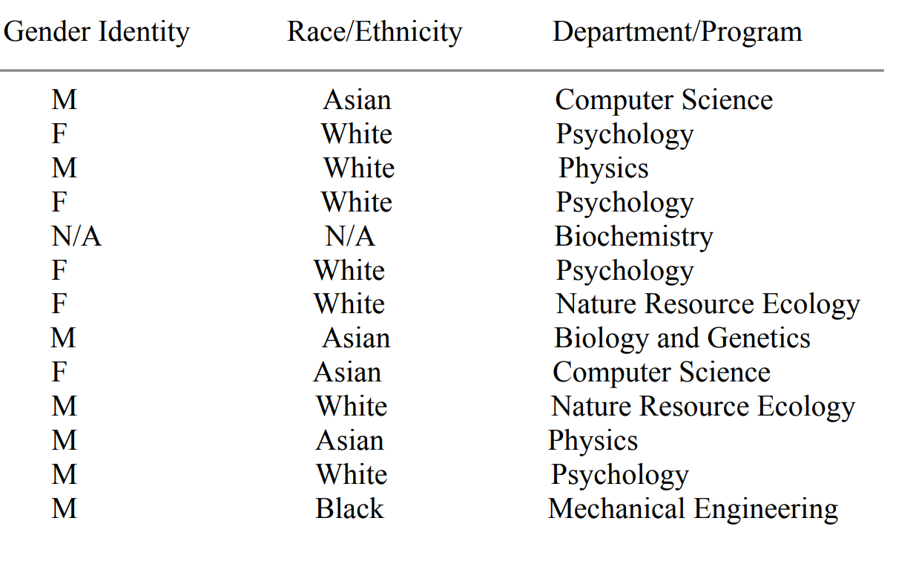
Participants

Slide 37
Procedure
Semi-structured interviews were conducted during Fall 2023
The interviews averaged around 45 minutes were held via Webex or in-person
All interviews were recorded and transcribed

Slide 38
Analysis
Thematic analysis approach
Systematic coding
Continuous review of transcripts
All to ensure that the methodical approach supports the transparency and replicability of the analysis.

Slide 39
Results
The thematic analysis revealed consistent pattern among mentors:
Individualization
Flexibility
Student goal-oriented focus
Many mentors aim to recognize interests and ambitions to create a personalized and supportive atmosphere
Our results also highlights the collaborative and adaptable nature of mentorship in academia

Slide 40
Individualization
"I do not like a blanket approach to mentoring because I truly believe that each student is so different." -Faculty Mentor 2
"I am seeing them as an individual and trying to understand what they need specifically in terms of like what their career goals are or what, you know, they are trying to work on.”
- Faculty Mentor 10

Slide 41
Flexibility
“So, I try to be helpful in letting students dictate what they want to get out of the experience and I then try to adapt to that.”
- Faculty Mentor 15
“ I tried to be flexible and adjust depending on what the student needs and where they're at and what their interests are. I mean, every single student I've worked with is so different.”
- Faculty Mentor 2

Slide 42
Student Goal Oriented
"I think a lot of being a good mentor (for the students), especially in academia is letting you know the mentee, they're not alone."
-Faculty Mentor 3
“But really couldn't convince her to go to grad school. She got a job. I think she's done really well. I think she ended up very happy with the research program.”
- Faculty Mentor 17

Slide 43
Discussion
Limitations
Exclusive focus on Iowa State University faculty members
Future Direction
Long-term studies of mentoring relationships shed light on how to develop and continue to impact people's professional development

Slide 44
Conclusion
Notable Commonalities
Found characteristics of individualization, flexibility, and a student goal-oriented
New Insights
How Iowa State University community mentors view and value mentorship
Implications
Guide future practical & provide foundation for future research aimed at refining and expanding effective mentorship practices

Slide 45
The Effects of Mentoring on ISU Faculty
Stephanie Diaz – Andrew Hokanson – Allyson Smithson

Slide 46
Introduction
Majority of research on the benefits of academic mentorship is focused on how the relationship positively impacts the students, not the faculty members.
The benefits faculty members gain from these relationships are largely unstudied and unknown
We examined the benefits faculty gain using three major categories:​
Skills faculty learn from their students​
Mentee impacts on research efforts​
Career fulfillment and motivation

Slide 47
Research Question
What impact does the experience of mentoring students have on faculty at Iowa State University?

Slide 48
Methodology
Procedure
Semi-structed interviews conducted in-person and virtually
Audio recorded and transcribed using Webex and otter.ai
Participants
10 male and 5 female faculty mentors
Race/Ethnicity | Number of participants
White | 9
Asian | 4
Black | 1
Hispanic/Latino | 1

Slide 49
Defining Themes
Skill Development
Broadly describes personal skills gained by faculty mentors like active listening, effective communication, etc.
Research Efforts
Broadly describes the meaningful contributions of students towards the faculty mentors' research goals
Career Motivation
Broadly describes the factors influencing the faculty mentors' desires to exert effort to progress in their careers

Slide 50
Analysis
Interview review process
Collected quotations mentioning elements associated with predetermined and emergent themes.
Interpretation
All faculty mentors indicated that the mentorship experience had a positive impact on their research efforts.
Obtained a deeper understanding of the relationships concerning the impact of mentoring students on Iowa State University faculty.

Slide 51
Skill development
"I keep to myself, and I had a more gregarious and outgoing graduate student. That was what I thought, very well skilled. You know, things that we take advantage of like small talk and so on. And I think that was very good for me because it’s helped me be better at those kinds of things, rather than, you know, being reserved." –Faculty Mentor 15

Slide 52
Research Efforts
"My mentees have many good ideas about how we conduct different research tasks... how we solve problems we encounter, what approaches we use, what tools we use to solve those problems. Yeah, my students are clever and think about those things." –Faculty Mentor 13
"...they’ve made so much of my career possible, because I couldn’t really do any of the research that I wanted to do without some assistance and so they’ve made it possible..." –Faculty Mentor 8

Slide 53
Career Motivation
"When I’m tired or […] my motivation is flagging, it’s wonderful to have students who have fresh energy and fresh eyes, and creative ideas, and it reinvigorates my own self in doing research. So that’s probably the best part in mentoring students, I feel useful.... it’s probably my favorite part of my job." –Faculty Mentor 5

Slide 54
Discussion
Faculty gained skills working with and teaching students with various backgrounds and disciplines
Diverse mentee backgrounds allows for faculty to learn new skills
Faculty stated that research projects would progress much slower and would be smaller in scope without student aid
Faculty expressed that seeing mentees succeed after graduation was one of the major highlights of their role as a mentor

Slide 55
Future Research
Explore how working with mentees promotes career motivation and longevity.
Our results suggest that positive mentorship experiences with undergraduate and graduate researchers may be important drivers for ISU faculty to continue in academia.
More research into the benefits of having a strong relationships with undergraduate and graduate students could inspire faculty to prioritize building strong relationships with their mentees

Slide 56
Conclusion
Mentoring enhances skill development, research efforts, and career motivation.
Interpersonal skills
85% of faculty improved communication through diverse mentorship
Intellectual challenge
Over a third of faculty were intellectually challenged by mentees
Career motivation
27% found student success highly motivating to continue in academia

Slide 57
Questions?

Slide 58
Session 2416

