Slide 1
From the Ground Up
The Pop-Up Shop as a Case Study on Student Services Grassroots Movements​
​

Slide 2
Grassroots Movements
"We can begin by doing small things at the local level, like planting community gardens or looking out for our neighbors. That is how change takes place in living systems, not from above but from within, from many local actions occurring simultaneously."
-Grace Lee Boggs

Slide 3
Land Acknowledgement
"Iowa State University aspires to be the best land‐grant university at creating a welcoming and inclusive environment where diverse individuals can succeed and thrive. As a land‐grant institution, we are committed to the caretaking of this land and would like to begin this event by acknowledging those who have previously taken care of the land on which we gather. Before this site became Iowa State University, it was the ancestral lands and territory of the Baxoje (bah-kho-dzhe), or Ioway Nation. The United States obtained the land from the Meskwaki and Sauk nations in the Treaty of 1842. We wish to recognize our obligations to this land and to the people who took care of it, as well as to the 17,000 Native people who live in Iowa today."

Slide 4
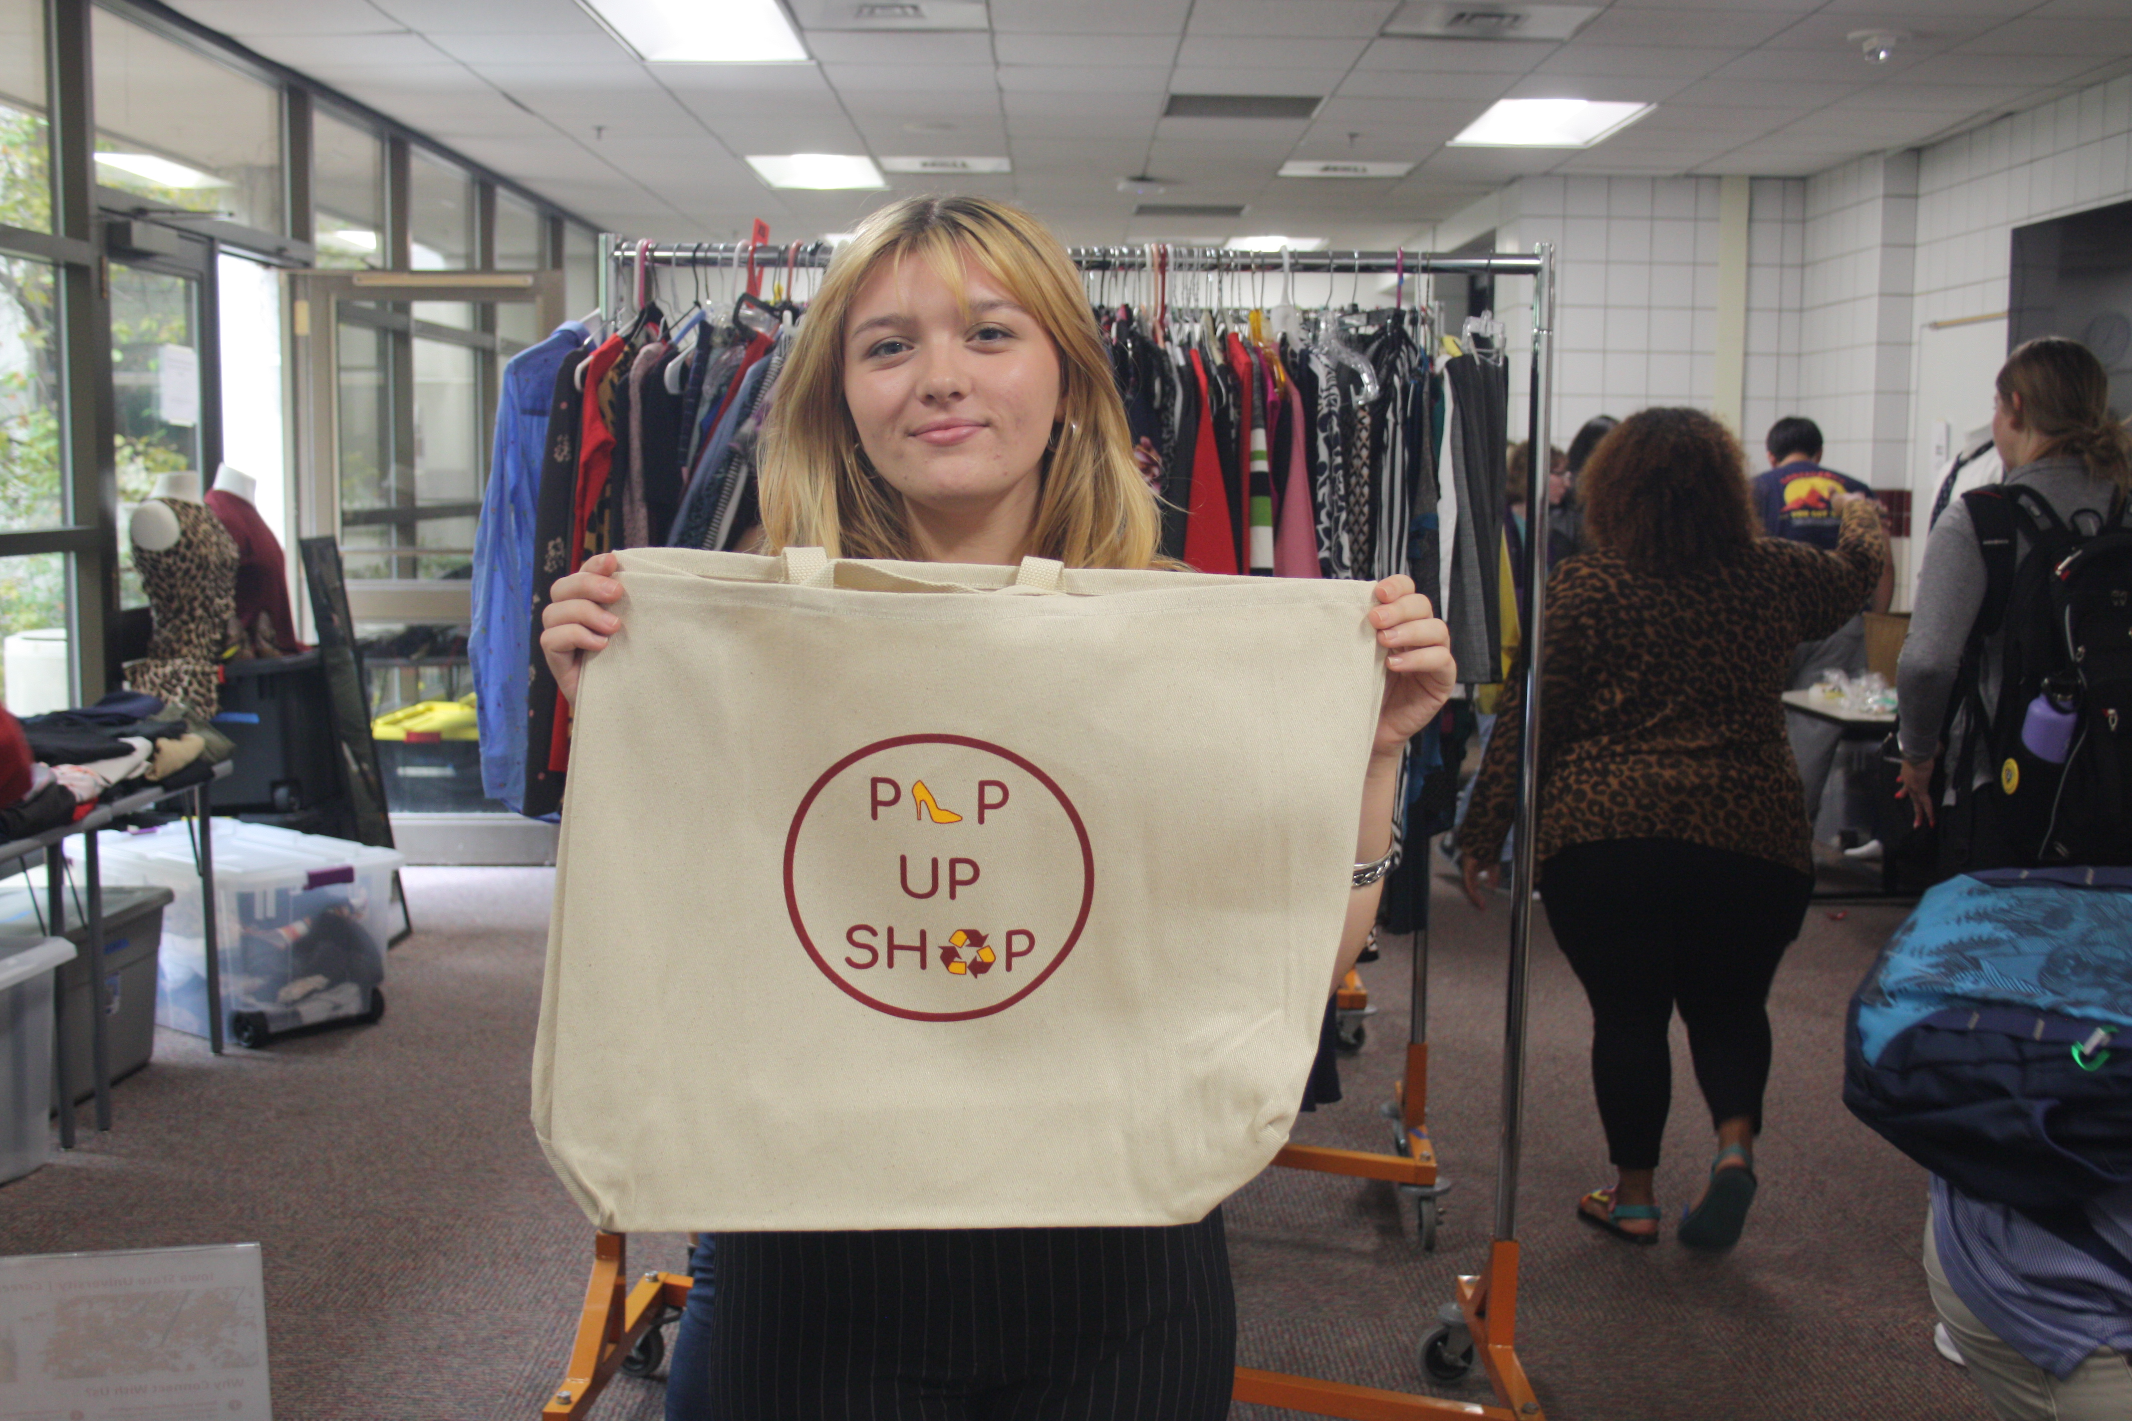
Learning Outcomes
After attending this presentation, we hope that you will be able to:
Identify key steps in the Pop-Up Shop's history that they could incorporate into your own grassroots projects.
Describe the mission of the Pop-Up Shop and feel confident making referrals to us.
Begin the process of developing your own grassroots resource.

Slide 5
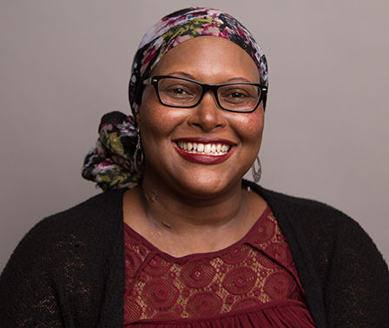
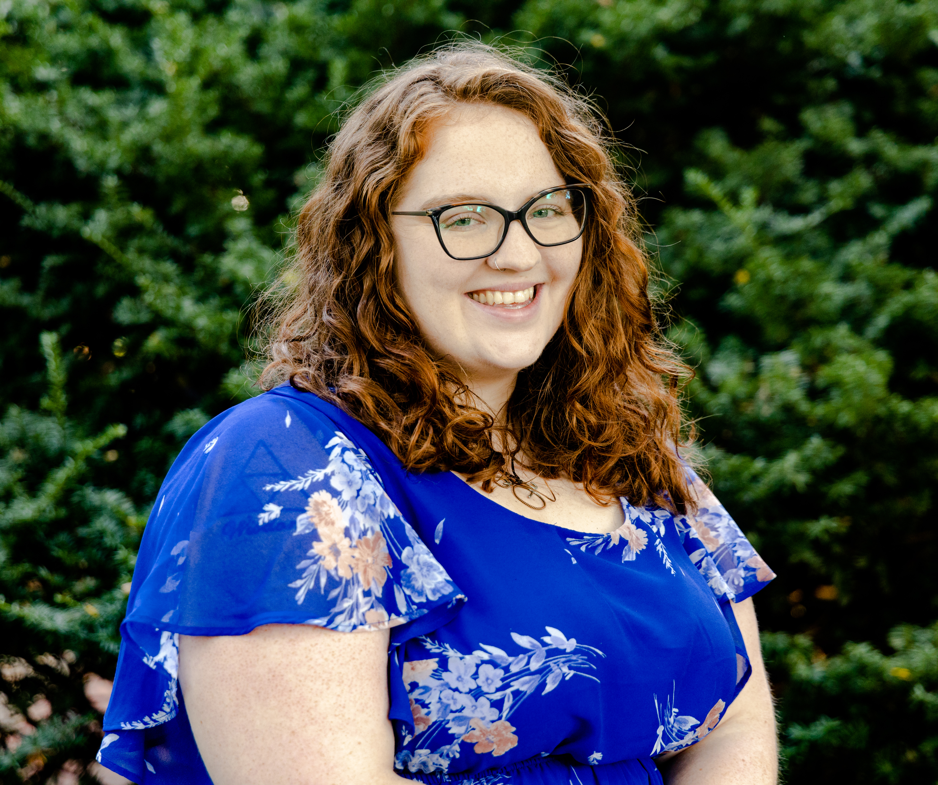
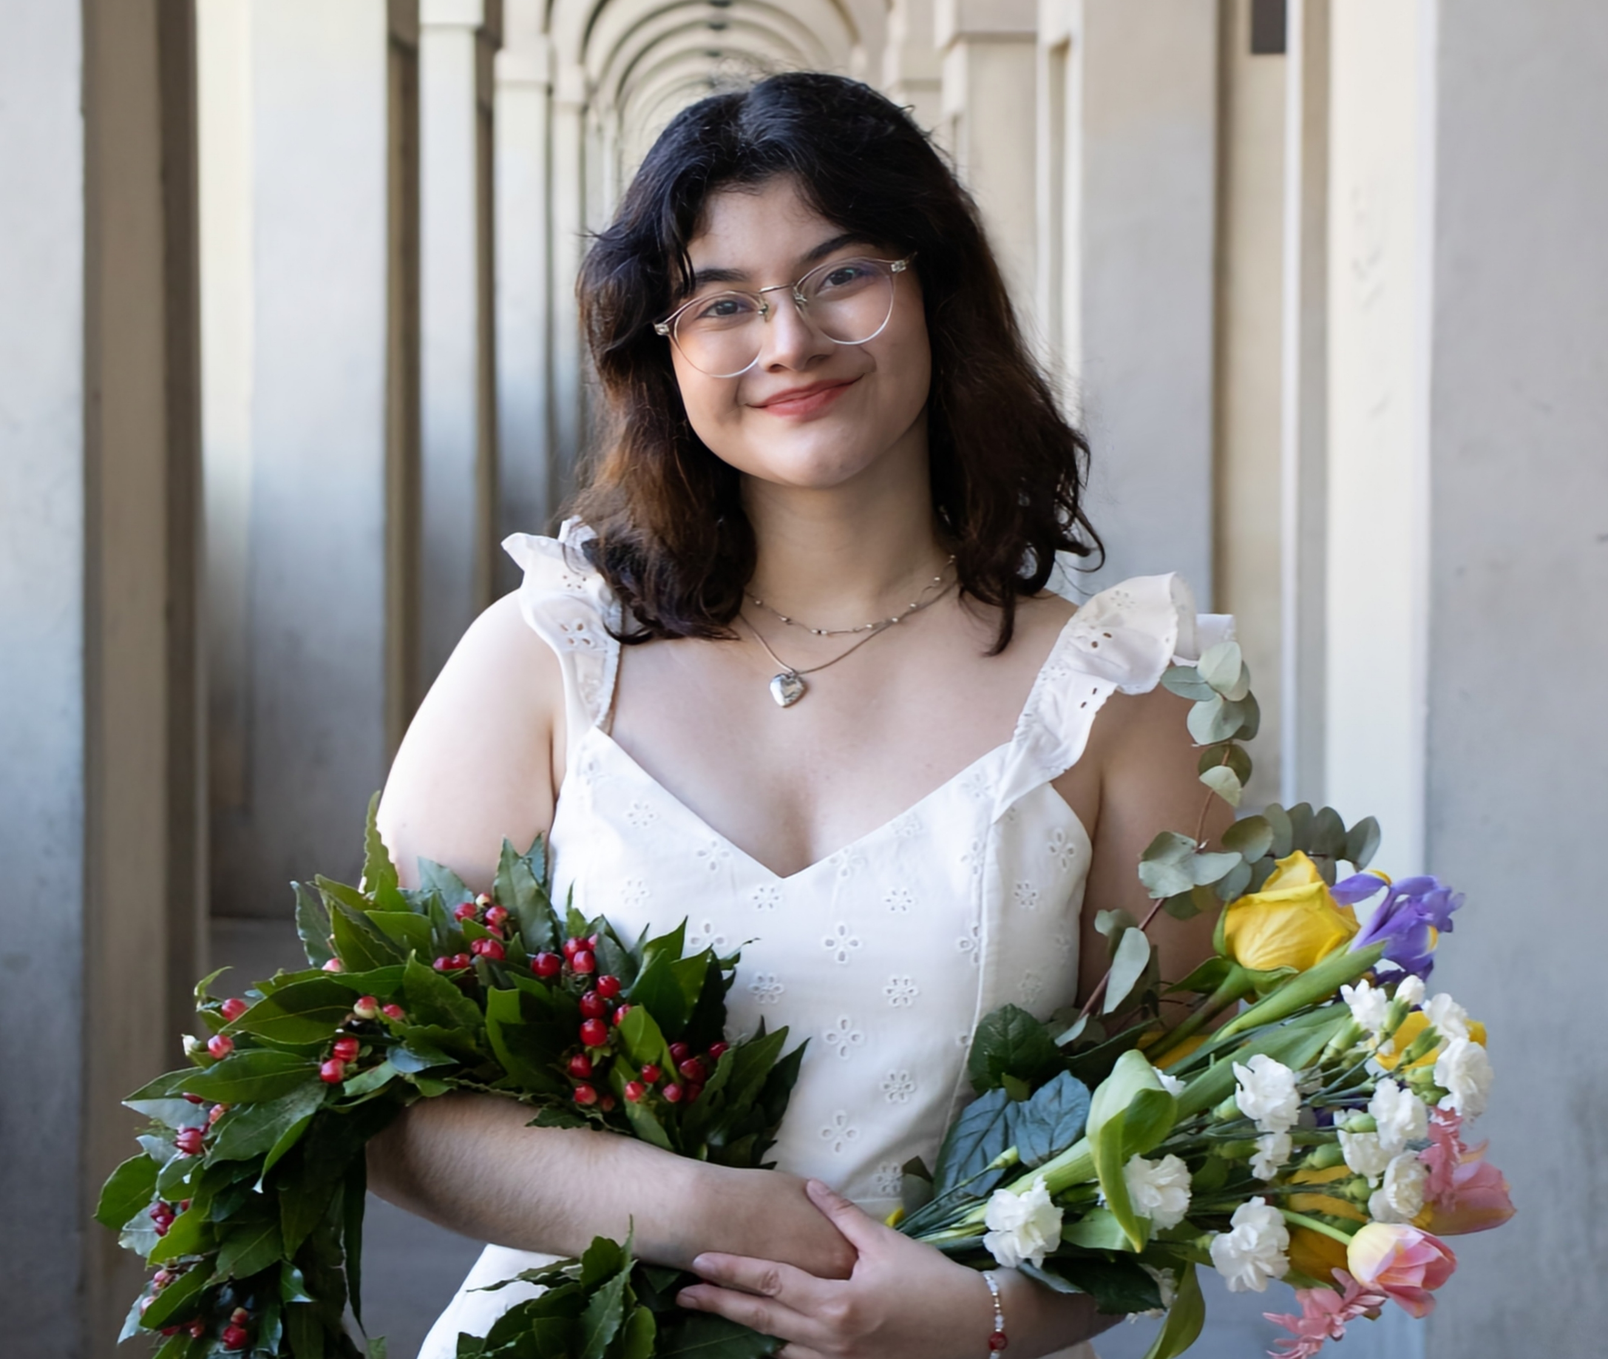
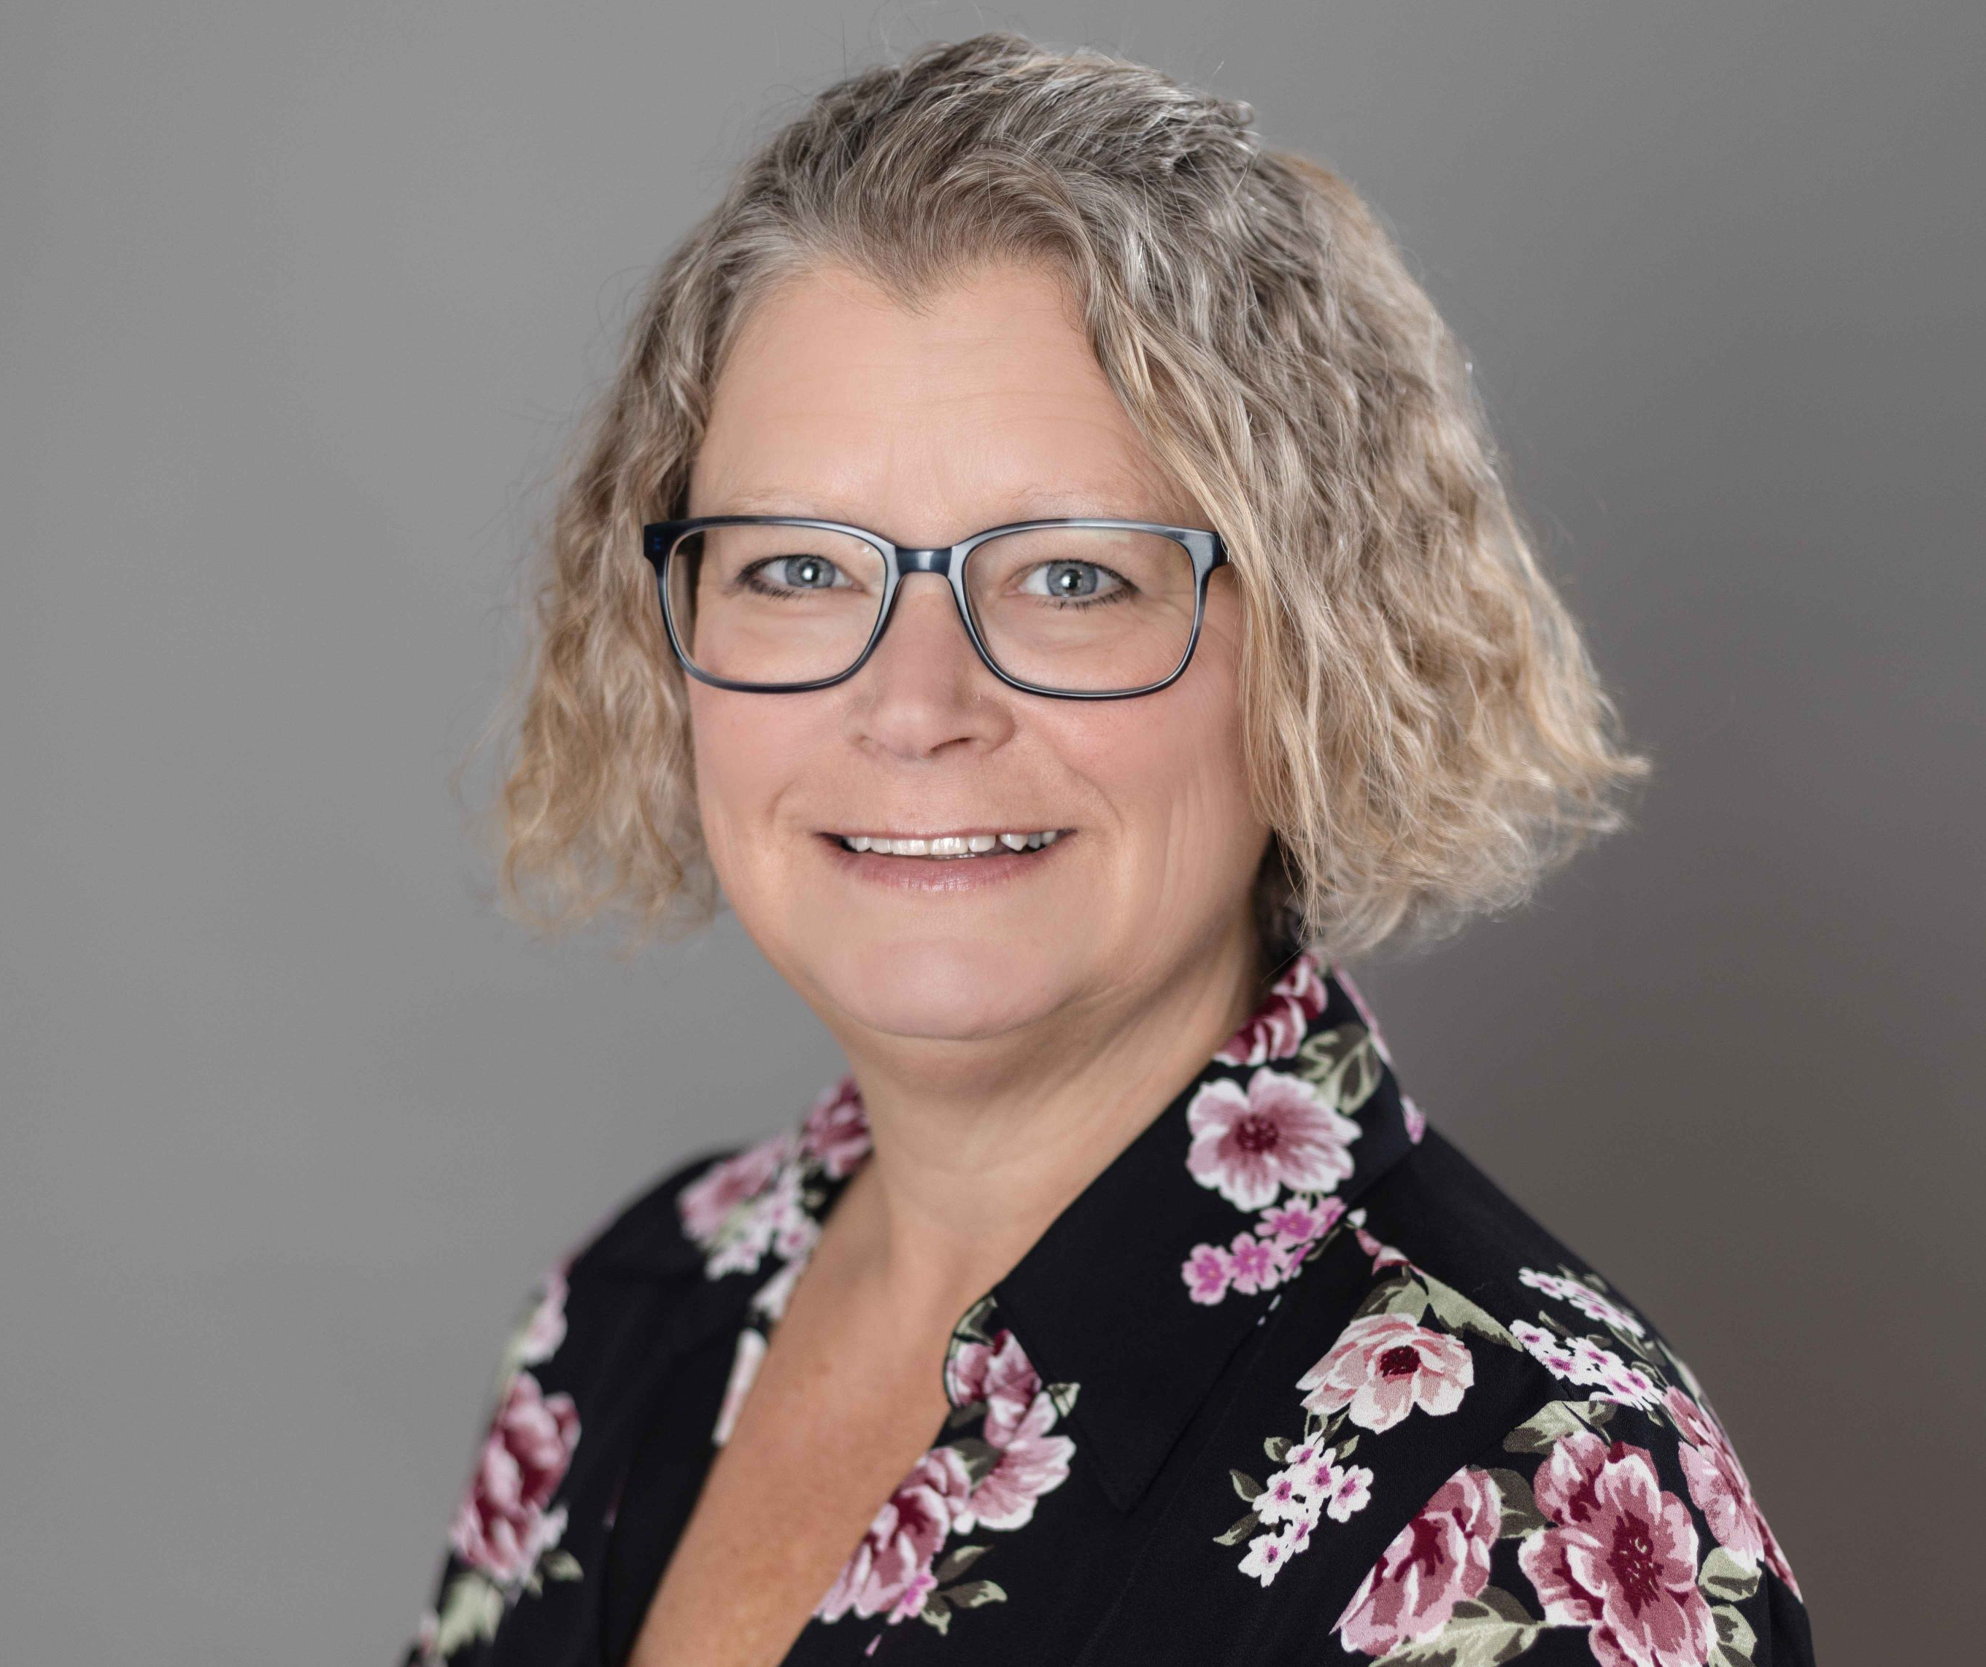
Meet the Team
Carmen Flagge
Director of Multicultural Student Success
Holly Clemons
Student Services Program Specialist
Sara Mejia
Social Media and Promotions Specialist
Dr. Amy Shane-Nichols
Assistant Teaching Professor

Slide 6
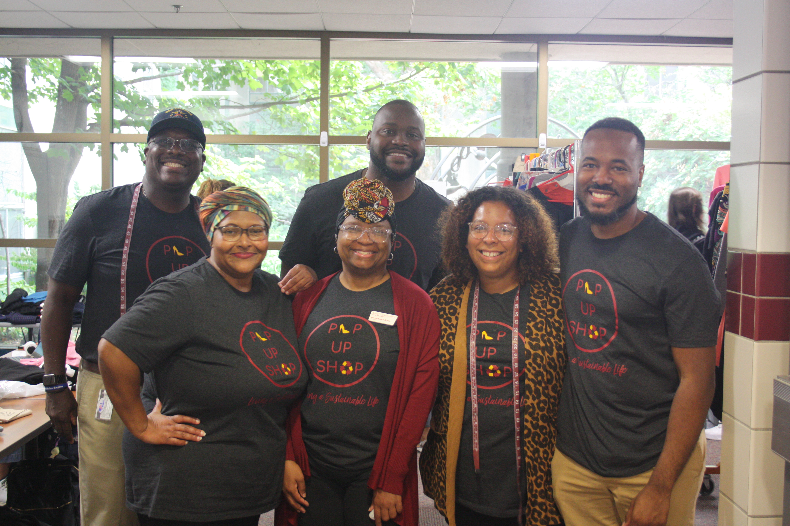
Meet the Advisory Board
Brady L. Talley, DMSS, Ivy College of Business
Carmen Flagge, DMSS, College of Human Sciences
Dr. LeQuetia Ancar, DMSS, College of Engineering
Jarael Madyun, DMSS, College of Design
Carah Mabry, DMSS, College of Agriculture and Life Sciences
Arnold Woods, DMSS, College of Liberal Arts and Sciences

Slide 7
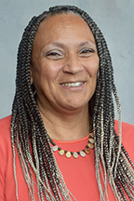
Meet the Advisory Board
Dr. Monica Howard, DMSS, Assistant Dean of Veterinary Student Success College of Veterinary Medicine
Jordan Brooks, Assistant Dean of Students & Director of Multicultural Student Affairs

Slide 8
Our Beginnings & Mission

Slide 9
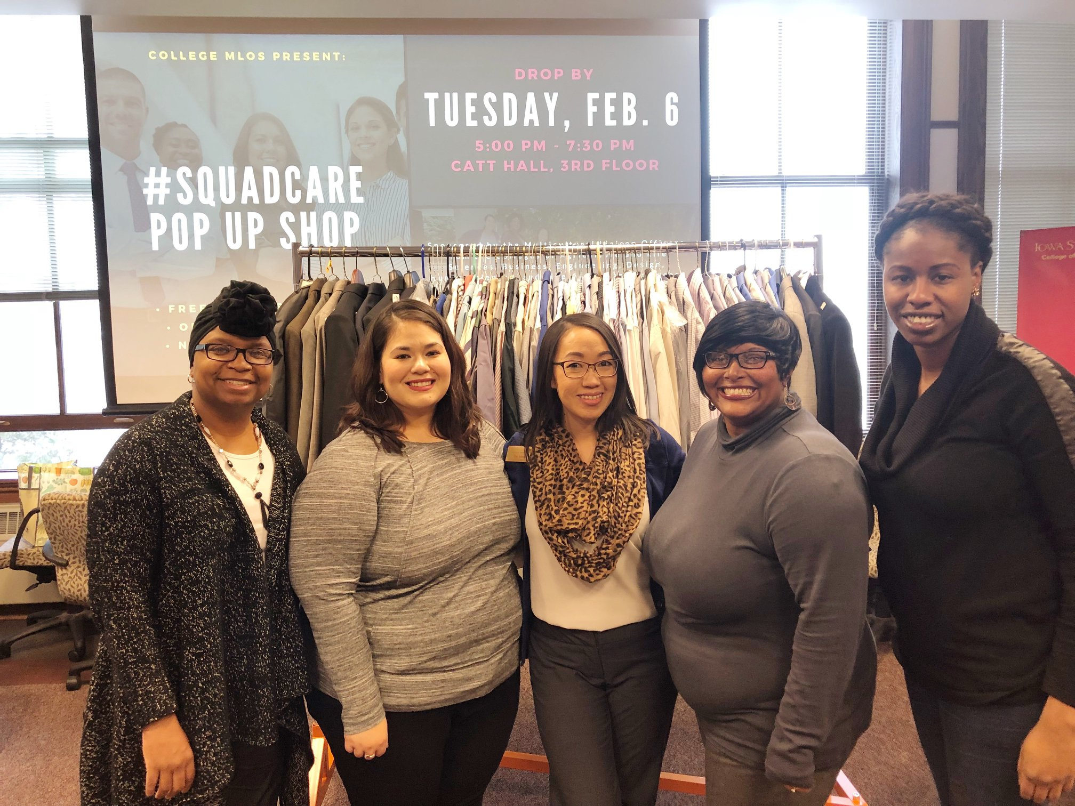
The Beginning
Student interactions are qualitative data à identifying a need
Ask for forgiveness, not for permission
You don’t have to have the data to start, you can start and collect the data as you go
Use the quantitative data you collect along the way to demonstrate the need to outside stakeholders who aren't "in the field" with you
Student Government funding as a Student Supported Service

Slide 10
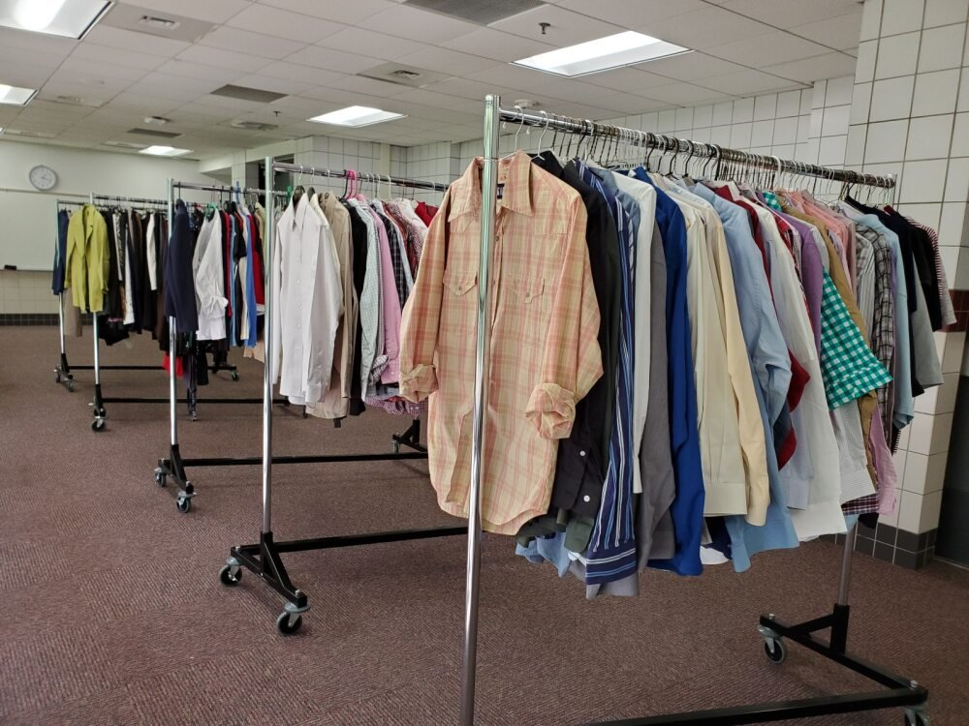
The Numbers
Since its inception, the Pop-Up Shop has:
Served over 3000 undergraduate, graduate, and professional students from every college
Partnered with current and past faculty, staff, alumni, and community resources including the Loft and Overflow to collect over 10,000 items (clothing, shoes, accessories, etc.)

Slide 11
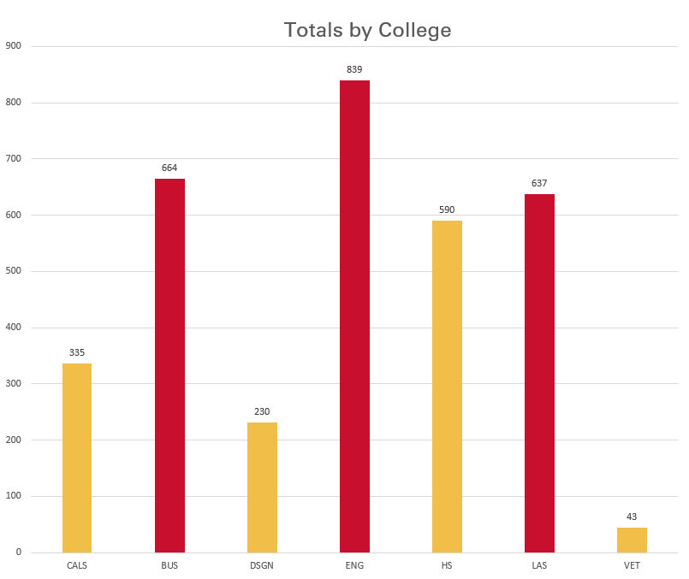
Who Do We Serve?
Engineering: 24.77%
Business: 19.60%
Liberal Arts & Sciences: 18.81%
Human Sciences: 17.42%
Ag & Life Sciences: 9.89%
Design: 6.79%
Vet Med: 1.27%
Note: No data available for Fall 2020 and Spring 2021

Slide 12
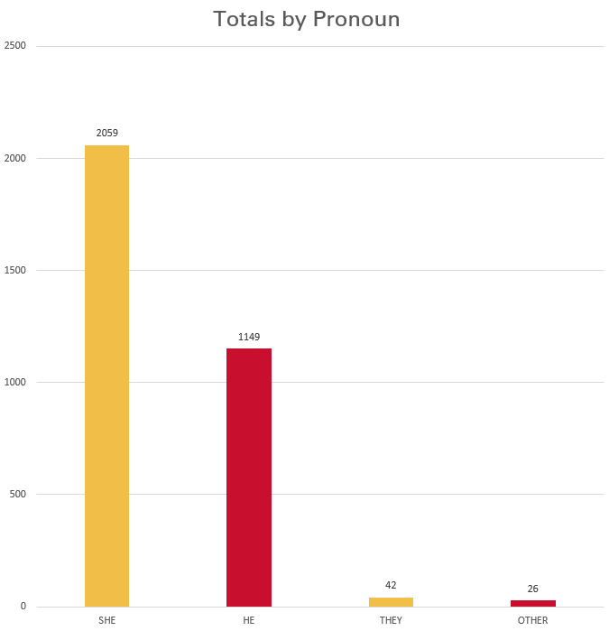
Who Do We Serve?
She/hers: 60.79%
He/Him: 33.92%
They: 1.24%
Other: 0.77%
Note: No data available for Fall 2020 and Spring 2021

Slide 13
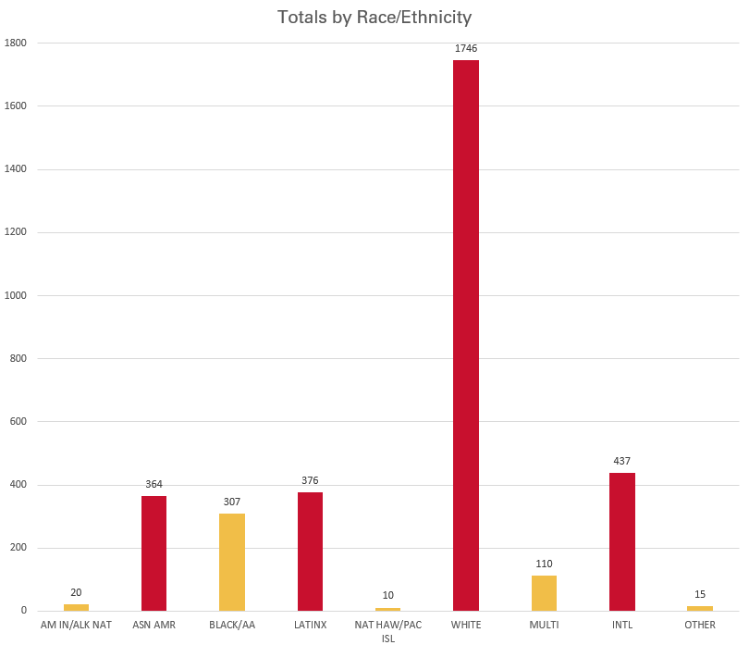
Who Do We Serve?
White: 51.55%
International: 12.90%
Latino/a/x: 11.10%
Asian American: 10.75%
Black or African American: 9.06%
Multiracial/2 or more races: 3.25%
American Indian/Alaskan Native: 0.59%
Other: 0.44%
Native Hawaiian/Pacific Islander: 0.30%
Note: No data available for Fall 2020 and Spring 2021

Slide 14
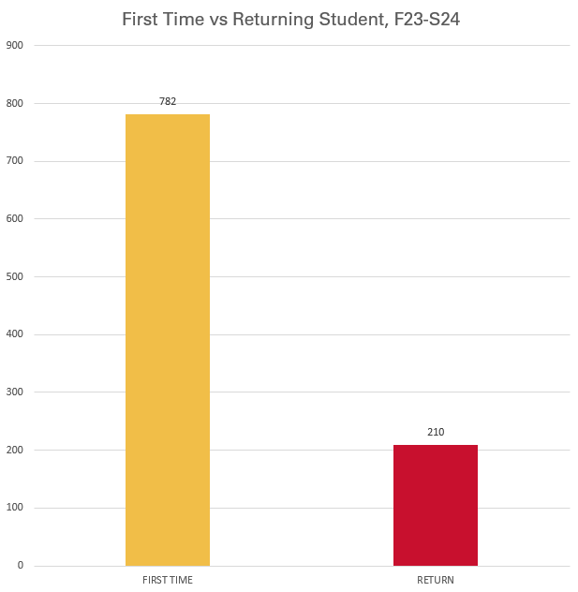
Who Do We Serve?
First time attendee: 78%
Returning attendee: 21.13%
Note: Question added Fall 2023

Slide 15
What do the Data Tell Us?
Students need business attire. Period.
Significantly fewer returners à students are keeping business attire from previous Pop-Ups and reusing them, contributing to our mission of sustainability.
We disproportionately serve students with minoritized identities.
Enrollment not proportionate to who we are serving

Slide 16
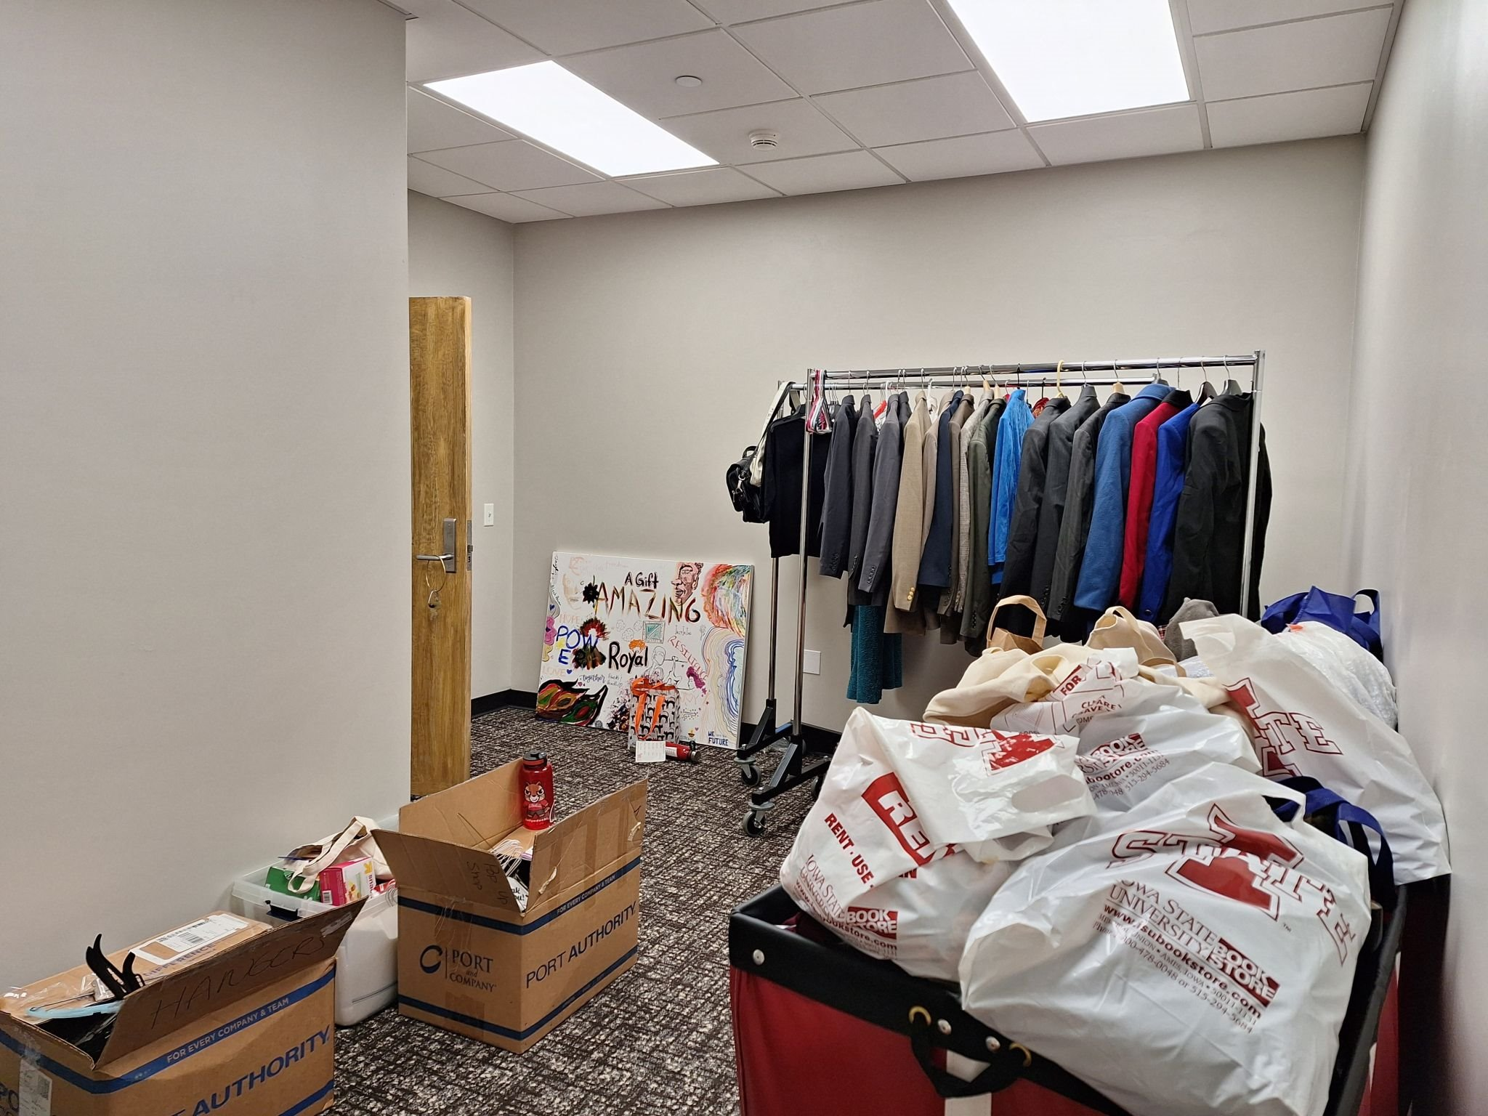
Needs Over Time
Pop-Up Shop is established à Students are reaching out throughout the semester for attire
Need for a permanent location identified
Collaborations with campus partners: securing a spot in the Memorial Union
Know your colleagues!
Jordan Brooks
Brad Hill & Mario Filippelli
Dr. Amy Shane-Nichols

Slide 17
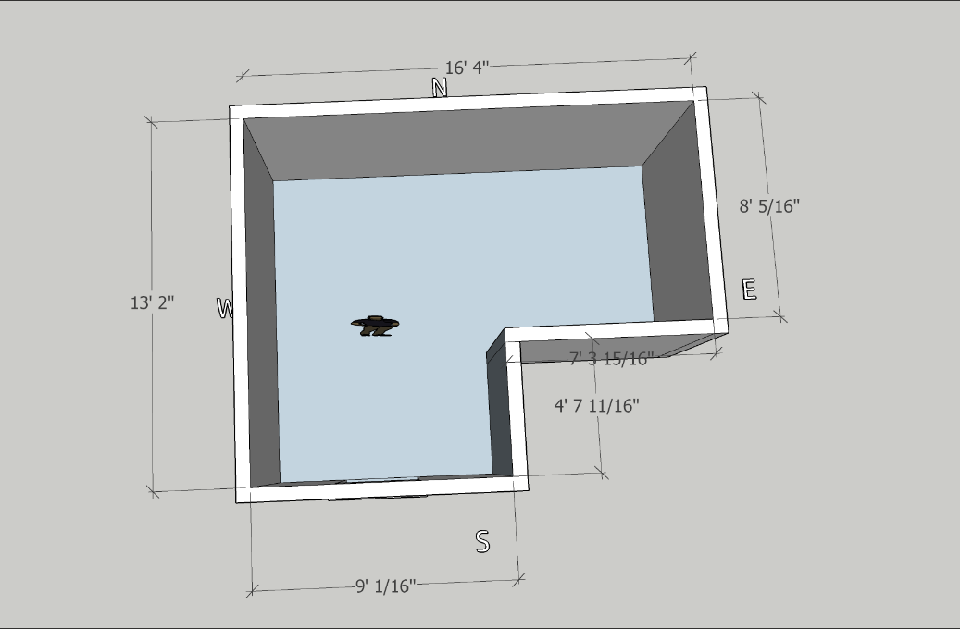
The Closet: Design
Images courtesy of Palay Display

Slide 18
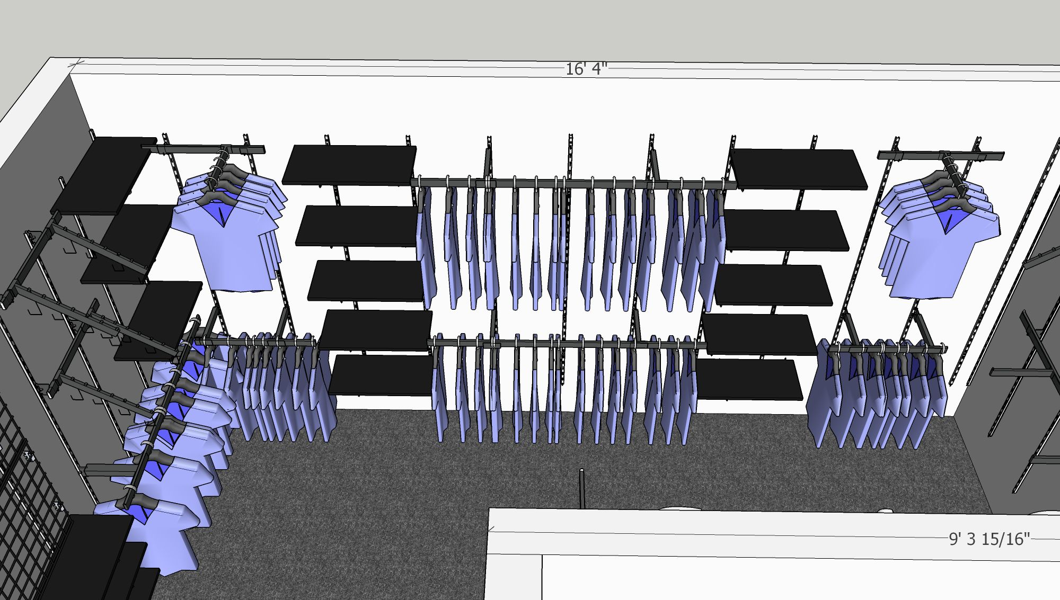
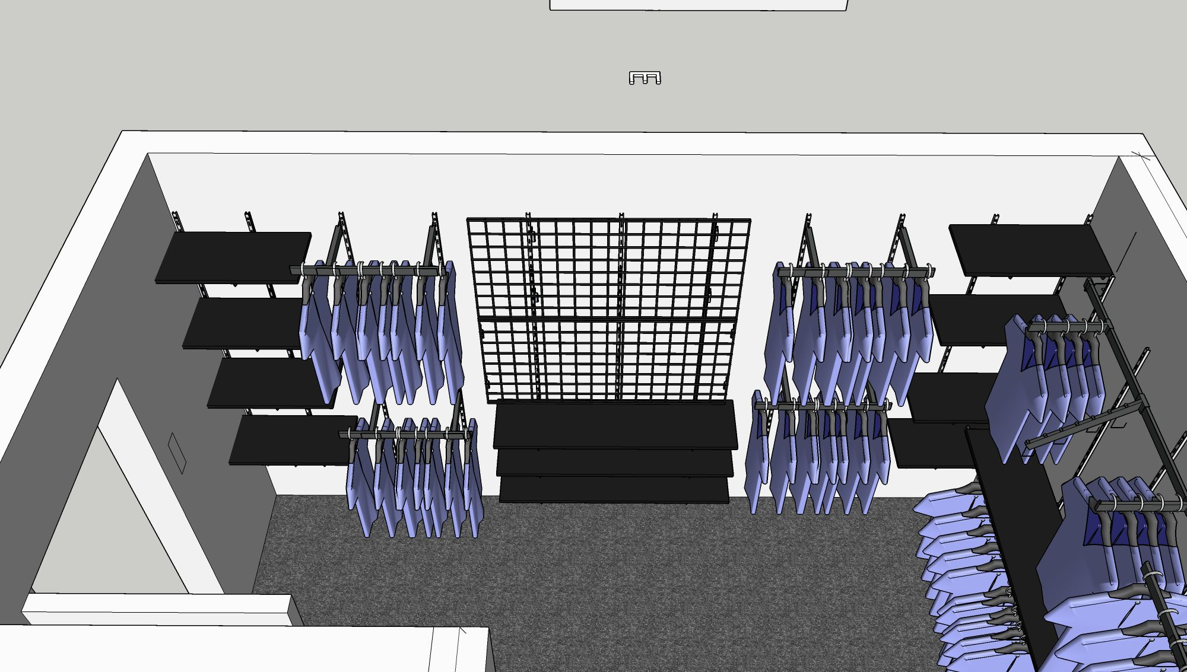
The Closet: Design
Images courtesy of Palay Display

Slide 19
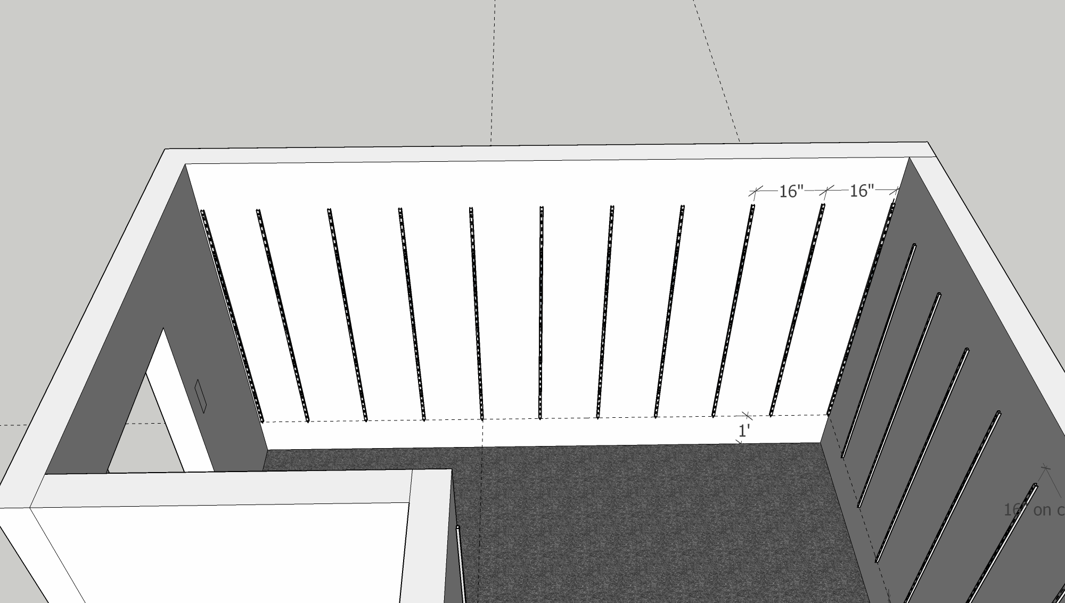
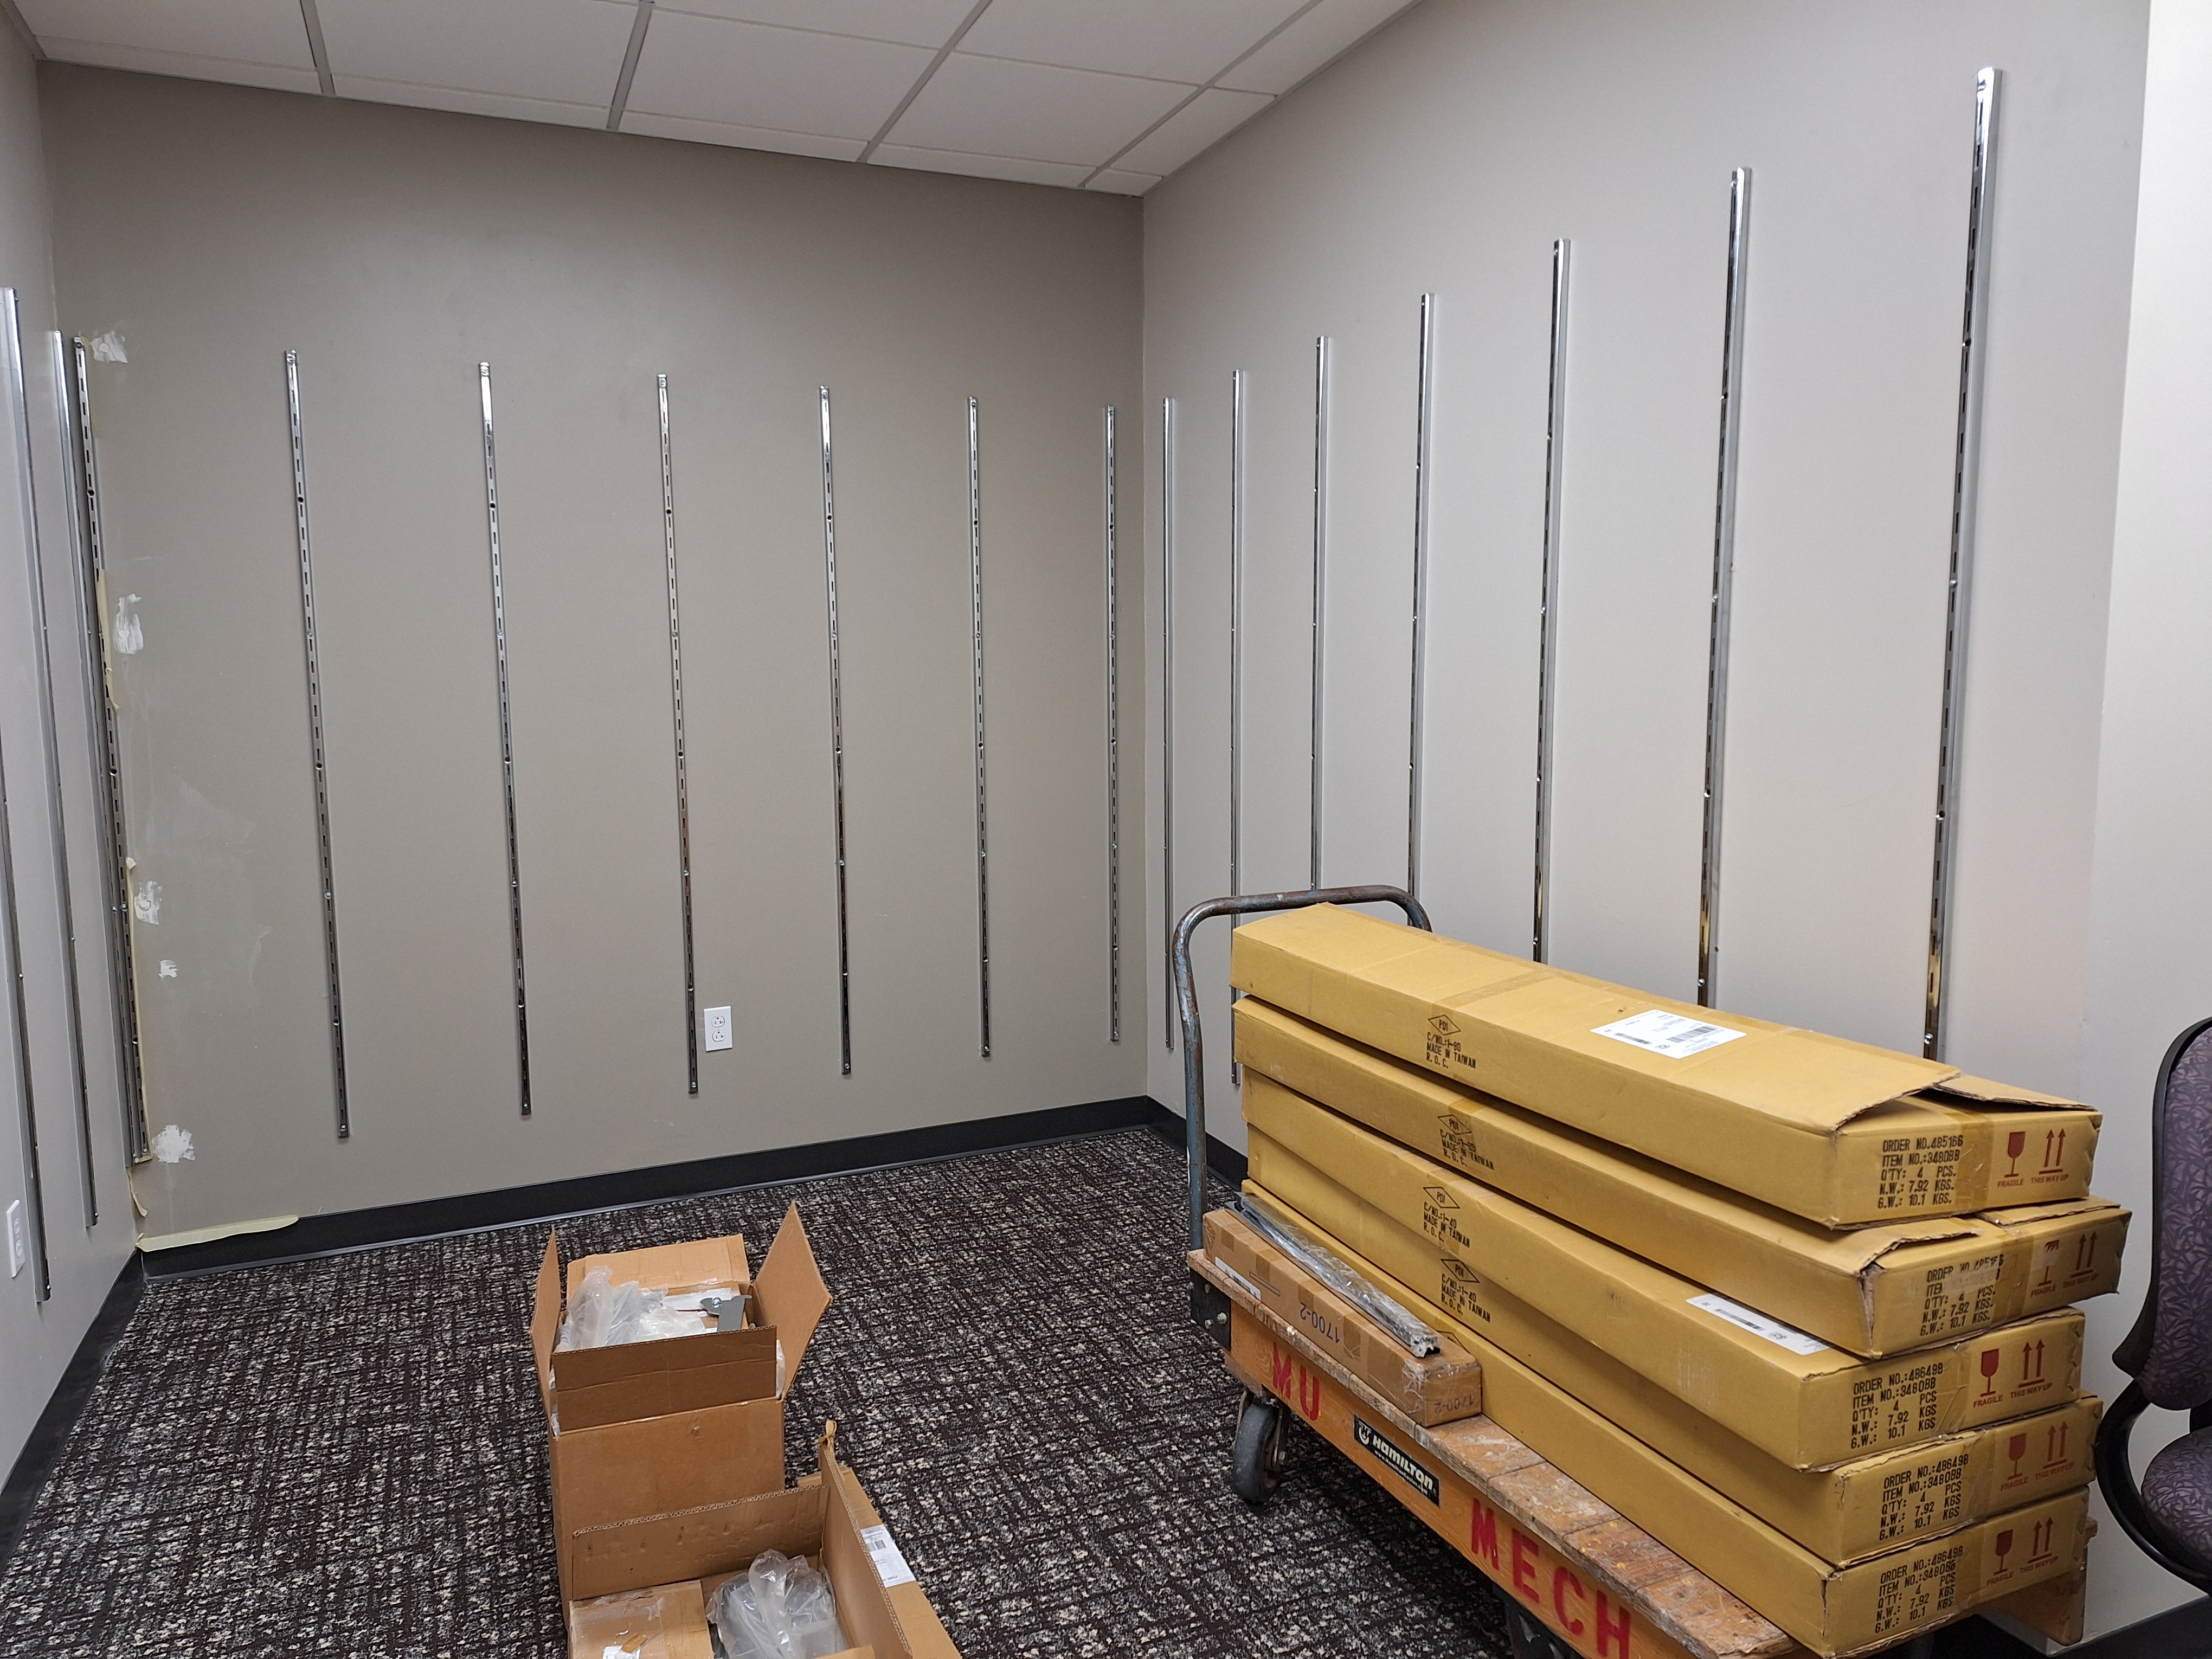
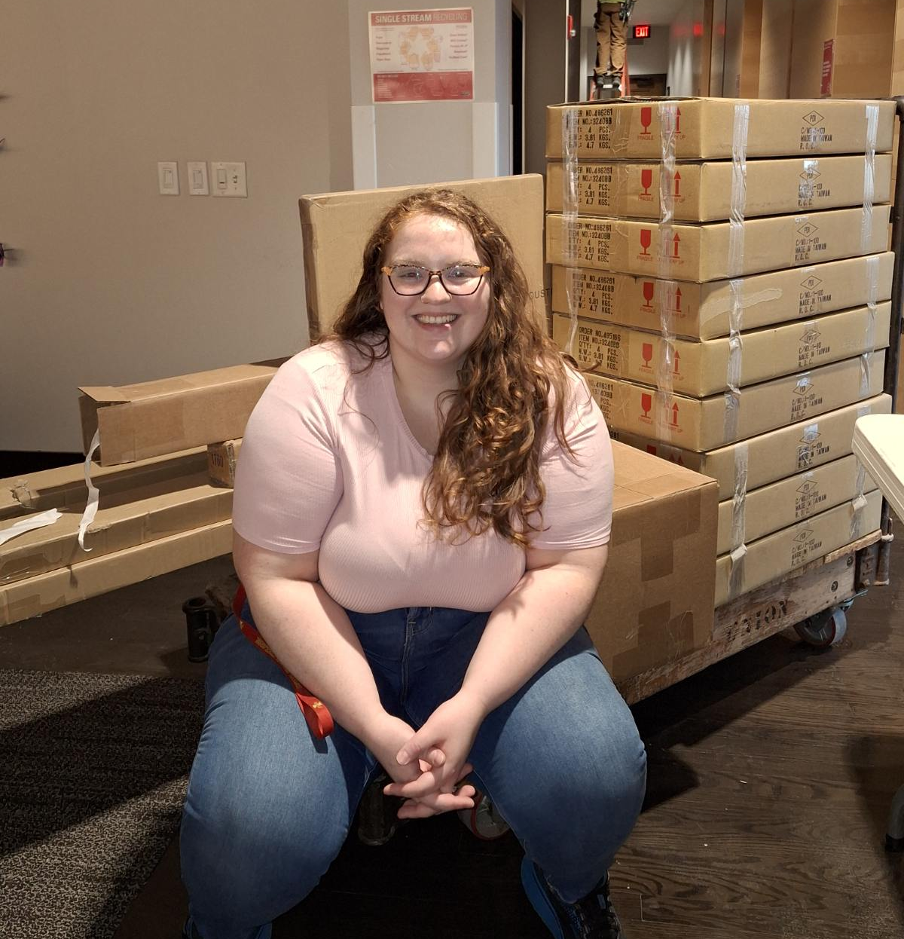
The Closet: Installation

Slide 20
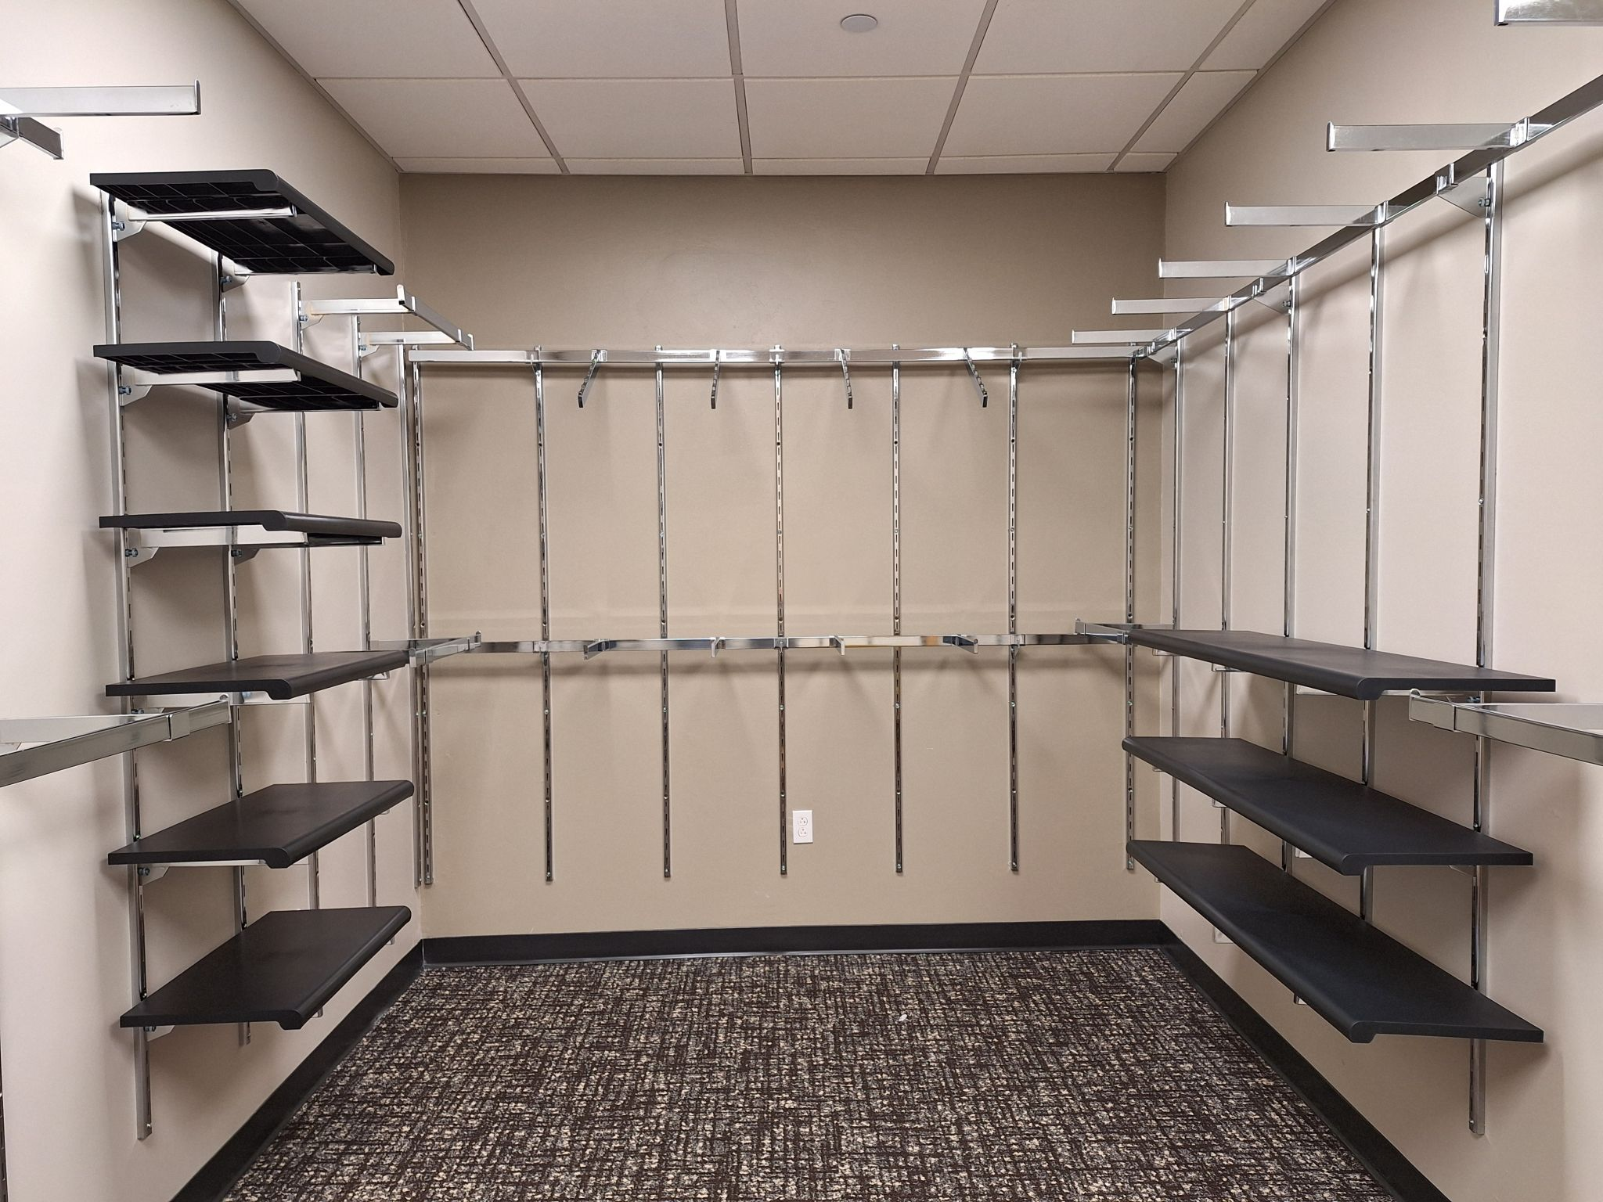
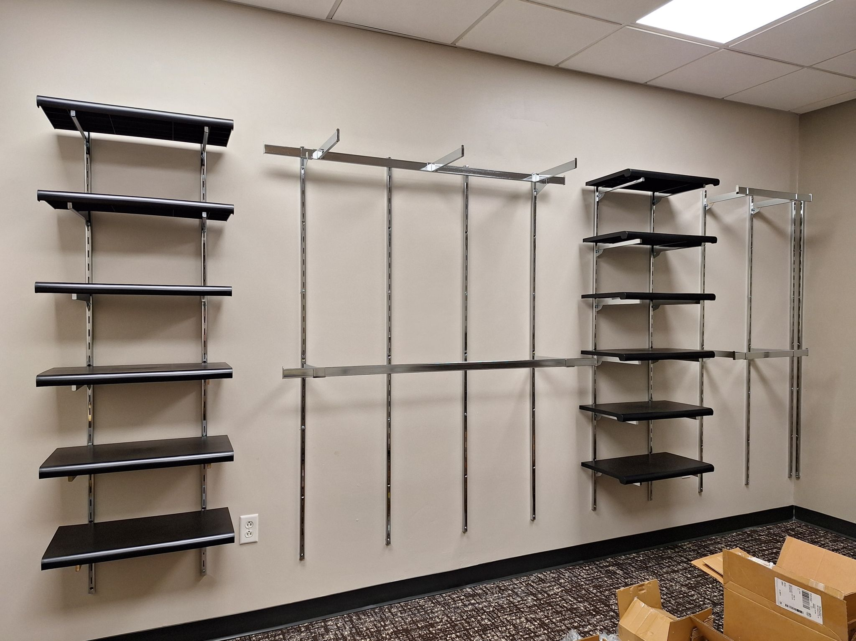
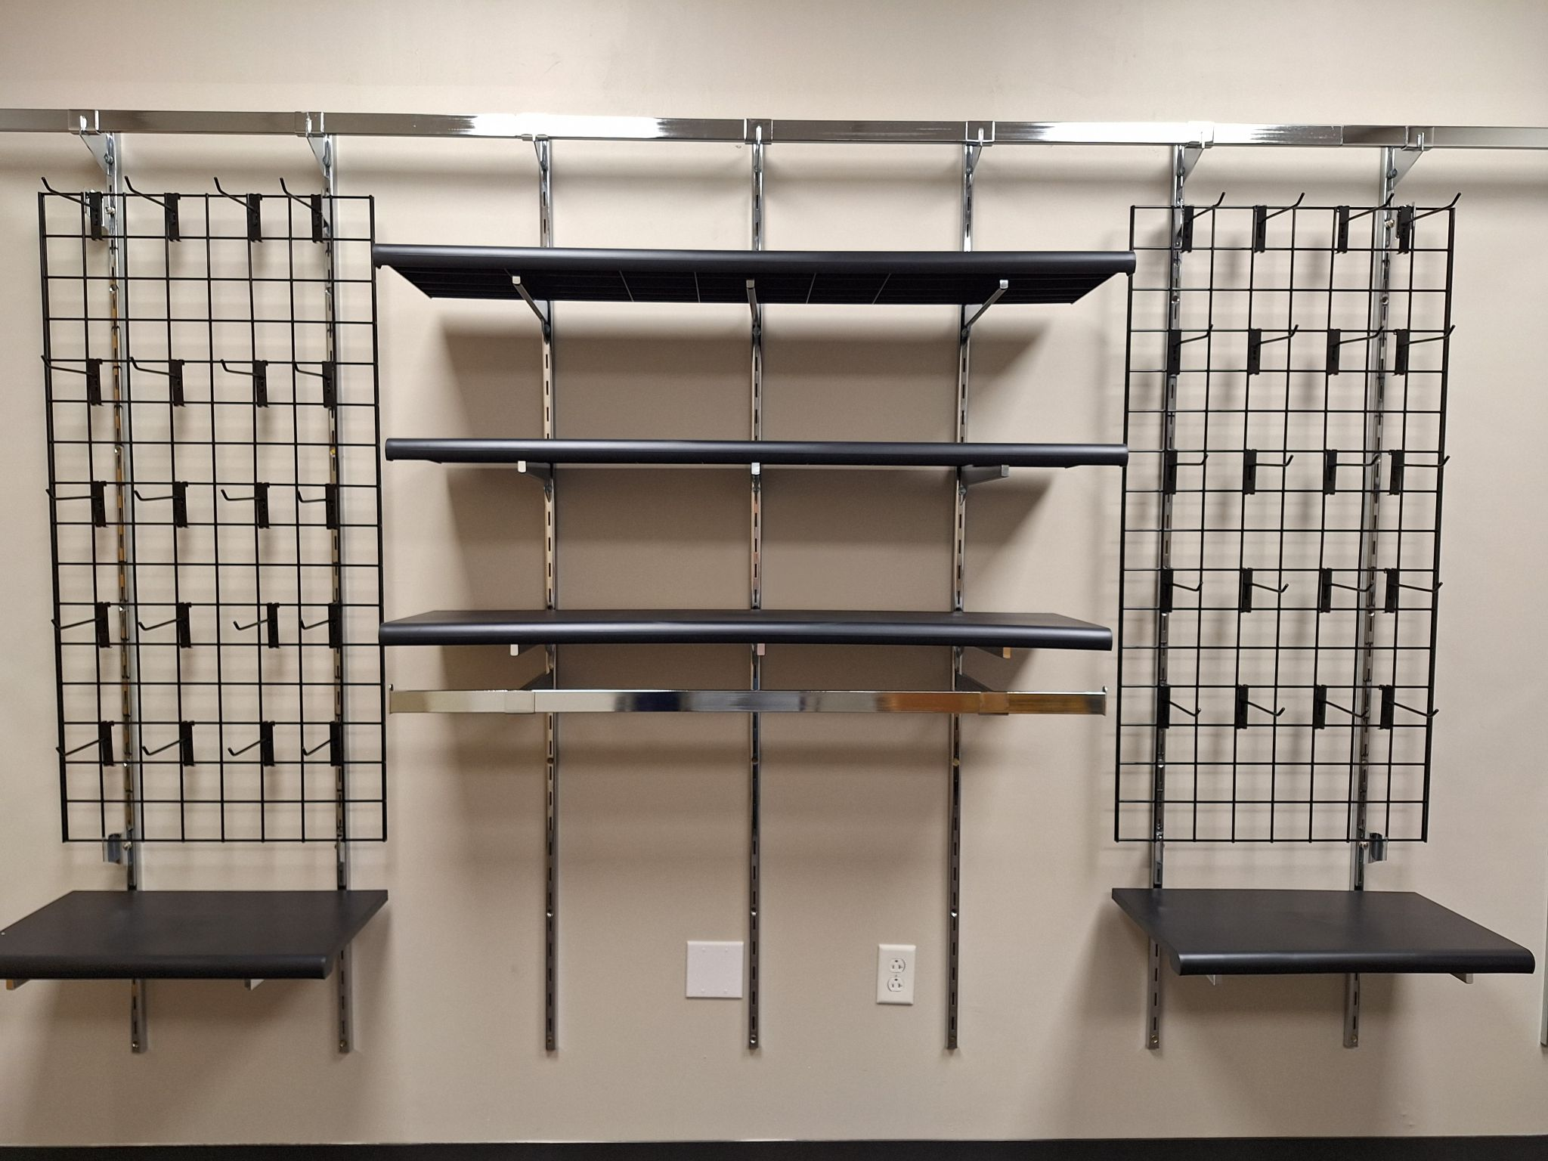
The Closet: Installation

Slide 21
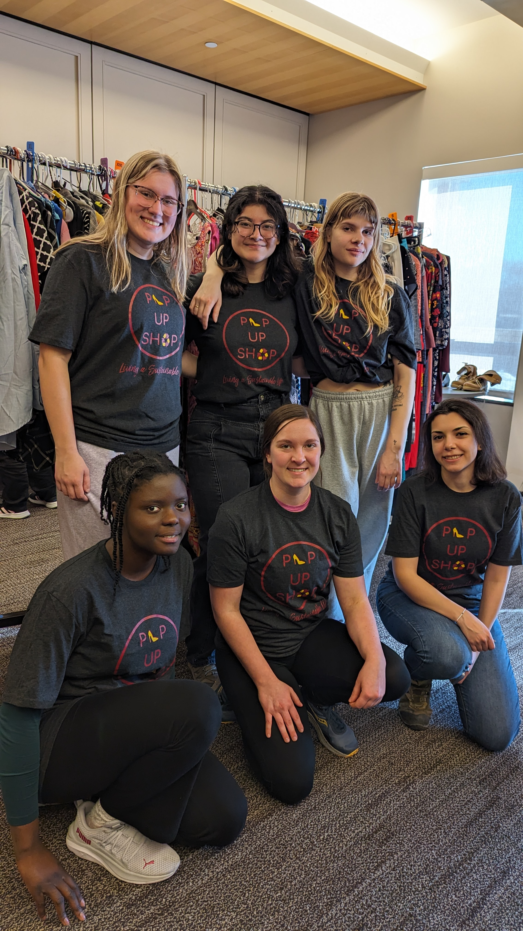
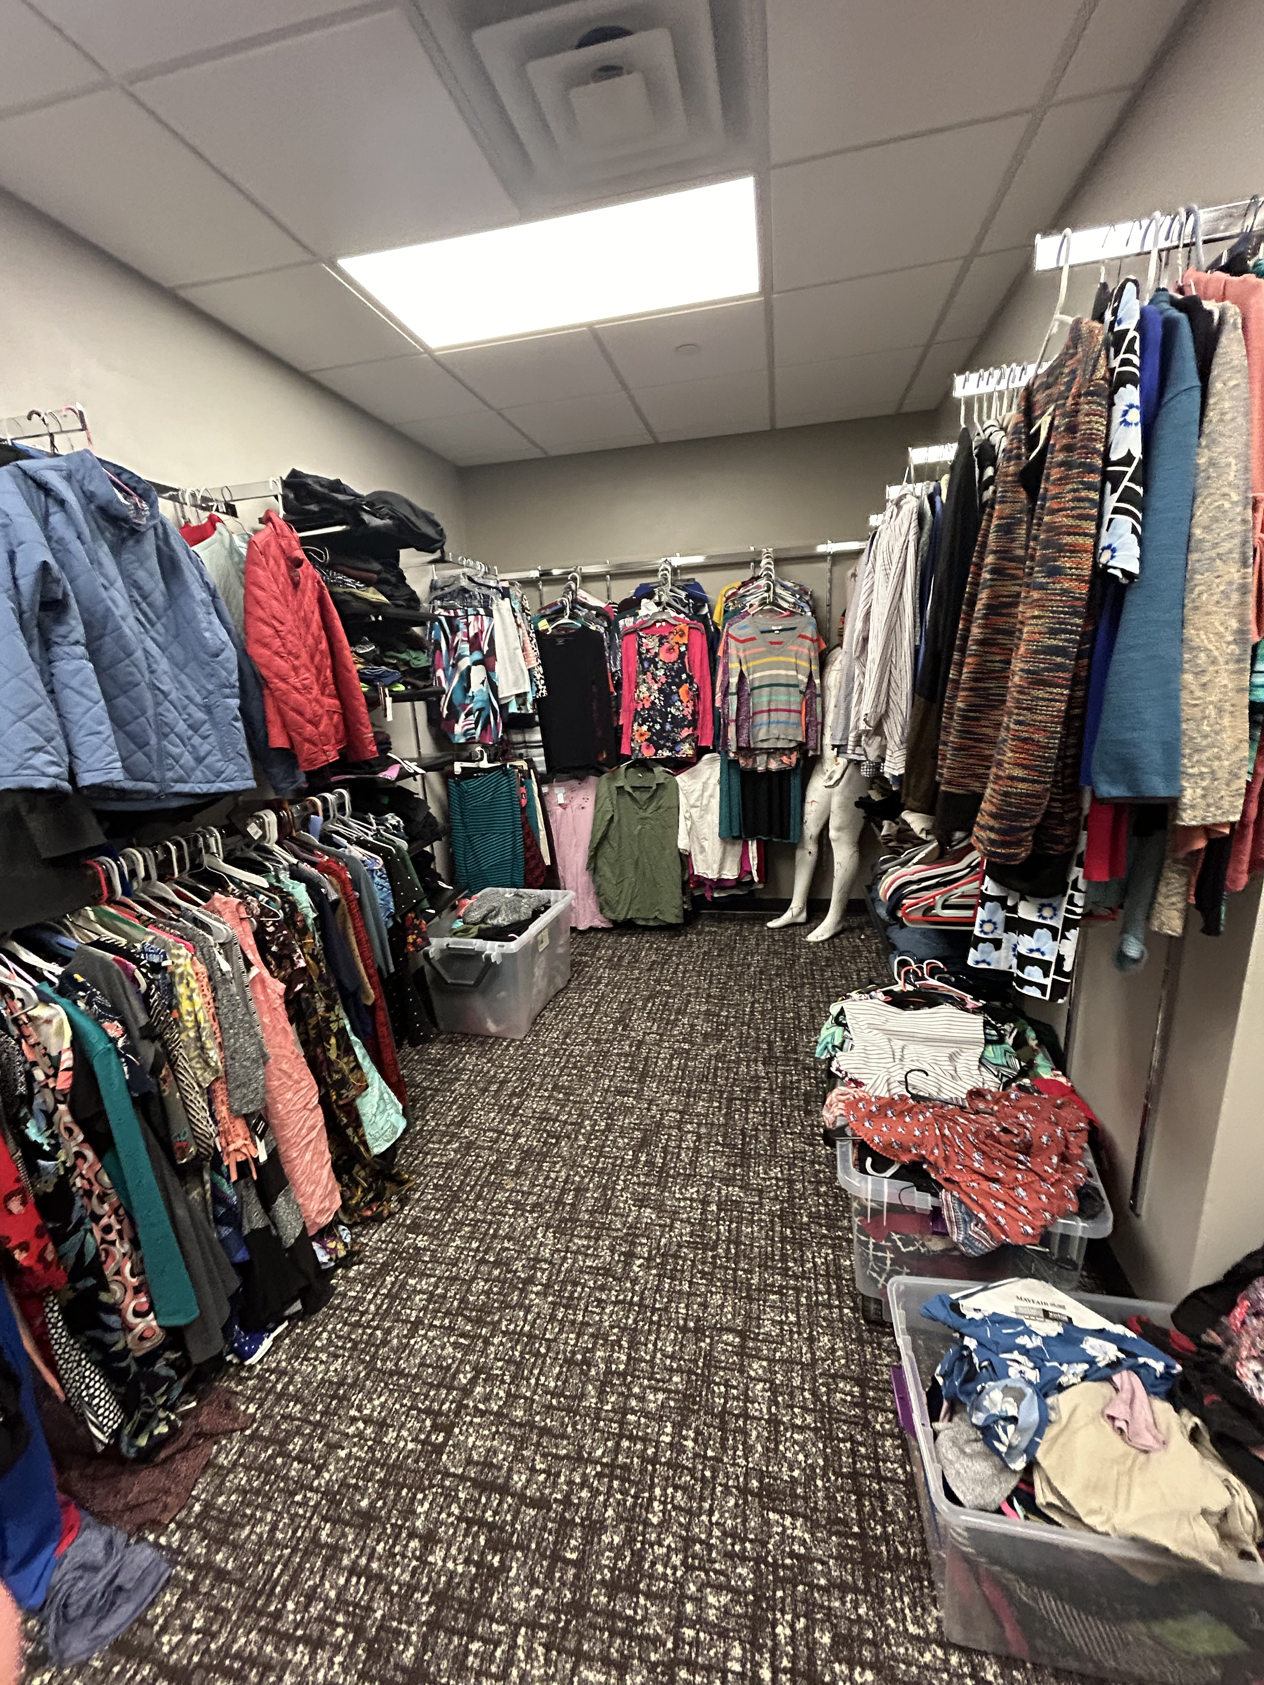
The Closet: Stocking

Slide 22
Social Media and Promotions Overview
Social Presence
Branding
Tech
Engagement
Advertise Impact
Analyze Impact
Increase Advertising
Build Partnerships
Campus Orgs
Local Businesses

Slide 23
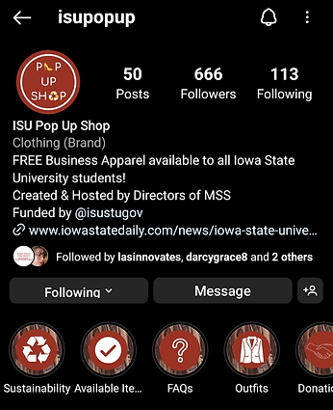
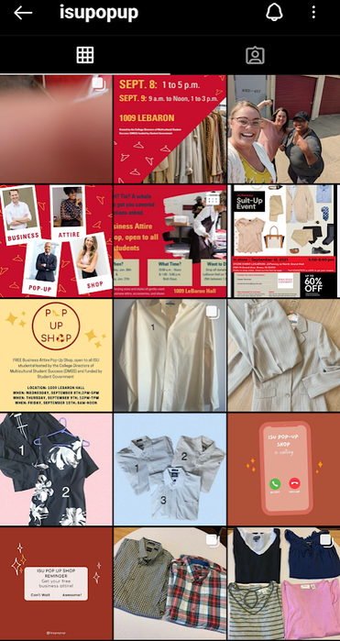
Social Presence - Branding
Goal: strengthen the brand image & update with new information
Bio concerns:
Long bio
No link tree
Old info in story highlights
Page concerns:
Inconsistent colors
Inconsistent aspect ratios

Slide 24
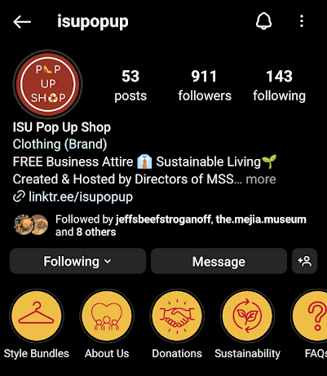
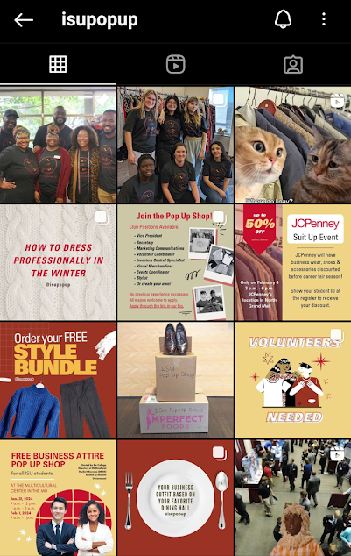
Social Presence - Branding
Goal: strengthen the Instagram page's brand image & update with new information
Shortened bio with emojis
+ Linktr.ee
Used 1:1 aspect ratio
Used consistent brand colors and fonts
New cover for story highlights:
Easy to see
Timeless info

Slide 25
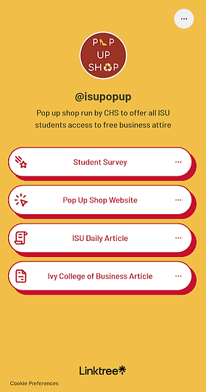
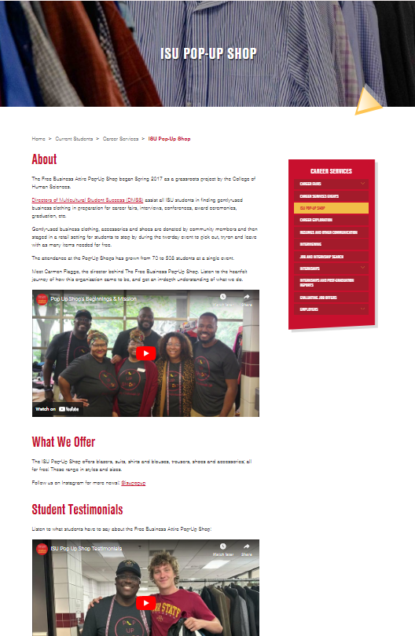
Social Presence - Technology
Goal: Bring the Free Business Attire Pop Up Shop into a more interconnected world
1.) Linktree
2.) Website
Purpose: Utilized to have one place for students to find everything coming up: surveys, volunteer sign up forms, website, etc.
Purpose: To show up in web search. Fills out the small details that we can't express on Instagram
Includes:
Mission statement
What we offer
Student Testimonials
Partnerships
FAQ

Slide 26
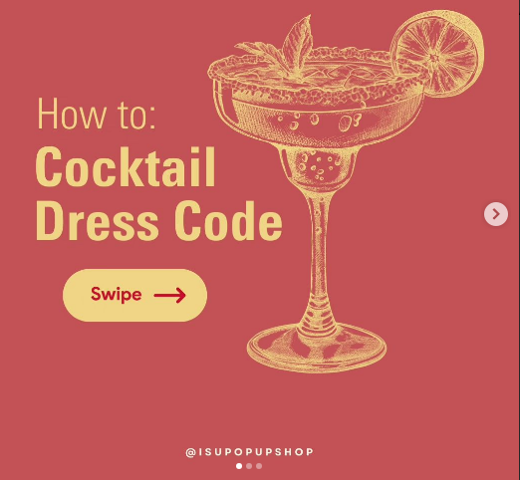
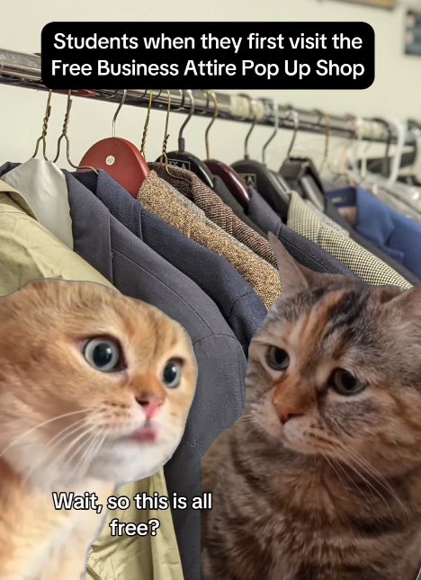
Social Presence - Engagement
Goal: Boost engagement on social media by making professionalism less intimidating to our primarily Gen-Z audience
EDUCATIONAL
PERSONABLE
INFORMATIVE
Notes:
To me, the opposite of fear is knowledge
Gen-Z as a whole has an aversion to professionalism and prefer informal conversations and settings. This reality may sound conflicting to how we market to them as an ISU-affiliated organization. However, I believe there can be a space to accommodate Gen Z's preferences without offending the university. Here's how...

Slide 27
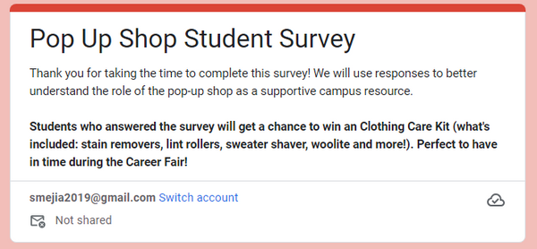
Advertising Impact – Surveys

Slide 28
Advertising Impact - Data
Qualitative Data
72.2% visited the Pop Up Shop before
100% said they would be visiting the Pop Up Shop in the future
82.3% said having free access to professional attire helped them financially
82.3% said that staff was friendly and helpful

Slide 29
Advertising Impact - Data
How students found us:
58.8% social media
35.3% advertising
5.9% through ISU faculty member

Slide 30
Advertising Impact - Testimonials

Slide 31
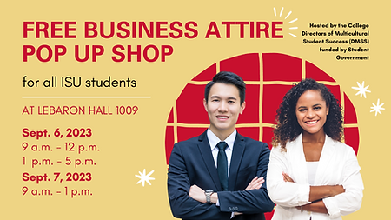
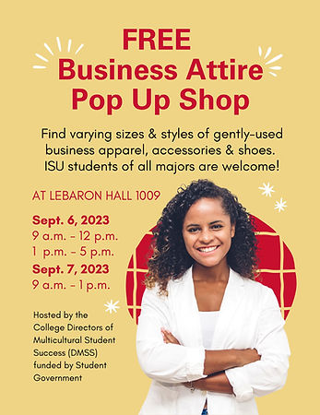
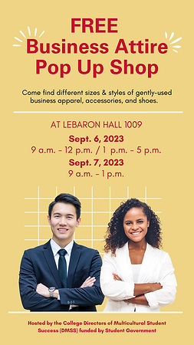
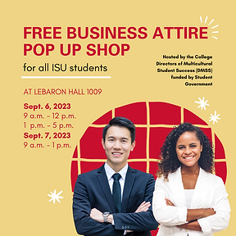
Dormitory Flyers
MU, food court & outside of every Student Services office in every college
ISU Daily & Instagram

Slide 32
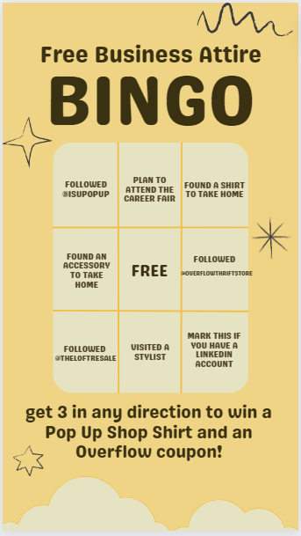
Building Partnerships - Businesses
Local Businesses
The Loft
Consignment store in Ames and Ankeny
Donated clothes through both locations for years
80% of our clothing is from them
Overflow
Thrift store in Ames
Donated store coupons and business shoes

Slide 33
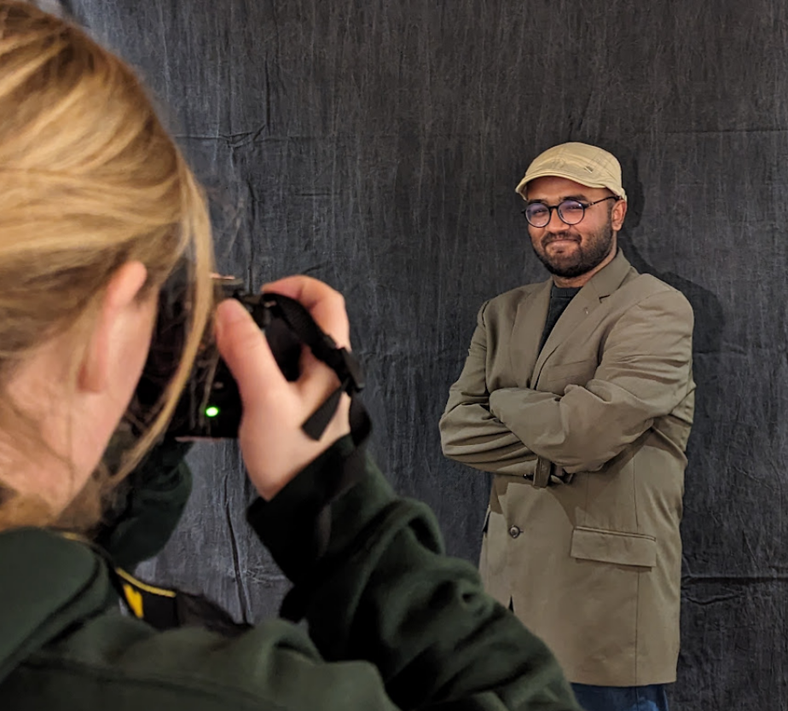
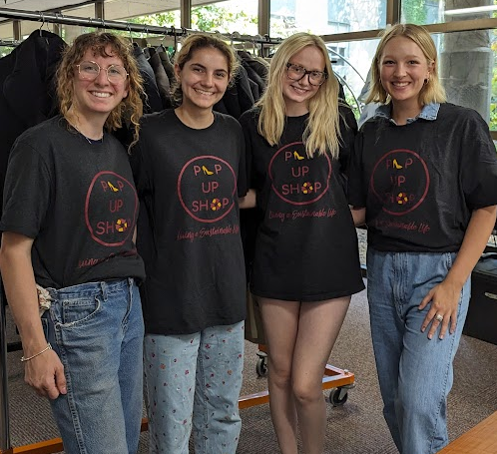
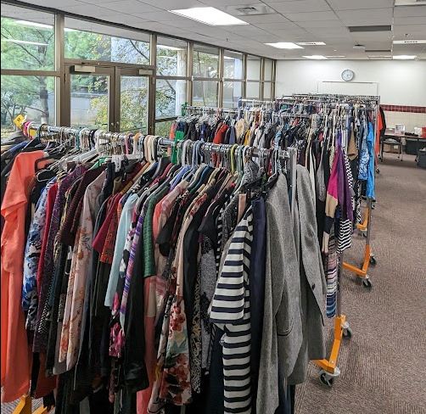
Building Partnerships – Campus Orgs
Catt Center - Headshots
Sir Magazine - Headshots
Trend Magazine - Volunteering
NSBE: National Society of Black Engineers - Volunteering

Slide 34
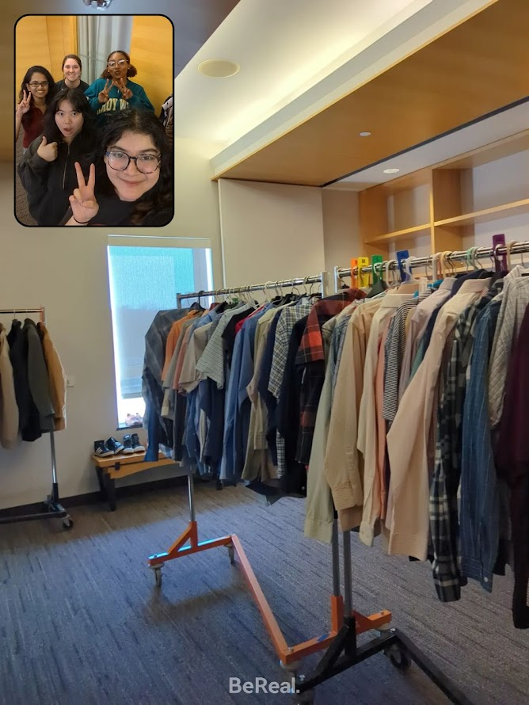
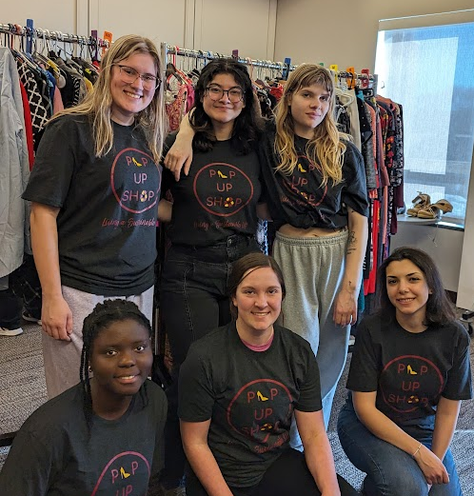
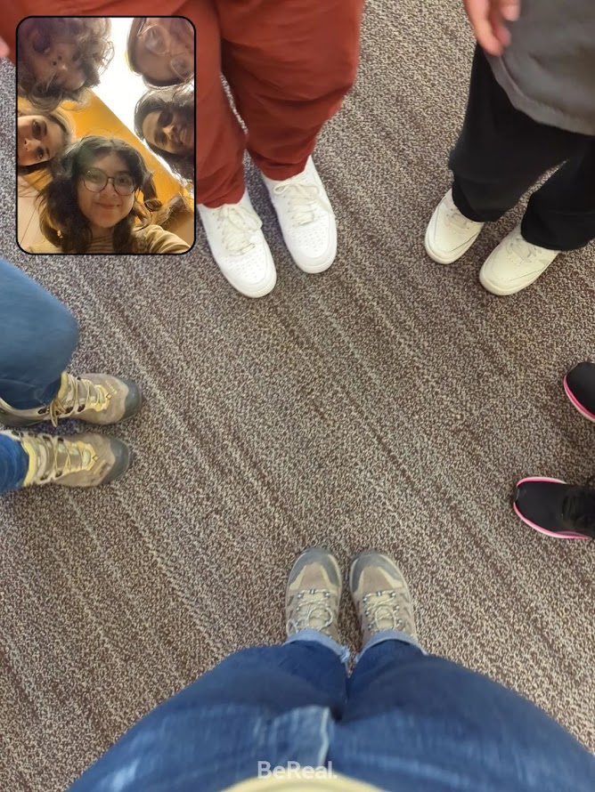
Building Partnerships – Volunteering
This year, we opened volunteer opportunities for individuals!
31 students signed up to volunteer in Spring 2024

Slide 35
Wanna help?
Donate clothing to MacKay 131
Monday-Friday, 8 a.m.-5 p.m.
Bring empty cans and bottles to the recycling bins around MacKay Hall
Connect us with a campus org or local business that would like to help
DM us: @isupopup
Follow us on Insta: @isupopup

Slide 36
Next Steps
Renewing our contact with Student Government with our updated needs and student data
Data collection is key to demonstrating to outside stakeholders what exactly you do
Supporting our Closet volunteer student organization
Providing them with freedom to run the Closet how they want
Planning for the Grand Opening (announcement soon—stay tuned!)
Workshops, more collaborations on and off campus (e.g. Sustainapalooza, Ames Repair Café, more community donors)

Slide 37
Passing the Torch
We challenge you:
Pay attention to what students around you need.
Think critically and cleverly to provide a solution.
Collaborate with like-minded colleagues (faculty, staff, students, etc.)
Ask for help when you need it.
Don't let the perfect get in the way of the good.

Slide 38
Please complete the session survey by scanning the above QR Code and entering the follow session code:
[2421]

