Slide 1

Race and Human Trafficking

Slide 2

Land Acknowledgement
Iowa State University is located on the ancestral lands and territory of the Baxoje, or Ioway Nation. The United States obtained the land from the Meskwaki and Sauk nations in the Treaty of 1842. I wish to recognize my obligation to this land and to the people who took care of it, as well as to the 17,000 Native people who live in Iowa today.

Slide 3
Sex Trafficking
Legal definition: Sex trafficking is the recruitment, harboring, transportation, provision, obtaining, patronizing, or soliciting of a person for the purpose of a commercial sex act in which a commercial sex act is induced by force, fraud, or coercion, or in which the person induced to perform such act has not attained 18 years of age. (22 U.S.C. § 7102(11)(A)).
Human trafficking occurs when a trafficker takes any one of the Actions, and then employs the Means of force, fraud or coercion for the Purpose of compelling the victim to provide commercial sex, labor, and/or services

Slide 4
Human trafficking statistics
There are an estimated 27 million victims of human trafficking globally at any one time, with 100,000 people trafficked each year in the United States (International Labor Organization).
Forced labor and human trafficking is a $150 billion industry worldwide, with up to $99 billion generated by sex trafficking just in the United States alone (exoduscry.com).
Human trafficking is second only to drug trafficking as the most profitable form of transnational crime. (Office of Homeland Security)
Approximately 5% of trafficking cases are ever reported (U.N. Office on Drugs and Crime)
3-6pm and 4-8am are the most common times that trafficking occurs
Approximately 40% of trafficking victims know their trafficker

Slide 5

National Human Trafficking Hotline
1-888-373-7888
www.humantraffickinghotline.com
10,360 human trafficking cases identified from 1/1/21-12/31/21
  8,142 female victims 7,499 sex trafficking cases
  1,292 male victims 1,066 labor trafficking cases
  132 gender minority victims 400 sex and labor trafficking cases
  794 gender unknown victims
Top venues for sex trafficking Top venues for labor trafficking
  Pornography Domestic work
  Illicit massage parlors/spas Agriculture
  Hotels and motels Construction
  Residence-based commercial sex Restaurants/Food Service
  Online advertisements Illicit activities

Slide 6
National Human Trafficking Hotline
1-888-373-7888
www.humantraffickinghotline.com
86 human trafficking cases identified in Iowa from 1/1/21-12/31/21
  74 female victims 62 sex trafficking cases
  16 male victims 10 labor trafficking cases
  3 sex and labor trafficking cases
Top venues for sex trafficking Top venues for labor trafficking
Hotels/Motels Other venues
Residence-based commercial sex
Illicit massage parlors/spas
Pornography
Other venues

Slide 7
National Human Trafficking Hotline
1-888-373-7888
www.humantraffickinghotline.com
Top 10 states with identified human trafficking cases (2021)
  California
  Texas
  Florida
  New York
  Michigan
  Ohio
  Georgia
  Illinois
  Missouri
  Washington and Mississippi (tied)

Slide 8
Human trafficking in Iowa
How can it happen here?
  Iowa shares borders with Minneapolis, Chicago, Kansas City, St. Louis, and Omaha which are all known human trafficking hubs
  Increasing seasonal, immigrant, and refugee population
  Large metropolitan areas connected by network of interstate highways reaching all four U.S. borders; lined with truck stops, restaurants, hotels/motels, casinos, strip clubs, and massage parlors
  Rural areas create “safe havens” for traffickers to operate undetected; described as “the perfect hiding place” for trafficking
  Imogene/Denison/Decorah/Fredricksburg/Wellman/Council Bluffs/Cedar Rapids/Missouri Valley/Hills/Humboldt/Urbandale/Dubuque/Waterloo
  Des Moines/Runnells/Spencer/Sioux City Coralville/Clive

Slide 9
Common characteristics of a buyer
Age | 20s = 27 | 30s = 29 | 40s = 34 | 50s = 15 | 60+ = 12
Race/Ethnicity | White = 62 | Black = 15 | Hispanic/ Latino = 15 | Asian/East Asian = 19 | Other = 3
Income | <$30,000 = 38 | $30,000–$100,000 = 61 | >$100,000 = 20
Education | High school diploma = 26 | Higher ed degree = 82 | Neither = 10
Relationship Status | Single = 35 | Married = 78 | Divorced = 6
Children | Daughters = 64 | Sons = 12 | No Children = 26
Where They Live | Twin Cities/Metro area = 44 | Greater Minnesota = 74 | Outside Minnesota = 4
June 2018-August 2019 demographics of 122 men who participated in “John School” through Breaking Free in Saint, Paul, MN for court-ordered first-time offenders who bought sex from an adult; The majority of participants:
  40-49 years of age
  51% were White
  62% had children; 52% had female children
  64% were married
  67% had college degrees
  50% had an income between $30,000-$100,000

Slide 10
Common characteristics of a trafficking victim
Pregnant women and LGBT youth-higher levels of exploitation which can lead to more money for the trafficker
Recruited from strip clubs, massage parlors, nail salons, restaurants, malls, schools, big sporting events, state fairs, social media, etc.
Youth in the foster care system
  88% of human trafficking survivors have been involved in the child welfare system. (National Center for Missing and Exploited Children)
Keep to themselves, most are dressed nicely, usually with their trafficker, some are tattooed
Young ages, mental health issues, addicted to drugs, poverty, immigrants, elderly
The scary thing is that anyone can be trafficked!

Slide 11
How is someone trafficked?
Traffickers offer care, support, and companionship; take interest in their victims
Offer promises of modeling jobs, singing or television auditions, living the high life, opportunities to make quick money
Use other victims to lure new ones in to the “family”
Traffickers approach youth where there is no adult supervision (malls and schools); will try and look like students
Offer love and a sense of family
Glamorize sex

Slide 12
How do traffickers control their victims?
Mental and physical manipulation and abuse
“I will kill you or your family if you try and leave and/or report.”
Misrepresent U.S. laws when it comes to immigration-will take passports and other important papers so victims have no place to go if they try and leave; keep victims uneducated about their rights; language barriers
Tell them they have to pay off their “debt” before they leave, but the debt gets bigger and bigger
Moving victims around a lot; keeps them feeling unsettled, lost, and isolated
Some traffickers use drugs to control their victims
Shaming the victim-”No one will want you.”

Slide 13
Racial and gender disparities in the sex trade
Sex trade survivors are disproportionately girls and women of color
  In a 2-year review of all suspected human trafficking incidents in the United States, 94% of sex trafficking victims were female, 40% were Black, and 24% were Latinx.
  In South Dakota, Native American women represent 40% of sex trafficking victims, though Native Americans are only 8% of population.
Sex buyers are disproportionately white men
  A 2017 study on sex buyers in Minnesota found that the majority of buyers were White, middle-to-upper class, married men.
  In a 2012 study of men who use the internet to buy sex, researchers found that virtually 85% of the buyers were White men.
Women and girls of color bear the brunt of prostitution arrests
  Black adults account for approximately 37% of adult prostitution arrests —more than any other racial group.
  Black children account for nearly 53% of all juvenile prostitution arrests—more than any other racial group.

Slide 14
Race and Human Trafficking
Race and Human Trafficking:
How This Crime Disproportionately Affects Ethnic Minorities and Indigenous Persons
(Paiz & Van Schooneveld, 2022)
BiPOC are more likely to experience:
  Poverty
  Involvement in the foster care system
  Unstable care environments
  Homelessness
  Systemic racism
  Historical oppressions
*These are the same vulnerabilities that are exploited by traffickers.
“Trafficking is inherently discriminatory. In the case of trafficking into the global sex industry, we are talking about men from relatively prosperous countries paying for the sexual services of women and girls—and sometimes men and boys—from less wealthy countries. This is more than a labor rights issue or an issue of unequal development. It is a basic human rights issue because it involves such a massive and harmful form of discrimination.”
~Mary Robinson, Former UN High Commissioner for Human Rights

Slide 15
Why are people of color overrepresented in human trafficking?
Economics
  Demand for one race is higher than the demand for another race
Racial and sexual stereotypes; marginalization; sexual violence
  Women of color are usually deemed “sexually free or deviant;” no one will miss them (“Missing White women syndrome”)
Legal reasons
  In an Urban Institute study, the majority of traffickers interviewed believed that trafficking White women would make them more money, but trafficking women of color would land them less jail time if caught.
Structural poverty
  Exploitation of vulnerabilities

Slide 16

The Racial Roots of Human Trafficking
Cheryl Nelson Butler
"Race intersects with other forms of subordination including gender, class, and age to push people of color disproportionately into prostitution and keep them trapped in the commercial sex industry. Its intersectional oppression is fueled by the persistence of myths about minority teen sexuality, which in turn encourages risky sexual behavior."
"While Black children are more likely to experience some form of sex trafficking, other children of color are similarly at a higher risk than their White counterparts. Native Americans, in particular, argue that a strong connection exists between colonization and a persistent targeting of native people for prostitution."
"Any vulnerable child can be a victim of sex trafficking, but we can longer gloss over the fact that the majority of those who are victimized are girls of color. By illuminating the problem and potential solutions, we are taking the first steps toward ending the abuse and exploitation of our most marginalized girls...The first step is to have compassion for the pain, the discrimination, and the trauma these girls have experienced..." (Gabrielle Union, 2020)

Slide 17
Human trafficking laws and legislation
2000-U.S. government recognized human trafficking and passed the Trafficking Victims Protection Act
2005-Human trafficking became a federal offense in Iowa
2006-Iowa Human Trafficking Act was enacted (Iowa Criminal Code Chapter 710A)
2012-The federal government made human trafficking one of its top five law enforcement priorities
July 2015-Human trafficking was classified as a forcible felony in Iowa (any felonious crime in the first degree); pimps and buyers are charged the same and have to serve a mandatory minimum which is approximately 70% of their sentence
Buying sex with an adult in Iowa is considered an aggravated misdemeanor, punishable up to 2 years in prison and a fine. Buying sex with a minor is considered a felony, and is punishable up to 5 years in prison.
There are no statute of limitations on human trafficking cases

Slide 18
What Can You Do?
National Human Trafficking Resource Center Hotline: 1-888-373-7888
  24/7/365; more than 200 languages
Polaris Project Be Free Text Line: Text HELP to 233733 (24/7/365)
Live Chat at https://humantraffickinghotline.org/chat
Submit a tip online at https://traffickingresourcecenter.org/report-trafficking
State of Iowa Human Trafficking Hotline: 1-800-770-1650
  Text “iowahelp” to 20121; www.survivorshelpline.org
You can always call 911.
If something seems wrong, then it probably is!

Slide 19
Local and State Resources
•ACCESS (www.assaultcarecenter.org)
•Garden Gate Ranch (www.gardengateranch.com)
•Wings of Refuge (www.wingsofrefuge.net)
•Lila Mae’s House (https://lilamaeshouse.org/)
•Dorothy’s House (https://dorothyshouse.org/)
•The Set Me Free Project (www.setmefreeproject.net)
•Polaris Project (www.polarisproject.org)
•ISU Network Against Human Trafficking and Slavery (https://www.facebook.com/isu.naht)
•Iowa Network Against Human Trafficking and Slavery (www.iowanaht.org)
•WGS/SOC 410/510: Human Trafficking (offered every Fall semester)
•Human Trafficking Honors Seminar (offered every Fall semester)

Slide 20

Questions?
Alissa Stoehr, PhD
WGS Program/Department of Sociology
330 Carver Hall
astoehr@iastate.edu

Slide 21
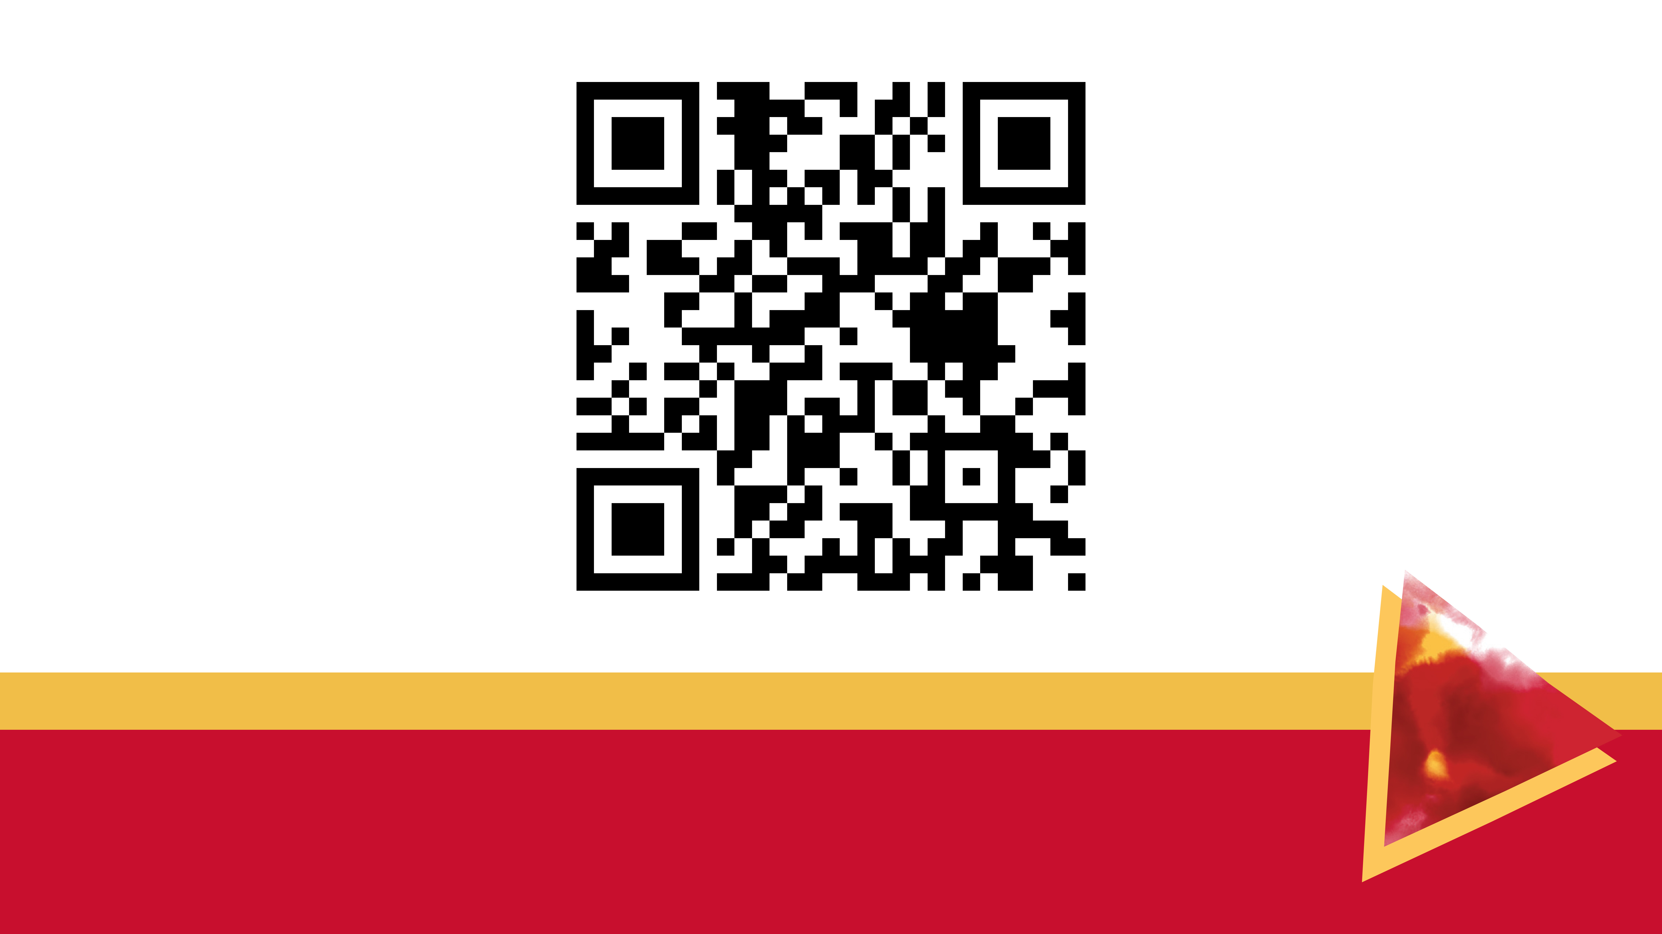
Please complete the session survey by scanning the above QR Code and entering the follow session code:
[2410]

