Slide 1

State of Well-being at Iowa State University

Slide 2

Roadmap
Definitions & Guiding Questions
  What is well-being?
  How does well-being relate to social conditions?
  How is well-being impacted by social systems and forces?
Guided Discussion about the well-being at Iowa State
Strategies for Moving Forward

Slide 3

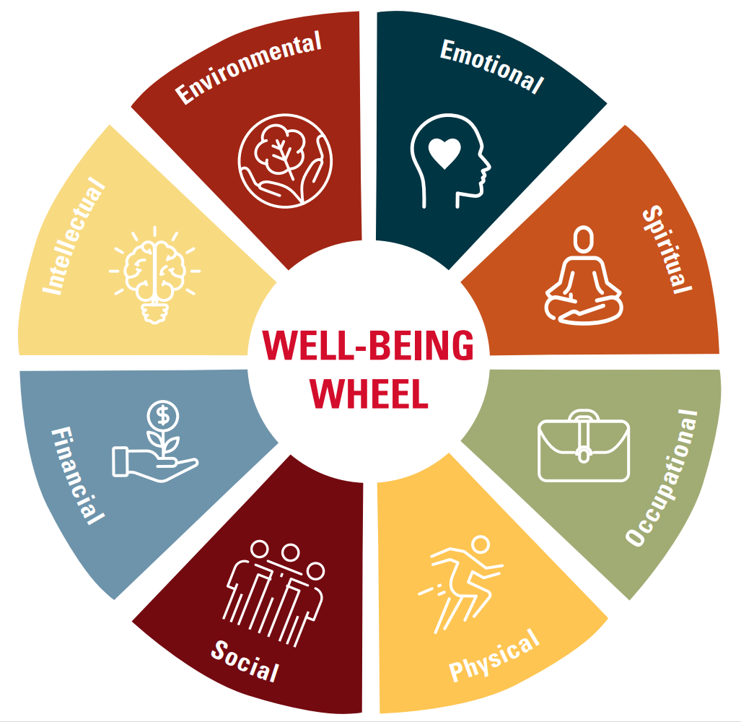
What is well-being?

Slide 4
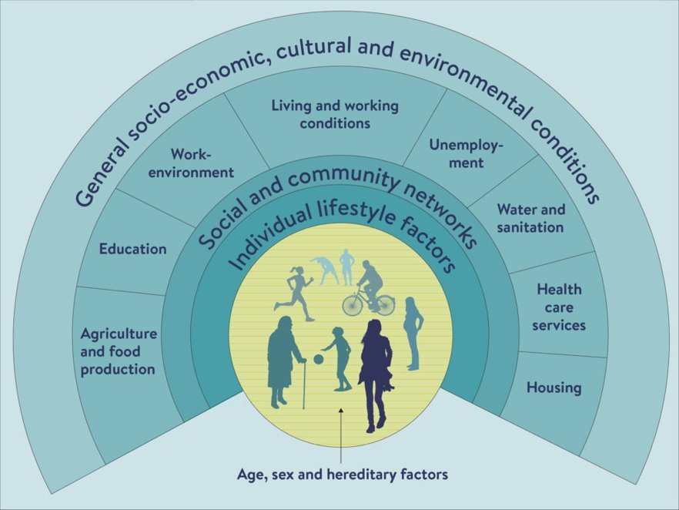
What influences well-being?

Slide 5
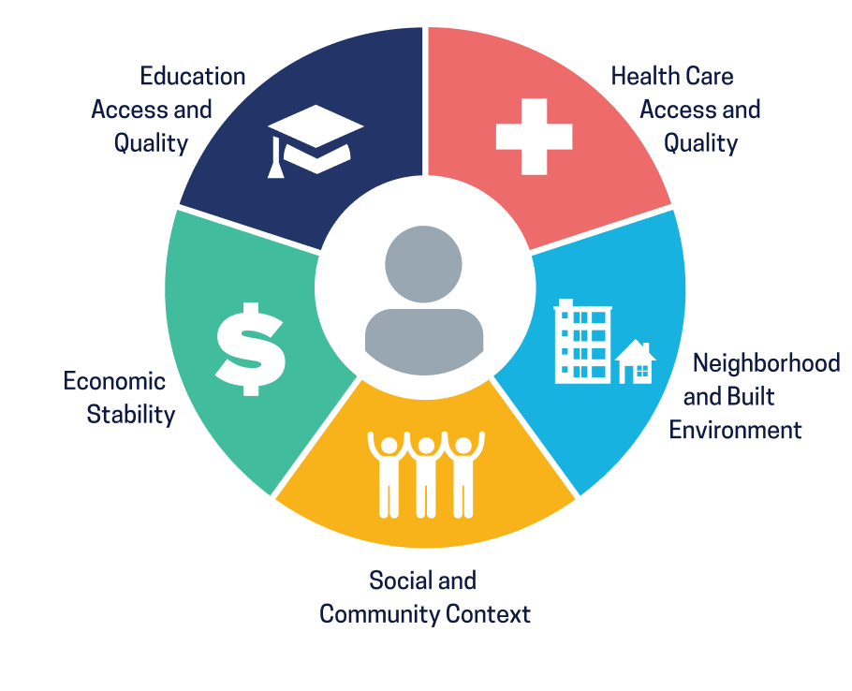
Social Determinants of Health & Well-Being
The conditions in which people are born, live, work, and age.
They are shared by distributions of money, power, and resources and global, national and local levels

Slide 6
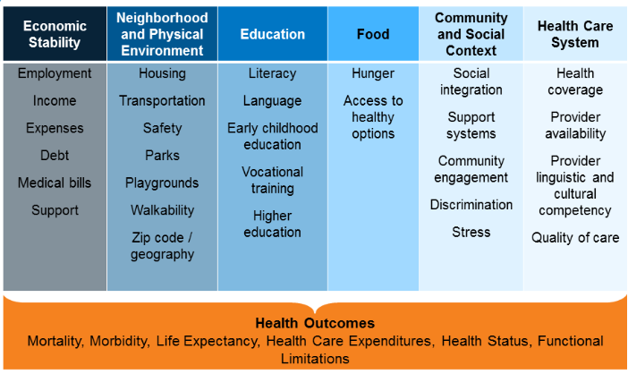
Social Determinants of Health & Well-Being

Slide 7
How do SDOH show up at ISU?
Economic Stability | Neighborhood and Built Environment | Education Access & Quality | Health Care Access & Quality | Social & Community Context
33.5% of students screen positive for food insecurity SHOP supports 3% (971) of the student population (30,117) | 32.31% of multicultural students feel unsafe on campus at night vs. 18.54% of white students | 16.54% of multicultural students feel they do not belong at ISU, 26.77% feel that students' health and well-being is not a priority, and 34.65% feel that ISU is not a campus where we look out for each other. | Multicultural students were more likely to experience the following barriers to help seeking for mental or emotional health: Financial Reasons (10.47%) People providing services don't understand me (8.14%) Not sure where to go (10.47%) | 59.6% of multicultural students expressed indicators of loneliness vs. 49.2% of white students
HMS, 2023; NCHA, 2023

Slide 8
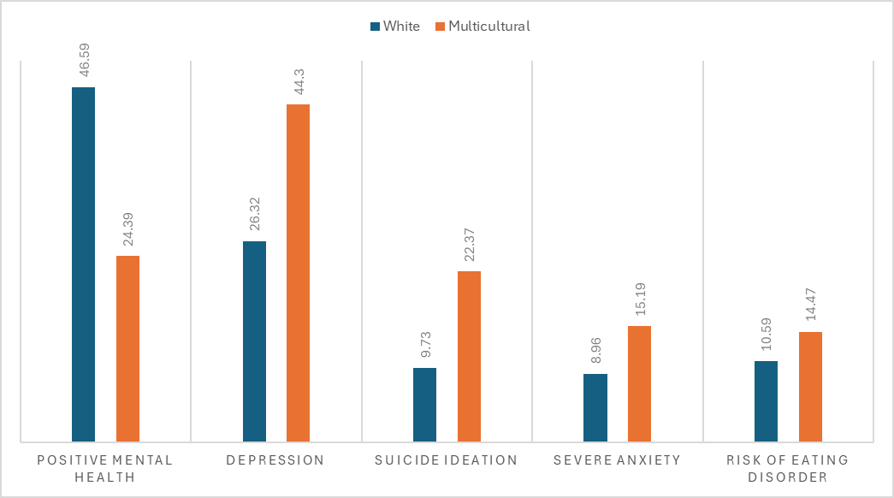
How do SDOH show up at ISU?
HMS, 2023; NCHA, 2023

Slide 9
Health Promoting Universities
International Movement
Okanagan Charter
  Aligning vs. Siloing
  Work is interconnected

Slide 10
Discussion Prompts
How are you embedding well-being into your context(s) (e.g., classes, departments, work, residence, etc.)?
  Think about embedding well-being through systems, practices, policies, and academic mandates
What aspects or dimensions of well-being need greater attention at the individual, departmental, and institutional levels?
What strategies could we implement to better promote well-being across all areas of the university?

Slide 11
Action Items
ISCORE 2024 | Present mode (sli.do)

