Slide 1
Transracial International Adoptees (TRIAs) Loss of Cultural Identity

Slide 2
Agenda
Transracial International Adoptees (TRIAs)
Cultural Identity
Code Switching
Challenges
Panelist Adoption Stories
Panelist Q&A
Audience Q&A

Slide 3
Transracial International Adoptees (TRIAs)
Transracial adoption occurs when a child or children from one race are adopted by a family from another, either domestically or internationally (Lee, 2003)
Intercountry
Transcultural
In 1971 largest surge of international adoptions over 330,000 children adopted by families from the United States (Lee et al, 2006)
2019 – only 2%
Decrease by 73% from 2010-2019

Slide 4
Cultural Identity
“Cultural identity refers to identification with, or sense of belonging to, a particular group based on various cultural categories, including nationality, ethnicity, race, gender, and religion” (Chen, 2014)
Biological Cultural Identity
Adoptive Cultural Identity

Slide 5
Code Switching
According to Jenkins, “code-switching is the act of changing one’s speech or behavior to best assimilate in different spaces” (2022)
Adoptees intentionally change their behavior to try and adapt to different environments and expectations for their identity
Chameleon
Faking it

Slide 6
Challenges
Behavioral and health issues
Mental health issues (depression)
Criminal behavior
Language barriers
Cultural identity issues
Suicide
Adoption-related loss (abandonment, grief)
Discrimination/racism
Code switching

Slide 7
Panelist
Holly Frette
Janeice Garrard
Kim Lybrand
Dr. Anirudh Naig

Slide 8
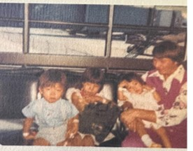
Sarah Frette (Adoptee)
Biological race: Asian (Korean)
Hometown: Radcliffe, IA
Adoptive Parents: White
Age of Adoption: 18 months

Slide 9
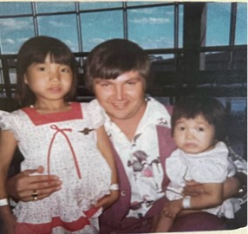
Holly Frette (Adoptee)
Biological race: Asian (Korean)
Hometown: Radcliffe, IA
Adoptive parents race: White
Age of Adoption: 5 years

Slide 10
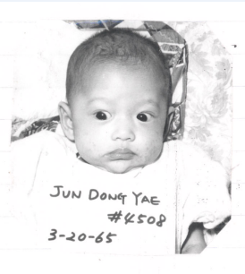
Janeice Garrard
Biological race: Asian (Korean)
Hometown: Ainsworth, NE
Adoptive Parents: White
Age of Adoption: 6 months

Slide 11
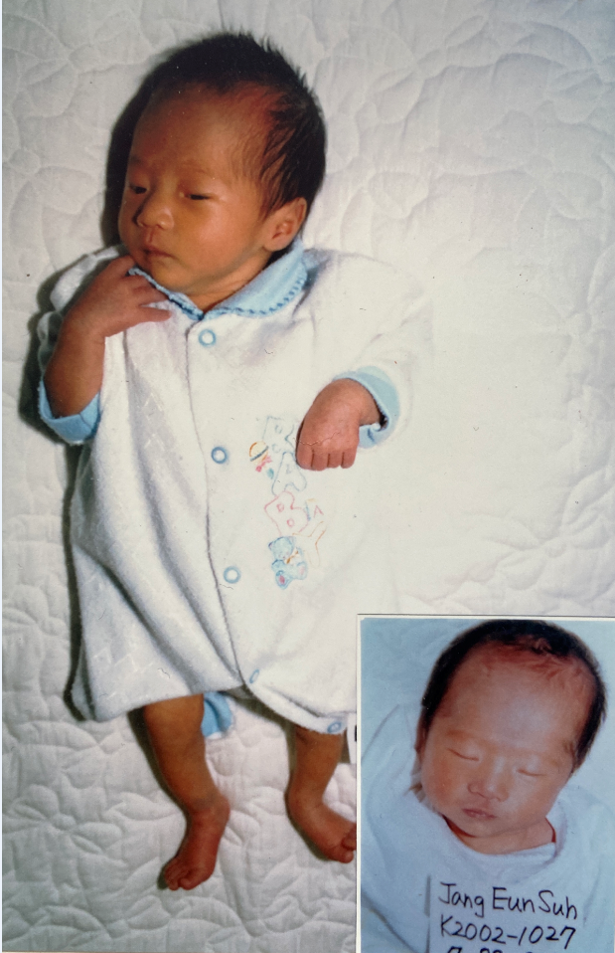
Kim Lybrand (Adoptee)
Biological race: Asian (Korean)
Hometown: Ashland, MO
Adoptive parents race: White
Age of Adoption: 6 months

Slide 12
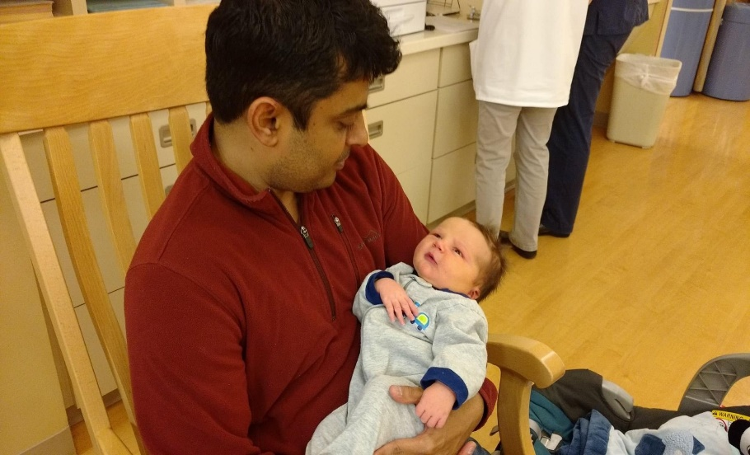
Dr. Anirudh Naig (Adoptive Parent)
Biological race: Asian
Hometown: Mumbai, India
Adoptive Child: White
Age of Adoption: Birth

Slide 13
References
Chen, V., (2014). Cultural identity. https://centerforinterculturaldialogue.files.wordpress.com/2014/07/key- concept-cultural-identity.pdf
Child Welfare Information Gateway. (2022). Trends in U.S. adoptions: 2010–2019. U.S. Department of Health and Human Services, Administration for Children and Families, Children’s Bureau. https:// www.childwelfare.gov/pubs/
Jenkins, J., (2022). From an adoptee’s perspective: interracial adoption and identity. https://soundideas.pugetsound.edu/cgi/viewcontent.cgi?article=1868&contex =summer_research#:~:text=Adoptees%20use%20code%2Dswitching%20as,they %20do%20not%20fully%20belong.
Lee, R. M., (2003). The transracial adoption paradox: History, research, and counseling implications of cultural socialization. Counseling Psychology, 31(6), 711-744.DOI: 10.1177/0011000003258087
Lee R. M., Grotevant, H. D., Hellerstedt, W. L., Gunnar, M. R. (2006). Cultural socialization in families with internationally adopted children. Journal Family Psychology, 20(4), 571-580. doi: 10.1037/0893-3200.20.4.571

Slide 14
Please complete the session survey by scanning the above QR Code and entering the follow session code:
2431

