Slide 1

The Other Iowa Girl:
Seeking Validation in the Heartland
Emili L. Johnson
Recruitment Program Specialist
Office of Admissions – Iowa State

Slide 2

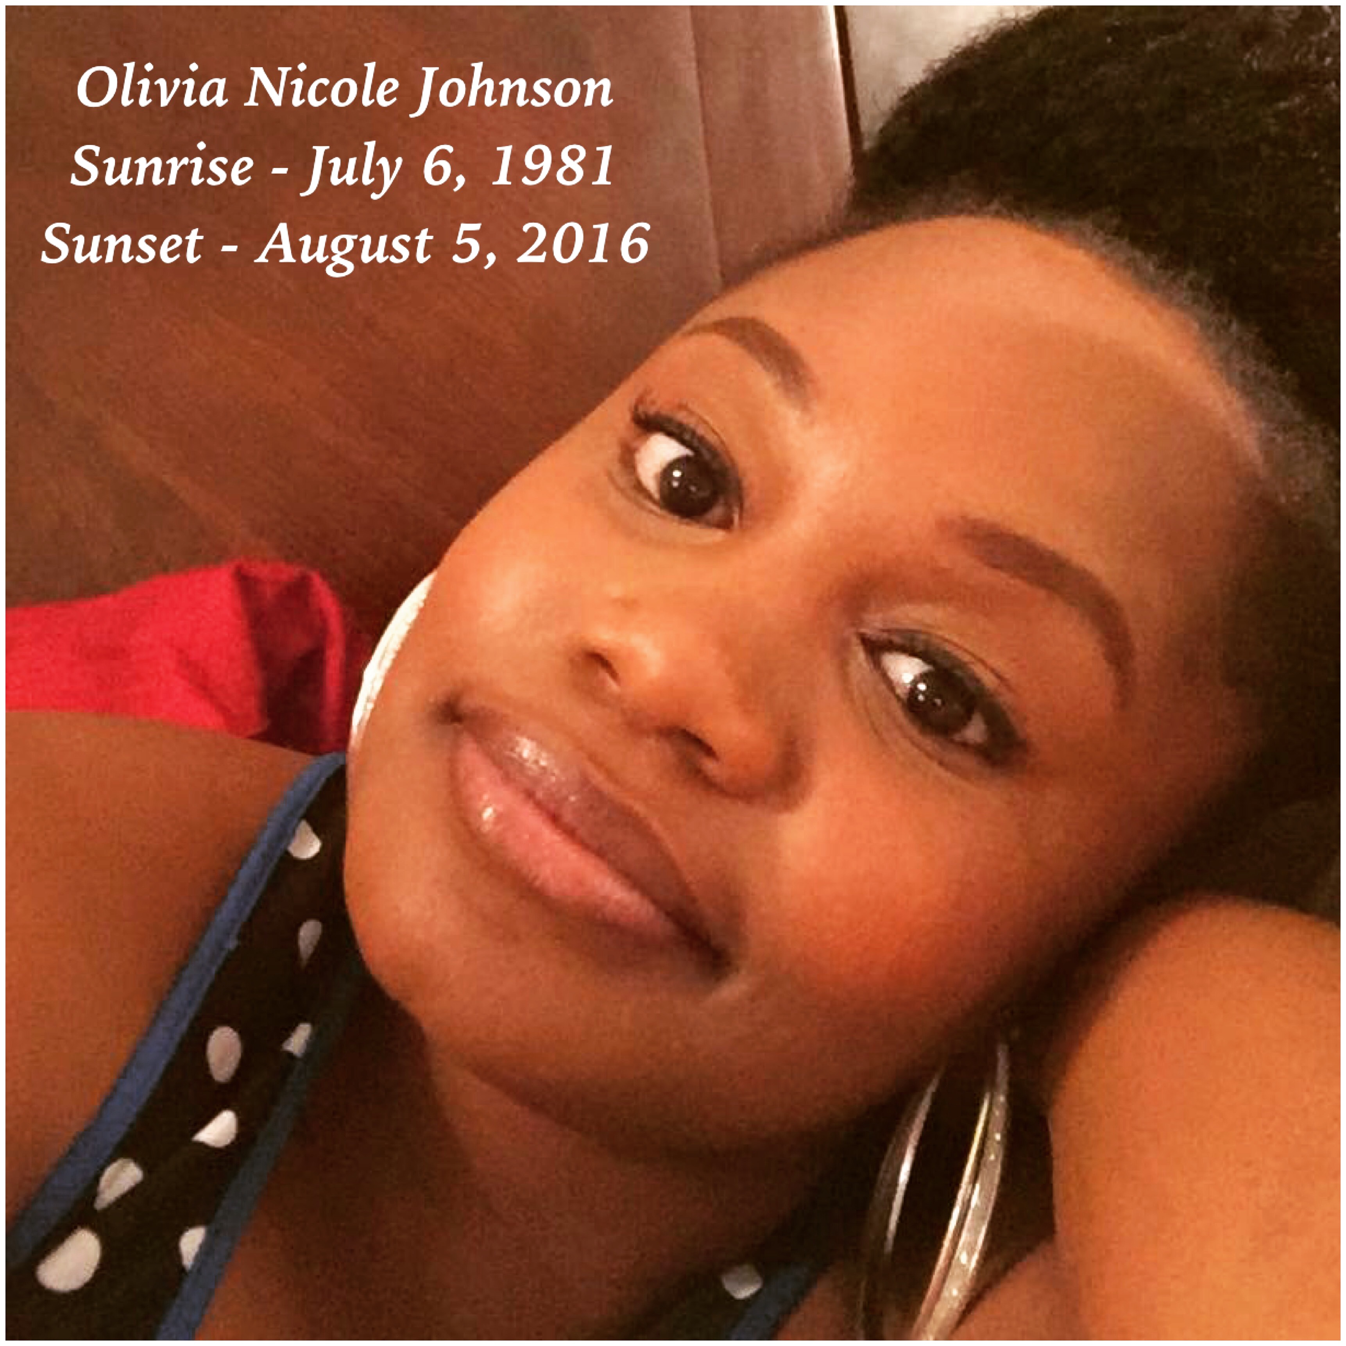
In loving memory…

Slide 3

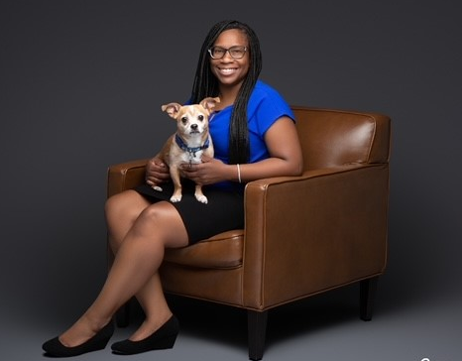
Bio
Hometown - Des Moines, IA
  Born & Raised
Divorced, no kids
Dog Mom to George
  10-year-old
  Dachshund/Chihuahua mix
Professional Background
  20+ years in Customer Service
  10 years in Auto/Home Insurance
  5 years in Higher Education
Education
  Roosevelt High School, ‘04
  Simpson College, ’08
    B.A. in Journalism & Mass Communication
  Drake University, ’24
    M.A.C. in Communication Leadership & Public Advocacy

Slide 4

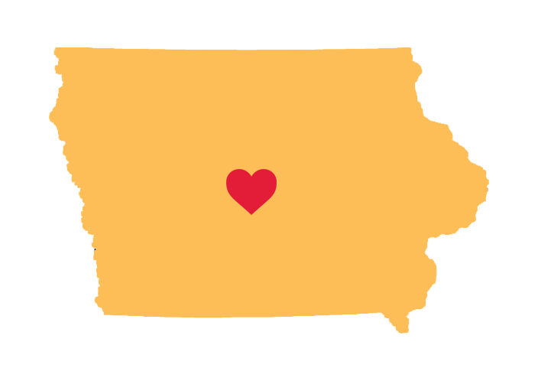
Quick Facts
As of July 2022 – US Census Bureau
  Total Population – 3,199,693
    White – 89.8%
    Black – 4.4% (141,000)
Location
  48.3% of Black population reside in Des Moines, Waterloo, Davenport or Cedar Rapids
Education
  Black represent 6.7% (34,646 students) of Iowa’s school enrollment in the state’s elementary, middle and high schools (518,087).
Occupation
  67.8% of labor force participation rate of Iowa are Black, age 16 and over in 2021. The labor force participation rate for Iowans age 16 was 66.1%.
Earnings
  Black women in Iowa had median earnings of $33,809. In comparison the median earning for women in the state of Iowa is $44,801 respectively.

Slide 5

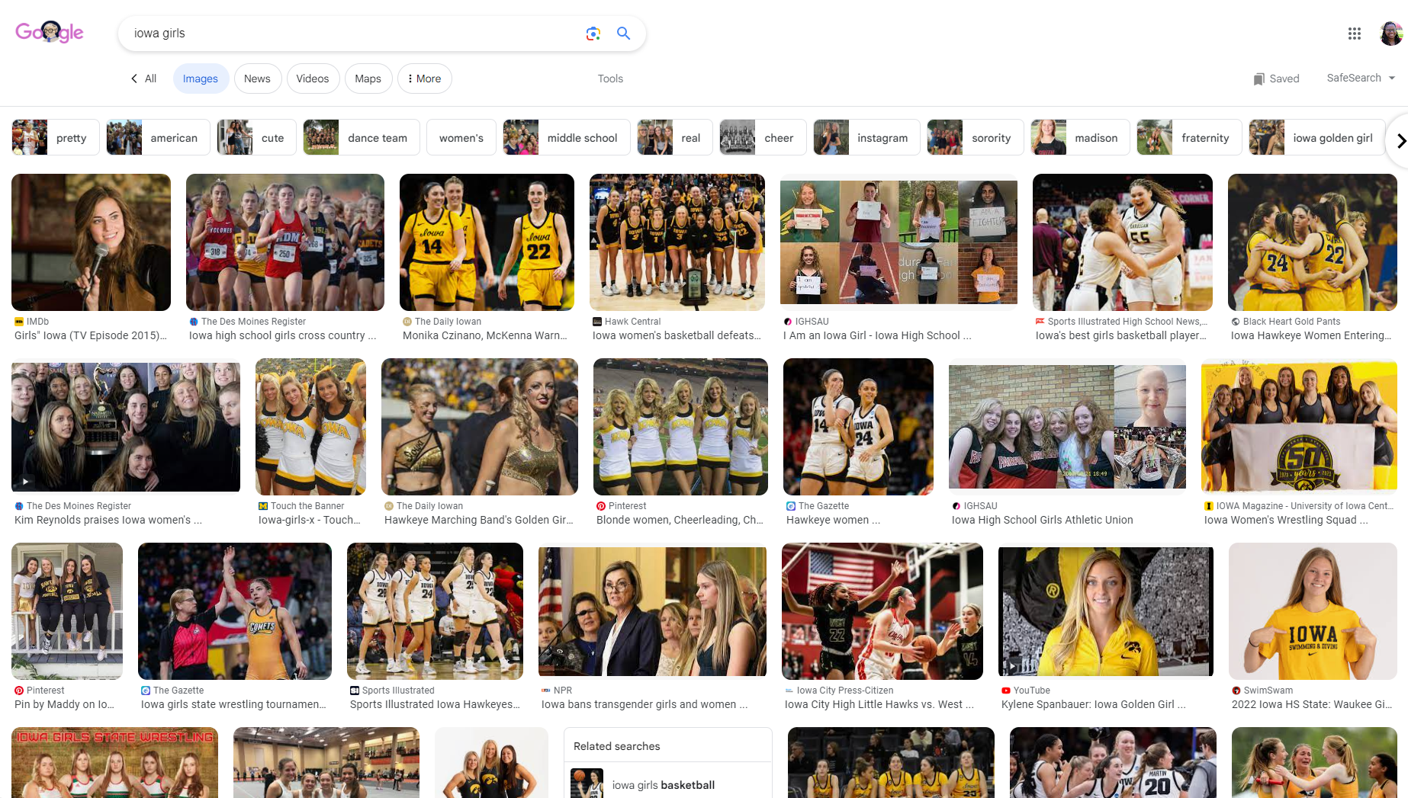
Google – ‘Iowa Girls’

Slide 6
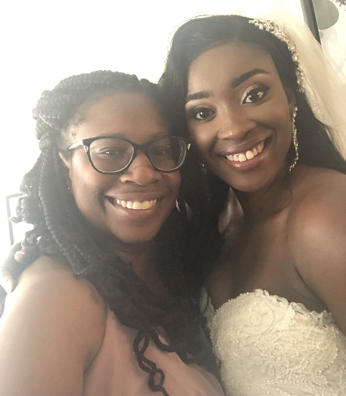
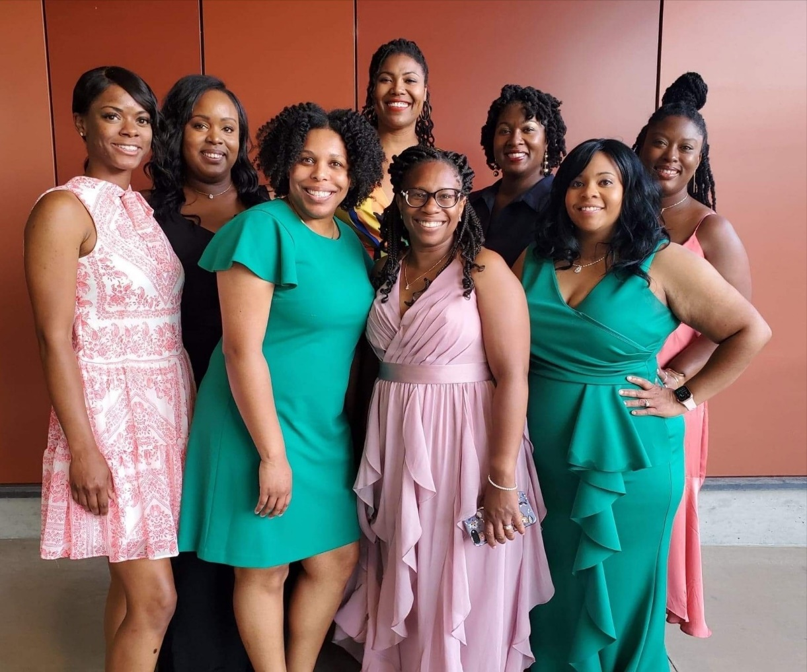
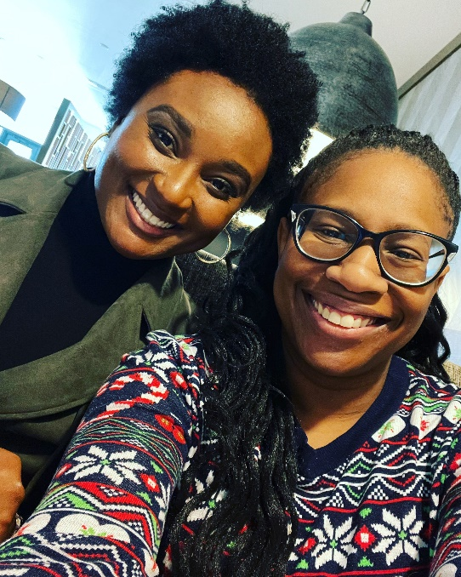
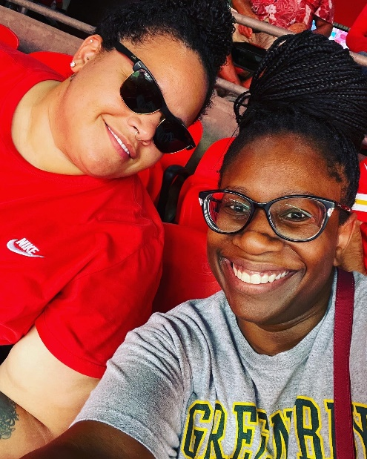
The Other ‘Iowa Girls’
Left to Right:
Espree Stewart
Kahara Hunafa-Addo
Dr. Wanakee Carr
Dawniece Trumbo
Dionne Siyavora
Brittani Leake
Jontell Harris
Chika Igbowke-Yates
Erika Bailey
Liza Sharp

Slide 7
Purpose
Share Experience regarding
  Community
  Validation
  Misconceptions
  Microaggression
Why?
  Identify similarities in our experiences as Black women in Iowa
  Our existence is rooted in strength, self-love and awareness of the predominately world around us

Slide 8
Survey Questions
Tell me about the community you grew up in. How did you and your family connect with other Black people in your area?
How important was it for you to receive validation when you were growing up?
Where did validation come from? (Ex. Parents, Siblings, Friends, Teachers, etc.)
What are some misconceptions about growing up as a Black woman in Iowa?
What are some misconceptions about Black women in the workplace that have been placed on you?
Tell me about a time (if any) where you experienced microaggressions in the workplace. How did that experience make you feel?
How did the validation you received growing up impact how you handle microaggressions in the workplace now?
What advice do you have for Black girls currently growing up in Iowa about validation and workplace experiences?

Slide 9
Community
Tell me about the community you grew up in. How did you and your family connect with other Black people in your area?
  “The 50314 – was a tight knit majority Black community with thriving Black businesses. I remember riding my bike at a young age around the community and feeling safe.”
  “Although the Black population in Des Moines was small, we felt a strong sense of community though family, church, school, after school programs and work.”
  “My family was the only Black family that owned property in my neighborhood for a long time, and unfortunately, this led to jealousy from white neighbors that lived in the trailer park adjacent to our property.”
  “My mom made sure that she submerged me and my older brothers in spaces where our culture was highlighted. We also lived in predominately Black neighborhoods so seeing people that looked like me in my neighborhood, schools, and social spaces was an everyday occurrence.”

Slide 10
Validation
How important was it for you to receive validation when you were growing up?
  “…external validation was always looming. I felt self-conscious, I always felt I had to be twice as smart, speak twice as well, etc. than my white counterparts because I am Black.”
  “It became important when I got into middle school as this was a very difficult time for me to adjust as I was bullied my sixth-grade year and didn’t know how to stand up for myself.”
Where did validation come from? (Ex. parents, siblings, friends, teachers, etc.)
  “The primary source for validation was my parents, who did their best to instill strong values and a sense of self-worth in my brother and I.”
  “Parents (particularly, my step-dad), grandparents, aunts, uncles, teachers, administrators, counselors, friends and friend’s parents.”

Slide 11
Validation
How did the validation you received growing up impact how you handle microaggressions in the workplace now?
  “It was critical because I can easily recognize the microaggressions and know it has nothing to do with me, and everything to do with the aggressor’s ignorance and/or arrogance.”
  “…having people believe in me and my abilities throughout the years allows me to not seek validation from co-workers or those who don’t know me personally, but from other sources.”
  “…it taught me how to better recognize them and handle them, I document, document, document and you better believe I will go to HR!”
  “As I’ve gotten older and have gotten more fed up with microaggressions and unfair treatment, I call them out on the sport and make sure the offender understands what they did and that it won’t be tolerated.”
  “I will write-off chronic offenders as low-intelligence, jealous, or chaos-mongers and actively ignore them if I must.”

Slide 12
Misconceptions
What are some misconceptions about growing up as a Black woman in Iowa?
  “There are Black people in Iowa??”
  “…the misconception that I am ‘whitewashed’ because I grew up in a ‘white state’.”
  “That we ‘act or talk white’, we aren’t ‘Black enough’ and we ‘lack cultural awareness’.”
  “…we’re not ‘Black’ enough or that we aren’t familiar with ‘Black Struggle’”
What are some misconceptions about Black women in the workplace that have been placed on you?
  “…not caring about advancing my career; that I don’t know what I am talking about.”
  “DEI efforts. Being one of the few Black women in my field in the state, the burden of education and representation is placed on me.”
  “We are incapable of greatness.”
  “…I’m tired of always having to be resilient. Sometimes, I just want to BE.”

Slide 13
Microaggressions
Tell me about a time (if any) where you experienced microaggressions in the workplace. How did that experience make you feel?
  “During a discussion about health disparities in a meeting of my peers, I was singled our as the only minority in the room and directly asked my personal experiences with healthcare providers as a Black female.”
  “I wear my hair in an afro and was told upon entry that my hair may not be seen as professional.”
  “A white peer, who I didn’t know very well, once walked up behind me in a big meeting and stroked my hair while saying, ‘Is that real?’ She did the super loud so the whole room heard her. No not corrected her behavior.”
  “Hair! Hair touching, fascination and inappropriate questioning has been the main thing.”
  “Use of stereotypical AAVE (African American Vernacular English) as an attempt to relate. It always makes me feel annoyed and disrespected.”

Slide 14
Advice
What advice do you have for Black girls currently growing up in Iowa about validation and work-place experiences?
  “Don’t put your self-worth in your career or people that will disappoint you. Have a village outside of work – a community of friends, family, mentors who can help give you advice through tough work situations.”
  “Look to yourself for validation. You are the one who should be looked up to as inspiration for others. Black women are the blueprint.”
  “Always know your self-worth and never let anyone dim your light. If you are not receiving the validation you seek from those around you, then look for it elsewhere or from within. Not everyone wants the best for you.”
  “Stand strong in the fact that you are worthy.”
  “Never second guess your achievements or place in this world.”
  “Get a network of cheerleaders and a group of women to help you achieve your goals.”

Slide 15
Conclusion
Common Themes
  BLACK PEOPLE LIVE IN IOWA!!!
  Racism and safety
  Unnecessary Usage of AAVE
  ‘White-washed’
  Hair – DON’T TOUCH MY HAIR!!!
  Family Validation
  Self-Worth
What’s Next?
  Outreach to Black Women in Iowa and continue to share our stories
  Community - Give time, effort and energy

Slide 16

Please complete the session survey by scanning the above QR Code and entering the follow session code:
2413

