Slide 1
Community History in Minnesota during a Pandemic: What comes next?
Rebecca Ebnet-Desens, Anoka County Historical Society
Jenna Jacobs, Hennepin County Library
Daardi Sizemore Mixon, Minnesota State University, Mankato
Adam Smith, Minnesota State University, Mankato

Slide 2
Documenting a Pandemic: COVID-19 Community History Project
Midwest Archives Conference, May 13, 2021
Daardi Sizemore Mixon, University Archivist Adam Smith, Archives Technician
Presentation contributors include: Heidi Southworth, Digital Initiatives Librarian, Anne Stenzel, Archives Technician
Notes:
Welcome to the presentation, “Documenting a Pandemic: COVID-19 Community History Project” at Minnesota State University, Mankato.
My name is
Daardi Sizemore Mixon and I’m the University Archivist at Minnesota State University, Mankato and with me today is Adam Smith an Archives Technician at Minnesota State Mankato.
While I am presenting today, this project (and presentation) would not be possible without the work of our colleagues, Heidi Southworth, and Anne Stenzel. My presentation today is based on one we provided to our University Administration earlier this summer.
Today I will be providing an overview of our project; a little about our project management; some project outcomes; and some final thoughts on the project.

Slide 3
Background
Minnesota State University, Mankato
Public, comprehensive university
Located in southern Minnesota
More than 14,000 students, including more than 1,170 international students from 89 countries
Over 130 undergraduate programs and 85 graduate programs, including several doctoral programs.*
University Archives and Southern Minnesota Historical Center
https://library.mnsu.edu/archives
Digital Collections
ARCH - https://arch.lib.mnsu.edu/
Cornerstone - https://cornerstone.lib.mnsu.edu/
* “Fast Facts,” Minnesota State University, Mankato, accessed 2/8/2021.
Notes:
A quick overview of where we are coming from. Minnesota State University Mankato is the largest university in the Minnesota State system. We are located about 90 miles southwest of the Twin Cities of Minneapolis and St. Paul. We serve over 14,000 students studying in a wide range of programs.

Slide 4
Project Overview
Notes:
First I’ll provide a little project background about why we developed the project and how it is organized.

Slide 5
COVID-19 Community History Project at MSU
The COVID-19 Pandemic has become a unique and significant part of world history. As these historic events continue to affect our everyday lives at Minnesota State University, Mankato and the greater Mankato community, the University Archives plans to document personal experiences in the form of a community history project.
The University Archives will collect, preserve, and provide access to these COVID-19 Pandemic experiences for current and future researchers. Many of these experiences will be made accessible through our digital collections, freely available on the internet through ARCH, the University Archives digital collections site. We want to ensure we leave behind a substantial record for future scholars and historians.
Notes:
In March 2020 as the global pandemic was declared and Minnesota State University, Mankato like many other schools moved to a remote learning and remote working environment, the University Archives considered how to document what was happening on campus and in the greater community. We started collecting university communications about our pandemic response. We also started considering ways to get personal experiences. Many historical societies and university archives started posting on social media about their goal to collect material on the pandemic. The University Archives at Minnesota State Mankato utilized existing oral history project expertise and developed the COVID-19 Community History Project.
As outlined on this side, (depending on timing, I think we could skip this part)
“The University Archives at Minnesota State University, Mankato will collect, preserve, and provide access to these COVID-19 Pandemic experiences for current and future researchers. Many of these experiences will be made accessible through our digital collections, freely available on the internet through our digital collections sites. We want to ensure we leave behind a substantial record for future scholars and historians.”

Slide 6
COVID-19 Community History Project Collection
Official University communications
University social media posts
Oral History Interviews
Individual Experience
Self Interview
Journal or Diary
Reflective essay
Creative work (poetry, photography, drawings, etc.)
Other ways as suggested by Participants
“Fiesta Postponed” by Cali Cantu
Notes:
In February/March, we started collecting official University communications to staff and students, such as emails, website and social media posts. We wanted to collect and preserve the University’s official response.
Moving beyond University communications, it quickly became clear that this project would be more than a traditional oral history project. Oral histories are intentional interviews between two or more people that have a clear focus and set of questions. We expected that individuals may want to provide their experience in a variety of ways and as a result we labeled it a Community History Project.
The Archives identified examples of the types of experiences we would be open to collecting including: self-interviews, journals, and creative works. We also wanted to be open to the ideas of our participants. Students come from all parts of the university and bring unique skills and ideas to the project.
For example, Cali Cantu created a drawing entitled, “Cinco de Mayo, Fiesta Postponed” which spoke of her family finding new ways to celebrate this festival.

Slide 7
Who would contribute to this project?
Students in University courses
Some professors may include the oral history or individual experience documentation as part of their course. All donations to the Archives should be voluntary.
Members of the Community
Individuals who want to contribute their experiences are welcome to do so.
This includes the campus and greater Mankato community.
This component of the project was launched June 2020.
Student Workers at the University
In collaboration with University Archives staff, Student Supervisors can assign this project as a work task.
International Students were hired to specifically work on this project.
Notes:
We initially thought that this project could be advertised to professors and we would get contributions from community members.
As we started working out details, we were approached by the Dean of Library and Learning about the need for remote work opportunities for student employees and we felt the COVID-19 project could be an option.
We have had few contributions from students in courses and from members of the community. That is primarily because the student worker component of the project became such a focus. Following Spring Break, the COVID-19 Community History Project became part of the work assignments of many student employees. For International Students laid off by the campus food service vendor, funding was provided by the Dean of Global Education to work on this project.

Slide 8
Project Management

Slide 9
A LOT of Student Employees
Project Management Team
Student Supervisors across campus
18 supervisors from 9 departments
Project website was integral to communication
Enhanced Training
Supervisors
Project expectations and overview
All student training
Students
Project expectations and overview
Readings on conducting oral histories, journaling, and more.
Weekly themed emails
Notes:
The archives has previously worked with interns and graduate assistants conducting oral history projects on our behalf, but we did not have any experience with managing such a large group of student employees for an archives project. Add in the remote work component and it quickly became clear the Archives needed significant campus support. Thankfully we had a number of individuals and departments step up to help. The project management team included the entire University Archives team, the Deans of Library and Learning and Global Education, and staff from the Kearney Center for International Student Services and Student Financial Services., We had 18 campus supervisors from eight departments help manage the student employees.
Another thing that quickly became clear was the importance of our project website. (I’m using quickly a lot here, and that is because much of this initial work happened over a three week time-span alongside staff transitioning to working from home.)
The project website became the home to general information about the project along with training for students and supervisors. The initial components of the site were up by the end of March. We continued to make regular additions (particularly to the FAQs) through April as the project really got underway. We used LibGuides for our project website.

Slide 10
Public Facing Tools (aka Software)
LibApps by SpringShare
LibGuides
Project Website (public)
Project Website (student employee)
https://libguides.mnsu.edu/ covid19historyproject
LibWizard
Training Quiz
“My COVID-19 Experience” submission form
Notes:
First we’ll provide a little project background about why we developed the project and how it is organized.
Complications
Quiz was attached to the creator
Sending the wrong link from the LibGuides
Successes
Overall ease of use in a team environment
User friendly for team and project participants
Use this project as a framework for future collaborations to strengthen University Archives and Southern Minnesota Historical Center collections
As we are nearing the end of this project, we have begun to reflect of some of the complications and successes we have had with using LibApps for this project.
In terms of complications, there were very few and relatively minor. In fact, we really had a hard time coming up with complications!
One of them that we quickly found out is that the quiz was attached to Heidi’s account since she created the quiz. So she was the only one who could run reports on the quiz.
We did find a way for others to access the information, but we were not able to share access to our student worker Ericka who was helping us over the summer as she did not have a SpringShare Account.
Since we had moved to creating weekly quizzes as professional development opportunities for the students, we did end up moving the quizzes to Microsoft Forms, and through our Microsoft Team environment, we felt that we were better able to see and share results.
Another issue that we ran into quickly is not really an issue with the software, but more so a reminder to make sure you are sharing any links very carefully and NOT do what we did.
For example, what is wrong with this link: https://mnsu.libapps.com/libguides/admin_c.php?g=1018807&p=7394776
We shared this link in an email to students and immediately got a student asking for access to LibApps because it was asking them for a User Name and Password. Oops!
We had accidently shared the link to the Admin page rather than the Page URL.
Here’s the correct link = https://libguides.mnsu.edu/c.php?g=1018807&p=7394776
In the End, we had more successes than complications!
Overall, LibApps were easy to use in our team environment and very user friendly for us and all of the project participants.
We were able to create project pages that we could quickly adapt and update.
We feel that we will be able to use this LibApp framework for future collaborations to strengthen University Archives and Southern Minnesota Historical Center collections.
In fact, we are currently working with a graduate student in History who is developing a Community History project called #NoJusticeNoPeace, which seeks to record personal experiences related to the protests in Minnesota in the summer of 2020.
We copied the COVID-19 LibGuide to create a similar guide for this new project with forms and quizzes to assist in gathering these experiences.

Slide 11
Internal Management Tools (aka Software)
Microsoft Teams
Stored all submissions in a COVID-19 Team
Excel Tracking Document
Stored all social media and campus communications
Move-It Securely
Shared Email
archives@mnsu.edu
Notes:
First we’ll provide a little project background about why we developed the project and how it is organized.
Complications
Can only have one Team open at a time
Not video friendly
Successes
Overall ease of use in a team environment
1 TB of storage for each team
Ability to bring a specific document to a person (or groups) attention
Chat saved lots of time

Slide 12
Project Summary
Notes:
This project provided a number of students employment opportunities while also providing a rich collection of primary source materials to the University Archives for future researchers.

Slide 13
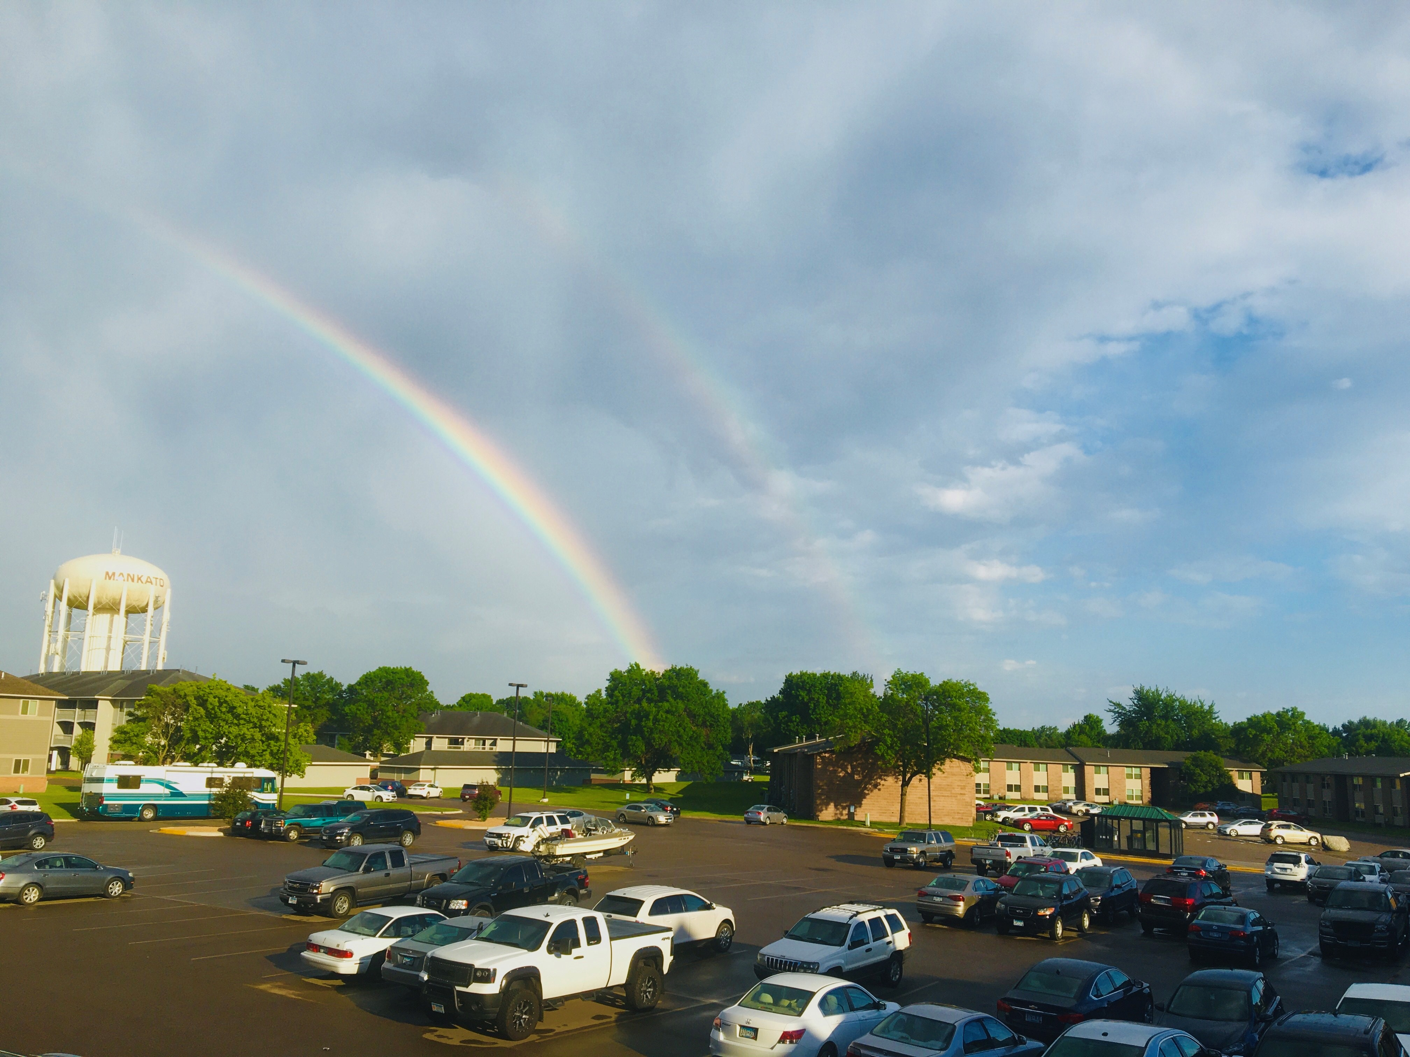
Project Contributors
Total Students: 124
Student Workers from campus departments
International Students
Total Student Supervisors: 18
Students added to project throughout the spring semester and summer.
Level of engagement varied throughout the project. (June & July participation was high.)
Photograph by Felix Asante
This Photo by Unknown Author is licensed under CC BY-SA
Notes:
Here is a look at the student employee participation in the project. We had student workers from several campus departments participate in the project.
International Students participated in the project participation grew over the summer because of summer classes and advertising for the project. Overall, we had approximately 122 individual, unique students provide submissions to the project. 18 different supervisors provided management of their students, supervising between 5 and 20 student employees each.
During the project, the Archives Team realized we needed to find new ways to encourage and provoke engagement and ideas for exploration in their projects. We encouraged students to reflect on the George Floyd murder and subsequent protests, both in Minnesota and worldwide. We also increased our professional development opportunities by providing weekly readings and a quiz so students could learn and improve.

Slide 14
Contributions by Type
Oral Histories (recorded and written)- 396
Recorded self-interviews – 395
Drawings/Paintings – 141
Other creative projects – 251
Total contributions: 1183
“Closed Restaurants” by Steven Orvaiti
Notes:
We were amazed by the types and quality of entries we received from the students as a part of this project. Their creativity was outstanding! Here are some statistics on the 1181 individual contributions we’ve received.

Slide 15
Creative Projects - Artwork
Joshua Lazarus
Jacqueline Asplund
We Can Beat This - Together
Notes:
Students have reflected on the social justice movement both in Minnesota and worldwide. They are drawing comparisons to past and current events. Here are two examples of artwork created by students. The drawing of the viewer’s left was drawn by Joshua Lazarus and depicts a nurse in front of the United States flag. The painting on the viewer’s right was created by Jacqueline Asplund and is entitled “We Can Beat This – Together.”
(Delete) According to Asplund: “When I first started this painting, I thought about what 2020 has symbolized for me. This time has been lonely even though we all are a part of it. I wanted to get in as much as possible about what is going on right now to try to get future researchers an understanding of my feelings and emotions. We are not just going through a pandemic, but also a revolution of Black Lives Matter. For me, it was important to get this part into the drawing somehow since even though they are two different happenings, they are synced together and will always be in the history books.”

Slide 16
Audio Oral History, May 31, 2020
Portion of an oral history interview conducted in Spanish and translated into English
Notes:
Interviews, both oral and written have occurred with people all over the United States and across the world. Students on the project were encouraged to conduct interviews in their 1st language and then provide translations of the interviews in the form of transcripts. This example is from a student conducting an interview in Spanish.

Slide 17
Next Steps

Slide 18
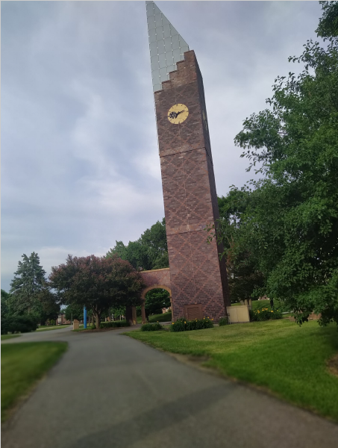
Processing the Collection
Archives Collections
Physical Collection in Archives
ARCH: University Archives Digital Collections – In development
Access dates are TBD
Collection Restrictions
Restricted for 10 years - 186
Anonymous - 606
Physical collection only - 151
Photograph by Anonymous student of Ostrander Student Memorial Bell Tower
Notes:
We planned to start processing this fall and life and COVID continued to happen. This isn’t an easy processing project for a number of reasons. We are currently debating how to process a mostly digital collection with some physical components while also honoring the anonymity and restrictions placed by our contributors. We’re also working to develop a plan to track contributors who contributed in multiple ways across the project. One idea we’ve created is to assign numbers to our participants to track them across the project and allow future researchers to make connections. We hope to use this project to help set up some best practices for digital accessioning and processing and enhance our Digital Preservation Plan.

Slide 19
Survey of Contributors
Students – 22 Responses
How this project impacted them
What they learned
What was the most helpful
What would they recommend changing
Photograph taken by Joyce Aigbokhan
Notes:
We surveyed the students who participated in the project to learn how the project impacted contributors and learn how to improve our resources and methods for future projects.
The survey helped us identify the most useful training materials and identify how to better organize our communication and documentation processes.
Students wrote the following feedback:
“Participating in this project has helped me unearth many of my talents. For example, this project has made me realized that I can write poems, journals and draw very well and I'm happy to unravel my talents through this project.”
“The most positive as aspect is the interaction with interviewees from different backgrounds and how the Covid-19 pandemic has affected them.”

Slide 20
COVID-19 Community History Project
Complications
Successes
Paying students to be contributors was challenging
Technology provided both innovation and struggles for this type of project
Use this project as a framework for future collaborations to strengthen University Archives and Southern Minnesota Historical Center collections
Global collection of COVID-19 projects experiences.
Notes:
One of the biggest complications for the project was paying students to collect the oral histories and other contributions to the project. Payroll and project management (especially personnel management) became a large part of the project
Technology provided both innovation such as using zoom to collect oral history and using transcription software but also problems, mainly trying to do project management from laptop. Working from home helped us better understand student challenges who often work on coursework from home.
We did have a lot of successes, such as collecting a global collection of COVID-19 project experiences and oral histories. We are also using this project as a framework for future collaborations and partnerships.

Slide 21
Reuse Project Framework
Examples of new projects
Elements reused
#No Justice, No Peace Community History Project
Mankato Kiwanis 100th Anniversary Oral History Project
Website structure (LibGuides)
Training resources
Submission forms (pdfs)
Online submissions (web form)
Web based tools for interviews
FAQ
Notes:
We reused our project framework to develop two new community history projects. The first was our #NoJusticeNoPeace Community History Project that records personal experiences related to the social justice protests that began in the summer of 2020. The second is a Mankato Kiwanis 100th Anniversary Oral History Project that documents the experiences of Mankato Kiwanis club and its history.
We reused the website structure, training resources, submission forms that were PDFS, online submission forms, web based tools for interviews and the FAQ section.

Slide 22
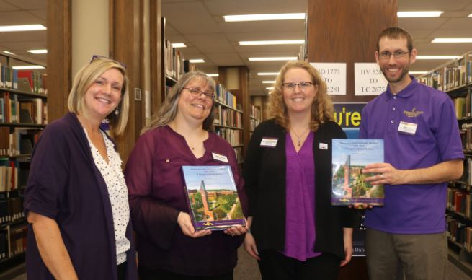
Wrap Up
University Archives and Southern Minnesota Historical Center
Phone: 507-389-1029
Email: archives@mnsu.edu
Today’s Presentation: https://cornerstone.lib.mnsu.edu/lib_services_fac_pubs/184/
Project Website: https://libguides.mnsu.edu/covid19historyproject
Notes:
Make some concluding statements about would we do it again, how we’re using it, and how …..
Please feel free to view presentation available in Cornerstone, Minnesota State Mankato’s Institutional Repository and the MAC ……
Feel free to contact us if you have any additional questions about today’s presentation. We would now like to transition to ……..

Slide 23
Creating a COVID-19 Web Archive
Jenna Jacobs, Archivist
jjacobs@hclib.org

Slide 24
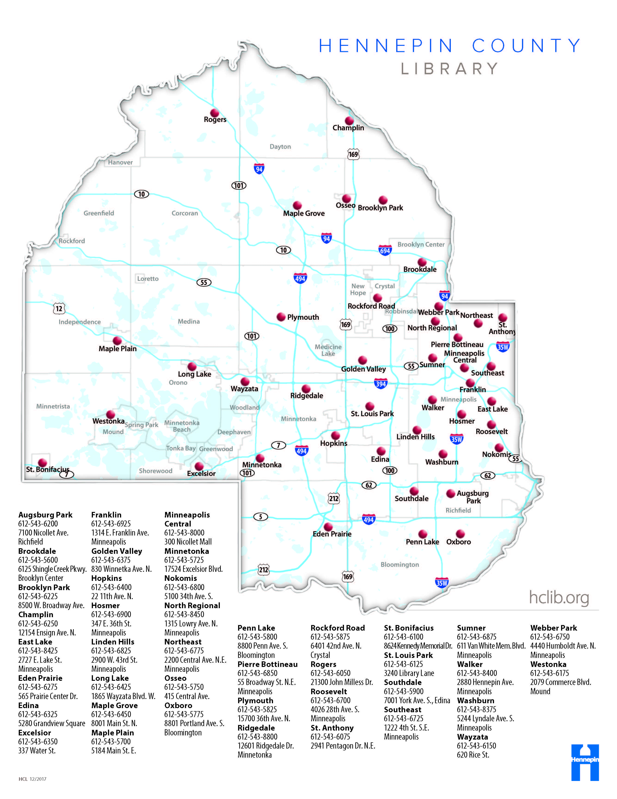
Hennepin County Library
Minneapolis and suburban Hennepin County, Minnesota
41 library locations
1.2 million county residents and 611 square miles
Notes:
Quick note on HCL
Hennepin County Library – located in Minneapolis and Hennepin County, MN
Archives and rare books for the library
Home of Minneapolis History Collection – documenting Minneapolis and Hennepin County history
Over 400 processed archival collections
Extensive digitization program and our digital collection address is listed here
We collect local history in all formats – books to film to photographs and more. A format we’ve been increasingly interested in over the past few years is web content and web archives.

Slide 25
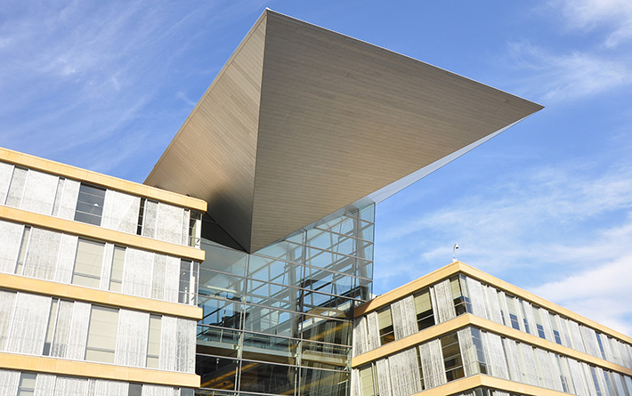
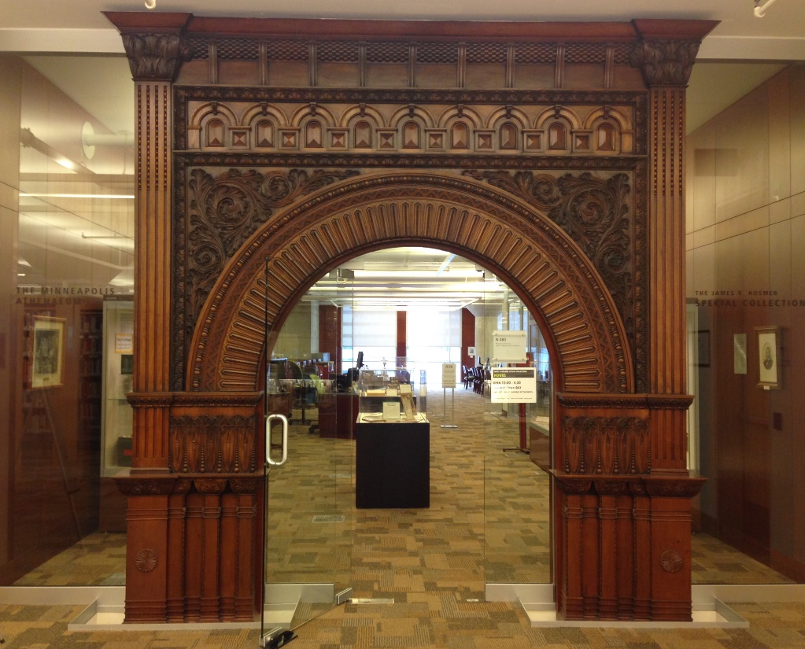
Hennepin County Library Special Collections
Minneapolis and Hennepin County Collection
Over 400 processed archival collections: https://archives.hclib.org/
Digital Collections: www.hclib.org/digitalcollections
Notes:
Quick note on Special Collections:
Downtown Mpls, Minneapolis Central library
Archives and rare books for the library
Home of Minneapolis and Hennepin County collection
Over 400 processed archival collections
Extensive digitization program and our digital collection address is listed here
We collect local history in all formats – books to film to photographs and more. A format we’ve been increasingly interested in over the past few years is web content and web archives.

Slide 26
What are Web Archives?
Preserved copies of live web content collected for permanent retention and access (SAA Dictionary)
Interactive captures of websites at a point in time
Minneapolis Public Library Website, 1996, Internet Archive Wayback Machine
Notes:
For those of you who aren’t familiar, What are web archives?
[read slide]
Key is interactivity – not just a screenshot, but a clickable copy that functions like the original
Most wellknown example is Internet Archive Wayback Machine (where I got this image of the MPL website from 1996)
Also may know of Archive-It (another major platform)

Slide 27
Web Archiving at HCL Pre-COVID
Active, but small program
Focus on donated sites and library’s sites
Long-term plans for expansion
Notes:
Active but small program
Focus on sites donated to us by their creators (blogs) and the library’s own websites (mainly the library’s building projects – renovations at library buildings—that are routinely removed from the website)
Long-term plans for expansion of web archiving, but it was not a priority project – that changed with COVID

Slide 28
Why Archive the Web during COVID?
Growth of web content
Social distancing
Ephemeral content
Employees pose with Minneapolis-Honeywell’s First Computer, 1947.
Hennepin County Library Digital Collections.
Notes:
Growth of web content
Everything was going online
includes COVID plans and procedures
Seemed to move away from physical mail/paper (safety concerns) – surprising! Fast!
Listed changed services on website
Social distancing
Collecting we can do remotely and during stay at home order
No shortage of work, but shortage of ways to document the moment
(Finally, and most importantly) Fleeting content
Things changing so fast, content being removed
Expectation that some services/businesses will not survive the pandemic OR will be essentially changed – biggest challenge
Big picture: compare web archives as the vertical files (and sometimes periodicals) of the future, and the future is now.

Slide 29
Conifer (Formerly Webrecorder)
Pros:
Free 5GB online storage
Public or private collections
Downloadable WARC files (ISO standard for web archives)
Designed for interactive content
Easy to use
Cons:
Limited storage
Manual capture
Notes:
Needed to act quickly
Used the same platform we were using
[Don’t read everything – pull out a couple: Free storage, downloadable WARC files – ISO standard for web archives that could be moved to a different platform

Slide 30
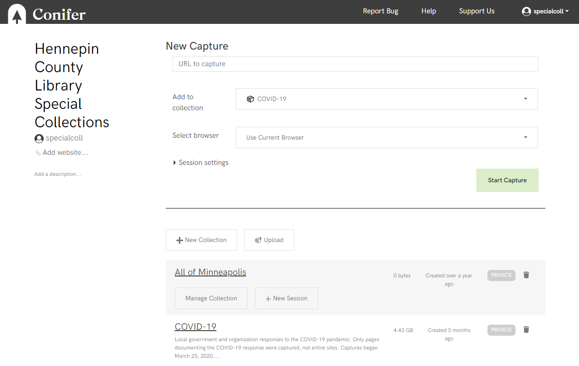
Website URL
Collection Title
Notes:
Pretty straightforward interface
Enter URL, enter collection, add notes
One session per website
Click through the website, any link you click on is captured for inclusion in the archive. Any link you don’t click will not be captured.
Easy enough that all our staff (4 people) did crawls w/o much instruction from me

Slide 31
In the Archive
Began March 2020
Over 700 websites captured
Downloaded all WARCs
Created descriptive metadata
Categories:
Government
Healthcare
Places of Worship
School Districts
Private Schools
Restaurants
Neighborhood Organizations

Slide 32
Example: Bachelor Farmer (April 8)
Notes:
Example of what we captured and replayed in Conifer
Bachelor Farmer was a well-known restaurant in Minneapolis that routinely appeared on lists of the best restaurants in the state and the country
Website as it appeared April 8 – closed w/message about a community food support service
This is an image, but if we were in the live archive, we could click out of this pop-up and interact with the website behind it.

Slide 33
Example: Bachelor Farmer (May 1)
Notes:
Same URL on May 1
Day or so after announced closing
Note: old website completely gone. Only this message to community. Can’t get back to old content on live web.
Now, this website is entirely gone.
Information that might be lost if not captured

Slide 34
Permissions and More
Notifying all private organizations (opt-out option)
Survey
Offer as repository
Notes:
After capturing sites, we began the permissions process.
Letters to all private orgs do 3 things:
1 notify w/opt out
2 send survey
Simple
Chance to supplement website
Offer as repository
Not many takers, yet
Have gotten a few programs/bulletins
This was where we were last summer. The program was up and running as the pace of COVID changes began to slow.

Slide 35
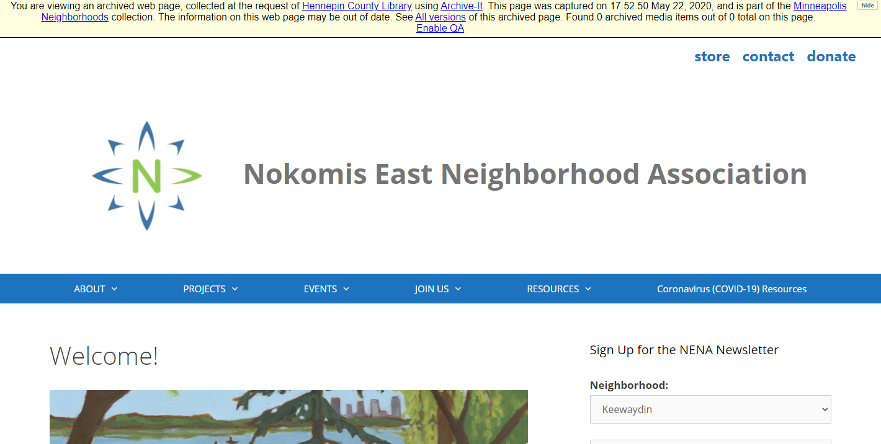
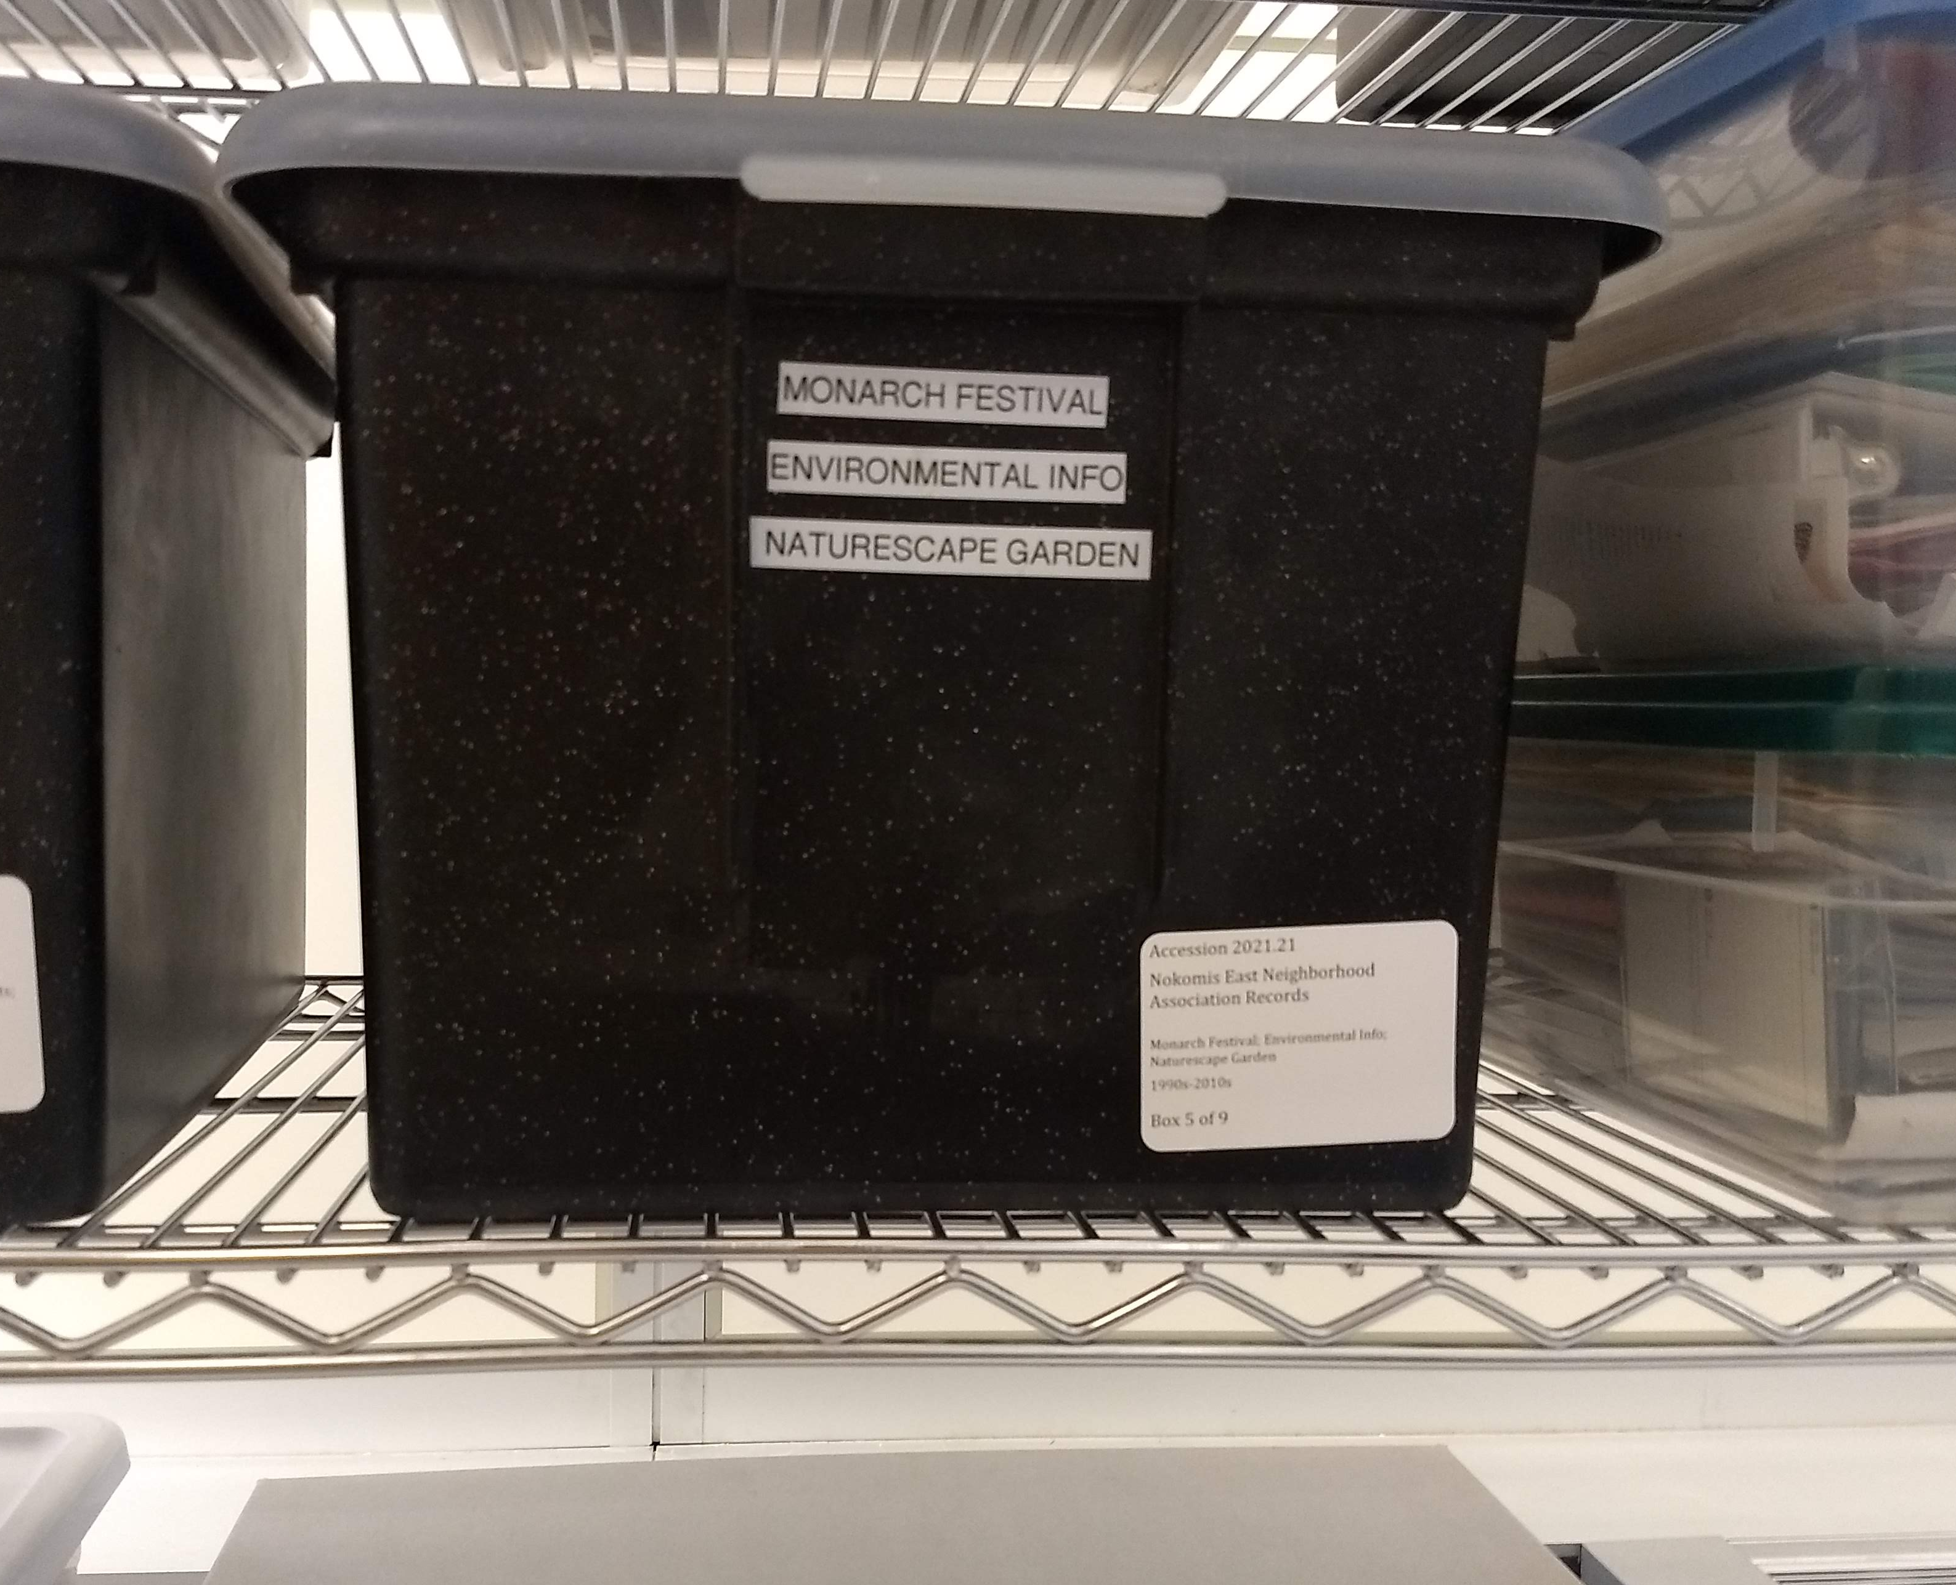
Growing Beyond COVID: New Collections
New donor relationships
Tools in place to document spontaneous events
Notes:
New Collections
New Donations
Two ways that web archiving has helped us in building relationships with donors and community
1. If we have the web content, organizations may want to donate traditional archival content. Has happened with some organizations –neighborhood organization here we notified for web archive, and they were interested in donating the physical archive.
2. Option to present to donors of physical materials and way to build relationships for physical collections. When we accept donation, we can offer web crawling.
We had a working structure in place to document other spontaneous events – specifically, to document events following the killing of George Floyd. Many materials gathered – more difficult, but very important.

Slide 36
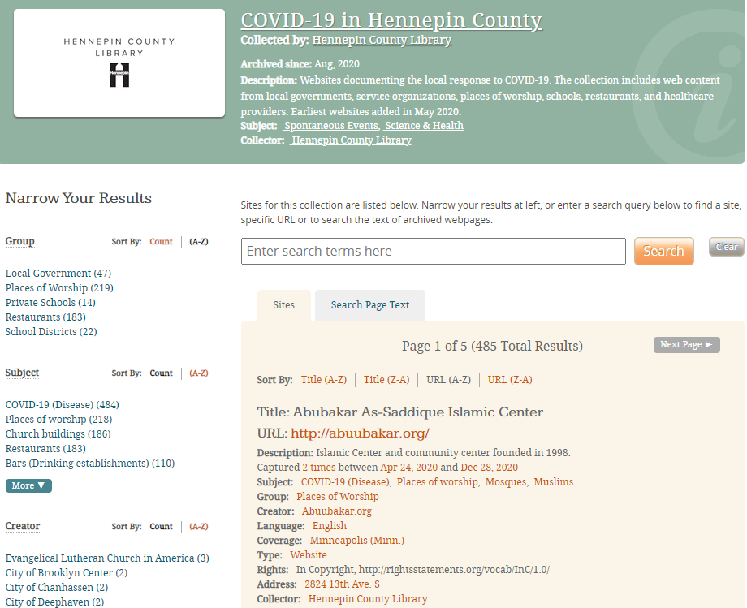
Growing Beyond COVID: New Platform
Transition to Archive-It through Community Webs program
Public, searchable site
Scheduled, automatic crawls
https://archive-it.org/home/hclib
Notes:
New Platform
Always envisioned a different, automated platform as program grew
Had long planned on Archive-It and had done trials before
Very luck to have been able to benefit from Archive-It’s offer of free covid storage space and able to be added to Community Webs
Community Webs is a grant funded program through Archive-It for public libraries to create best practices and create web archives

Slide 37
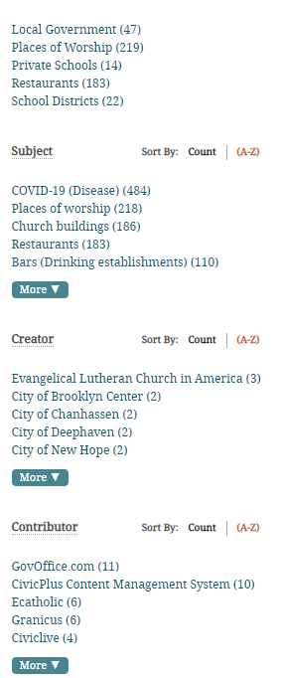
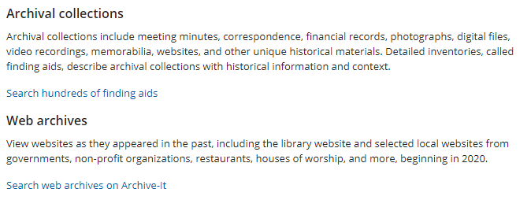
Growing Beyond COVID: New Access Points
Develop metadata standards
Integrate with library website and collections
Notes:
New Access Points
Metadata
Decided on our standards for metadata (derived from OCLC)
Volunteers and interns helping to create metadata for each URL, including subject headings, descriptions, and creator information
Integration
- linked from library website and linked in digital collections

Slide 38
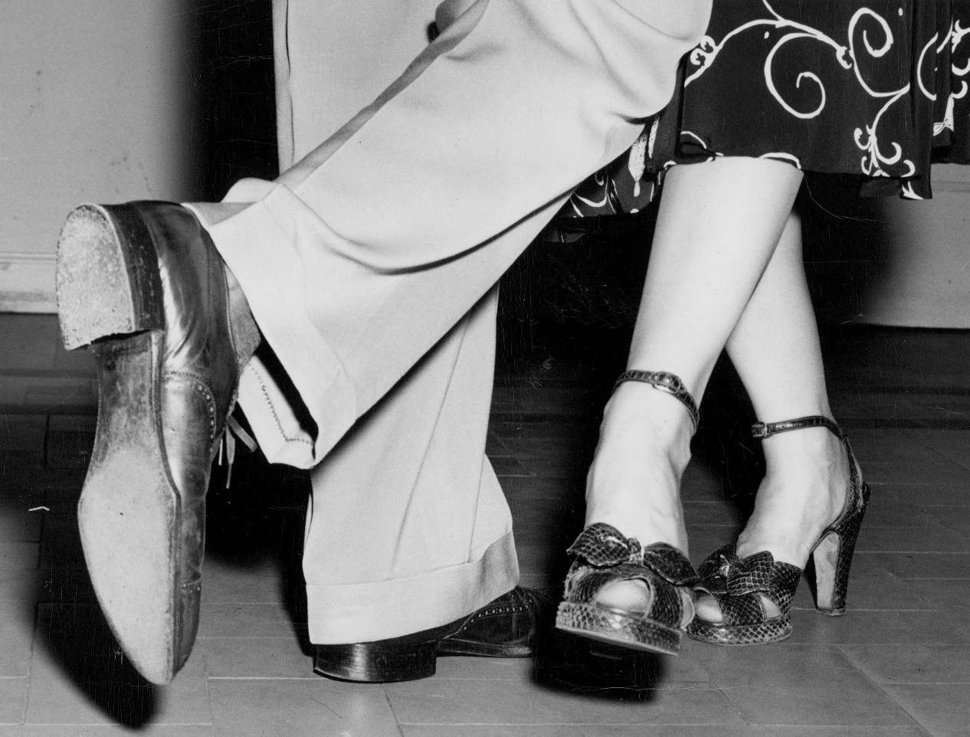
Next Steps
Public access (ongoing)
Automated follow-up crawls
Increase awareness
Proactive web archiving program
Jenna Jacobs
jjacobs@hclib.org
(612) 543-8206
David and Sally LaVay demonstrate dance steps, 1948.
Hennepin County Library Digital Collections.
Notes:
Public Access – most exciting!
Some content still to be added to Archive-It; metadata to be enhanced
Integration with finding aids and digital collections
Follow-up crawls
Increase awareness
Promotion of web archive to content creators and library patrons
Tools and guides for using web archives effectively
Proactive web archiving
Still respond to spontaneous events, but also further develop a less reactionary, more systematic collection. Going back to VF analogy, we want to collect the everyday, topical materials that document our local community online.

