Slide 1
s403
Archival Traces of a Tennessee Unionist Enslaver Who Founded a Chicago Suburb
MOVING ARCHIVES FORWARD
Midwest Archives Conference annual meeting
May 5-7, 2022
Madison, Wisconsin

Slide 2
Why study local history?
“Local history reflects the reality that our lives are shaped by particular places and that our physical place in the world is a major determinant to how our lives are lived. Local history is the study of the everyday struggles and triumphs of ordinary people. The study of local topics allows for in-depth research to connect the past with the present, which is done more simply and with more meaning than studying the national, faceless masses. It allows for greater depth in studying the history of our communities and the relations to the people within them.”
—Ohio Local History Alliance, https://ohiolha.org/best-practices/what-is-local-history/

Slide 3
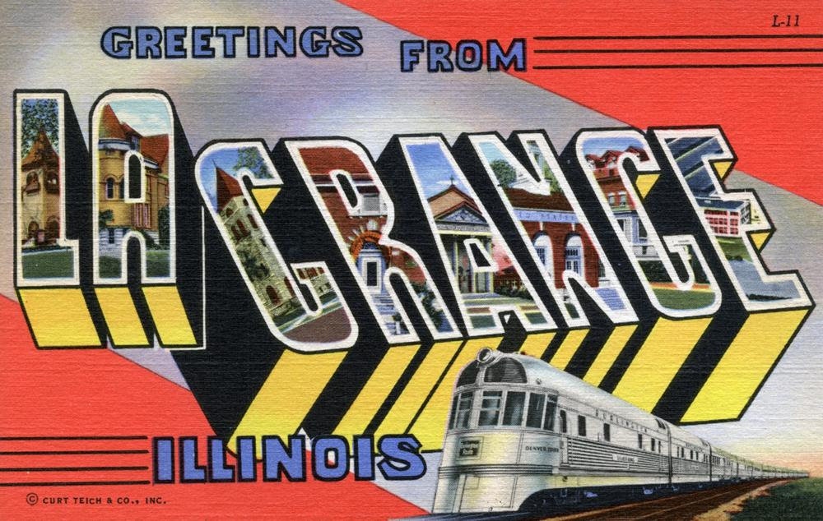

Slide 4
La Grange, Illinois
Village of 16,000 in western Cook County (Lyons Township).
Median income for a family is $95,554.
Train service to Chicago since the 1860s. Takes 35 minutes. Many residents commute.
Area was first “settled” in the 1830s but its Native American (Potawatomi) history goes back much further.

Slide 5
La Grange, Illinois
In the 2000 Census, the village was 6% African American.
The East Side of La Grange, east of Bluff Avenue, has historically been home to most of its African American residents.
Some early residents were servants to wealthier white families.
La Grange’s Community Diversity Group is looking at the history of redlining in the area.

Slide 6
La Grange Area Historical Society
Founded in 1972. Website is Lagrangehistory.org
The society has an archive of files on every house in La Grange with newspaper clippings on the residents.
They also have some files on schools and organizations and a large collection of historical clothing and other ephemera, and put on historical tours and other events.
They have several “Black history” folders with clippings on various projects related to La Grange’s African American residents, organizations, and history. However, there are no clippings in the house files from the Chicago Defender, which is fully digitized and searchable and contains articles on La Grange residents and events.

Slide 7
Archival Silence
Carter, Rodney G.S. 2006. “Of Things Said and Unsaid: Power, Archival Silences, and Power in Silence”. Archivaria 61 (September), 215-33. https://archivaria.ca/index.php/archivaria/article/view/12541.
Carter explains how the absence of individuals or groups from the archive can be a form of violence, and suggests that archivists should extend the invitation to all groups into the archive, while recognizing that some groups may choose to remain silent.
What silences exist in La Grange’s historical society’s archive? African American and other minority residents? The town’s earliest residents?

Slide 8
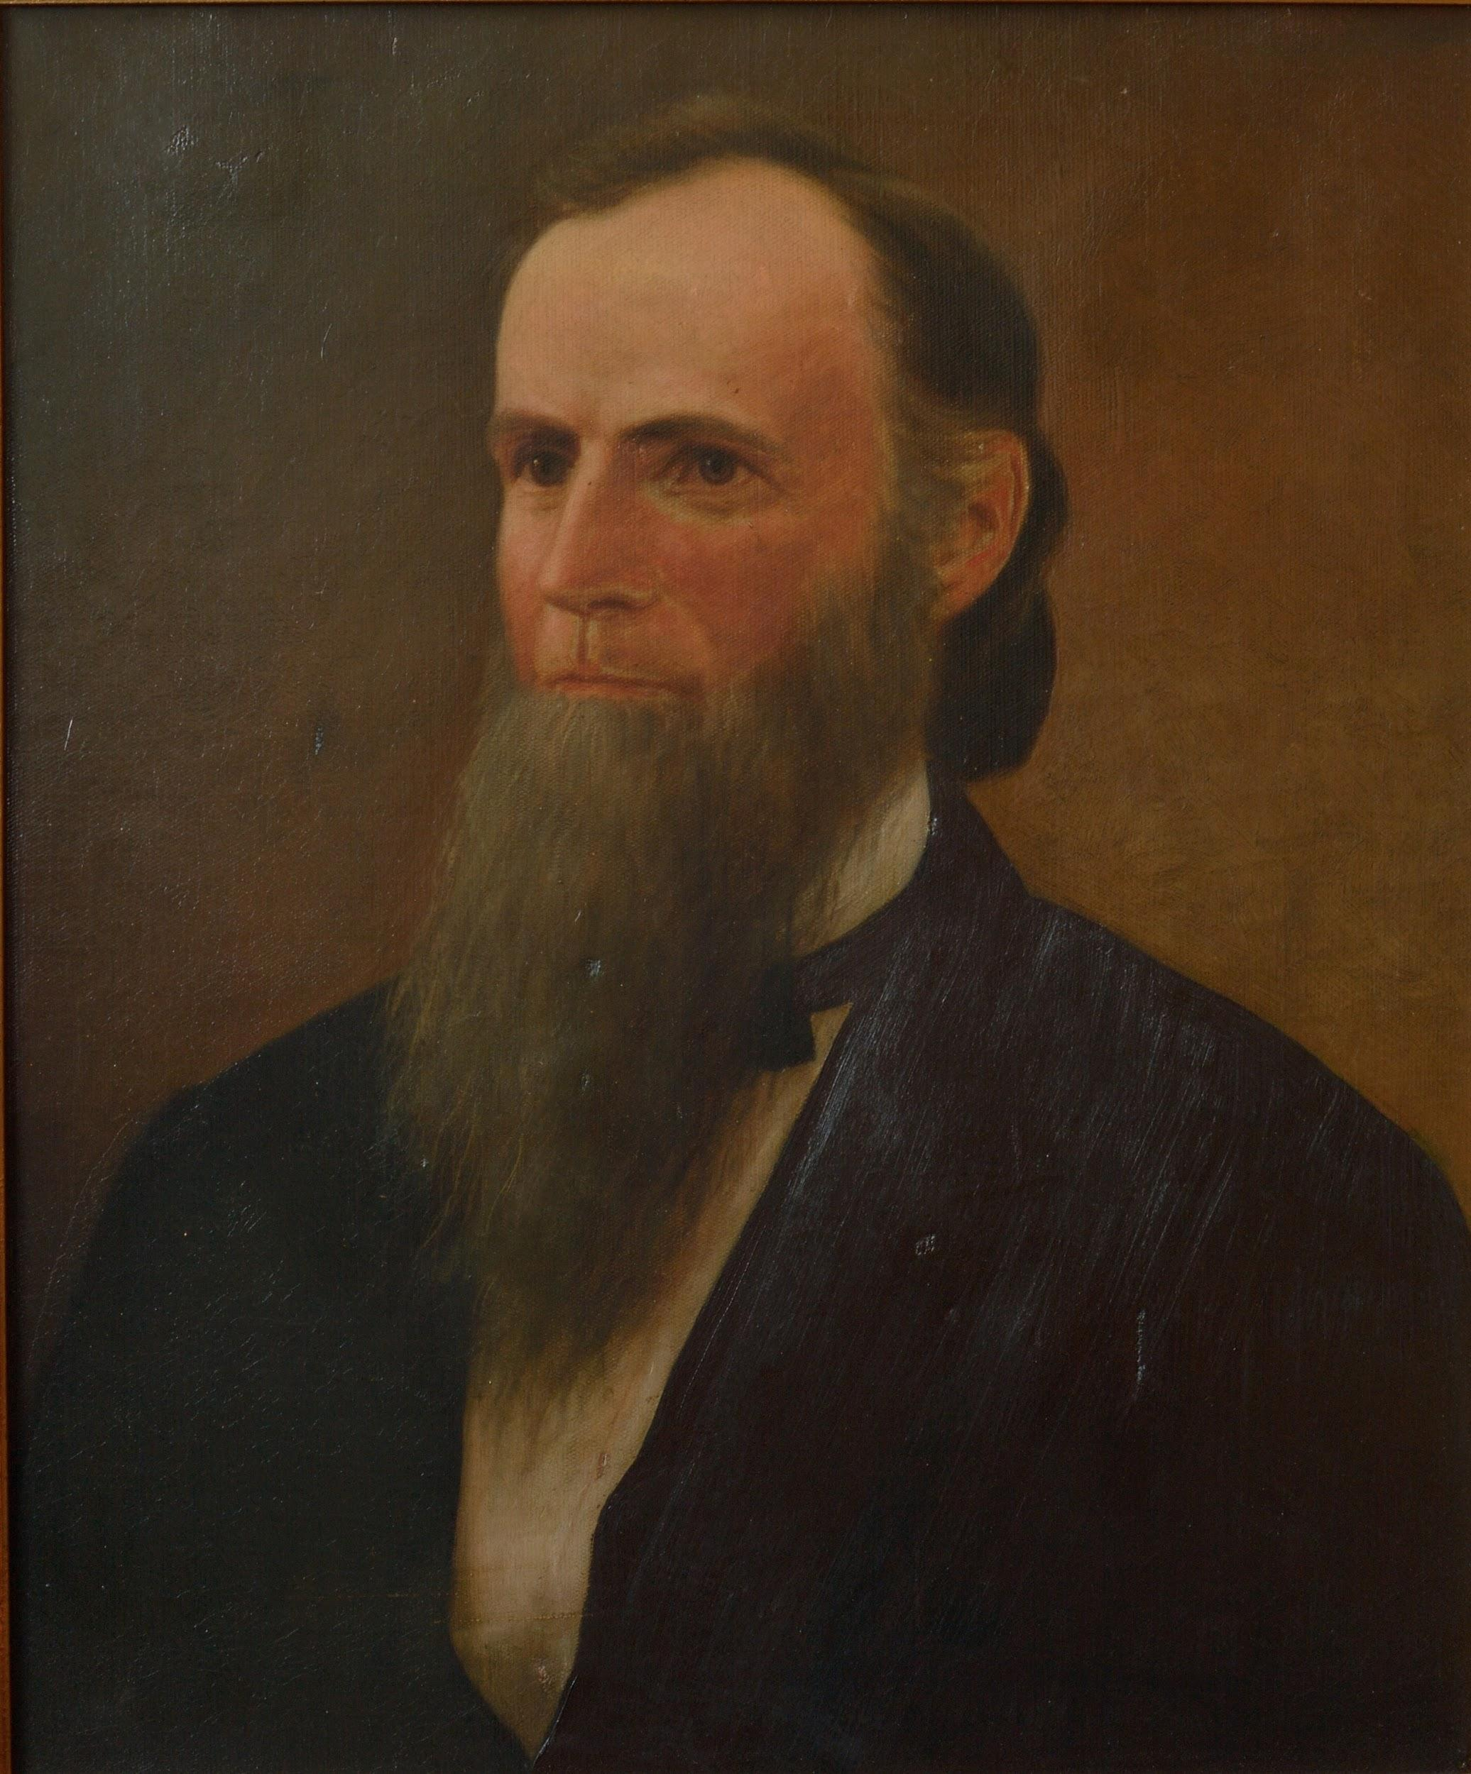

Slide 9
Franklin D. Cossitt (1821-1900)
Bought 600 acres in western Cook County in 1870.
Named the area Kensington, but there was already a Kensington, Illinois post office, so he named it La Grange, after his previous home in Tennessee.
Subdivided the area that became La Grange starting in 1871.
Village was incorporated in 1879 with Cossitt as its first president.

Slide 10
Franklin D. Cossitt (1821-1900)
From an early biographical sketch:
“Mr. Cossitt is sagacious and far-sighted, straightforward and honorable in all dealings. His investments have proved judicious, and through the legitimate channels of business he has won his fortune. His habits have always been temperate, and his successful life should serve as an example and inspiration to every ambitious young man.”
—Genealogical and Biographical Record of Cook County, Illinois, containing Biographical Sketches of Prominent and Representative Citizens of the County. Chicago, 1894.

Slide 11
Franklin D. Cossitt (1821-1900)
He enslaved people. How many?
Chicago Tribune obituary says 61.
Biographical sketch from 1894 says 160.
Slave Schedule of the 1850 United States Census said 15.
Slave Schedule of the 1860 United States Census said 125.
Testified to Southern Claims Commission under oath in 1876 that he owned 127.

Slide 12
Franklin D. Cossitt (1821-1900)
1821 Sep 19 Born in Granby, Connecticut.
1834-1835 Father dies.
1836 Moves to La Grange, Tennesee, to work with his uncle.
1842 Separates from his uncle and goes into business for himself.
1844 Marries Martha Malone of Virginia.

Slide 13
Franklin D. Cossitt (1821-1900)
1850 Cossitt is listed on the Slave Schedule of the U.S. Census as enslaving 15 people in Tennessee. His real estate was valued at $10,000.
1853 Martha Malone Cossitt dies.
1854 Marries Martha Moore of Tennessee.
~1856 Cossitt tells enslaved person William Cossitt that he will be free soon.

Slide 14
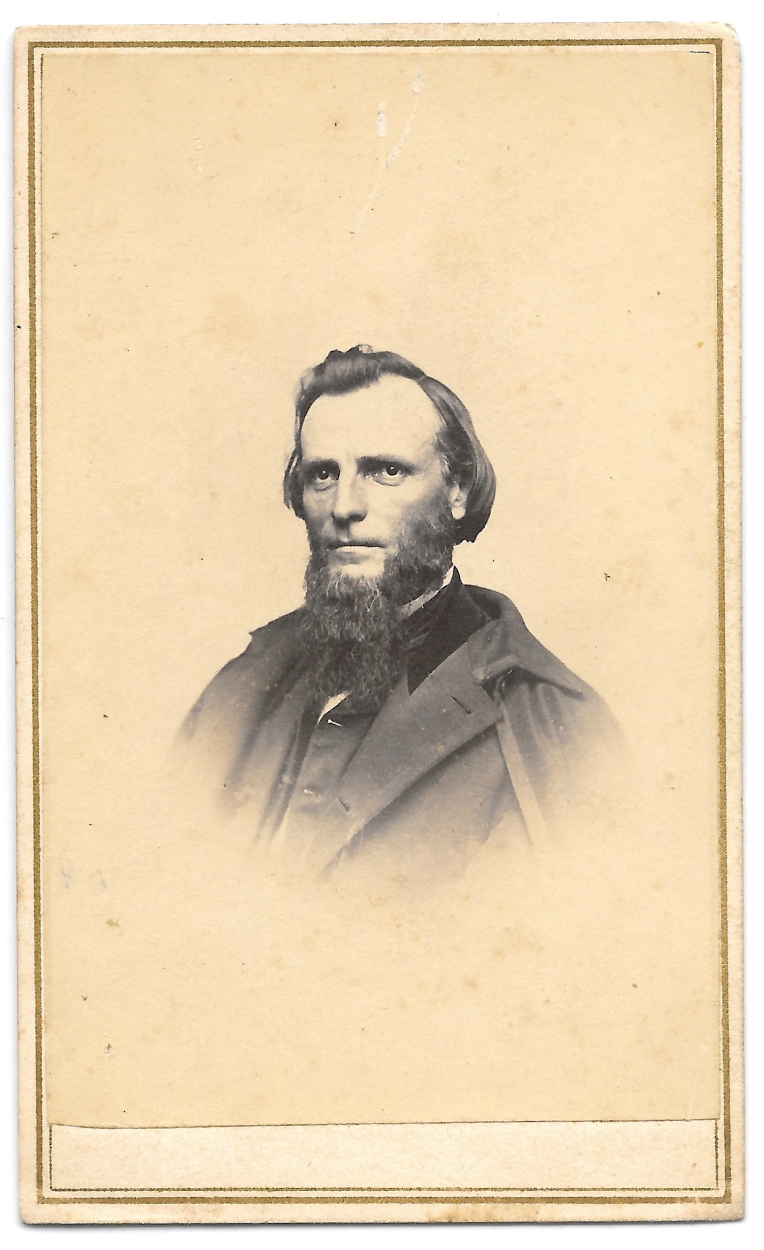

Slide 15
Franklin D. Cossitt (1821-1900)
1860 Cossitt is listed on the Slave Schedule of the U.S. Census as enslaving 125 people in Tennessee and Mississippi. Real estate valued at $82,000. Personal estate valued at $152,000.
1862 Tells Union generals in Tennessee that rebel forces don’t amount to much.
1863 Takes oath of allegiance to the United States and moves to Chicago. Martha Moore Cossitt dies.
1863-1875 Co-owns Barrett & Cossitt (1863-1870), and owns Cossitt & Co. (after 1870), wholesale grocers (and later, real estate), Chicago.

Slide 16
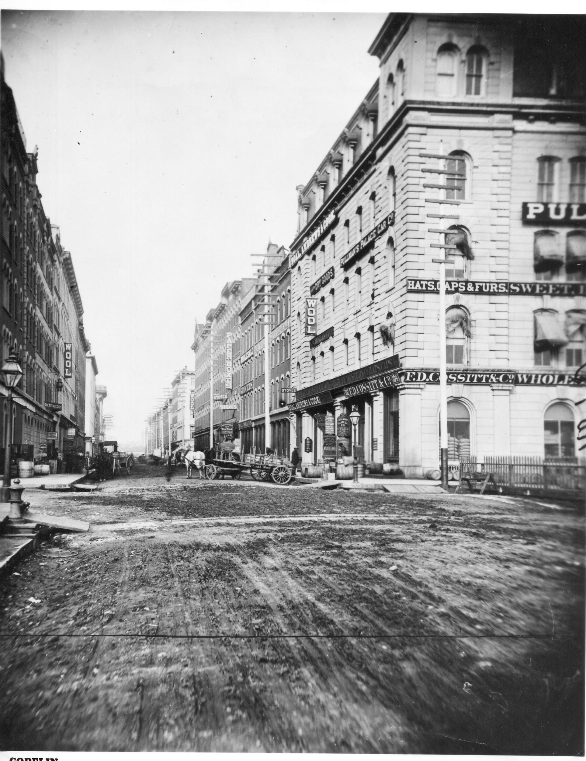

Slide 17
Franklin D. Cossitt (1821-1900)
1864 Marries Addie C. Hedges Hunt of Chicago.
1869 Buys 80 acres and establishes the town of Montrose, Illinois.
1870 His real estate is valued at $30,000. His personal estate is valued at $10,000.
1870-1871 Buys 600 acres in western Cook County.
Subdivides La Grange, Illinois.
1871 Oct 8 Great Chicago Fire.
1875 Moves to La Grange, Illinois.

Slide 18
Franklin D. Cossitt (1821-1900)
1876 Testifies to Southern Claims Commission in Washington, D.C. and is awarded $14,102 for losses during the Civil War.
1878 Testifies in Alvaro Clark (Clark-St. Peter) murder trial.
1879 La Grange, Illinois, is incorporated with Cossitt as village president.
1900 Jul 9 Dies by suicide in La Grange, Illinois.

Slide 19
Franklin D. Cossitt (1821-1900)
Cossitt’s enslaving is either not mentioned:
La Grange: A Centennial History, 1979.
Images of America: La Grange and La Grange Park, Illinois by RoseAnna and Robert Mueller, Arcadia, 1999.
Wikipedia
La Grange Historical Society’s webpage
But it is mentioned:
Cossitt’s Chicago Tribune obituary (July 10, 1900)
A 2006 blog post by a Cossitt descendant about the Southern Claims Commission file

Slide 20
Movement to rename things named after enslavers
30 public schools in Chicago are named for slaveholders; surprised CPS promises changes, Chicago Sun-Times, December 30, 2020
What about things named after enslavers who were loyal to the United States?

Slide 21
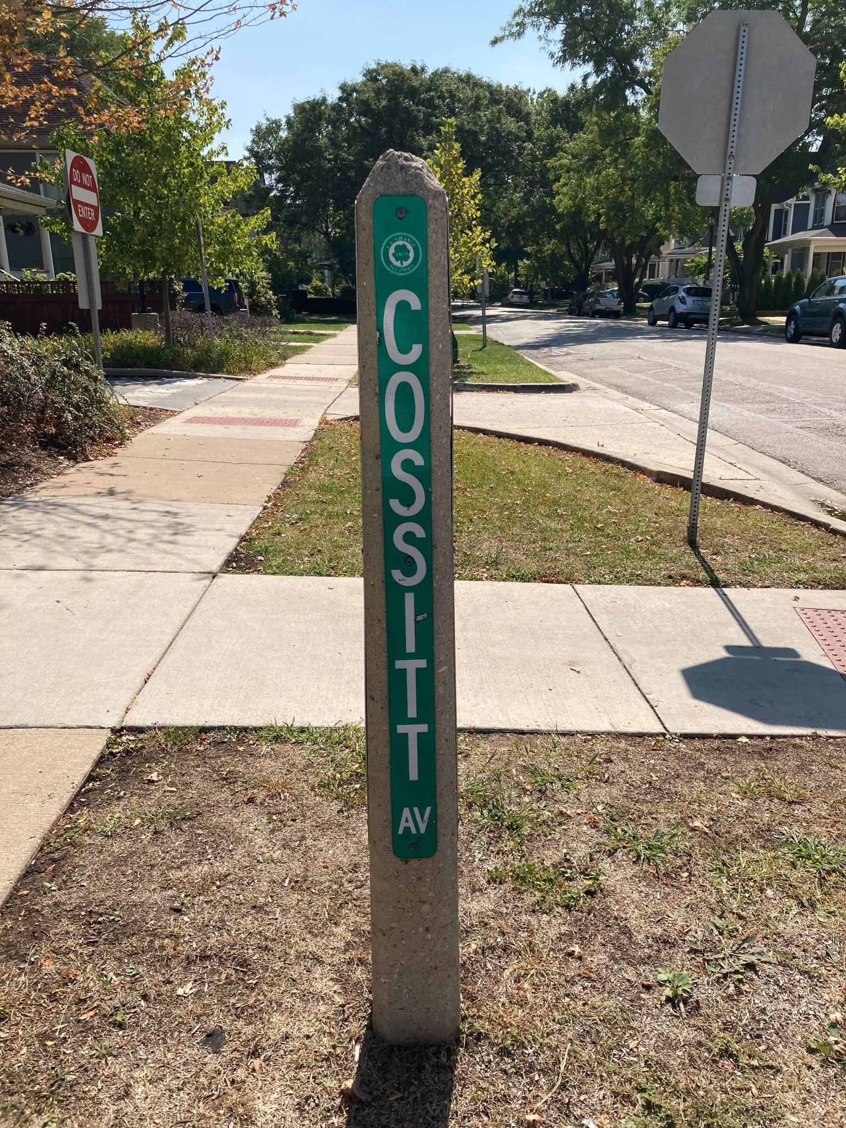

Slide 22
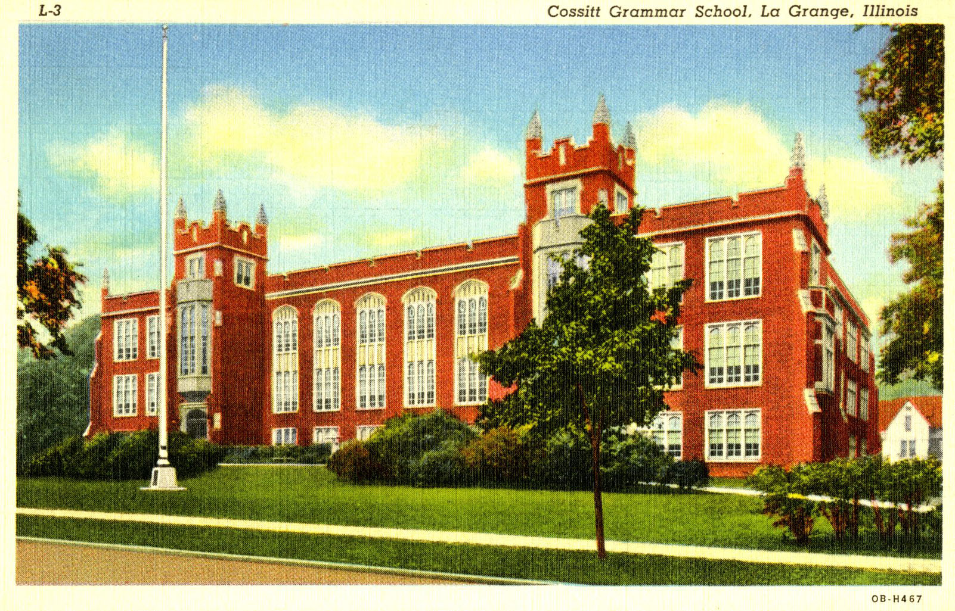

Slide 23
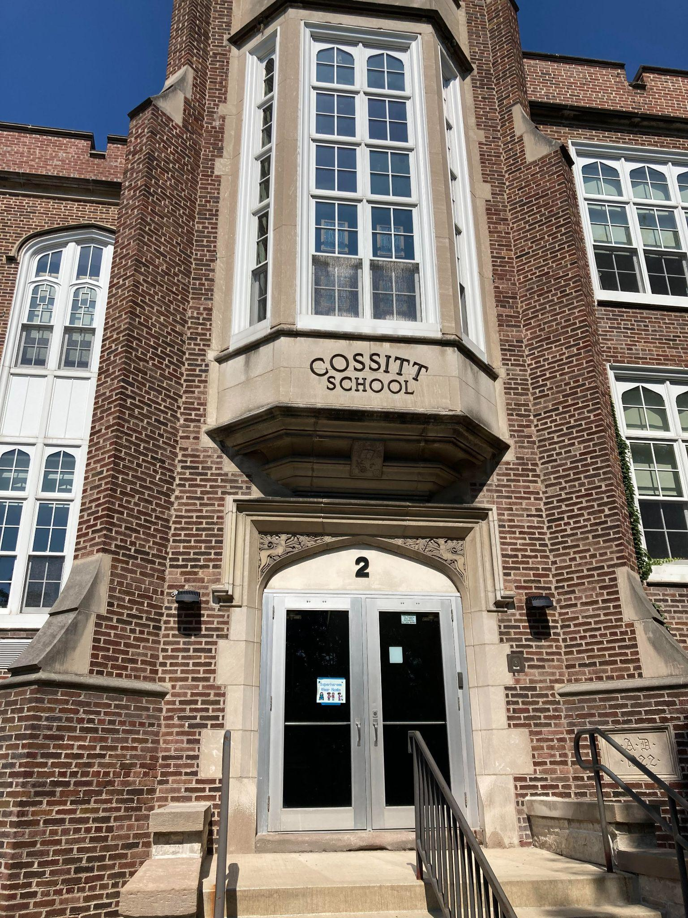

Slide 24
The Southern Claims Commission
A commission established by the federal government in 1871 to compensate loyal southerners for their assistance to the Union during the Civil War. Claimants were not compensated directly for slaves or cotton.
Frank W. Klingberg, The Southern Claims Commission, California, 1955.
Gary B. Mills & K. Mills, Southern Loyalists in the Civil War: A Composite Directory of Case Files Created by the U. S. Commissioner of Claims, 1871-1880. Genealogical Pub. Co., 1994.

Slide 25
Cossitt’s Southern Claims Commission file
Available at fold3.com, a genealogical site with military records.
Claim files are organized by state and county.
Cossitt’s file is about 390 pages, including scans of original receipts given by soldiers, handwritten affidavits, handwritten letters about the claim from witnesses, and a transcript of the testimony in his hearing before the commission in 1876.
I have transcribed much of the file, including the claim summary and all of the testimony, and can provide a PDF (77 pages) on request. kfakhreldin@oppl.org

Slide 26
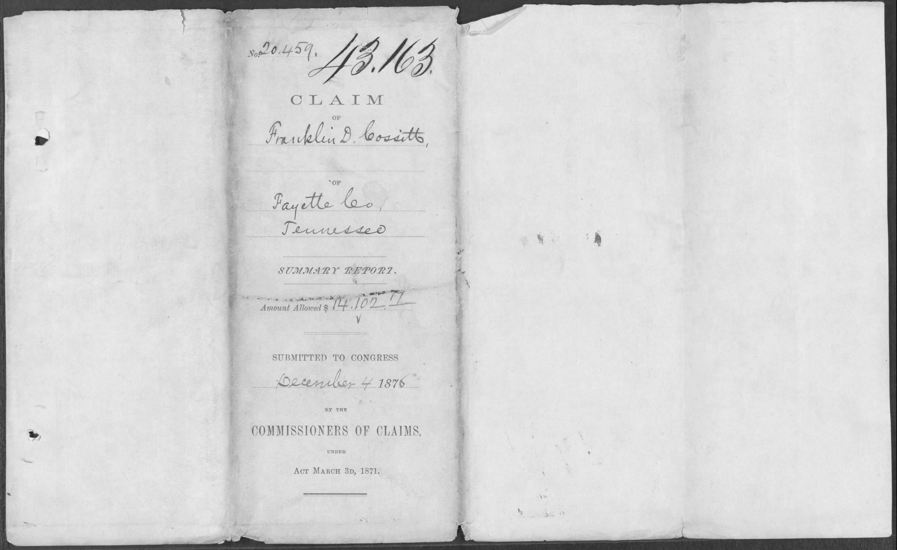

Slide 27
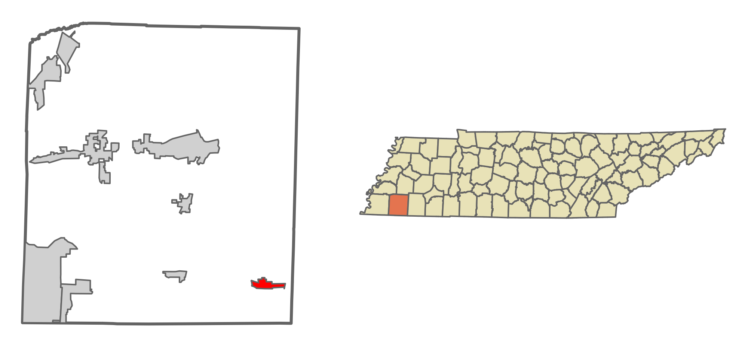
Location of La Grange, Fayette County, Tennessee

Slide 28
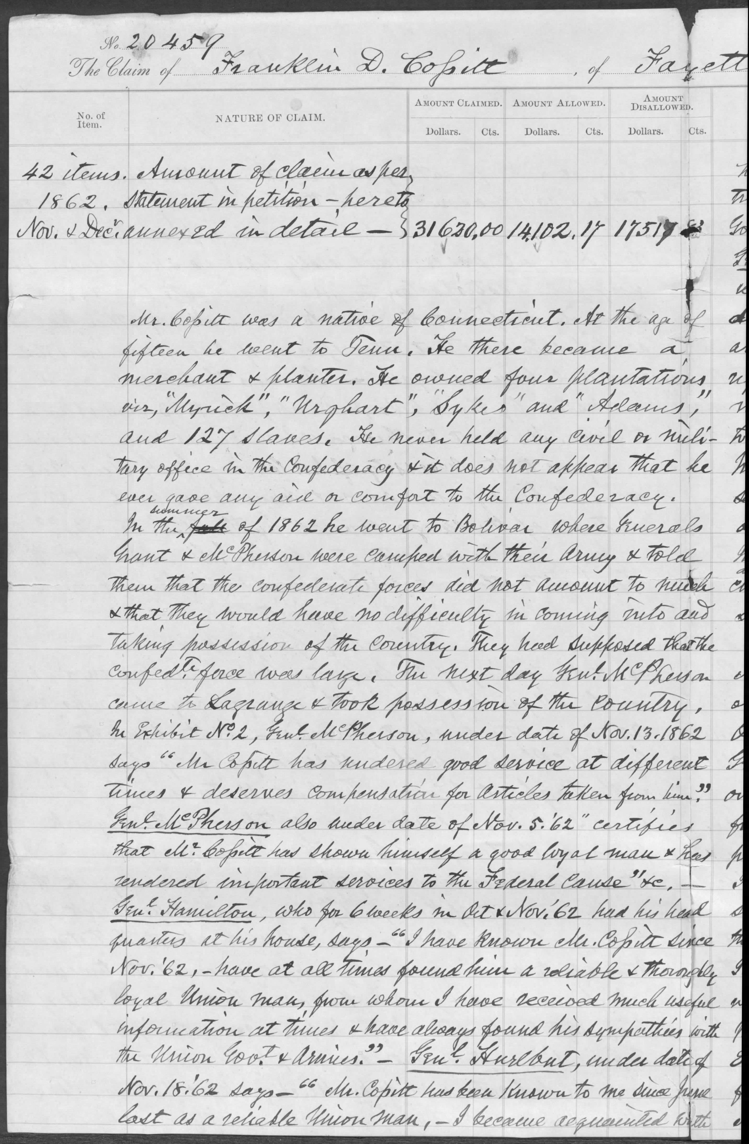
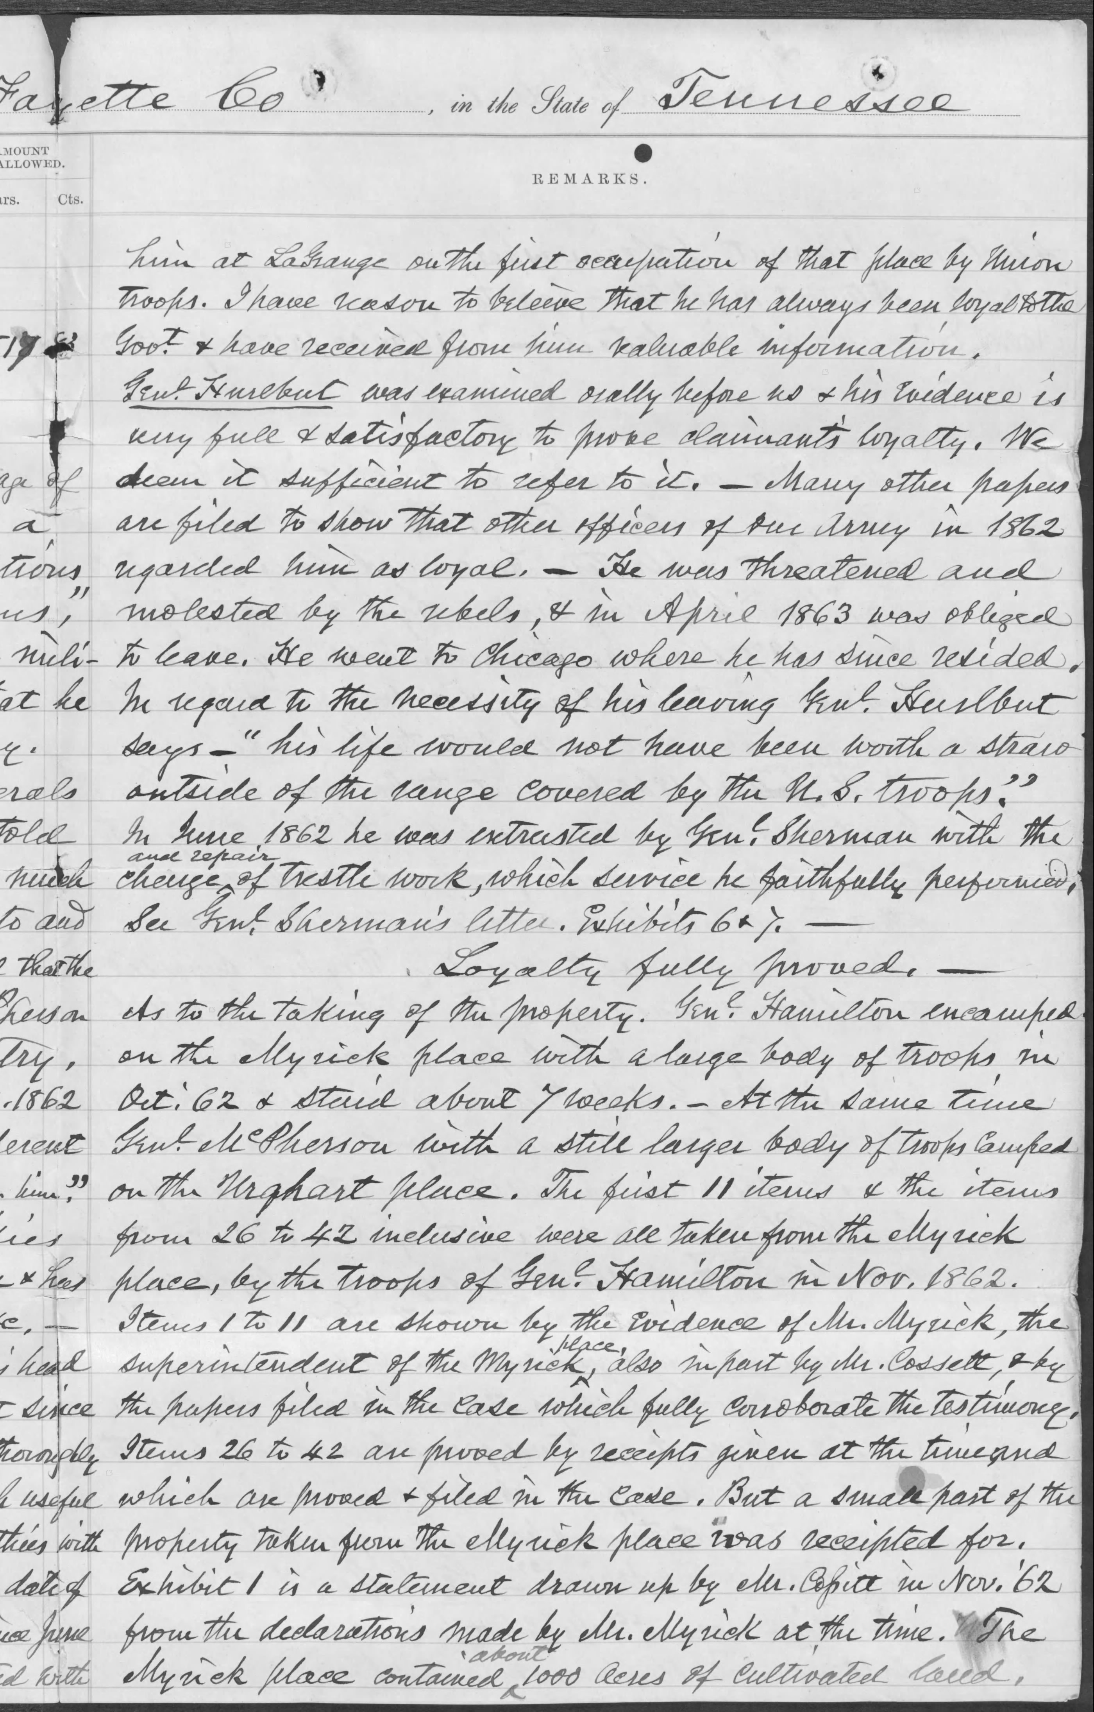

Slide 30
Cossitt’s Southern Claims Commission file
Summary of the claim:
Cossitt claimed $31,620, of which the commission allowed $14,102.27
Allowed claims included:
$4,000 for mules (32 mules at $125 each)
$2,270 for livestock (hogs, beeves, cattle)
$1,612.50 for corn (3,750 bushels)

Slide 31
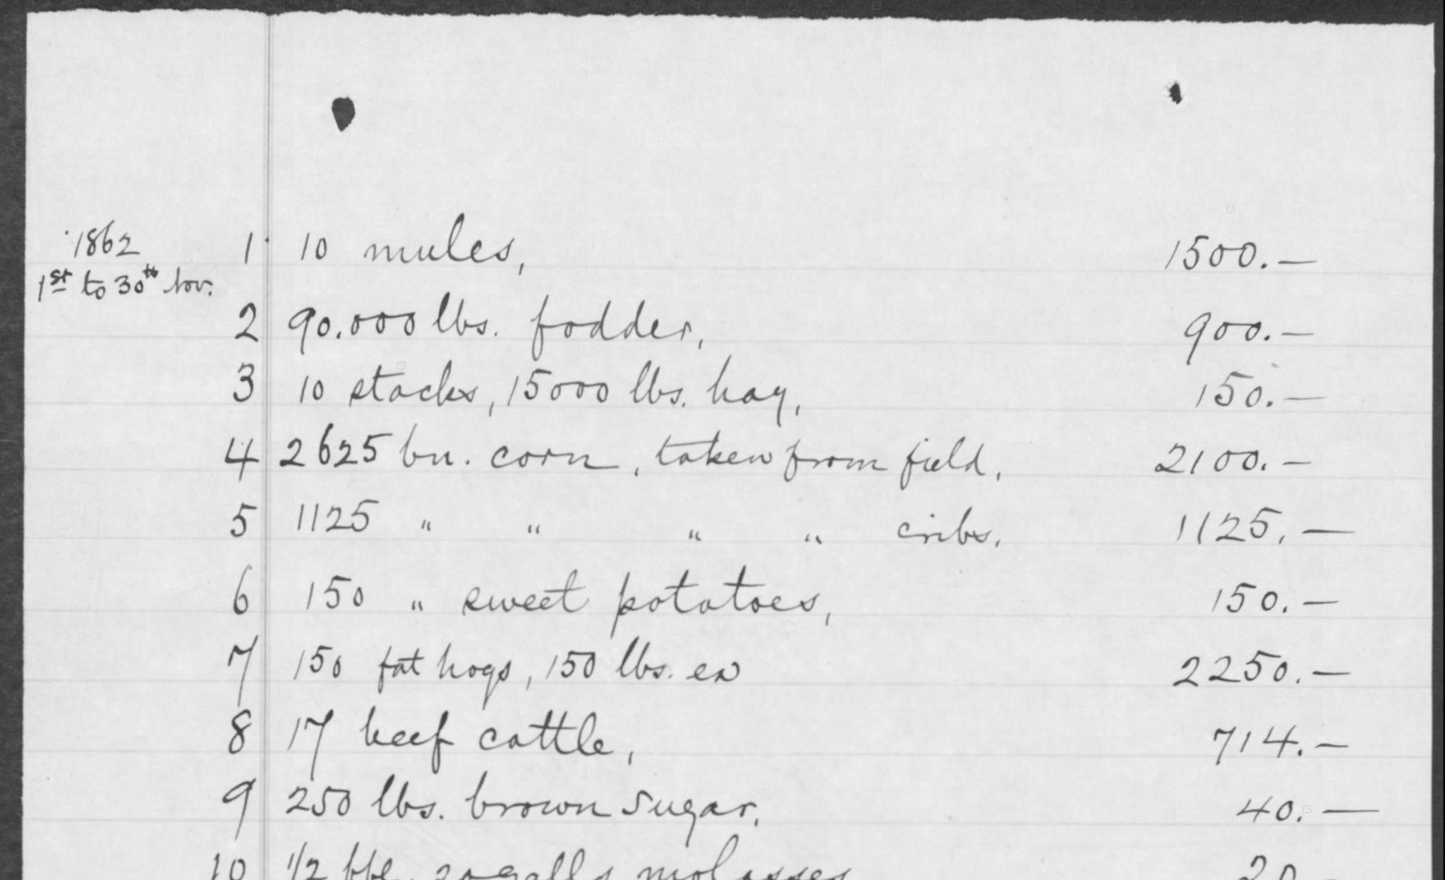

Slide 32
Cossitt’s Southern Claims Commission file
Testimony to the commission is about one-half of the file, about 160 pages.
Four witnesses testified:
F. D. Cossitt himself
Stephen A. Hurlbut, a Union general who commanded at La Grange and later was a member of Congress from Illinois
Edward M. Myrick, one of the overseers on Cossitt’s plantations
William Cossitt, a person who had been enslaved by Cossitt who described himself as Cossitt’s businessman or foreman

Slide 33
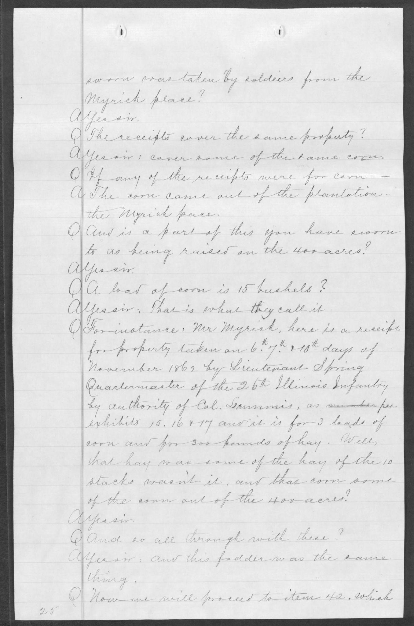

Slide 34
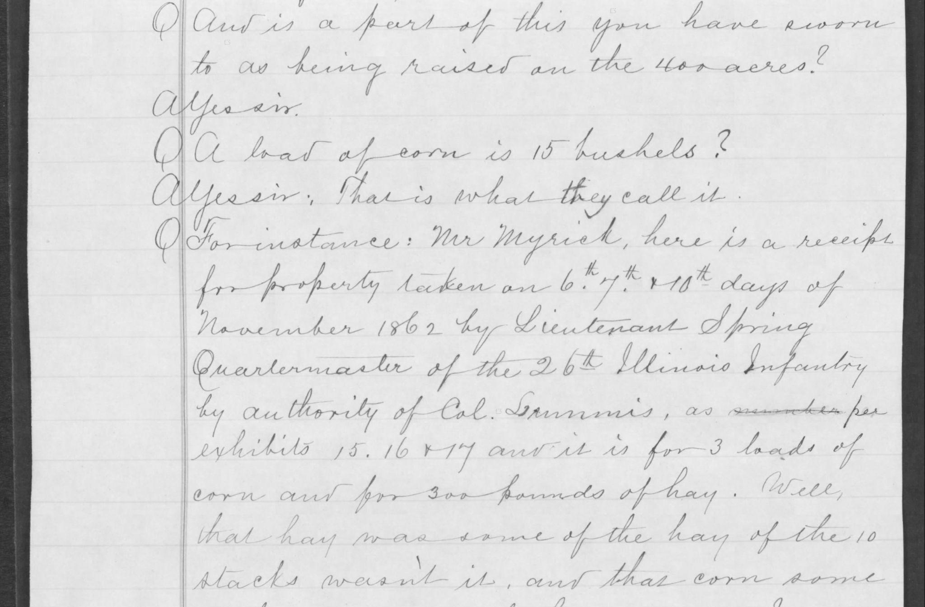

Slide 35
Cossitt’s Southern Claims Commission file
Cossitt’s testimony:
Q. Did you own slaves?
A.Yes sir—127 of them.
Q. What was the amount of your capital invested in them?
A. I hardly know. It was a general stock. I kept a little of everything.

Slide 36
Cossitt’s Southern Claims Commission file
Cossitt’s testimony:
[Speaking about the store he established in 1842 in La Grange, Tennessee:]
Q. What kind of store was it?
A. General stock. I kept a little of everything.

Slide 37
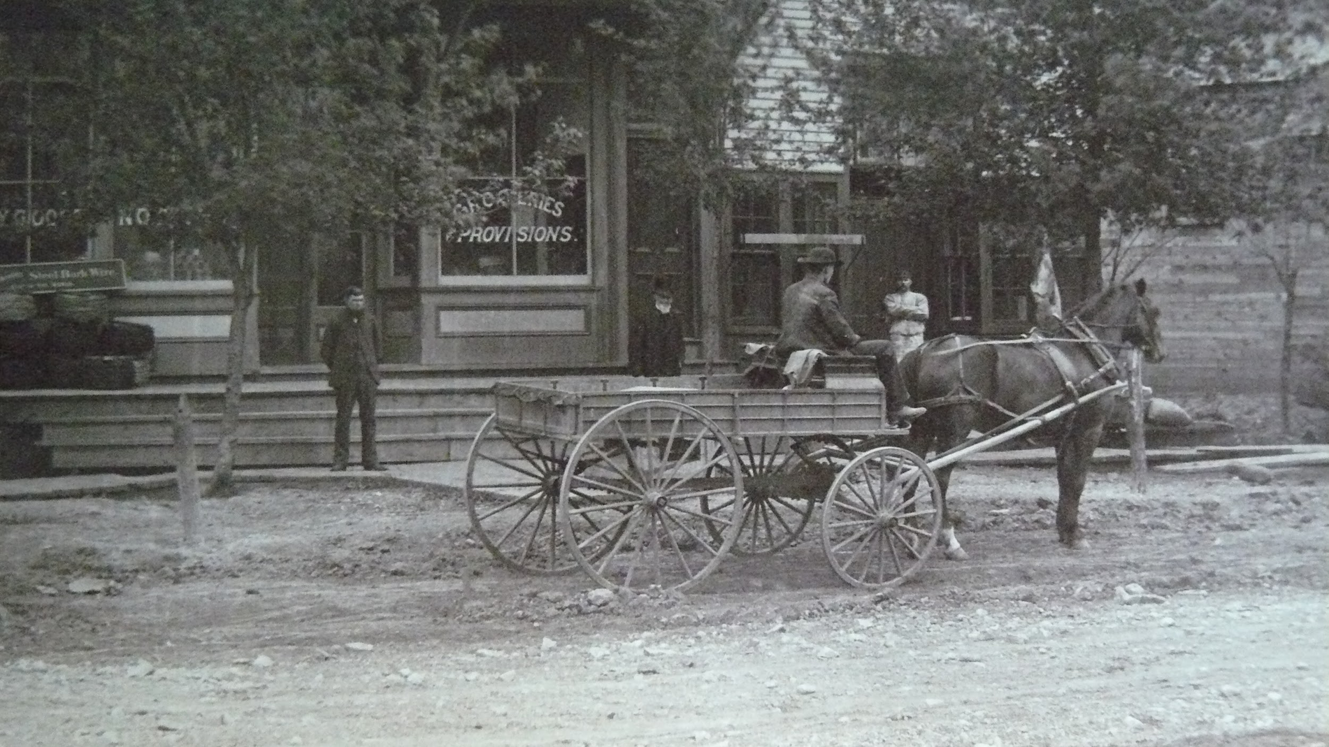

Slide 38
Cossitt’s Southern Claims Commission file
Cossitt’s testimony:
Q. Was your business very prosperous there?
A. Very.
Q. What property did you become the owner of there—state the whole thing.
I went on merchandizing & commenced buying land & negroes & planting.
…
Q. You have stated you had 127 slaves. What were they worth?
A. I suppose about a thousand dollars apiece at that time.

Slide 39
Cossitt’s Southern Claims Commission file
Tennessee Unionism
Q. Who did you vote for in 1860?
A. Bell & Everett.
Q. Were they considered Union men or secessionists in that part of the country?
A. Union men.
John Bell of Tennessee and Edward Everett of Massachusetts were the nominees of the the Constitutional Union Party in 1860, and won three states, including Tennessee, and 39 electoral votes.

Slide 40
Cossitt’s Southern Claims Commission file
Tennessee Unionism
Unionism (support for the Union and opposition to Southern secession) was more prevalent in East Tennessee than West Tennessee. In his testimony, Cossitt says his area in Southwest Tennessee near the Mississippi line was strongly secessionist.
However, he names several Union men who may have been afraid to identify themselves as such publicly.
Cossitt and other Union men opposed the burning of cotton, which the Confederates wanted to do so it would not fall into the hands of the Union army. Confederate troops burned 260-odd bales of Cossitt’s cotton, roughly 125,000 lbs. (worth more than $100,000).

Slide 41
Cossitt’s Southern Claims Commission file
Cossitt’s plantations:
The Myrick place (1,000 acres, 700 in cultivation)
The Urquhart place (1,650 acres, 1,000 in cultivation)
The Sykes place (800 acres, 400 in cultivation)
The Adams place (300 acres, 100 in cultivation)
Total: 3,750 acres, 2,200 in cultivation.
For reference, the Village of Oak Park, Illinois, is 4.7 square miles or 3,000 acres.

Slide 42
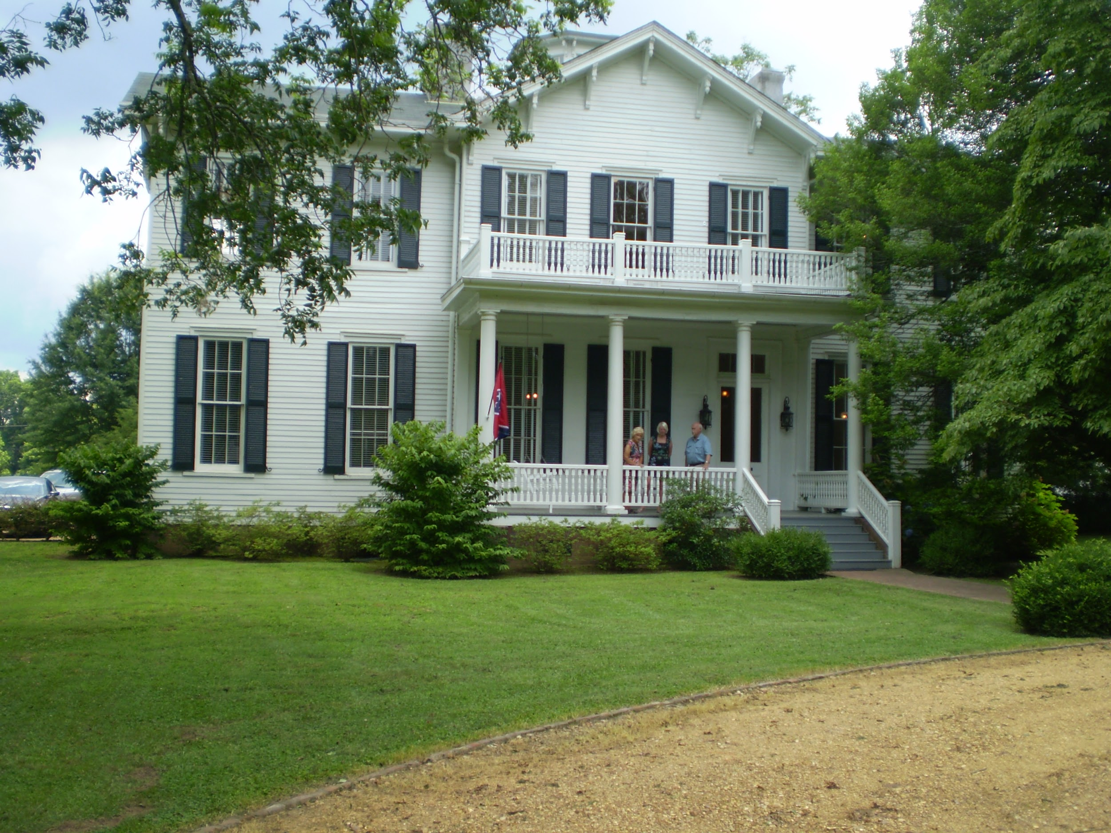

Slide 43
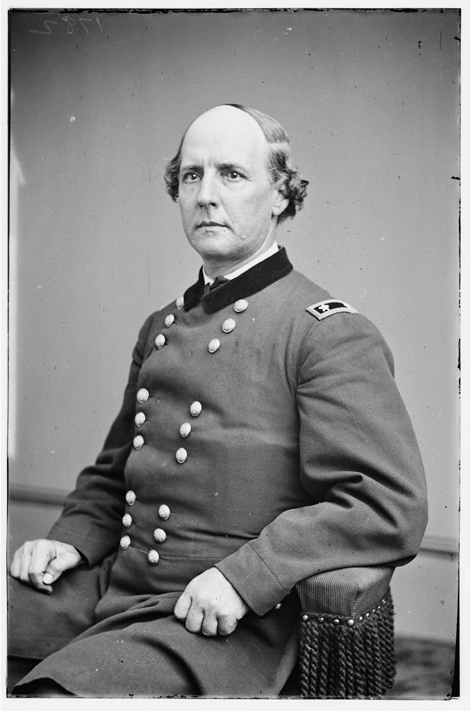

Slide 44
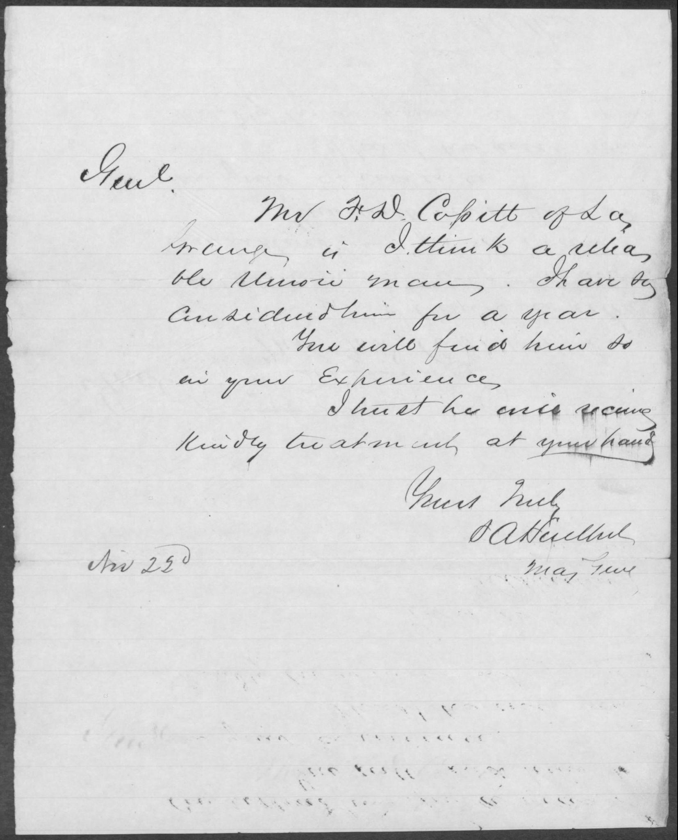
General S. A. Hurlbut letter on behalf of Cossitt
Genl.
Mr. F. D. Cossitt of La Grange is I think a reliable Union man. I have so considered him for a year.
You will find him so in your experience.
I trust he will receive kindly treatment at your hand.
Yours truly,
S. A. Hurlbut
Maj. Gen.
Nov. 23d [1862]

Slide 45
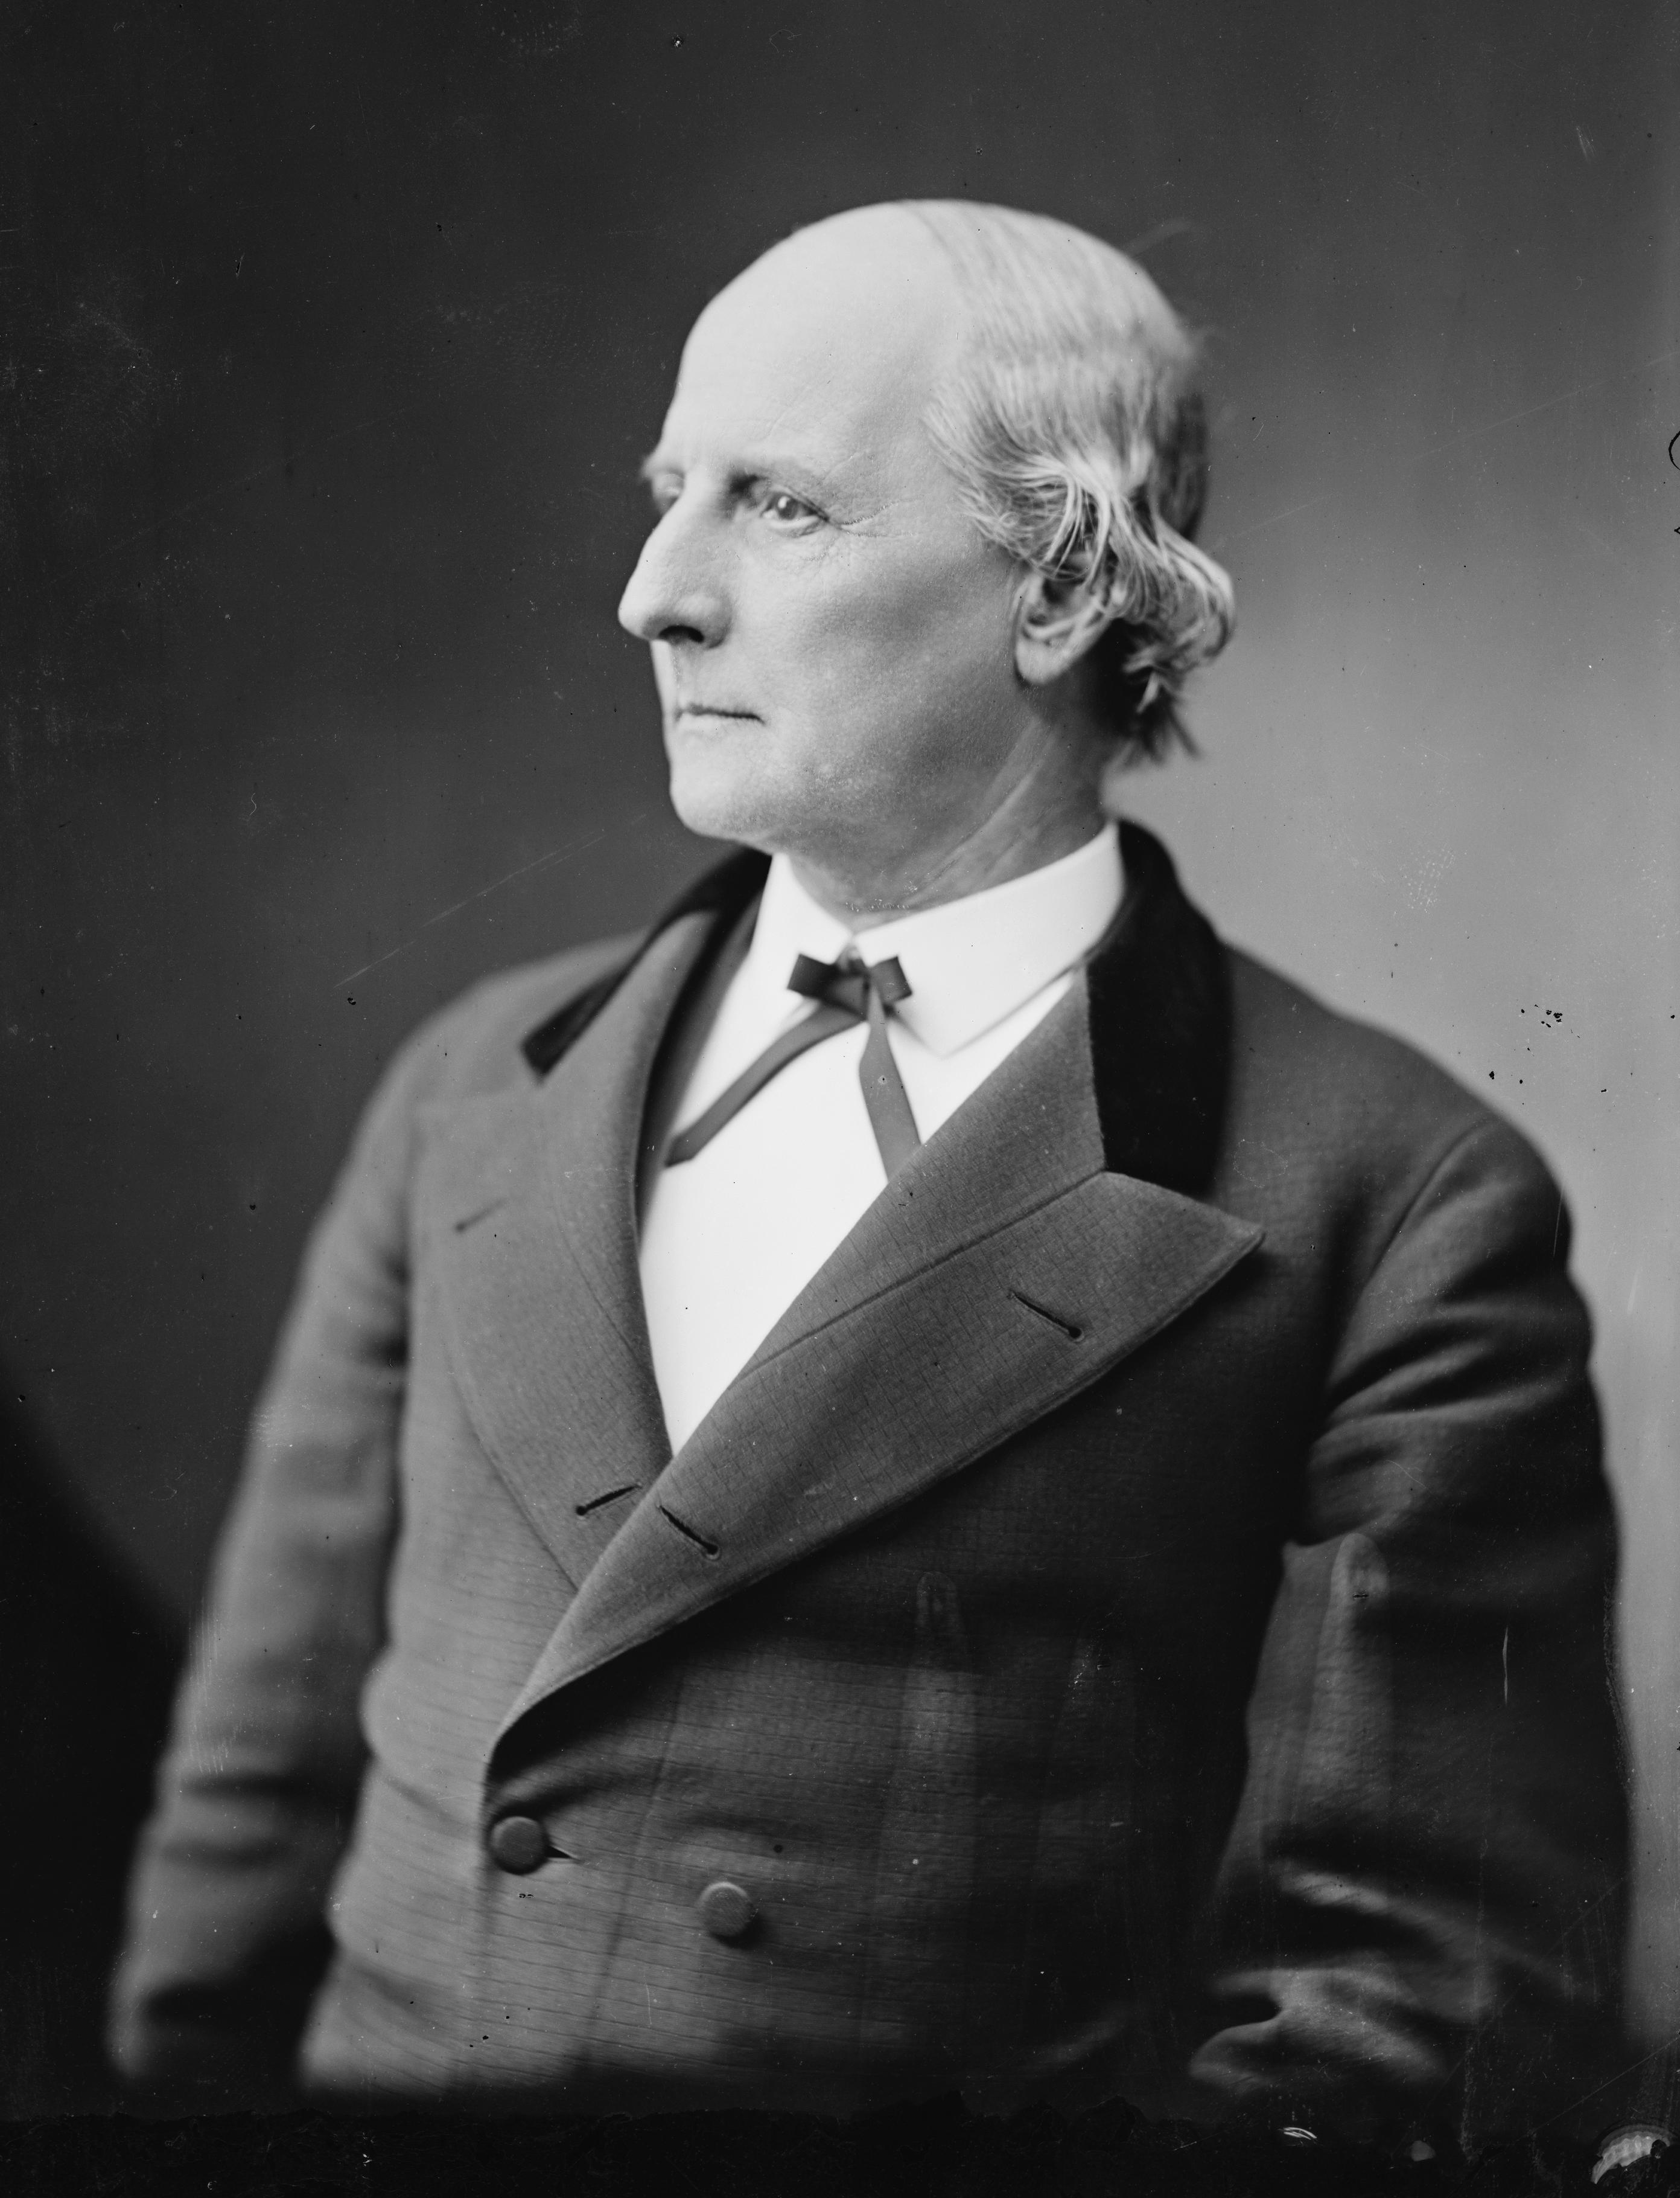

Slide 46
Cossitt’s Southern Claims Commission file
Stephen A. Hurlbut’s testimony
Q. Please state your means of knowledge as to his being a loyal or disloyal man to the US. gov’t.
A. Mr. Cossitt was among the first of the men in that region of country who came out openly & avowedly when the army came there, as a Union man & so declared himself at once to me & to my officers, & I found upon inquiry that he was so considered by the people there before we came. He was under a cloud. That section of Tennessee along the line of the Memphis & Charleston R.R. was bitterly secession. The region North of it, up above, was very much more divided in sentiment. From all the means of information I could get at that time (and it was my business to know) I was advised that he was distinguished as a Union man & has always been loyal to the gov’t….

Slide 47
Cossitt’s Southern Claims Commission file
Stephen A. Hurlbut’s testimony, continued
“….He gave us a great deal of important information, & his conduct was so marked by his known fidelity to the Union that when I was about to move on from La Grange to Memphis & there was no probability that the troops would be retained there, Mr Cossitt considered it necessary (and I have no doubt it was) for him to leave the country & he went, I think, immediately to Chicago—I would not be positive about that.
Q. In your judgement it would not have been safe for him to have remained?
A. No sir. They would have executed him, sure. He was about my headquarters a good deal & was known to give me information—important information too, & that connected with his marked career before, would have made it absolutely unsafe for him to have remained there. I do not think his life would have been worth a straw outside of the range that was covered by the US. troops. There are not a great many people in the South that I can vouch for as being essentially Union people, but I can for Mr. Cossitt.”

Slide 48
Cossitt’s Southern Claims Commission file
Edward M. Myrick’s testimony:
He was born about 1820. He testifies that he could not write. He was able to sign his name. In 1876, he was living on land bought from Cossitt, including the place on which he was overseer before the war. Much of his testimony involves his recollection about the taking of mules by the Union army in 1862. (The mules were worth $125 each.)
For more about men like Myrick, see Masterless Men: Poor Whites and Slavery in the Antebellum South by Keri Leigh Merritt (Cambridge, 2017).

Slide 49
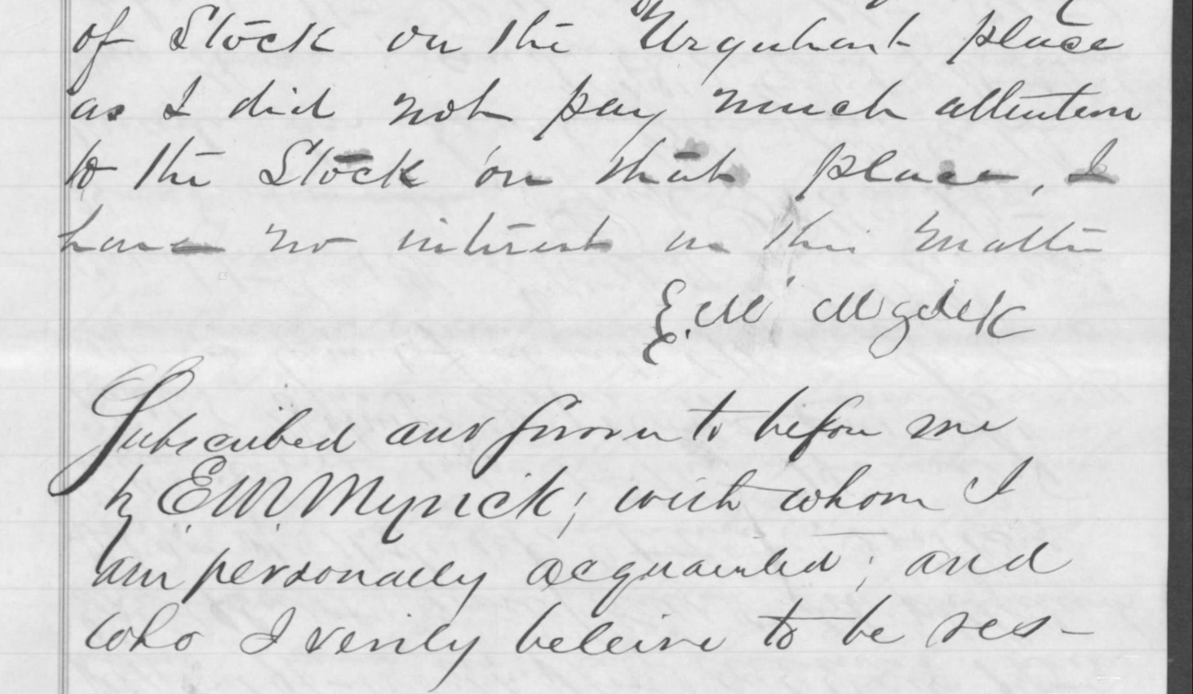

Slide 50
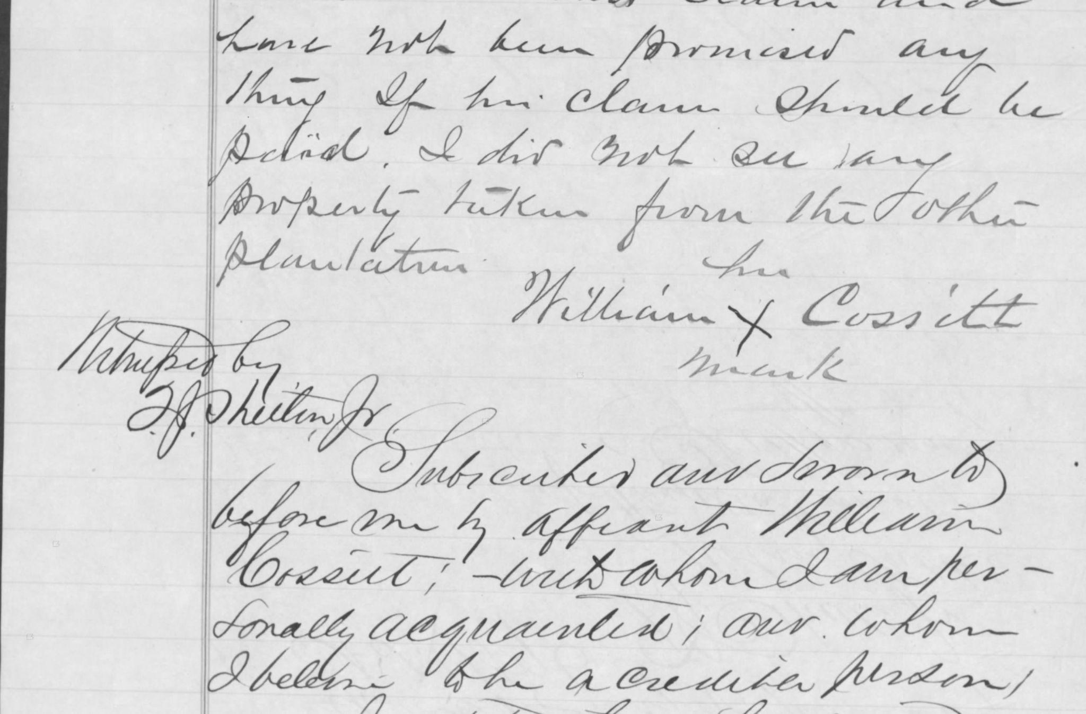

Slide 51
Cossitt’s Southern Claims Commission file
William Cossitt’s testimony:
He is referred to in affidavits and the transcript as William Cossitt (Colored).
His age in 1876 was 41 or 42 (“between that”). He was born in 1834 or 1835.
His first enslaver was Holer Hudgey. His second enslaver was Jack Bailey of Tennessee. Bailey sold him to F. D. Cossitt around 1846, when William was about 12 years old.
He lived on Cossitt’s Urquhart place since 1856.

Slide 52
Cossitt’s Southern Claims Commission file
William Cossitt’s testimony
Q. Did you hold any position or office on the plantation?
A. I attended to business for him.
Q. Were you overseer?
A. No sir: I was just what I call businessman—seed to everything.
Q. Did they ever call you foreman or anything?
A. Yes sir: I was a foreman.

Slide 53
Cossitt’s Southern Claims Commission file
William Cossitt’s testimony:
He cannot read or write. He has been married 10 or 12 years. He was married before the war.
He answers questions about the Urquhart plantation, how the soldiers used it, and what they took from it. He says he heard there were 40,000 troops there.
He says they had 52 hands on the Urquhart plantation, including 25 hoe hands (“Little chaps half grown some of them.”) Myrick interrupts his testimony to say there were 600 acres of corn on that plantation.

Slide 54
Cossitt’s Southern Claims Commission file
William Cossitt’s testimony
He testifies about the number of mules taken, when he saw them taken, who took them, and how many were taken (30). He says the soldiers did not leave a single mule.
He testifies about the number of hogs taken (250).
He says there were about 175 stock hogs left, which were not going to be killed.

Slide 55
Cossitt’s Southern Claims Commission file
William Cossitt’s testimony
Q. How do you know about these hogs? Did you take care of them?
A. Yes sir.
Q. You yourself took care of them?
A. Yes sir: I did. I attended to them every morning and every night.
Q. Did you feed them yourself?
A. Yes sir: I fed them myself.
Q. Didn’t you have other men to do the work for you?
A. Do the work for me! No sir, I fed them myself. I attended to them myself….

Slide 56
Cossitt’s Southern Claims Commission file
William Cossitt’s testimony
Q. How many cattle did you have in all there?
A. Ninety head of cattle in all.
Q. They haven’t got but 66 charged: what became of the rest?
A. Well, there was 90 head of cattle, that is sure.
Q. I should like to know how you could remember there was 90 head?
A. How can I remember? Well, I can remember that I have got my thumbs on to my hands.

Slide 57
Cossitt’s Southern Claims Commission file
William Cossitt’s testimony
Q. Well, it is a different thing about cows and cattle?
A. I had them there to attend to and I suppose that was my business and I was as regular to do it as you are to sit down here writing with your pen.
Q. Ninety head?
A. Yes sir: 90 head of cattle.
Q. Of course you didn’t count them, did you?
A. I expect I ought to have counted them to attend to my business if I had business to attend to.

Slide 58
Cossitt’s Southern Claims Commission file
William Cossitt’s testimony
Q. Now the question is this: I don’t want to deal unfairly with your memory but I still want to know how you came to remember.
A. Well, I kept it in my mind: if I does anything like that I keep it in my mind and once in a while I go back and look over it, what I done, as near as I can, but I ain’t been doing it regularly like I used to do it. When I was tending to business I kept all these things perfect in my mind so that I should not be bothered. After I laid down nights I would be studying over it….

Slide 59
Cossitt’s Southern Claims Commission file
William Cossitt’s testimony
Q. Were any of Mr. Cossitt’s servants in the Union army?
A. Yes sir: nearly all of them.
Q. Did he ever try to prevent them?
A. No sir. He told me it would happen five years before it happened. I told him it would not be so. He told me I would be free after a while. I told him no it would not be so. I told him I didn’t expect to live to see it, and he said if you die it will be so anyhow, and you will come see the day that your children and my children will play together. He told me that five years before, but I didn’t believe it.

Slide 60
Cossitt’s Southern Claims Commission file
From the summary of the claim, regarding the number of mules:
“Myrick testifies that once on the road he met 22 mules of claimant’s that had been taken from the Urquhart place & that with 10 taken from Myrick’s wd. leave just the 32…. It may be doubted whether Myrick would distinguish between mules from Urquhart’s or the other plantations.—
“Wm. Cossitt’s testimony that they took 30 in all from the Urquhart place is testimony as to numbers, in which respect we cannot much rely on colored men’s testimony after so long a lapse of time.—”

Slide 61
Defying Archival Silence
The La Grange Area Historical Society has a copy of Cossitt’s Southern Claims Commission file on CD-ROM. The resistance of the historical society generally and descendants of Cossitt’s particularly to address, explore, and wrestle with Cossitt’s role as an enslaver creates archival silence, and does not help address the substantial archival silence that exists around La Grange’s (and the United States’) African American history. Cossitt’s fortune was made with stolen African American labor. I have found no evidence he ever saw anything wrong with cotton planting as a way of making money, though he apparently recognized in the 1850s that slavery would end soon, and that African American children and white children would someday play together.

Slide 62
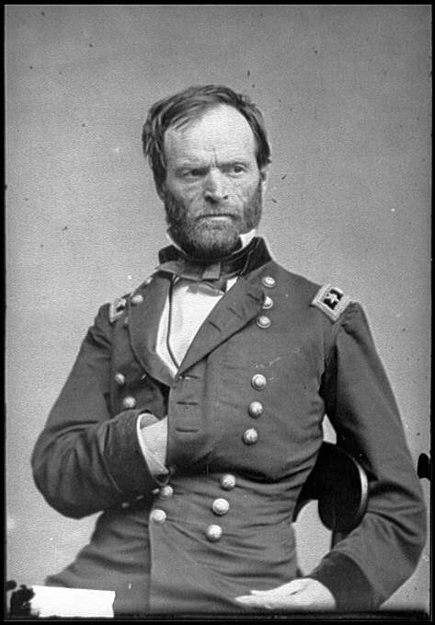

Slide 63
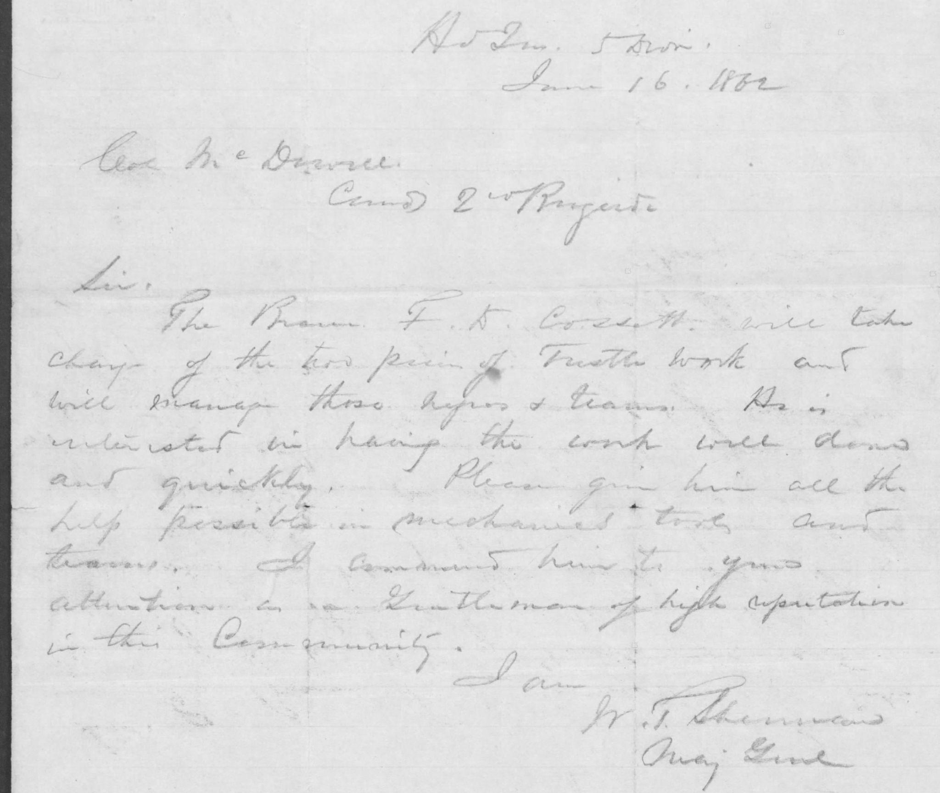
Gen. William T. Sherman letter about Cossitt
HdQrs, 5th Divn
June 16, 1862
Gen McDivitt [?], Comd 2nd Regiment [?]
Sir,
The Bearer F. D. Cossitt will take charge of the two [?] of trestle work and will manage those negroes and teams. He is interested in having the work well done and quickly. Please give him all the help possible in mechanical tools and teams. I commend him to your attention as a Gentleman of high reputation in this Community.
I am
W. T. Sherman
Maj. Genl

Slide 65
125 people enslaved by F. D. Cossitt listed on the Slave Schedule of the 1860 United States Census.
1. Man, age 35, Black, born ~1825.
2. Girl, age 10, Black, born ~1850.
3. Boy, age 11, Black, born ~1849.
4. Woman, age 30, Black, born ~1830.
5. Girl, age 5, Black, born ~1855.

Slide 66
125 people enslaved by F. D. Cossitt listed on the Slave Schedule of the 1860 United States Census.
6. Woman, age 32, Black, born ~1828.
7. Man, age 42, Black, born ~1818.
8. Boy, age 12, Black, born ~1848.
9. Woman, age 40, Black, born ~1820.
10. Woman, age 50, Black, born ~1810.

Slide 67
125 people enslaved by F. D. Cossitt listed on the Slave Schedule of the 1860 United States Census.
11. Man, age 40, Black, born ~1820.
12. Woman, age 30, Black, born ~1830.
13. Girl, age 7, Black, born ~1853.
14. Girl, age 6, Black, born ~1854.
15. Man, age 20, Black, born ~1840.

Slide 68
125 people enslaved by F. D. Cossitt listed on the Slave Schedule of the 1860 United States Census.
16. Man, age 40, Black, born ~1820.
17. Boy, age 10, Black, born ~1850.
18. Woman, age 70, Black, born ~1790.
19. Girl, age 10, Black, born ~1850.
20. Girl, age 4, Black, born ~1856.

Slide 69
125 people enslaved by F. D. Cossitt listed on the Slave Schedule of the 1860 United States Census.
21. Male infant, age 2 months, Black, born ~1859.
22. Woman, age 30, Black, born ~1830.
23. Man, age 42, Black, born ~1818.
24. Man, age 42, Black, born ~1818.
25. Man, age 18, Black, born ~1842.

Slide 70
125 people enslaved by F. D. Cossitt listed on the Slave Schedule of the 1860 United States Census.
26. Male baby, age 2, Black, born ~1858.
27. Woman, age 30, Black, born ~1830.
28. Woman, age 20, Black, born ~1840.
29. Man, age 20, Black, born ~1840.
30. Boy, age 14, Black, born ~1846.

Slide 71
125 people enslaved by F. D. Cossitt listed on the Slave Schedule of the 1860 United States Census.
31. Girl, age 10, Black, born ~1850.
32. Female baby, age 1, Black, born ~1859.
33. Man, age 19, Black, born ~1841.
34. Man, age 40, Black, born ~1820.
35. Man, age 40, Black, born ~1820.

Slide 72
125 people enslaved by F. D. Cossitt listed on the Slave Schedule of the 1860 United States Census.
36. Man, age 30, Black, born ~1830.
37. Girl or woman, age illegible, Black.
38. Girl, age 8, Black, born ~1852.
39. Man, age 60, Black, born ~1800.
40. Boy, age 10, Black, born ~1850.

Slide 73
125 people enslaved by F. D. Cossitt listed on the Slave Schedule of the 1860 United States Census.
41. Woman, age 40, Black, born ~1820.
42. Man, age 18, Black, born ~1842.
43. Woman, age 20, Black, born ~1840.
44. Woman, age 20, Black, born ~1840.
45. Man, age 20, Black, born ~1840.

Slide 74
125 people enslaved by F. D. Cossitt listed on the Slave Schedule of the 1860 United States Census.
46. Woman, age 40, Black, born ~1820.
47. Woman, age 20, Black, born ~1840.
48. Female baby, age 2, Black, born ~1858.
49. Female baby, age 1, Black, born ~1859.
50. Male infant, age 3 months, Black, born ~1860.

Slide 75
125 people enslaved by F. D. Cossitt listed on the Slave Schedule of the 1860 United States Census.
51. Boy, age 10, Black, born ~1850.
52. Male baby, age 1, Black, born ~1859.
53. Boy, age 10, Black, born ~1850.
54. Man, age 45, Black, born ~1815.
55. Man, age 70, Black, born ~1790.

Slide 76
125 people enslaved by F. D. Cossitt listed on the Slave Schedule of the 1860 United States Census.
56. Boy, age 12, Black, born ~1848.
57. Female infant, age 2 months, Mulatto, born ~1860.
58. Girl, age 10, Black, born ~1850.
59. Man, age 18, Black, born ~1842.
60. Male baby, age 3, Black, born ~1857.

Slide 77
125 people enslaved by F. D. Cossitt listed on the Slave Schedule of the 1860 United States Census.
61. Woman, age 20, Black, born ~1840.
62. Woman, age 18, Mulatto, born ~1842.
63. Male baby, age 2, Black, born ~1858.
64. Woman, age 20, Black, born ~1840.
65. Woman, age 20, Black, born ~1840.

Slide 78
125 people enslaved by F. D. Cossitt listed on the Slave Schedule of the 1860 United States Census.
66. Man, age 40, Black, born ~1820.
67. Man, age 30, Black, born ~1830.
68. Woman, age 30, Black, born ~1830.
69. Woman, age 18, Mulatto, born ~1842.
70. Female infant, age 6 months, Mulatto, born ~1859.

Slide 79
125 people enslaved by F. D. Cossitt listed on the Slave Schedule of the 1860 United States Census.
71. Male baby, age 1, Black, born ~1859.
72. Woman, age 40, Black, born ~1820.
73. Woman, age 50, Black, born ~1810.
74. Woman, age 40, Black, born ~1820.
75. Man, age 30, Black, born ~1830.

Slide 80
125 people enslaved by F. D. Cossitt listed on the Slave Schedule of the 1860 United States Census.
76. Boy, age 15, Black, born ~1845.
77. Girl, age 12, Black, born ~1848.
78. Male baby, age 2, Black, born ~1858.
79. Woman, age 20, Black, born ~1840.
80. Woman, age 19, Mulatto, born ~1841.

Slide 81
125 people enslaved by F. D. Cossitt listed on the Slave Schedule of the 1860 United States Census.
81. Man, age 50, Mulatto, born ~1810.
82. Boy, age 16, Black, born ~1844.
83. Male baby, age 3, Black, born ~1857.
84. Woman, age 30, Black, born ~1830.
85. Man, age 40, Black, born ~1820.

Slide 82
125 people enslaved by F. D. Cossitt listed on the Slave Schedule of the 1860 United States Census.
86. Man, age 40, Black, born ~1820.
87. Man, age 30, Black, born ~1830.
88. Man, age 19, Black, born ~1841.
89. Male baby, age 3, Black, born ~1857.
90. Male infant, age 1 month, Black, born ~1860.

Slide 83
125 people enslaved by F. D. Cossitt listed on the Slave Schedule of the 1860 United States Census.
91. Man, age 42, Black, born ~1818.
92. Man, age 20, Black, born ~1820.
93. Man, age 80, Black, born ~1780.
94. Man, age 30, Black, born ~1830.
95. Male baby, age 2, Black, born ~1858.

Slide 84
125 people enslaved by F. D. Cossitt listed on the Slave Schedule of the 1860 United States Census.
96. Male infant, age 6 months, Black, born ~1859.
97. Woman, age 40, Black, born ~1820.
98. Male baby, age 1, Black, born ~1859.
99. Woman, age 18, Black, born ~1842.
100. Man, age 25, Black, born ~1835.*
*Possibly William Cossitt.

Slide 85
125 people enslaved by F. D. Cossitt listed on the Slave Schedule of the 1860 United States Census.
101. Woman, age 38, Black, born ~1822.
102. Girl, age 12, Black, born ~1848.
103. Man, age 48, Black, born ~1812.
104. Man, age 36, Black, born ~1824.
105. Girl, age 12, Black, born ~1848.

Slide 86
125 people enslaved by F. D. Cossitt listed on the Slave Schedule of the 1860 United States Census.
106. Man, age 26, Black, born ~1834.
107. Man, age 23, Black, born ~1837.
108. Woman, age 38, Black, born ~1822.
109. Man, age 33, Black, born ~1827.
110. Woman, age 20, Black, born ~1840.

Slide 87
125 people enslaved by F. D. Cossitt listed on the Slave Schedule of the 1860 United States Census.
111. Girl, age 11, Black, born ~1849.
112. Female baby, age 3, Black, born ~1857.
113. Woman, age 18, Black, born ~1842.
114. Girl, age 12, Black, born ~1848.
115. Woman, age 28, Black, born ~1832.

Slide 88
125 people enslaved by F. D. Cossitt listed on the Slave Schedule of the 1860 United States Census.
116. Girl, age 15, Black, born ~1845.
117. Woman, age 43, Black, born ~1817.
118. Woman, age 50, Black, born ~1810.
119. Man, age 24, Black, born ~1836.
120. Girl, age 13, Black, born ~1847.

Slide 89
125 people enslaved by F. D. Cossitt listed on the Slave Schedule of the 1860 United States Census.
121. Man, age 26, Black, born ~1834.
122. Man, age 50, Black, born ~1810.
123. Male baby, age 3, Mulatto, born ~1857.
124. Girl, age 8, Black, born ~1852.
125. Boy, age 6, Black, born ~1854.

Slide 90
Recommended reading:
On the economics of slavery in the United States:
Lee Soltow, 1975. Men and Wealth in the United States, 1850-1870. New Haven: Yale University Press.
Samuel H. Williamson & Louis P. Cain, "Measuring Slavery in 2020 dollars," MeasuringWorth, 2022.
On the mentality of enslavers:
James O. Breeden, 1980. Advice Among Masters: The Ideal in Slave Management in the Old South. Westport, Conn.: Greenwood Press.

Slide 91
Archival Traces of a Tennessee Unionist Enslaver Who Founded a Chicago Suburb
Thanks to: Tom Hayden, Chuck Brand, David Wallace, Sarah Parkes, La Grange Area Historical Society, Tennessee Historical Society, Newberry Library.

Slide 92
Archival Traces of a Tennessee Unionist Enslaver Who Founded a Chicago Suburb
Kheir Fakhreldin
kfakhreldin@oppl.org
Oak Park Public Library
Midwest Archives Conference
Moving Archives Forward
May 6, 2022

