Slide 1
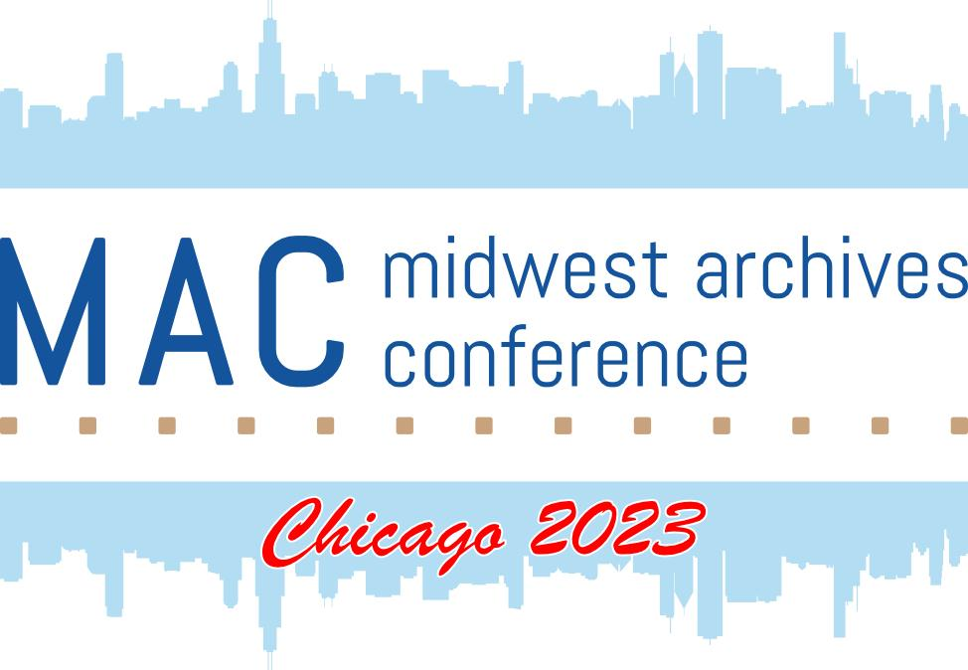
s303
One Foot in Both Worlds: The Challenges of Working Across Departments and Meeting Our Goals
DIG DEEP
Midwest Archives Conference annual meeting

Slide 2
One Foot in Both Worlds: The Challenges of Working Across Departments and Meeting Our Goals
Jennifer Motszko, Head of Archives
Melanie Jones, Archives & First Year Experience Librarian Autumn Oakey, Library Assistant
Notes:
Welcome everyone. I’m Jennifer Motszko and these are my two colleagues Melanie Jones and Autumn Oakey. We will each introduce ourselves during our sections. We are here to talk about the challenges of working cross-departmentally and trying to meet our goals. Each of us has a position where we spend some of our time doing archival work and some time, well, doing everything else.

Slide 3

Outline
Overview of UW-Whitewater Library & Archives
Job descriptions/challenges
Solutions
Benefits

Slide 4

UW-Whitewater Libraries
Downturn in enrollment
Addition of second library
Decrease in staff
Notes:
How did we get here?
After an all-time record enrollment in 2016 (roughly 12,500 students), the University of Wisconsin-Whitewater enrollment has been on a decline. Additionally, the university was asked to spend the 9 million dollars in reserve funds that the university had been saving for a rainy day.. So, that means less revenue coming in and less ability to cover funding issues.
At the same time - UW System broke apart the UW Colleges system, which oversaw two year colleges and gifted most UW-Universities with a two college campus. That gave UW-W a second library in another city
Beginning in 2019, we had a number of retirements in the library and, in an effort to retain staff with a decreasing budget, the library lost 6 full time position. All were unfilled at the time - that decreased the library staff by almost 25%
Addition of UW-W Rock County Campus (secondary library location)
Downturn in enrollment starting in 2017 and loss of reserves
Decrease in staffing beginning in 2019
Decrease in staffing (beginning in 2019), retirements &

Slide 5



UW-Whitewater Archives
University Archives, Special Collections, and Area Research Center
Serve internal and external researchers
Run records management and disposition for campus
Notes:
-working towards an overall organizational change in the library where almost everyone in the library now works in either reference or circulation in addition to their other job duties
-Things that got dropped as my responsibilities changed
digital repository
Staffing changes
2 FTE (2018)
1 FTE (2020)
1.5 FTE (2021)
2.25 FTE (2022)
4-6 student employees (20-30 hrs/week)
1-2 student interns (8 hrs/week)

Slide 6
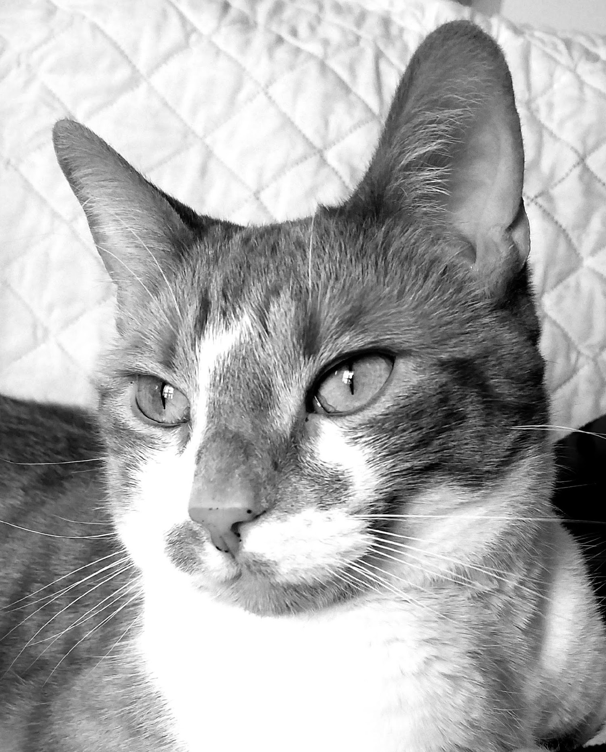
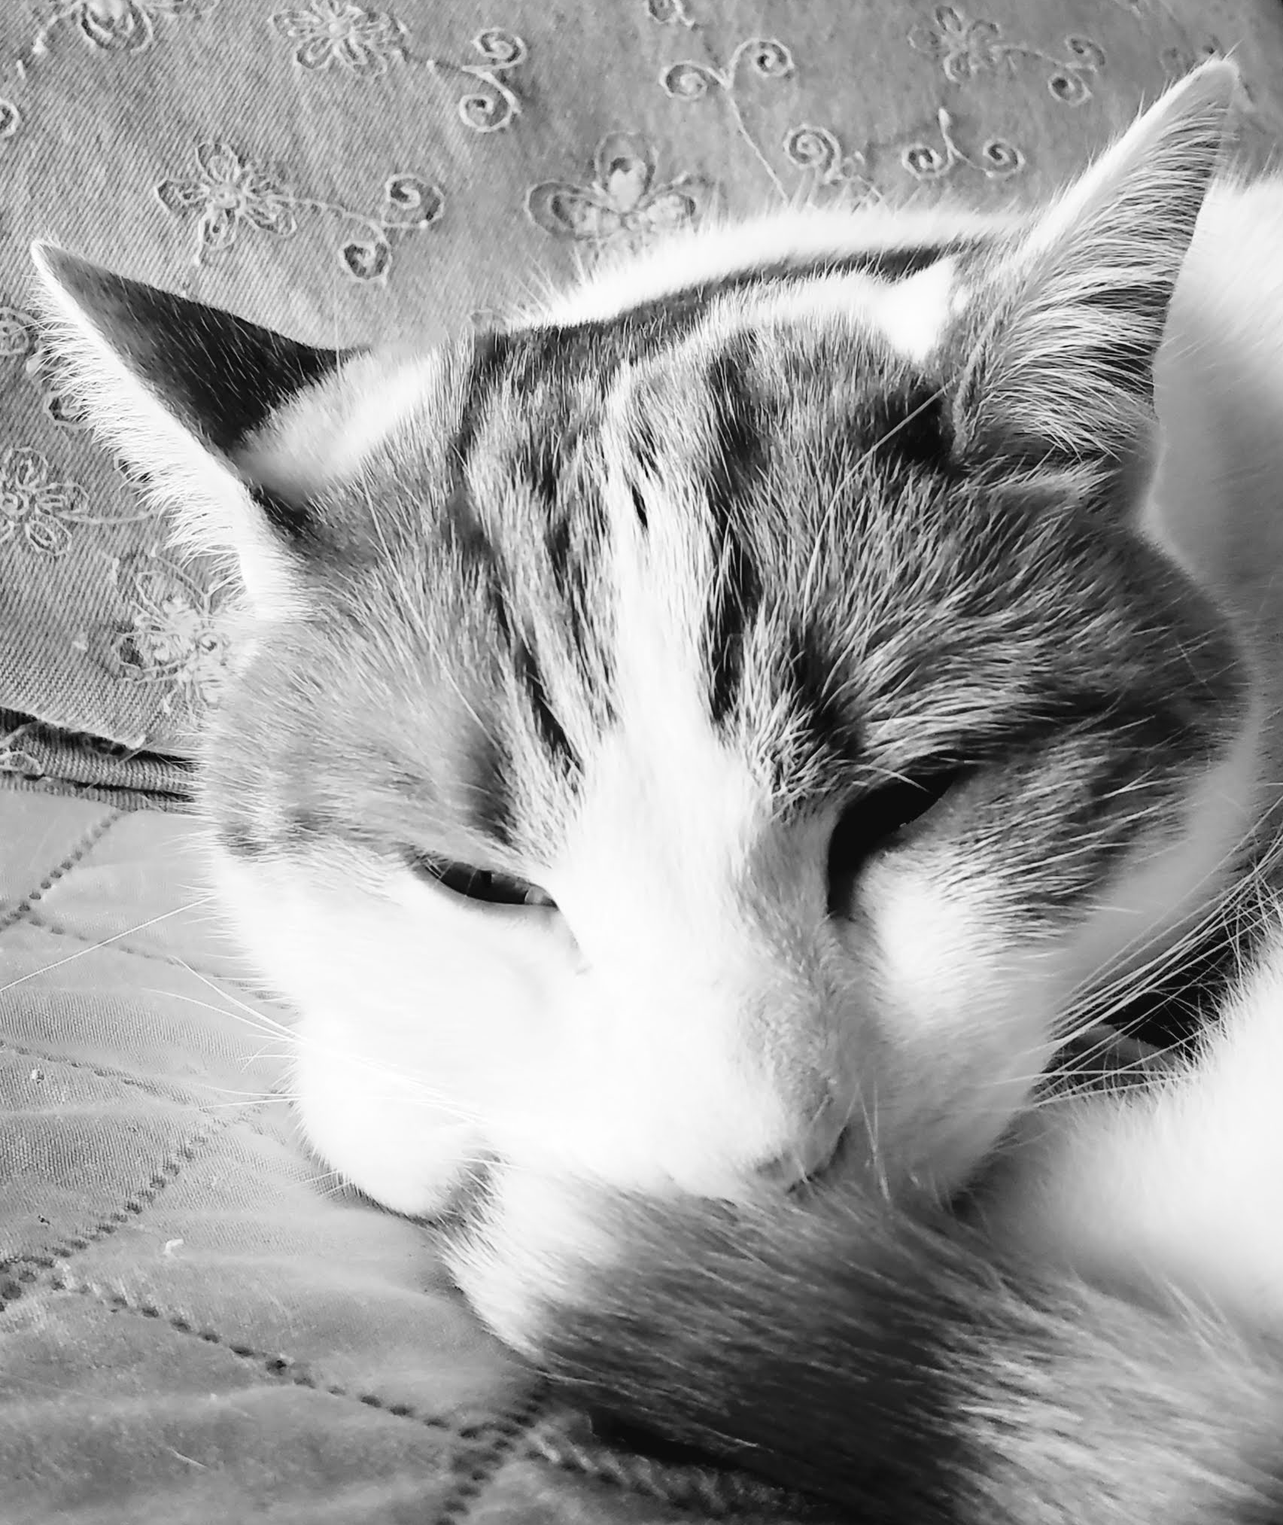
Jennifer Motszko
2018
Started at UW-Whitewater
Head Archives
  supervise staff/students
Records Officer
Digital Repository
Teach primary source literacy classes
2020
Liaison to History Department
Access to Archives
Notes:
11 years of experience prior to arrival in
2018
First full-time archivist at UW-W
Hired to oversee archives, records management program, digital repository, primary source literacy classes
Rolls changed to include liaison to History Dept, teaching info lit. classes and research assistance to students

Slide 7

Challenges as a manager
Moving projects forward
Advocating for/balancing workload of staff
Consistent communication with staff
Communicating needs to other supervisors
Setting priorities within department
Notes:
As a manager

Slide 8








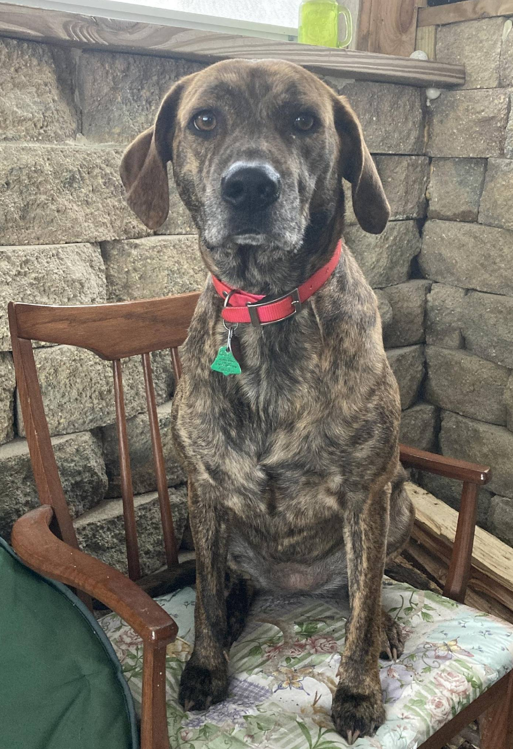
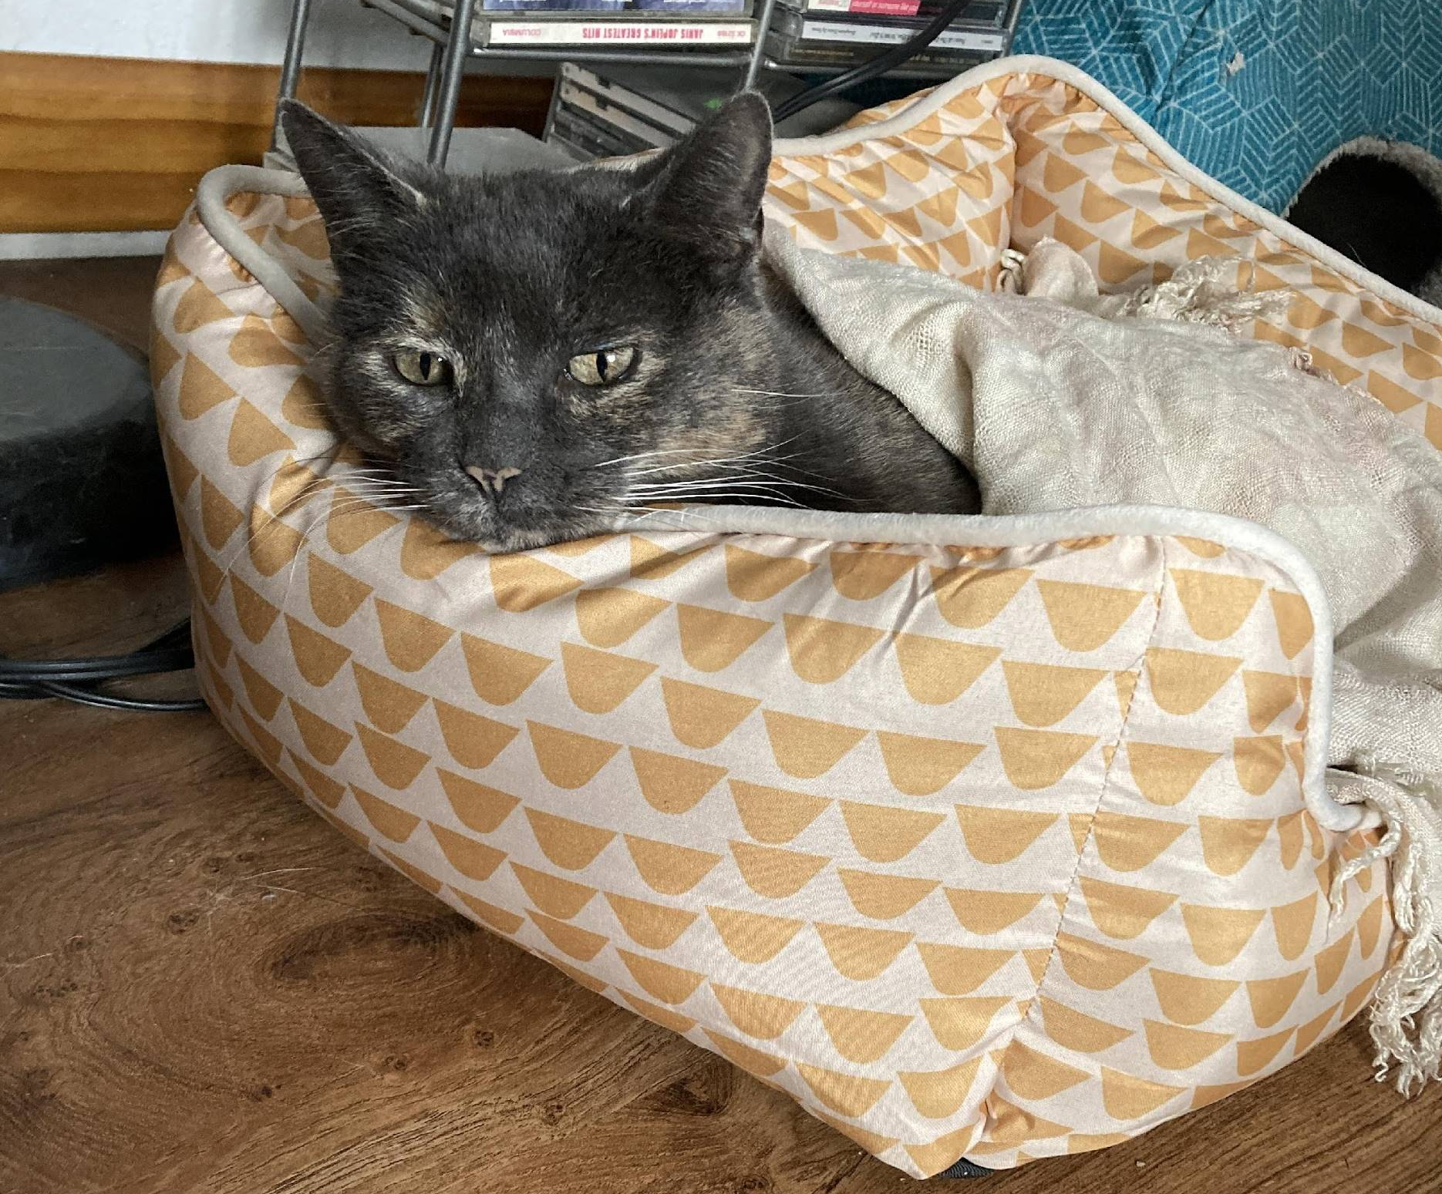
Autumn Oakey
January 2021
June 2021
July 2022
September 2022
Undergraduate intern at UWW UA-ARC
Library Assistant at UWW Andersen Library
Library Assistant at UWW Rock County campus
Graduate Student at UW-Milwaukee
Notes:
45 seconds

Slide 9




Challenge of Rock County/Archives position
UW-W Main Campus
UW-W-Rock County Campus
Juggling
Distance
Technology
Experience
Notes:
(5 minutes)
Juggling 1 minute
Distance 1 minute
Technology 1 minute
Experience 45 seconds

Slide 10






Communication Challenges
Developing communication style
Communicating projects between supervisors
Busy schedules
Gaps in communication
Notes:
(3 minutes)
Developing communication style (1 minute)
Communicating between supervisors and departments (1 minute)
Busy schedule (30-45 seconds)
Gaps in communication (30-45 seconds)

Slide 11
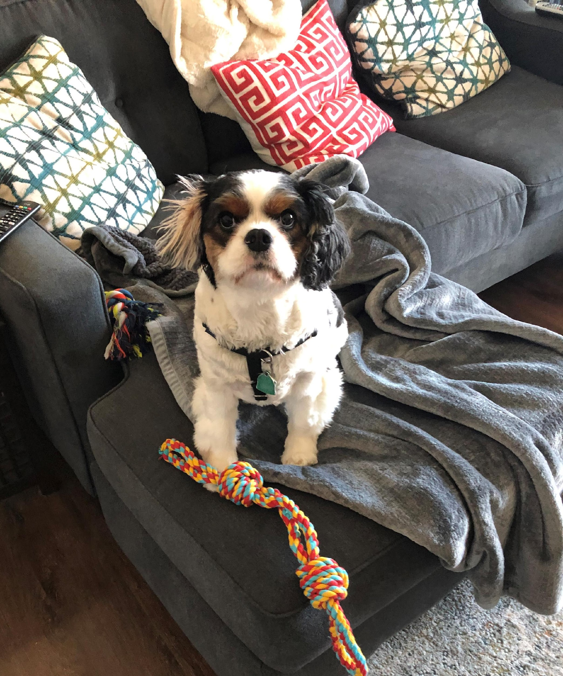
Melanie Jones
Started Summer 2022
Part-time Archivist
  Research Assistance
  Assist with Projects
Part-time Librarian
  Staff Reference Desk
  First Year Experience Liaison
  Communication Dept. Liaison
Notes:
Before starting at UW-W, 3 years as reference librarian at Lakeland University, but I had done a number of internships at archives while in college and getting my master’s degree and missed the work.
Started this job in Summer 2022 that was a good fit for my interests where I work part time as an archivist and part time as a reference librarian.
Archivist: Help with research assistance for both the university (students, administrative) and general public (genealogists, etc.)
Librarian: Staff reference desk, serve as FYE and Comm Dept. liaison in which I instruct many NSS library visits and comm/journalism classes

Slide 12
Balancing Act Challenges
Archive & ARC
Reference & Instruction
Notes:
Think of my role as a balancing act. Not a strictly half and half balance – some days/weeks/events/questions prevail or outweigh the other. Not always going to be an equal distribution.
Examples: Normally scheduled for 5 hours a week staffing the library’s reference desk – some weeks that doubles to about 10 depending on staff availability – heavy instruction times for instance.
School Year ebbs and flows really dictate this balance as well – as FYE Librarian, naturally early fall is going to be busier, responsible for coordinating and instructing many NSS library visits
Homecoming – shifts back to focusing on archival exhibits, tours, etc. once the heavy tide of beginning of school year and NSS start to slow down

Slide 13


Communication Between Departments
Archive
Virtual
Smaller Dept.
Lateral
Ad hoc Procedures
Reference
In Person
Larger Dept.
Structured
Established Procedures
Notes:
The two departments in which I work have at times vastly different communication styles and preferences
Starting with our communication:
Due to our working on separate floors and separate campuses, our communication tends to be virtual – online meetings, chats, emails, etc.
We are a smaller department with just the three of us and so that leads us to naturally having a more lateral communication structure
Due to the above, we are coming up with procedures as we figure out what works best for us.
Reference Dept. Communication:
In Person – I work in the same hallway as most other R & I librarians and so I can discuss things in person just next door or at our weekly meetings held in person (thought virtual option)
It is a larger department (6-7 R & I librarians with a few other librarians joining in to staff reference desk and attend meetings
Due to the larger department, the communication is often more structured and formal in nature
Because it is larger and longer established dept (some librarians have been here in dept. for 20 + years) there are long-standing procedures

Slide 14

Reference
Records Officer
Head of Archives
Student Supervision
Resource Sharing/ILL
Instruction
MJ
JM
AO
First-Year Experience
MLIS Student
Student Supervision
External
Boards
Archives
Archives
History Liaison
R&I
Digitization/Metadata
Assist with interns/students
Digitization/Metadata
Reference
Instruction
Records
Management
Rock County

Slide 15

Solutions
Understanding library priorities
  Doors open
  Instruction
  Research/Reference
Fabulous communication
  Regular departmental meetings
  Shared calendars
  Shared chat
  Creating procedures
  Improved Statistics

Slide 16

Benefits
Outreach
  Archivist at UW-W Rock
  Allows for more external exhibits/tours
  Versatility
  Less siloed
Notes:
1.Autumn - – develop archives/RM program
2.Melanie
3.Jennifer nimbleness/adaptable/multi-talented – varied skillset
4.Melanie – communication among departments/campuses

Slide 17



Value of Varying Levels of Experience
Training on the job for beginners
Fresh perspectives from newer professionals
Education both up and down
Relationships among generations of archives professionals
Beginner
Intermediate
Advanced

Slide 18
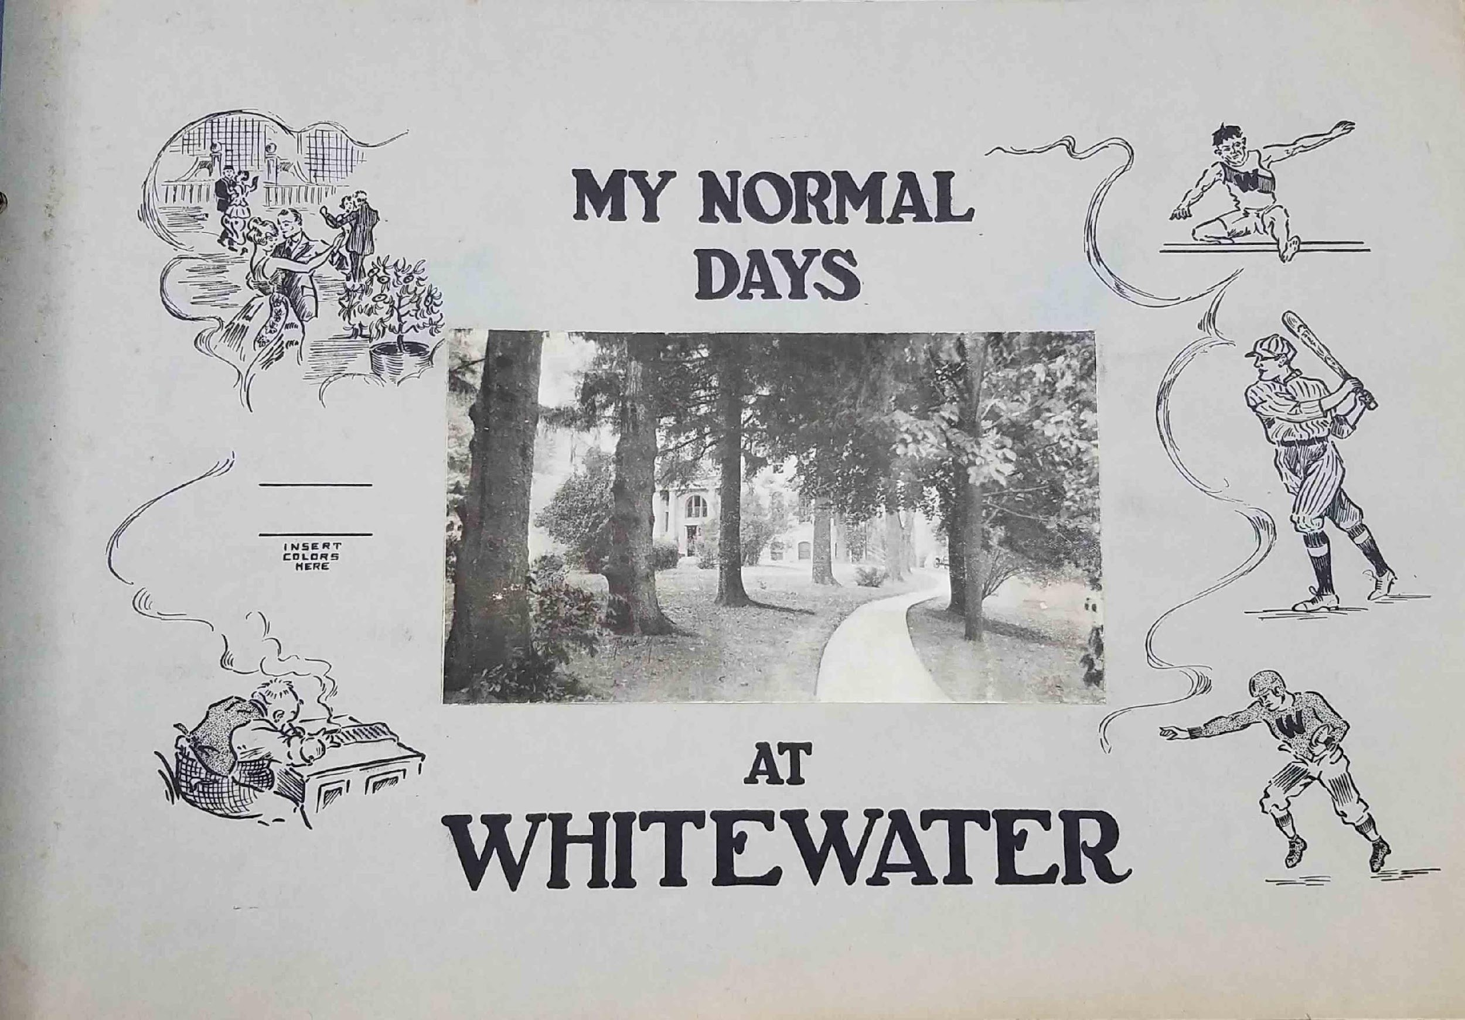
Questions?

Slide 19
Contact Us
Jennifer Motszko – motszkoj@uww.edu
Melanie Jones – jonesme@uww.edu
Autumn Oakey – oakeyaf13@uww.edu
https://www.uww.edu/library/archives
262-472-5520

