Slide 1
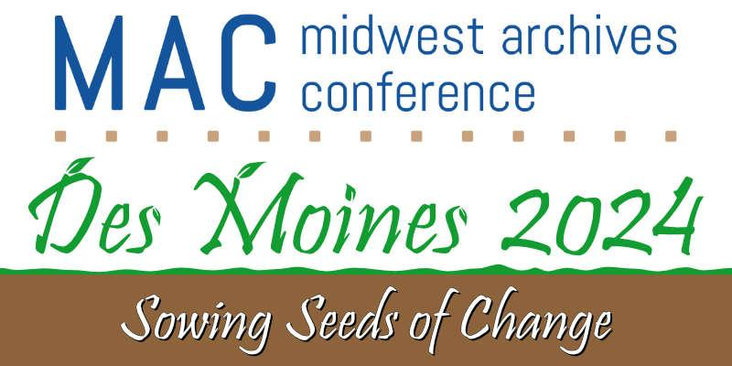
Session 402
Good Things Come in Threes:
Building a Digital Collection at the University of Minnesota
Notes:
Welcome, thank you everyone for joining us

Slide 2
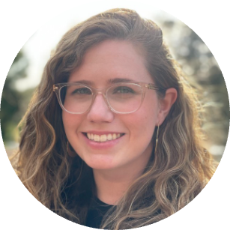
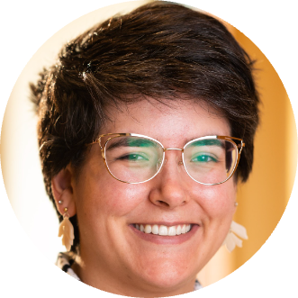
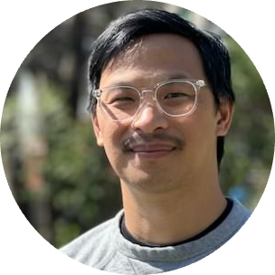
Welcome!
Theresa Berger (she/her)
Head of Digital Library Services
Erin McBrien (she/her)
Interim Curator - Upper Midwest Literary Archives
Scott Lawan (he/him)
Libraries Web Applications Developer
Notes:
T

Slide 3
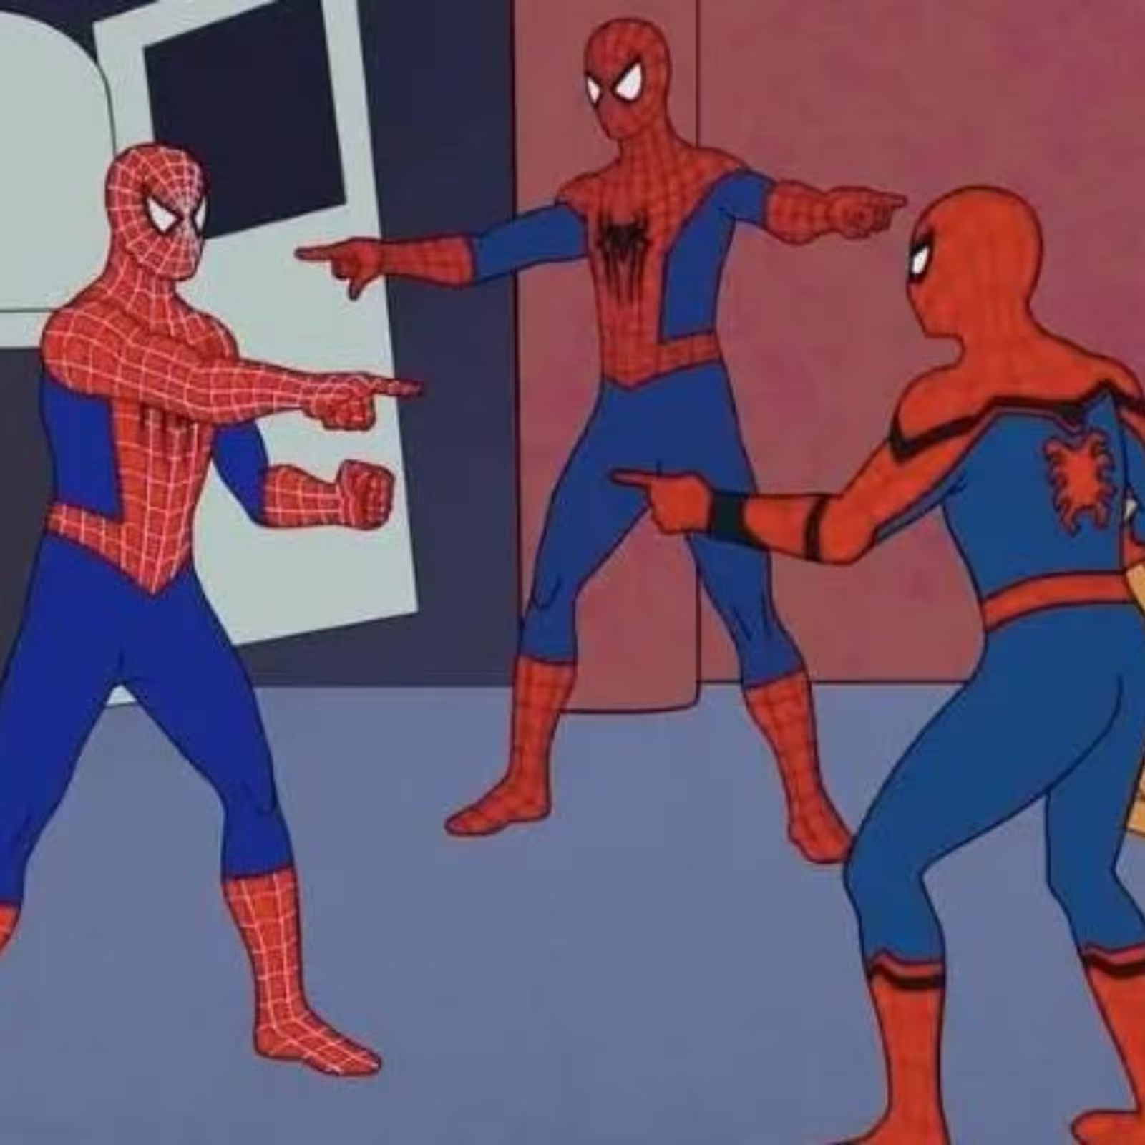
Road Map / Agenda
Collection Overview: The John Berryman Collection
Processing and Digitization / Digitization and Processing
Digitization and Site Design / Site Design and Processing
Questions
Theresa
Scott
Erin
Notes:
T -We have some visuals here to help set the tone for how this project developed amongst the 3 of us. Over the last 9 months or so, we have each been working on individual projects and trying to meet major milestones for our specific roles within the Libraries. When we came together to talk about the John Berryman papers, a high profile collection at the University, it became very clear that our everyday work had much more overlap than any of us realized. We are going to try to highlight those overlaps and frame them as best practices and strategies for bridging the gap between physical and digital collections. To that end, we’ll start with an overview of the collection; work through overlaps between processing and digitization; and also introduce overlap between processing, digitization, and web design; and then hopefully have some time for questions

Slide 4
Pause
This presentation contains both visual examples and discussion of potentially sensitive and/or harmful content.
Topics include: racism, sexism, misogyny, and suicide.
Notes:
T - Before we begin.. As many of us know, such is the nature of working with archival and special collections material. We share these examples and discussions in the spirit of intellectual exploration and conversation in hope of being better archivists, colleagues, and contributors to our communities.

Slide 5
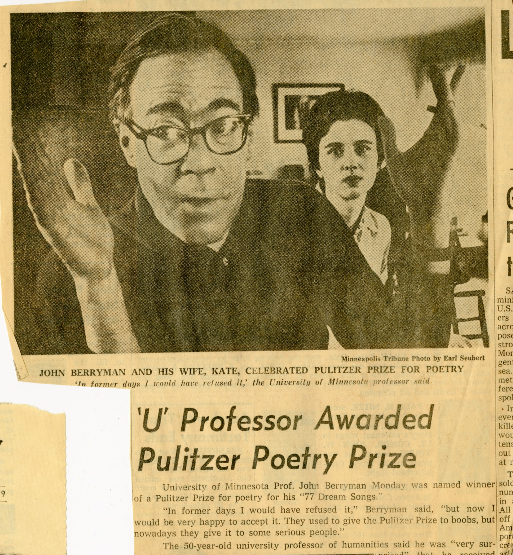
The John Berryman Collection
The John Berryman Papers are the personal, professional, and creative papers of the poet John Berryman–who rose to fame in the 1960s and 70s while he was a professor at the University of Minnesota, particularly with his publication of 77 Dream Songs. A few years after its publication, at the height of his fame and cultural relevance, John Berryman committed suicide. The University of Minnesota acquired the papers in approximately 1978.
Notes:
E - Due to the sudden nature of Berryman’s death (he had not allocated a place for his papers to go), the height of his fame at the time, and a frank mishandling of donor relations between the first UMLA curator and Berryman’s widow Kate Donahue, the John Berryman Papers were entirely locked from public access between 1978 and 1998. After 1998 the papers remained accessible only by explicit permission from Kate Donahue on a case by case basis. Between 2015 and 2020 the accessibly of the collection was reassessed by then-curator Cecily Marcus and Kate Donahue. While they were in the process of renegotiating access, three things happened: Cecily Marcus left for a new position in 2019, the pandemic started in 2020, and Kate Donahue passed away in 2021. Before Kate passed away, literary custodianship passed to Martha, Kate and John’s eldest daughter. When I came on as interim curator in 2023, Martha, our library director, and I came to the decision that the collection could be open for public research access.This also opened up the possibility for Martha and I to talk about digitization options. We decided on digitizing John’s professional and creative papers (not including those that are under an active copyright outside the family, i.e. publisher copyright, etc.) but not digitizing the personal family documents.

Slide 6
Processing Priorities
Better shelf utilization
Renumbering boxes (so not every series restarted with “box 1”)
Assigning locations
Non-acidic housing (boxes and folders)
Legible and informative labels
Comprehensive folder inventory
Weeding (social security numbers, bank information, excessive duplicates, etc.)
Improved Finding Aid hierarchies
Also an opportunity for digitization.
Notes:
E-The processing priorities up on this slide are listed in a kind of snowballing order. We made one decision, which led into another, which led into another. We realized everything the collection needed as we went along, and doing these steps not only helped with future digitization, they also immensely helped our needs in regard to preservation, findability, and security. I didn’t set out to do all these things for the Berryman papers at once, we added steps as they became relevant to our goal and learned more about the collection.
Physical reboxing was the first identified need. Reprocessing initially started with a need to make better use of our space, so everything was getting moved from a hollinger to a paige box. The original box numbering system had started over at “1” with every new series in the collection, which may have worked for other systems, but does not work with ASpace. Because we were moving things into new boxes anyway, we were also able to update the box numbering system so that every box in the collection was numbered sequentially. And because we were creating new box records in ASpace already, why not actually add locations to the boxes as well?

Slide 7
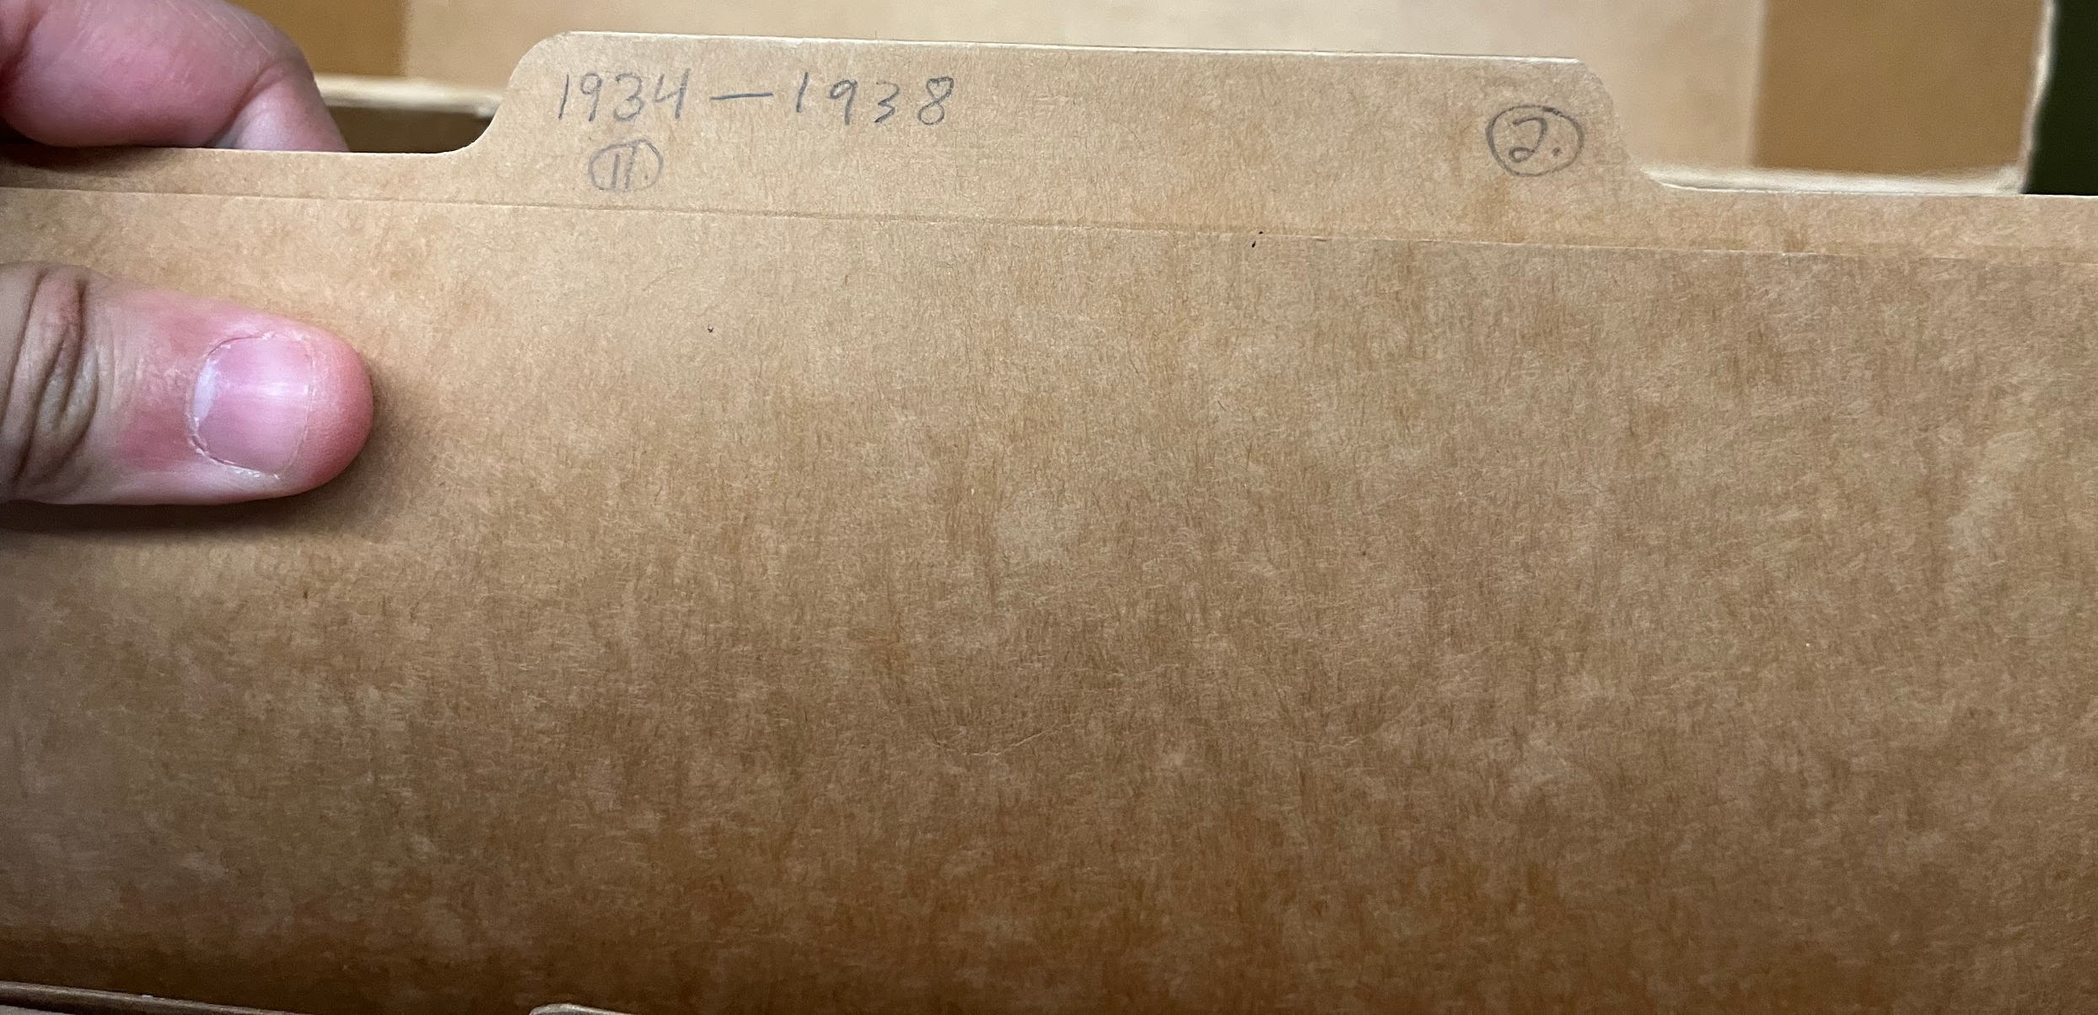
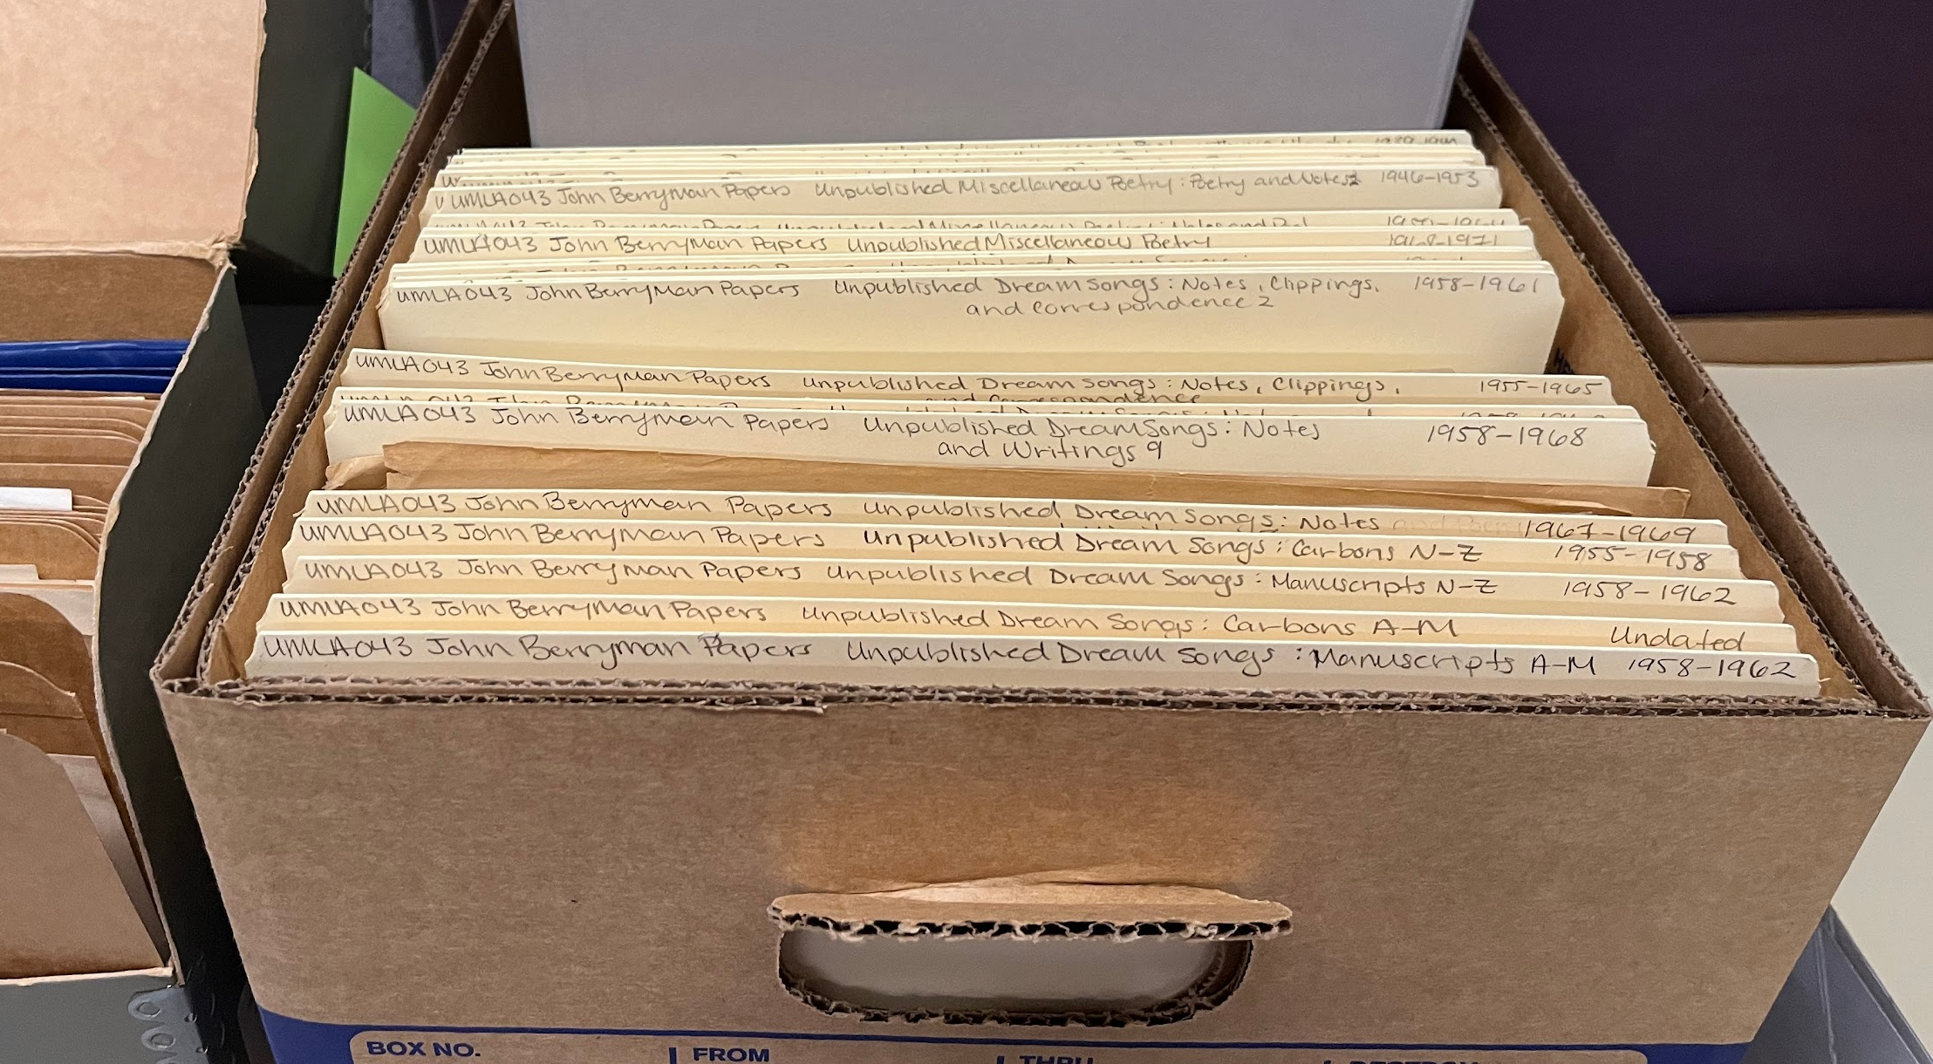
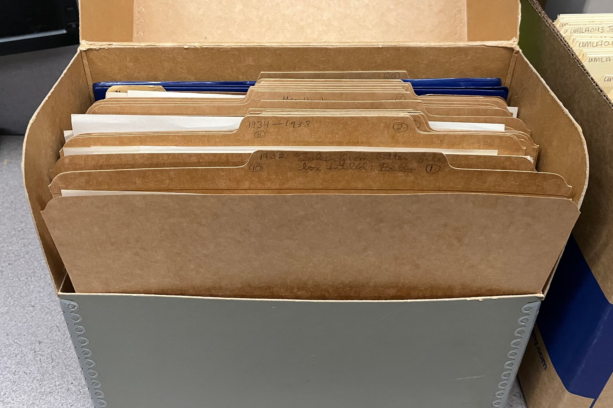
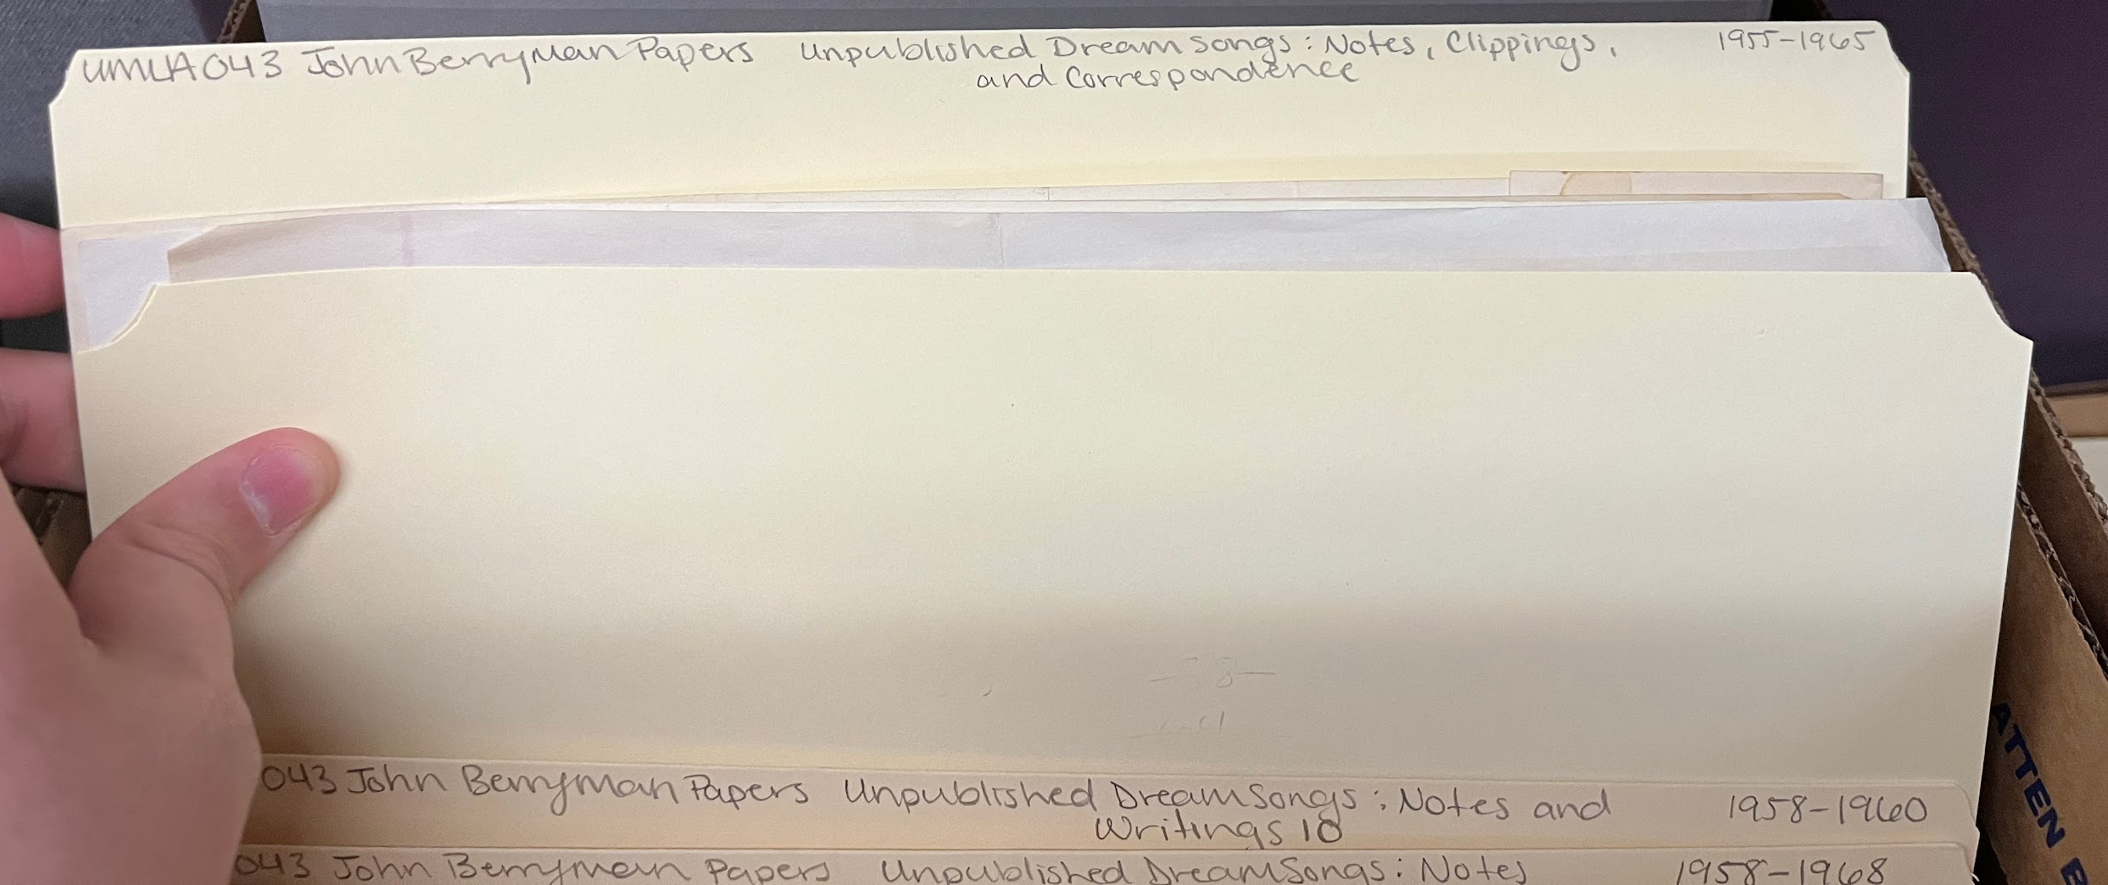
Processing Priorities
Notes:
E-We also realized that all the folders were from the late 70s and highly acidic, so we transferred materials into new folders. This was probably our biggest time sink, but honestly I think it was extremely important. The Berryman collection mostly spans from the 1930s to the 1970s at the height of cheap, acidic paper that’s eating itself alive. So keeping things in equally acidic folders wasn’t just kind of bad, it was really detrimental to the collection’s longevity. I think refoldering was worth it in this case. Because we were already needing new folders we also decided to improve the folder labels to be legible and informative. And if we’re actually giving the folders a legible and informative label physically, then why not record those on ASpace with a folder level inventory? The Berryman Papers initially came to us in the late 70s, and while it had a finding aid on ASpace, it was clearly just a copy of the old paper finding aid. The old finding aid really only covered the collection by series on the most surface level. It obscured details of what was in the collection, as well as how big the collection actually was. As we went, we also weeded out numerous documents with ssn’s, sensitive bank and credit information, and excessive duplicate publications. We also deaccessioned one other notable item:

Slide 8
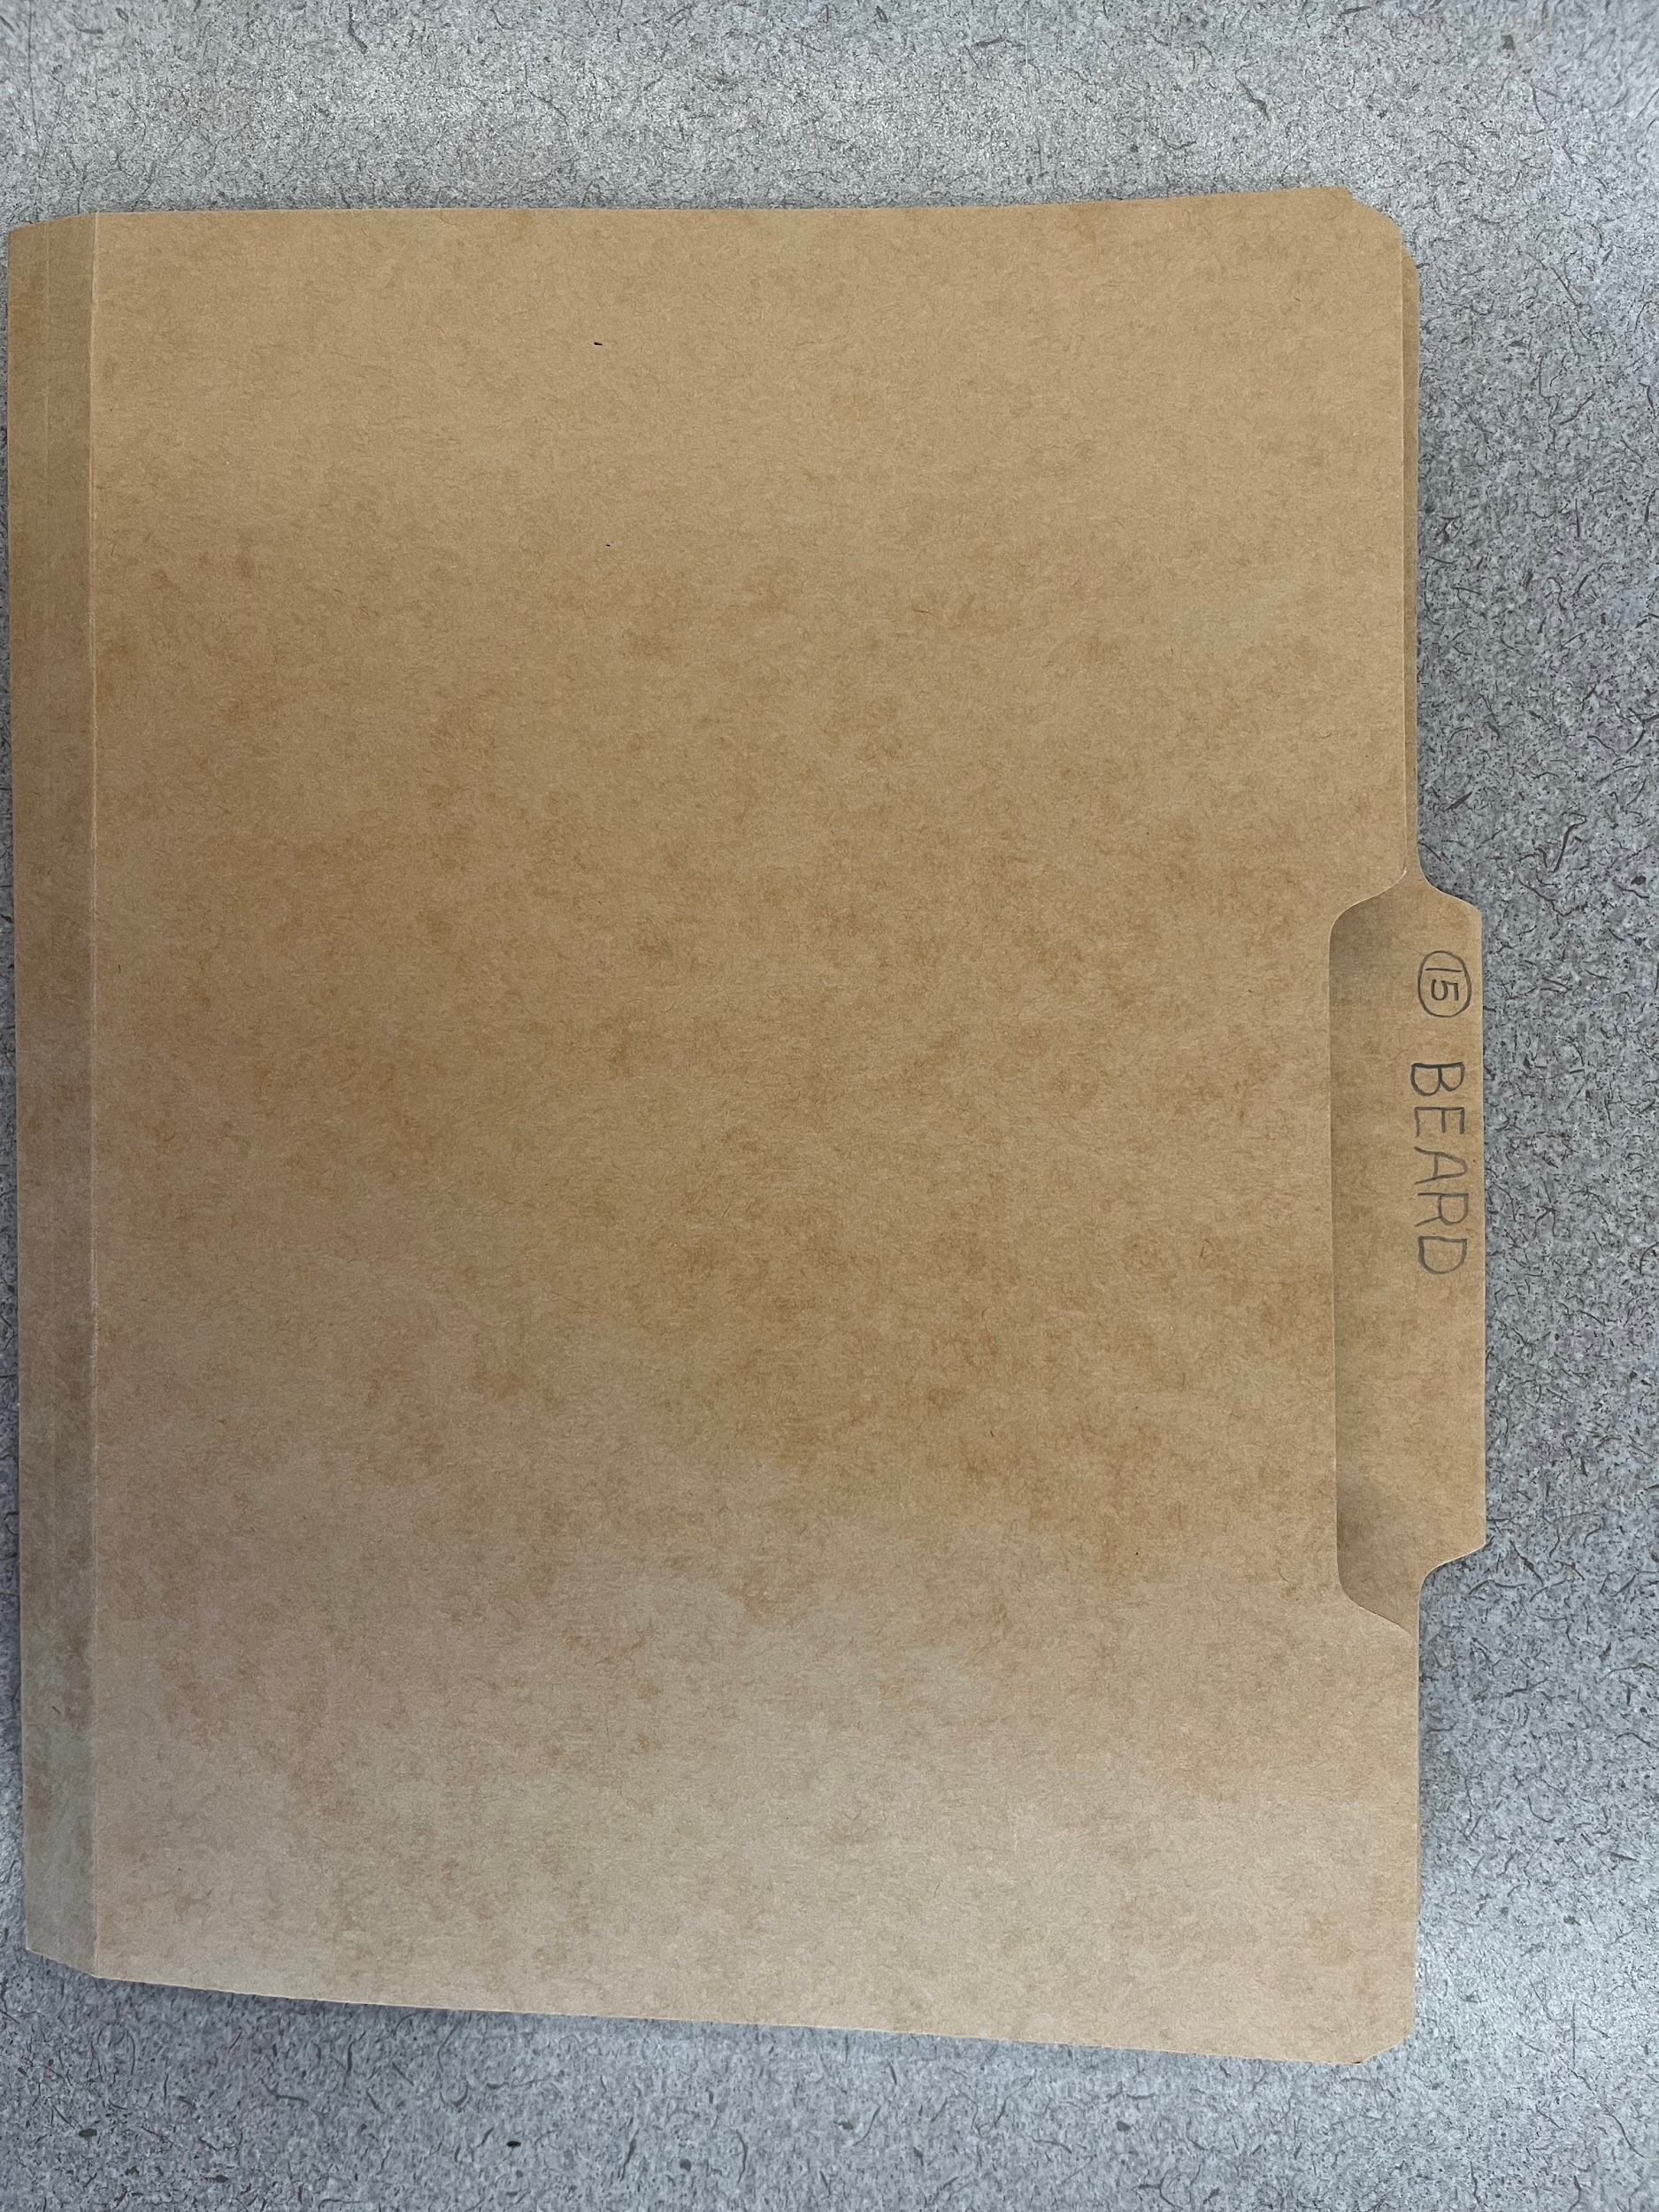
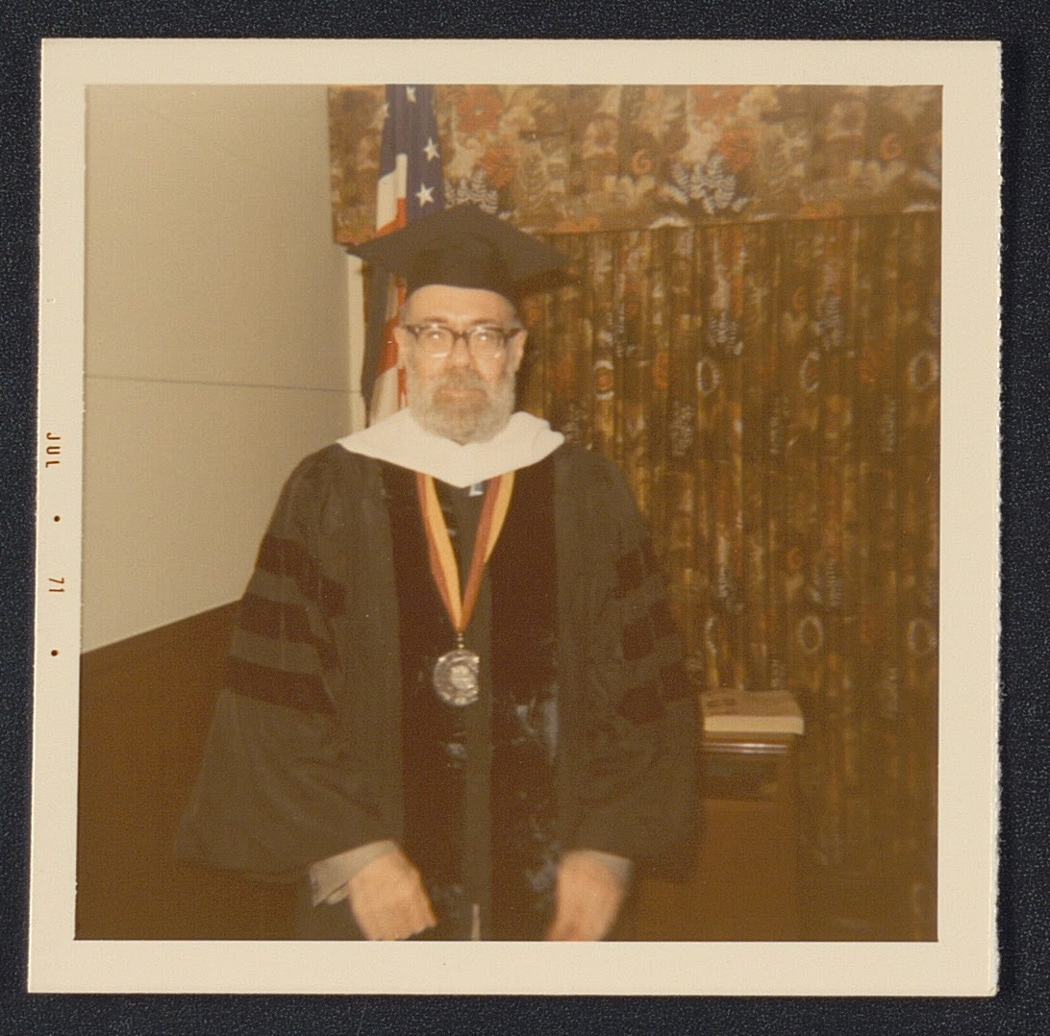
Processing Priorities
Notes:
E-No one wants to find human remains in their collection. What you can see on this slide is the “Beard” folder, which contained an envelope full of human hair. This folder was found at the end of a box of “misc correspondence.” It wasn’t included in the finding aid, notes about previous processing, the accession materials, or any other paperwork associated with the collection. I don’t know how we got it, I don’t know why it was saved, I don’t even strictly know whether it’s beard hair or if it’s John’s. I think it is, but that might be just for the sake of my own sanity. As much as I hated finding this, I’m horrified by the idea that we might have sent this collection off to digitization before reprocessing and forced them to finding it instead. Because we reprocessed on a more detailed level, that didn’t happen. As curator, I have Martha’s contact info, I was able to look into whether the family wanted this back or in the collection, and make an informed decision regarding disposal that no one else could. While it wouldn’t have been the end of the world for digitization to have discovered this first, I’m still grateful it was me instead.

Slide 9
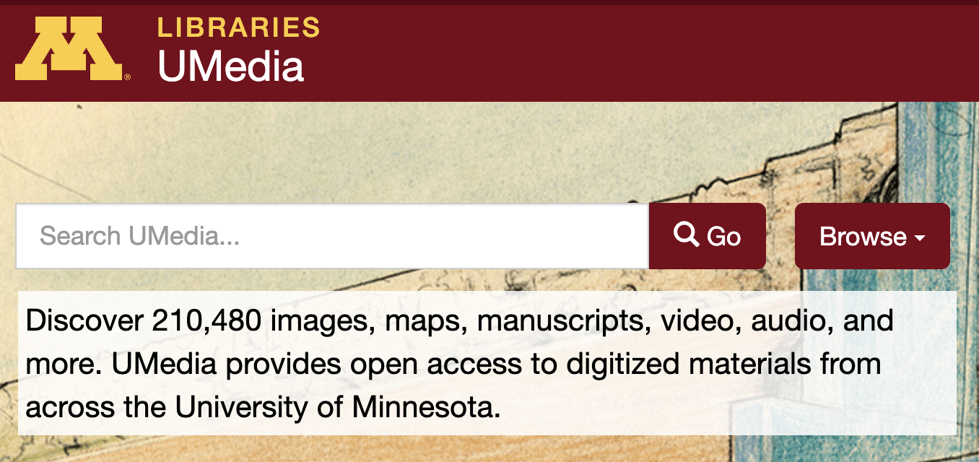
Processing Meets Digitization
UMN Libraries Strategic Digitization Program (SDP)
Review criteria:
Content / subject matter
Copyright/ ethical considerations
Project Size
METADATA
Notes:
T: Part of my role in the Libraries is direction our Strategic Digitization Program. This is generously funded by our Preservation and Collections Management Directors and AUL’s, and allows us to issue a call for proposals to digitize up to good-sized 10-12 digitization projects per year. Everything we digitize is uploaded to our digital collections platform, UMedia, and in turn harvested to DPLA and other major digital collections portals. We try to keep requirements as non-restrictive as possible but specific review criteria for these projects includes: Content, Copyright, Specific breakdown of materials including length and format, and Descriptive Metadata. We knew the content was exciting and certainly worth it from a subject matter perspective; Erin had also done a great job building a relationship with Martha and getting the copyright permission we needed to digitize a portion of the collection. The next 2 pieces, then, are what Erin and I have been focusing on to make sure the project is approved under SDP.

Slide 10
Digital Collections Metadata
Digitize and describe at the folder or item-level for access
Lots of challenges when working with large collections, limited resources, or general MPLP-style processing
Goal is to pull from findings aids as much as possible and minimize extra while work still honoring principles of searchable, clear, descriptive metadata
Specific title format /schema:
[Series]. [Folder Title]. [Dates]. [(Box Number, Folder Number)] .
Notes:
T - [We] have already talked a bit about the size of the collection and how getting a better sense of that was a motivator for re-processing. (Again, it was also something we needed to know in order to make the digitization award). The other big piece, however, is the level at which the collection is described and whether or not we can turn that archival description into digital collections metadata. When working on archival collections, our policy is to usually digitize at the folder or item-level (folder for print or text materials; item for visual or photographic materials if possible). We also need the box and folder information to assign a unique identifier to the digital objects (whether simple or compound)Unfortunately, as the collection was currently processed and the finding aid currently existed, we wouldn’t be able to do any of this sort of digitization or online description.

Slide 11
Digitization Needs as Processing Priorities
Too generalized (these are not actually item-level records, they’re just groupings)
Doesn’t accurately represent the size of the collections
No box records, no locations
Notes:
E - The reprocessing work we’ve done has drastically changed how we understand the Berryman papers. Though we’re not at this point quite yet, we’ll eventually be able to restructure the finding aid hierarchies–and clean up all our notes to ourselves–so we can give a more accurate account of what we have in the collection. This is work that’s not only useful for our finding aid and our researchers, but makes digitization possible for us. As our records currently stand, the data available is too vague for digitized records to effectively draw upon. It’s hardly detailed enough for us to find things–there’s no box numbers, no locations, and none of the “item” or “file” entries actually correlate back to a single volume or folder. Up on the screen, I have two of our series as they appear in the old finding aid: Diaries and newspaper clippings. Diaries has five entries, arbitrarily broken up into date ranges. It’s unclear how many diaries there actually are or what dates each diary represents. It’s also kind of misleading, implying that there are only five diaries, each of which covers these large chunks of time. Newspaper clippings has numbers of folders listed in groups that link back to a single record, no contents descriptions, and no dates at all.

Slide 12
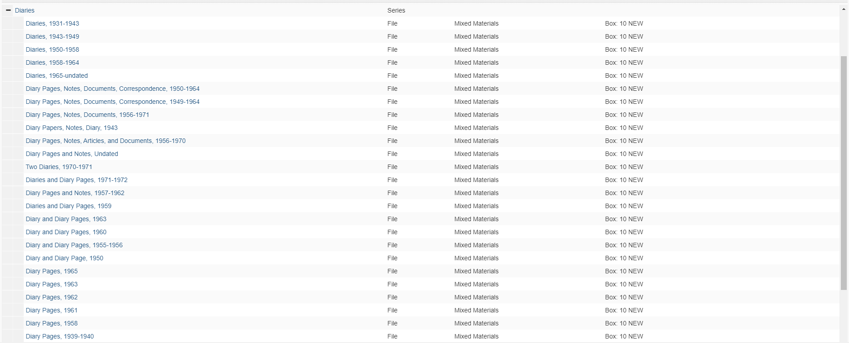
Digitization Needs as Processing Priorities
Notes:
E - Example of what the folder/volume-level inventory looks like for Diaries after reprocessing. As you can see, there are way more diaries than implied by the first finding aid, as well as loose diary pages that were found among the volumes. We also have multiple diaries that overlap the same time periods. These new records are able to list details that allow our researchers to make more targeted requests, and we’ll even know where they are because we have a box number listed.

Slide 13
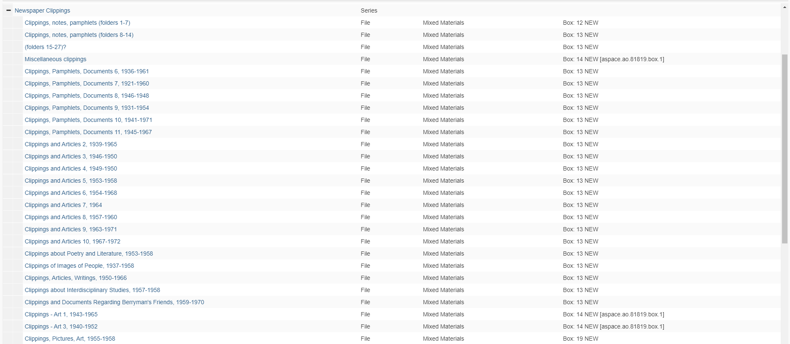
Digitization Needs as Processing Priorities
Notes:
E - Example of what the folder/volume-level inventory looks like for Newspaper Clippings after reprocessing. Same with the diaries, we’re able to attach box records and dates, as well as extra details in folders predominantly on one subject. We’ve got a much better idea of what we’re actually working with now as far as newspapers. Most importantly, when we’ve finalized and cleaned things up, these individual folder records will be able to provide the needed metadata that will make our digitized newspaper clippings accessible. I suspect this will become the preferred way for our researchers to access the articles and clippings we have on Berryman, even if they still visit us in person to access other collection pieces.

Slide 14
Digital Object (Folder) Titles Before & After Reprocessing
Before
Diaries, 1931-1943 (unknown box and folder)
Diaries, 1931-1943 (unknown box and folder)
Clippings, notes, pamphlets (unknown box, folders 1-7)
After
Diaries, 1931-1843 (Box 10, Folder $)
Diary Pages, Notes, Documents, Correspondence, 1950-1964 (Box 10, Folder $)
Clippings, pamphlets, documents, 1936-1961, 6 of 11, (Box 13, Folder $)
Notes:
T - Just to drive this point home: on one side, here’s how the instance titles would have exported from ASpace and been mapped to my metadata upload sheet. I would have had the same title repeating across various items; I wouldn’t know any of the box or location information, which would have screwed up my identifier naming schema. Now that Erin has made these updates, I have much more descriptive titles that include date information, and when the folder title repeats itself like in that last example, I have the signifier of 6 of 11, or 7 of 11, to make sure that digital object title is truly unique, something that goes a long way when doing online research. The point about box and folder numbering is also important here. Erin went ahead and added the box numbers during her reprocessing, but determined it would take a bit too much time to add the folder numbers. That’s A-OK and is a good example of the compromising between our types of works; my staff can go ahead and count the folder number within the box when we are digitizing and add that to our metadata spreadsheet. The key here is that we have the box information and we can then fill in the rest.

Slide 15
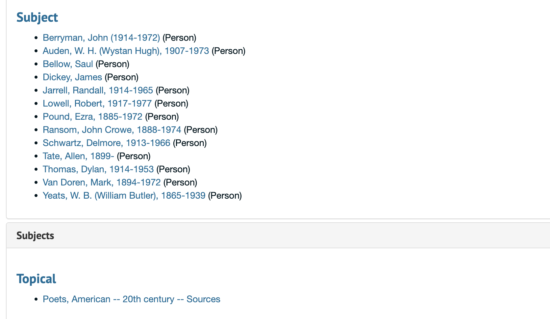
Digitization Needs as Processing Priorities: Metadata Mapping
Abstract → cdm/dc. coll description
Subject / Subject Topics → cdm/dc. subjects
Title → cdm/dc. title
SC desc → cdm/dc. description
Notes:
T: The other space where we had a lot of overlap, and I think where there is a lot of collaboration to be had between processing and digital collections or descriptive metadata for digital collections more generally, is mapping our metadata schema and creating metadata based on what already exists in the finding aid. I think this mapping already existed in my head and in my predecessor’s head, but it wasn’t until I started working with Erin on this that I realized it wasn’t exactly clear to our archivists which parts of the finding aid we were using for digital collections metadata. Generally, we copy the Abstract and map it to the Collection Description online (which you see in the upper left and bottom right hand corners); Erin understandably thought we would pull from the Scope and Content note - that’s arguably one of the most important pieces of a finding aid, right? But when you’re thinking about UX and sometimes accessibility requirements, the large text block generated from an SC note can create problems. So that’s why we use the abstract. We also pull from any topical or person-based subjects included in the finding aid, and map those to our subject field. These are really key from an online UX perspective because we make sure those subjects are keyword searchable across the entire UMedia platform of over 500 collections. This has given Erin a good reason to go in and enhance those subjects as she is processing (again, something that is not necessarily prioritized in traditional processing). Working on this together has prompted me to start creating a mapping guide for our archivists, so that they can take our metadata fields into consideration when they are processing or reprocessing in their daily work.

Slide 16
Digitization Needs as Processing Priorities:
Noting Sensitive or Potentially Harmful Content
Notes:
T: The other major space where the reprocessing of the physical collection prompted key decision making for the online collection is when it came to noting sensitive or harmful content. We had ZERO idea that this existed in the Berryman collection until Erin started working on it. So it was very important to know about and have these conversations. Our Archives staff have been doing a great job coordinating work in reparative description (if you haven’t seen our poster here at the conference, please go take a look!). Prior to my starting my position, we had a link to our content notice in the footer of the UMedia homepage; but, it’s in a footer, it’s buried. I’ve known I wanted to do something more explicit for users when it came to including some sort of content notice, but the question of “what” exactly is something I have been pondering for months. Do we implement a pop-up, do we blurr items and ask users to click something, and WHAT, exactly, do we note as harmful? There’s a lot of nuance and a lot of subjective decision making that comes with this work, I think it’s especially intimidating in a digital collections environment when objects are disassociated from their hierarchical context. This is something we have been exploring across our collections and discussing with staff as a whole but the Berryman papers, after Erin did that work, became a very good example of how challenging this decision making can be. For example, correspondence between Berryman and some of his college buddies or “bros,” as demonstrated in this excerpt on the slide, is incredibly sexist (almost to the point of being comical in some instances). [READ] I don’t know, I’d like to think Heddy was NOT the biggest bitch of all time, but probably rejected John’s friend after one too many comments on her thrilling curves.

Slide 17
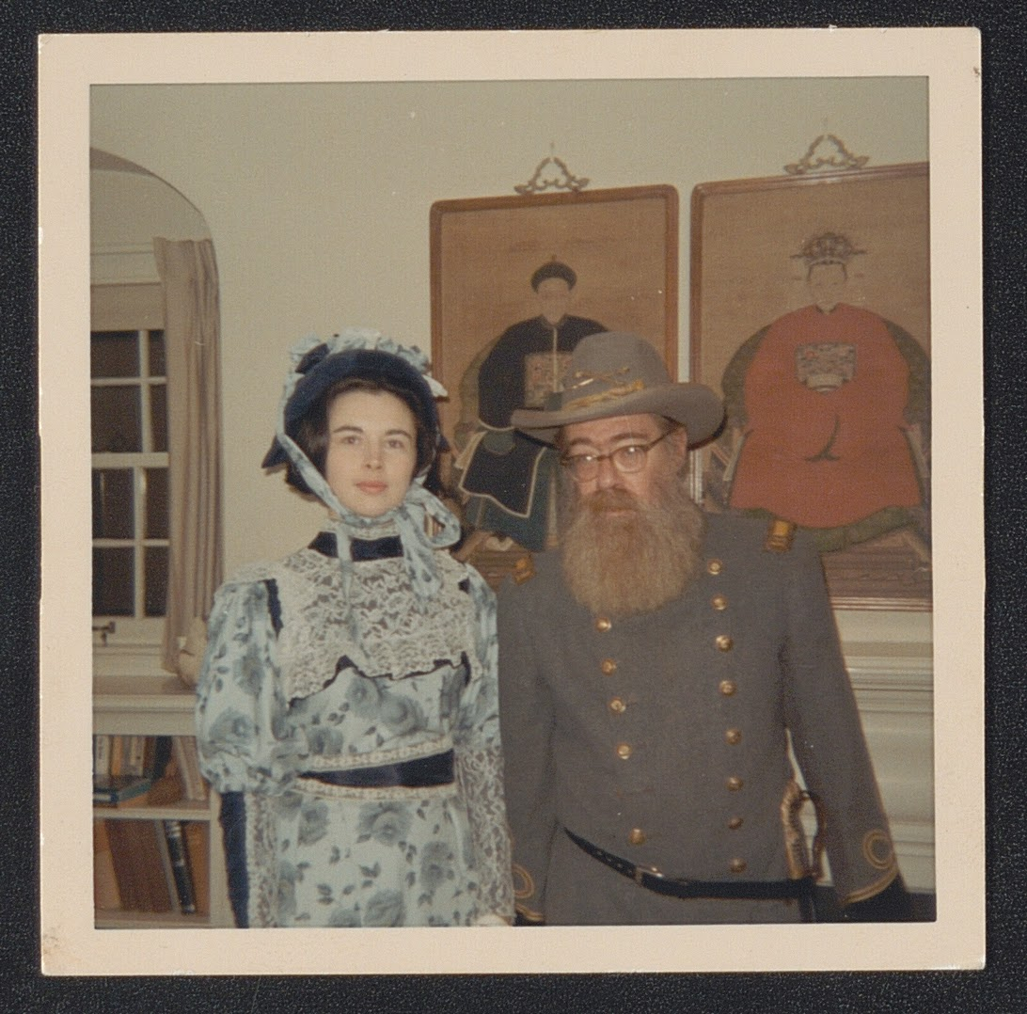
Digitization Needs as Processing Priorities:
Noting Sensitive or Potentially Harmful Content
Notes:
T: But, at the same time as those various letters (I think those excerpts covered 5 different pages from 3 different letters, so they’re a bit hidden); we also have images like this, with Berryman dressed in costume as a Confederate soldier. I think there’s something to do with him exploring his family roots and ancestry like all sensitive artists and writers do; but, that’s besides the point. It’s yucky and it’s racist but it’s there.
At the same time, I think judging how harmful something like these letters vs this image is is besides the point. I don’t think that’s the right approach when thinking about content statements or reparative description; there’s no ranking to be done. It’s just work that NEEDS to be done, period. I also consider things like scale, and the fact that we have almost 2.5 million pages of material on UMedia, and how difficult that would be to go through everything and how much time it would take me, my staff, or me and Erin to make these decisions.

Slide 18
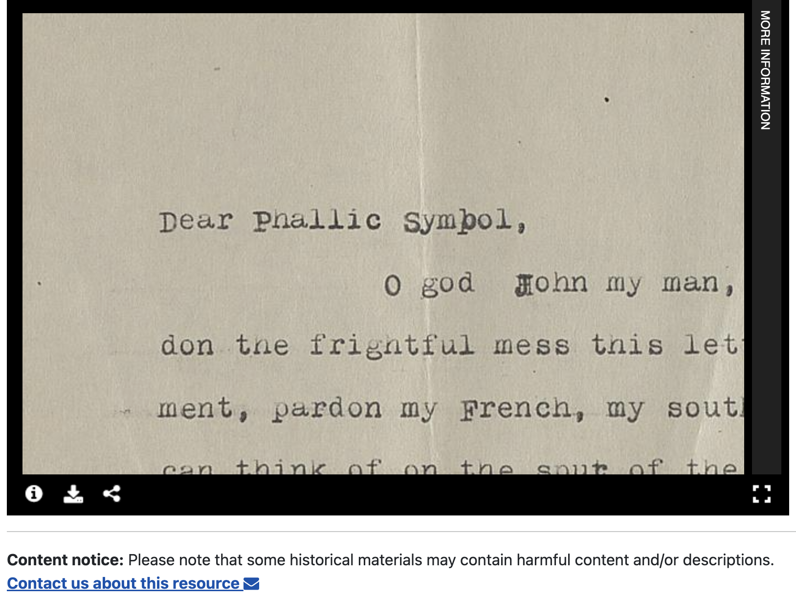
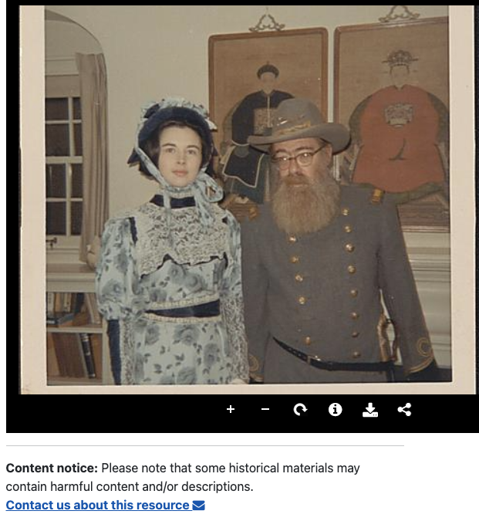
Content Notices in Digital Collections
Notes:
SO: what we’ve decided to do, is to include a Content notice at the item-level for every single item in our collection. [This wasn’t my idea, I know Duke and North Carolina State have done this as well]. But what we’re doing here, is not trying to make decisions about content and engage in that slippery slope of what is and what isn’t harmful; we’re also not burying our statement at the bottom of the web page in a footer. We’re putting this front and center, RIGHT below the object, whether it’s this confederate soldier photo, these letters, or a drawing of a flower as in some of our horticultural collections. We’re also hyperlinking out to additional explanation on harmful content in our collections, the work of our reparative description group within archives, and also an option to contact us. The other thing that I’m working on, but don’t have an example of here, is a workflow where curators like Erin can ask DLS to insert a cover sheet as the first image in a particular digital object that repeats the content notice; that way, users have the notice visually intervening before they interact with the object. I think this is especially helpful when we’re dealing with photographs and other visual material.

Slide 19
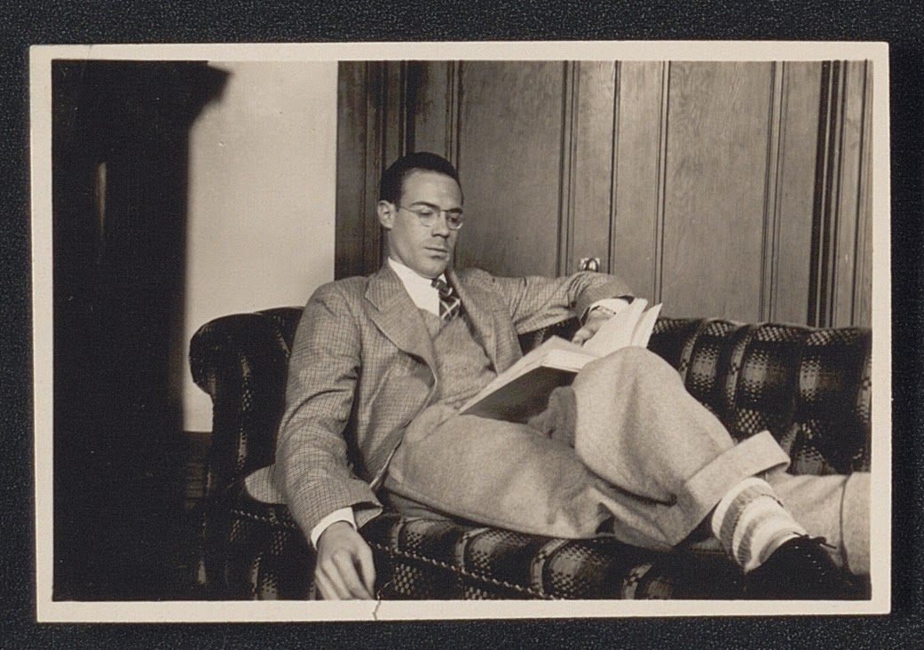
Digitization and [Back-End] Digital Collections Overhaul
Notes:
T: At the same time that Erin and I have been talking about processing and digitization/description for this project, I have also been working with our Web Development Team, specifically with Scott, to redesign the entire UMedia website. Implementing the new content notice would not have been able to happen if this development work wasn’t already in motion. So, with the content notice work as our initial starting point, I realized we had an opportunity to further think about site redesign and development, through the lens of the Berryman collection and with the input of not just me and Scott, but also Erin, whose work is a key piece to the overall platform. And with that, I’m going to turn it over to Scott to talk about some of the work he has been doing.

Slide 20
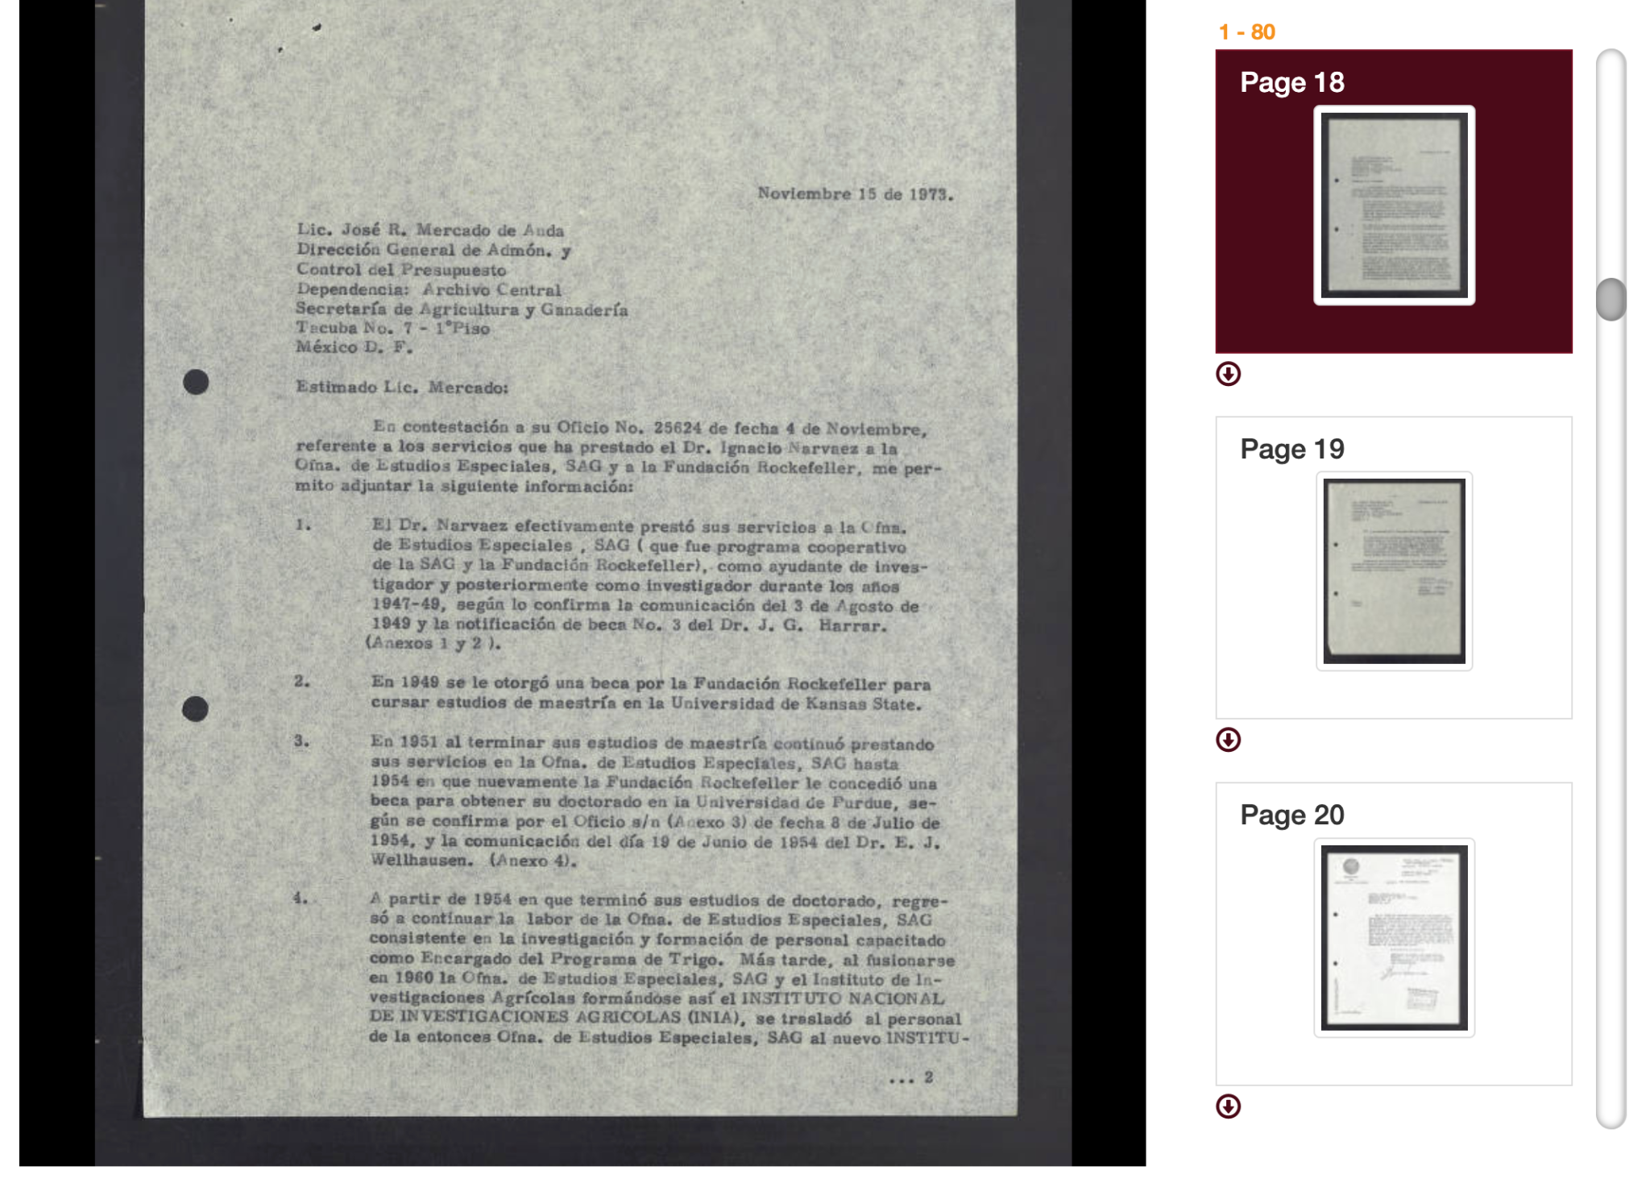
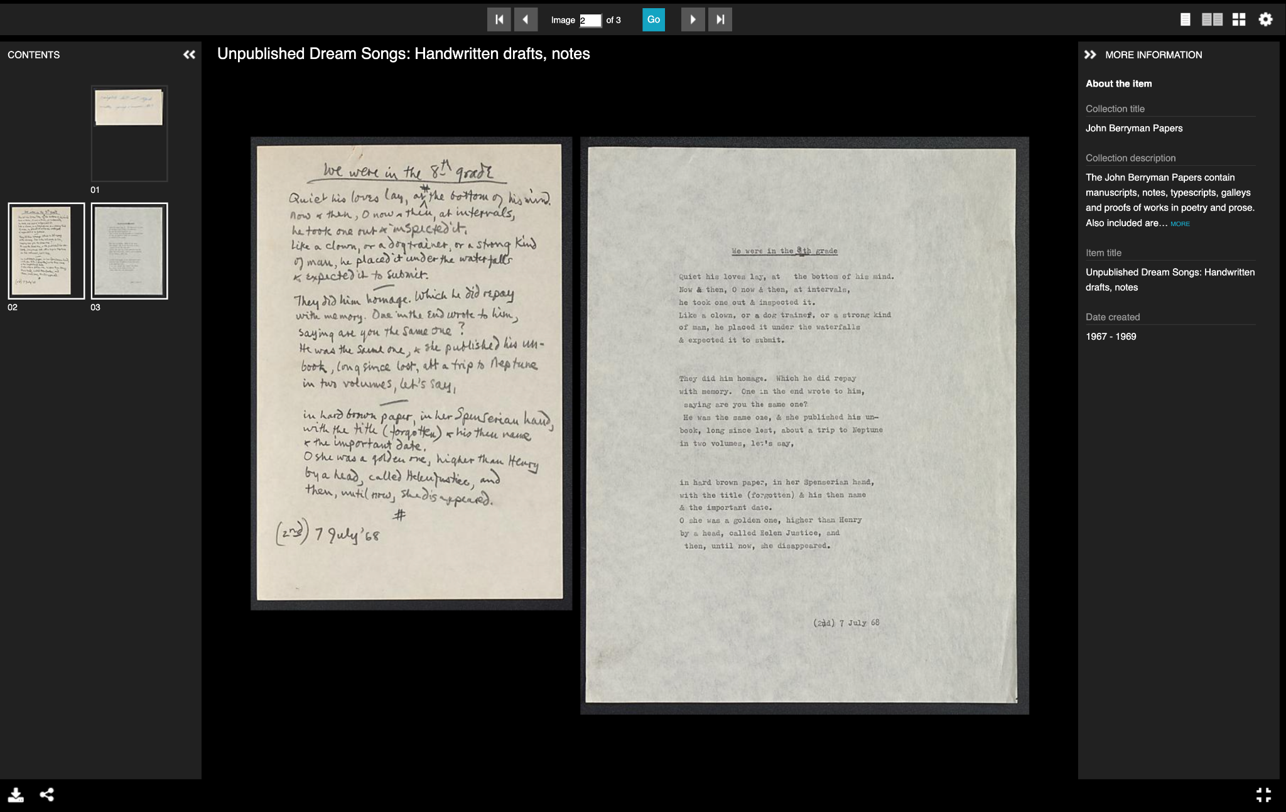
Site Design: Viewer
Notes:
( Scott ) Link to demo: here || Umedia correspondence example: here
History
So, a little bit of history, Our current digital collections platform is getting close to 7 years old at this point and one of the things we often receive feedback on is the desire for a different image viewer
An example of the viewer can be seen on the left here. It’s a little clunky, in that in that there is only one way to interact with with an object
The user has to scroll vertically and click on the individual pages. The pages are only displayed singularly in this tray off to the side. People have complained that there is a lot scrolling and clicking and overall coordination required to interact with and image. If you go full screen, you lose the slide tray. so, this viewer is basically limited to a single page view only
Because of this, one of the important things about the new digital collection site was to utilize a new/different image viewer
Why we chose uv
With that, we ultimately settled on a viewer called Universal Viewer
There are a few reasons for that . . .
One, It is a more robust viewer. Something we talked about was that umedia needed a big interactivity overhaul so collections such as this could have a better user experience and the viewer was a good place to start. There are a variety out there, but we chose ultimately chose the Universal Viewer, which is a general purpose image viewer that allows for a lot of interactivity.
In this demo here, you see these are excerpts of unpolished drafts from the berryman collection.
There are Many ways to navigate. Don’t have to do scrolling in single window. Hand written version vs. typed version.
Its has a few more options and features: user can choose singular or side by side page viewer, the index is a little less clunky, the metadata is also available to the user right in the viewer. In fullscreen, everything is right there
On thing that is nice is showing the hand written page and the typed page side by side
The Side by side view is Important for a collection like this
Hand written version followed typed
The other reason in choosing this viewer was that it supports the digital object display standard iiif. . . .

Slide 21
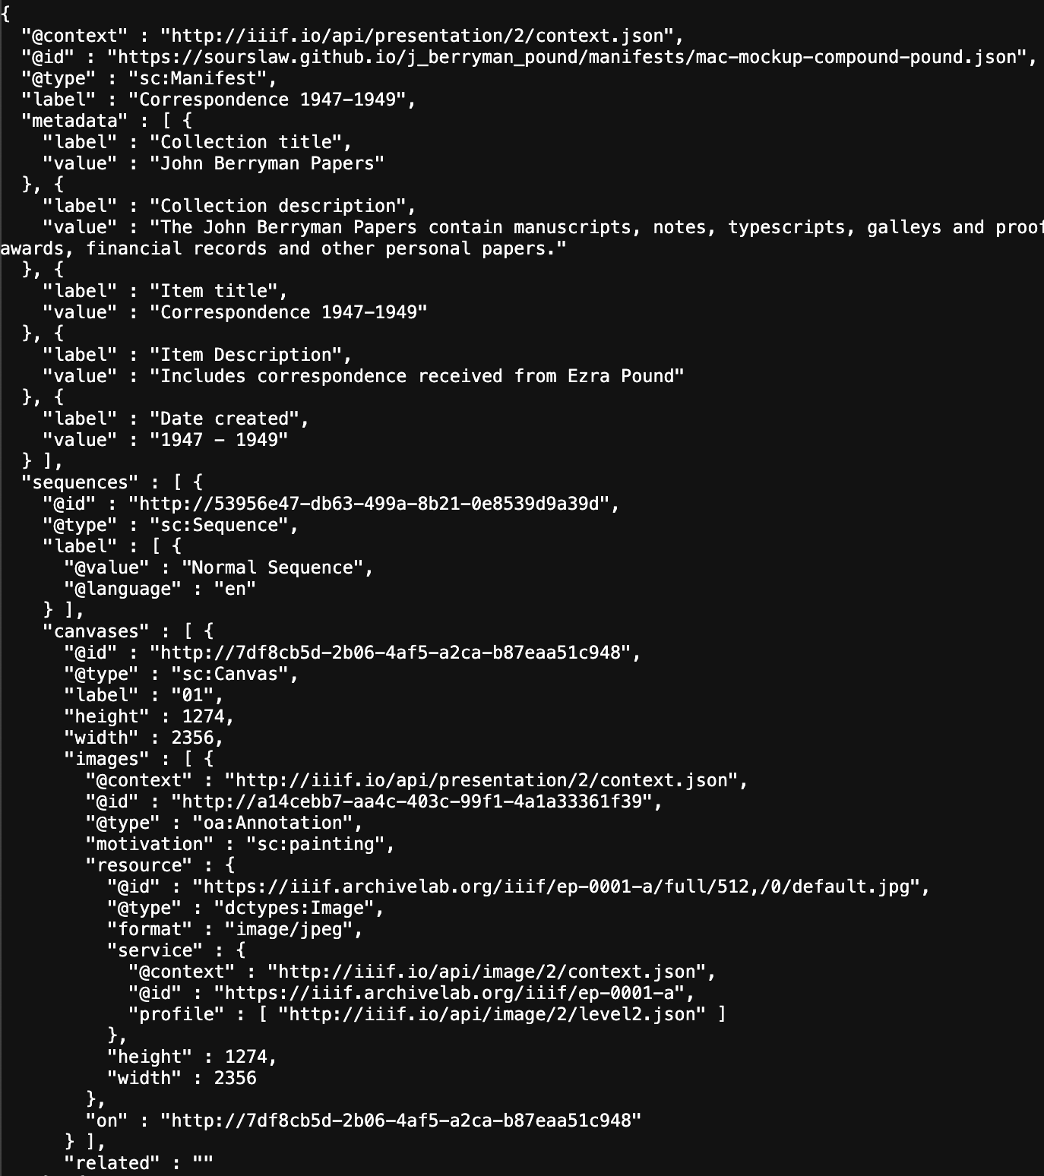
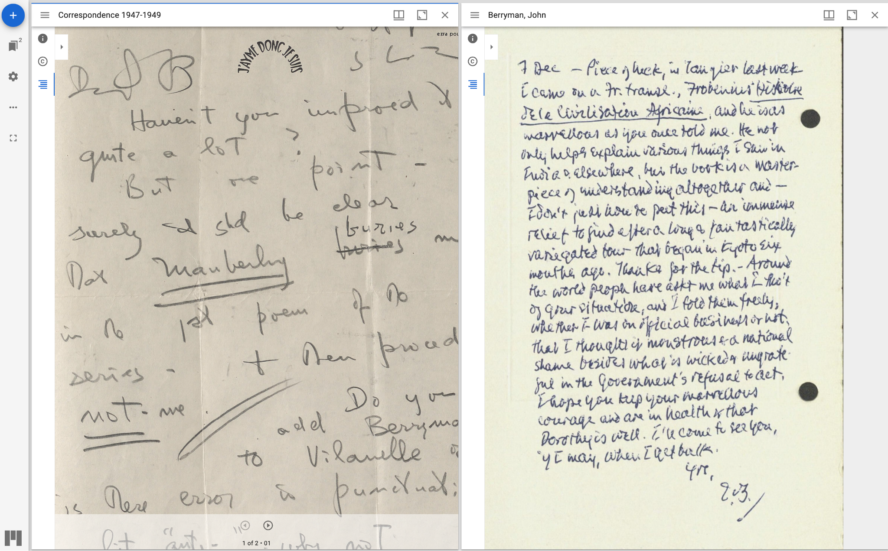
Site Design: IIIF
Notes:
( Scott ) IIIF
a) iiif: International image interoperability framework
A globally-adopted open source, standardized model for delivering many types of image-based resources to help archives, museums, and libraries host and share digitized collections as well as help users find and interact with those collections
1) what do we mean by interoperability ?
Just the ability for software tools to use content from anywhere on the web through common apis. In doing so, iiif “erases the boundaries” between different institutions
2) Why do we need iiif ?
Usually, Everyone is hosting, managing their own images . . everyone is reinventing the wheel/creating their own infrastructure. Not ideal for the users
Example: users need to go to different places/collections to get the information that they need. the institutions are not communicating with each other.
Iiif helps mitigate this by wrapping each of these images and their metadata and provides a uniform package (json) for them call the manifest. This allows for sharing of all the associated metadata across the internet
A json is just structured metadata like xml.
Ultimately, just a solution for sharing and managing images and metadata
Because they are all wrapped, the packages (manifest) can be used interchangeably in various tools/websites/viewers. As can be seen in the next example
b) example: looking at correspondence between berryman and pound side by side
With regards to this collection, the collection has a quite a bit of correspondence with notable writers of the era. And a thing that we don’t necessarily think about is that generally when you visit an institution’s collection, they will only have one half of the correspondence
An example of the type of scholarship that is possible with two remotely distributed images/objects following the same standard, the interoperability aspect is that the images can be viewed in together
In this example with the second image, we are using a different iiif viewer, a feature of which is that it allows for side by side comparisons
The berryman received pound letter is at umn, the betterman sent letter is at yale
And so we can compare and interact with both sides of the correspondence
So we’re coming full circle
Erin has processed this notable correspondence at the item level, theresa has digitized it and ensured that the metadata is descriptive enough for users to find online, and then I have made sure that the online object is packaged in away such that this type interaction is possible
You can see how all of our work informs one anther

Slide 22
Takeaways and Recommendations
Communicate!
Be honest about what you don’t know
Be clear about expectations (for processing, digitization, online, etc.)
Be open to suggestions; priorities may be different across stakeholders
Be strategic about your time (not everything can be processed and described at the folder level; put resources where you know they have greatest impact)
Emphasize UX on the front and back-end to have the greatest/widest use
Collaboration is always happening
Notes:
(scott) bullet points, expound on a few
Collaboration is always happening - Erin and I probably wouldn’t have even met if she and Theresa had not been discussing the digitization for this collection

Slide 23
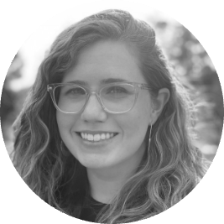
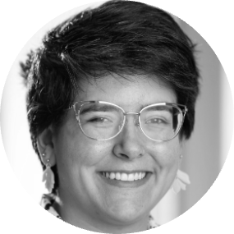
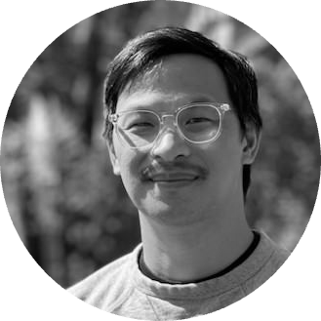
Thanks! Questions?
Theresa Berger | Head of Digital Library Services ✉ theberg@umn.edu
Erin McBrien | Interim Curator - Upper Midwest Literary Archives
✉ emcbrien@umn.edu
Scott Lawan | Libraries Web Applications Developer
✉ lawans@umn.edu
Notes:
Scott - Thanks, Questions?

