Slide 1
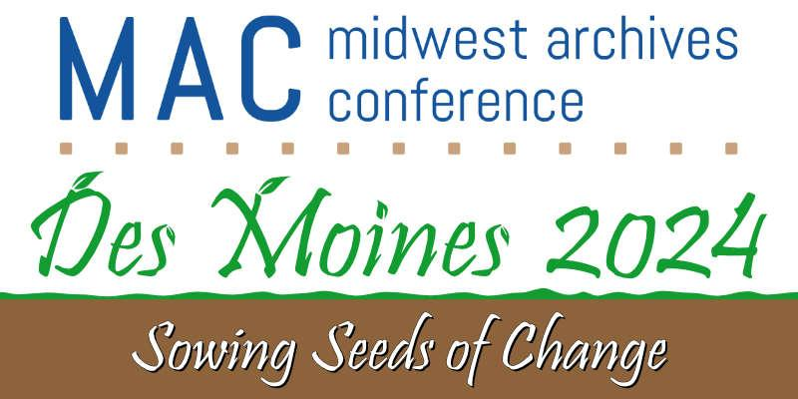
#S601
Incoming! Changes to Archival Accessioning

Slide 2



Who we are and what we're talking about
How are processing and accessioning related/separate?
How does a processing foundation influence accessioning work, and how can that base be used in Onboarding/training?
What skills can these accessioning archivists take into their next role, and what exactly is career progression for an accessioning archivist?
How are legacy issues being addressed when there is a new approach to creating accession information and gathering data about collections that especially seeks to highlight historically underrepresented voices?
What should institutions of various sizes/staffing structures take away from this “trend” in larger academic archives?
Roadblocks we faced and victories, aka lessons learned

Slide 3
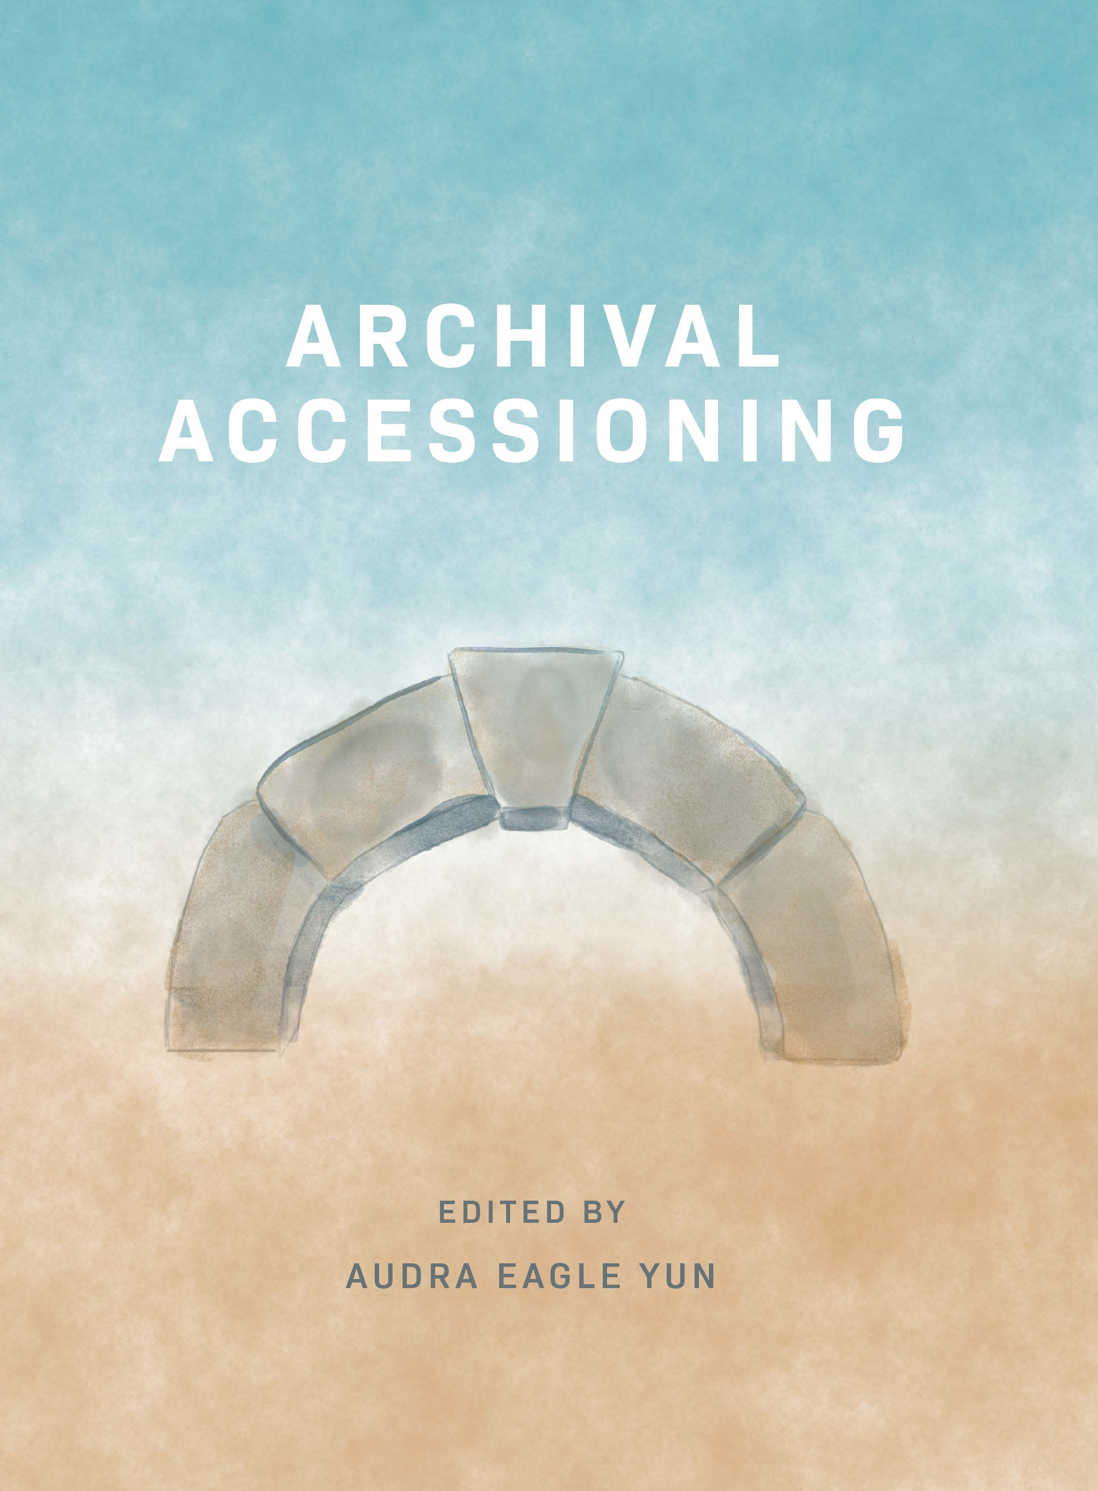
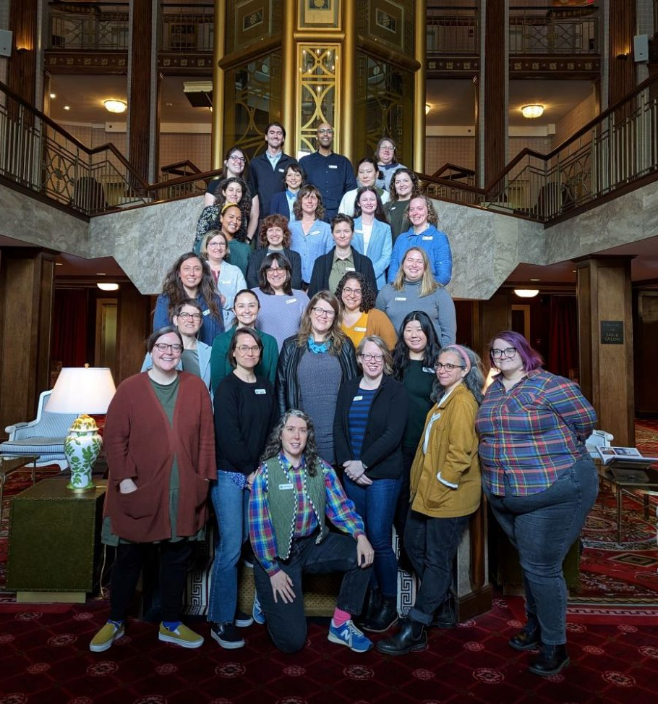
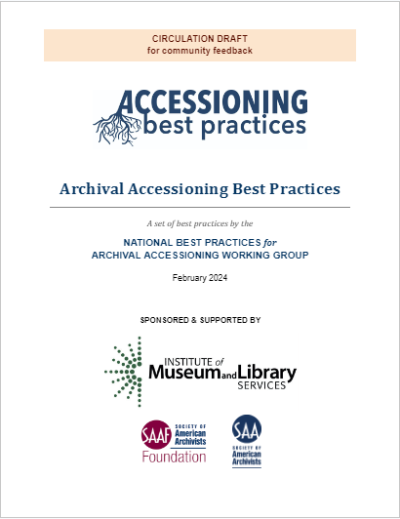
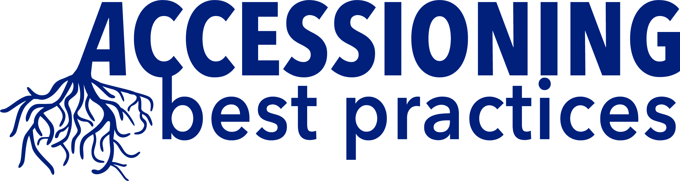
Resources
Accessioning Collective Slack Channel
Archival Accessioning edited by Audra Eagle Yun
National Best Practices For Archival Accessioning Working Group https://accessioningbestpractices.com/

Slide 4

Special Collections and University Archives

Slide 5
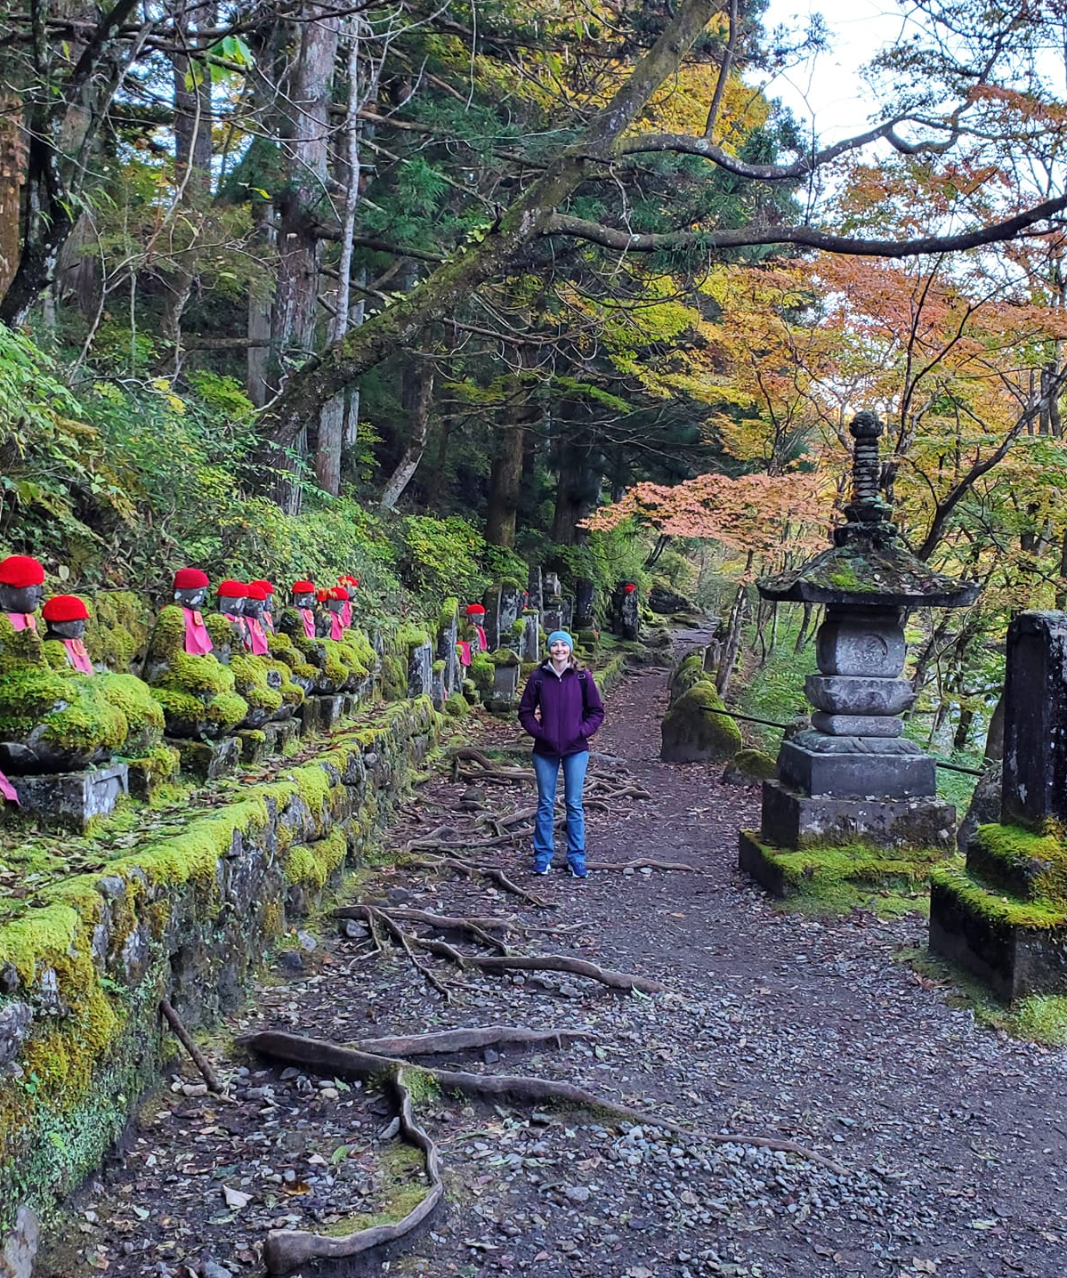
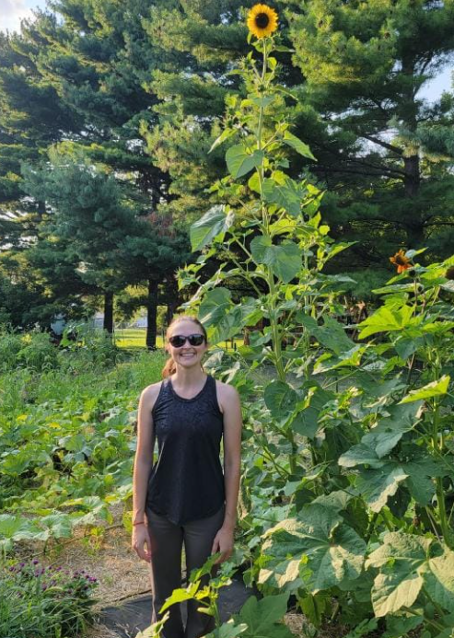
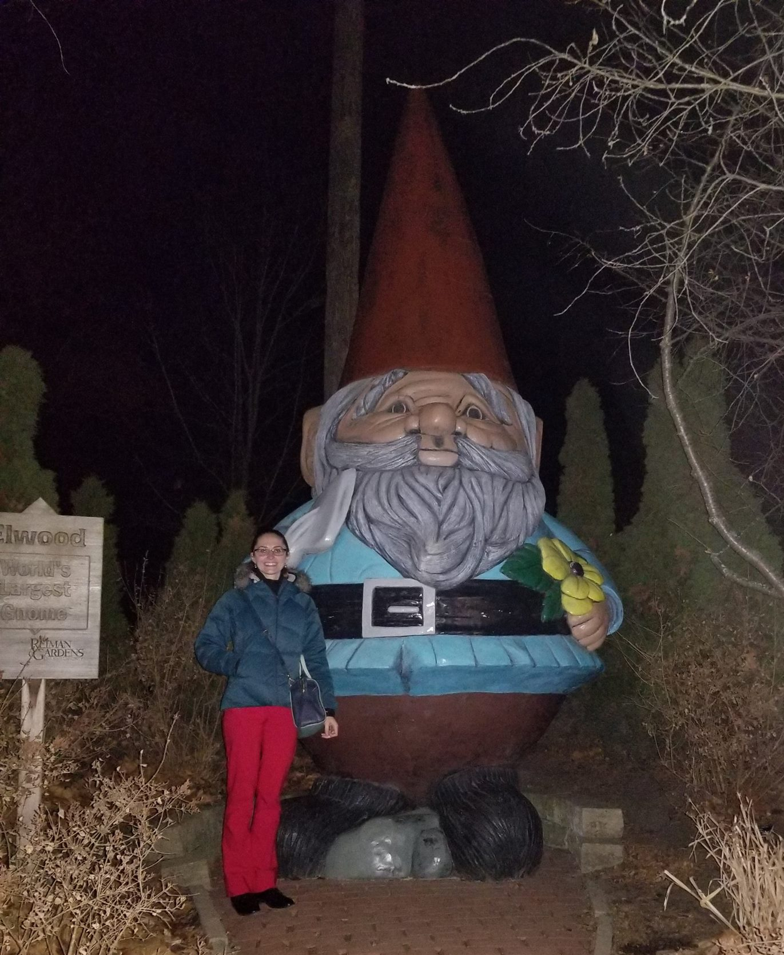
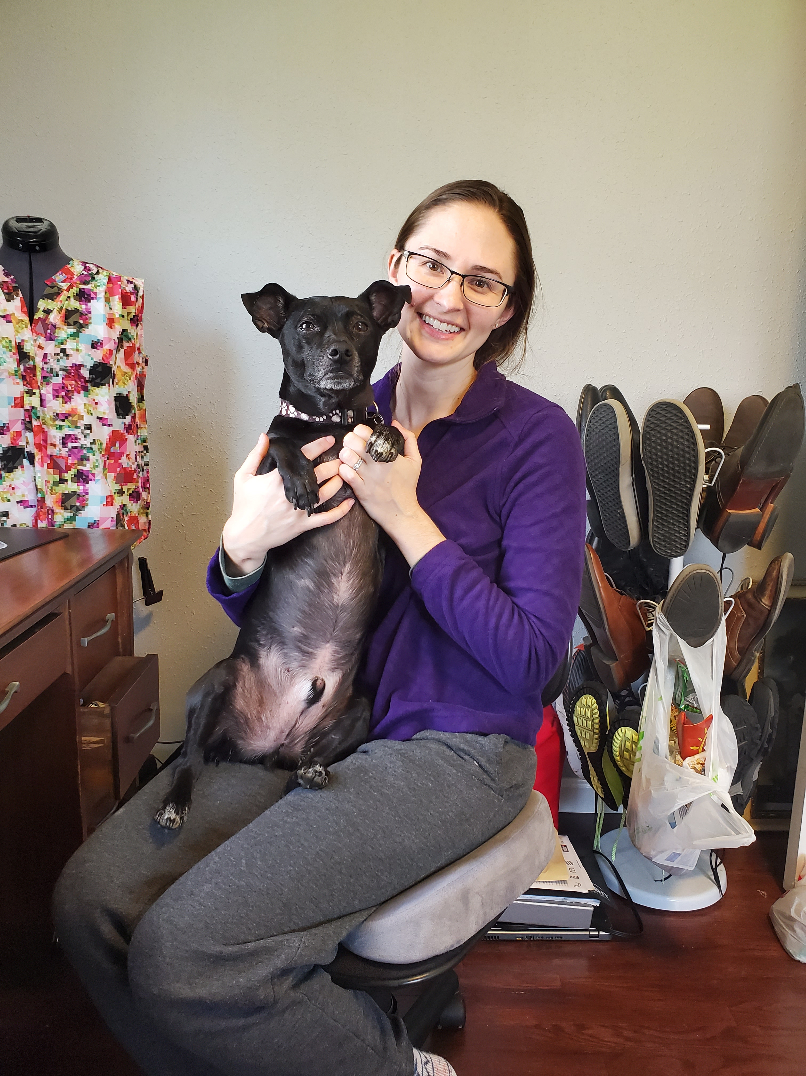
Rosalie Gartner
Lead Processing Archivist
Simmons College, 2013
Joined Iowa State University in 2017
Member of SAA Acquisition & Appraisal Section Best Practices Sub-group in 2017
Member of National Best Practices for Archival Accessioning Working Group, 2021 - Present
Unit or Department Name Here
Special Collections and University Archives

Slide 6
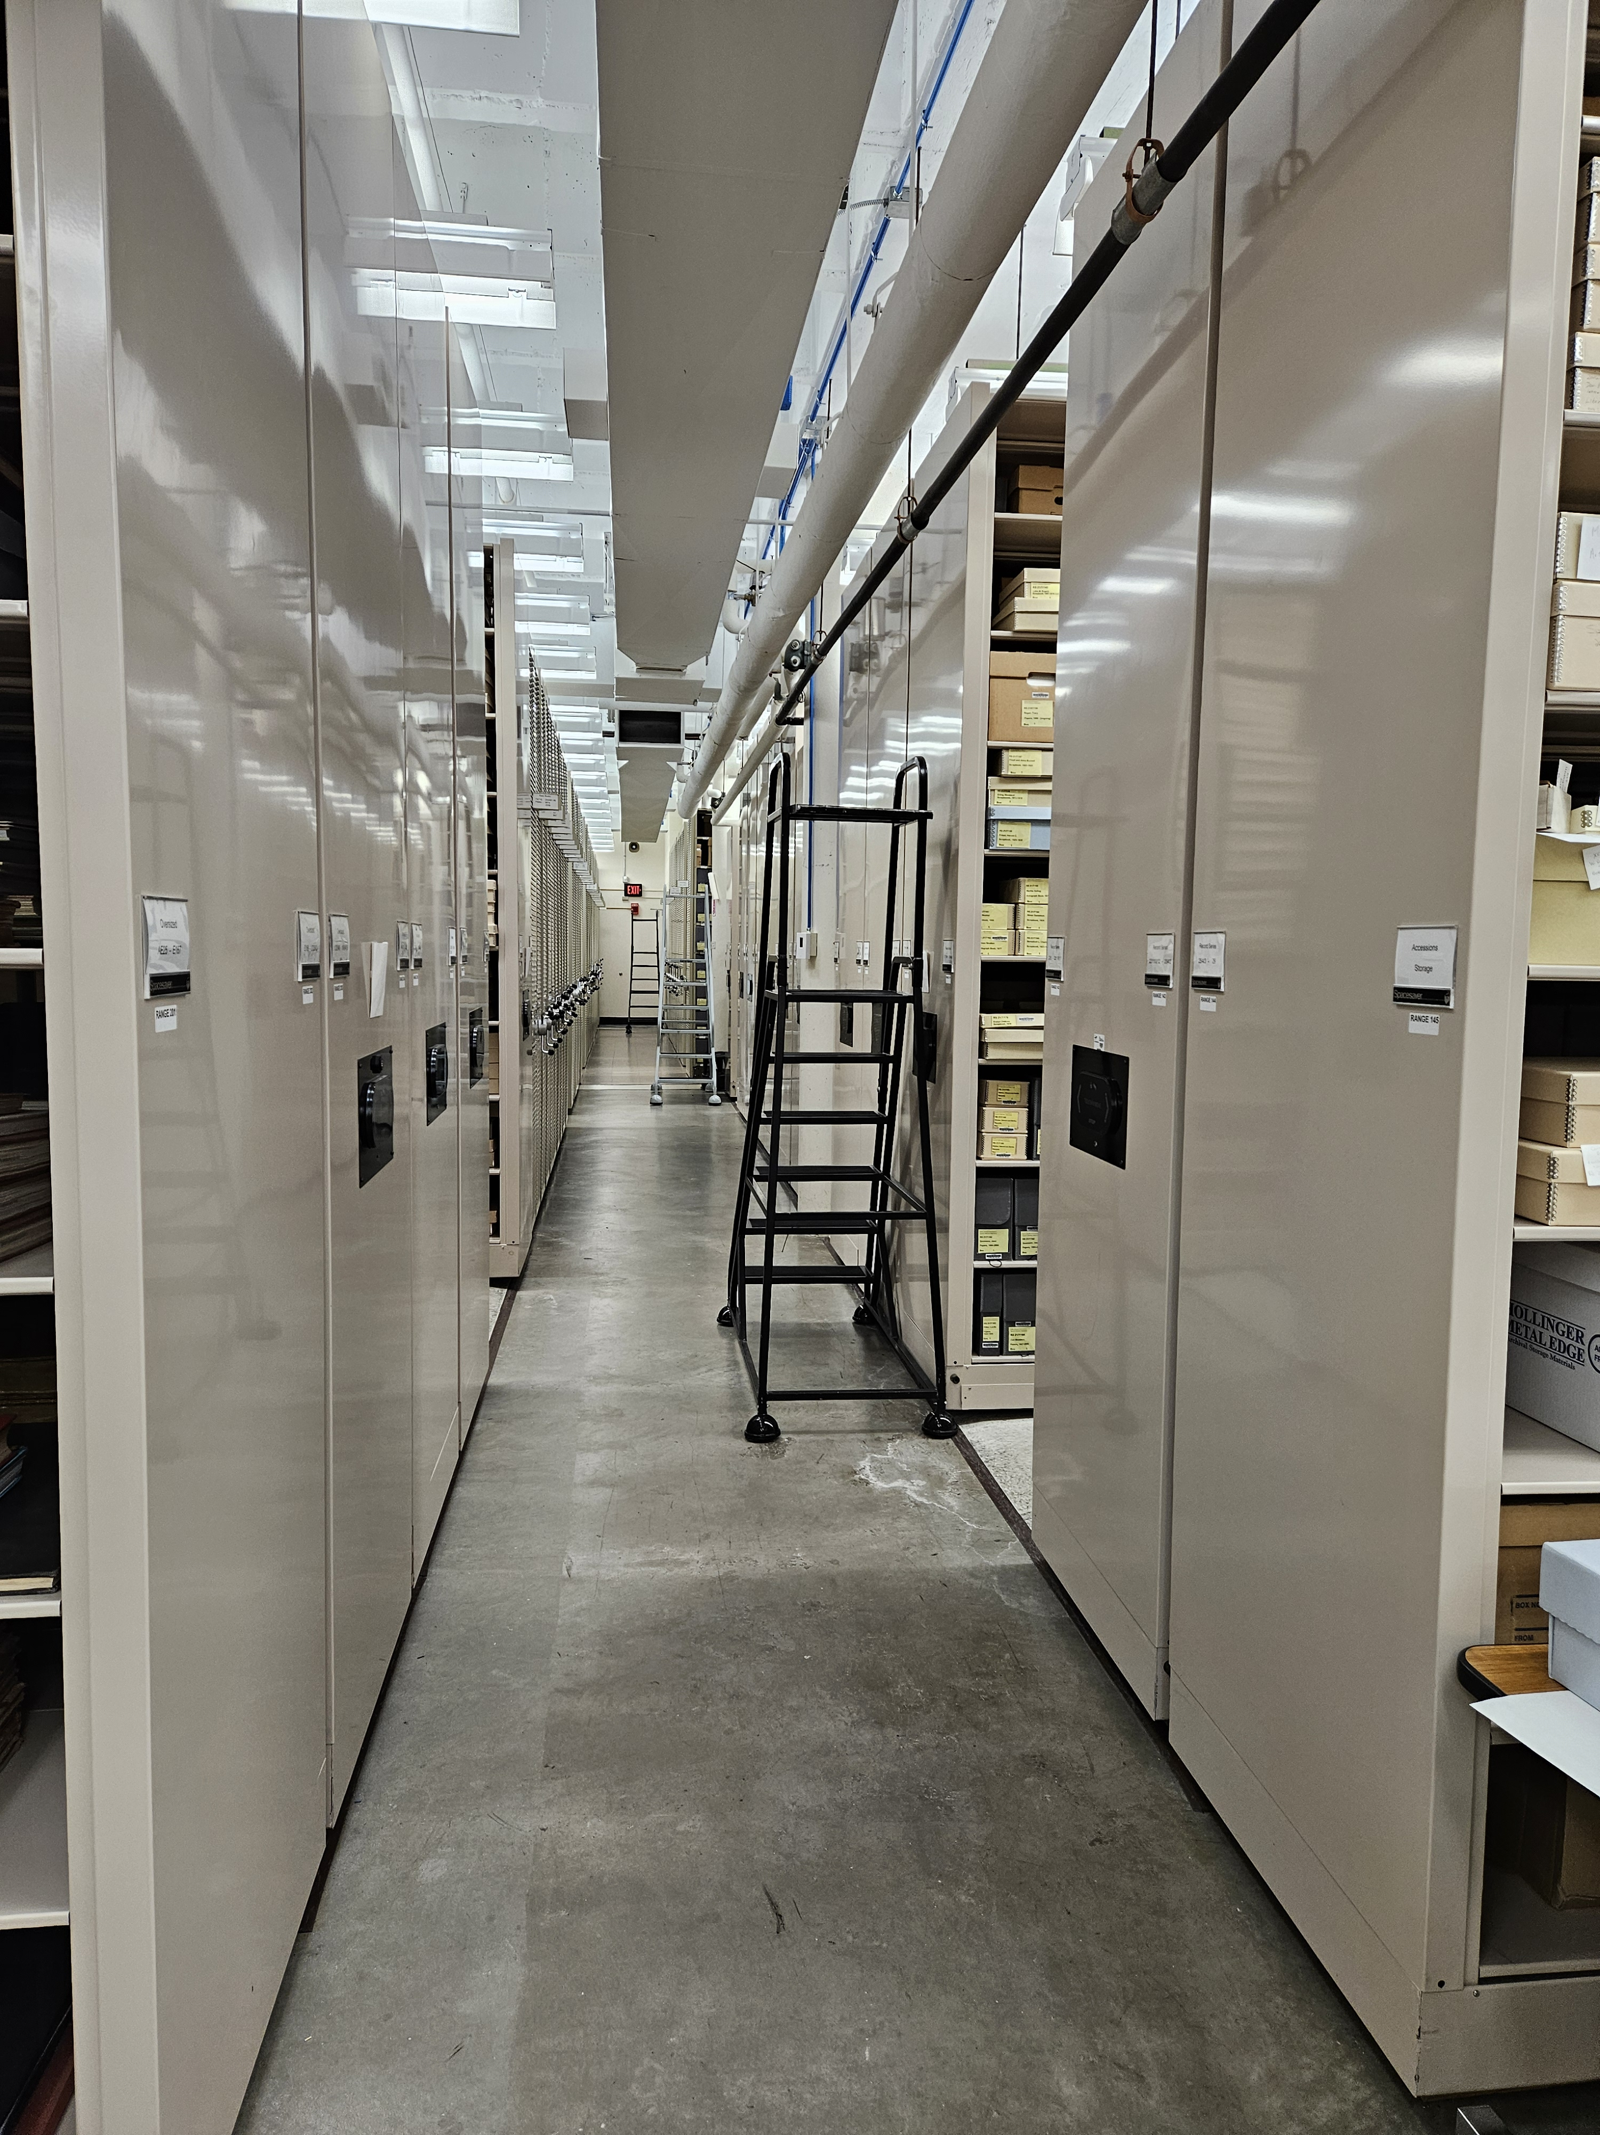
Special Collections & University Archives
Department was founded in 1969
Rare books, manuscripts, and university archives (including Student Life)
12,000 accession records and 2,000 published finding aids
4,000 artifacts, over 15,000 A/V, 20,000 LF, an unknown amount of born digital
First AMS in 2018, migrated to ArchivesSpace in 2021
Unit or Department Name Here
Special Collections and University Archives

Slide 7
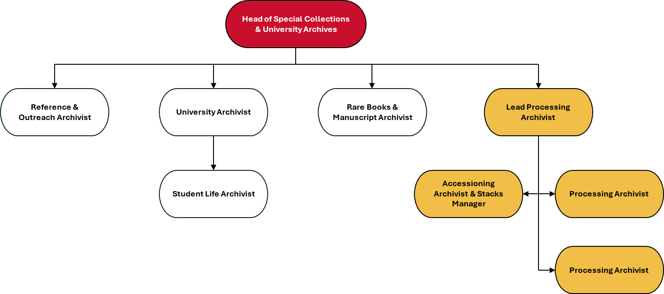
Unit or Department Name Here
Special Collections and University Archives
Notes:
SCUA has several open positions right now, but we typically have 10 full time professional staff, as well as a hand full of student workers. Moving from left to right, we have outreach and reference, the next 2 arms are all collections archivists or curators, and the yellow branch on the right is my team, responsible for accessions and processing.

Slide 8
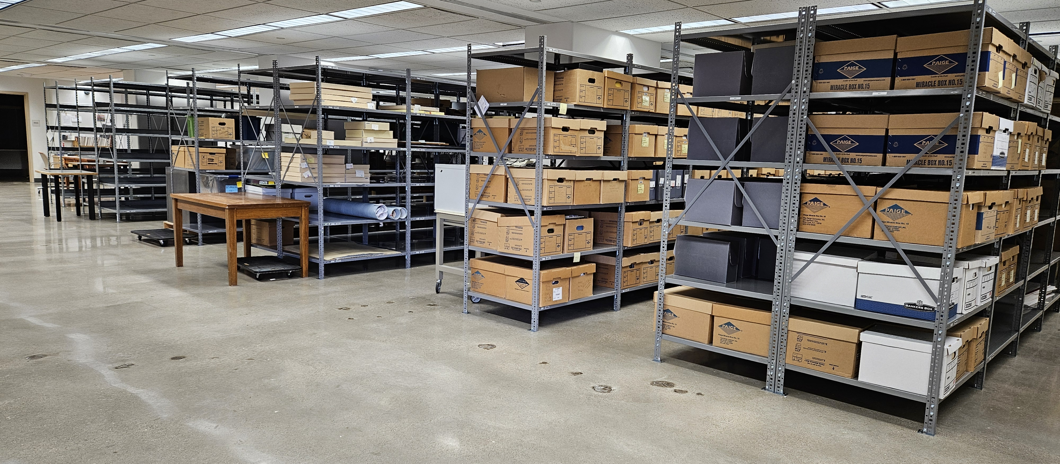
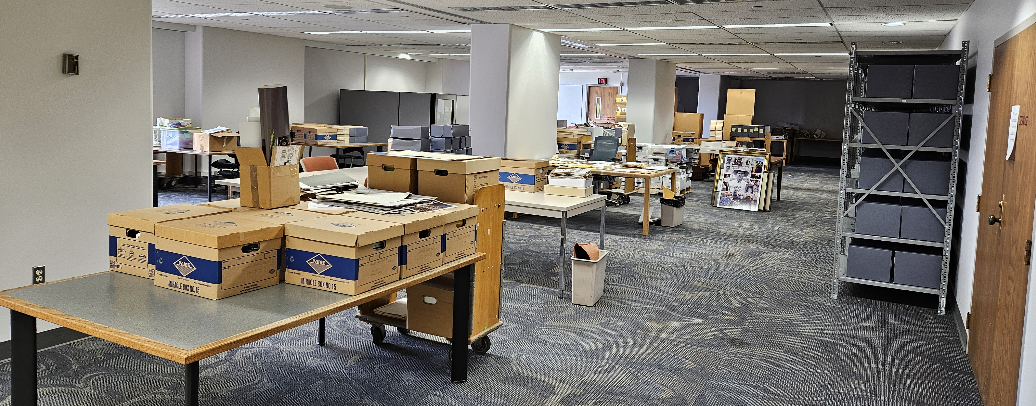
History of SCUA Accessions
Three accession record creators with no shared procedure
One para-professional stacks manager who handled some accessioning tasks
Have to check 3+ locations for accessions data prior to 2020
End of year rush (20-30%), missing data, no Deeds
Accessioning Archivist & Stacks Manager hired in 2022
Created a new Intake Space in 2023
Unit or Department Name Here
Special Collections and University Archives

Slide 9
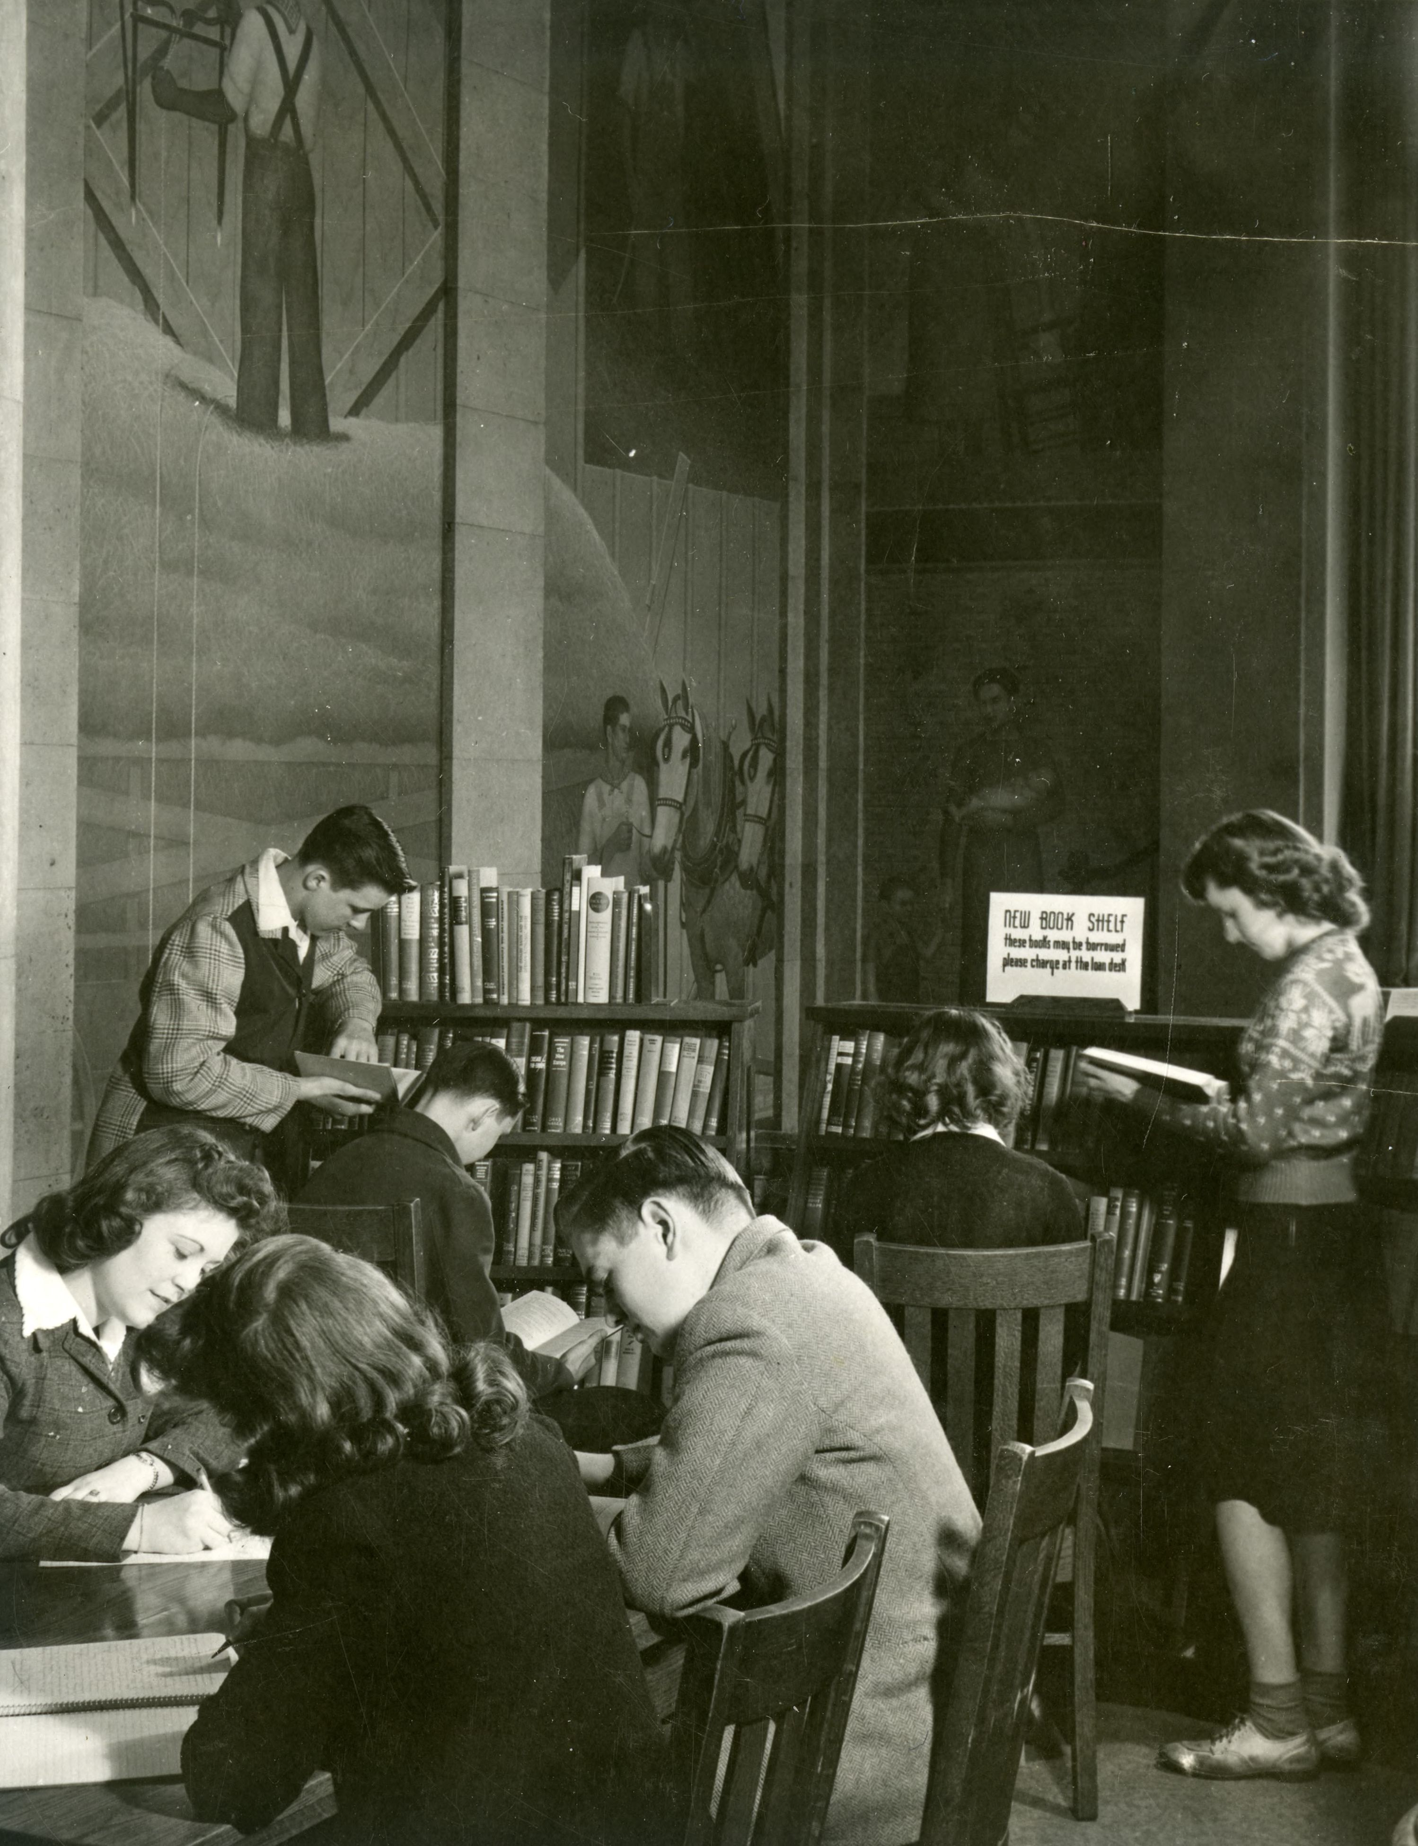
Goals with AA&SM position
Improved accession records
Backlog and bottleneck reduction
Active donor relations
Improved use of physical resources
Improve activities downstream
Stop accessioning everything!
Unit or Department Name Here
Special Collections and University Archives

Slide 10
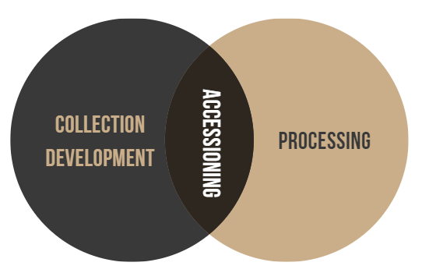
Hiring and Onboarding
Overlapping documentation needs
  Review ArchivesSpace manual
  Review past accessions
Similar tasks during job duties
  Review Processing manual, draft Accessioning manual
Impact
  Talk to Collections Archivists
  Process a collection
Unit or Department Name Here
Special Collections and University Archives
Notes:
How does a processing foundation influence accessioning work, and how can that base be used in Onboarding/training?

Slide 11
A Year in Review: Manager's Perspective
Challenges
"Stacks Manager"
Scope Creep
Legacy/Retrospective issues
Who does what
Accessioning is not secretarial work
Born Digital & removable media
Victories
Decreased backlog
Increased access
Easier stats/priorities
Not creating legacy problems
Easier processing
Format pipelines done earlier
Special Collections and University Archives
Notes:
Stacks Manager: don't want this to be 2 jobs shoved into 1, but this is a leftover from the old position and still a need we have.
Duty Breakdown: Most of us have never worked with a dedicated accessioning archivist before, so it can be confusing where the line between the collections archivists work and accessioning archivists work is. After talking to other colleagues, it seems pretty common for some curators to feel a little territorial over their collection area, but it can be frustrating when it impacts your work. Also still working on getting people to include JG earlier in the conversation about incoming donations, rather than after the details are figured out.

Slide 12
Takeaways for other institutions
Open communication is the key, as always
Resource allocation problem
Most bang for your buck is earlier in the process
Sustainable is best
Unit or Department Name Here
Special Collections and University Archives

Slide 13
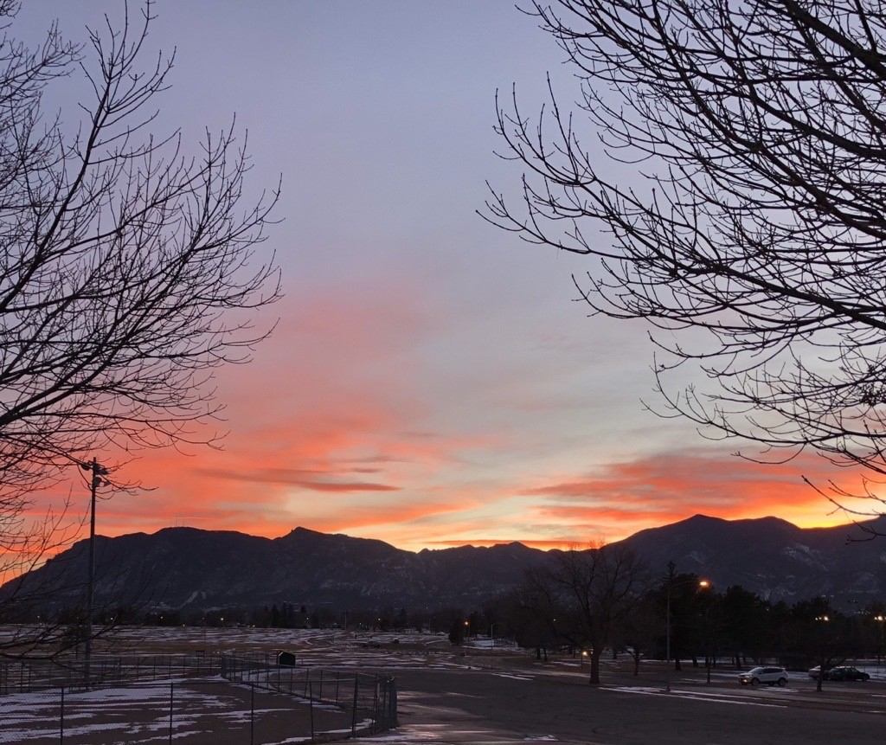

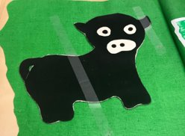
Jessica Green
Accessioning Archivist and Stacks Manager
MLIS from UW-Madison in May 2022​
Started at Iowa State University in December 2022​
Accessioning Archivist for both University Archives and Special Collections materials​
Stacks Manager for Special Collections and University Archives spaces on- and off-site
Pictured: A sunset from my hometown, Colorado Springs; myself from the ISU Library Directory; a picture of a child made felt cow with big eyes from a 4-H scrapbook [accessioned, unprocessed]
Unit or Department Name Here
Special Collections and University Archives

Slide 14
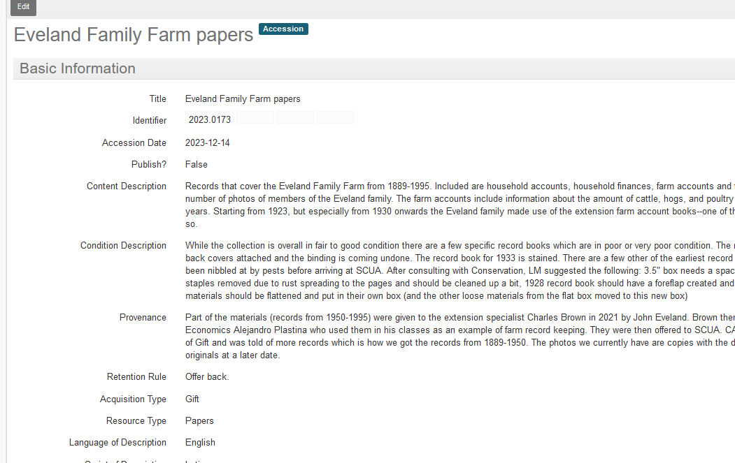
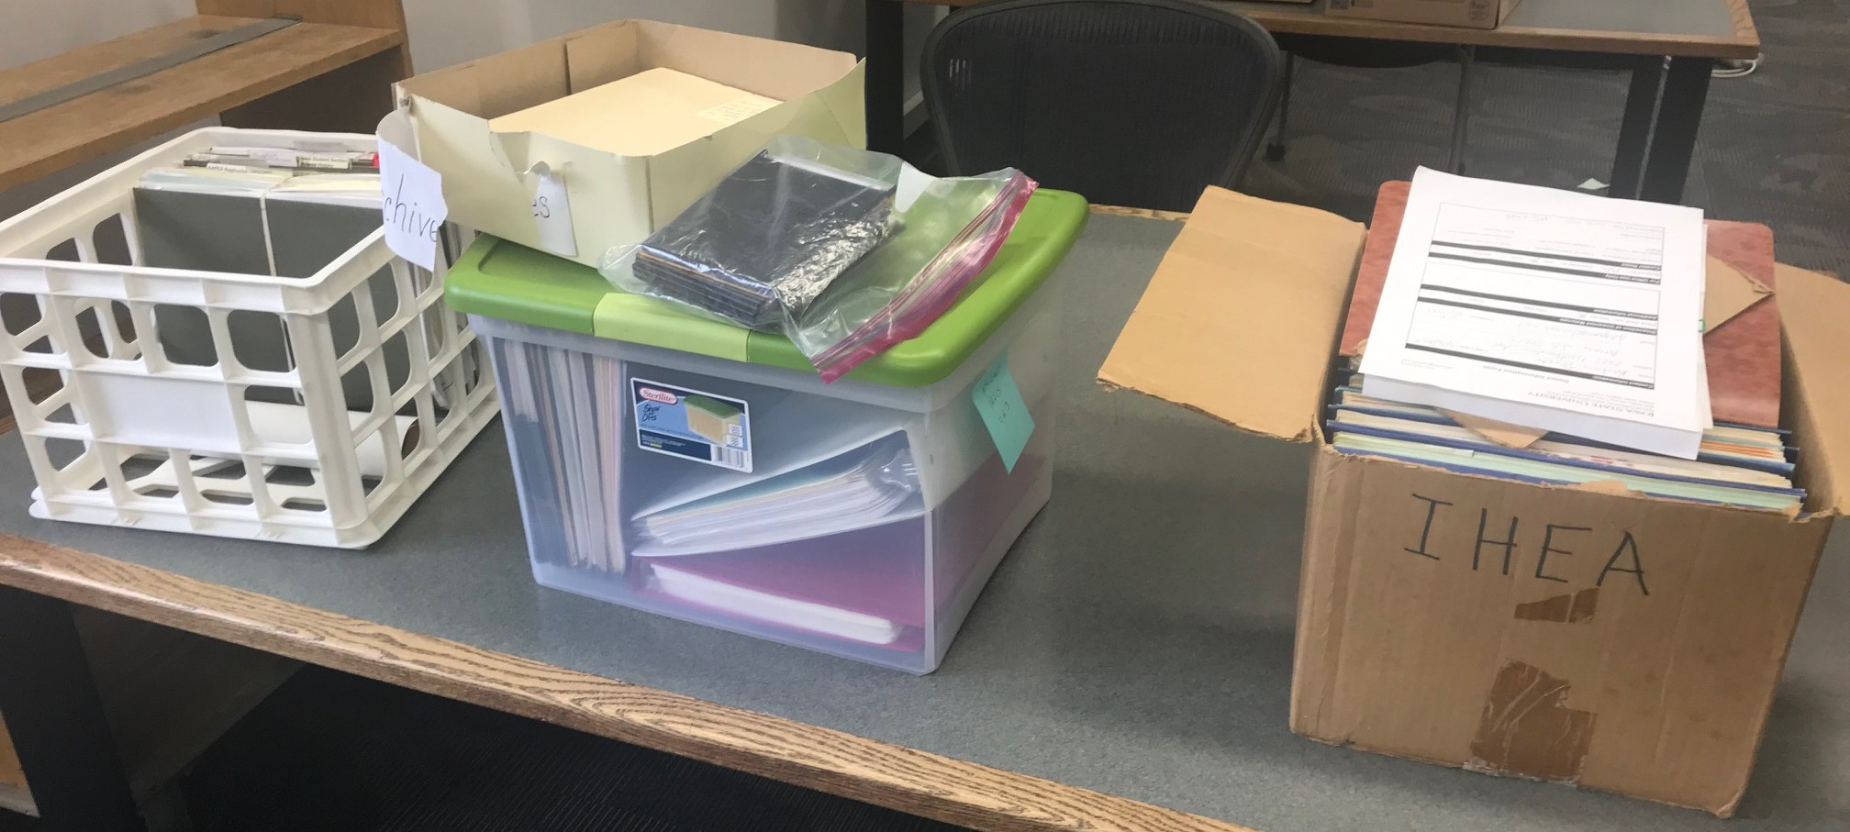
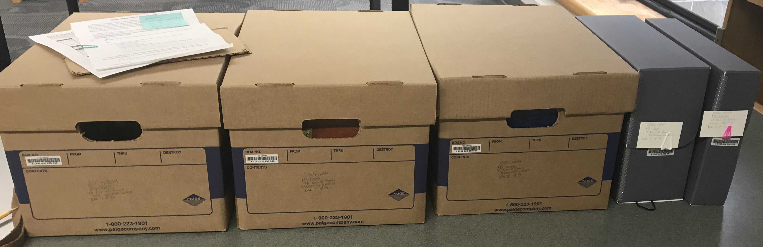
Accessioning-Not Processing
Communication: to myself, colleagues, and future archivists.
Accessible to patrons
Stable while awaiting processing
"Baseline does not mean sparse"¹
¹ Searcy, Rachel. “Beyond Control: Accessioning Practices for Extensible Archival Management.” Journal of Archival Organization 14, no. 3–4 (2017): 153–75. doi:10.1080/15332748.2018.1517292.
(Pictured Top to bottom: A completed ASpace accession record for the unprocessed Eveland Family Farm papers; an acquisition before accessioning; an acquisition after being accessioned)
Unit or Department Name Here
Special Collections and University Archives

Slide 15
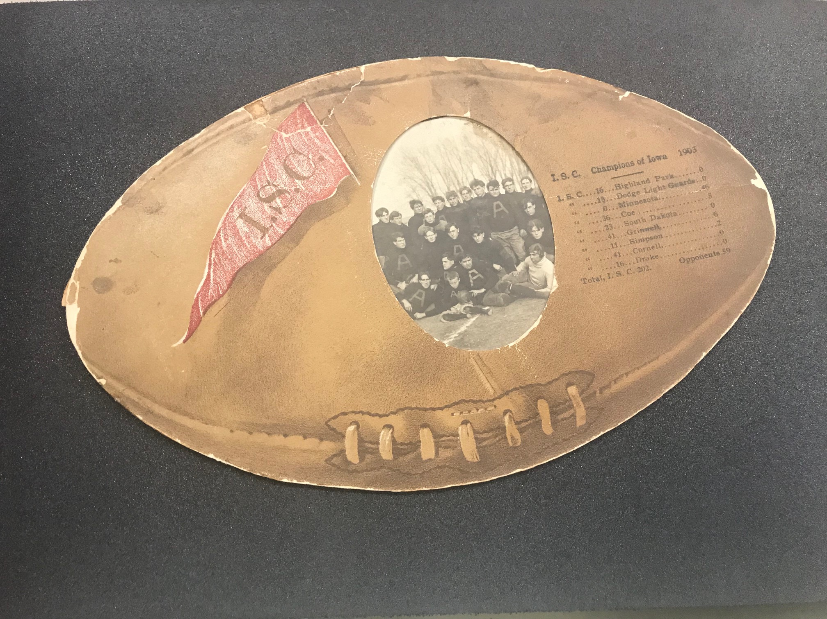
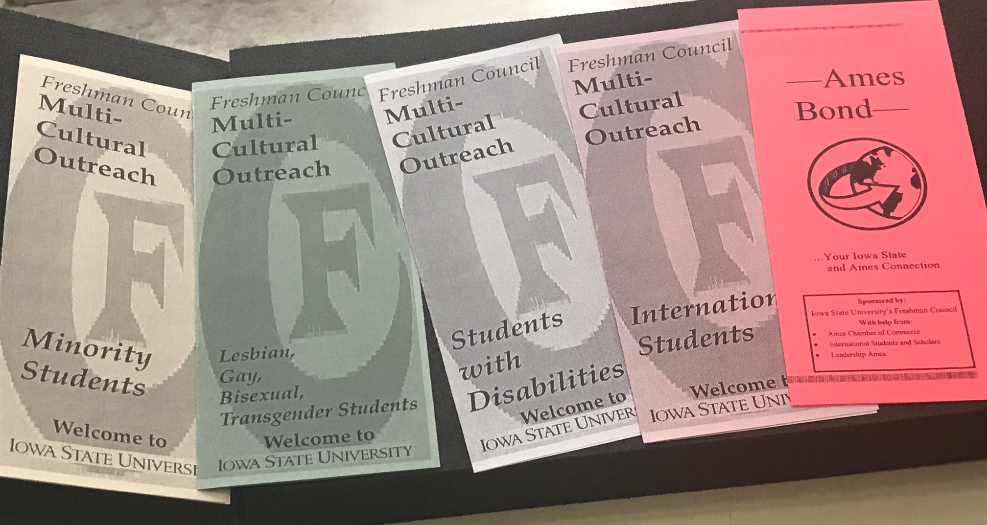
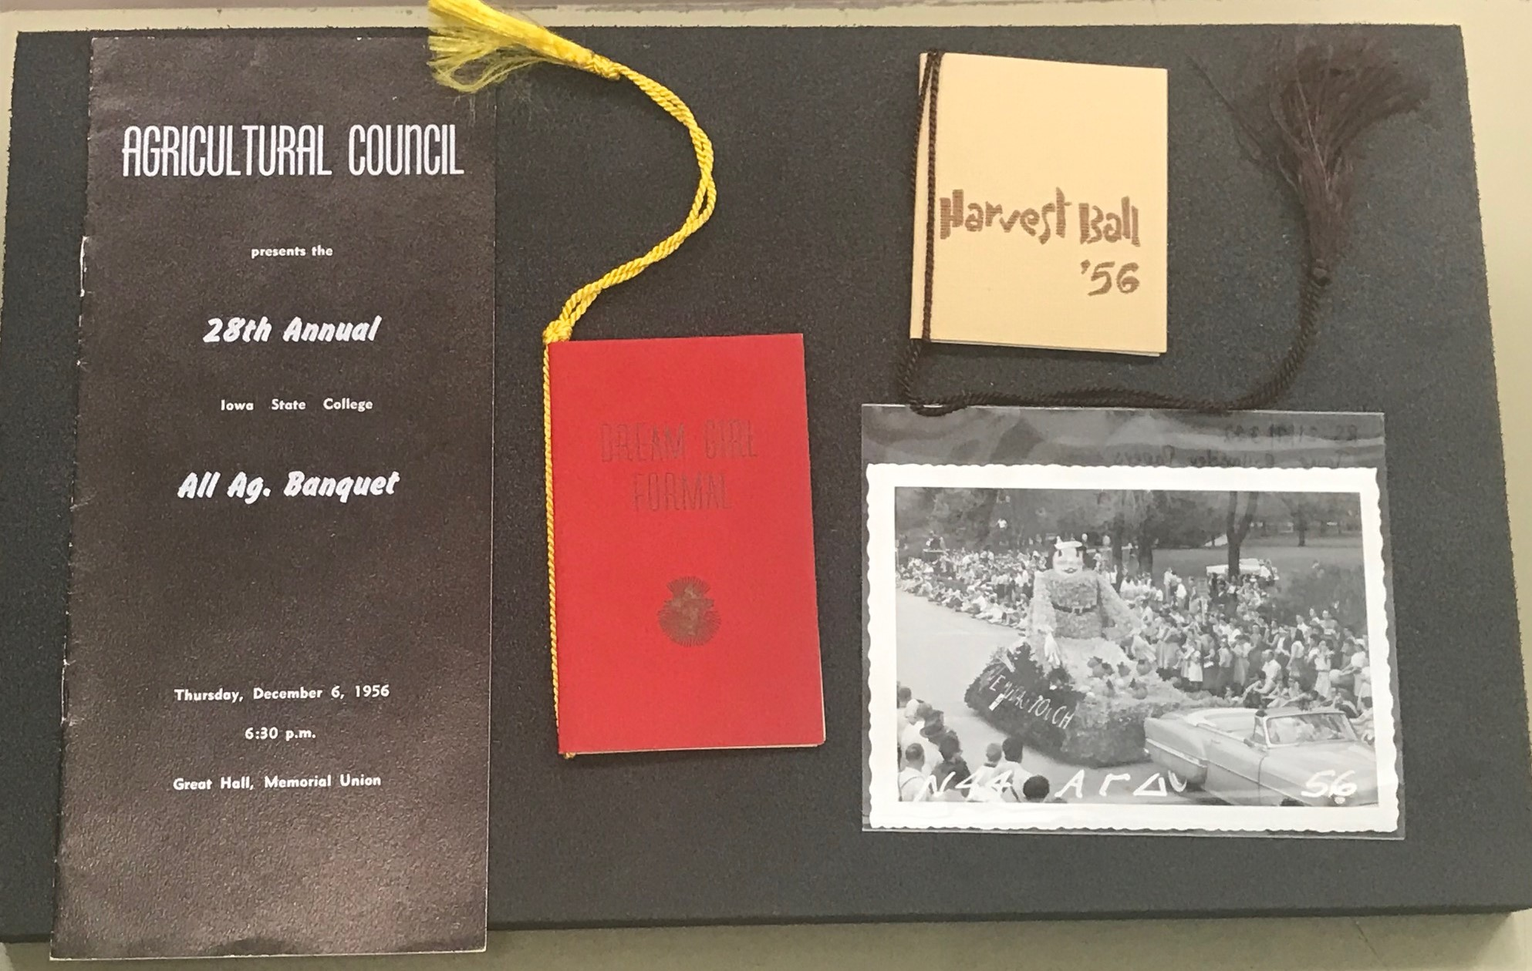
Accessioning for Access
Mostly accruals, but some new collections too.
Examples: Freshman Council pamphlets (accrual), a football program (accrual), an alumna's papers (new)
Dependent on size and level of processing required for access—draft guideline table
Pictured Top to Bottom: Football Mat Photo, 1903, RS 24/6/1.; Multicultural Outreach Pamphlets, Freshman Council, 1993-2012, RS 22/4/0/1; Jane Rylander papers, 1955-1957, RS 21/7/322
Unit or Department Name Here
Special Collections and University Archives

Slide 16
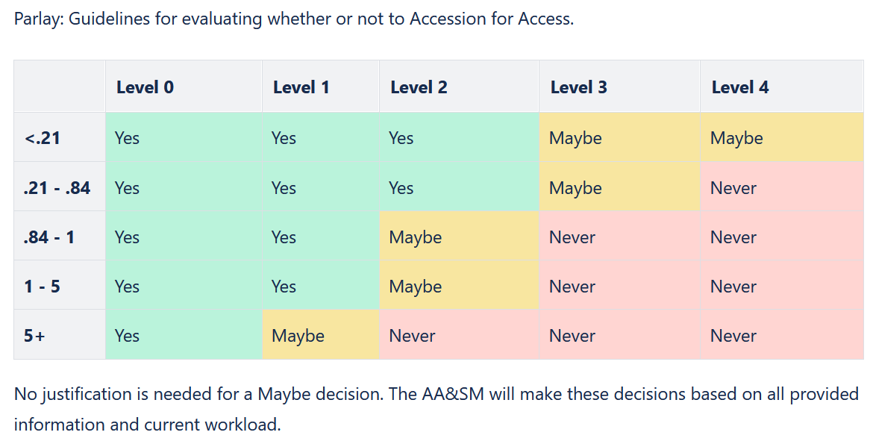
(Draft Guidelines for Accessioning for Access)
Unit or Department Name Here
Special Collections and University Archives
Notes:
A screenshot of the Accessioning for Access guidelines. The columns read from level 0 to level 4 (depths of processing) and the rows read from smaller than 0.21 to 0.21-0.84 to 0.84-1 to 1-5 to more than 5 (linear feet). The table is then filled in with yes, maybe, or no.

Slide 17
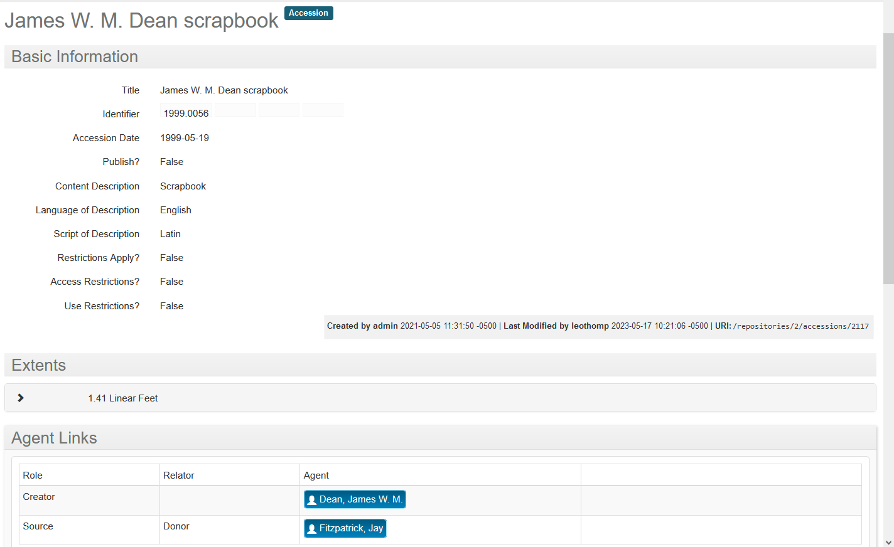
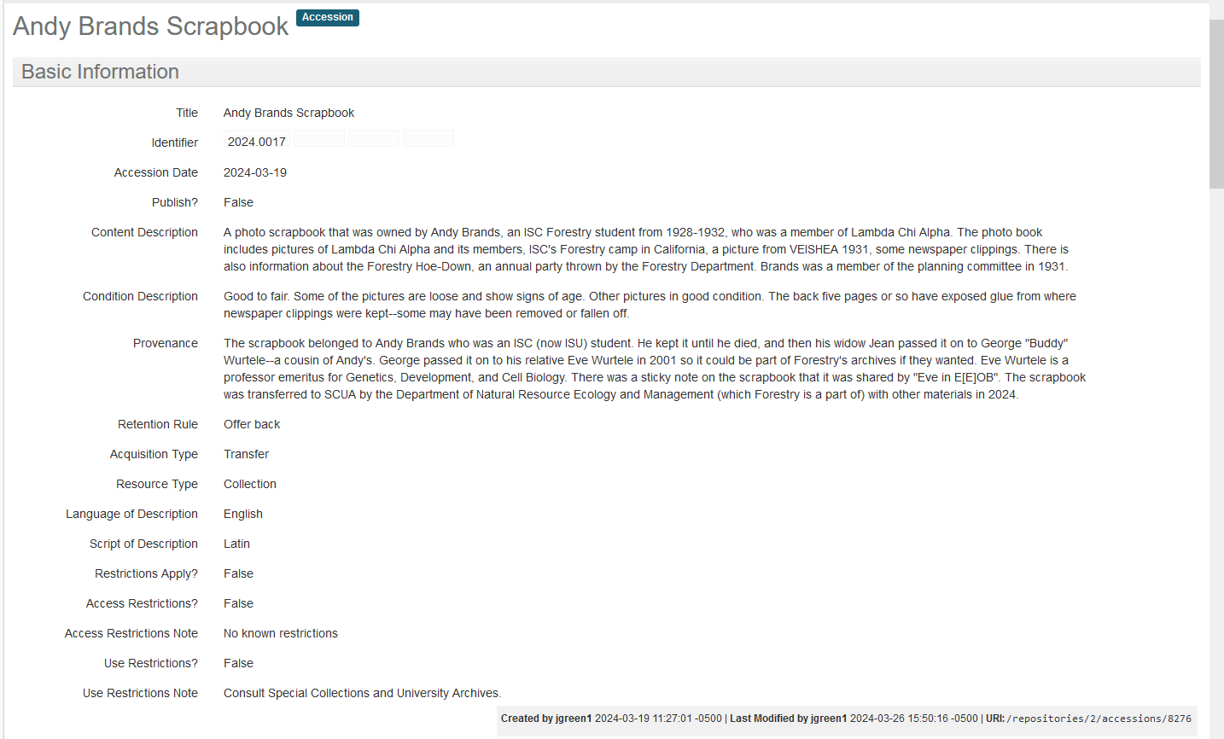
Legacy Issues
Old accession records often lack context and at times even content.
Sometimes there are donor files to expand understanding but not always.
New accessions try to answer questions of Who, What (and What Condition), When, Where, How which can be used to answer biggest question: Why
Pictured top to bottom: An accession record from 1999 for a scrapbook; An accession record from 2024 for a scrapbook.
Unit or Department Name Here
Special Collections and University Archives

Slide 18
Legacy Issues
Orphans/Legacy Collections/Found in Collection=Unaccessioned materials
Sometimes they have a donor file and sometimes they don’t
Record both what we DO and DO NOT know about the collection
Work on creating these as there's time—not a quick project
Unit or Department Name Here
Pictured on the next slide left to right: an accession record for the Walter Lovely papers (no additional information or donor file found); an accession record for the Carl Hamilton papers (donor file and additional information found)
Special Collections and University Archives

Slide 19
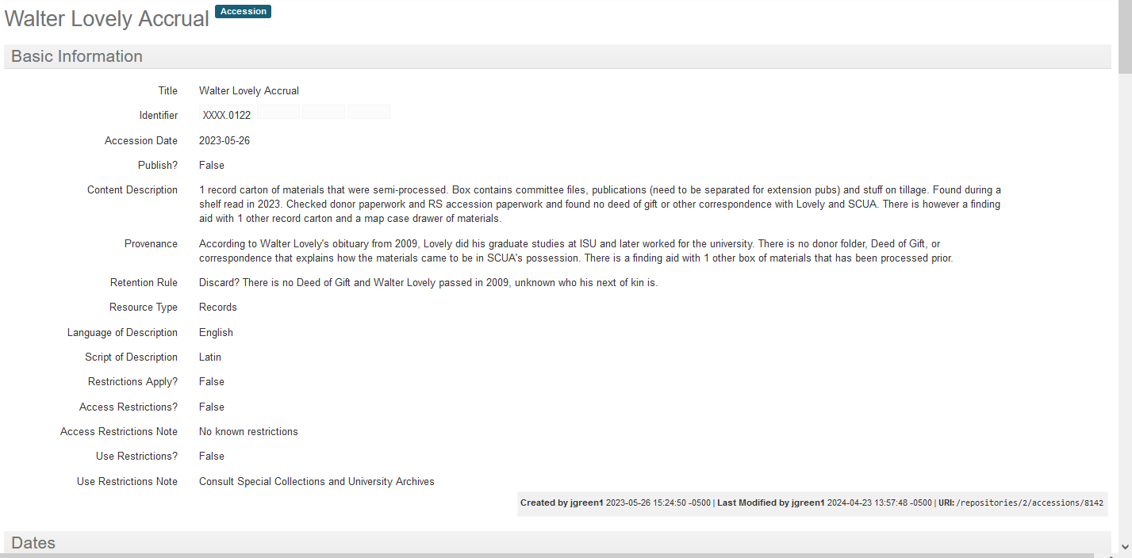
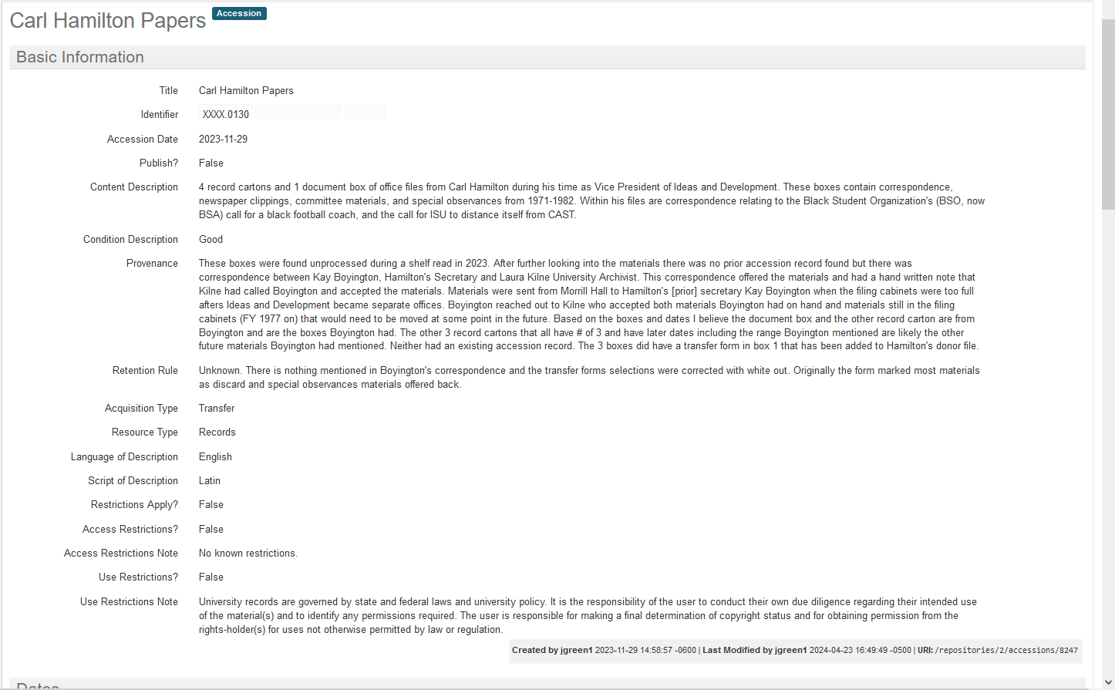
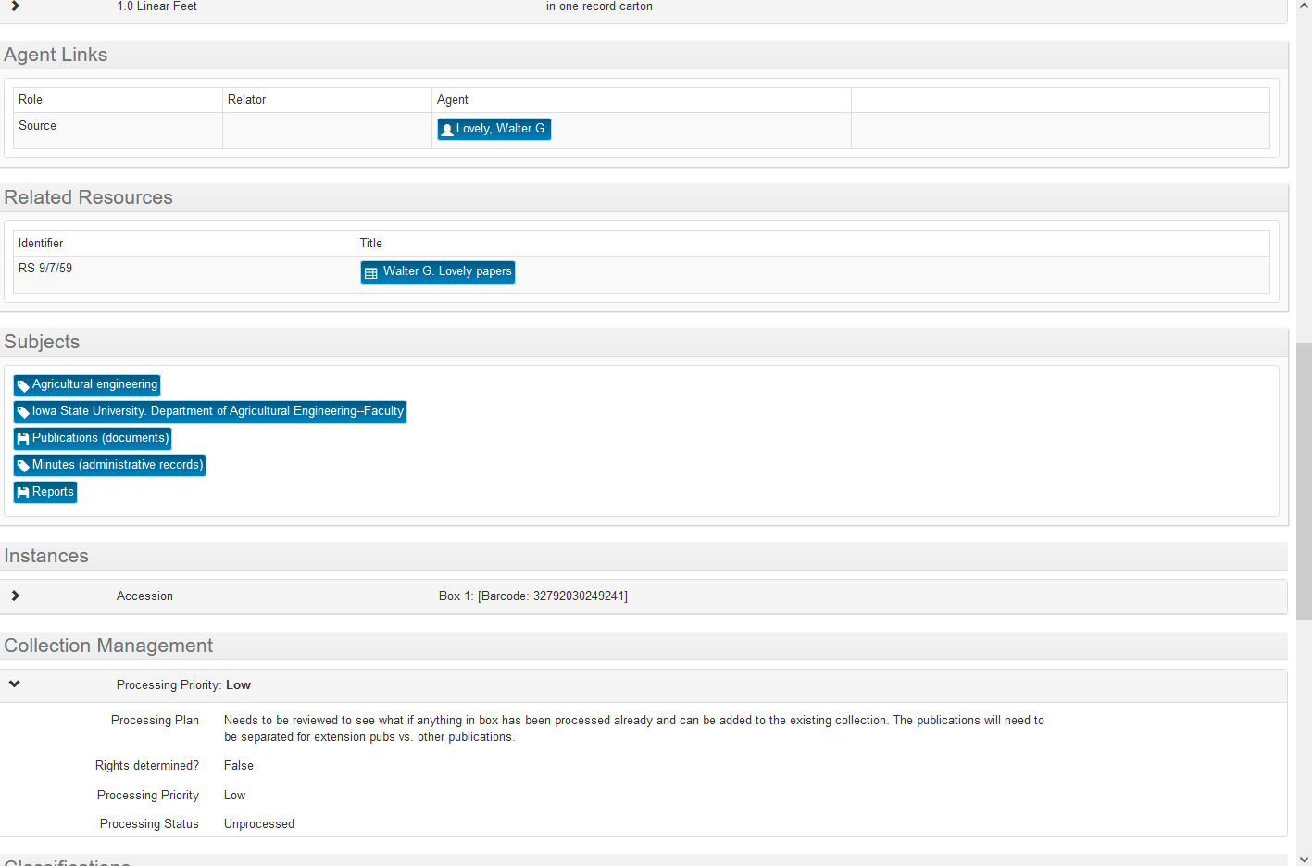
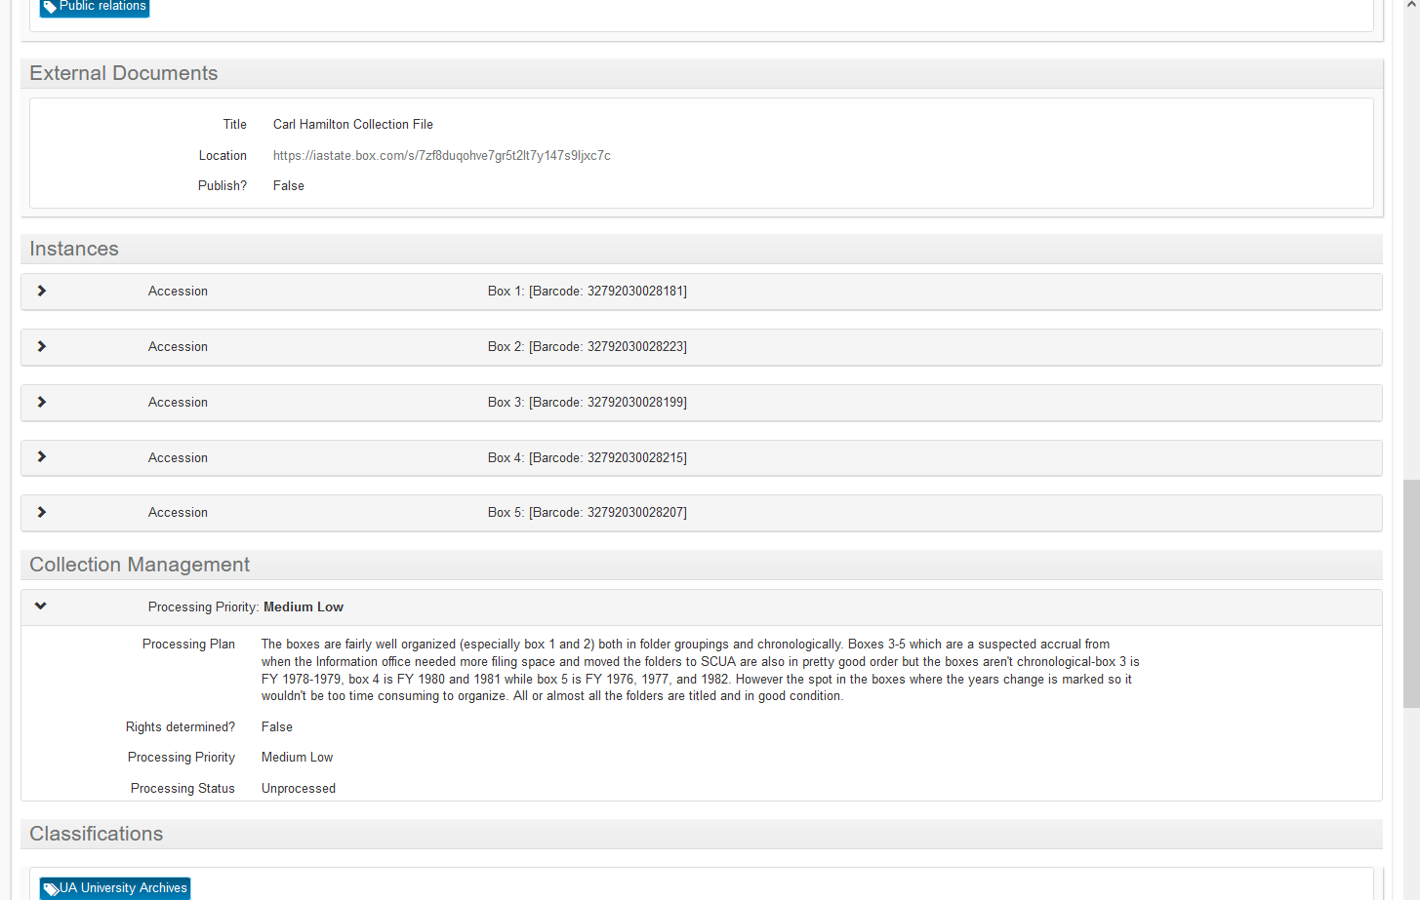
Unit or Department Name Here
Special Collections and University Archives
Notes:
A screenshot of the Accessioning for Access guidelines. The columns read from level 0 to level 4 (depths of processing) and the rows read from smaller than 0.21 to 0.21-0.84 to 0.84-1 to 1-5 to more than 5 (linear feet). The table is then filled in with yes, maybe, or no.

Slide 20
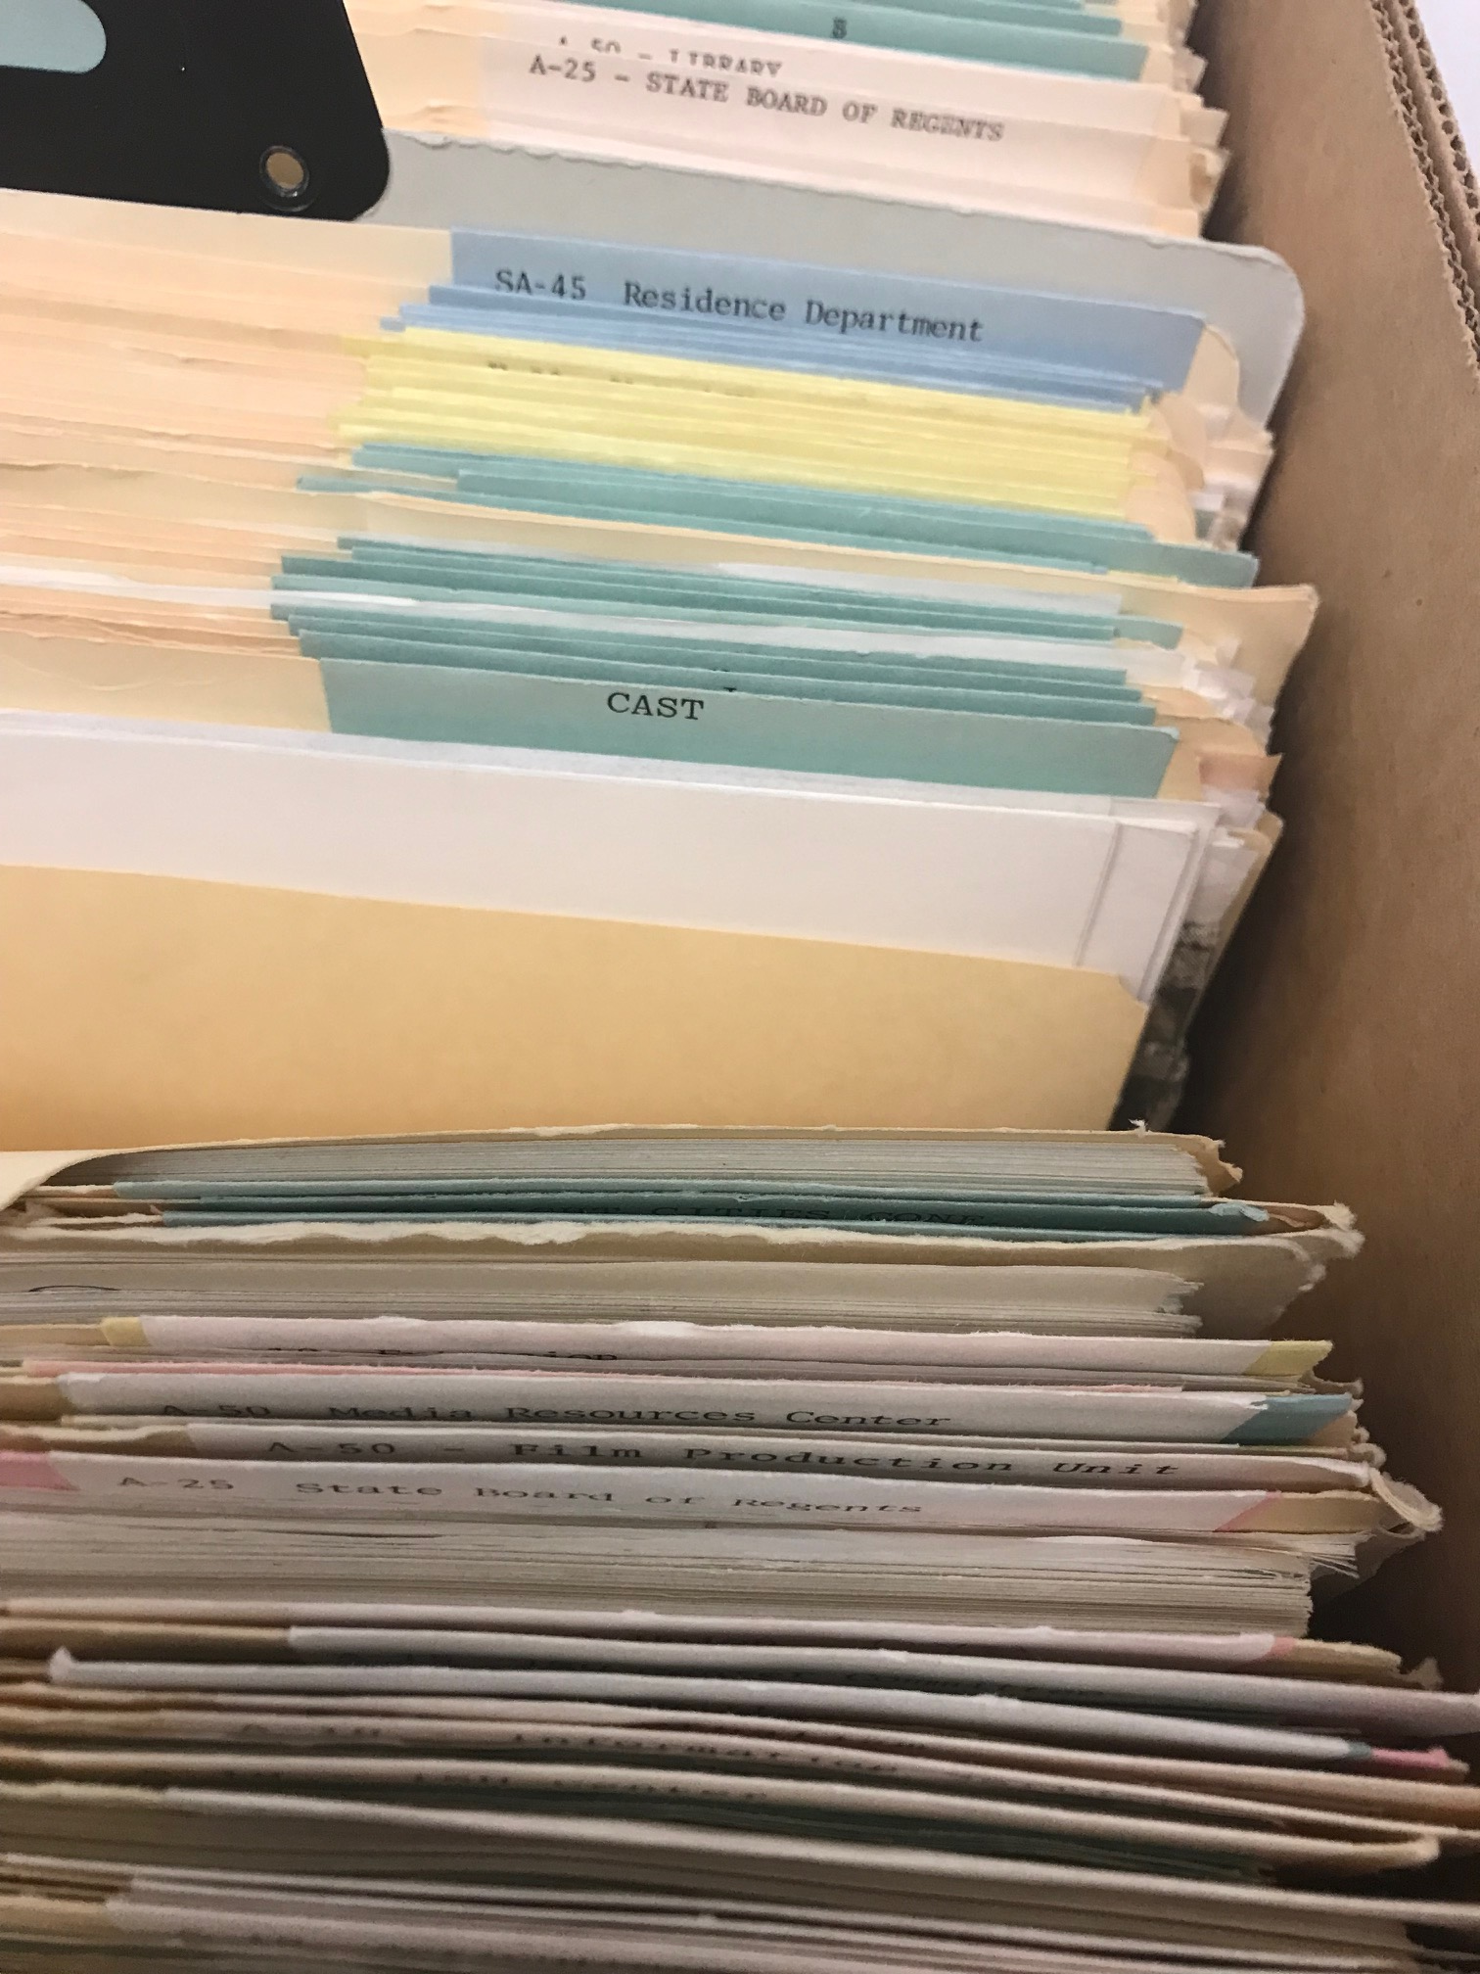
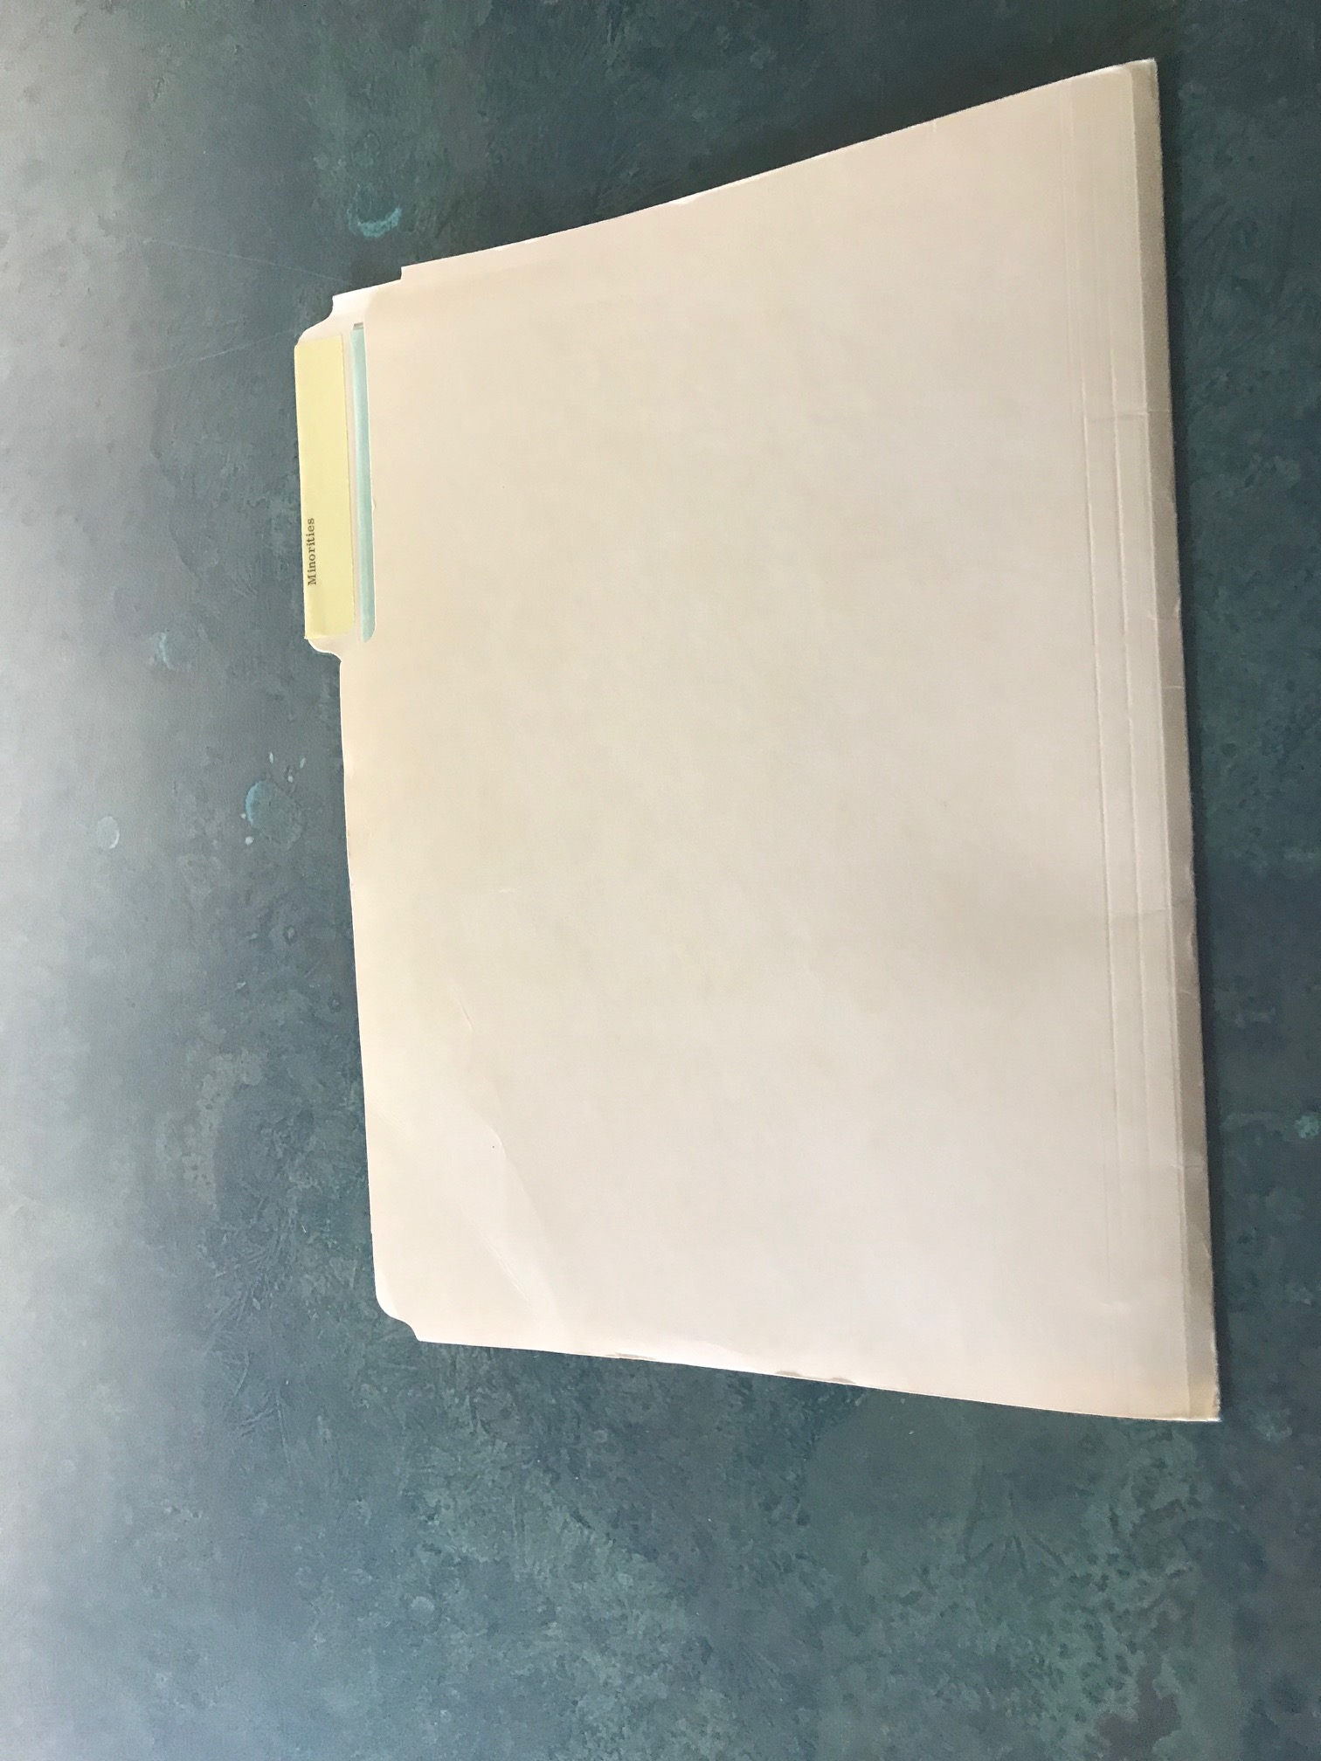
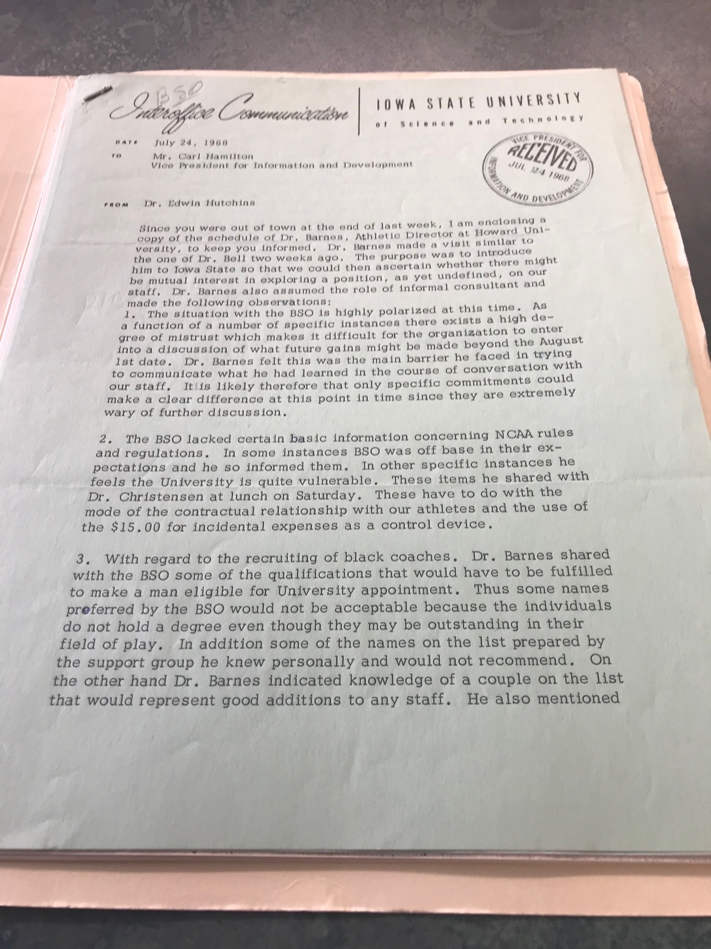
Legacy Issues
Sometimes revisiting these legacy collections reveal other voices in the collection.
Made a point to add these potential voices to the content description.
Depending on size of what is in collection can be made a bigger deal—in this case 2 folders
Pictured Top to Bottom: 1 CAST folder in an accession of 5 boxes, 1 of 2 "Minorities" folders from an accession of 5 boxes, an example of correspondence in the folder mentioning the Black Student Organization and their demands (from accessioned unprocessed Carl Hamilton papers)
Unit or Department Name Here
Special Collections and University Archives

Slide 21
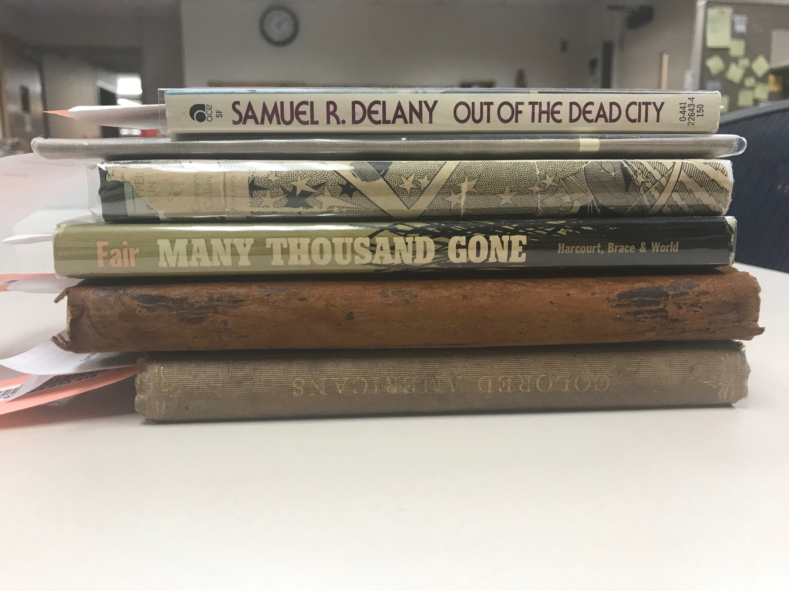
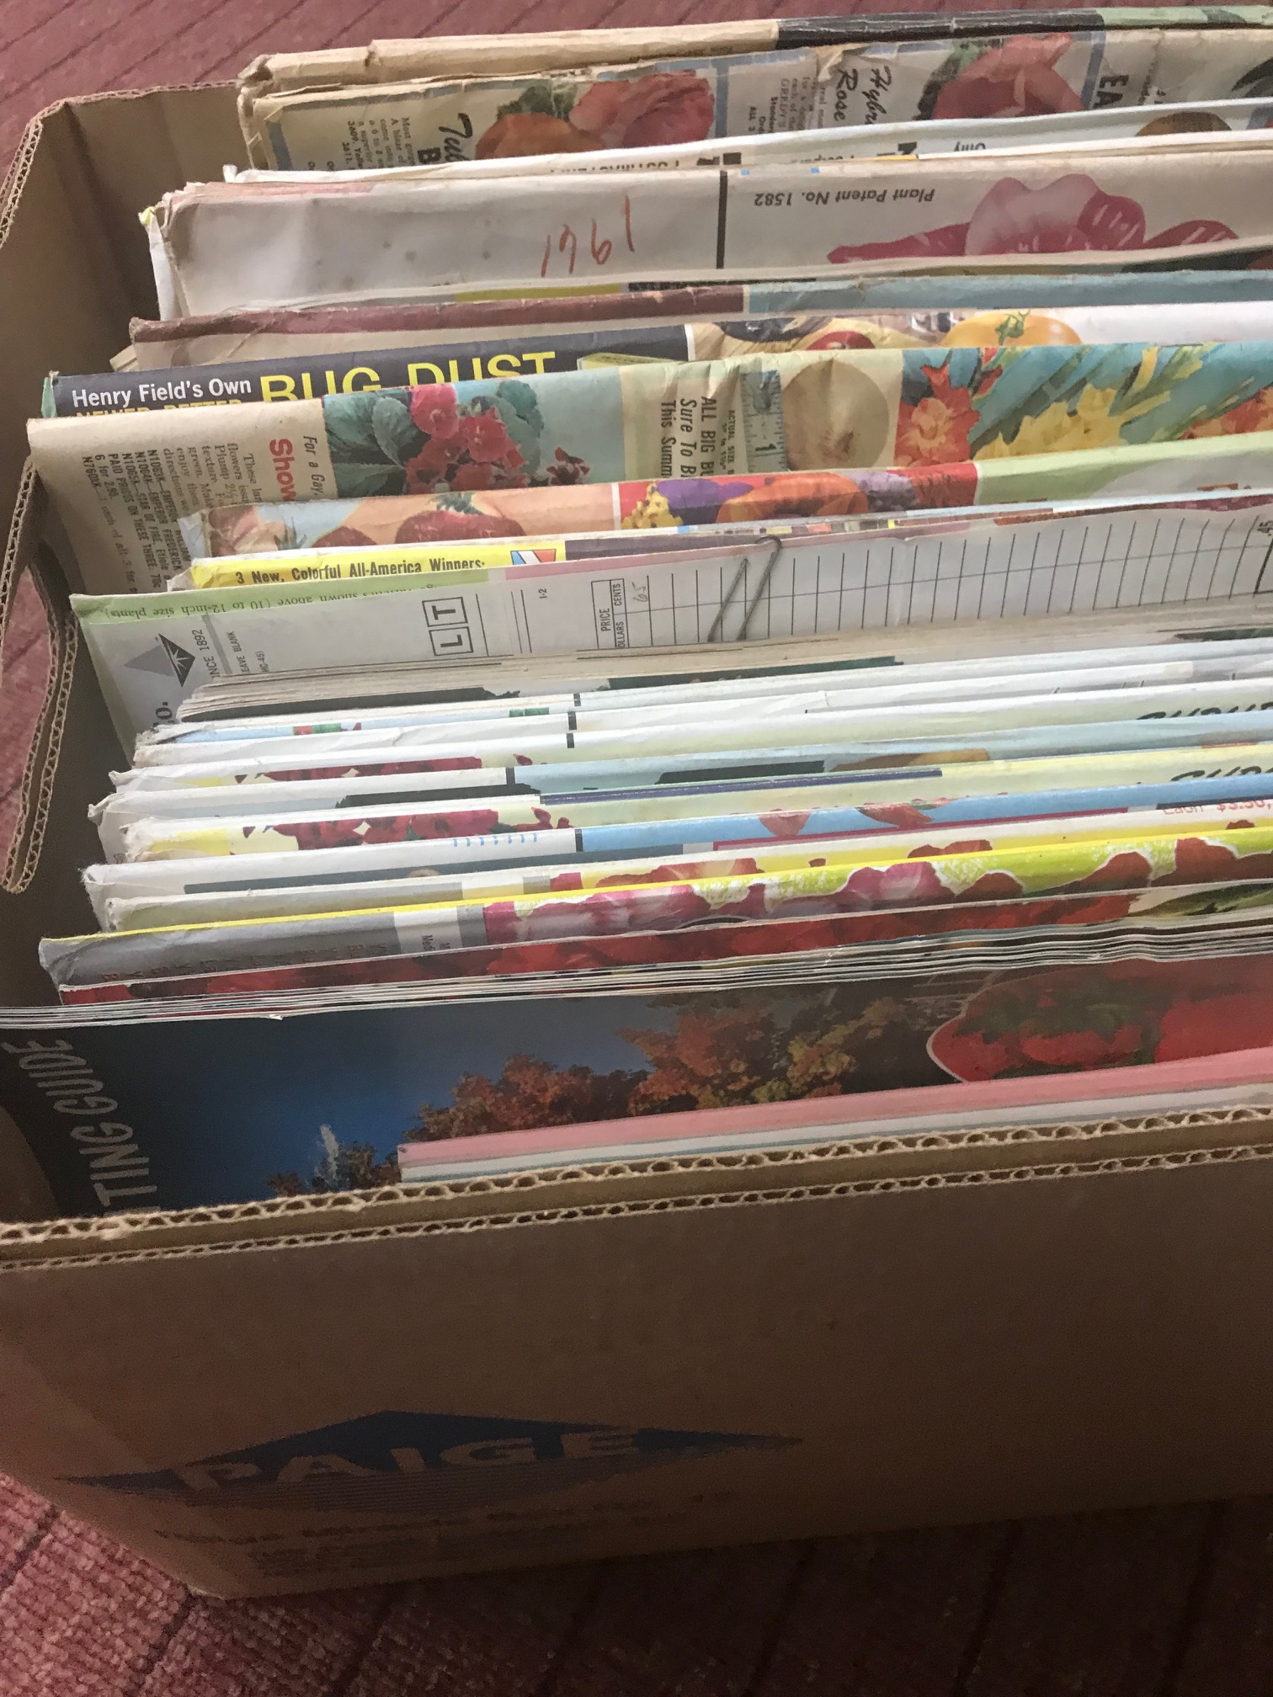
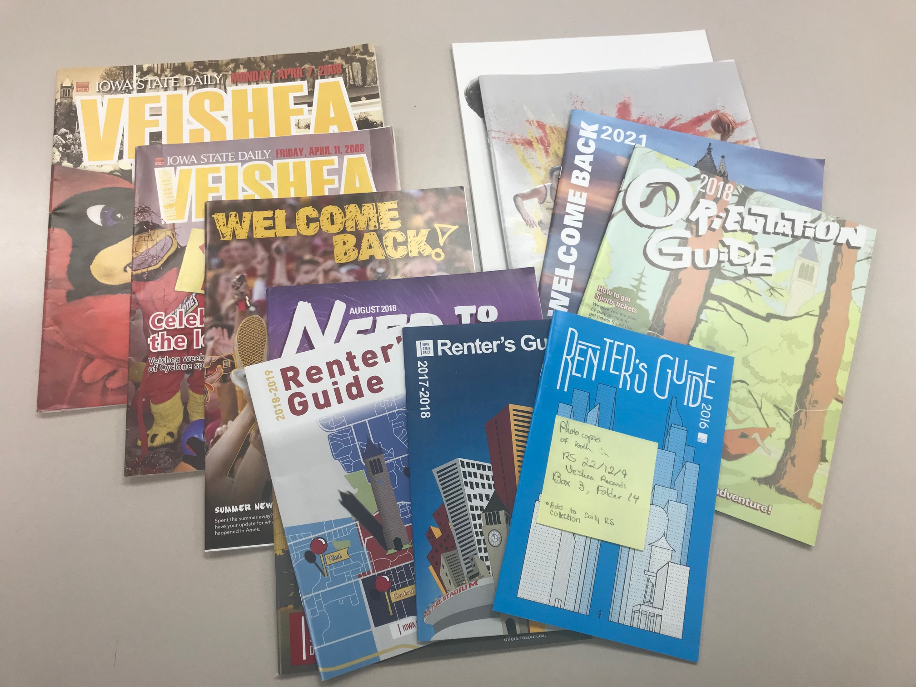
Roadblocks
Legacy Collections: continuing to accession materials found in the stacks or the department
Lack of personal experience accessioning
  "Beyond Control: Accessioning Practice for Extensible Archival Management" and "Archival Accessioning" helped in moving from theoretical to practical.
Cataloging
Varied Workload
Procedure Writing
Pictured Top to Bottom: books which are accessioned and then cataloged; garden seed catalogs which are accessioned and cataloged; ISU Daily special editions which are accessioned and processed. Not pictured: serial publications that are cataloged only.
Unit or Department Name Here
Special Collections and University Archives

Slide 22
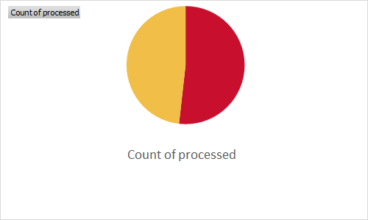
Victories
Almost half of accessions created by AASM were processed through Accessioning for Access (47%)
Writing procedures down (for both Accessions and Stacks Management)
Backlog of Accessions being addressed
Stacks Management successes—shifting project of two collections over 115 boxes switching places due to size and use of the collections
processed | Count of processed
no | 58
yes | 54
Unit or Department Name Here
Special Collections and University Archives

Slide 23
Contact Us
Rosalie Gartner
Lead Processing Archivist
rgartner@iastate.edu
(515)-294-9527
www.specialcollections.lib.iastate.edu
Jessica Green
Accessioning Archivist and Stacks Manager
jgreen1@iastate.edu
(515)-294-5311
www.specialcollections.lib.iastate.edu
Special Collections and University Archives

Slide 24

Re-Building an Archival Technical Services Program Around Accessioning
Archival Technical Services
Ohio State University Libraries

Slide 25
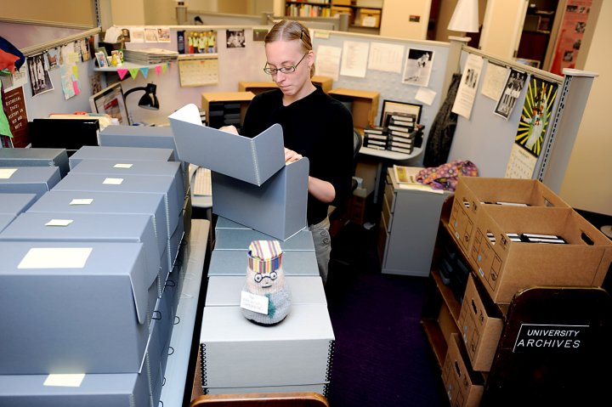
Cate Putirskis
Archival Technical Services unit manager, OSU Libraries (2013-current)
MA in Public History (North Carolina State University, 2007) putirskis.1@osu.edu
At my first job with accessioning responsibilities (2008)
Special Collections Research Center, North Carolina State University
Notes:
Good morning; and my apologies for not being able to be there in person this morning. I’m Cate Putirskis, currently the manager of the Archival Technical Services unit at the Ohio State University Libraries. My accessioning experience began around 2008 at North Carolina State University, where accessioning for the University Archives was one of my regular responsibilities. At Ohio State, I have built (and re-built) the accessioning program, and along with Rosalie, I have been a member of the National Best Practices for Archival Accessioning Working Group for the past three years.
I’m going to talk today about the process of rebuilding our accessioning program, including the challenges that prompted this choice and factors I used to determine what should change to yield a more effective program. I encourage you to consider which components of our rebuilding might also contribute to more effective accessioning at your institution.

Slide 26
Special Collections & Area Studies at OSU Libraries
Archival Technical Services
Hilandar Research Library
Theatre Research Institute
Rare Books & Manuscripts Library
Byrd Polar and Climate Research Center Archival Program
Ohio Public Policy Archives
Area Studies
+ Units with their own technical services positions:
Billy Ireland Cartoon Library & Museum
University Archives
Notes:
Starting with a bit of context: Special Collections & Area Studies at Ohio State is a large operation; there are 8 separate collecting units. Several units have multiple curators, who each have their own collecting programs. The Archival Technical Services unit is a separate, centralized department that directly manages and provides tech services operations for six of the 8 collecting units, which is 11 total curators and librarians.
There are also two SPECIAL COLLECTIONS units that have their own tech services folks (which is the University Archives & the Cartoon Library). Archival Technical Services—or, ATS, as I’ll refer to us going forward—generally does not work on collections for these units.
It‘s complicated--and busy!

Slide 27
Archival Technical Services Unit Responsibilities
  Intake/pre-accessioning
  Accessioning
  Processing
  Collections maintenance
  Physical location & inventory management
  Archival CMS management
  Finding aid & web interface management (w/support from IT)
Notes:
The scope of tech services varies by institution, so for context of ATS’s responsibilities, this is the scope of work I am referring to.
I will share more about our unit structure and positions in a bit.

Slide 28
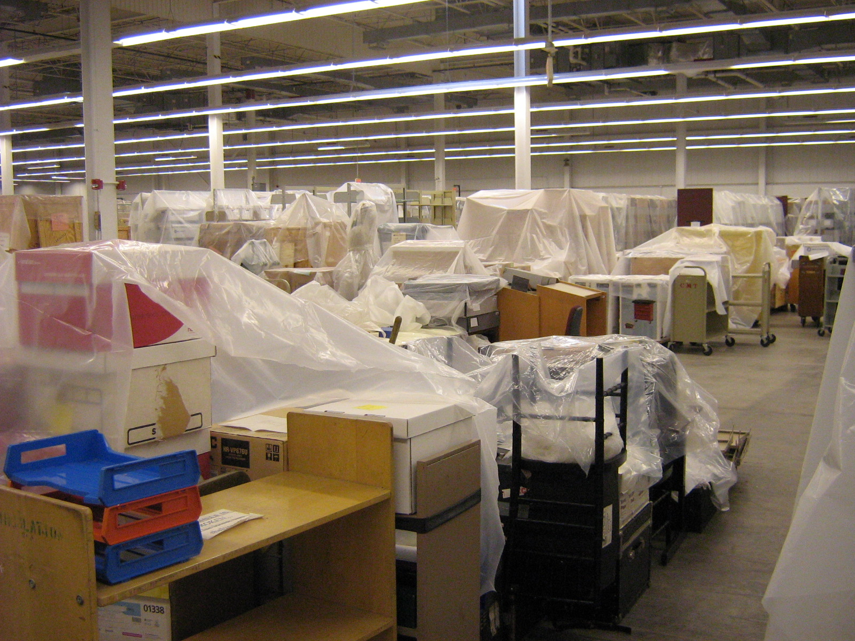
Technical Services Unit Timeline
pre-2013:
  no program
  no permanent positions
  limited collections work
Collections described/available to researchers: 200
Collections in backlog: 2800(?)
Collections accessioned: (?)
Collections storage (2013)
Notes:
Prior to 2013, most Special Collections units did not have dedicated tech services support. Some units had previously had contingent or project-based positions, and in others, the curatorial positions did occasional tech services work if their time allowed.
As of 2013, the six Special Collections units ATS now supports held approximately 3000 archival collections (comprising about 45,000 cubic feet). About 200 of these had been described in a format researchers could access (such as an online finding aid), and most had not been accessioned. About 2800 collections were largely or completely inaccessible. Donor agreements, deeds of gift, and purchase documentation did exist for most acquisitions, though.

Slide 29
Technical Services Unit Timeline
2013: Special Collections Processing Program established
2014-2020: Special Collections/Archival Description & Access Unit
  fluctuating staffing (1-11 positions (mostly contingent) + students)
Collections described/available to researchers: 900 (+700)
Collections in pre-2013 backlog: 2100
Arrival rate of new acquisitions: 200-800 cubic feet/year
  Accessioning rate per year: 50-200 cubic feet
Notes:
In 2013, a permanent program to manage tech services activities for Special Collections was created, which is what brought me to Ohio State.
The program focused initially on those 2800 under-described or inaccessible collections, with about a third made fully accessible to users by 2020. Positions were mostly contingent during this period, and staffing levels fluctuated between 1 and 11, with 5 to 6 positions being the average staffing level.
The first accessioning program was established in 2014; with up to two positions working on accessioning, depending on overall unit staff size. During this time, the accessioning program focused on completing donation documents, administrative processes, and physical stabilization for each new acquisition. Preliminary description (or, description for access, as I’ll refer to it going forward) was completed for some of these accessions, but not most.
By 2020, new collecting was significantly outpacing ATS’s accessioning turn around year over year, and our accessioning program was growing a new backlog of inaccessible collections.

Slide 30
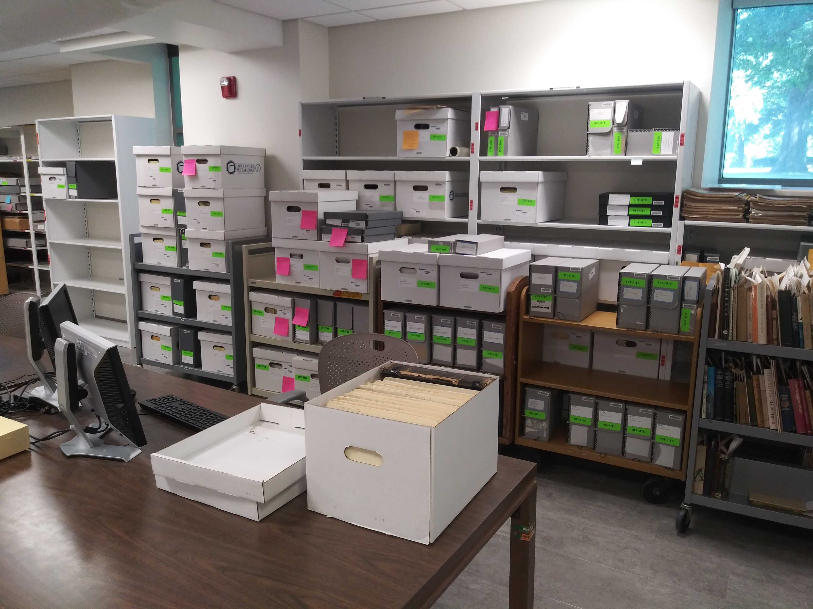
Centering Archival Technical Services Around Accessioning
Collections work in progress (2019)
Notes:
By 2020, the project-based contingent staffing model of the prior six years ended. Three permanent positions had replaced contingent roles between 2016 and 2019, and four additional permanent positions were allocated to ATS in 2020.
This brought the permanent staff of the unit to eight, and with it the question of what job responsibilities each of those eight positions should hold. Most unit operations were running successfully by this time, with the exception of accessioning. Internally, it was clear that accessioning needed more resources.
Not unsurprisingly, when I consulted with Special Collections, they agreed. Their efforts to build and diversify holdings and respond to user needs through collecting were not being adequately supported by ATS’s accessioning program. These colleagues also requested more resources for accessioning.

Slide 31
Re-Building Accessioning: Components
Define the scope & product(s) of the accessioning workflow
(+)
Determine the actual number of weekly hours (or, positions) needed to accession in line with collecting
(+)
Establish/employ prioritization processes
Notes:
With consensus to rebuild our accessioning program, I considered the challenges of our existing program. The lack of staffing for accessioning was a factor, but so was the actual work being done—and not done—during accessioning. Better prioritization for our accessioning staffing was also necessary.
If any of these challenges sound familiar at your institution, I encourage you to also consider these factors. I’ll explain how reviewing each of these areas determined how to structure our re-built program.

Slide 32
What Gets Done During Intake?
  Deed of gift
  Shipping/transportation coordination
  Receipt/inspection (including triage treatments)
  Stabilization & re-housing (as needed)
  Curatorial review & prioritization/sequencing
  Administrative control established
Notes:
The first step was to define the scope of accessioning. What work tasks do we mean when we use the term “accessioning”?
Special Collections colleagues are responsible for selecting new acquisitions, and for the majority of direct contact with their donors.
ATS is responsible for most other tasks to bring new acquisitions in, which we call “intake.” This division of responsibilities had been in place since the establishment of the accessioning program in 2014, and in most years, about three-quarters of the amount of the total time allocated for accessioning was actually being spent on these necessary but often time-consuming intake tasks. This needed to be accounted for in the rebuild of the accessioning program.
While intake and accessioning are differentiated groups of activities at Ohio State, they remain part of the same continuous workflow. Understanding how much time is actually going to the intake portion of your accessioning workflows may help reveal if you also have an imbalance of resources in this area.

Slide 33
What Gets Done During Accessioning?
  Accession record completed
  Fully processed at time of accession if:
    Prioritized during intake (and/or)
    Less than 5 cubic feet of materials
  Description for access during accessioning in all other cases
    Published + open for use
    Will not be processed (unless requested + demonstrated need)
Notes:
The next step was to answer the question: when is accessioning “done”?
Prior to 2020, our answer was when intake and an accession record were complete, with accession and collection numbers assigned. With those identifiers, physical materials could be shelved and minimal descriptive records created and stored in our content management systems. Further work—including most description and processing—was often intentionally deferred and routed to other queues in ATS.
From the perspective of managing archival workflows, this answer made sense in ATS. However, for our colleagues in Special Collections, this answer meant that the majority of materials they acquired were going into backlogs, not being described and made available to users. The rebuilt accessioning program needed to answer the question of when accessioning is done in a way that made sense for both ATS and Special Collections.
Description for access is now the minimum for all accessions. If the acquisition is small enough in size and/or prioritized by a curator at the time of arrival, processing occurs as a part of accessioning. If the acquisition is larger, processing does not occur, but a detailed enough description and container list are created that processing—while still always optional in the future—should be unnecessary for access to any collection.

Slide 34
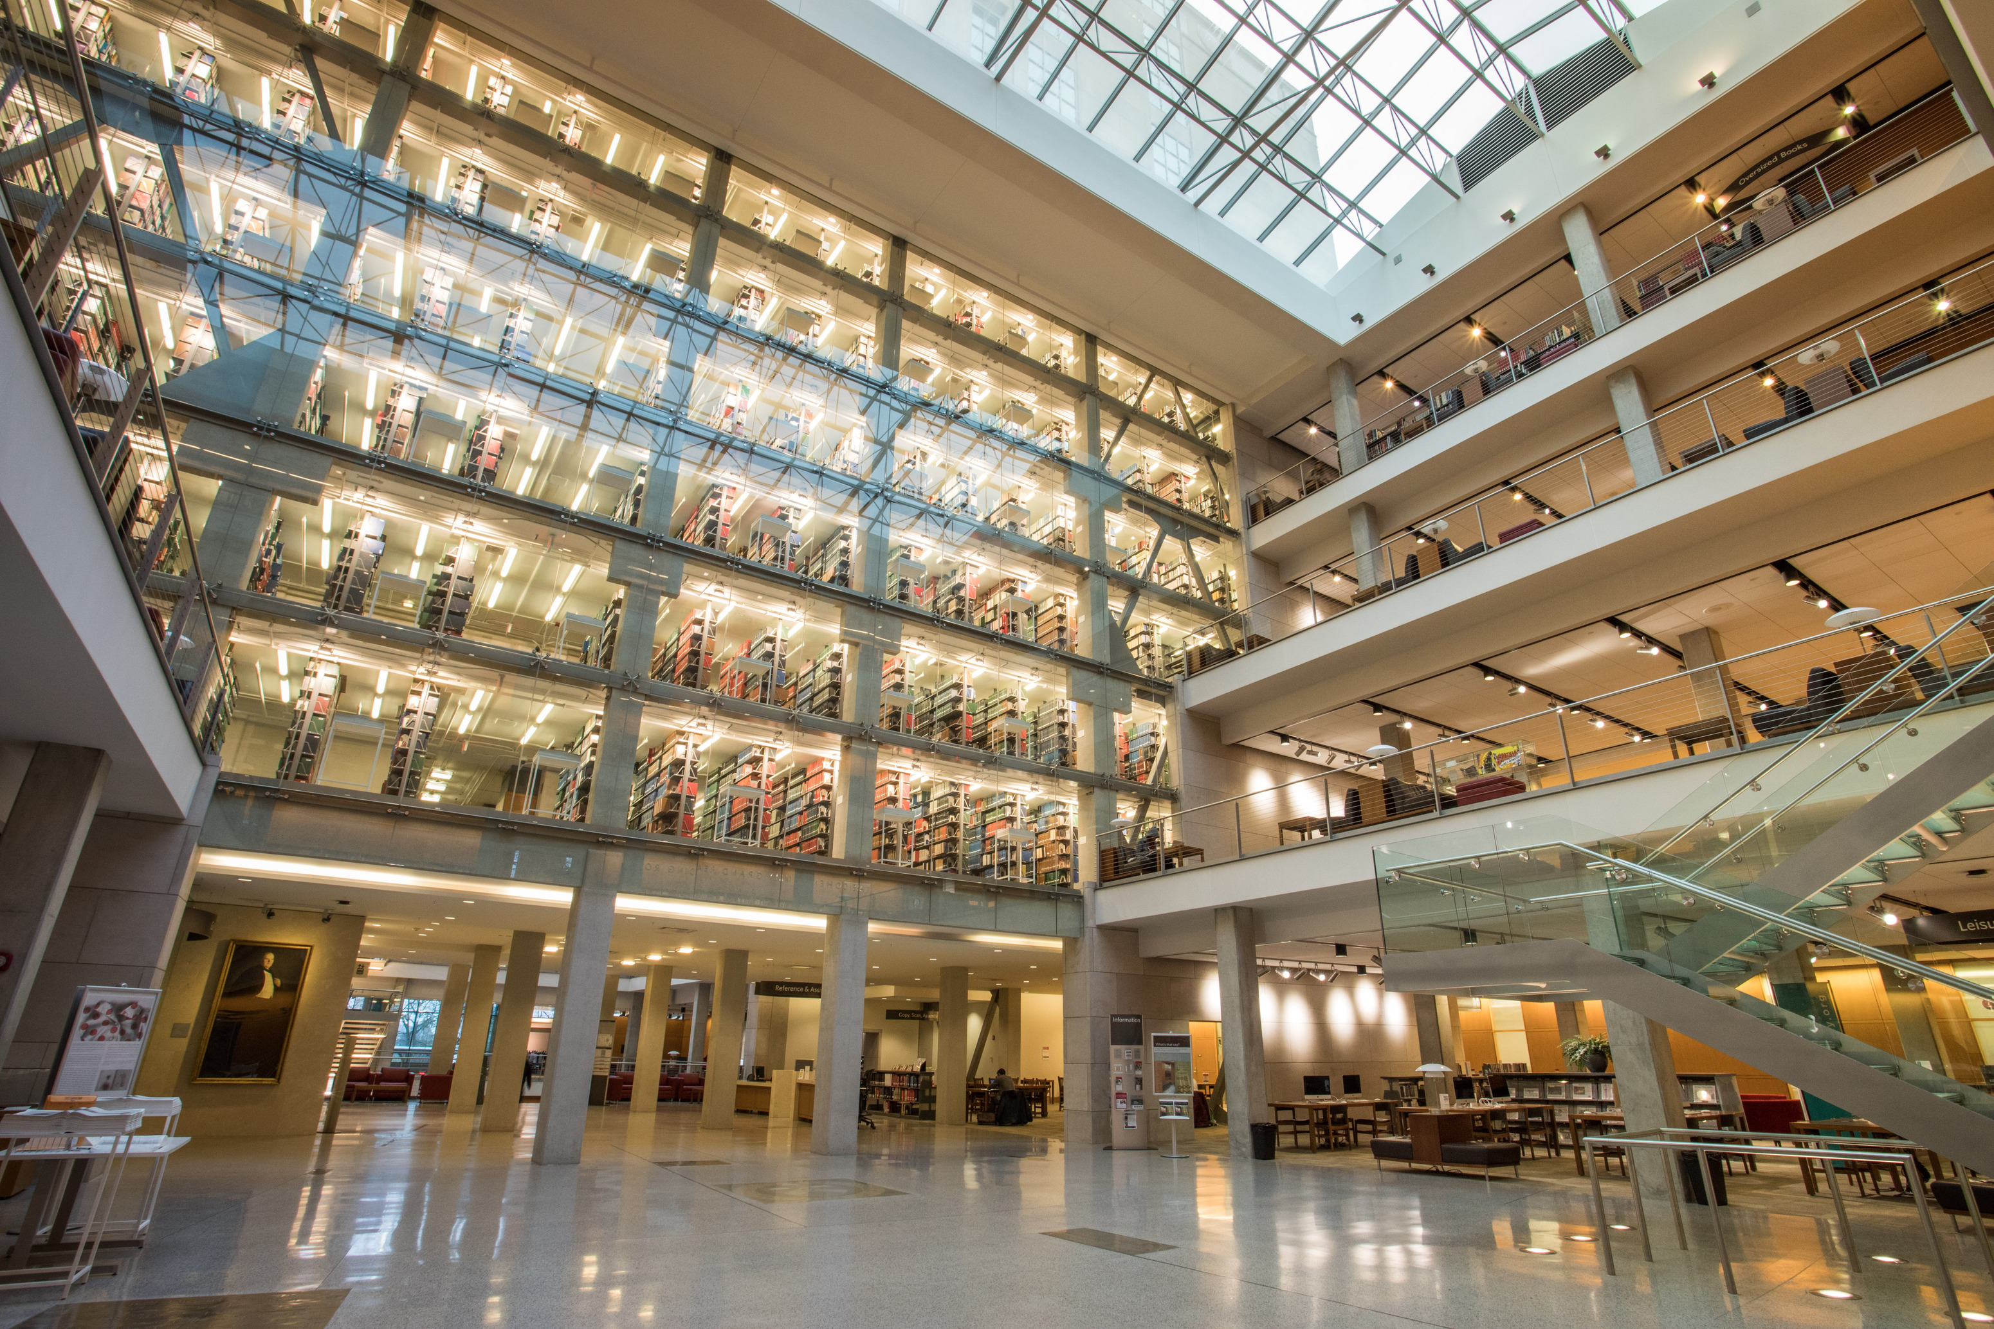
Technical Services Timeline
2021-current: Archival Technical Services Unit
  8 permanent staff (+ students)
  2 programs:
    Intake & Accessioning
      4 positions
    Collections Management
      3 positions
Thompson Library, as viewed from the Special Collections reading room
Notes:
Your institution’s answer to when accessioning is done may be different than ours, but having that answer is a key factor in determining the staffing resources needed to execute the work, which was my next step.
With our revised definition of the scope and products of our accessioning program, I used as many metrics and data points from 2014-2020 as I could find to determine what our actual accessioning staffing level should be. These included:
- Yearly collecting volumes of every unit;
- Time needed for intake;
- Time spent on accessioning under our initial workflows
- And projected time to accession under our expanded workflows
This analysis determined that four of the eight positions in ATS needed to be in the rebuilt accessiong program in order to effectively meet institutional needs and expectations.

Slide 35
Archival Technical Services organizational structure
Archival Technical Services Manager
Intake & Accessioning Lead Archivist*
Intake & Accessioning Archivist
Accessioning Archivist
Collections Management Lead Archivist
Collections Management Archivist
Collections Management Archivist
Accessioning Archivist*
lots of student employees
Special Collections Cataloging
* Vacant position
Notes:
This is the ATS unit structure now. Positions are arranged in two program areas: Intake & Accessioning (responsible for everything mentioned on the previous few slides), and Collections Management, which is responsible for the remainder of the lifetime needs of collections, include processing, if/when requested. Existing ATS staff were each in positions that transferred well into this structure, with two moved to the Intake & Accessioning program, and one to the Collections Management program. This left two openings in each program area.
Quick note about the Special Collections Cataloging program, which is fully integrated into our unit workflows. They do all of the accessioning for materials that are cataloged (and they share an office with us), so we consider them operationally a part of our unit, though administratively they do not report through us.

Slide 36
Accessioning Prioritization
Special Collections & Area Studies prioritization needs:
  Support for their responsive; “just-in-time” approach
    Many acquisitions are needed for specific courses, programs, events, or users
  Clear process for requests
  Transparency of overall queues
  Communication!
Archival Technical Services prioritization needs:
  Clarity of relative priority of each acquisition (low/medium/high/ASAP)
  Effective method to distribute accessioning resources amongst 11 curators
  Communication!
Notes:
The final step of rebuilding the accessioning program was establishing a prioritization system. Special Collections identified the needs for a better accessioning requesting system, and better transparency about where each acquisition was in the overall queue. ATS needed more structure to manage 11 competing collecting streams.
An underused prioritization policy was updated to require curators to identify each acquisition’s general priority at the point of arrival. If an accession was needed by a certain date, communicating that to ATS was also required.
Additionally, quarterly prioritization reviews of each curator’s queue began in 2022. These allow curators a regular opportunity to review all of their pending acquisitions, and to confirm overall sequencing. Quarterly queue review allows ATS to distribute our accessioning resources in an equitable manner, based on transparent and articulated need.
If you do not already have a method for prioritizing the sequencing of your accessioning, consider if employing one will help improve the overall efficiency of your accessioning program.

Slide 37
Re-Building Accessioning: Outcomes
Is it working? Overall, YES!
  Accessioning pace keeping up with collecting pace
  2014-2020 accessioning backlog decreasing 2-6% each quarter
  Timeline-driven requests all being met
Still working on:
  Filling positions
Notes:
The rebuilt accessioning program has now been in place at Ohio State since 2021, with some additional refinements introduced in the past three years, and it is working. All of the needs identified by both our own unit and by Special Collections are now being met. Accessioning output is on pace with collecting rates, and our prioritization process supports our colleagues’ needs. Researcher use of new acquisitions has increased, and the prior challenges in providing access to the these acquisitions have all but disappeared. We’ve even been able to dip into the accumulated accessioning backlogs of 2014-2020 and are clearing several accessions from those each quarter.
Ironically, our biggest outstanding task is to fill the two remaining vacancies in the Intake & Accessioning program; we are waiting for our turn in the recruitment queue. The primary impact of these vacancies is lack of time for larger acquisitions. However, large acquisitions are nearly always classified as ‘low’ priority by curators, so the vacancies are not impacting our overall ability to meet priorities.

Slide 38
Centering Accessioning: Takeaways
Scalable; can be done with a staff of any size
Underscores institutional responsibility to collecting/collections
Exposes the value of accessioning (especially description for access-based accessing)
Notes:
What can other institutions learn from our experiences re-building our accessioning program? While I certainly recognize the unique opportunities we had to add new positions and complete a unit restructuring, centering archival technical services work around accessioning is a scalable option that can work for archival repositories of varying size or resource level.
If you also have the opportunity to add new positions or re-scope existing positions to focus entirely on accessioning that’s great—dedicated positions certainly make a significant difference. But even archival repositories without pending growth opportunities can review the same components of their accessioning operations, and consider what other activities time can be reallocated from, such as moving some hours from processing to accessioning.
At Ohio State, we’ve learned to see accessioning as a necessity at the center of our work. We’ve rebuilt our workflows and positions to direct the greatest possible share of our resources to accessioning work. The specific way we’ve done this might look different from how your institution would make this pivot, but the nature of the outcomes should be similar.

Slide 39

Thanks!
Cate Putirskis
Archival Technical Services Manager
putirsksis.1@osu.edu
Notes:
Thanks for your time this morning; please do feel free to contact me with any questions or thoughts. I apologize that I can’t answer in person this morning. I’ll now turn things over to Sabrina Gorse, an archivist new to accessioning who joined OSU’s Archival Technical Services unit last year in one of our accessioning positions.

Slide 40

Sabrina Gorse
Intake and Accessioning Archivist, Archival Technical Services (ATS), The Ohio State University (September 2023-Present)
MLIS, Specialization in Archives and Information Science, University of Pittsburgh School of Information Sciences, 2014
Previously – Missouri Historical Society (January 2016-August 2023)

Slide 41
Processing and (Pre-) Accessioning
Stages in the same overall "lifecycle"
  Distinct, build off of and support one another
  CAN overlap
Intake and Pre-Accessioning ("first contact")
Accessioning ("framework")
Processing ("translation")

Slide 42
Intake and Pre-Accessioning in ATS
Oversee logistics of receiving acquisitions
Establish initial control
Gather information about acquisition
  Check for accuracy and condition
  Storage and initial "intake" housing
  Reviews
    Curators
    Conservators (potentially)
Legal – deeds of gift (donations), receipts and invoices (purchases)
Administrative – Jira (software program)
Context of acquisition – relationship between materials and source, why collected/created/organized, etc.
Future steps in accessioning and processing

Slide 43
Accessioning in ATS
Establish formal intellectual and physical control
Create accession record to centralize information gathered so far
  Different types and processes
    Full accessioning = full information
    Provisional accessioning = minimal information
  Internally:
    Track progress and status of acquisition
    Information accessible to everyone who has access to Archivist's Toolkit database
    Springboard to continue work
  Externally:
    Basic level of description that can potentially be published

Slide 44
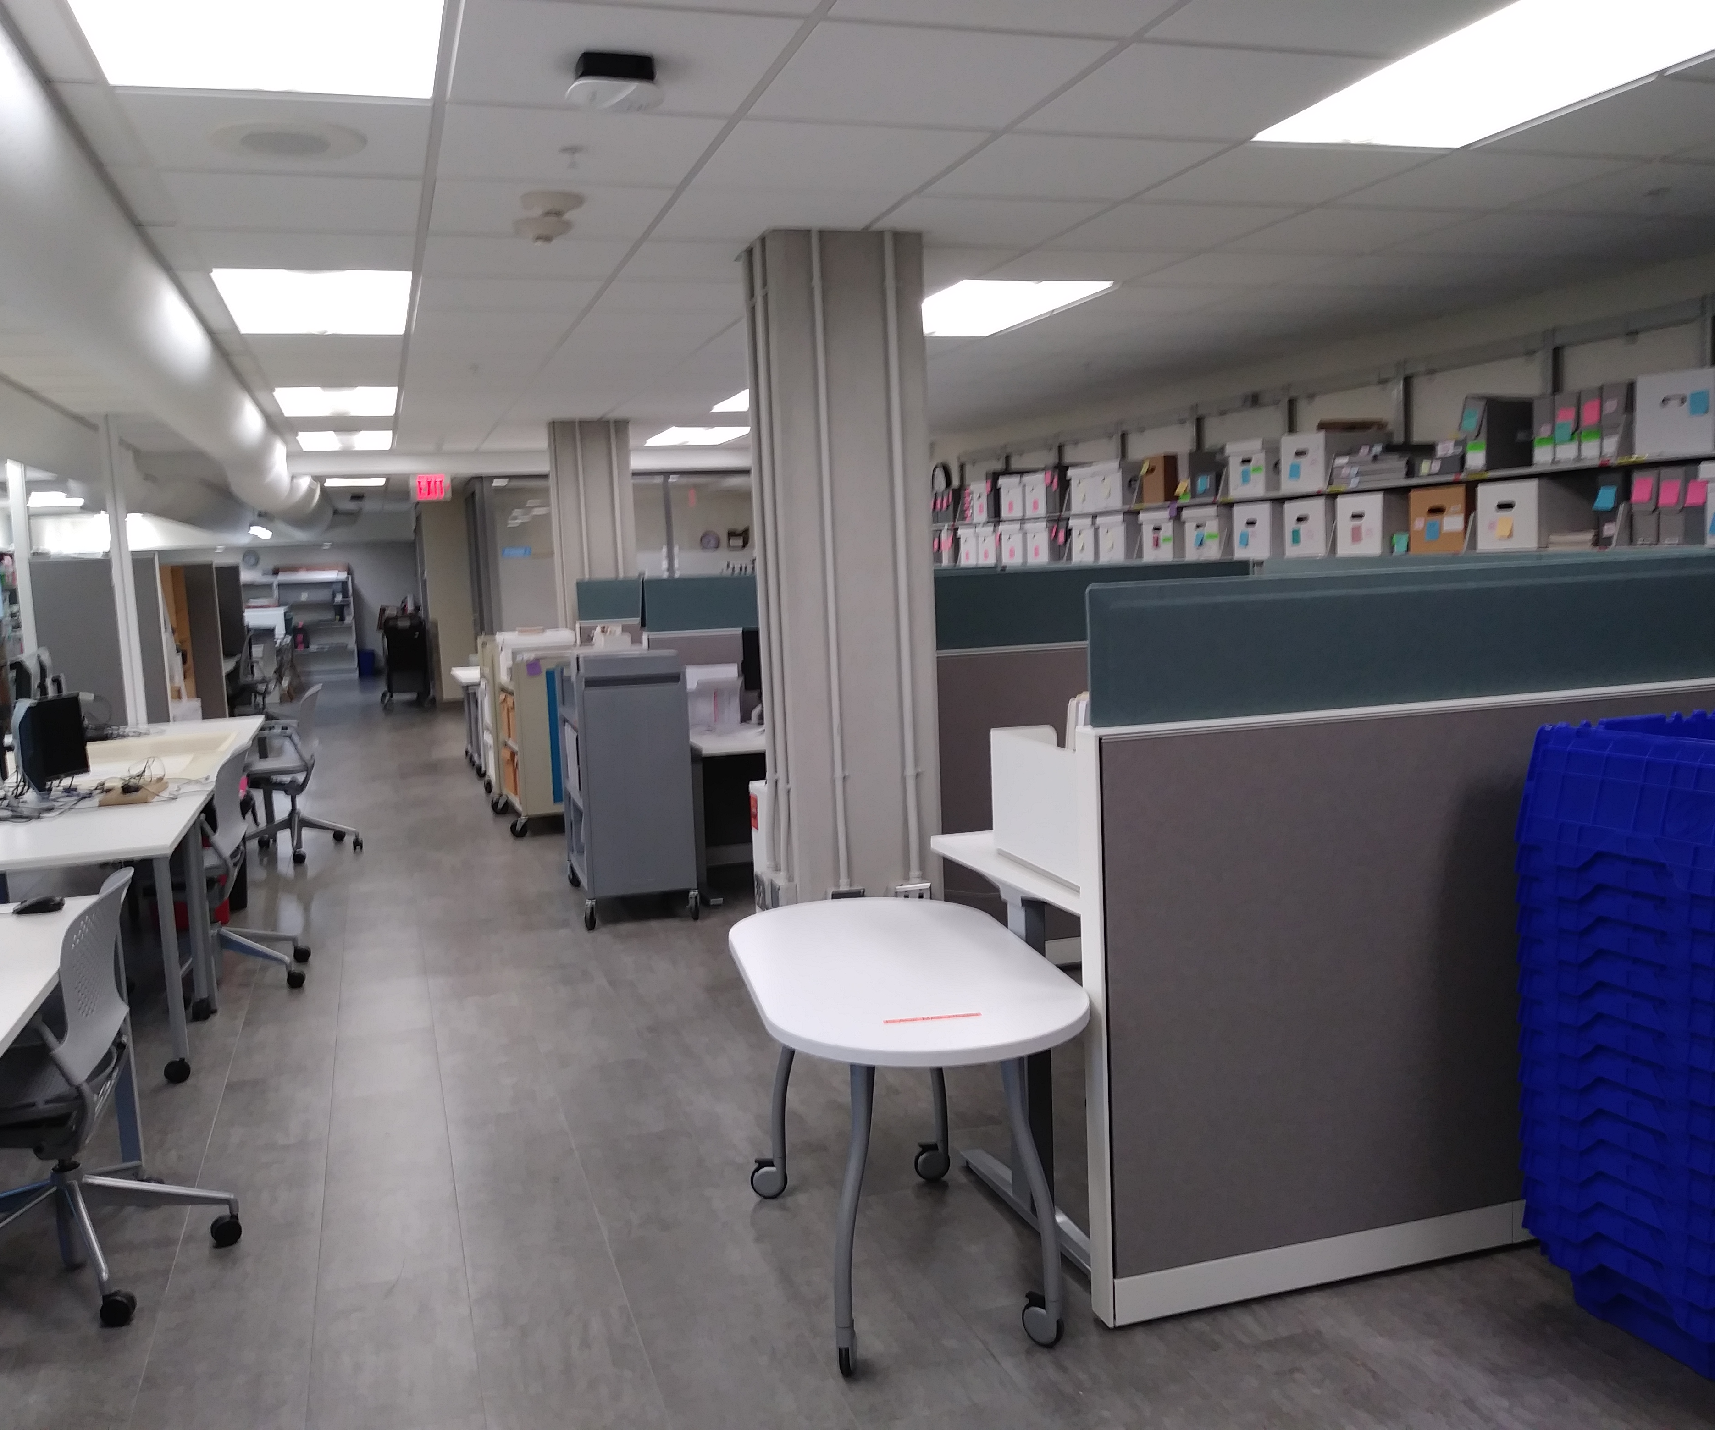
Processing at Time of Accessioning at ATS
Done in conjunction with accessioning to:
  < 5 cubic feet
  Keep up with new intake
  Fulfill reasonable priority requests
Continues work of intake, pre-accessioning, and accessioning
BUT more front-facing and outward focused
Translate information gathered into understandable language archivally

Slide 45
Having a Processing Background in an Accessioning World
Onboarding and training as I worked
  Learned each step as they come up naturally in my work
  Professional development to learn and improve
    Publications and other resources
      See "Resources" slide in introduction
      Descriptive Notes blog, Description Section of the Society of American Archivists
      National Best Practices for Archival Accessioning Working Group's Archival Accessioning Best Practices
      And many more!
    Department-wide professional development activities
    Groups/organizations focused on accessioning
      SAA's Accessioning, Acquisitions, and Appraisal Section

Slide 46
Having a Processing Background in an Accessioning World
  Processing acted as an anchor
    Already knew "final" steps in workflows
    Now - learning what leads up to processing and how fit together
  Practical opportunities to "weave" everything together
  Implement principles, techniques, and standards involved in processing
    Arrangement
    Description
    Descriptive standards (e.g. DACS)
    Subject headings

Slide 47
Skills Learned and Developed as an
Accessioning Archivist
People skills – communicating and working with donors, other departments, colleagues
Introduction to legal issues and ethics
Project management
Research
Increased familiarity with archival principles

Slide 48
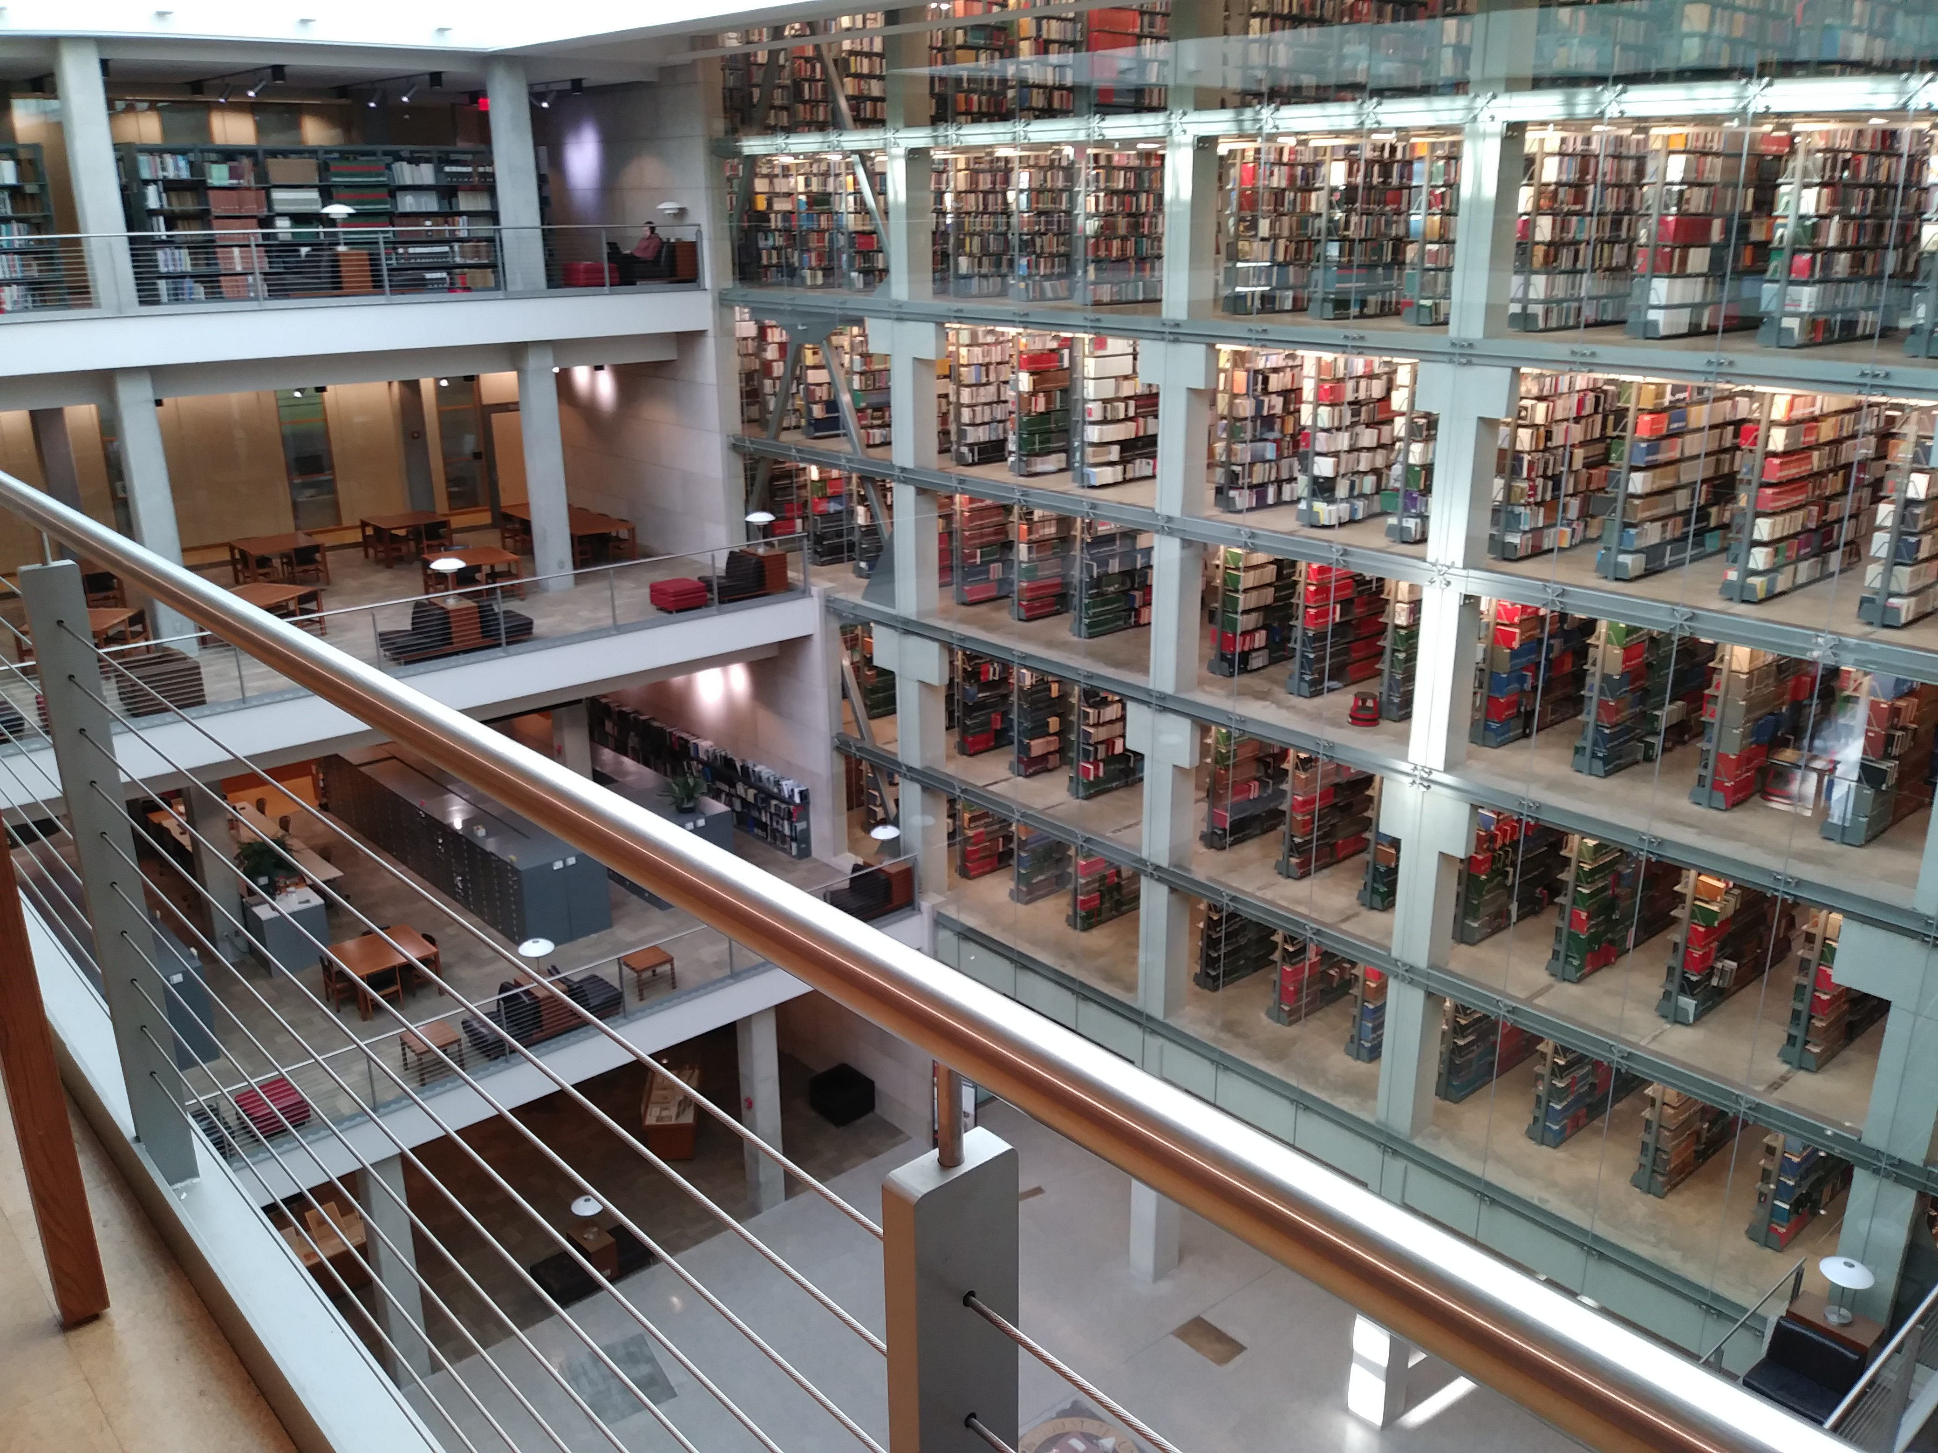
Career Progression for an Accessioning
Archivist?
Continuing along the path of an accessioning archivist
  Over time – develop skills, relationships, and archival theory crucial to accessioning
  Future paths
    Supervisory role
    Administrative role
    Advocacy role

Slide 49
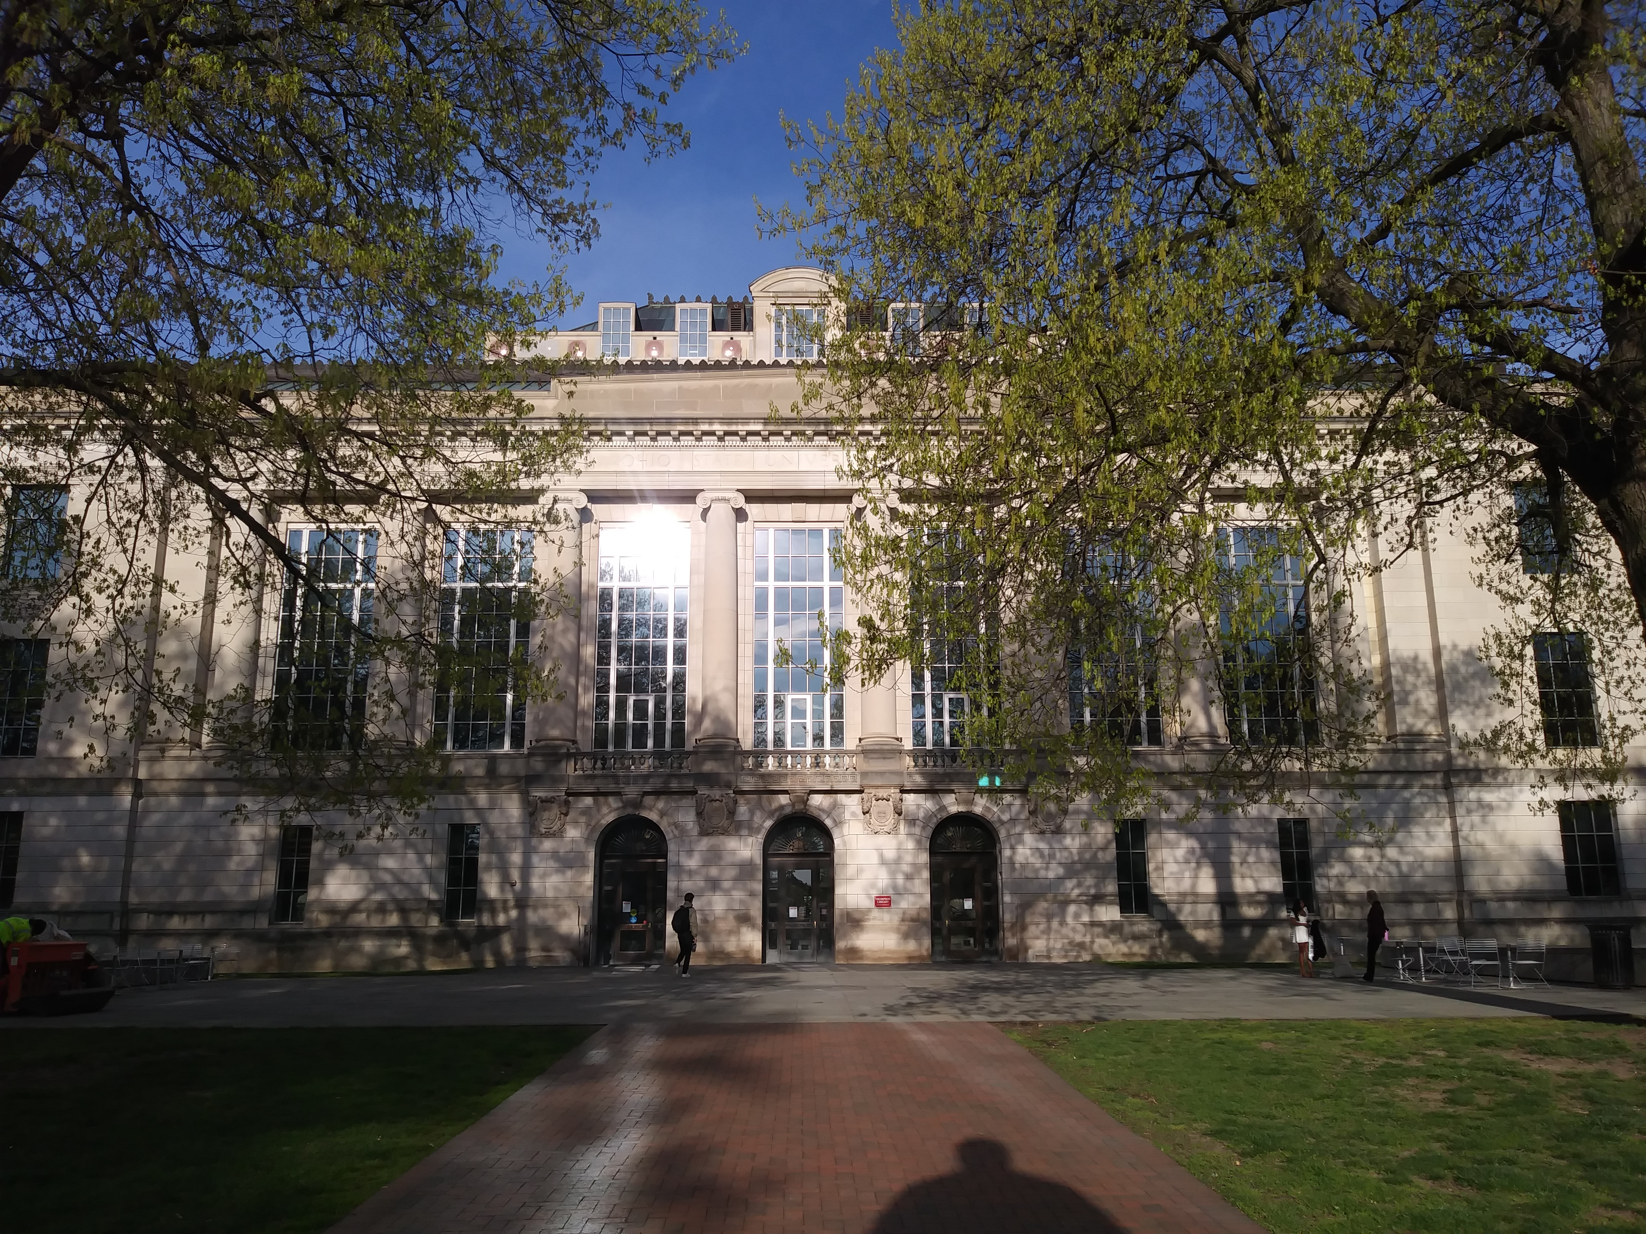
Career Progression for an Accessioning
Archivist?
Alternative paths
  Skills – transferable to other careers in Archives
    Processing archivist
    Specialist roles (e.g. born-digital media, audiovisual materials)
    Collections management archivist
    Reference archivist
    Archives manager

Slide 50
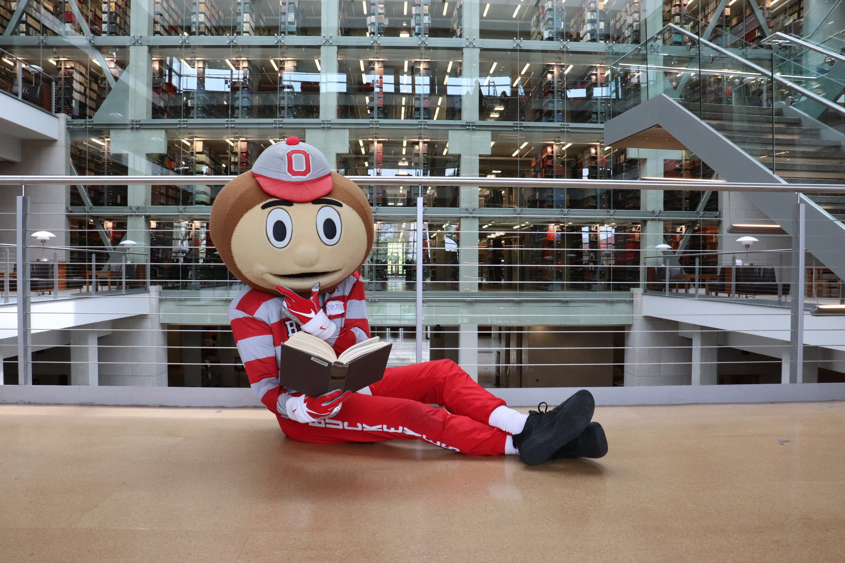
Contact Us:
Brutus visiting Thompson Library
Cate Putirskis
Archival Technical Services Manager
putirsksis.1@osu.edu
Sabrina Gorse
Intake and Accessioning Archivist
gorse.6@osu.edu

Slide 51

Special Collections and Archives

Slide 52
Sarah Keen
University Archivist

Slide 53
Special Collections and Archives
Director, Special Collections and Archives
University Archivist
Curator, Iowa Women’s Archives
Collections Archivist
Student Life Archivist
Assistant Curator
Collections Archivist
Curators (4)
Outreach and Instruction (3)
Public Services (2)
Processing Coordinator Archivist
Collections Archivist
Sackner Archive Project Coordinator
Digital Preservation Librarian
Digital Projects Librarian
Women in Politics Archivist

Slide 54
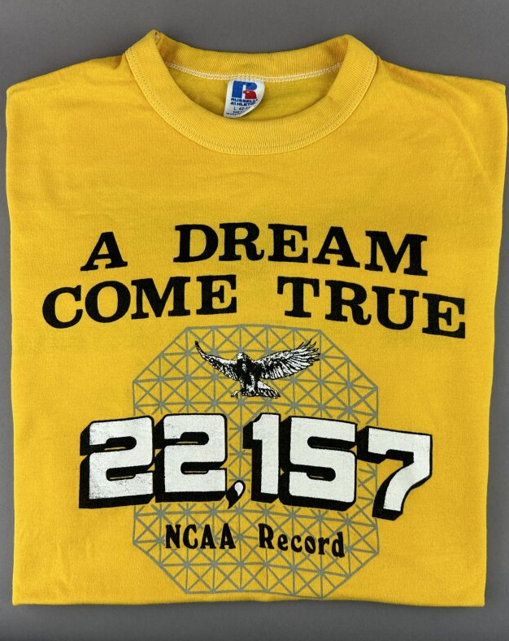
About the University of Iowa Archives
Founded in 1931 by Ruth A. Gallaher, BA 1908, PhD 1918
New staff, who dis?
  University Archivist – new hire 2022
  Student Life Archivist – new hire 2023, previously 3-year temporary position
  Collections Archivist – new hire 2023, reworked merit staff position
Almost 1000 numbered collections
Backlog of unprocessed accessions? Yes

Slide 55
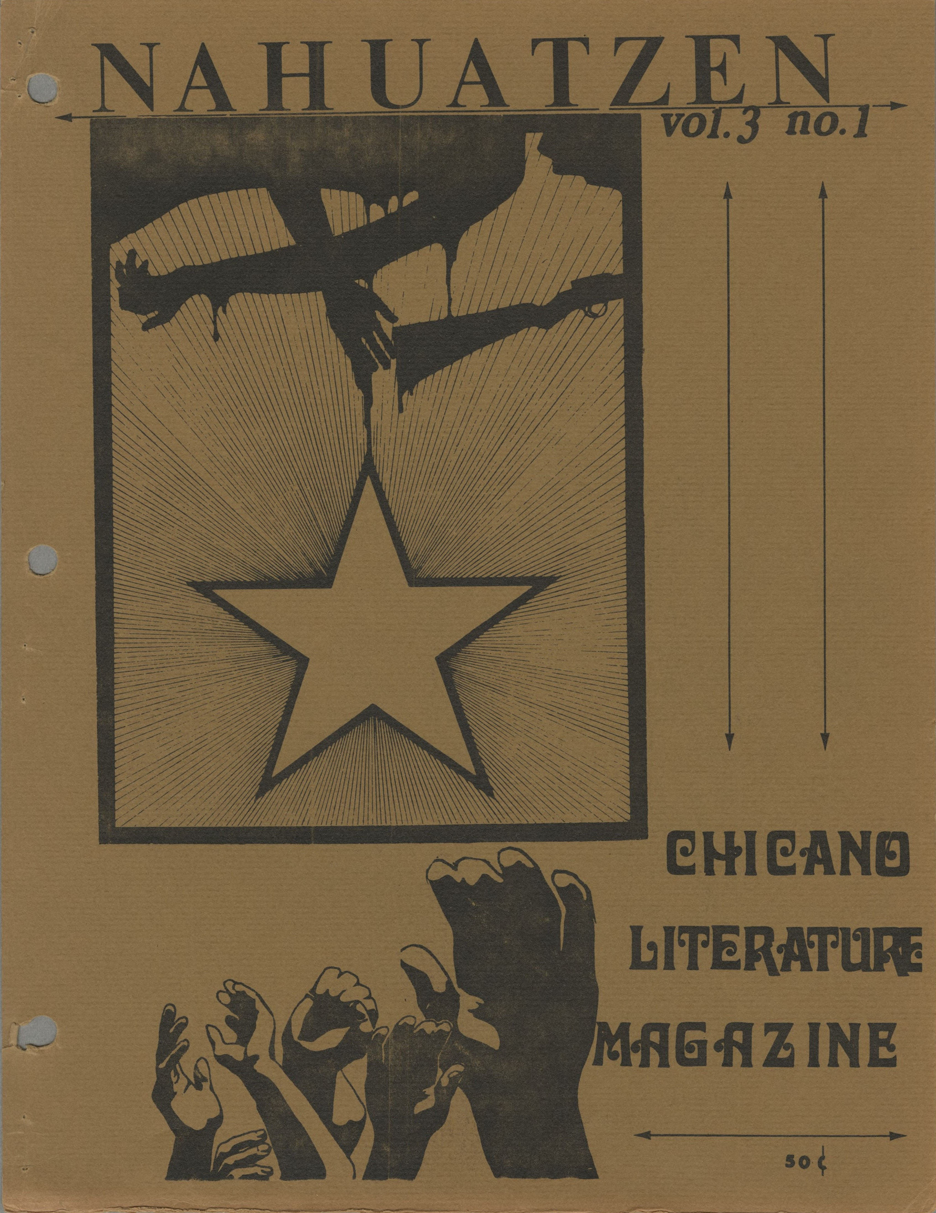
Evolving practices
Evolution of accession methods
  Paper
  Spreadsheet
  Collection management system (CMS) – ArchivesSpace
New workflows and changing collections practices
  Moving away from RG system
  Not dividing collections by format
Maximizing limited resources

Slide 56
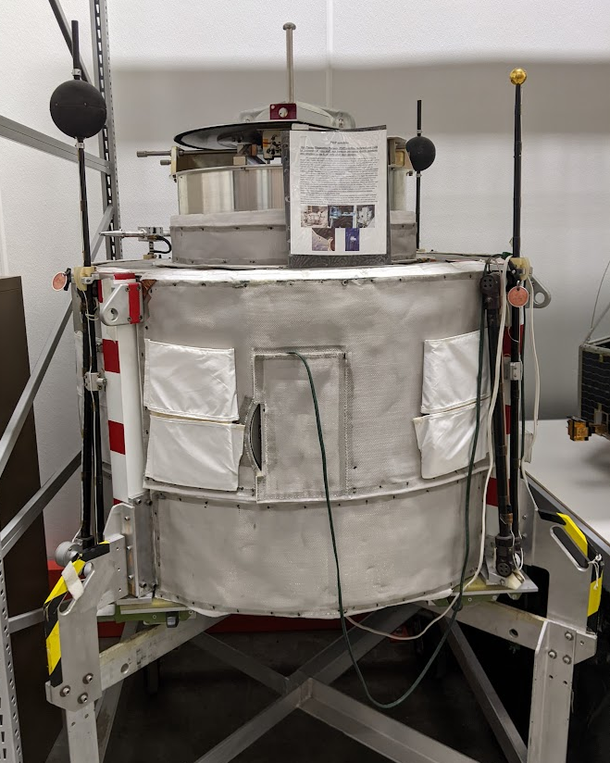
In progress - Watch this space (artifact)
Building on the work of our predecessors
  Document underrepresented communities
  Increase findability of materials
Incoming collections tool
Location survey
Motion picture film survey

Slide 57
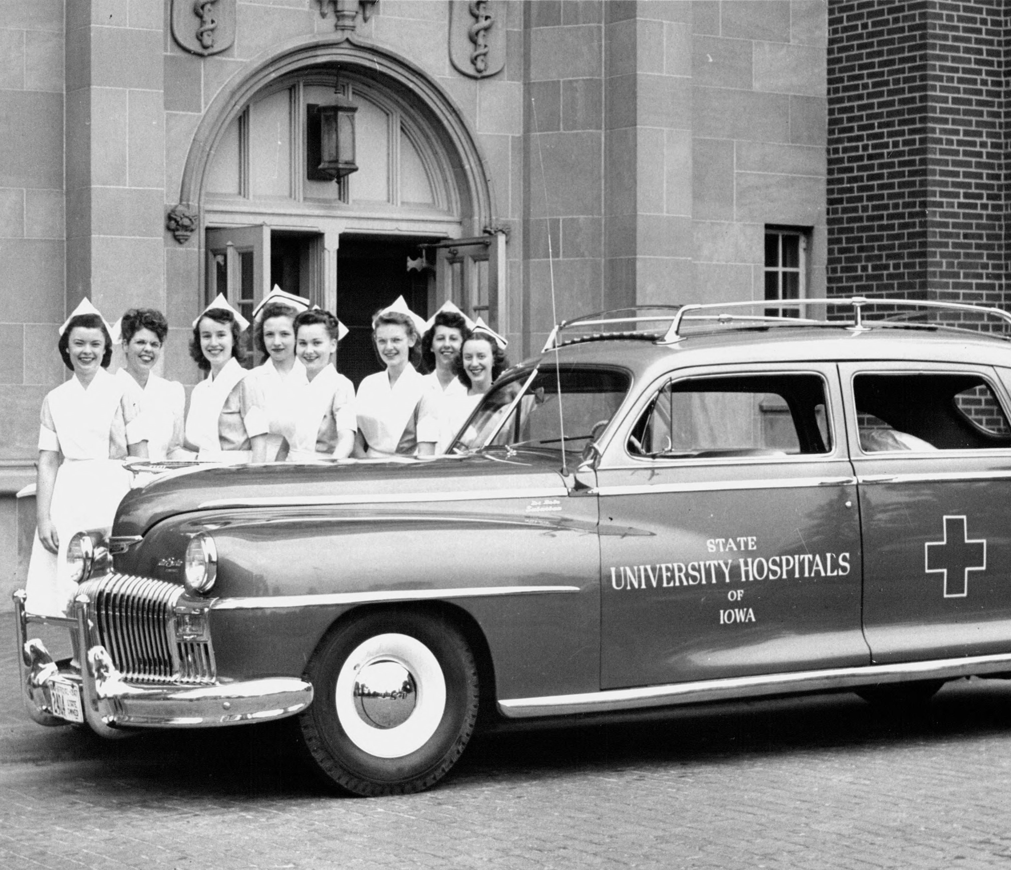
Next steps
Online records transfer form
Born-digital accessions
Department-wide processing manual

Slide 58
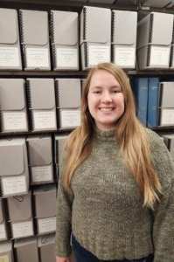
Rachel Poppen
Collections Archivist
MSIS from UT Austin in 2023, specialization in Collection Management and Preservation/Leadership, Management, and Governance
Started first job at Iowa in July 2023
Responsible for accessioning and processing University Archives collections

Slide 59

Background with Accessioning
Recent graduate – 1st full-time job
Education/student jobs heavily favored processing – only learned about accessioning from a theoretical framework
No practical accessioning experience

Slide 60

Similarities
Challenges
Same CMS – ArchivesSpace
Same fields as processing (dates, subjects, agents)
Naming accessions
Redundancy
Setting up accessions to be turned into resource records

Slide 61

Developing New Workflows
No established accessioning workflows
  Challenging for first accessions
  Ownership over process
  Still a work in progress
Accessioning with later processing in mind
  Spawning records
  Setting processing priorities

Slide 62
Thank you
Sarah Keen
University Archivist
sarah-keen@uiowa.edu
Rachel Poppen
Collections Archivist
rachel-poppen@uiowa.edu
www.lib.uiowa.edu/sc/

