Slide 1
Best practices: facilitating classes via webinar
COLLEGE OF HUMAN SCIENCES, ONLINE AND DISTANCE LEARNINg
October 2019

Slide 2
preparATION
Microphone works – no static
Speakers work at reasonable volume
Camera works
Internet connection is stable
Surroundings are quiet and distraction-free
Materials and activities have been created with the online learner in mind

Slide 3
PRACTICE
Know who to contact for technical support and/or training
Take time to learn about the webinar interface
Record yourself
Are you framed properly?
Is the lighting good—can you see your face clearly?
Can you be heard when speaking in a conversational tone?
Are your materials easy to see?

Slide 4
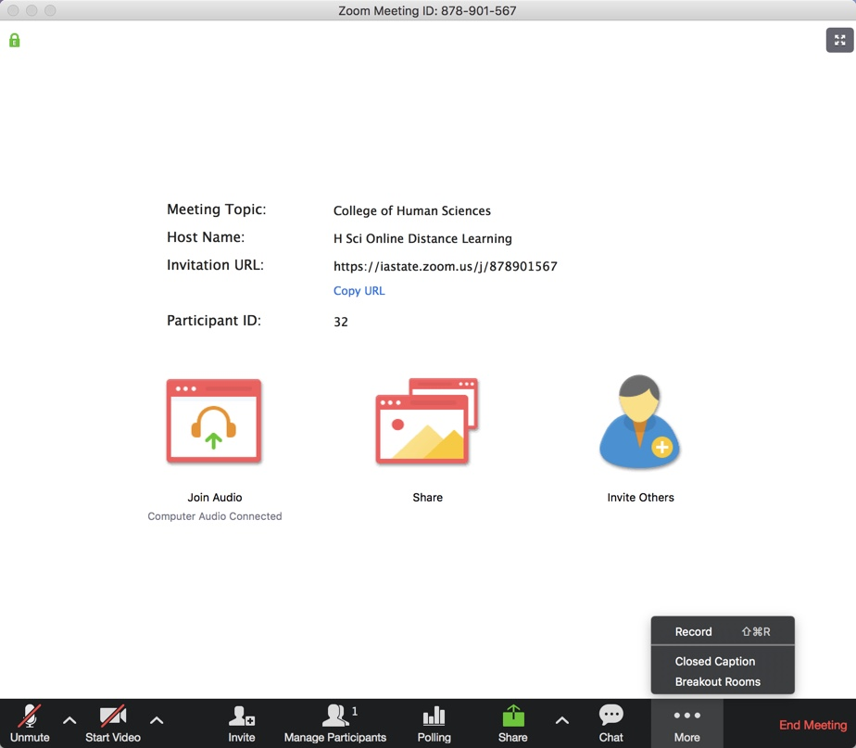

Slide 5
What’s wrong with this picture?
Bright window
Bright lamp
Not centered in frame
Face is not well lit
Clearly distracted

Slide 6
Much better!
Background is less distracting
Centered in frame
Face is well lit
Engaged in the meeting

Slide 7
MANAGEment
SET PARTICIPANT GUIDELINES
No one speaks twice before everyone has a chance to speak once
‘Raise your hand’
Speak one at a time
Mute your microphone when not speaking
Stay on camera and avoid distracting activities
Avoid side conversations
Be mindful of the microphone

Slide 8
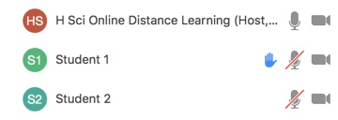
management
Watch the chat window for comments
Watch for raised hands in the attendee list
Have patience—wait for participants to unmute or chat

Slide 9
awareness
Use the mouse to point, not your finger
Speak clearly and slowly and consistently
Always be aware of the microphone!
Lapel
Ceiling
Tabletop
Podium
Headset/built-in

Slide 10
engagement
Call participants by name
Encourage in-room participants to interact with on-line participants
Look directly at the camera
Repeat questions/comments if necessary
Provide materials ahead of time if possible

Slide 11
consistency
Techniques will become second nature
Keep technology up to date
Always test new equipment
Replace equipment if it starts to fail
Get technical support and training as needed

Slide 12
for more information
Ann Bugler
Online and Distance Learning
College of Human Sciences
bugler@iastate.edu
4-5812

