Slide 1
Creating Attractive Courses in Canvas
Lisa Lund, M.Ed.
Iowa State University College of Veterinary Medicine

Slide 2
Focus on your ABC’s
Accessibility
Branding
Character

Slide 3
Accessibility Tips
Keep your design “clean”
Use the same font throughout your course
Label files with descriptive names
Group related items together in modules
Arrange modules in chronological order

Slide 4
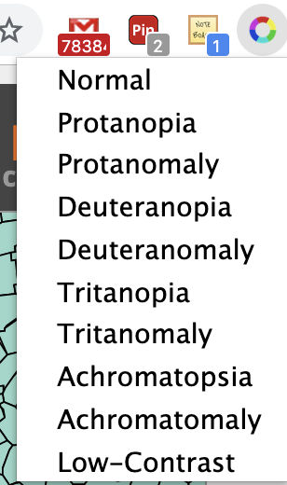
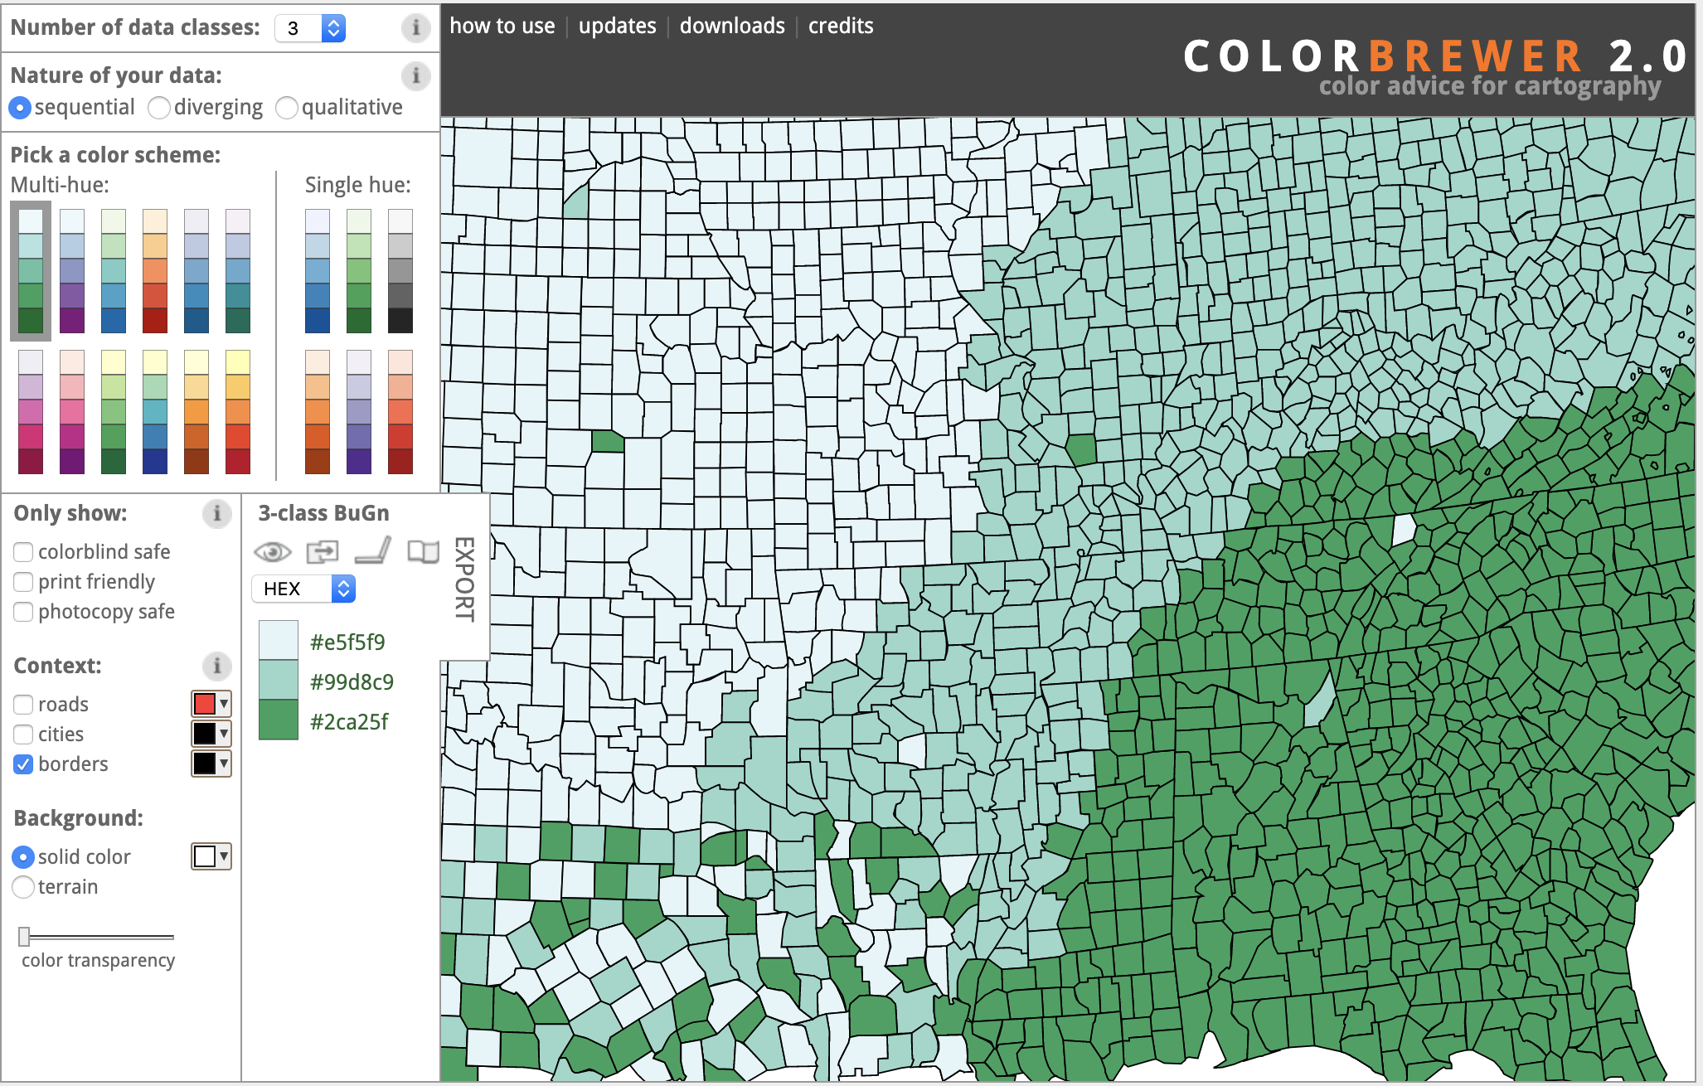
Accessibility tools
Spectrum (Google Chrome Extension)
ColorBrewer
Canvas Accessibility Checker

Slide 5
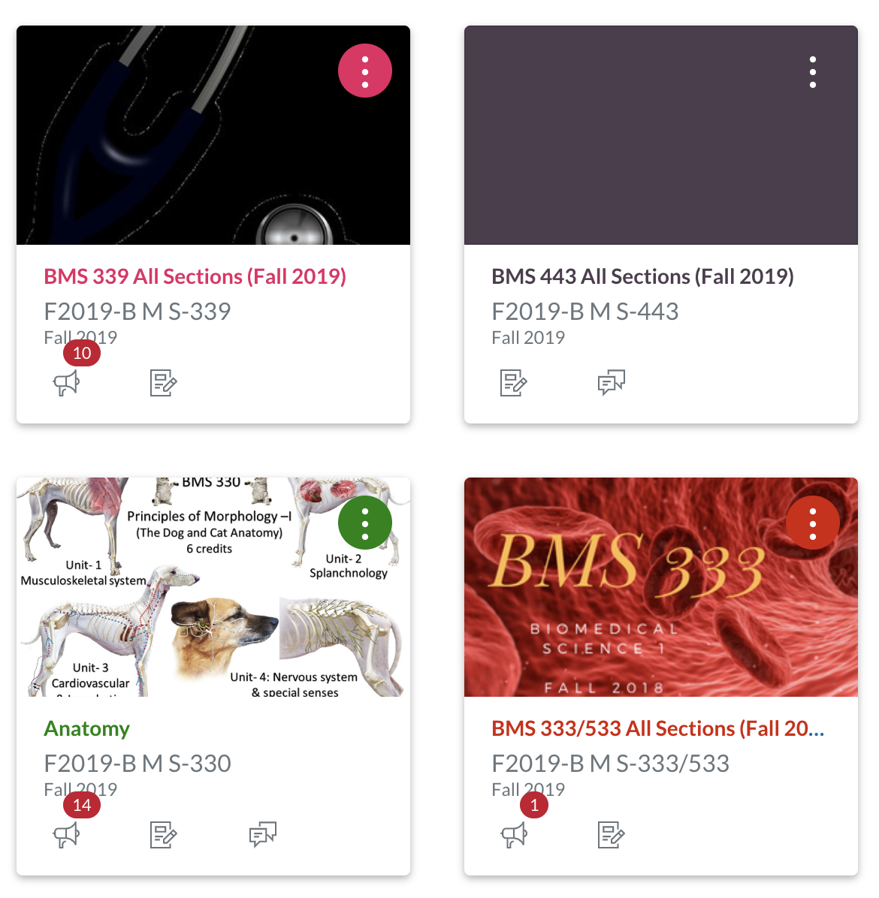
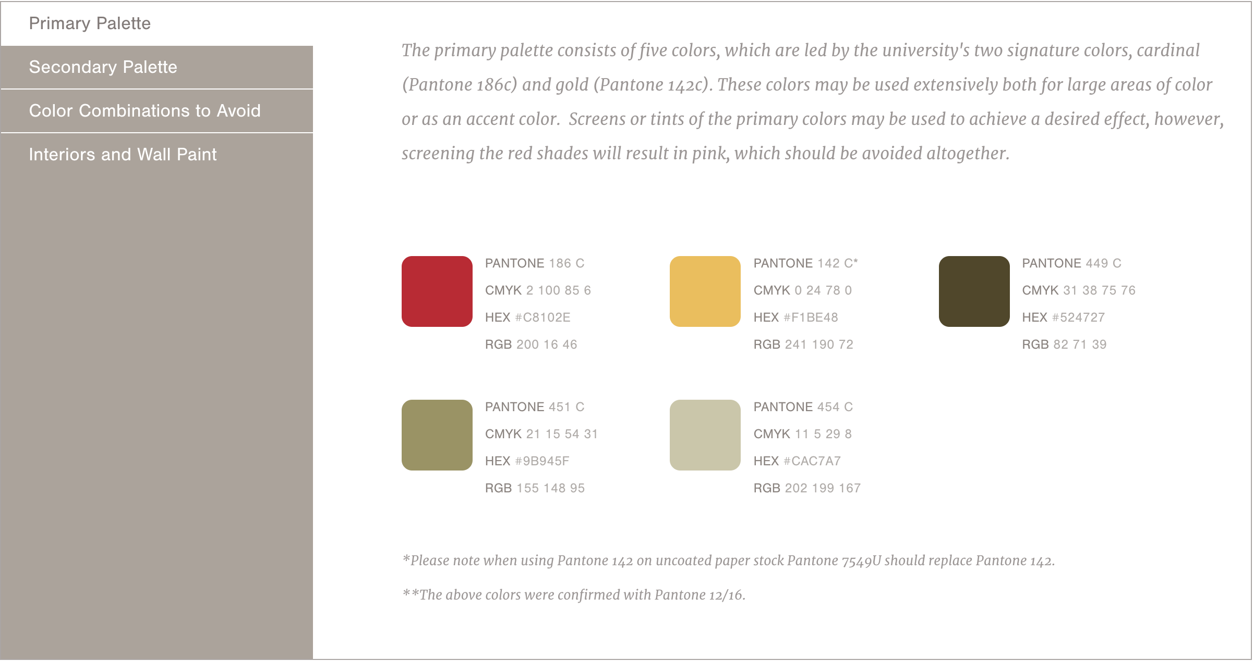
Branding tools
Iowa State color palette
Upload a picture for the course tile

Slide 6
Character Tips
Create a professional banner
Create buttons for easy navigation

Slide 7
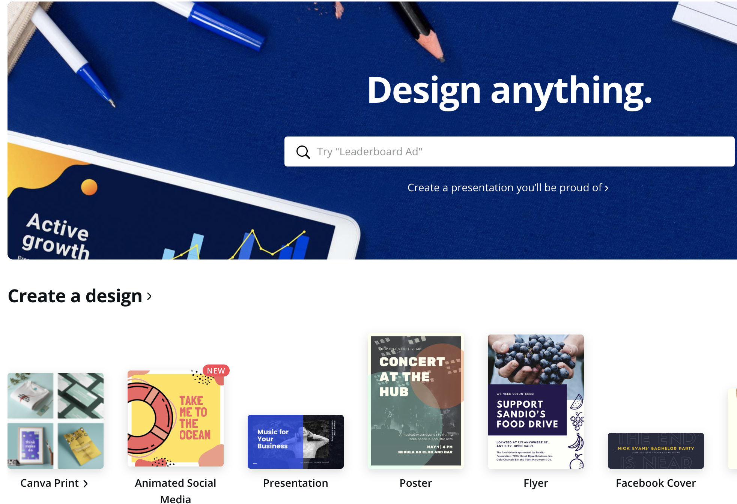
Character Tools
Pexels
Pixabay
Flickr in Canvas
Canva
Da Button Factory

Slide 8
EXAMPLES

Slide 9
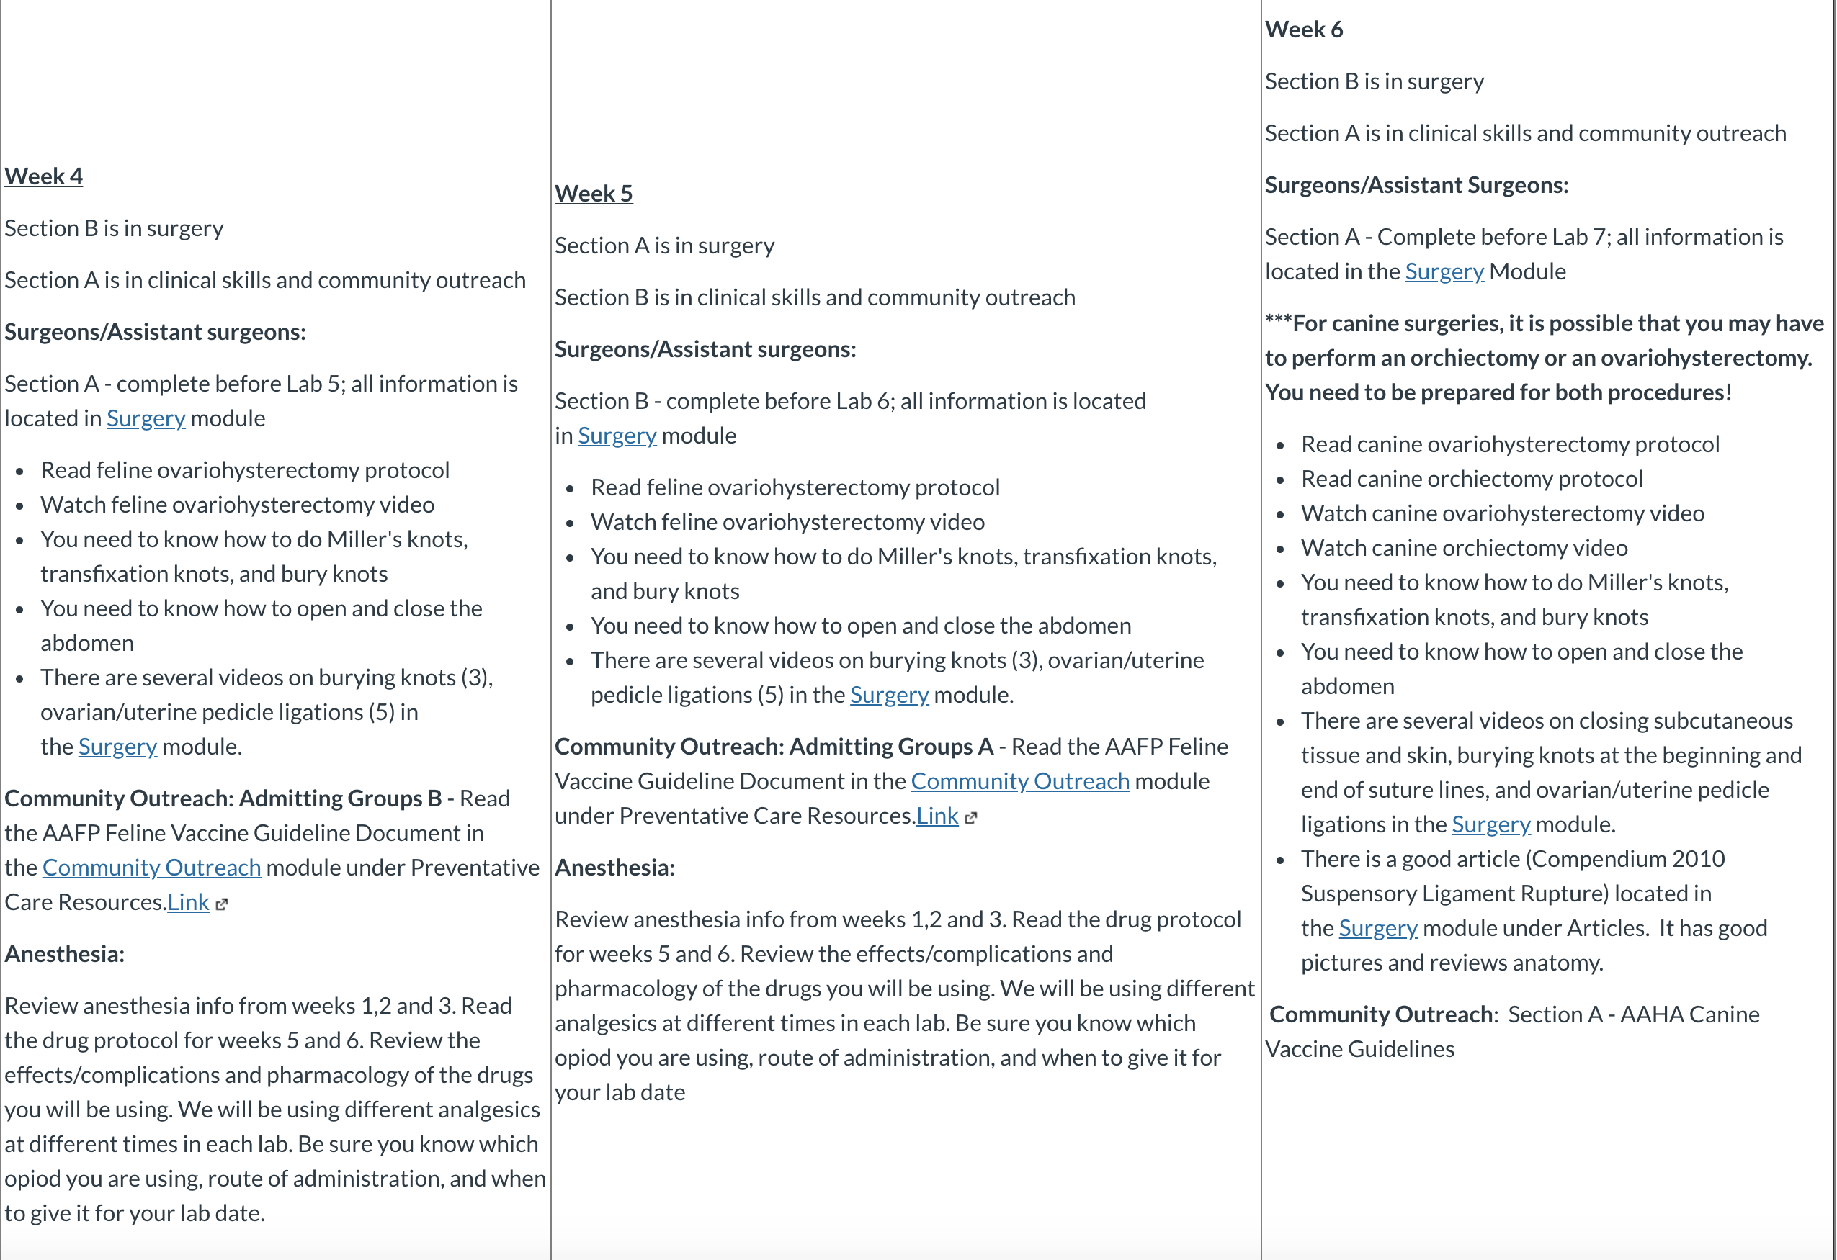
BEFORE…..

Slide 10
After…

Slide 13
Want more information?
https://www.celt.iastate.edu/resources/recognition/celt-spotlight/

Slide 14
Questions?
Lisa Lund, M.Ed.
gestrine@iastate.edu
Iowa State University College of Veterinary Medicine

