Slide 1
Getting your course QM certified: experiences shared by Engineering faculty
Dr. Jennifer Shane
Dr. Aliye Karabulut-Ilgu

Slide 2
Course information
CE 501: Pre-construction Project Engineering and Management
Required for MEng, MS, PhD in Construction
Catalog Description
Application of engineering and management control techniques to construction project development from conceptualization to notice to proceed. Emphasis is on managing complex projects using 5-dimensional project management theory.
Online since 2012
Course revision 2014
QM Certified Feb 27, 2019

Slide 3
Certification process
Faculty takes at least 2 courses
Designing Your Online Course (DYOC)
Applying the Quality Matters Rubric (APPQMR)
Internal Review
Self-Review
External Review
Support from the department
3 reviewers
External Review Process
Submit the worksheet
Pre-review meeting
Receive feedback
Submit Amendment if need to

Slide 4
QM general Standards
Course Overview and Introduction
Learning Objectives
Assessment and Measurement
Instructional Materials
Learning Activities and Learner Interaction
Course Technology
Learner Support
Accessibility and Usability

Slide 5
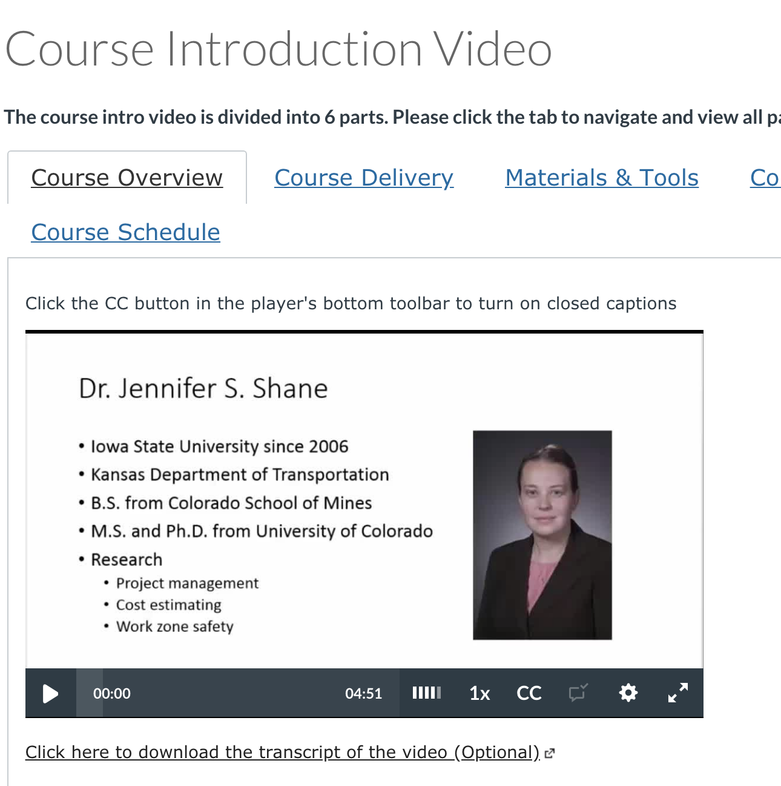
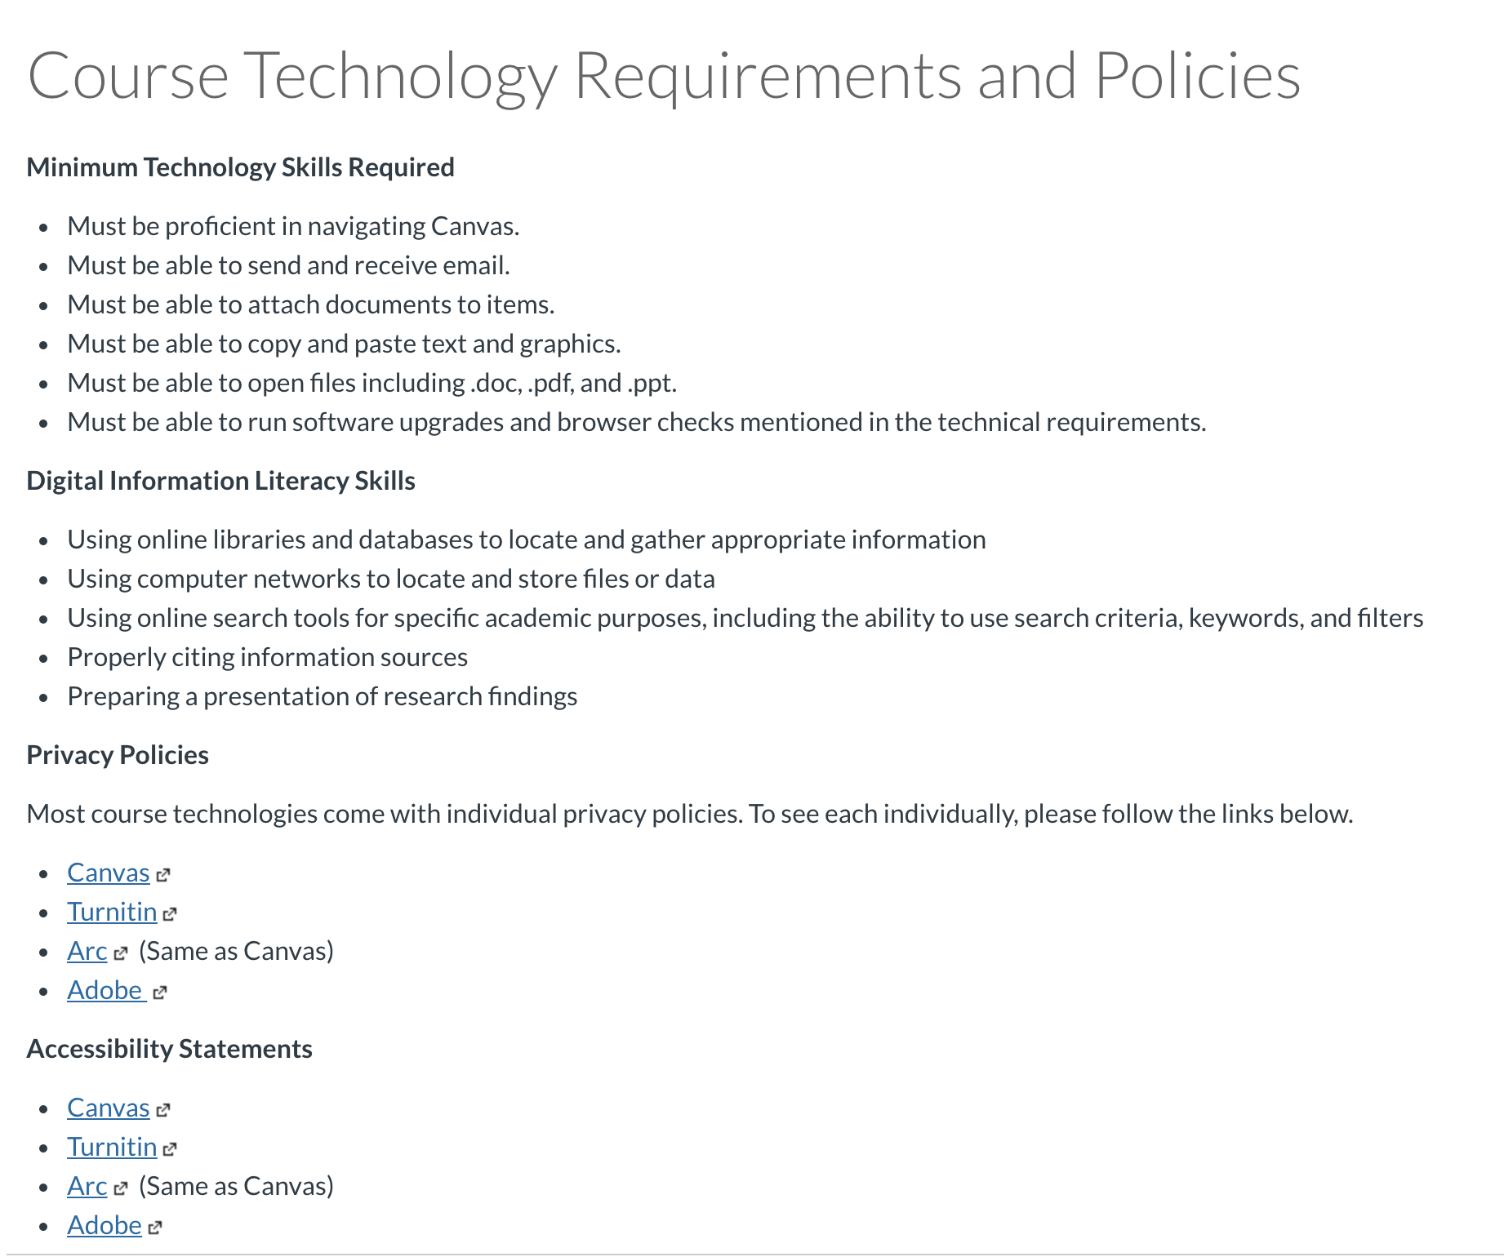
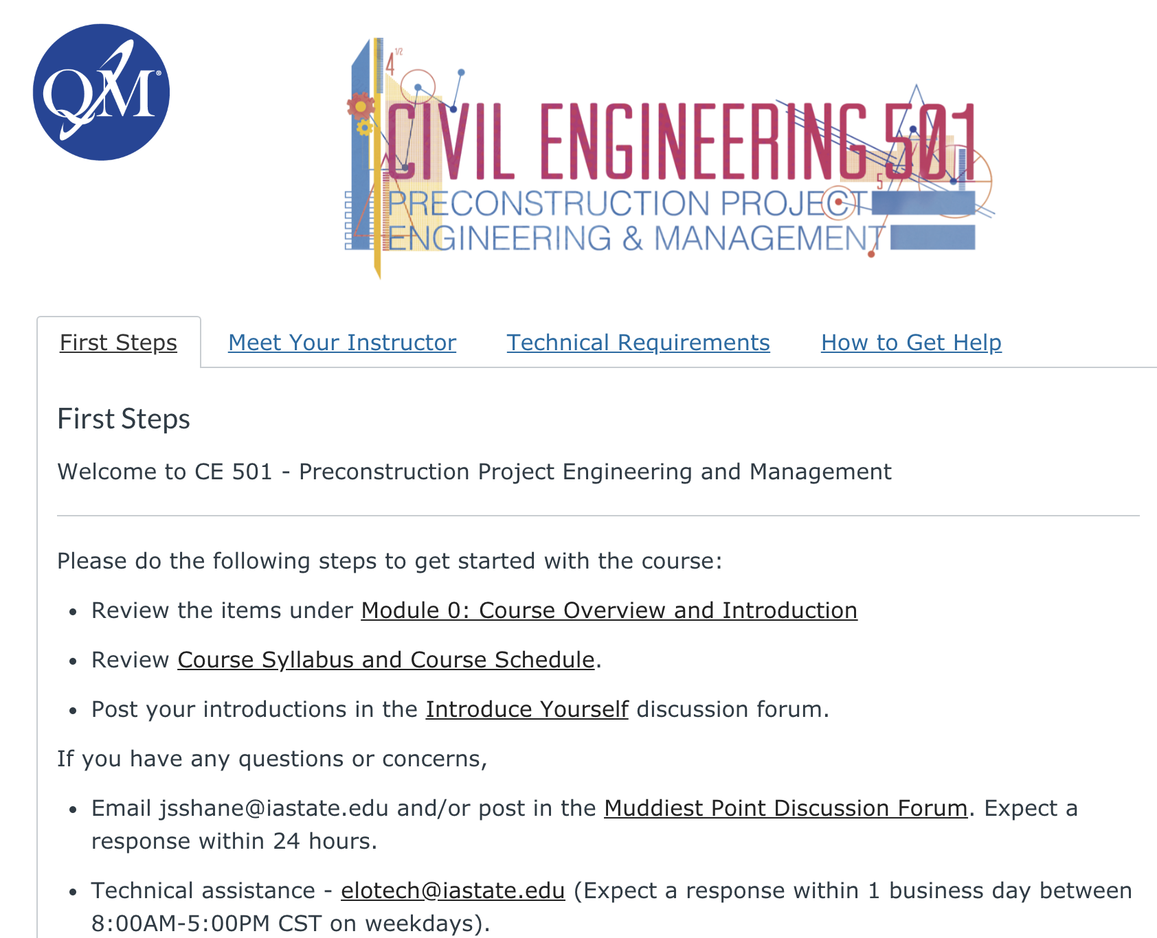
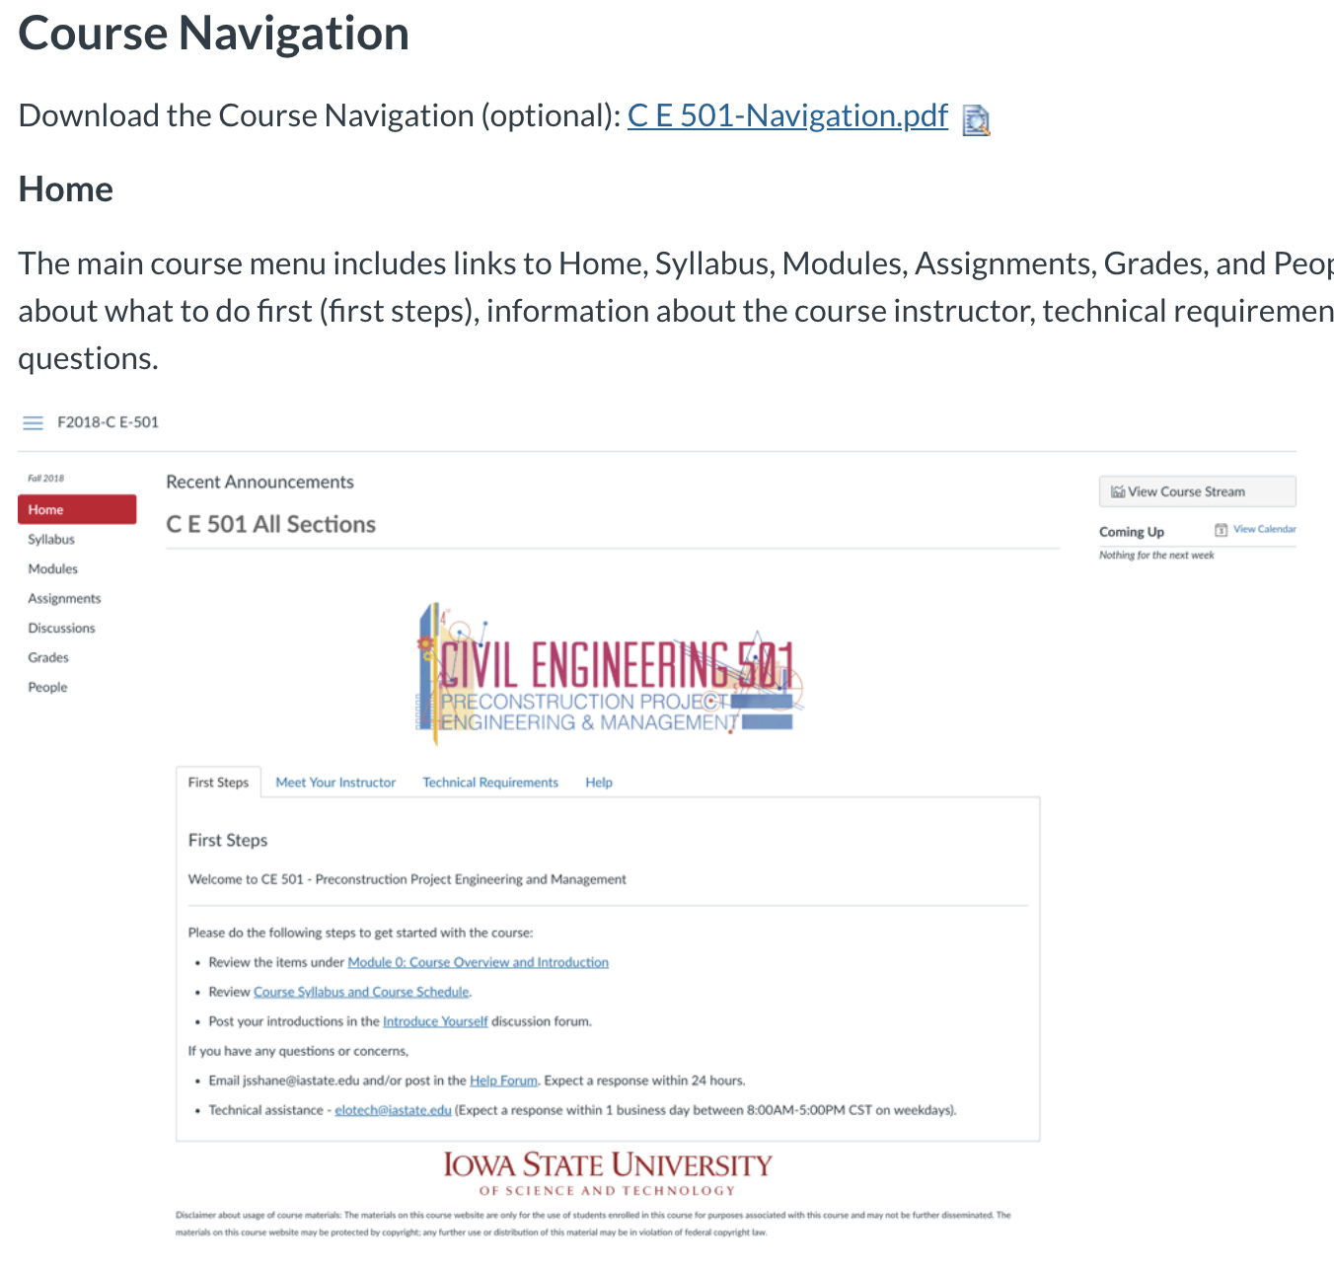
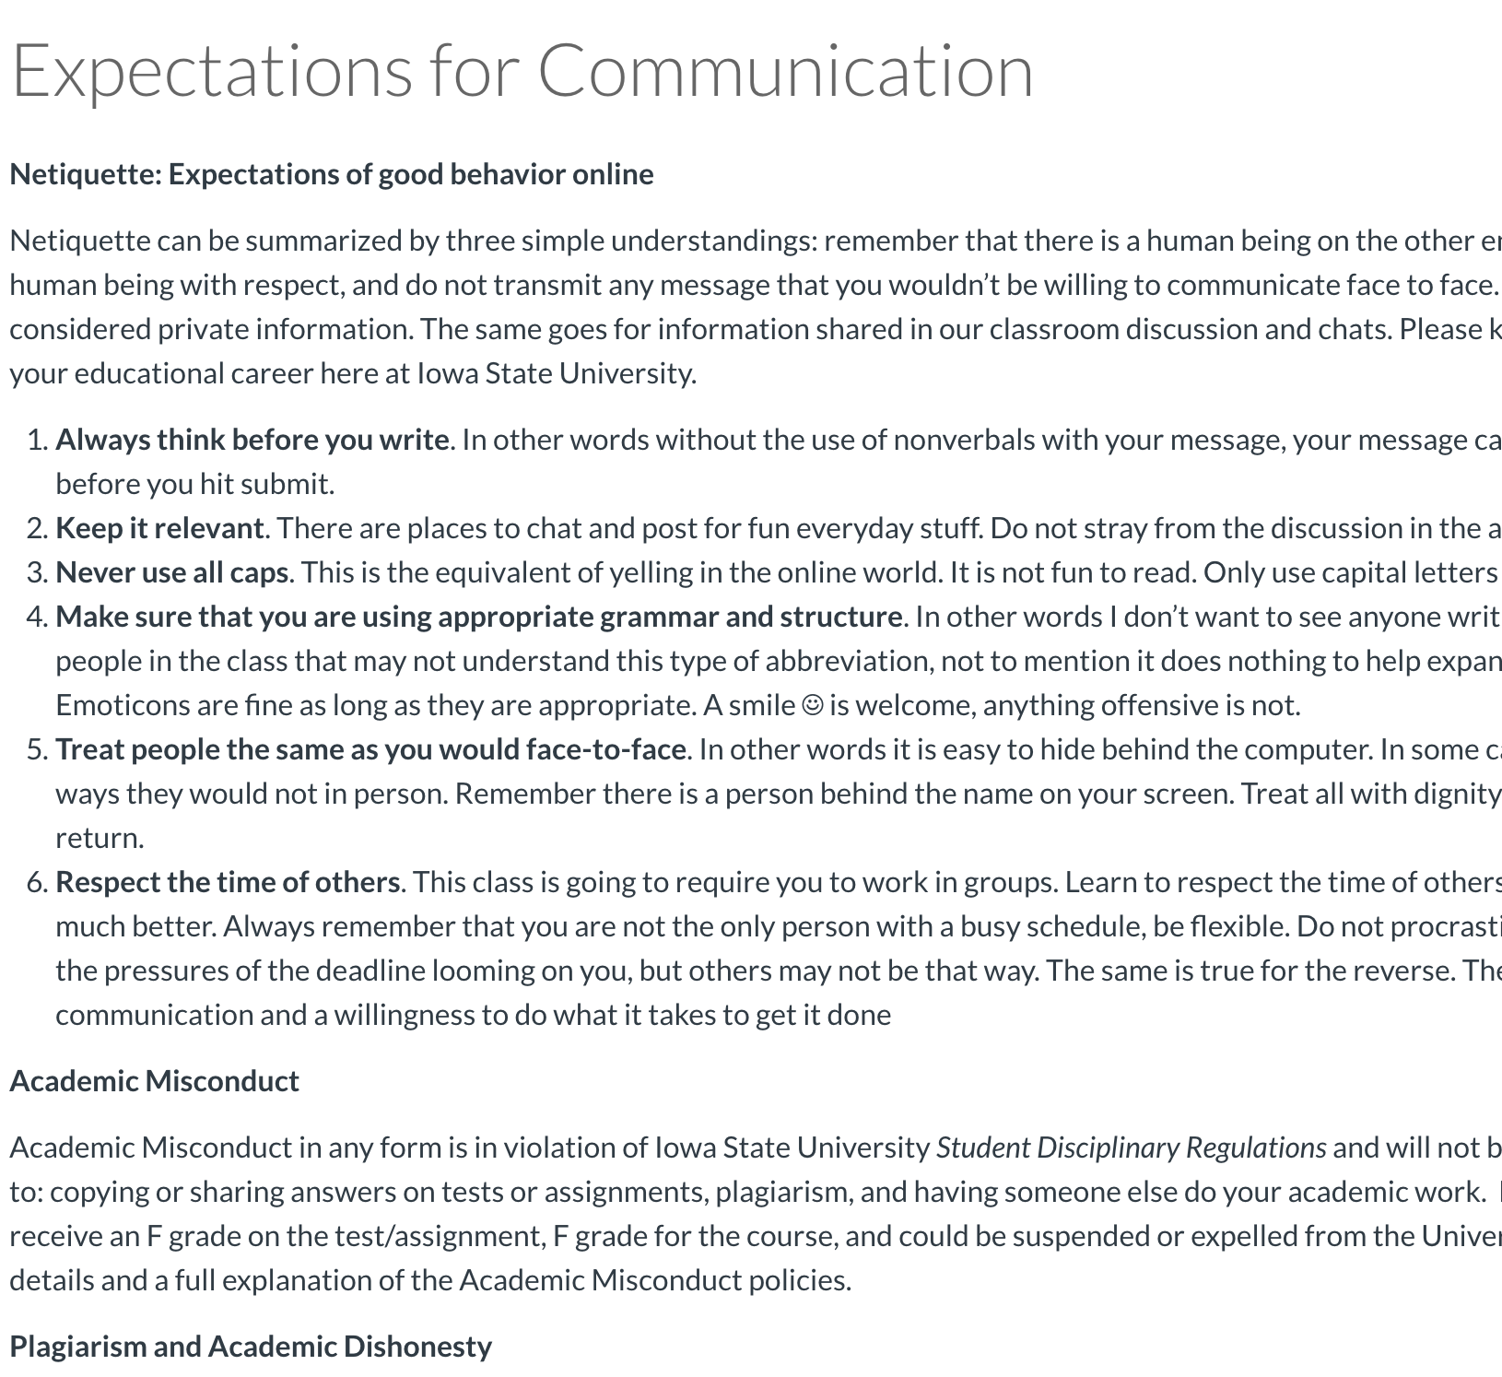
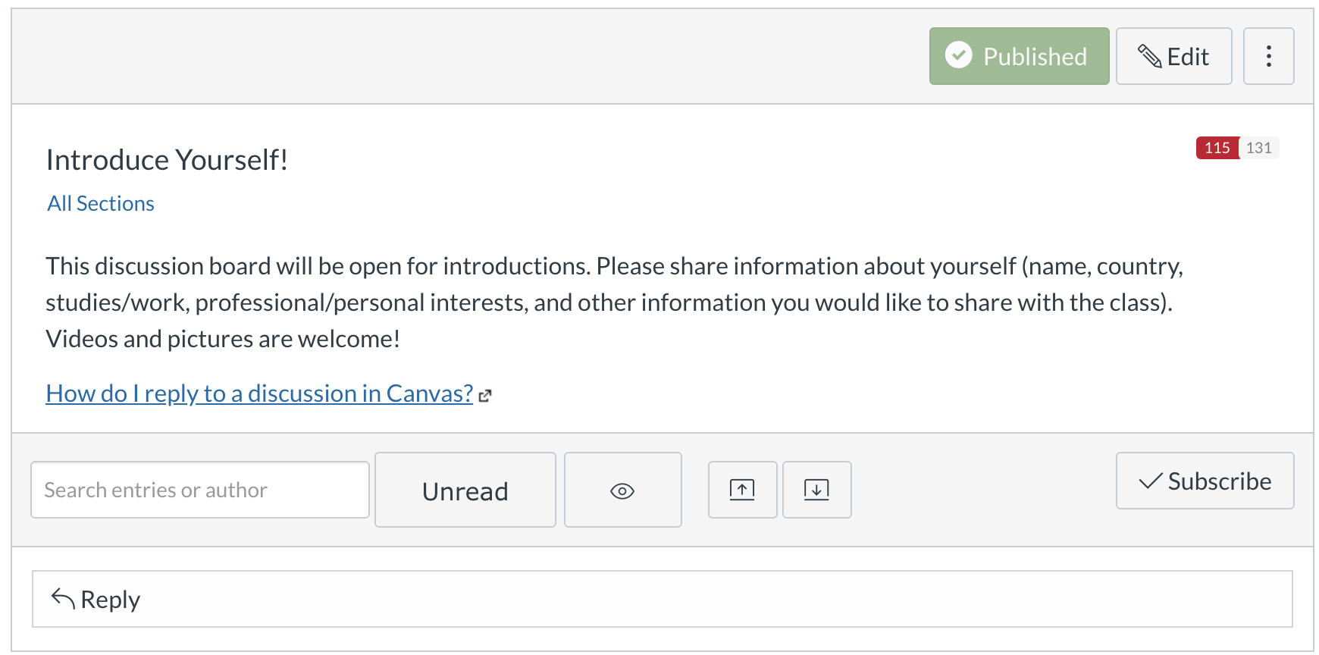
Course Overview and Introduction
The overall design of the course is made clear to the learner at the beginning of the course.
Instructions make clear how to get started and where to find various course components.
Learners are introduced to the purpose and structure of the course.
Communication expectations for online discussions, email, and other forms of interaction are clearly stated.
Course and institutional policies with which the learner is expected to comply are clearly stated within the course, or a link to current policies is provided.
Minimum technology requirements for the course are clearly stated, and information on how to obtain the technologies is provided.
Computer skills and digital information literacy skills expected of the learner are clearly stated.
Expectations for prerequisite knowledge in the discipline and/or any required competencies are clearly stated.
The self-introduction by the instructor is professional and is available online.
Learners are asked to introduce themselves to the class.

Slide 6
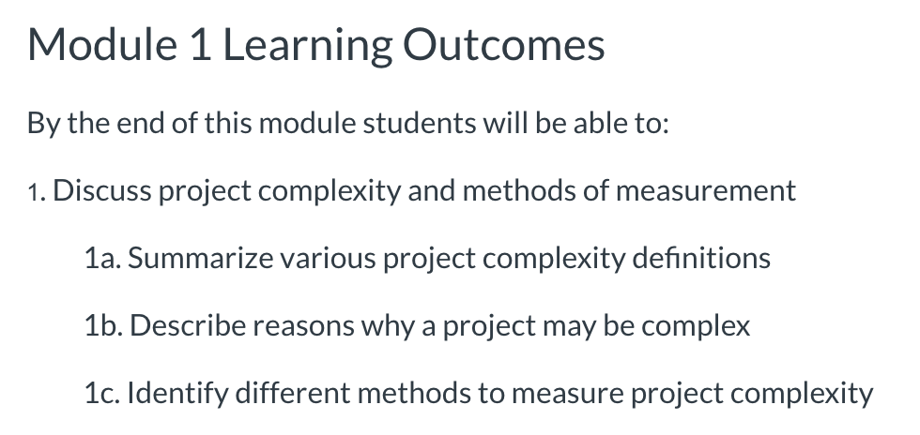
Learning objectives
Learning objectives or competencies describe what learners will be able to do upon completion of the course.
The course learning objectives, or course/program competencies, describe outcomes that are measurable.
The module/unit-level learning objectives or competencies describe outcomes that are measurable and consistent with the course-level objectives or competencies.
Learning objectives or competencies are stated clearly, are written from the learner’s perspective, and are prominently located in the course.
The relationship between learning objectives or competencies and learning activities is clearly stated.
The learning objectives or competencies are suited to the level of the course.

Slide 7
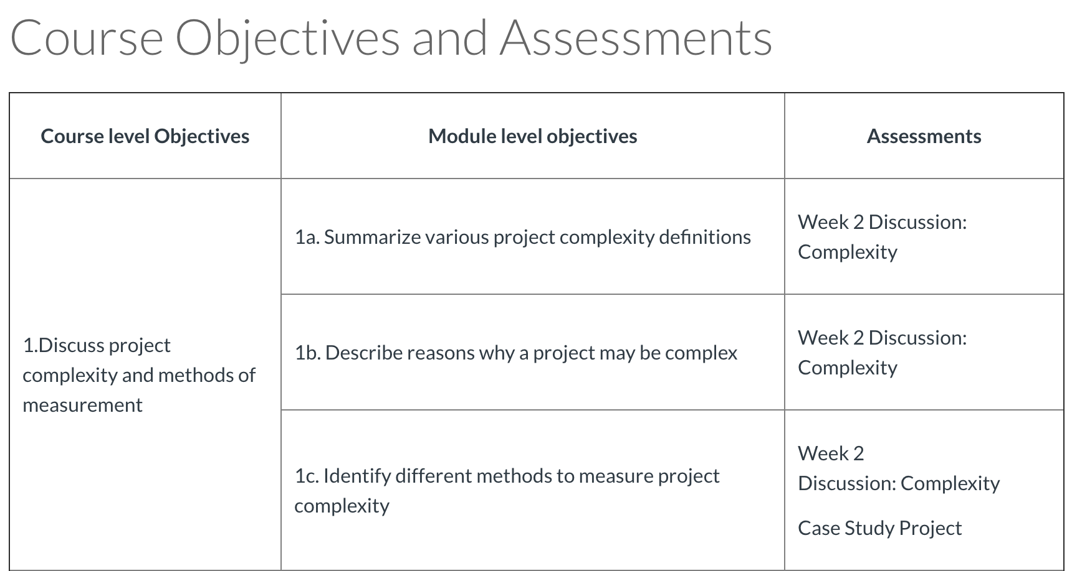
Assessment and measurement
Assessments are integral to the learning process and are designed to evaluate learner progress in achieving the stated learning objectives or mastering the competencies.
The assessments measure the achievement of the stated learning objectives or competencies.
The course grading policy is stated clearly at the beginning of the course.
Specific and descriptive criteria are provided for the evaluation of learners’ work, and their connection to the course grading policy is clearly explained.
The assessments used are sequenced, varied, and suited to the level of the course.
The course provides learners with multiple opportunities to track their learning progress with timely feedback.
Syllabus
Rubrics
Discussions
Case Study
Reflection
Grades Link

Slide 8
Instructional Materials
Instructional materials enable learners to achieve stated learning objectives or competencies.
The instructional materials contribute to the achievement of the stated learning objectives or competencies.
The relationship between the use of instructional materials in the course and completing learning activities is clearly explained.
The course models the academic integrity expected of learners by providing both source references and permissions for use of instructional materials.
The instructional materials represent up-to-date theory and practice in the discipline.
A variety of instructional materials is used in the course.

Slide 9
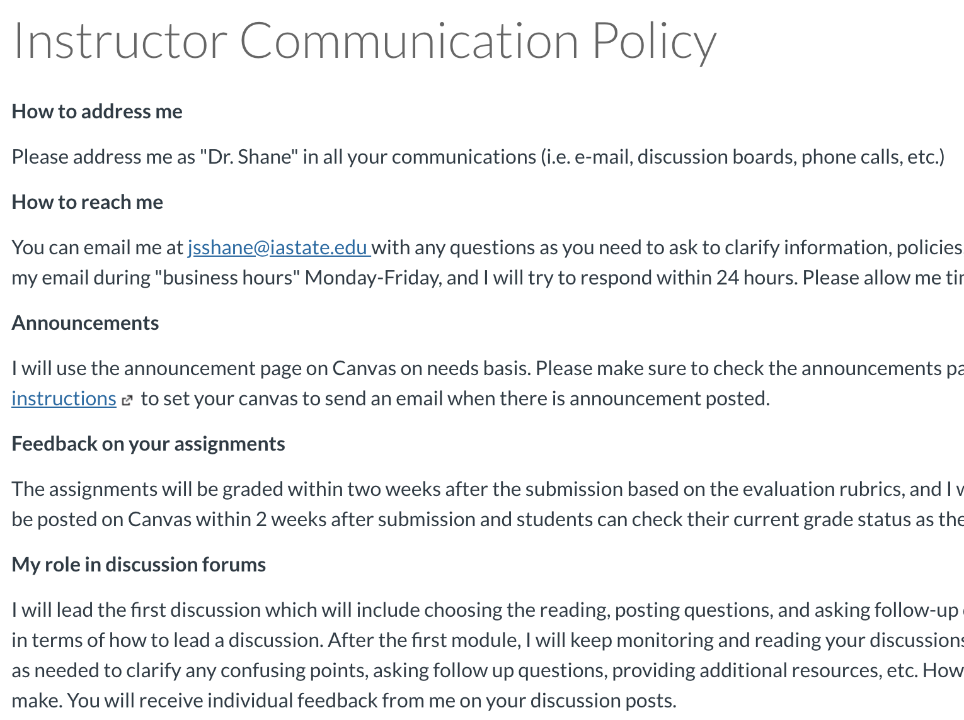
Learning activities and learner interaction
Learning activities facilitate and support learner interaction and engagement
The learning activities promote the achievement of the stated learning objectives or competencies.
Learning activities provide opportunities for interaction that support active learning.
The instructor’s plan for interacting with learners during the course is clearly stated.
The requirements for learner interaction are clearly stated.
Discussions, Case Study, Reflection
Discussion

Slide 10
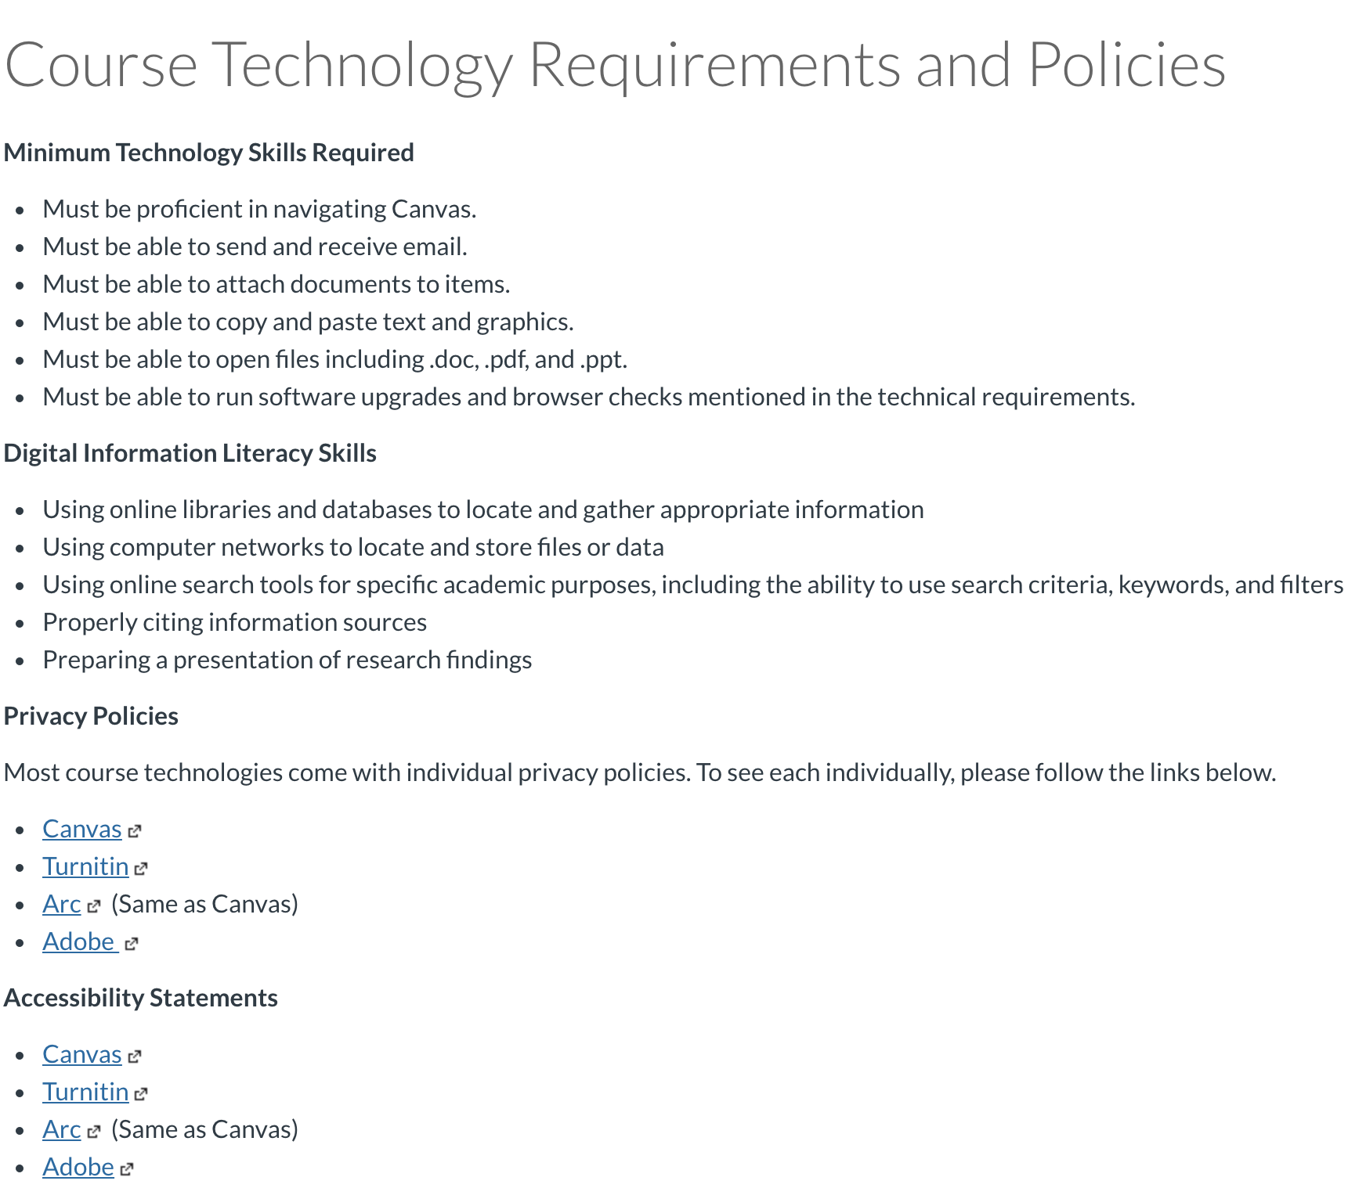
Course technology
Course technologies support learners’ achievement of course objectives or competencies.
The tools used in the course support the learning objectives or competencies.
Course tools promote learner engagement and active learning.
A variety of technology is used in the course.
The course provides learners with information on protecting their data and privacy.

Slide 11
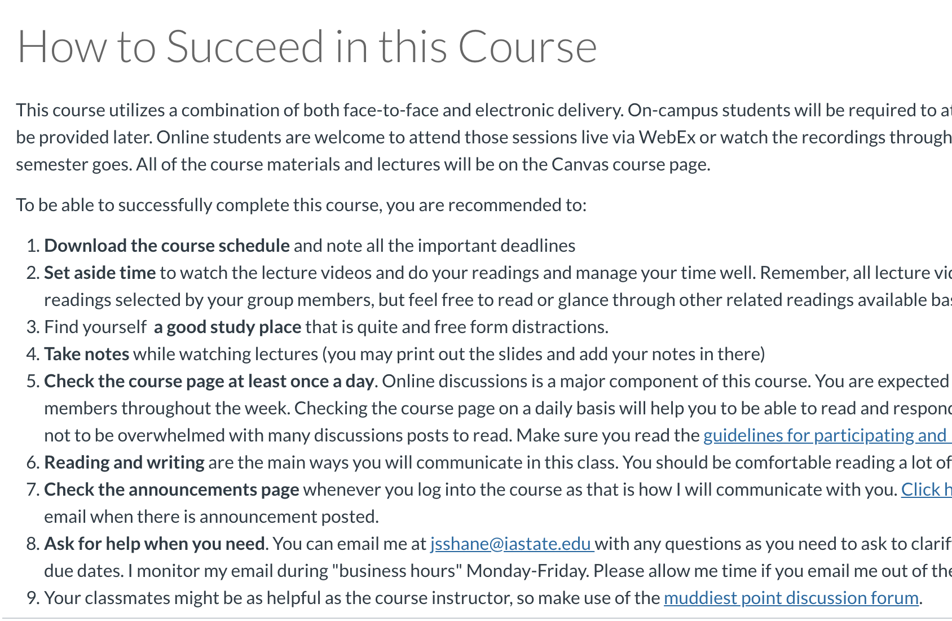
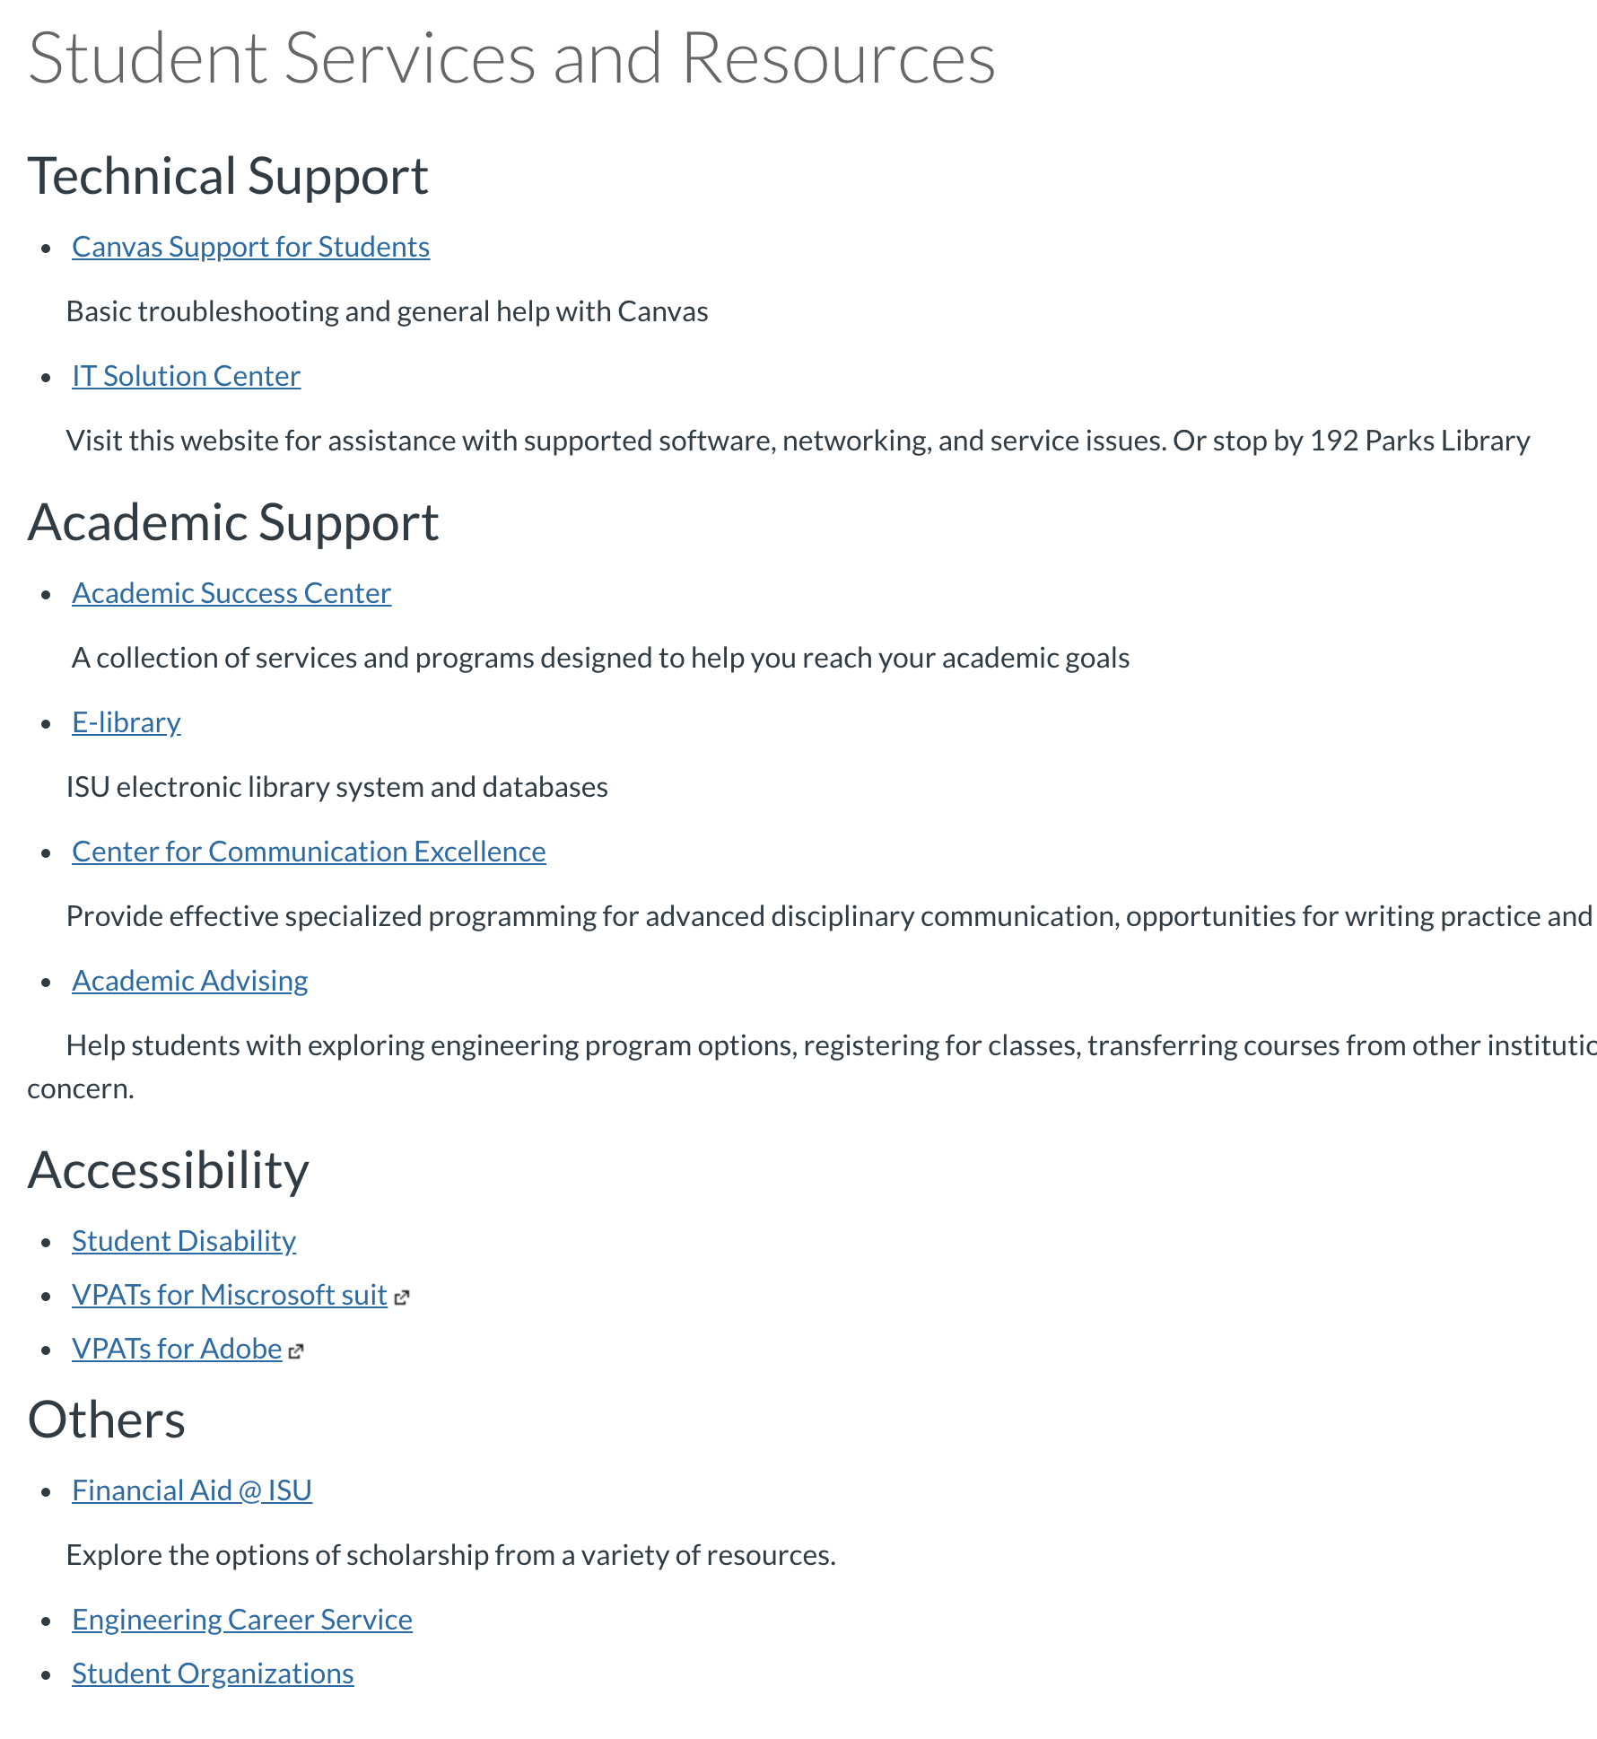
Learner support
The course facilitates learner access to institutional support services essential to learner success.
The course instructions articulate or link to a clear description of the technical support offered and how to obtain it.
Course instructions articulate or link to the institution’s accessibility policies and services.
Course instructions articulate or link to the institution’s academic support services and resources that can help learners succeed in the course.
Course instructions articulate or link to the institution’s student services and resources that can help learners succeed.

Slide 12
Accessibility and Usability
Course navigation facilitates ease of use.
The course design facilitates readability.
The course provides accessible text and images in files, documents, LMS pages, and web pages to meet the needs of diverse learners.
The course provides alternative means of access to multimedia content in formats that meet the needs of diverse learners.
Course multimedia facilitate ease of use.
Vendor accessibility statements are provided for all technologies required in the course.

Slide 13
Lessons Learned
Start with QM standards in mind
Focus on objectives-activities-assessment alignment
Reviewers might have pre-assumptions about how things should be done
E.g., We needed to convince them we did not need quizzes
Failing in the first round is no big deal
Focus on details

Slide 14
What is next for us?
Get CE 594A certified

Slide 15
Questions?

