Slide 1
Supporting LMS
ISU Solution Center

Slide 2
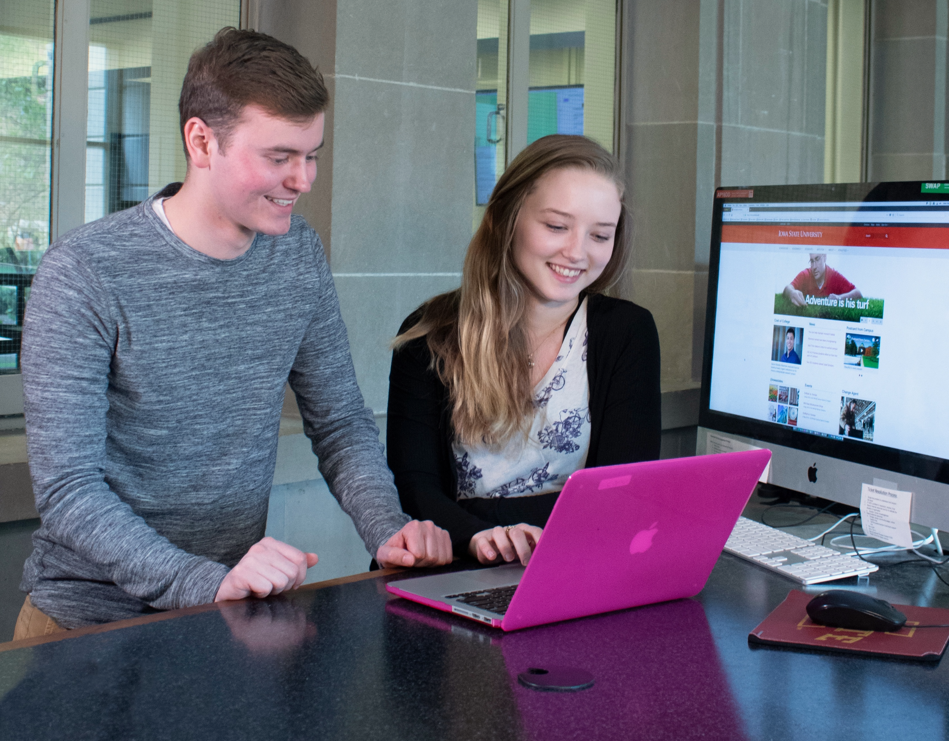
ISU Solution Center
Provides information technology support to faculty, staff, students, and visitors
Acts as a single point of contact for problem resolution

Slide 3
Solution Center Structure

Slide 4
Solution Center Structure
4 Full Time Employees

Slide 5
Solution Center Structure
4 Full Time Employees
50 Student Employees

Slide 6
Solution Center Structure
4 Full Time Employees
50 Student Employees
Tier 1
Tier 2
Tier 3
Tier 4
Tier 5

Slide 7
Solution Center Structure
4 Full Time Employees
50 Student Employees
Tier 1
Tier 2
Tier 3
Tier 4
Tier 5

Slide 8
Faculty Support
Our Priority:
Audiovisual Equipment in Classrooms
Networking
LMS (Canvas)
ISU Specific Tools
LTIs

Slide 9
LMS Support
Canvas
Registrar Data

Slide 10
LMS Support
Canvas
Registrar Data
ISU Specific Tools

Slide 11
LMS Support
Canvas
Registrar Data
ISU Specific Tools
Registrar and/or Departmental Support
Canvas Support
Solution Center

Slide 12
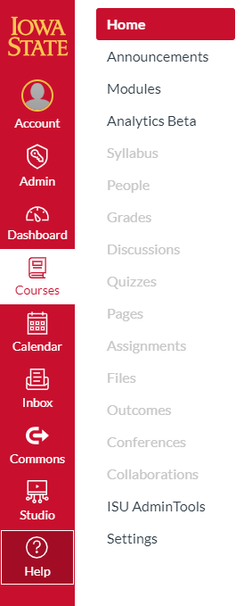
ISU Specific Tools
ISU AdminTools
Global Course Administration

Slide 13
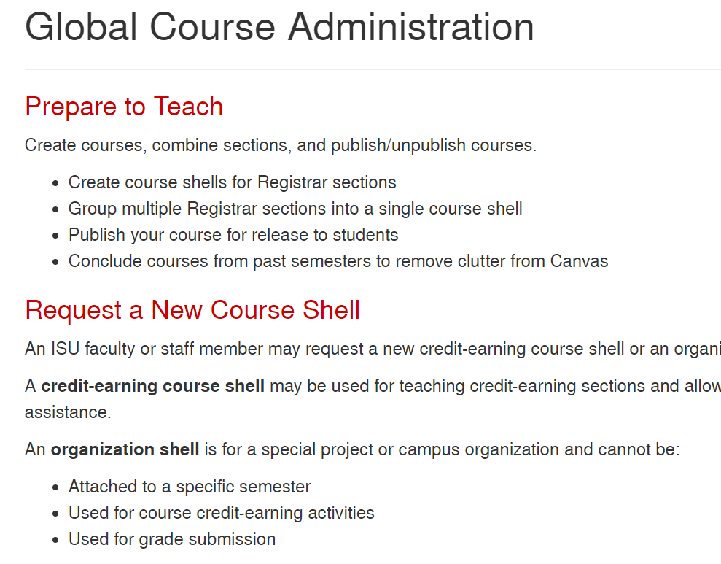
Global Course Administration
Common Inquiries:
Requesting a course shell
Using Prepare to Teach to link registrar sections and enroll students

Slide 14
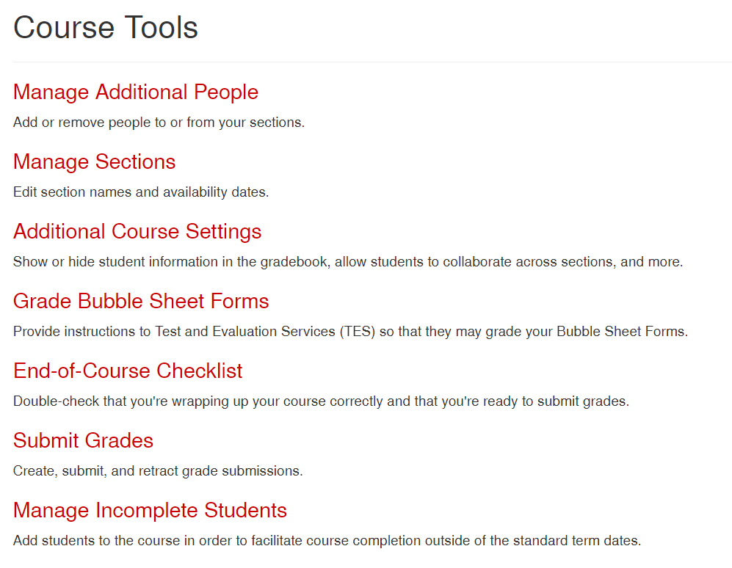
ISU AdminTools
Common Inquiries:
Adding additional instructors and TAs to courses
Submitting grades
Managing incomplete students

Slide 15
Collaboration is Key
Weekly meetings with CELT
Direct contact with Canvas Support
Evolving Solution Center Training

Slide 16
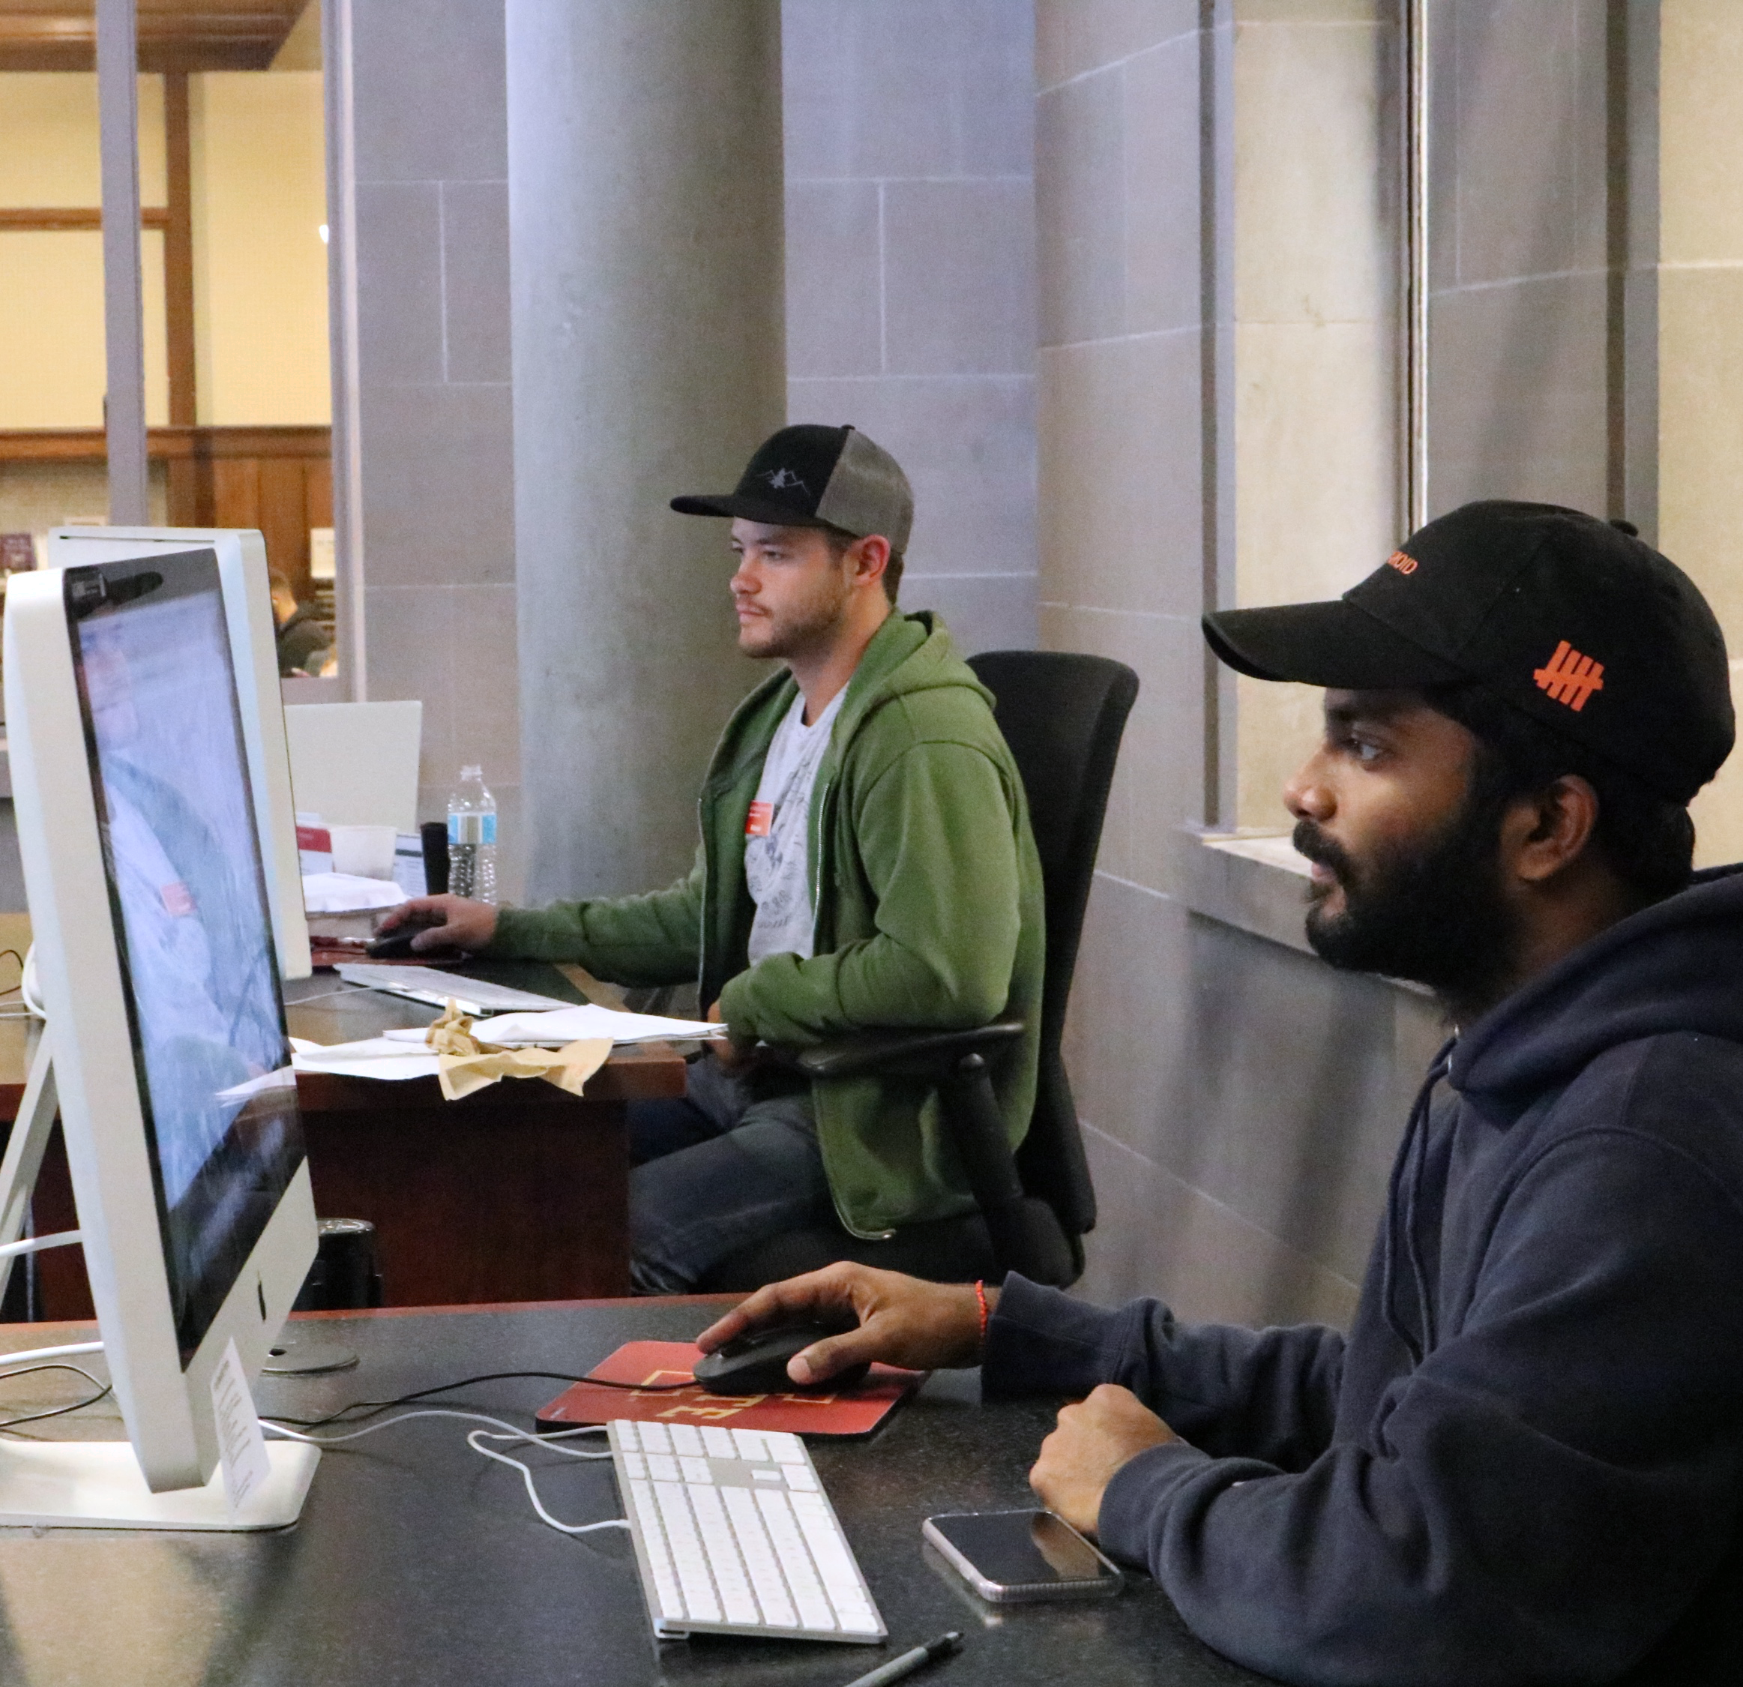
Here to Help
ISU Solution Center
192 Parks Library
Phone: 515-294-4000
Email: solution@iastate.edu

