Slide 1
Communicating Teacher Presence in a Course about Diversity
Racheal Ruble, Communication Studies
Notes:
I’ll talk with you today a bit about my course and approaches, what teacher presence means to me, and how I create video announcements using STUDIO to facilitate presence to clarify objectives and answer questions, provide feedback, and personalize content.

Slide 2
Course Description
Introduction to the role of diversity in communication. Training in competent communication with diverse social groups within interpersonal and organizational contexts. Topics include, but are not limited to, structured reflection of one’s role in diverse communication experiences, cultural variations in communication mores, impacts of racial/ethnic/gender identities on communication, workplace policies regarding cultural diversity, the intersection of communication and cultural privilege, communication practices that can reduce prejudice/discrimination, and communication characteristics of advocates for diversity. Specific focus on cultures within the United States.
Developed with assistance of an ELO Online Teaching Course Development Grant
Notes:
Students work through weekly (or biweekly in the summer) modules including assigned readings, powerpoint notes, external audio/visual content, group discussions, and individual assignments checking comprehension and encouraging reflection. When developing the course with the help of ELO, I went back and forth about whether or not to create lecture videos or other content. I began making them, and realized students could learn the content in other ways through the work I had already planned for them. But what I felt was missing was a personal connection to the specific students in the class in a given semester/section. I then decided to try video announcements that are sent at the start of each module. What I found (though it wasn’t necessarily what I had originally thought of when developing the idea), is that these video announcements connected students to the course and myself as the instructor in ways I didn’t imagine.

Slide 3
Teacher Presence/Social Presence
Presence: Immediacy and Intimacy that results from interaction.
Social Presence Theory (Short, Williams, & Christie, 1976)
Teacher Immediacy (Anderson & Anderson, 1982)
Notes:
Immediacy: Sense of nonverbal closeness, engagement, positive feelings
Intimacy: Sense of feeling we know who we are interacting with, who they are, information about them
Social Presence Theory: Communication media with more access to nonverbal cues increase a sense of presence in interactions
Teacher Immediacy: Verbal and Nonverbal cues (in a classroom setting: eye contact, gestures, relaxed body posture, smiling, varied voice tone, movement around room)
OUTCOMES: liking for the subject matter, teacher, and class, and to increase desire to learn, motivation (which in turn can increase cognitive learning)

Slide 4
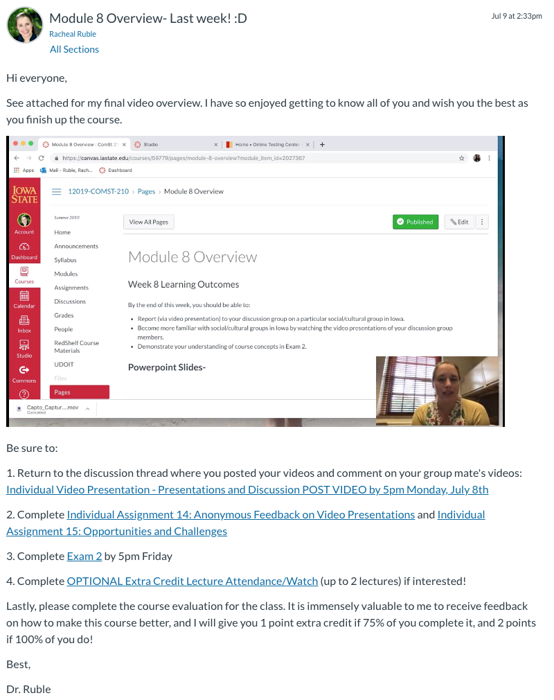
My Approach:
Course Announcements sent at the start of each module.
Create video using Studio and embed within the announcement (along with links to assignments due, etc.).
NOTE before sharing, I request auto-generated captions, edit as needed, and publish to the video

Slide 5
Format:
Screen share with webcam in corner.
Allows me to show students how to navigate the canvas page and explain content
Creates connection as they can see me as I speak (as they would in a ftf class)
Brief (under 10 minutes)

Slide 6
Content: Clarify Objectives and Answers Questions
Overview of module objectives and assignments
Questions I have been asked or that I anticipate
Notes:
I find students have a better sense of what we are trying to accomplish when I provide some insights on the current objectives and rationale behind them. I also anticipate the questions students might have on current assignments (or address questions individual students have emailed me in case others have similar questions) and answer those.
For example, if in past semesters, I have discovered that students are unclear on a particular section of the reading or an assignment, I will revise what I can, but including some additional clarification in my announcement video is important as well.

Slide 7
Content: Provides Feedback
General feedback as I would give in a ftf class:
Areas for improvement
Praise
No identifying information!
Notes:
I give general feedback to students as a whole in the same way I might in a face-to-face class. If I see students making strong progress toward objectives, actively participating, asking insightful questions, etc., I make sure to let them know! Similarly, if I see areas where students can improve, I make note of that as well (without identifying specific students).
Examples: Groups that have early participation have more in-depth conversations… I really appreciate your openness in sharing within your individual assignments.

Slide 8
Content: Personalizes Content
My own personal examples/connections to the content helps students feel more comfortable sharing their own.
Notes:
In my communication courses, I often ask students to connect what we are learning to their own lives and experiences. Though this can be useful for almost all subjects. To help students feel more comfortable sharing and see examples of what it might look like, I share my own personal examples. When students know more about me, they are more open with me and their classmates.
If I can share a brief story/example about how the content relates to me, I share. If there are current events going on that relates, etc.

Slide 9
Considerations
Adds to instruction time because I don’t reuse videos.
I make mistakes!
I didn’t track views, so I haven’t been able to directly measure outcomes (though something to consider for the future!)
Notes:
These announcements are created each semester with each course as it progresses, so it’s an extra step in my work as an instructor. At the same time, I treat these like a segment of a face-to-face course, so I don’t worry about small mistakes, and I don’t take time doing much editing or second-guessing the content. It’s not about being a professionally-made video; it’s about connecting with students as I would in any other learning environment. Try it in your classes!

