Slide 1
Interactive speaking online with goReact
Katie Fulton, Associate Teaching Professor
Department of English, Program in Speech Communication

Slide 2
How do we teach public speaking online?

Slide 3
Interactive Speaking Online with GoReact
About GoReact
Uses for GoReact
Current Use at ISU
Improving the Tool

Slide 4
About GoReact
Presentation capture software with robust feedback tools
Compliant: FERPA, HIPAA, data privacy
Canvas integration available
No special equipment (only webcam)

Slide 5
GoReact Student Access
Student Paid Accounts
$30 per student
6 months access
eBook Platforms: McGraw-Hill and Macmillan licenses

Slide 6
Uses for GoReact

Slide 7
Uses for GoReact: Assignment Types
Standard Assignment:
Students record/upload independently
Students present live
Stimulus: watch a video and record reaction simultaneously
Comment Only: watch a video and analyze with comment tools

Slide 8
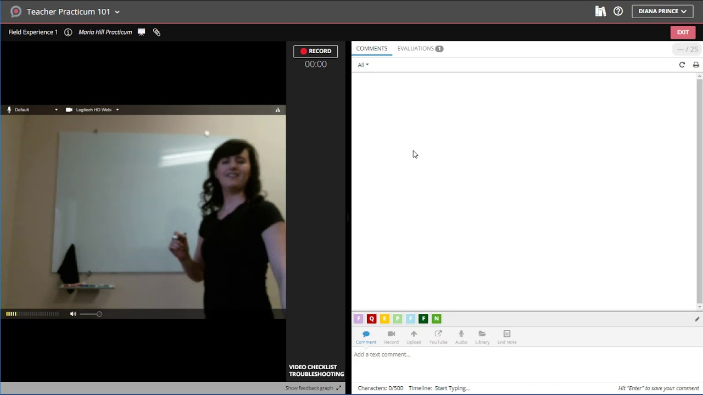
Standard

Slide 9
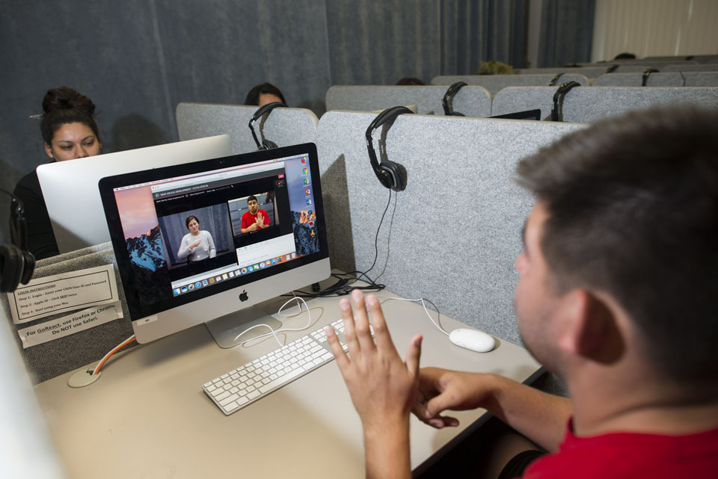
Stimulus
Students in the Deaf Studies Program at California State using GoReact
csunshinetoday.csun.edu

Slide 10
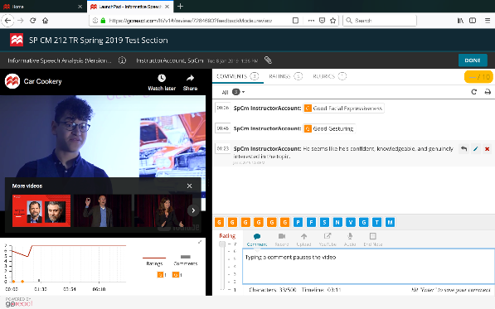
Comment Only

Slide 11
Uses for GoReact: Studio Comparison
Canvas Studio
GoReact
Discussions
Quizzes
Submit Recordings
Discussions
Submit recordings
Live presentations online & in class
Comments, Rubrics, Markers, Rankings
Private Comments
Multiple speakers

Slide 12
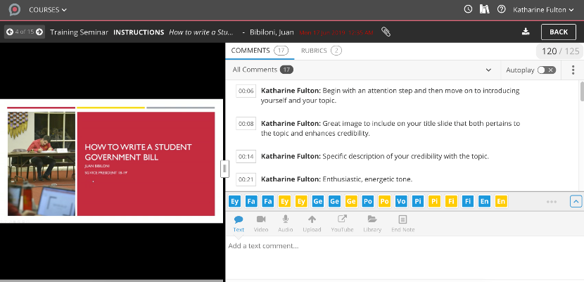
Uses for GoReact: Grading + Feedback

Slide 13
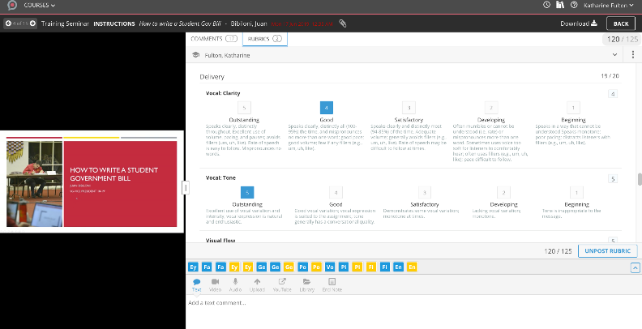
Uses for GoReact: Grading + Feedback

Slide 14
Use at ISU
Notes:
So far, the tool is being used in the Speech Communication Program and in Accounting 581. It has the potential to be used in any course that requires online presentations, as well as language courses and American Sign Language.

Slide 15
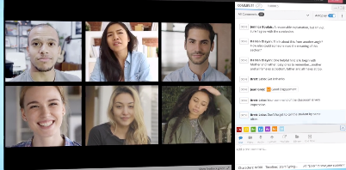
GoReact in SpCm 312 Online
All Major Speeches
Elevator Pitch
Training Seminar
Shark Tank Pitch
Team TED Talk
Peer Analysis
Self-assessment

Slide 16
GoReact in SpCm 212
Accessed via Macmillan LaunchPad tool
Web-blended:
Speech analysis
Mini speeches
All sections:
Practice session recordings
Notes:
In all sections of the course, students upload practice sessions and comment with feedback. In web-blended 212, students view speeches from YouTube or of past students and analyze them.
Students also post their own mini speeches: self-introduction, and recitation.

Slide 17
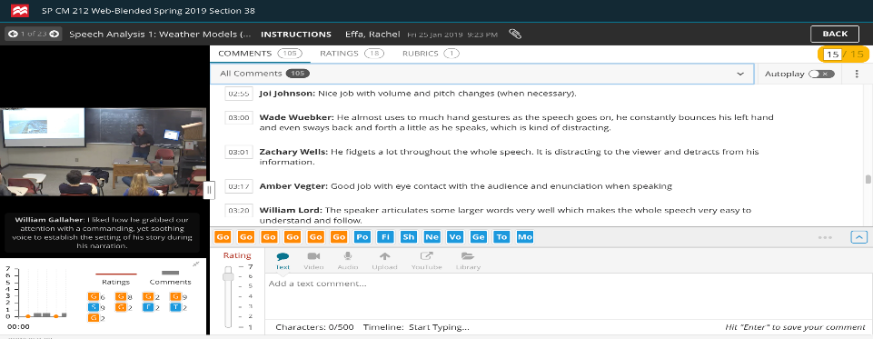
GoReact in SpCm 212
Notes:
In all sections of the course, students upload practice sessions and comment with feedback. In web-blended 212, students view speeches from YouTube or of past students and analyze them.
Students also post their own mini speeches: self-introduction, and recitation.

Slide 18
Improving the Tool
Notes:
An institutional license would be great, as well as Canvas integration.

Slide 19
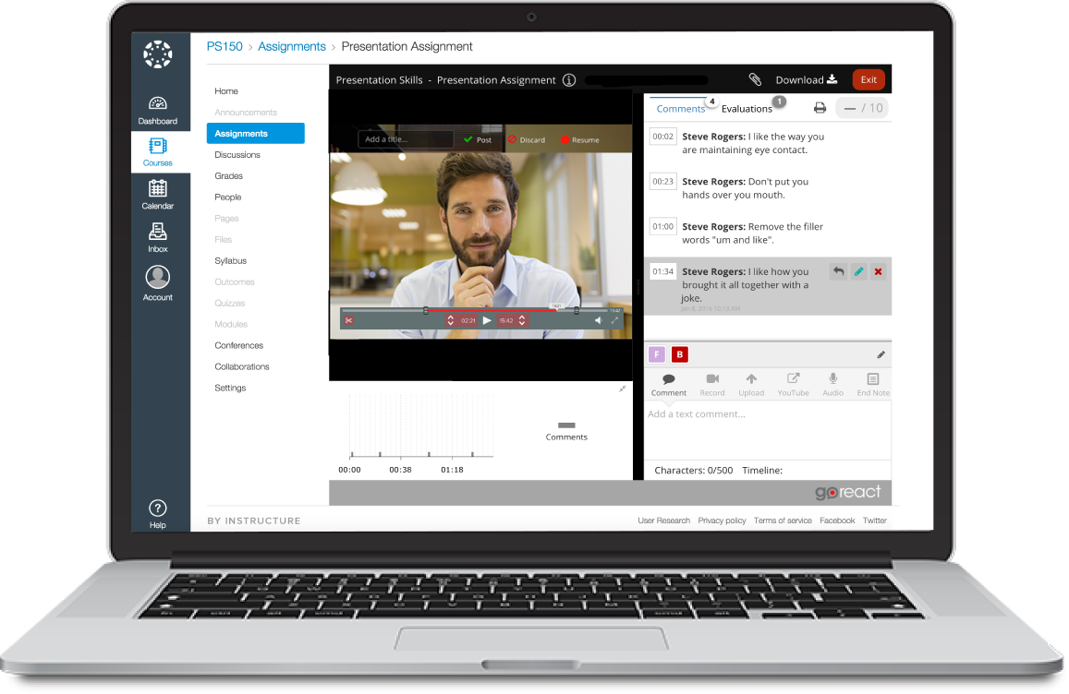
Canvas Integration

Slide 20
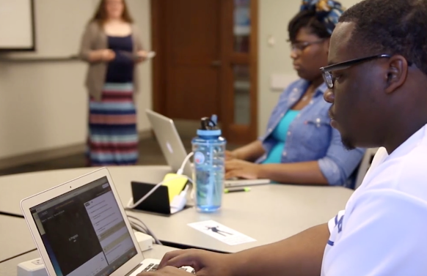
In-Class Speech Capture

Slide 21
Questions?

