Slide 1
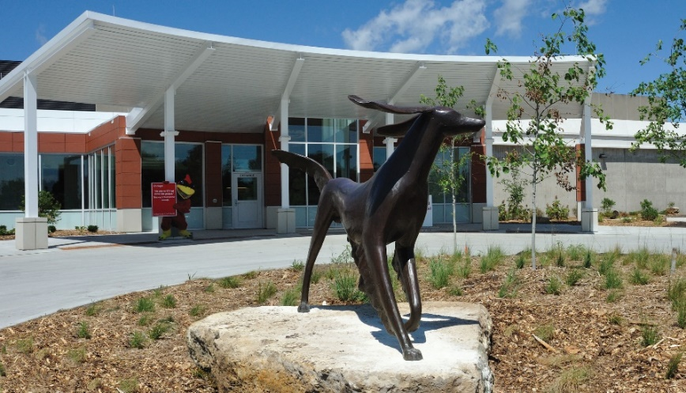
Hat Trick: Benefits of Top Hat for Students and Instructors
Jessica Ward, DVM, DACVIM (Cardiology)
Assistant Professor, Veterinary Clinical Sciences
Iowa State University College of Veterinary Medicine

Slide 2
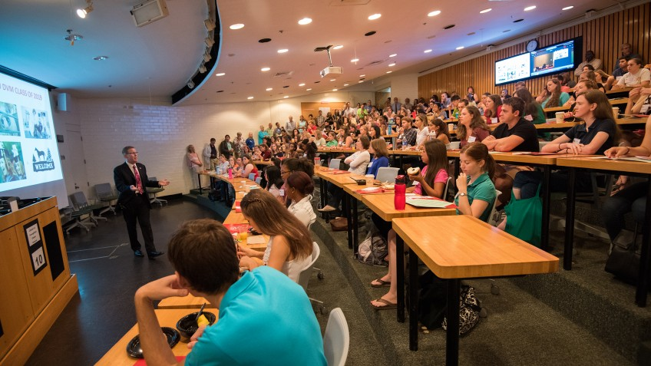
What is my teaching context?
Lloyd Veterinary Medical Center
Notes:
Veterinary medical curriculum is unique, but share similarities with courses in other colleges
Professional students: aged 22-28
Medium-to-large sized class: 120-140 students
Students are all together all day long; generally stay in same classroom (instructors rotate)
All students have CVM-issued laptop with paid subscriptions (including Top Hat) and are familiar with the technology by the time I see them
I teach in VM3 courses: core (140 students) and elective (60 students)

Slide 3
How do I use Top Hat in the classroom?
Test students on class preparation
Encourage active participation in clinical case studies
Foster small-group discussion
Lloyd Veterinary Medical Center
Notes:
Applications of Top Hat that will be discussed include testing student preparation at the beginning of class periods, encouraging active participation in clinical case studies, assessing student understanding, and enabling small-group problem-solving. The instructor will share benefits of Top Hat for both student learning and instructor enjoyment/satisfaction with didactic teaching.

Slide 4
Test students on class preparation
4 graded questions at beginning of each class period
Content: learning objectives from assigned vodcasts
Single correct answer; expect 100%
“Did you prepare for class?”
Lloyd Veterinary Medical Center

Slide 5
Test students on class preparation
Lloyd Veterinary Medical Center

Slide 6
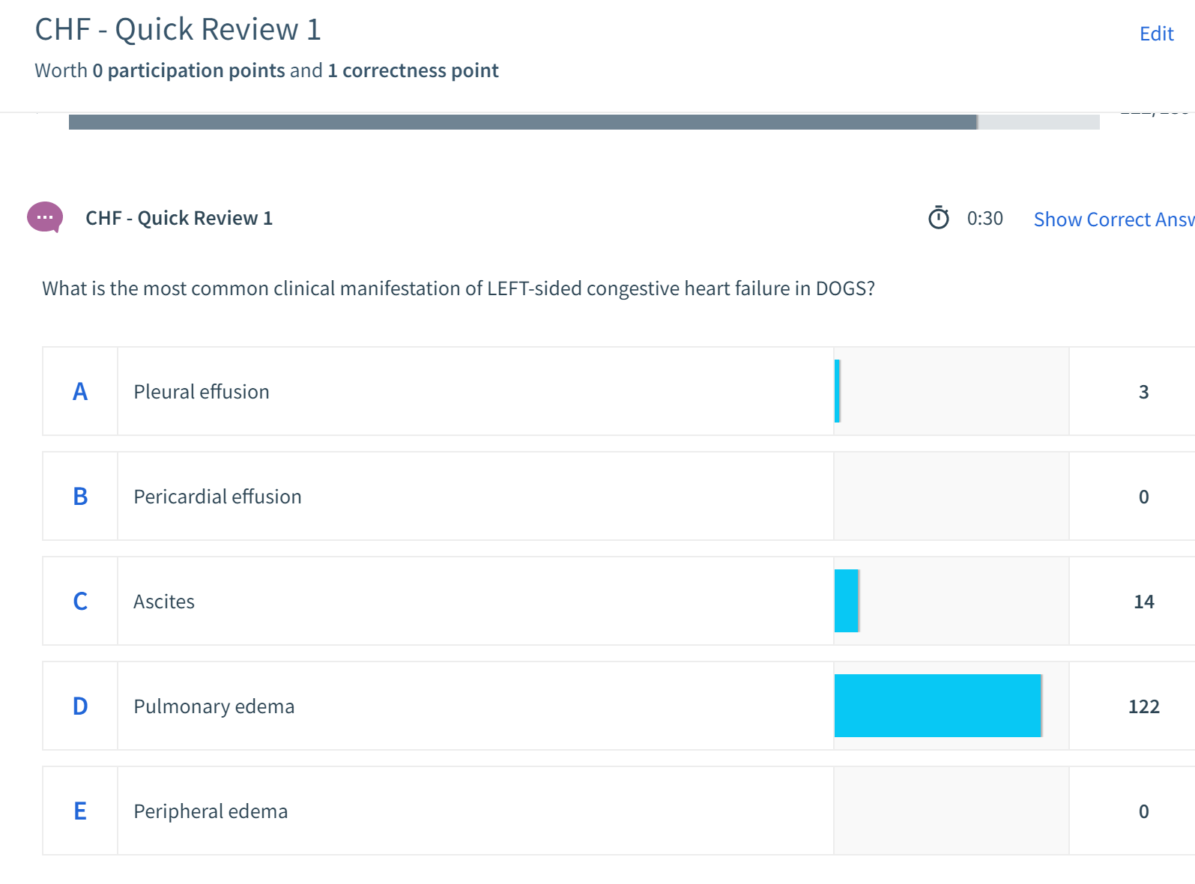
Test students on class preparation
Lloyd Veterinary Medical Center

Slide 7
Participation in clinical case studies
5-8 non-graded questions throughout class period
Content: differential diagnoses, diagnostic testing, or treatment options
Usually “most correct” answer, but multiple possible options
“Choose your own adventure”
Lloyd Veterinary Medical Center

Slide 8
Participation in clinical case studies
Lloyd Veterinary Medical Center

Slide 9
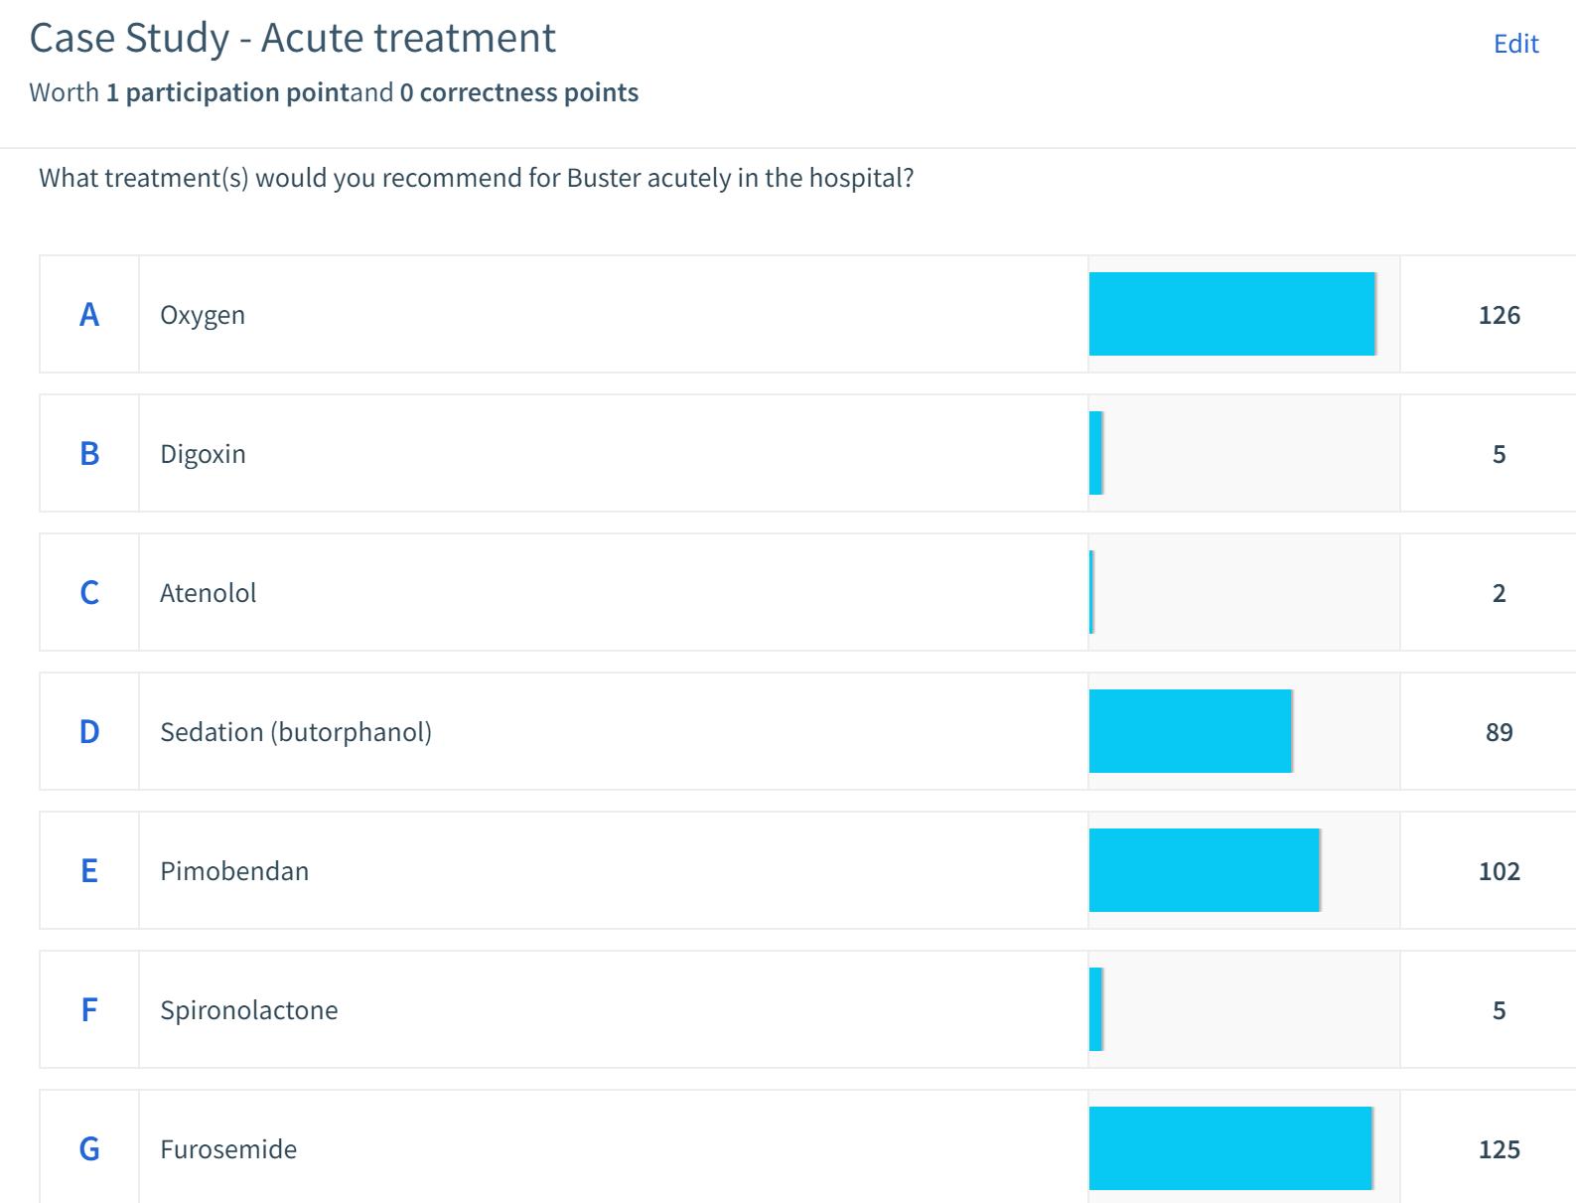
Participation in clinical case studies
Lloyd Veterinary Medical Center

Slide 10
Foster small-group discussion
1-5 non-graded discussions per elective class period
Content: literature review, case interpretation
Allows anonymous response; group or individual response; student reaction/comment
“What do you think, and why?”
Lloyd Veterinary Medical Center

Slide 11
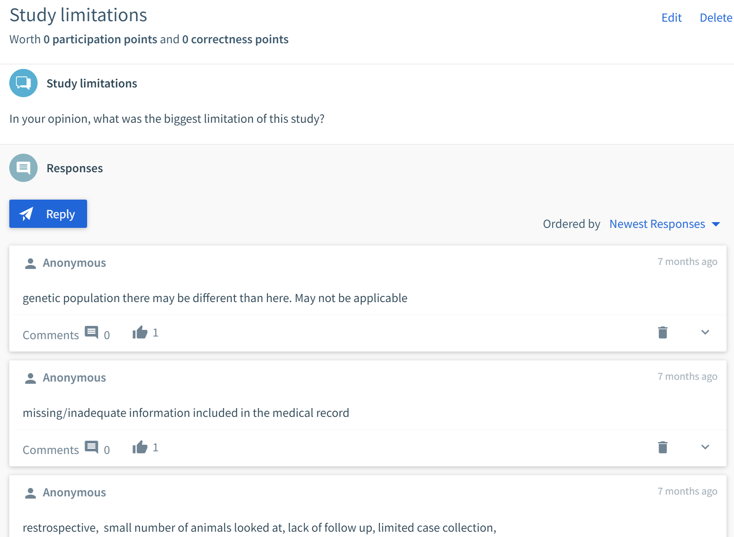
Foster small-group discussion
Lloyd Veterinary Medical Center

Slide 12
Benefits of Top Hat in my classroom
Encourages preparation before class
Increases student engagement during class
Breaks up class period
Enhances instructor stamina & enthusiasm
Identifies points of confusion
Lloyd Veterinary Medical Center

