Slide 1
Team Activities in TopHat
Tanya Austin Lead Instructor, BUSAD 203 Business Career Services
Ivy College of Business

Slide 2
BUSAD 203 Context
800+ students across multiple sections (1-13)
1-cr, 16-wk graded course
6 instructors (15-20% Teaching Contract)
TBL class format (no I-RAT/T-RAT)
8-12 teams/section
80% have existing TopHat subscription
Previously assigned pre-class work in Canvas and distributed worksheets for weekly activity points

Slide 3
TopHat ‘Assignment’ Process
Pre-Class Review
No points – ‘Review’
In-Class Activity
Weekly 5 pt – ‘Homework’
Syn with Canvas

Slide 4
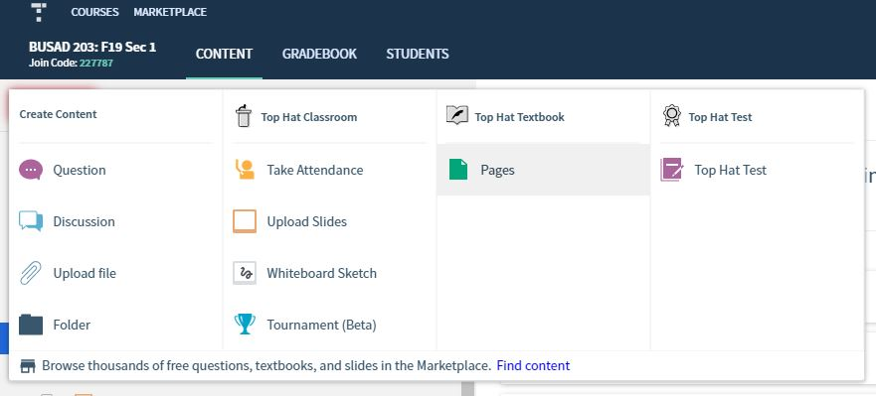
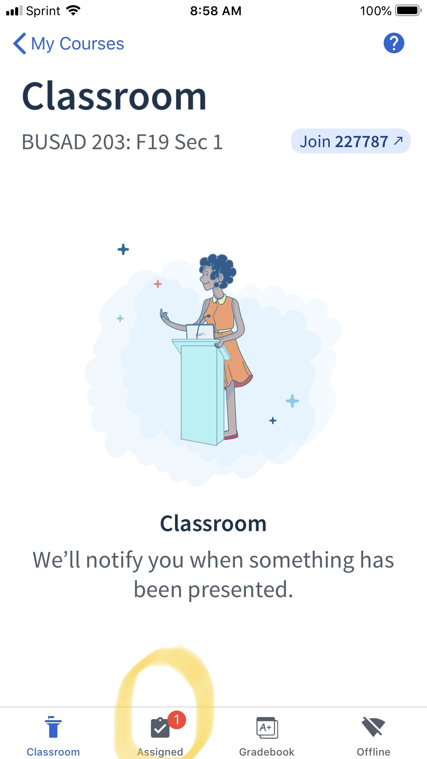
Creating Assignments

Slide 5
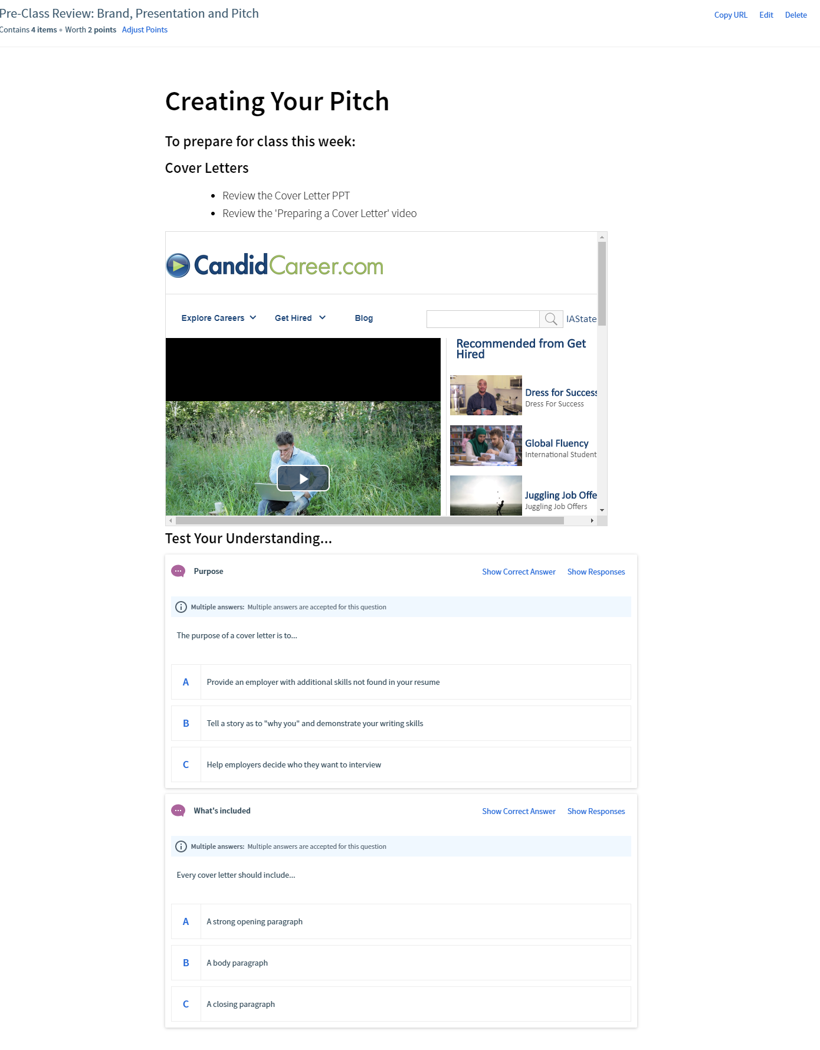
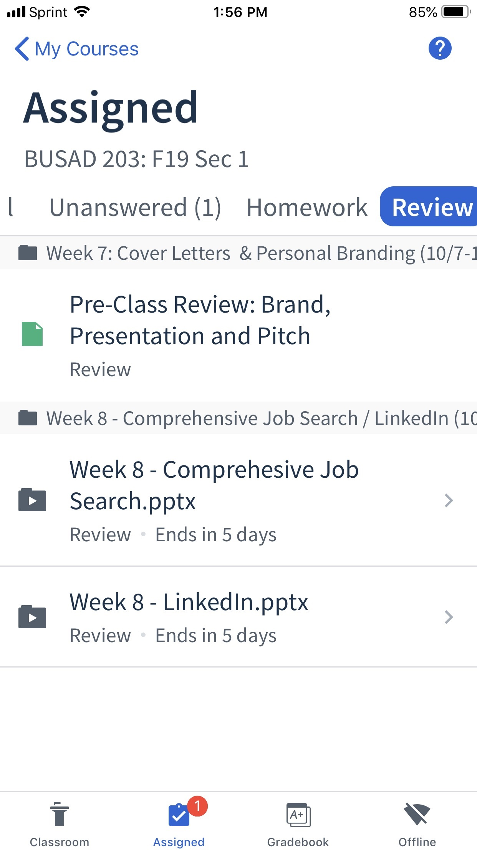
Accessing
‘Pre-Class Review’

Slide 6
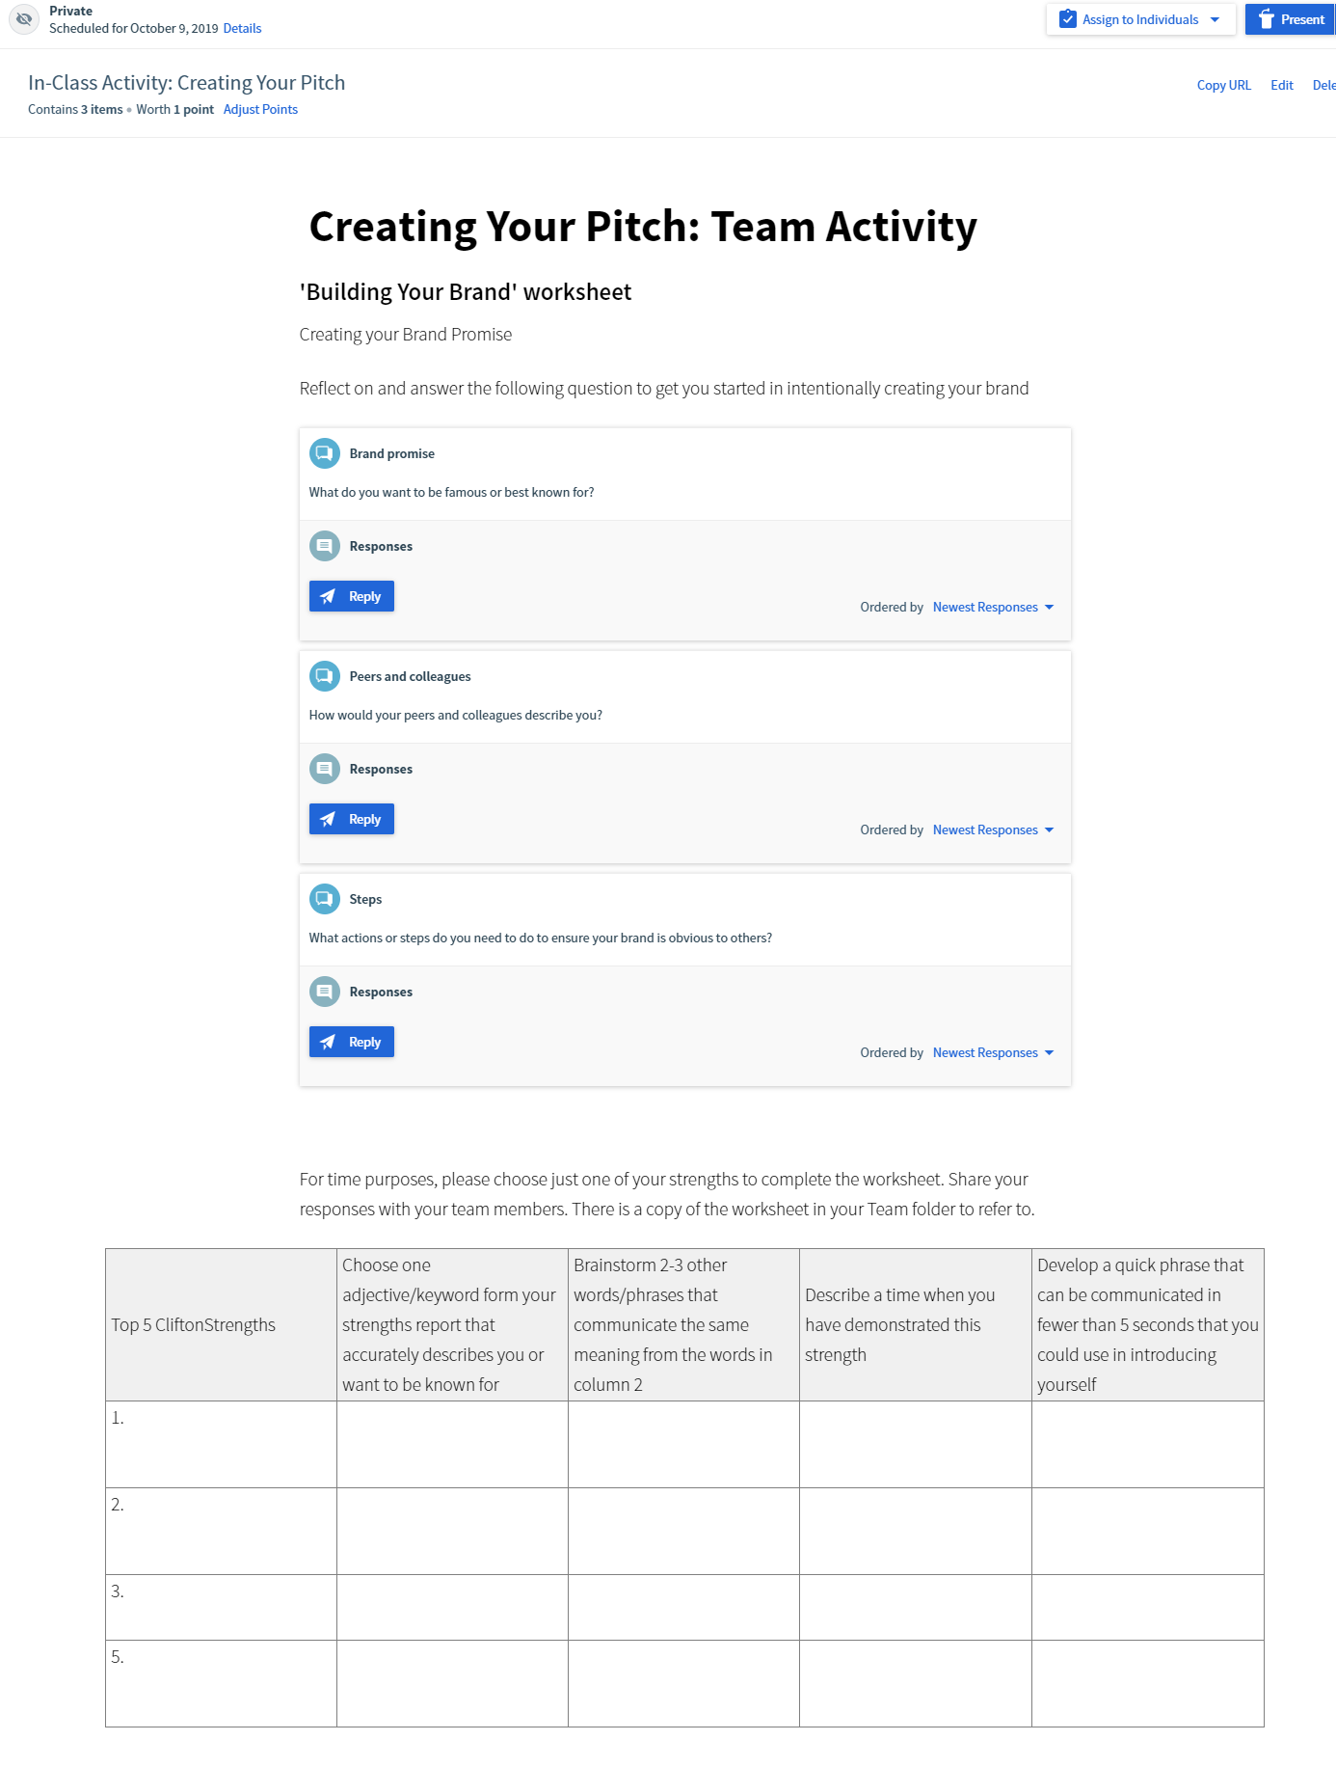
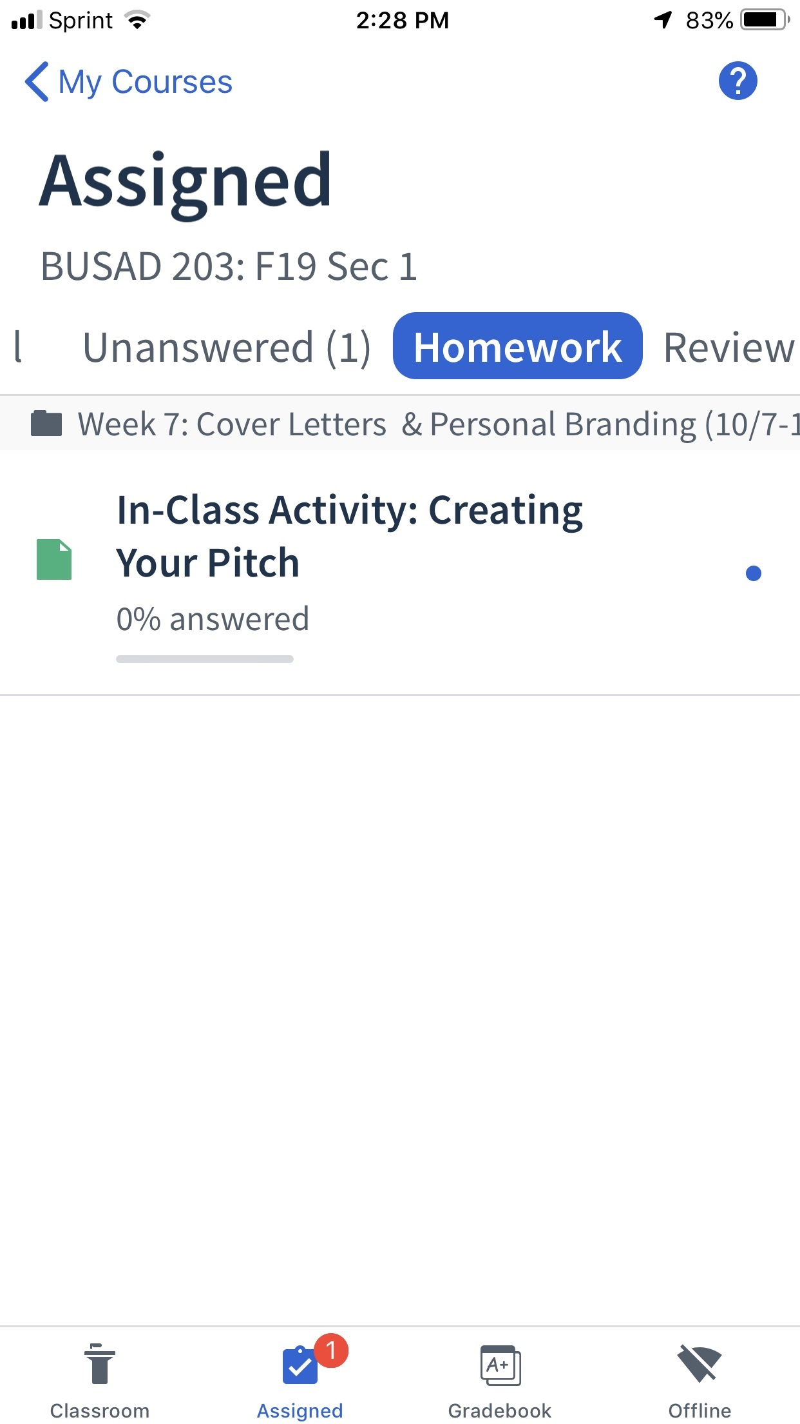
Create ‘Homework’
for In-Class Activities

Slide 7
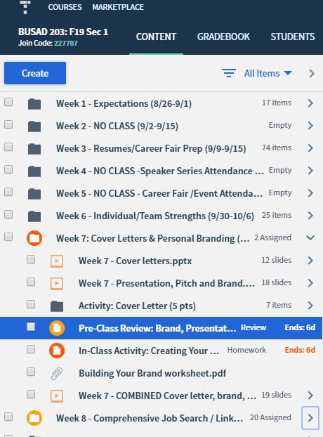
Managing Assignments
Quickly view what has been assigned
Identifies end dates

Slide 8
Syncing
Place your screenshot here
Seamlessly comes over as new column in the Canvas Gradebook
Can edit/update points when needed

Slide 9
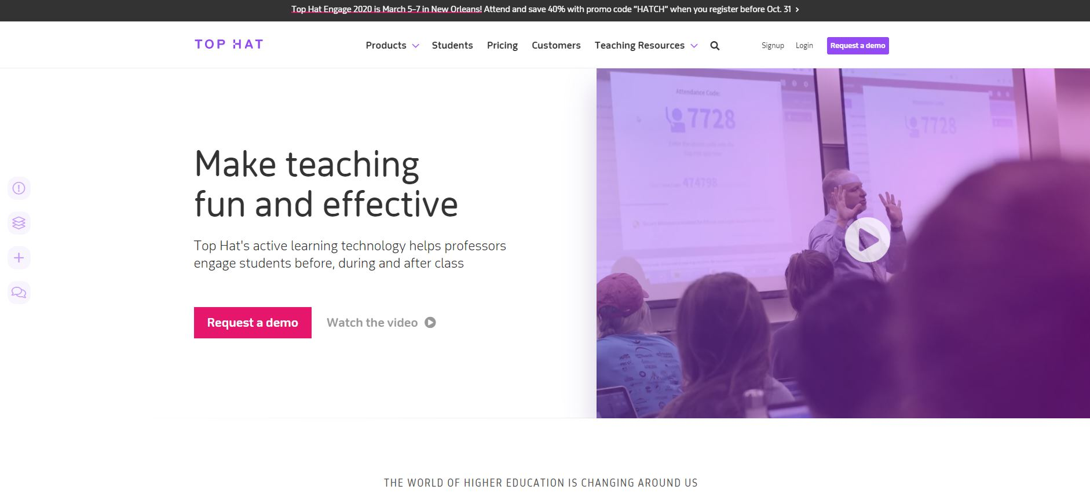
Challenges
Place your screenshot here
No ‘Group’ submission function
Creating worksheets
Types of files (iframe, discussion questions, Youtube)

Slide 10
Thanks!
Any questions?
You can find me at:
Ivy College of Business | Business Career Services
1320 Gerdin Business Building
tjaustin@iastate.edu

