Slide 1
Augmented Reality in Language Teaching: Incorporating HP Reveal to create a Virtual Museum in a Spanish Literature Class
Dr. Jacob Larsen, Director, Language Studies Resource Center (jlarsen@iastate.edu)
Dr. James Nemiroff, Lecturer, Department of World Languages and Cultures (nemiroff@iastate.edu)

Slide 2
Notes:
Introduction (30 seconds)
Many courses ask students to present their work or research in the form of a poster.
BUT, posters have some inherent limitations.
They are 2D, and use mostly writing and graphics
From a learning perspective, students miss out on audio, video and user feedback and interaction
Language learning and practice is as much about content as it is about using the different modalities of the language - reading writing speaking listening.
Enter HP Reveal

Slide 3
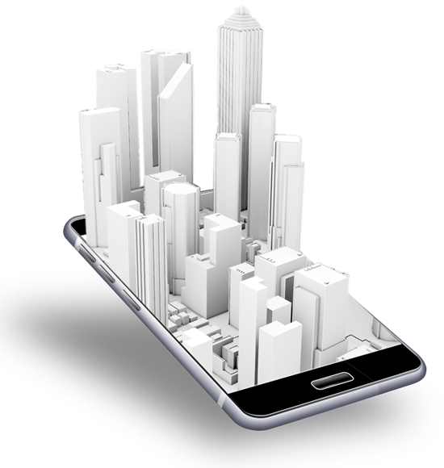
WWW.
Notes:
25 seconds
It allows students to work with different media to express their messages in different ways, via print, audio, and video.
It encourages more creativity.
It enables dialogue with viewers through the use of feedback forms.
Allows viewers to take something with them from the poster and continue to interact with the materials at a later time - such as a link to an article or video clip of a play.

Slide 4
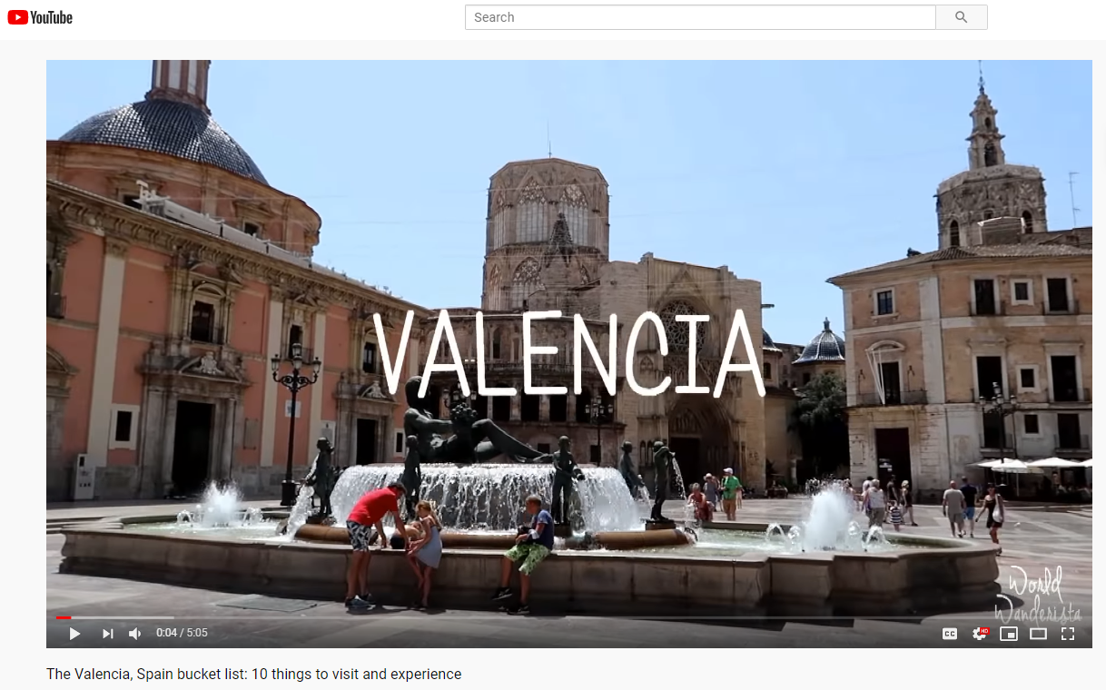
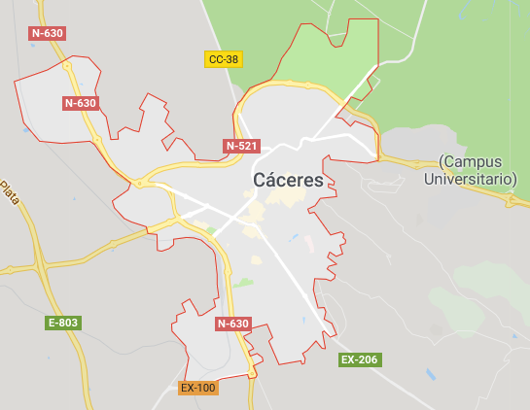
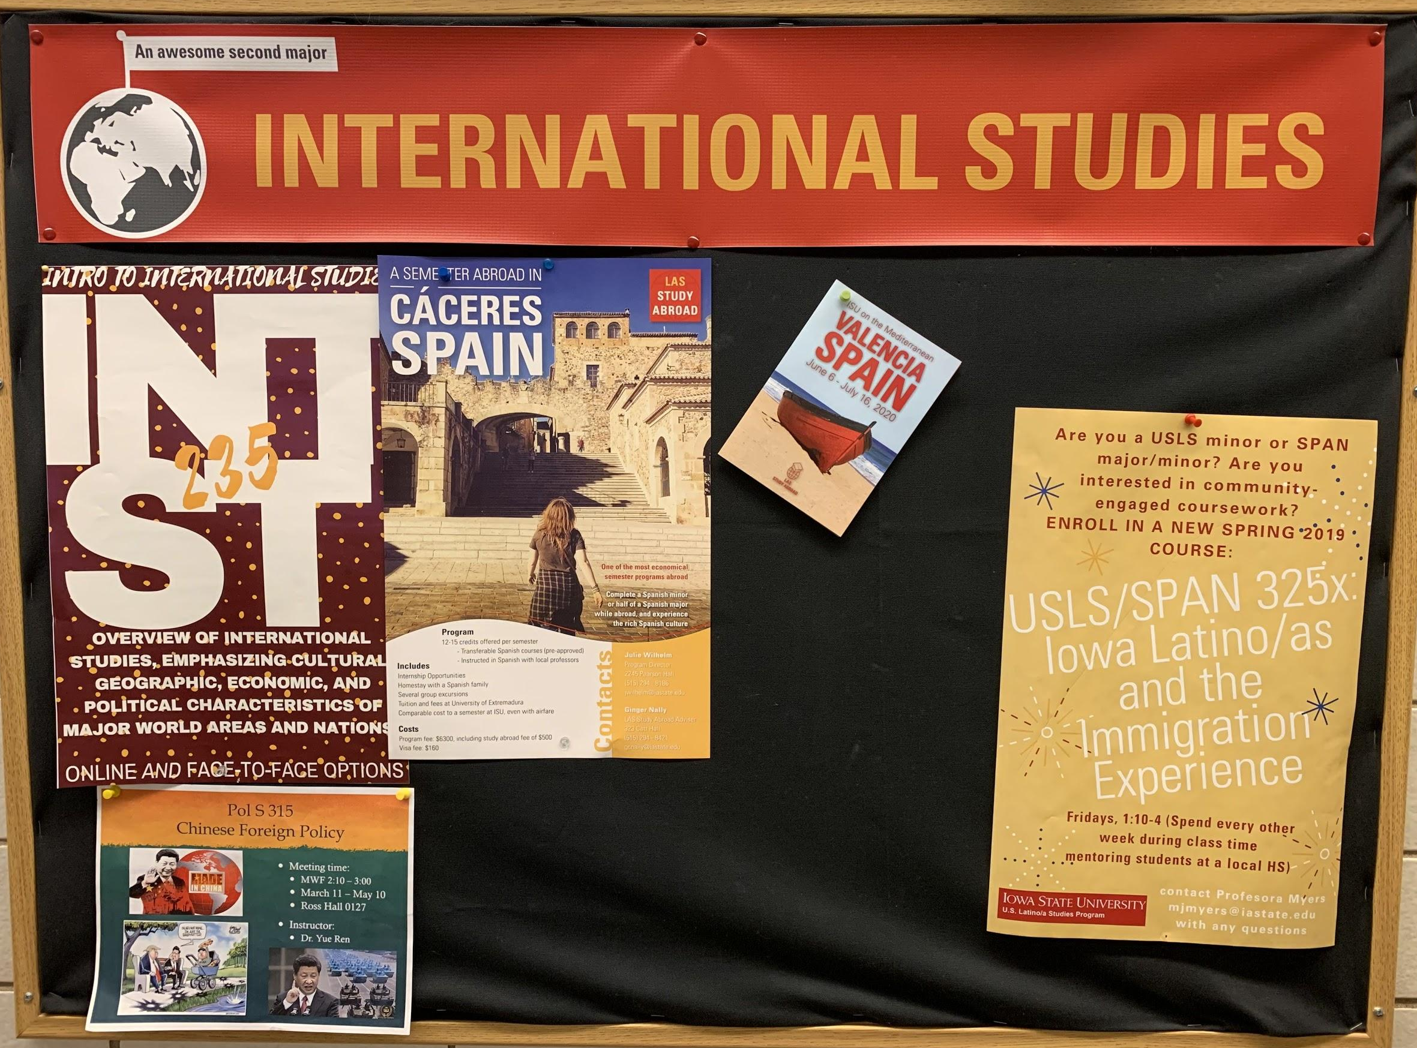
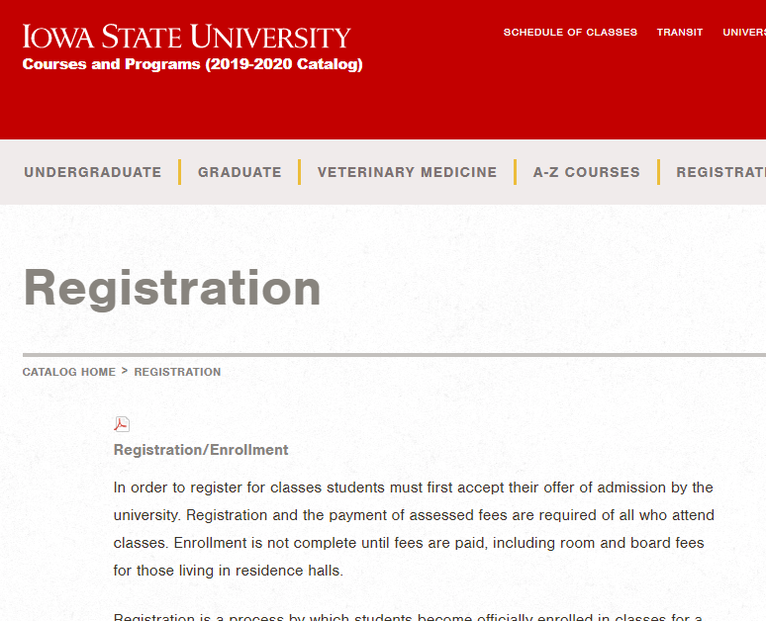
Notes:
30 seconds
It may also be used to provide interactive information about study abroad programs or majors and minors.
Interactive features, videos, student testimonies, etc. can be included in information posters.
You then post a note about the ability to see additional content through HP Reveal.
For example, link to a video about a study abroad destination - maybe even one featuring some of the teachers in the program
Or link to a map of where it is
Or maybe directly to the class registration page

Slide 5
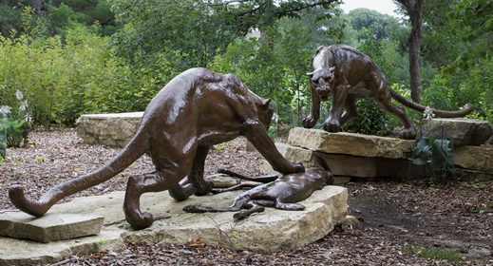
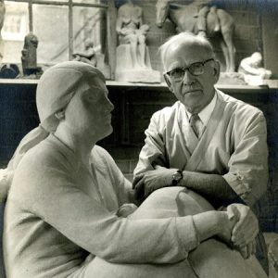
Notes:
25 seconds
There is also a potential for museums and art galleries on campus to use HP Reveal.
This would allow students and visitors to better interact with the different art pieces and could help spark more interest.
All people need to do is view the art piece through the HP Reveal app to load the augmented reality pieces
For example, the New Bedford Whaling Museum uses augmented reality through HP Reveal to bring their displays to life.

Slide 6
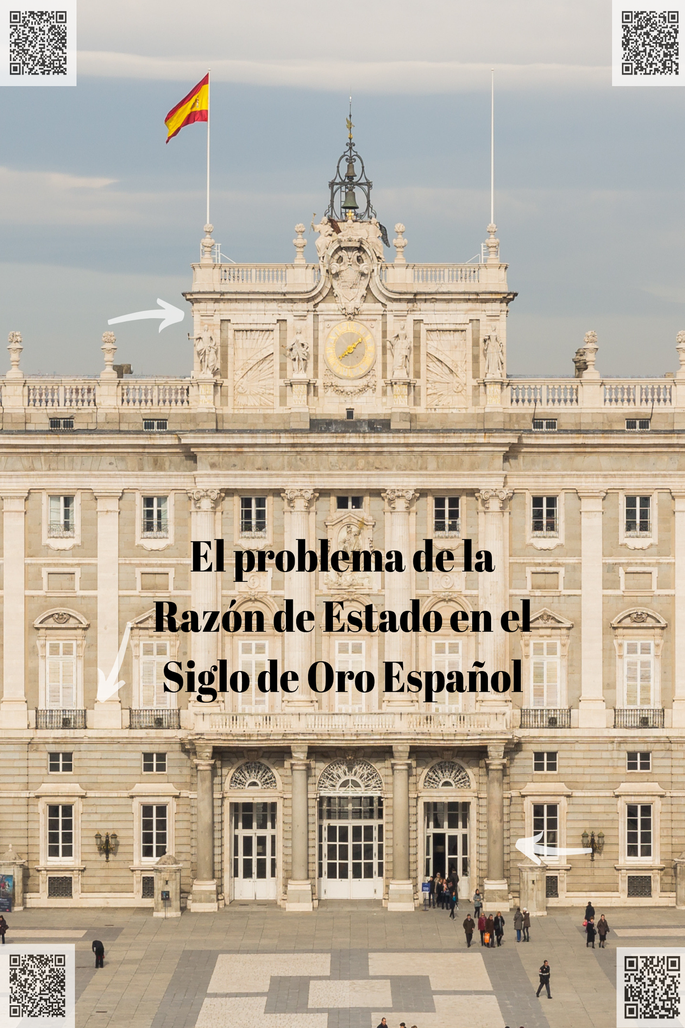
Notes:
35 seconds
How does HP Reveal work?
Use the app to photograph different parts of your poster you want to use for triggers
Upload trigger content through the app
Publish your triggers
When users run the app and point mobile device camera at poster, the content is triggered
Use QR codes for web links like Google forms, YouTube videos, etc. - the app reads those too
In this case we are looking at its application for learning Spanish.
James will explain the specific project

Slide 7
Collaboration Goals
Research Goals
Technology Goals
Notes:
-30 seconds
Research Goals
1. Understand how to do research starting at its earliest stages
2. Summarize another scholar’s argument in your own words
Collaboration Goals
3. Critique the argument of others about a topic of common interest
4. Define a term critically using relevant secondary criticism.
Technology Goals
5. Learn how to incorporate different modes of visual and digital rhetoric in order to persuade.
(1 min)

Slide 8
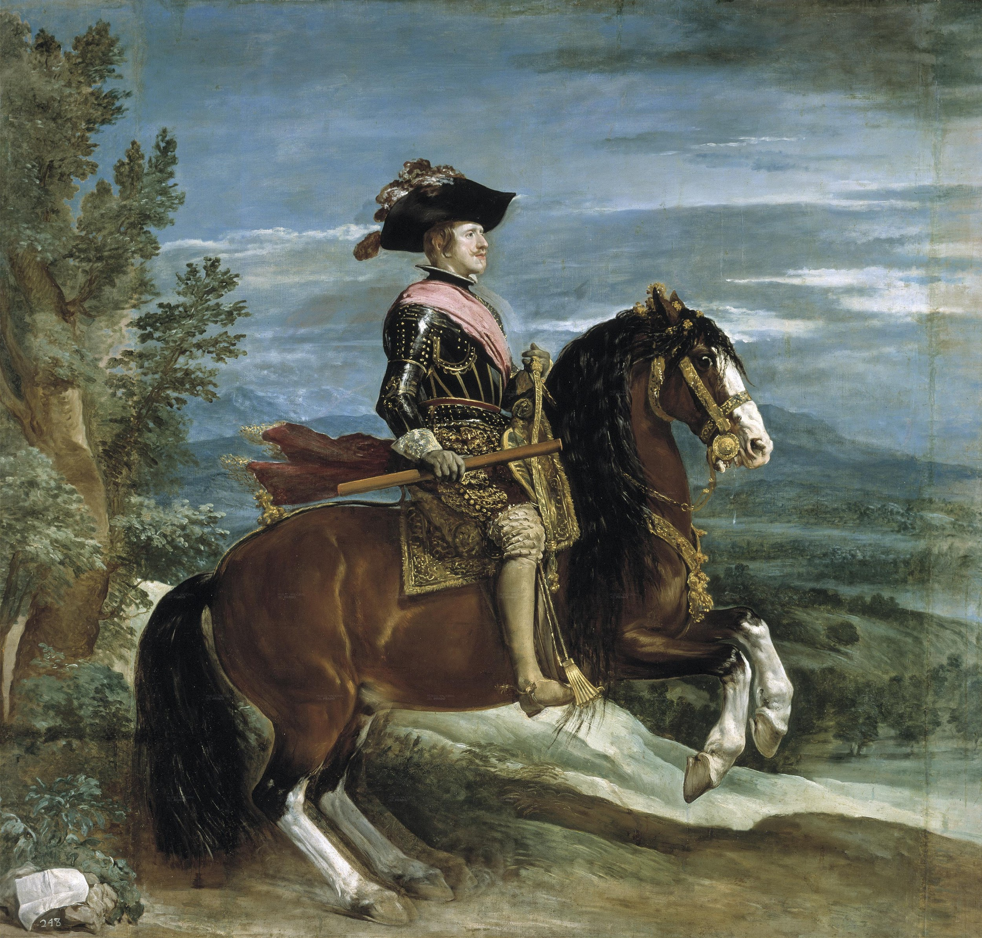
Notes:
-60 seconds
10-12 page collaborative paper based on an author or a genre (one text studied in class the other chosen in consultation with me after a proposal process)
Developing an augmented reality poster using HP Reveal that incorporates video, visual art and other kinds of visual rhetoric that complements the arguments presented in the paper
For the augmented reality poster, students have to:
Submit an image or a video that they want to incorporate in their posters (they turned them in last week)
Record videos that explains aspects of their argument
Using HP Reveal, integrate all material into a poster.
Present that poster at the end of the semester (during Dead Week).
Posters will remain on display for students and faculty to explore.

Slide 9
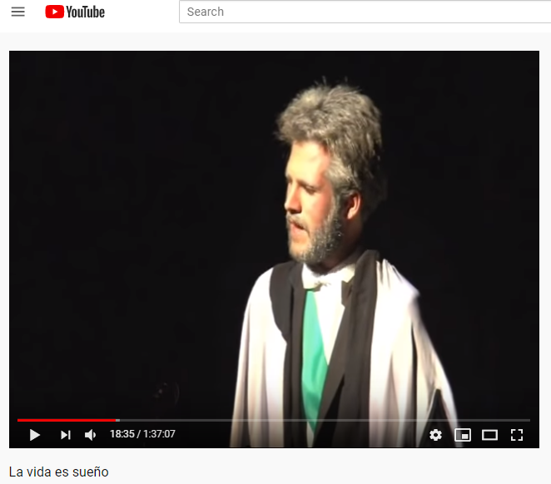
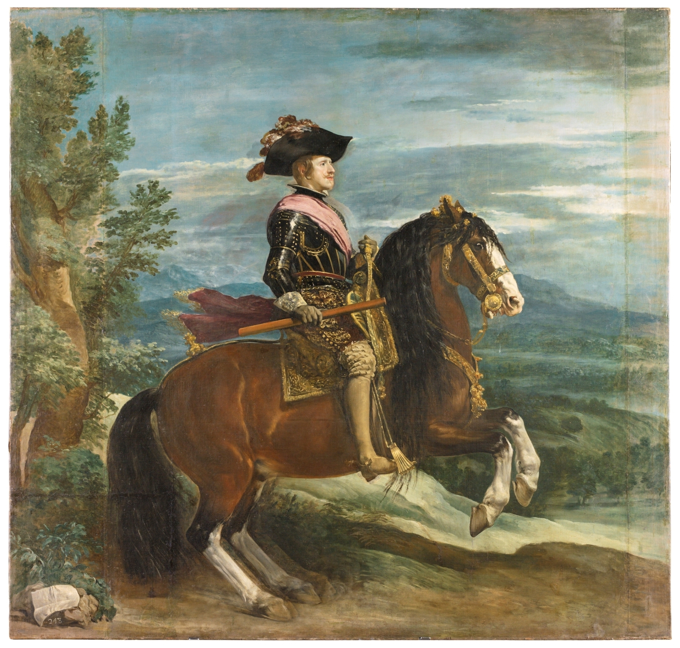
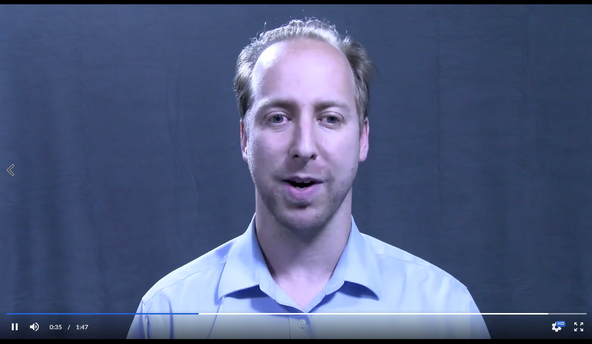
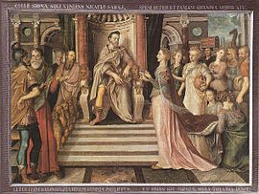
Notes:
2 minutes
Example Project (insert poster from LSRC) (2 min)

Slide 10
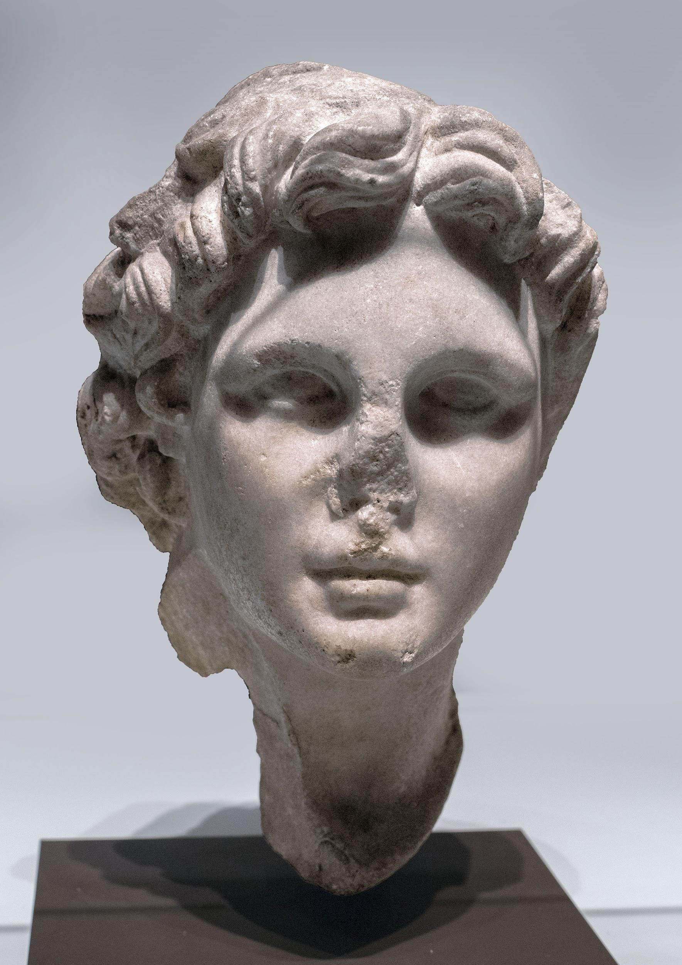
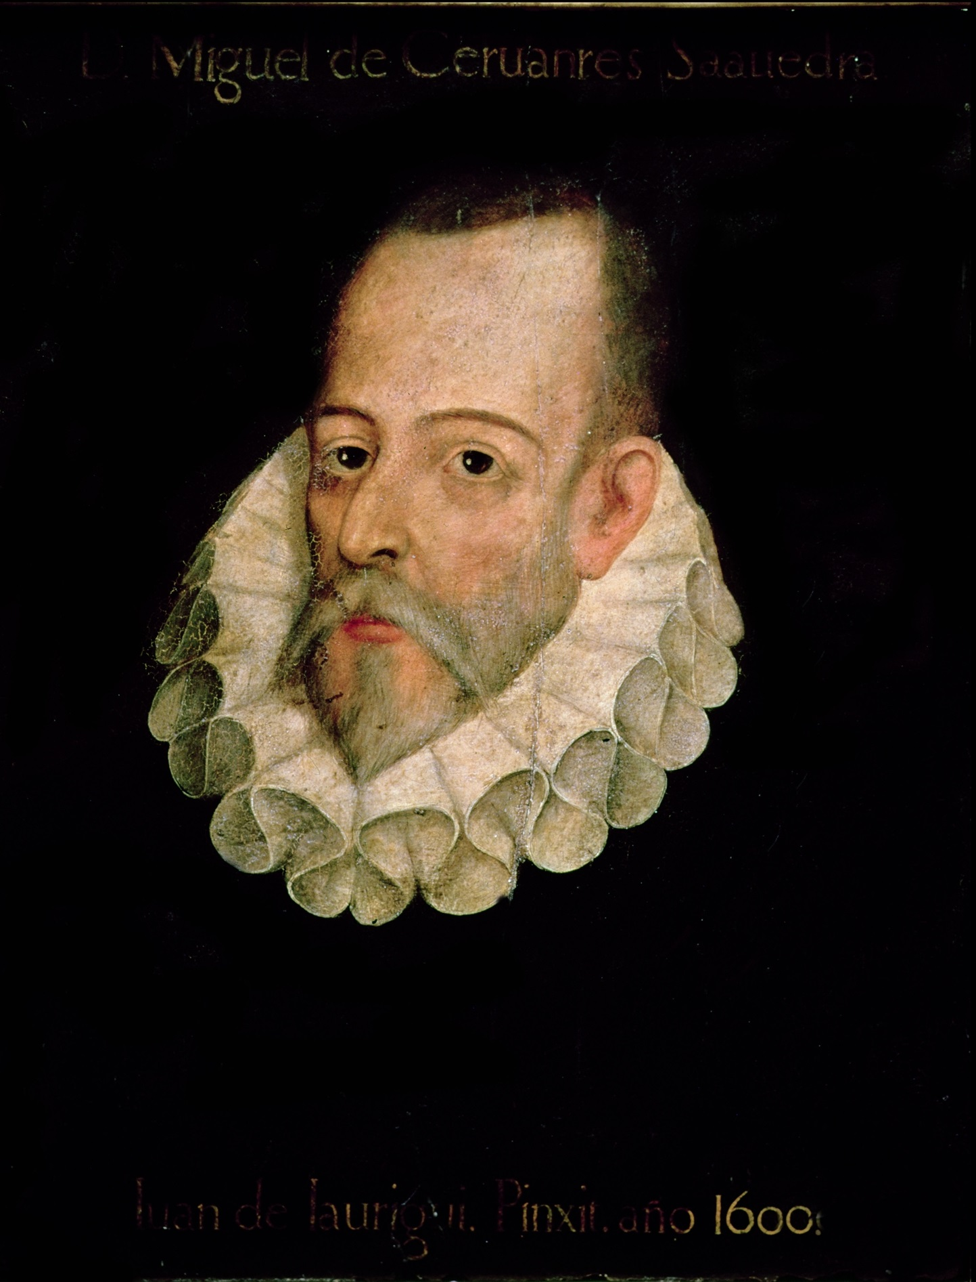
Example Titles from Student Projects
Notes:
90 seconds
Prophecy as a Theatrical Device in Medieval Spanish Epic
What students have engaged with, how students are engaged
Students vignetes
The Role of Education in the works of Miguel de Cervantes

Slide 11
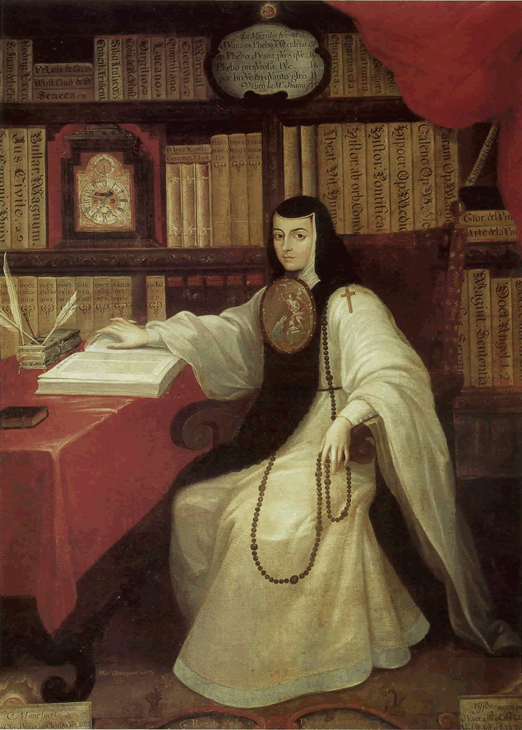
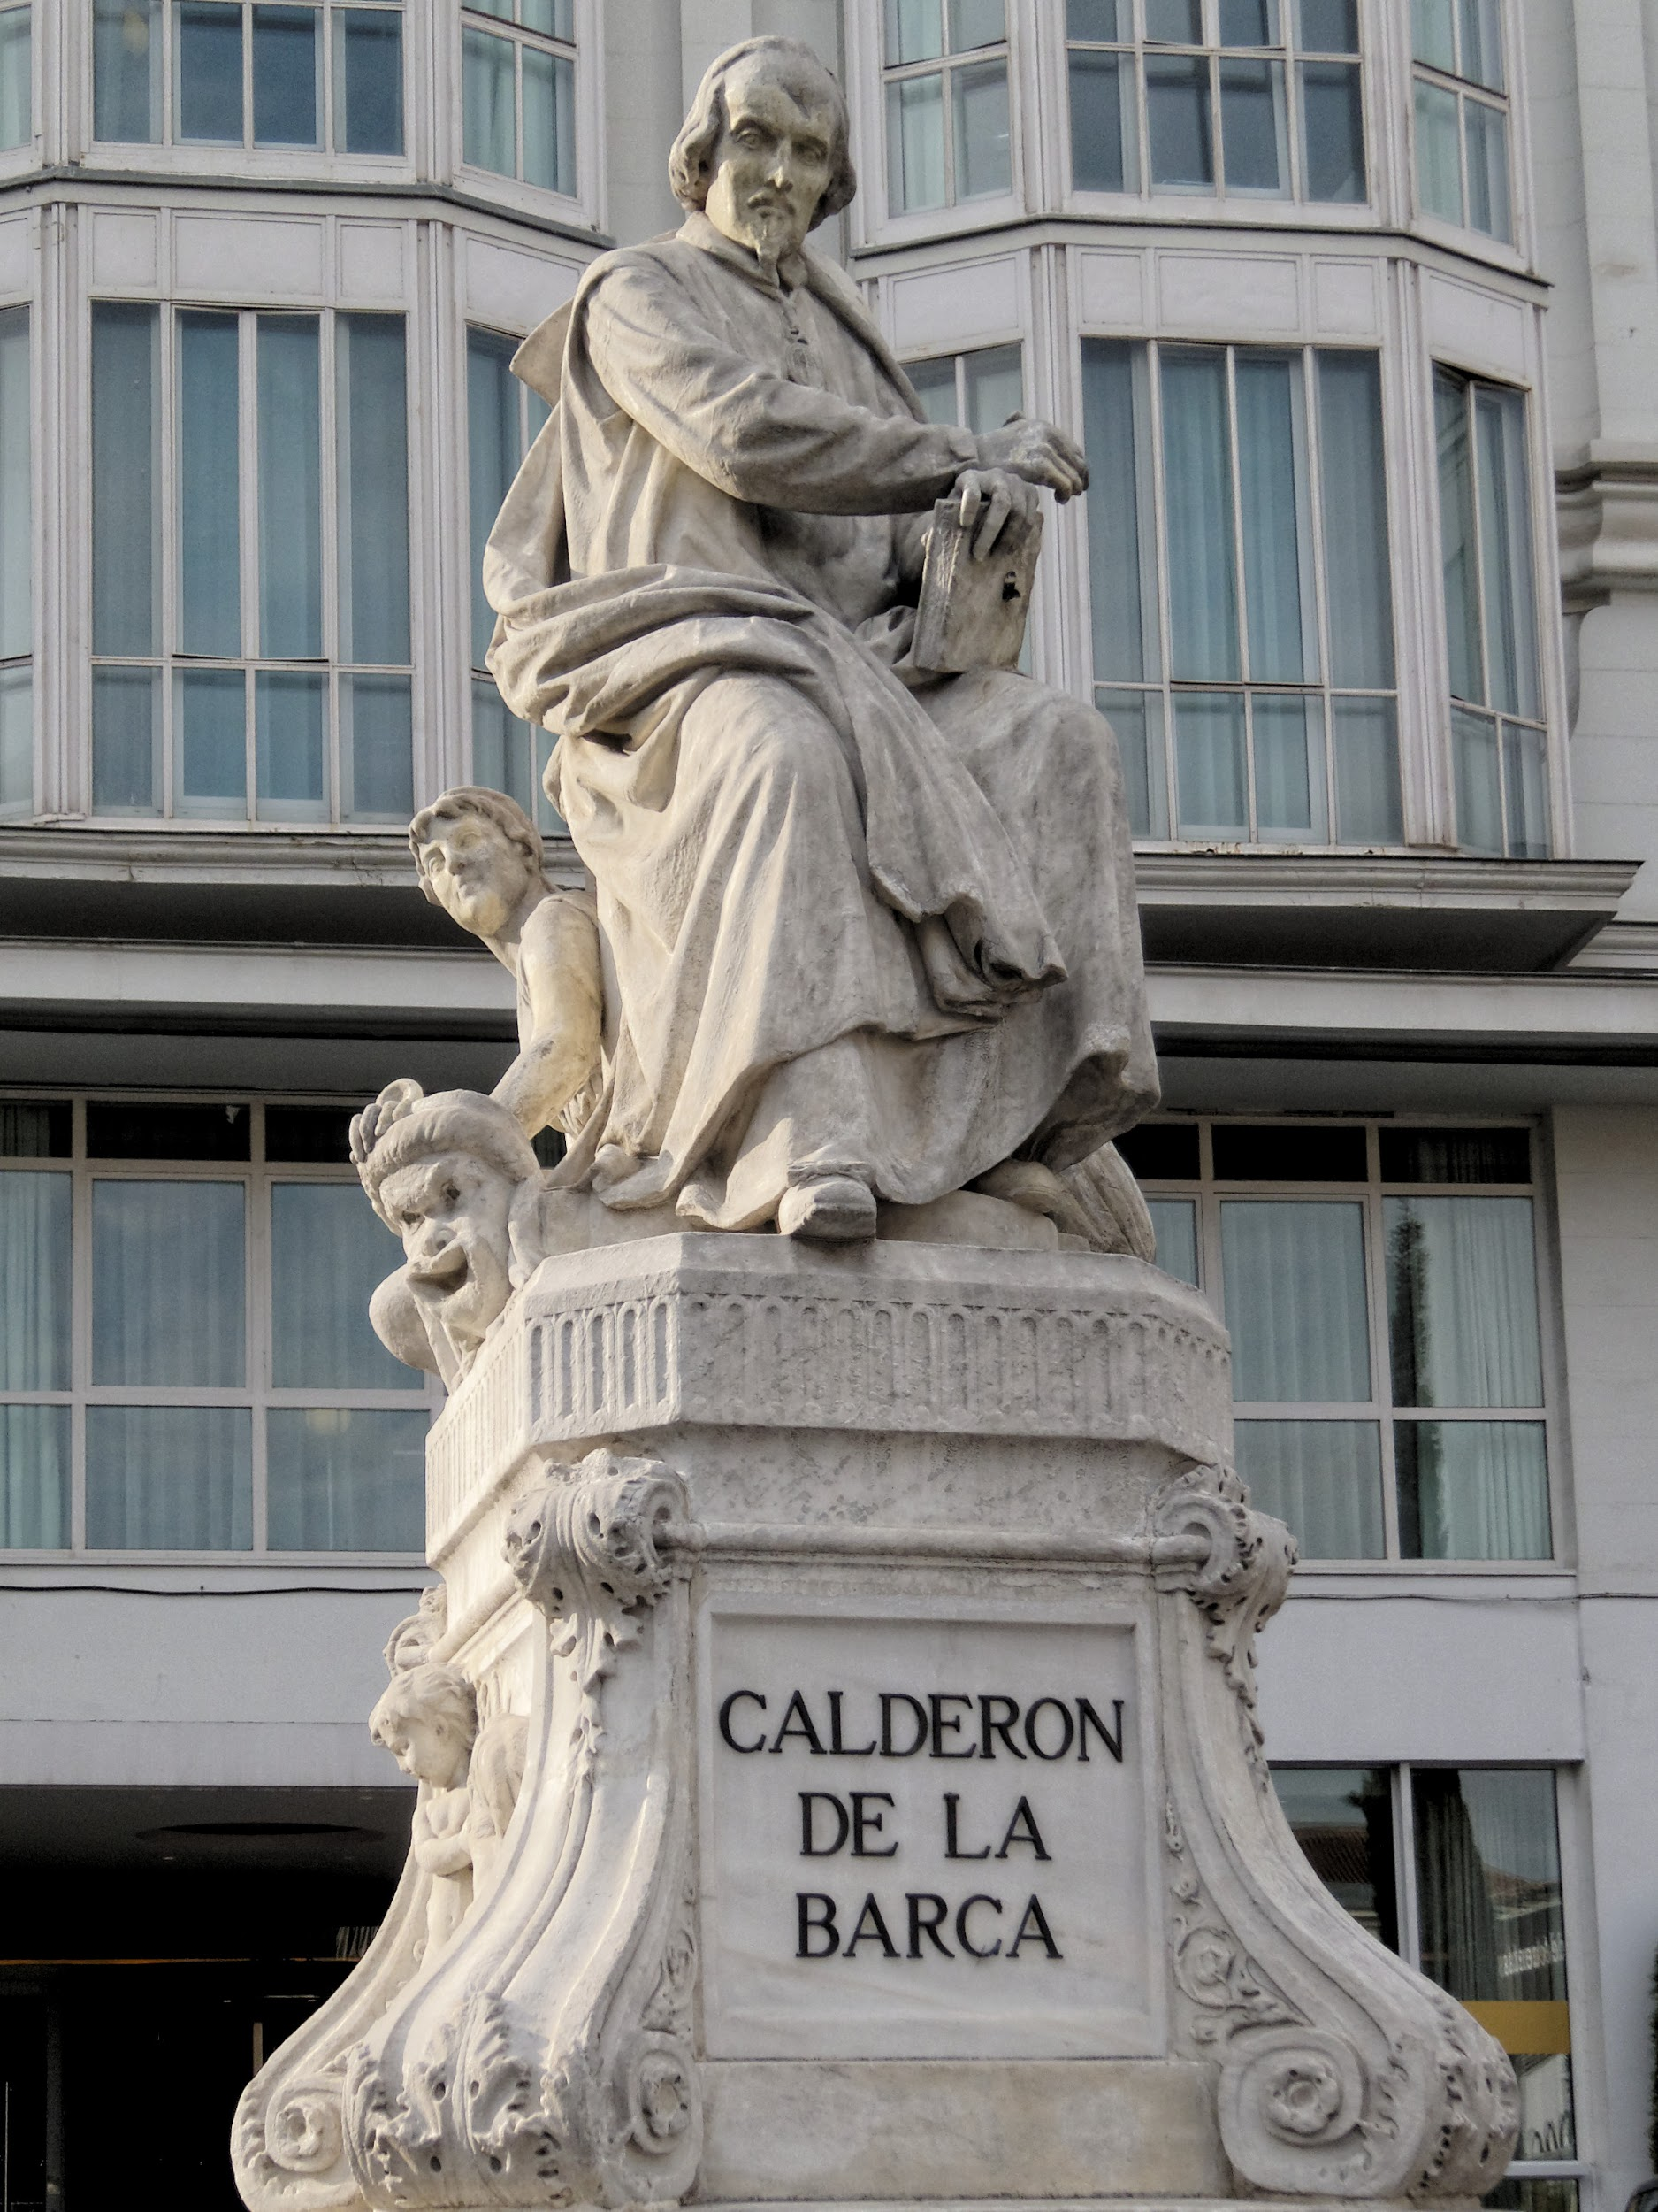
Notes:
90 seconds
Gender Dynamics in the Works of Sor Juana Inés de la Cruz
Theatricality and Free Will in the works of Pedro Calderón de la Barca

Slide 12
Dr. Jacob Larsen, Director, Language Studies Resource Center (jlarsen@iastate.edu)
Dr. James Nemiroff, Lecturer, Department of World Languages and Cultures (nemiroff@iastate.edu)
Notes:
7:25-10:00 Q and A

