Slide 1
Grading the quality of peer evaluations: a workaround
Assistant Teaching Professor Rebecca Cademartiri
Department of Materials Science and Engineering

Slide 2
The Problem
Canvas assignments only allow grading of the submitted work.
Peer evaluations cannot be graded in the assignment they are performed.

Slide 3
The Workaround
Make two assignments
First: Ungraded or 0 points for document submission and peer evaluation
Second: Used to provide grade for peer evaluation

Slide 4
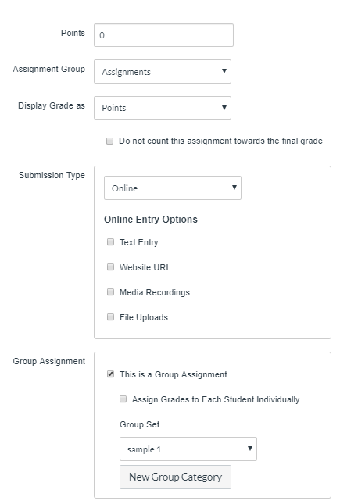
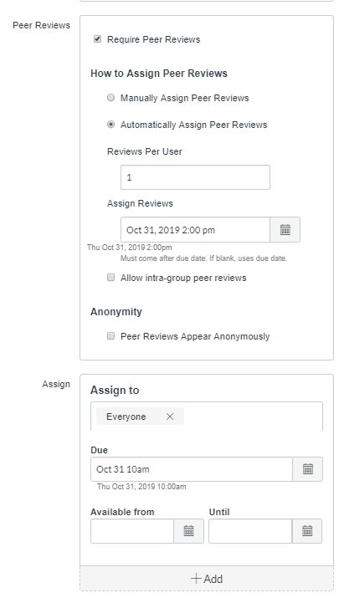
The How-To
1) Make standard assignment

Slide 5
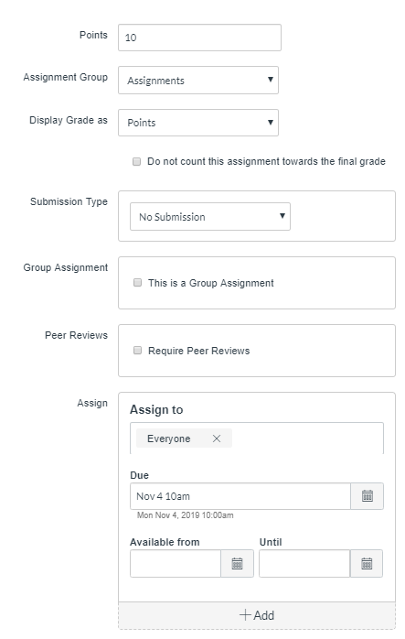
The How-To
2) Make assignment for peer evaluation grades

Slide 6
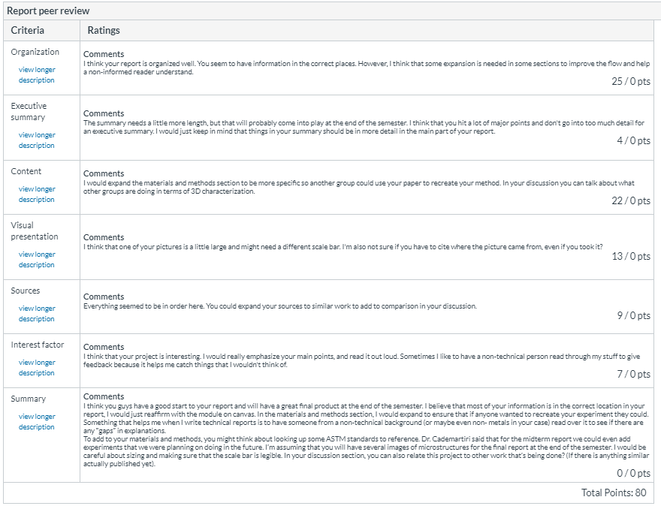
Grading
Manual check for on time submission (assignment page)
Speedgrader for peer review details

Slide 7
Information for students
Canvas page detailing the why and how
Rubric that I will use for grading the report
Assurance that I will grade peer review after grading report

