Slide 1
Using Canvas Blueprints
Gretchen Anderson

Slide 2
What is a Blueprint course?
Exactly like it sounds, you create your content in a Blueprint course, then push it out to all associated courses.

Slide 3
Potential uses
Creating a consistent starting point for multiple courses.
Maintaining consistent structure across courses in a single program.
Updating content across multiple courses at once.
Sending announcements to multiple classes at once.

Slide 4
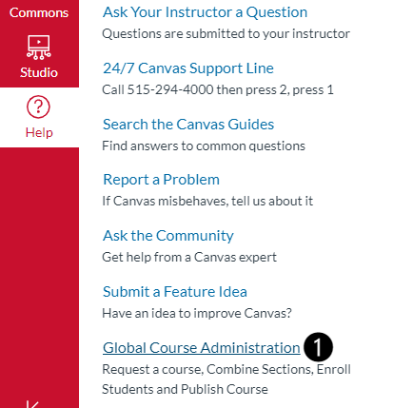
Request the course shells
From within the Help menu of Canvas, click Global Course Administration.
Use Prepare to Teach to create courses.
Use Request a New Course Shell to create the Blueprint course.

Slide 5
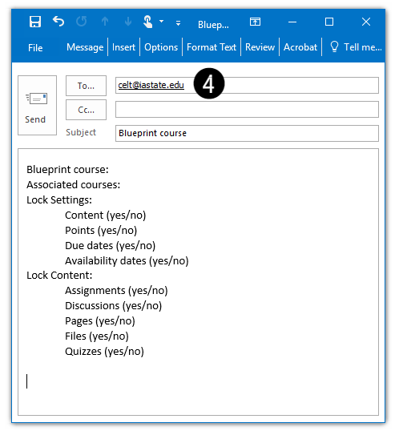
Contact CELT
Email celt@iastate.edu the details. Include:
Blueprint course ID.
Associated course ID(s).
Lock Settings. You can choose to lock content, points, due dates, and availability dates.
Content Settings. Apply the lock settings to assignments, discussions, pages, files, and/or quizzes.

Slide 6
Build your content
Build your content as you normally would in the Blueprint course.
Publish the content when finished.
Use the Blueprint Lock feature to apply the lock settings specified in your email to CELT.

Slide 7
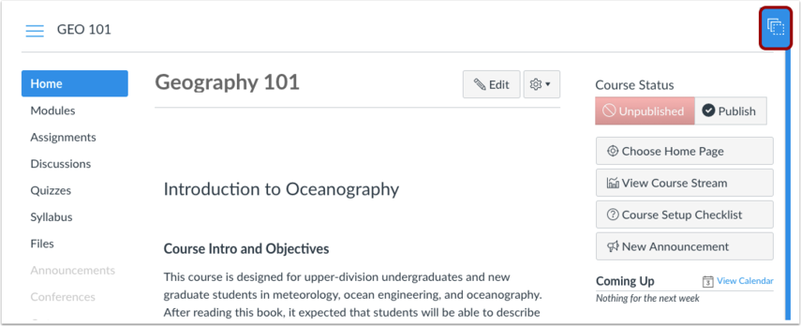
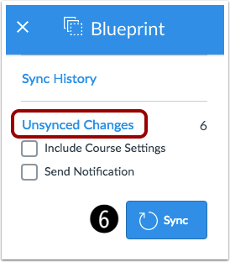
Sync the Blueprint course
Access the Blueprint overlay and sync your content.
Click the blue button in the top right corner of the screen
Click the Sync button to see the unsynced changes that will be pushed to the associated course(s).

Slide 8
The full process
Use ISU’s Global Course Administration to create the course shells as you normally would.
Steps are shown in the Prepare to Teach section of MyCanvas Teacher.
Use the Request a New Course Shell tool to create the course that will be used as the blueprint for all others.
Email celt@iastate.edu with the required details:
Course ID for the Blueprint course and associated course(s).
Which settings you want to be specified in the Blueprint course. You can choose to lock content, points, due dates, and availability dates for all content or only for specific content types such as quizzes.
Build your content in the Blueprint course.
Sync the Blueprint content to the associated course(s).

Slide 9
Caveats
Certain course and assignment settings cannot be synced to associated courses.
Modules and their structure cannot be locked.
Module items created in an associated course will be reordered above all blueprint synced module items following a new sync.
Modules created from a blueprint course and deleted from an associated course will not be restored in additional course syncs.

Slide 10
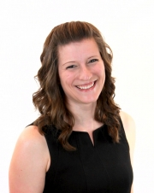
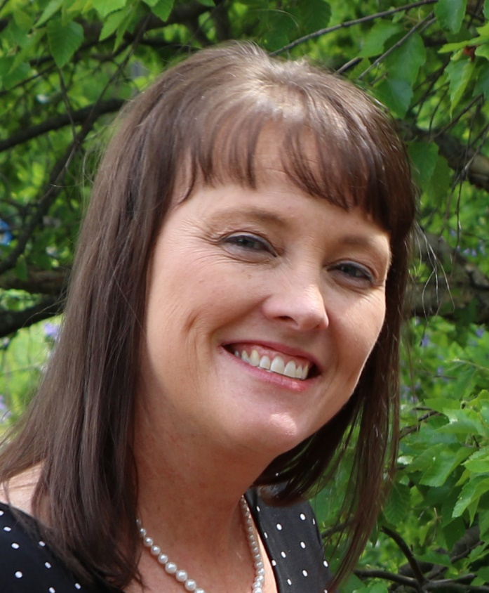
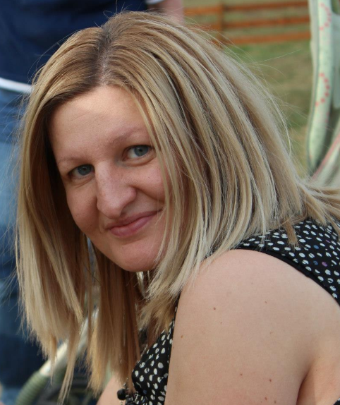
Questions?
Gretchen Anderson
Top Hat & Canvas training, communication & web presence
Amy Ward
Canvas strategic implementation & third-party tool integration
Lesya Hassall
Online course design, development
& quality assurance
Want to know more? Come to CELT Open Labs, hosted by our CELT staff on the 3rd floor of Morrill Hall from Sept. 3 to Dec. 12 at the following days/times:
Tuesdays (1-3 p.m.)
Wednesdays (11 a.m.-1 p.m.)
Thursdays (9-11 a.m.)

